Slide 1



Programs Annual Spend

Slide 2


Slide 3
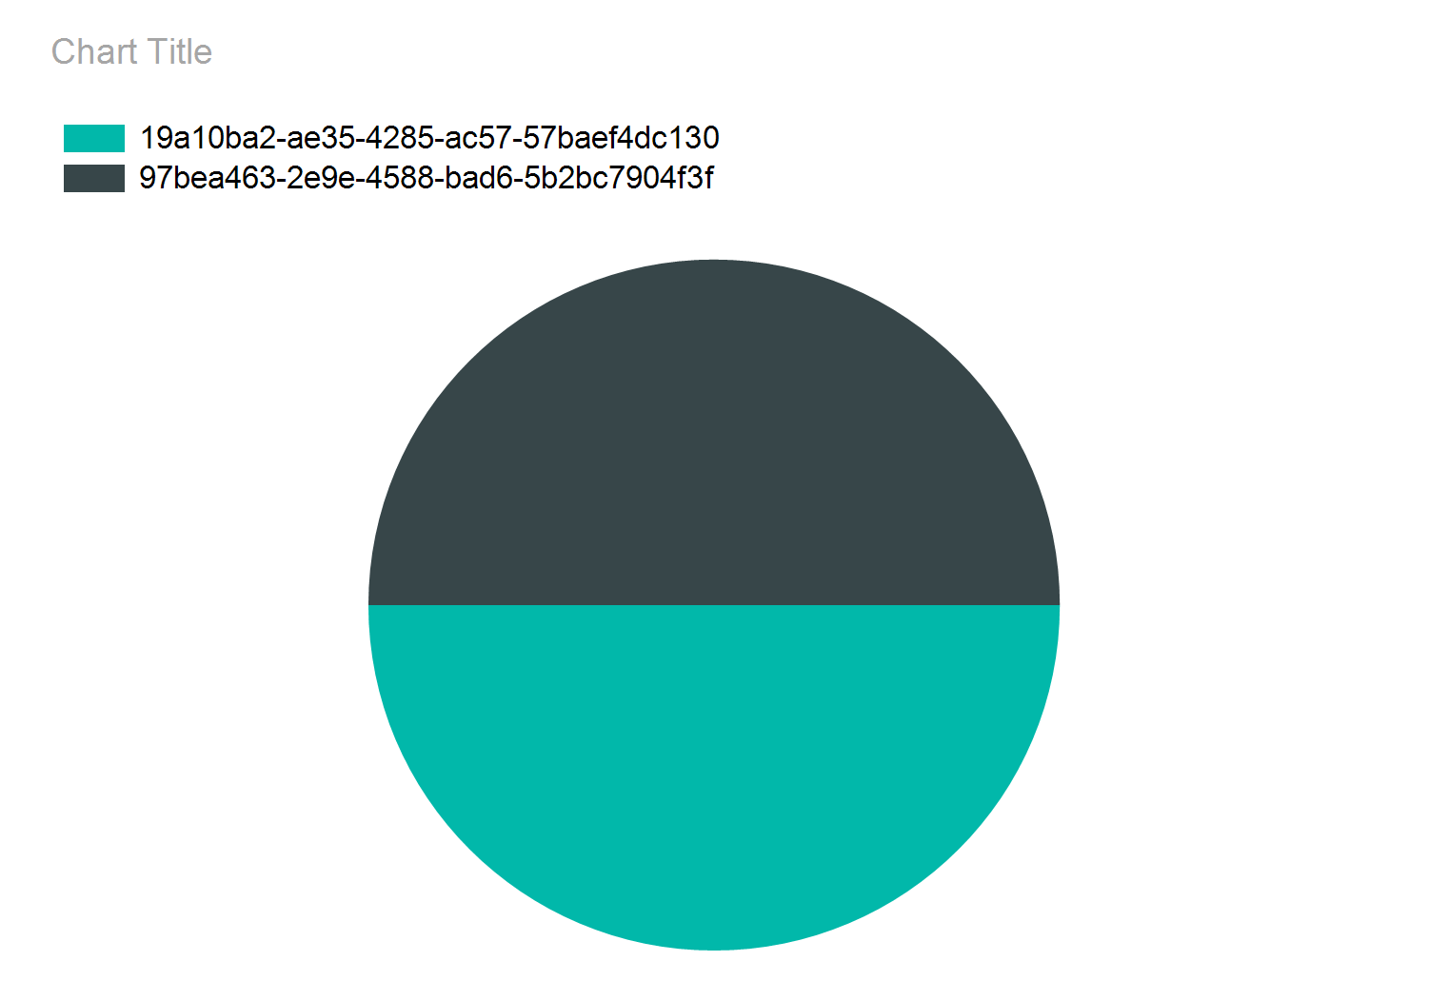

Slide 4
