Slide 1
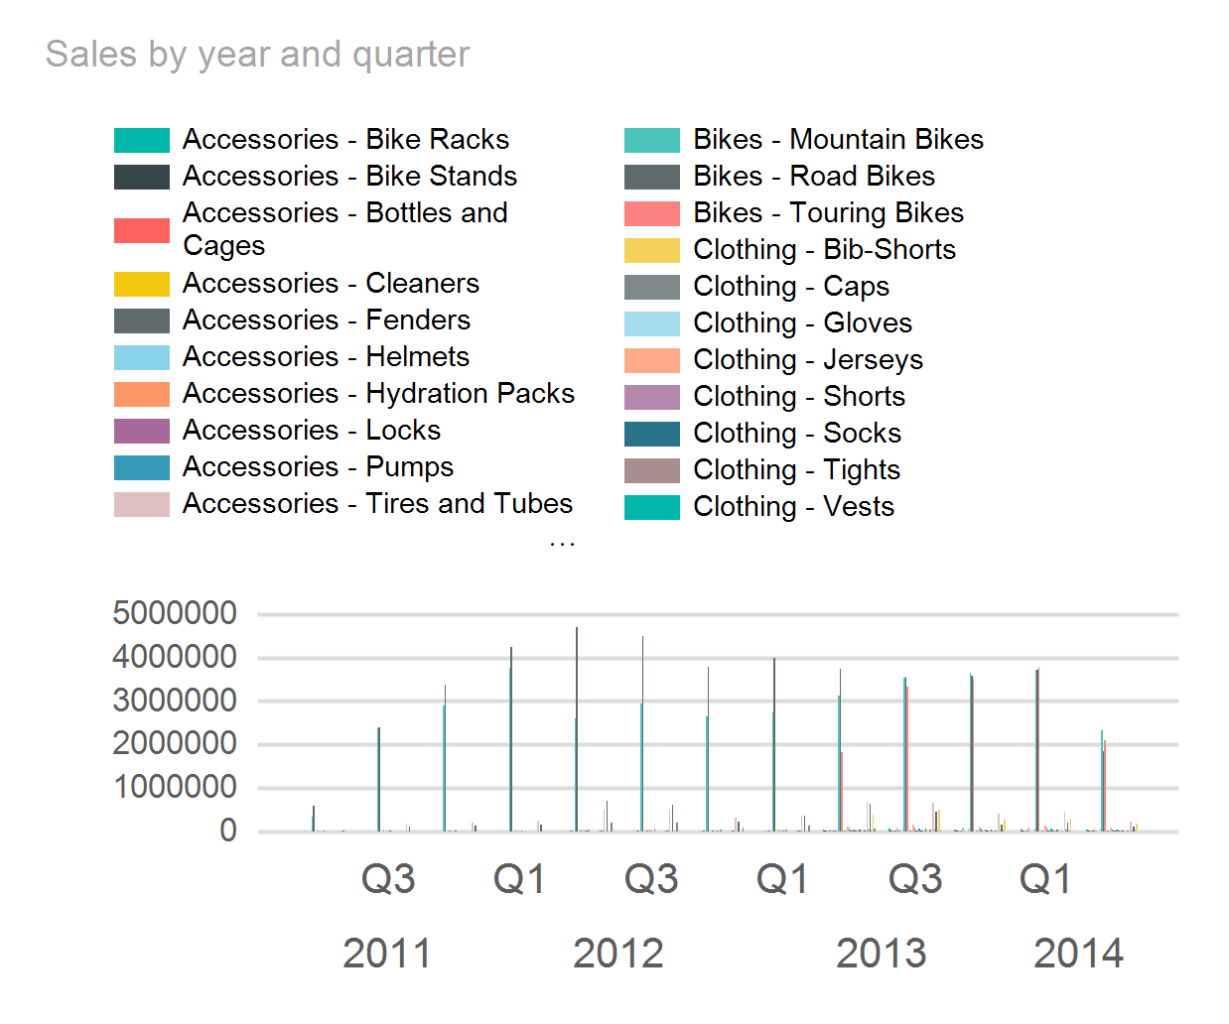

Adventure Works Sales

Slide 2
