Slide 1
The Contract - Technology Delivery in Context of Key Business Outcomes: Global Markets Reference Data Program
2020
10/21/2020 6:09:51 PM

Slide 2
The Contract - Technology Delivery in Context of Key Business Outcomes: Global Markets Reference Data Program
2020
10/21/2020 6:09:51 PM

Slide 3
Q1
10/21/2020 6:09:51 PM

Slide 4
Q2
Q3
Q4
10/21/2020 6:09:51 PM

Slide 5
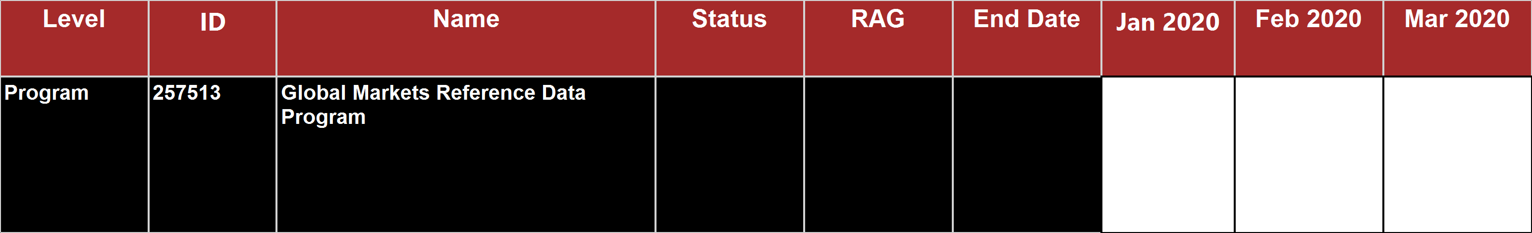
10/21/2020 6:09:51 PM

Slide 6
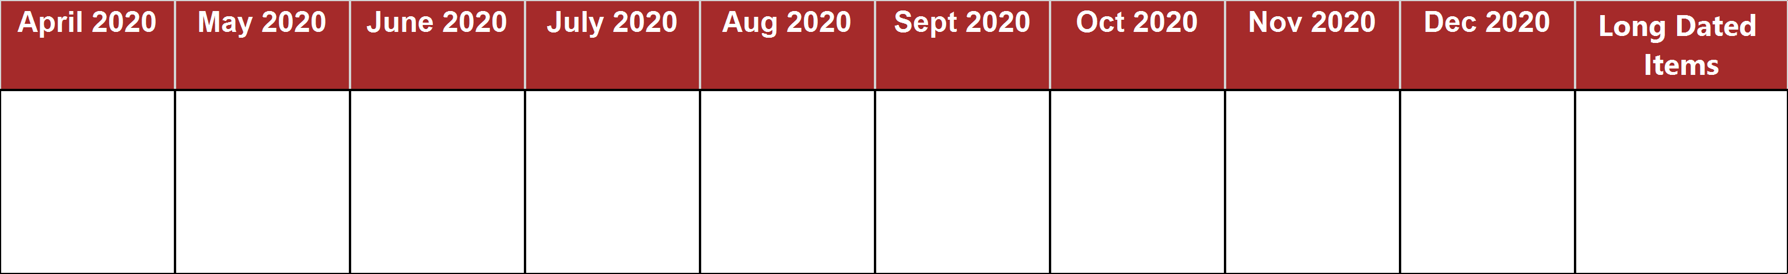
10/21/2020 6:09:51 PM

Slide 7
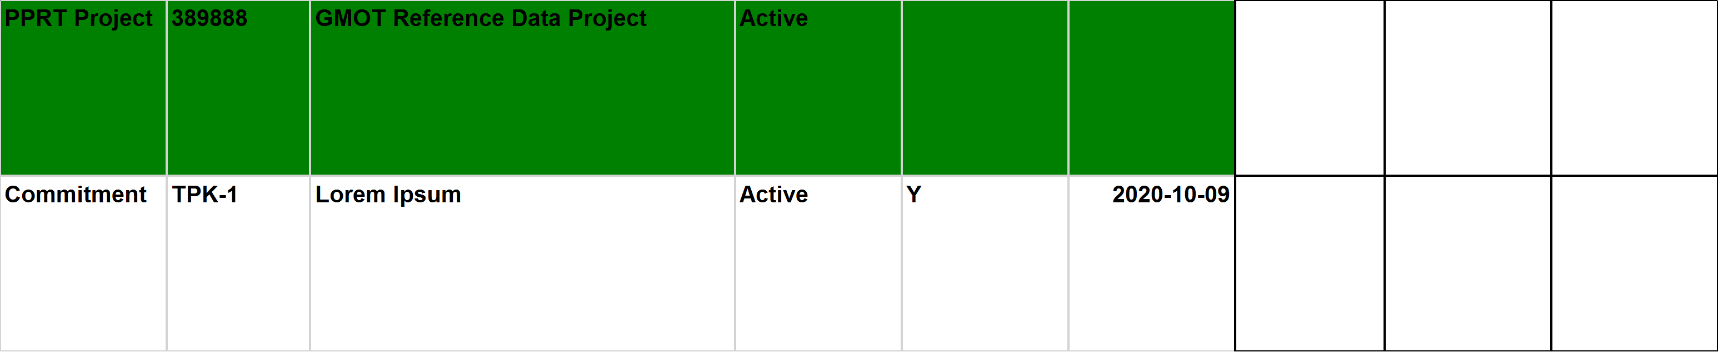
10/21/2020 6:09:51 PM

Slide 8

10/21/2020 6:09:51 PM

Slide 9
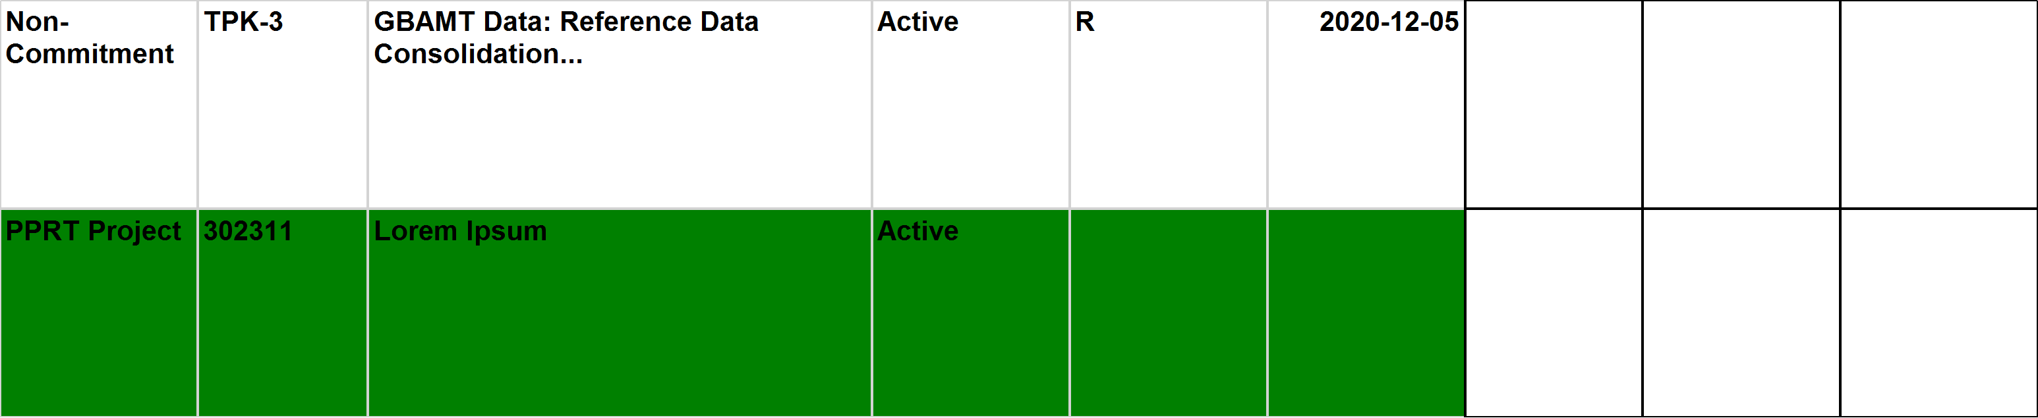
10/21/2020 6:09:51 PM

Slide 10

10/21/2020 6:09:51 PM

Slide 11
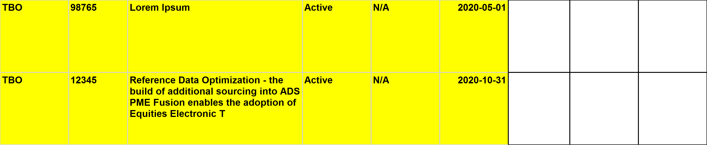
10/21/2020 6:09:51 PM

Slide 12

10/21/2020 6:09:51 PM

Slide 13
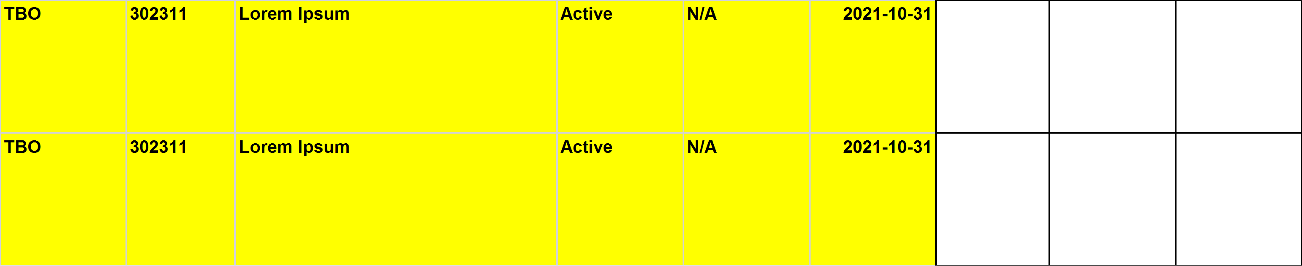
10/21/2020 6:09:51 PM

Slide 14

10/21/2020 6:09:51 PM

Slide 15
10/21/2020 6:09:51 PM

Slide 16
10/21/2020 6:09:51 PM

Slide 17
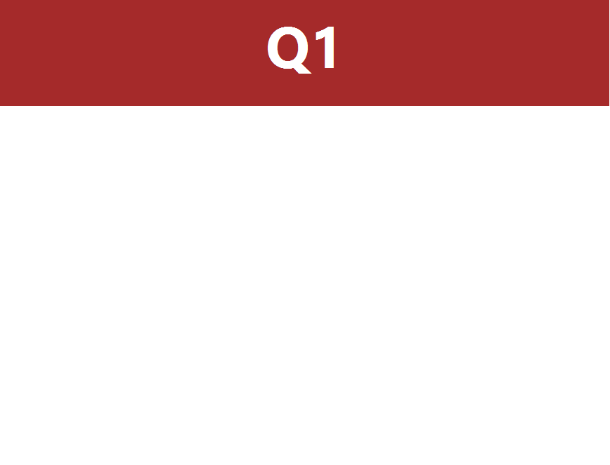
10/21/2020 6:09:51 PM

Slide 18
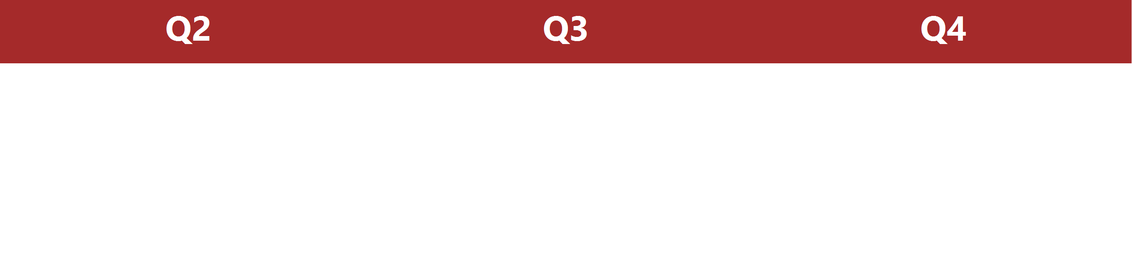
10/21/2020 6:09:51 PM

Slide 19

10/21/2020 6:09:51 PM

Slide 20

10/21/2020 6:09:51 PM

Slide 21

10/21/2020 6:09:51 PM

Slide 22
10/21/2020 6:09:51 PM

Slide 23
10/21/2020 6:09:51 PM

Slide 24
10/21/2020 6:09:51 PM

Slide 25
10/21/2020 6:09:51 PM

Slide 26
10/21/2020 6:09:51 PM

Slide 27
10/21/2020 6:09:51 PM

Slide 28
10/21/2020 6:09:51 PM

