Slide 1
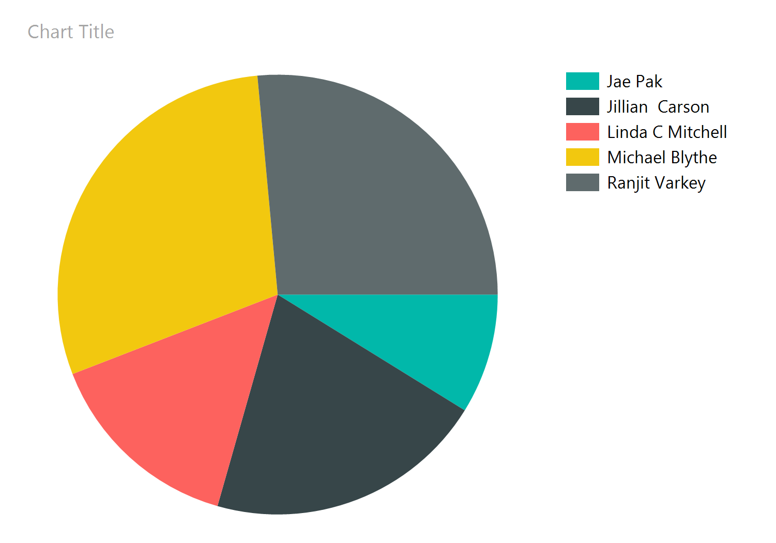
10/8/2020 6:44:44 PM

