Slide 1
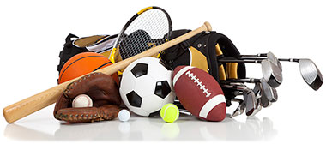
Capstone Project: The Battle of Neighborhoods
Opening a Sporting Goods Shop in Toronto
By: M Farshchin

Slide 2
Introduction / Business problem:
Goal:
Finding potential locations for opening a sporting goods shop in a shopping mall or shopping plaza in Toronto
Criterion:
Neighborhoods with more sport venues are more attractive
Neighborhoods with existing sporting goods shop are not suitable
Customer wants to open the new shop in a shopping mall or shopping plaza
Neighborhoods with more shopping plazas or shopping malls are more attractive
Audience of project:
distributors of sports goods that are interested in opening new shops in the Toronto.

Slide 3
Data Description:
Data of Toronto neighborhoods:
https://en.wikipedia.org/wiki/List_of_postal_codes_of_Canada:_M
Geographical information of Toronto neighborhoods:
https://cocl.us/Geospatial_data
Foursquare API to obtain venues

Slide 4
Methodology:
Collect and organize data about different neighborhoods of Toronto including their longitude, latitude, borough, and postal code
Use Foursquare to collect data for each neighborhood about available venues related to Sport, Shopping centers, and existing sporting goods shops.
Preprocess the data and perform exploratory data analysis to better explore and understand the data
Use K-Means clustering to cluster the neighborhoods based on the number of sporting venues and shopping centers
Select the cluster of potential neighborhoods

Slide 5
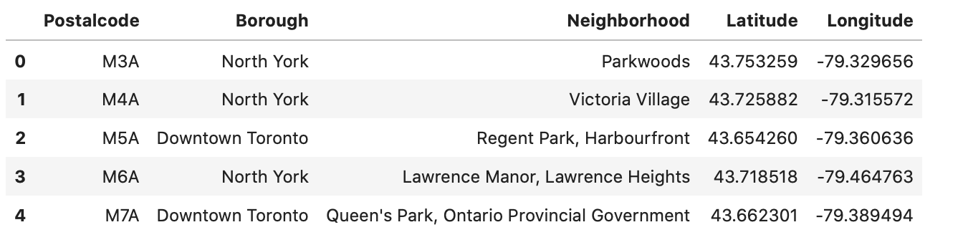
Collecting and organizing the data:
Neighborhood geographical data

Slide 6
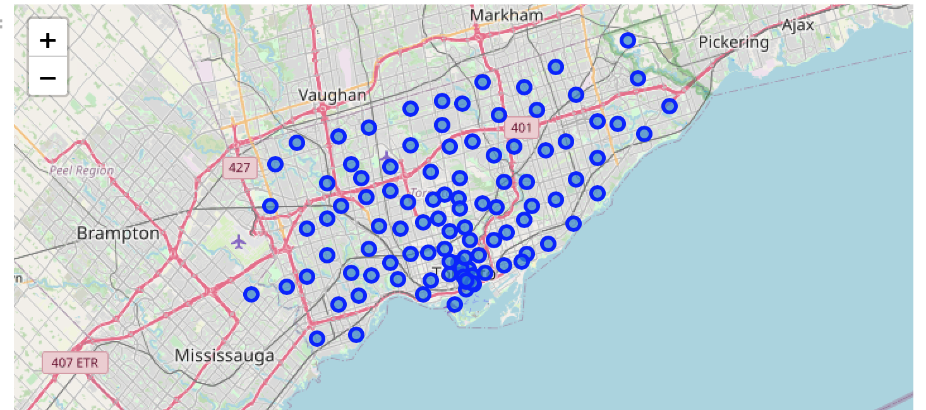
Collecting and organizing the data:
Neighborhood plotted on the Toronto map

Slide 7
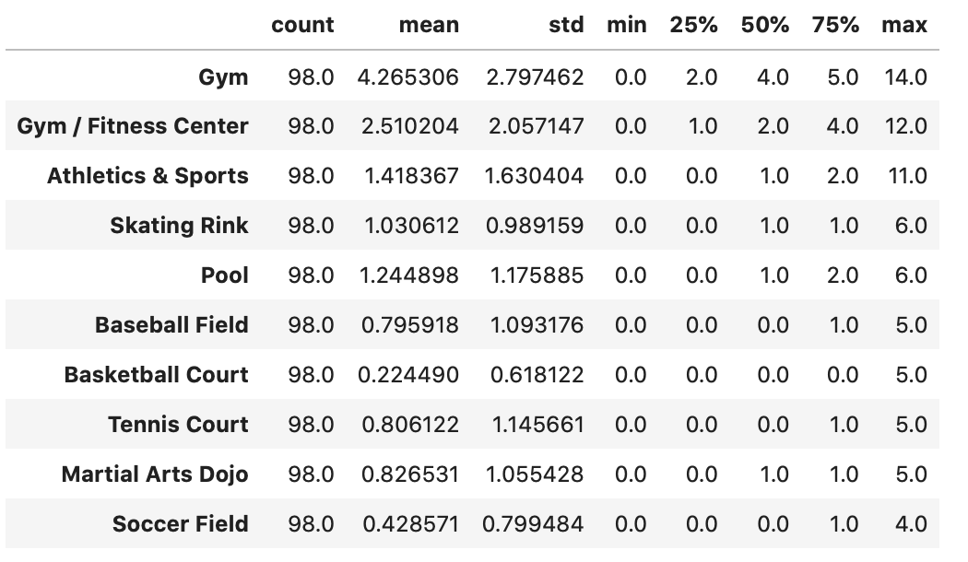
Exploratory data analysis:
Top 10 most popular sporting venues in Toronto

Slide 8
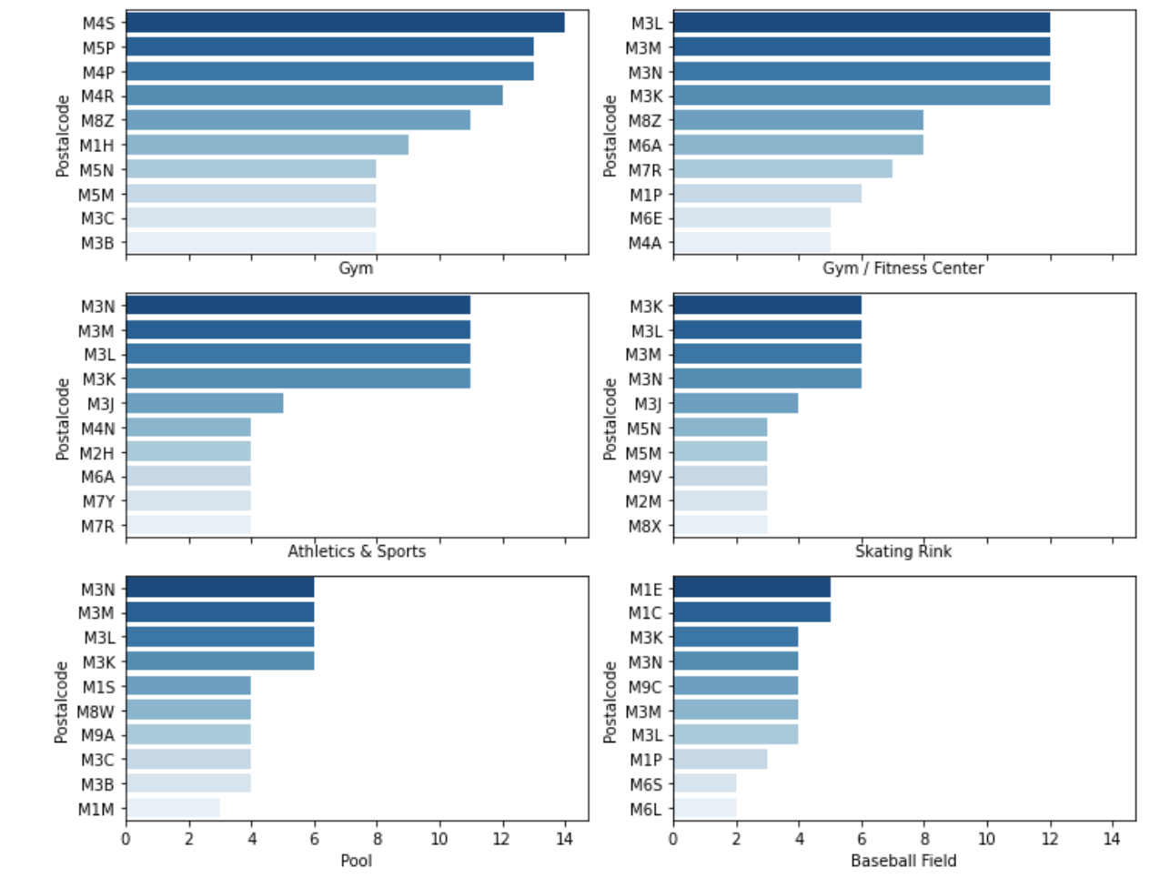
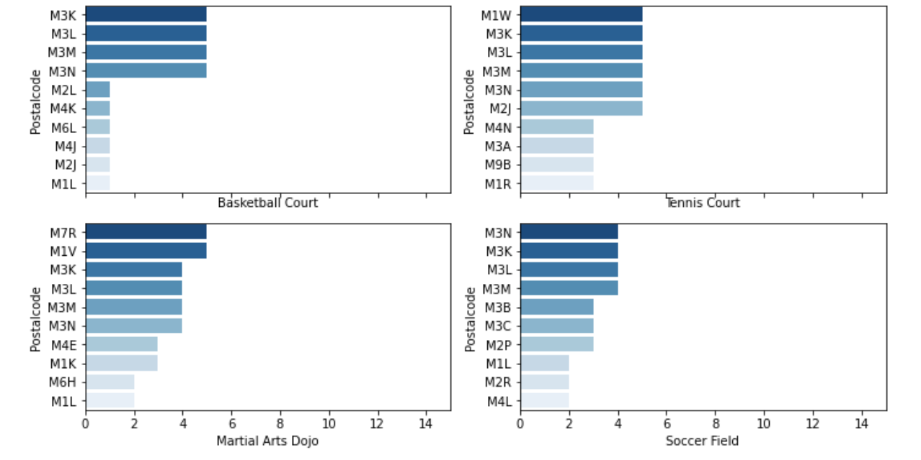
Exploratory data analysis:
Top 10 most popular sporting venues in Toronto

Slide 9
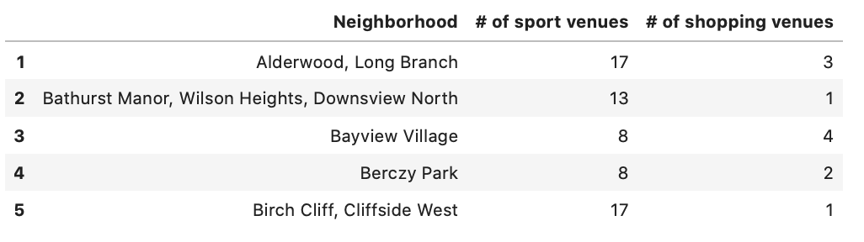
Exploratory data analysis:
Number of sport venues vs. shopping centers for different neighborhoods of Toronto

Slide 10
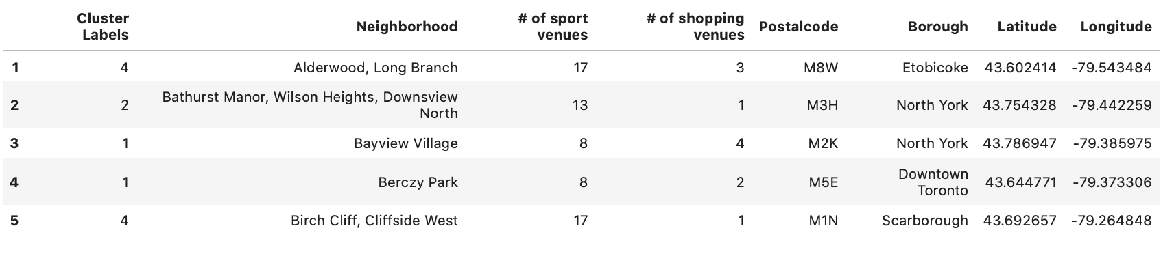
Analysis and K-Means Clustering of Neighborhoods:
Results of clustering the neighborhoods based on the availability of sport venues and shopping centers for each neighborhood within one-mile radius
Neighborhoods are categorized in 7 clusters

Slide 11
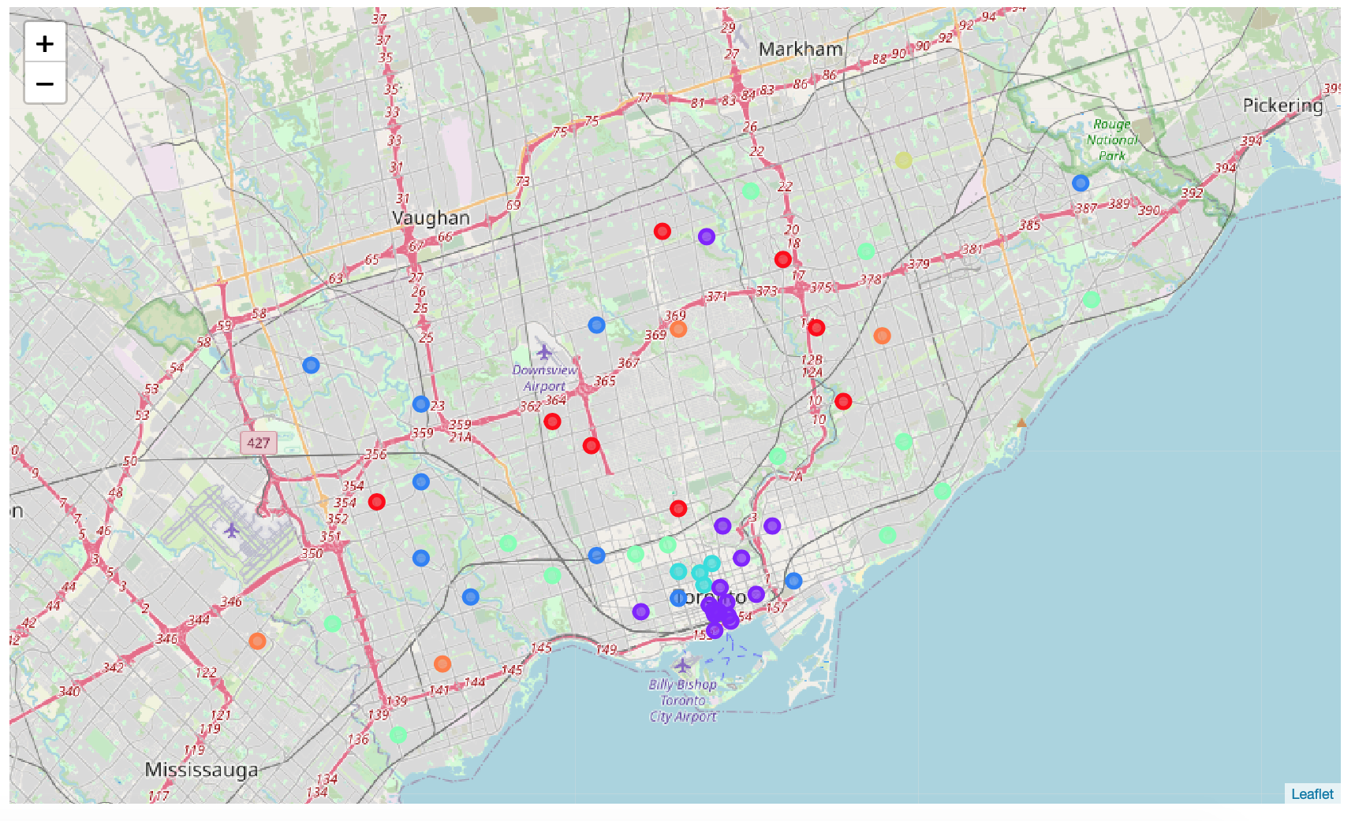
Analysis and K-Means Clustering of Neighborhoods:
Results of clustering the neighborhoods on the map of Toronto

Slide 12
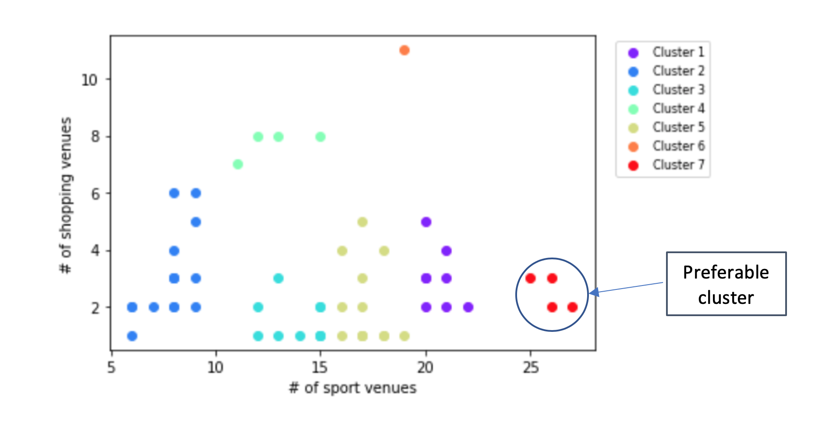
Results and discussion:
Results of clustering the neighborhoods Toronto, based on number of available sport venues and shopping centers
From the results, cluster number 7 seems to be superior, so we suggest this cluster

Slide 13
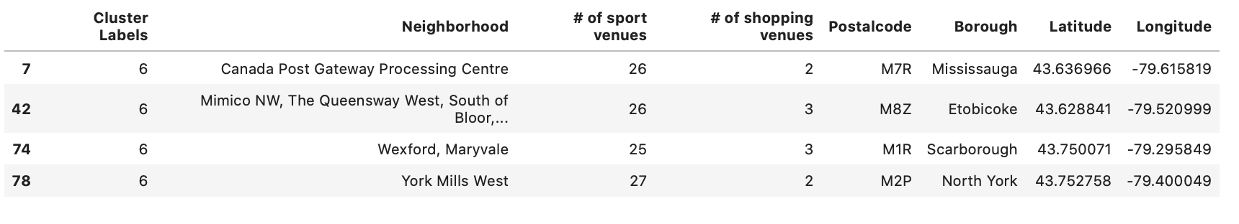
Results and discussion:
Details of preferred cluster:
The four neighborhoods in the above table could be suggested as the potential neighborhoods to open a new sporting goods shop because compared to other neighborhoods these neighborhoods have more sporting venues and there are minimum of two shopping malls or shopping plazas to open the new shop. Also there is no sporting goods shop in these neighborhoods

Slide 14
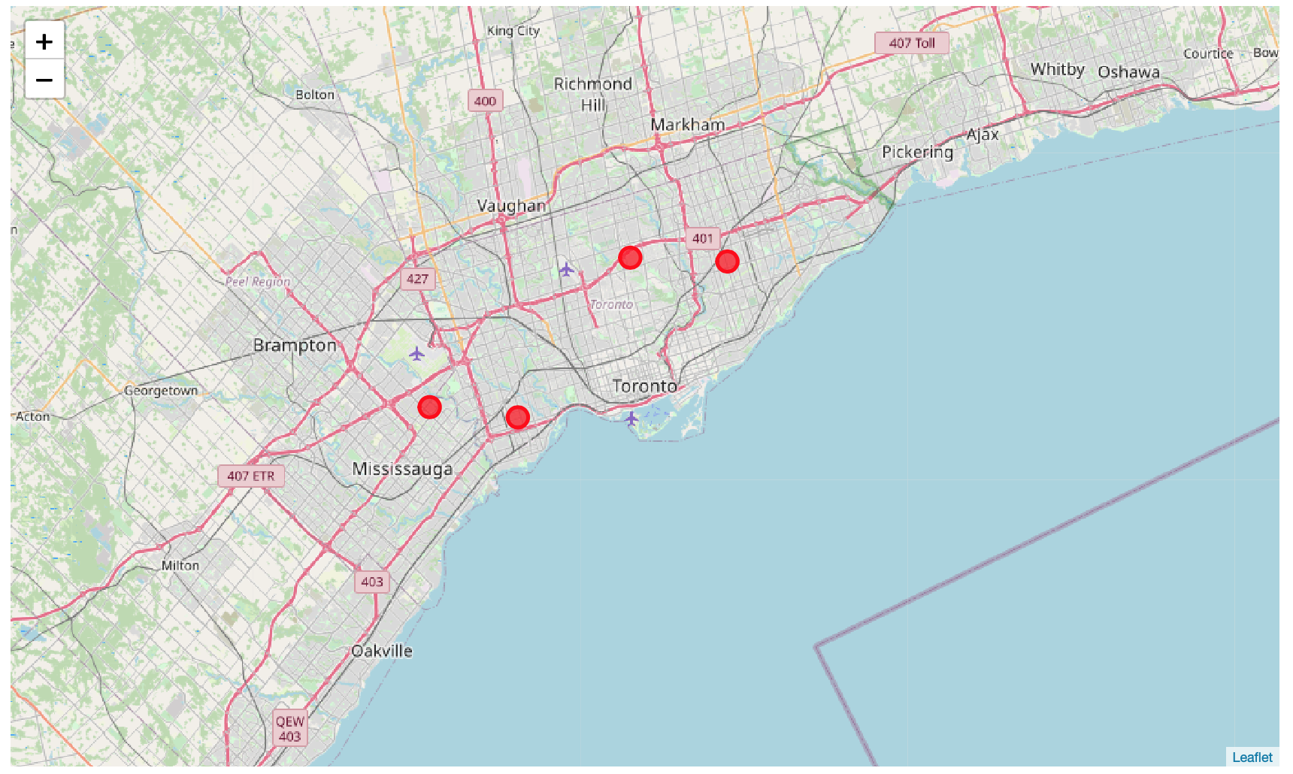
Results and discussion:
Location of the suggested neighborhoods to open the new shop on the Toronto Map

