Slide 1
Capstone Project
Identify best neighborhoods for opening a shop in a city
Case study: Identify best locations to open a sports good shop in a Toronto
Method: use clustering (k-means clustering)
By: M Farshchin

Slide 2
Introduction:
Goal:
Finding potential locations for opening a sporting goods shop in a shopping mall or shopping plaza in Toronto
Criterion:
Neighborhoods with more sport venues are more attractive (more customers)
Neighborhoods with existing sporting goods shop are not suitable
Consider neighborhoods with more shopping centers (mall or shopping plaza). Assume we are planning to open the shop in an existing shopping center.
Audience of project:
Retailers or individuals

Slide 3
Data collection sources:
Foursquare API to obtain information about venues
Data of Toronto neighborhoods:
https://en.wikipedia.org/wiki/List_of_postal_codes_of_Canada:_M
Geographical information of Toronto neighborhoods:
https://cocl.us/Geospatial_data

Slide 4
Methodology:
Collect and organize data about different neighborhoods of Toronto including their longitude, latitude, borough, and postal code
Use Foursquare to collect data for each neighborhood about available venues related to Sport, Shopping centers, and existing sporting goods shops.
Preprocess the data and perform exploratory data analysis to better explore and understand the data
Use K-Means clustering to cluster the neighborhoods based on the number of sporting venues and shopping centers
Select the cluster of potential neighborhoods

Slide 5
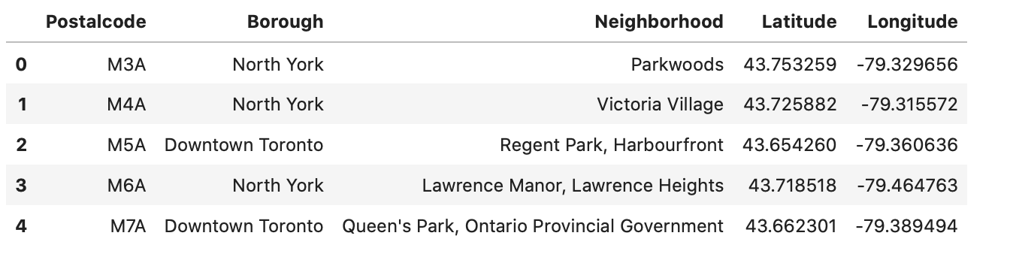
Collecting and organizing the data:
Neighborhood geographical data

Slide 6
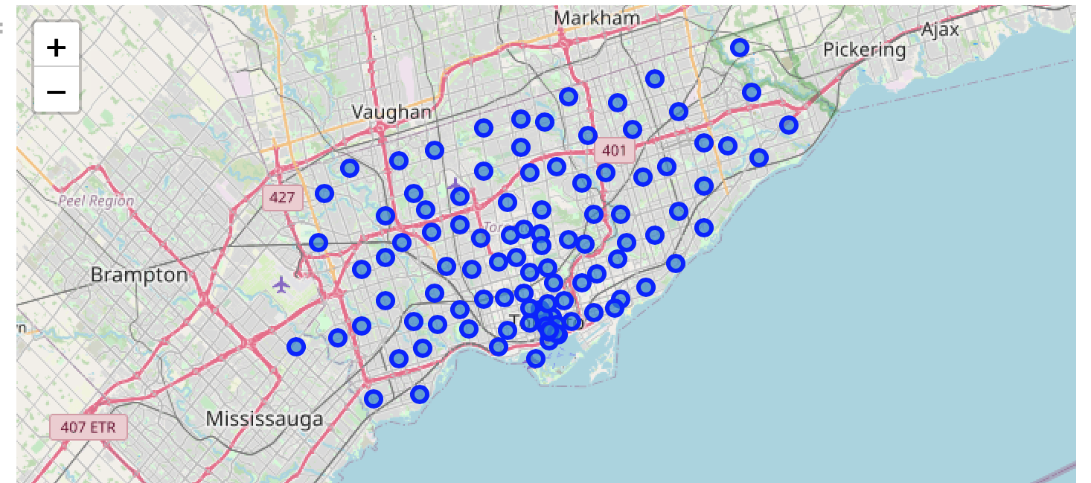
Collecting and organizing the data:
Neighborhood plotted on the Toronto map

Slide 7
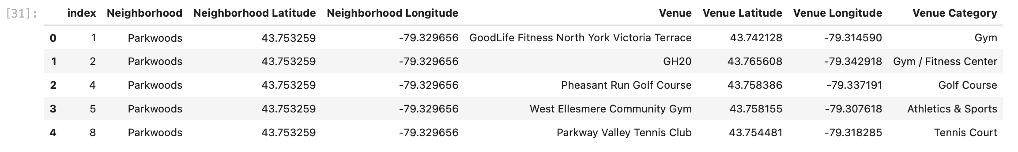
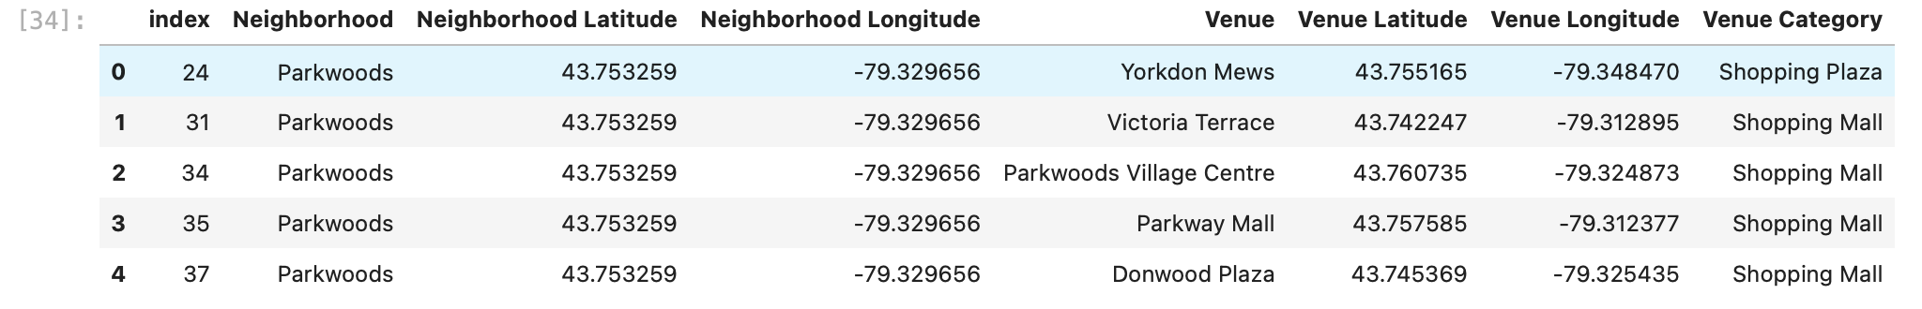
Collecting and organizing the data:
Foursquare data for sport venues in each neighborhood
Foursquare data for shopping centers in each neighborhood

Slide 8
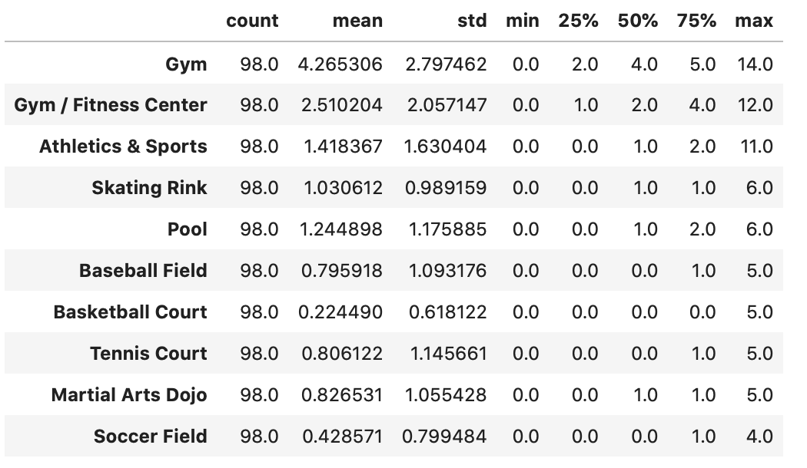
Exploratory data analysis:
Top 10 most popular sporting venues in Toronto

Slide 9
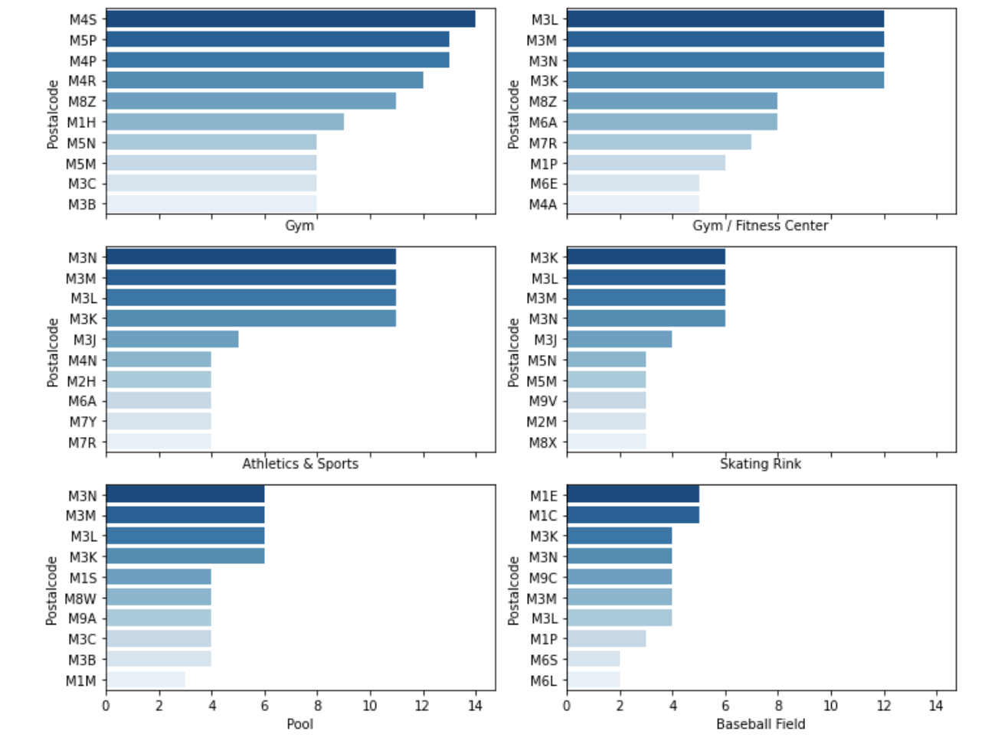
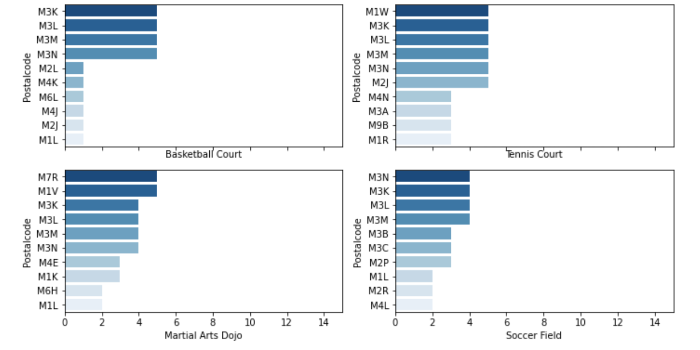
Exploratory data analysis:
Top 10 most popular sporting venues in Toronto

Slide 10
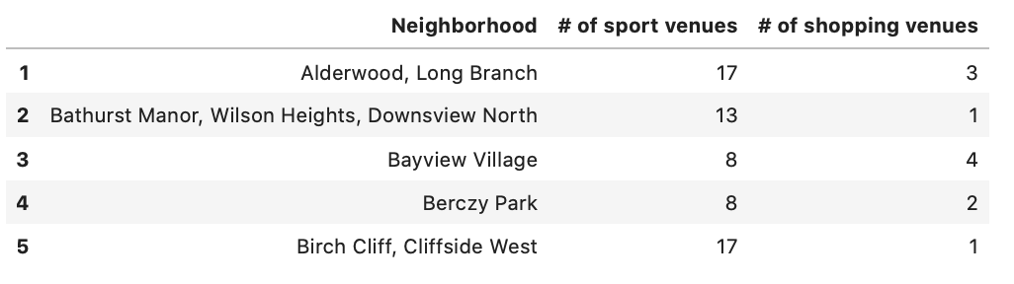
Exploratory data analysis:
Number of sport venues vs. shopping centers for different neighborhoods of Toronto

Slide 11
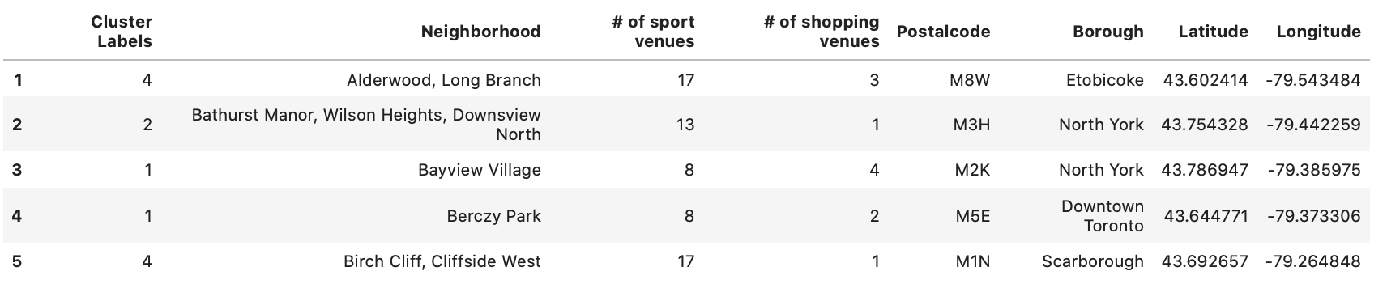
Analysis and K-Means Clustering of Neighborhoods:
Results of clustering the neighborhoods based on the availability of sport venues and shopping centers for each neighborhood within one-mile radius
Neighborhoods are categorized in 7 clusters

Slide 12
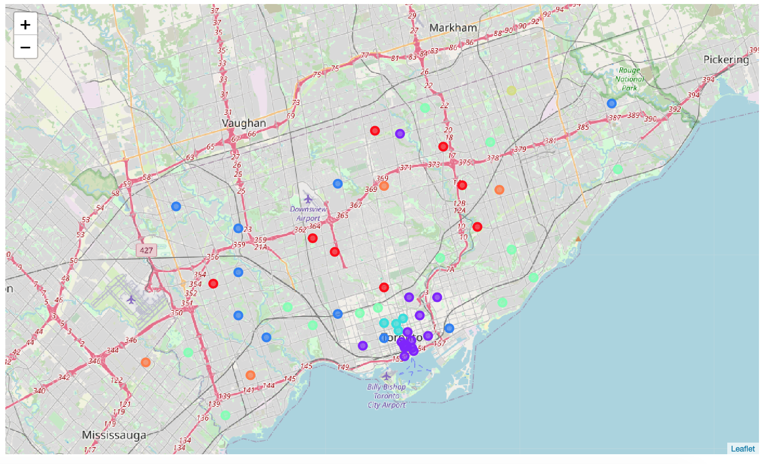
Analysis and K-Means Clustering of Neighborhoods:
Results of clustering the neighborhoods on the map of Toronto

Slide 13
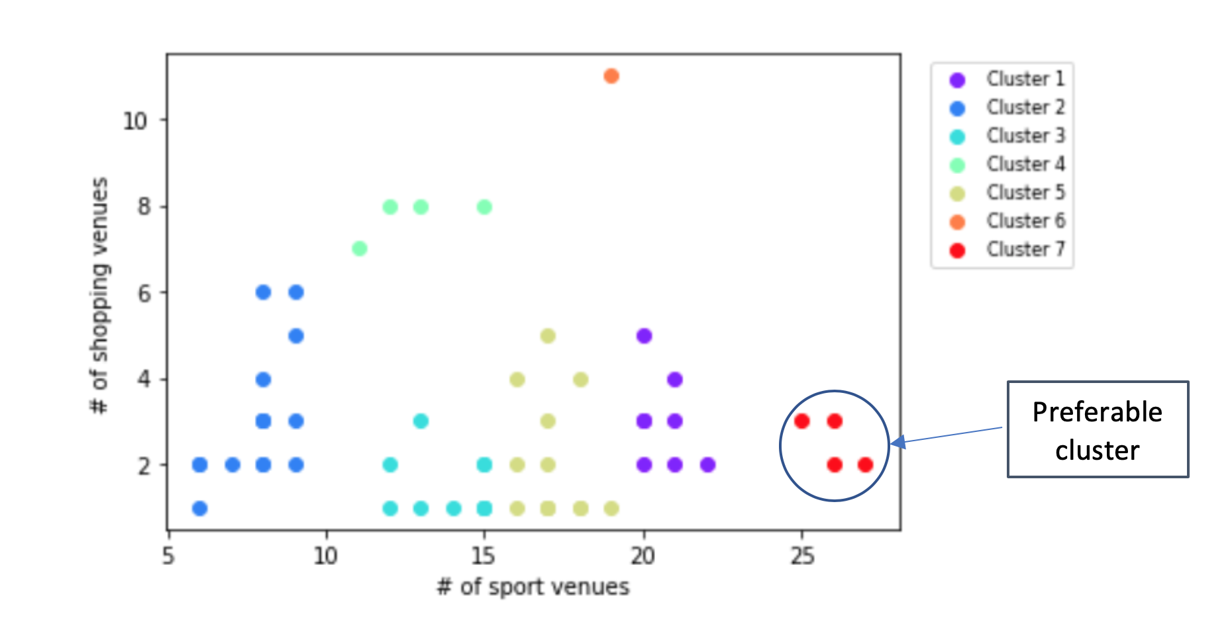
Results and discussion:
Results of clustering the neighborhoods Toronto, based on number of available sport venues and shopping centers
From the results, cluster number 7 seems to be superior, so we suggest this cluster

Slide 14
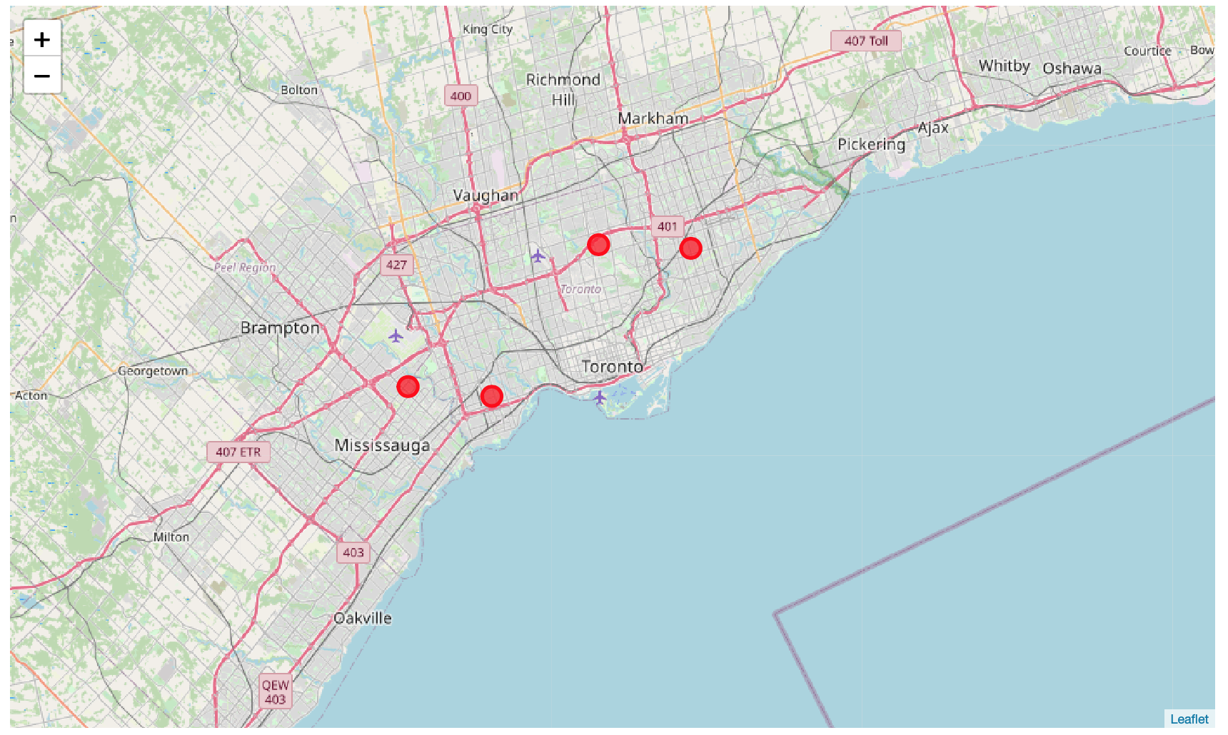
Results:
Location of the suggested neighborhoods to open the new shop on the Toronto Map

Slide 15
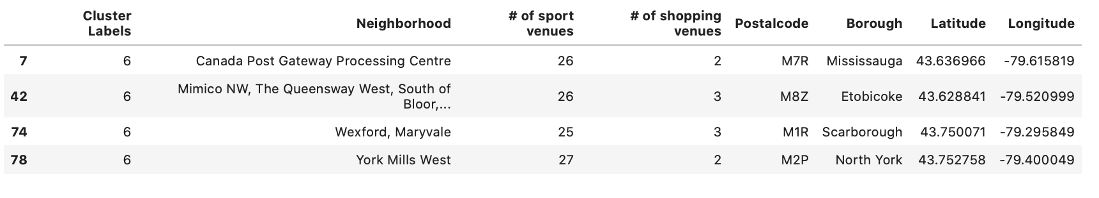
Results:
Details of preferred cluster:

