Slide 1
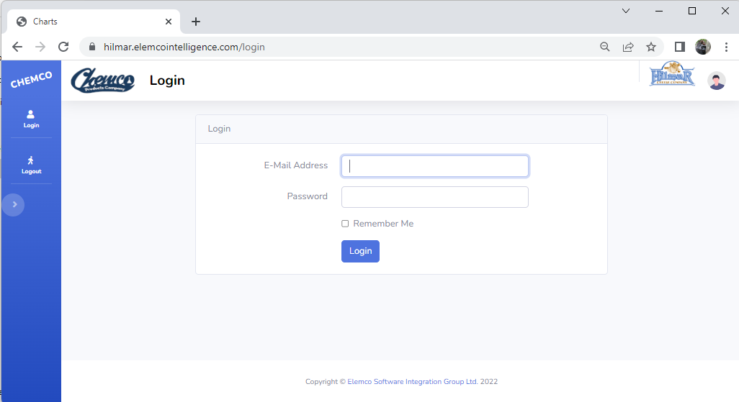
Elemco Intelligence Reporting Website
Usernames will be created to allow different roles to be assigned using two-factor authentication
Considerations to filter data by screen, plant and sensitive data (can you see $$?)

Slide 2
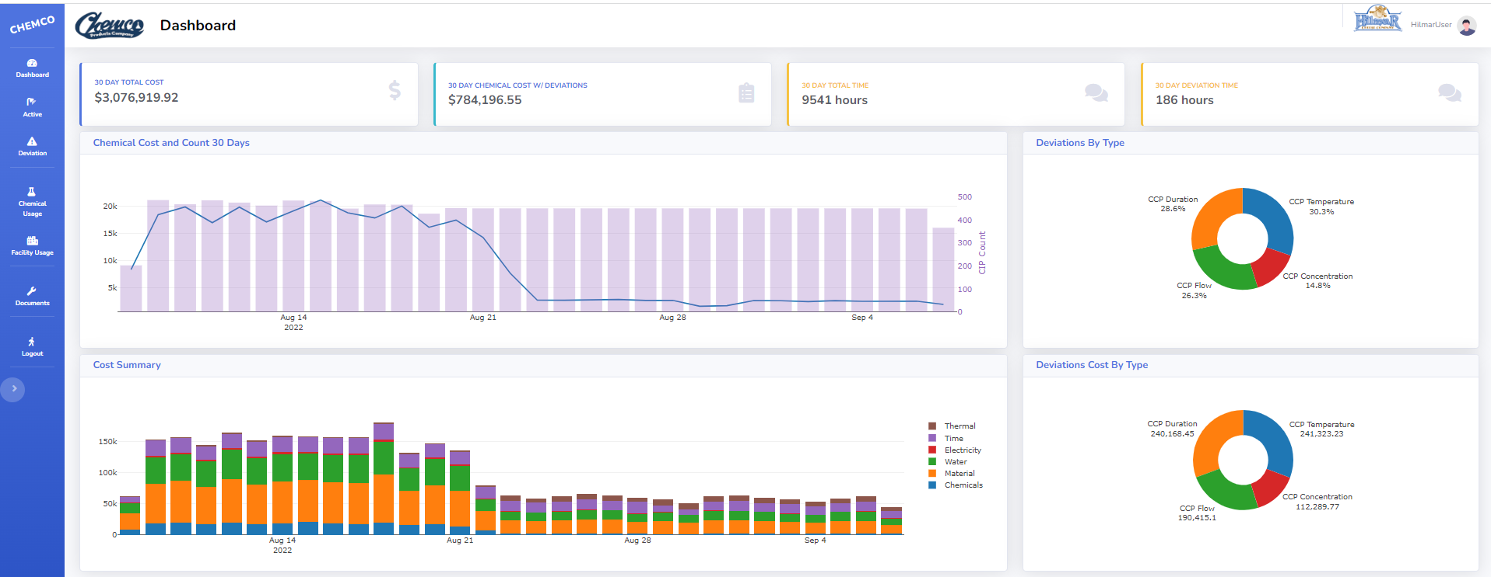
Elemco Intelligence Reporting Website
Initial Dashboard will present summarized data for a predefined time.
All data and menu options are filtered based on the user’s log in.

Slide 3
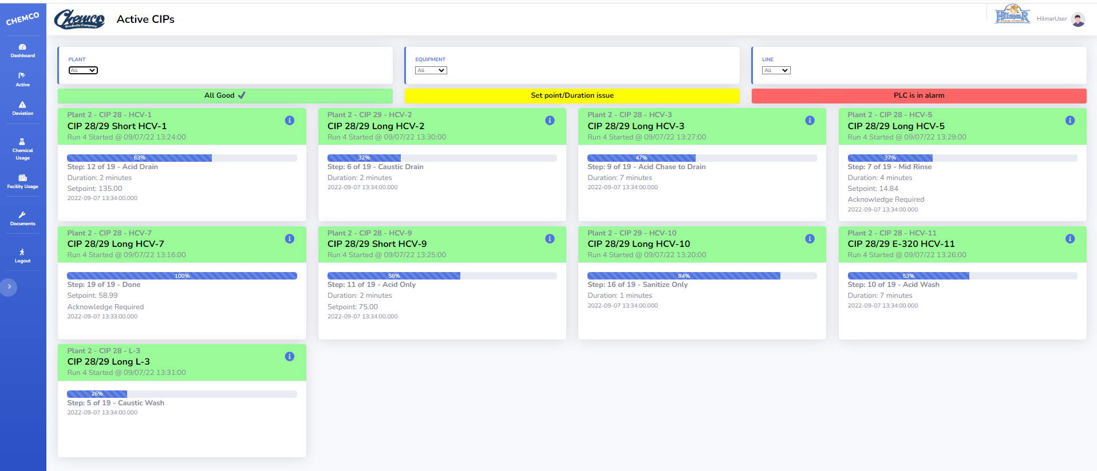
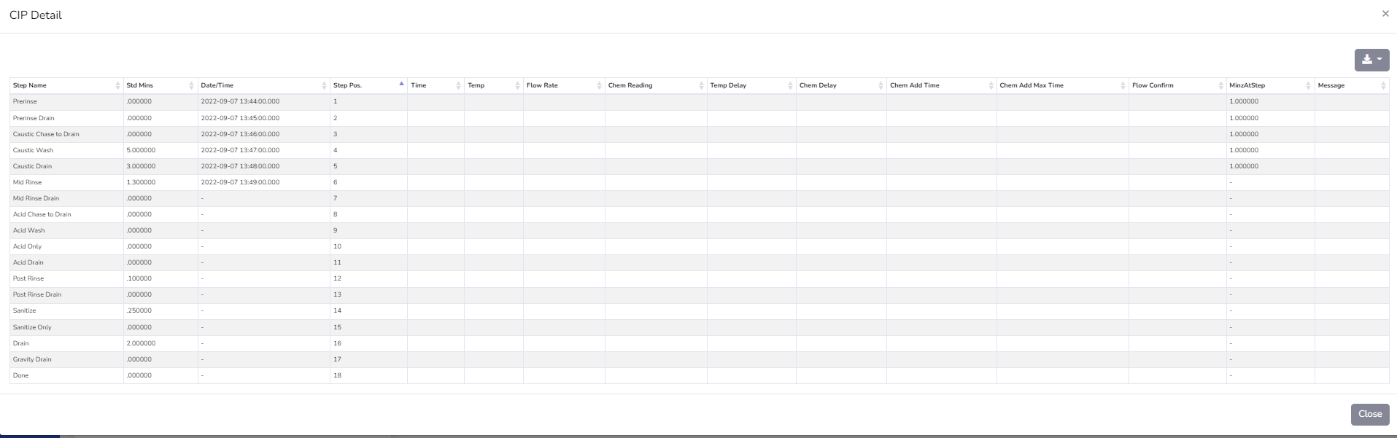
Elemco Intelligence Reporting Website
When near real time data is available a board showing currently active CIPs can display information
Data is automatically refreshed on a regular interval
Parameters (Line, Plant) can be passed in the URL to run in kiosk mode on large screens /active?plant=Plant%202&equipment=HCV-11#
Immediate issues can be reported (colors / messages) using the PLC’s alarms or built-in logic (e.g., do we have temperature readings?)
Emails and texts can be sent (and escalated) to assigned personnel based on plant, line, time in exception, etc.
Each customer can decide what information should be show on the header
Clicking on one of the CIPs will show its current vs. standard details

Slide 4
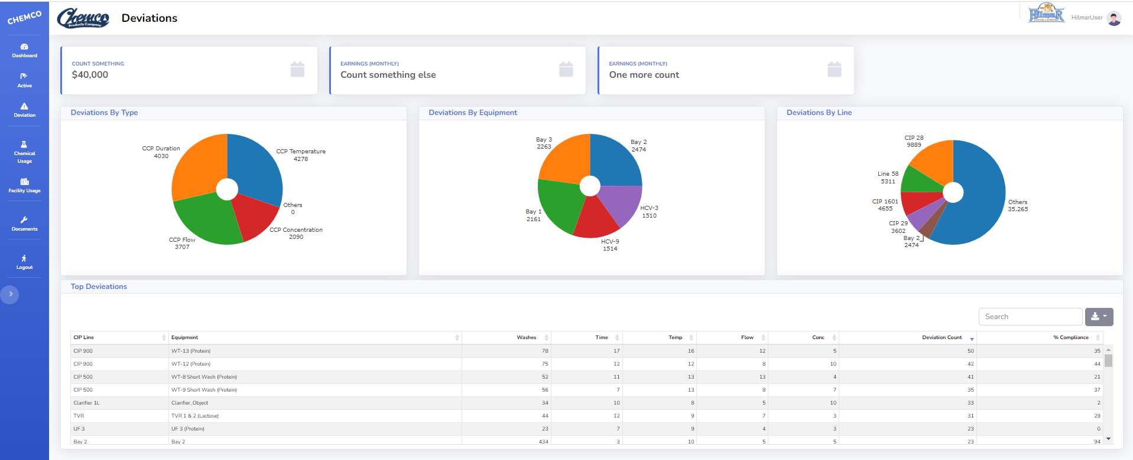
Elemco Intelligence Reporting Website
The Deviation screen will focus specifically on details about exceptions, variations and compliance.
When the data is available, we will report on the cost of the deviation for issues as well as usage that is different from the standard.

Slide 5
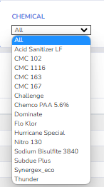
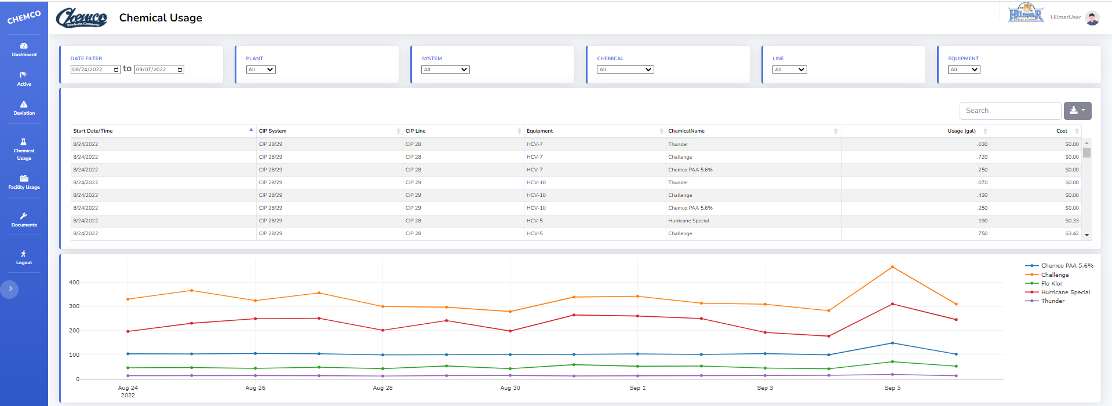
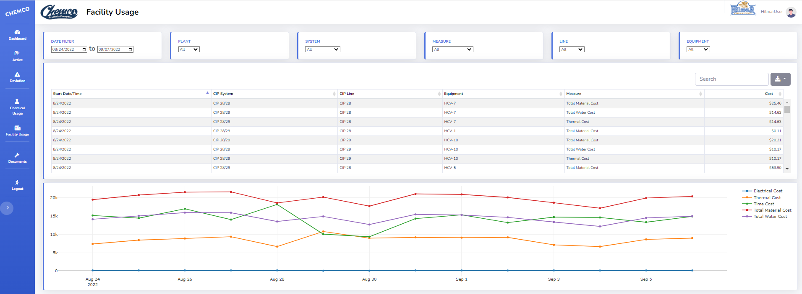
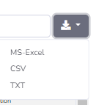
Elemco Intelligence Reporting Website
Chemical and Facility usage screens will allow you to further drill into details.
Interactive filters are based on user’s log in.
Data can be exported for further analysis.
Export data

Slide 6
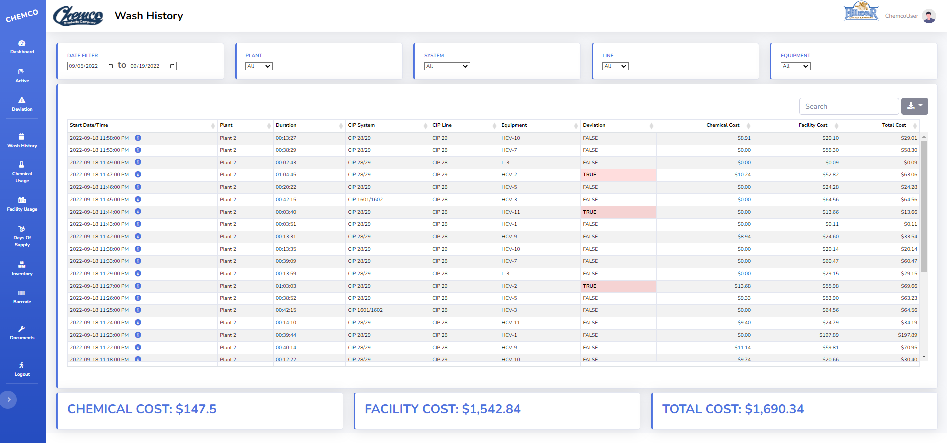
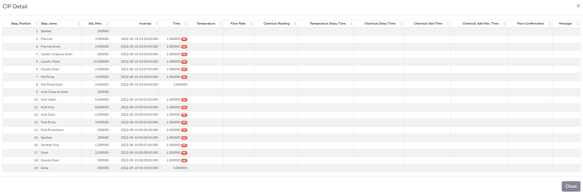
Elemco Intelligence Reporting Website
Wash history will allow you to further drill into details.
Quick view into deviation / compliance
Interactive filters are based on user’s log in.
Data can be exported for further analysis.
Clicking on one of the CIPs will show its current vs. standard details
Export data

Slide 7
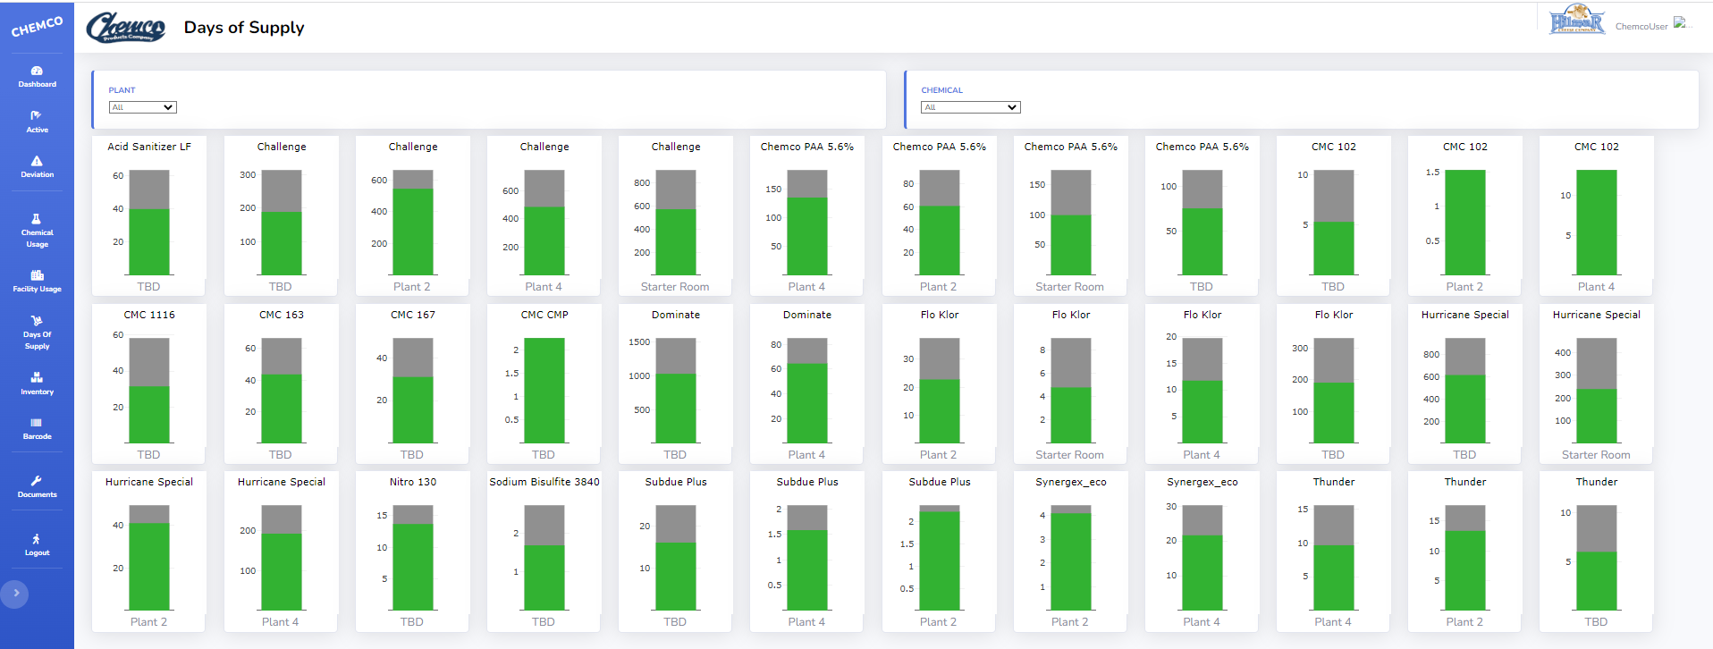
Elemco Intelligence Reporting Website
Days Of Supply will be determined using the inventory from a certain date for each plant.
Inventory data can be integrated from a source system or manually entered from provided screens.
Calculations are based on each chemical’s average use, safety and deliver days with options to add further days for dock and quality days / status.
Information can is reported in days and / or volume.
Green = stock is Good; Yellow = stock is below the re-order amount; Red = stock is below the safety stock amount.
This can be automated to snapshot information on a regular basis for trend analysis.
Summarized emails can be sent for issues.

Slide 8
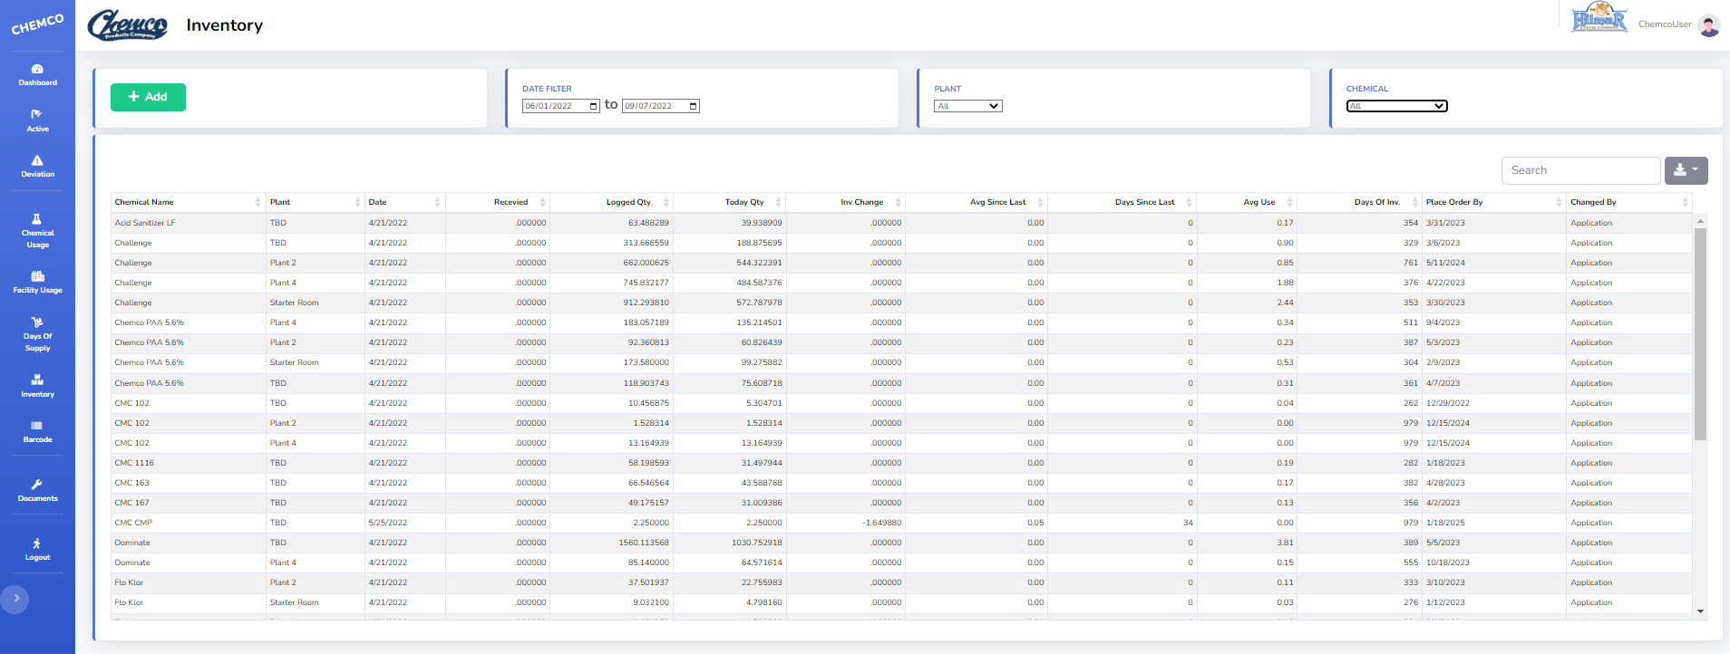
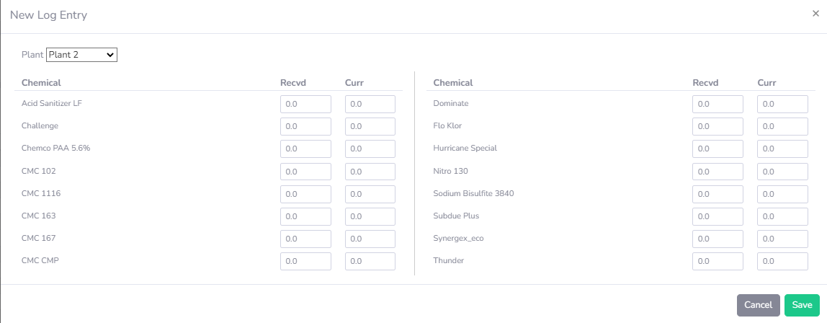
Elemco Intelligence Reporting Website
The inventory screen is used to drill down into the details behind the Days Of Supply graphs.
This screen will also allow one to manually record current inventory.
Previous entries can be viewed, and corrections can be made.
Spreadsheet data can be exported for further filtering.
ADD current
inventory for each plant
Export data

Slide 9
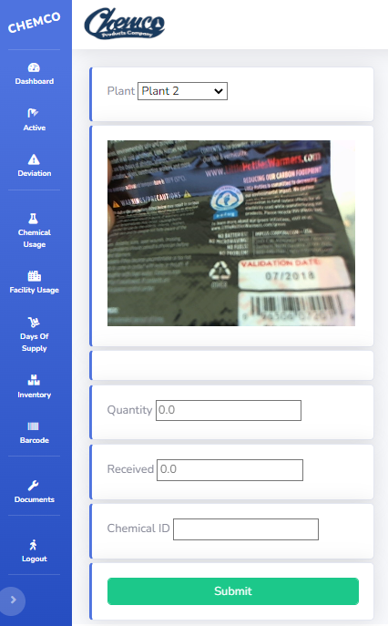
Elemco Intelligence Reporting Website
There is an option to use a phone or hand-scanner to scan the chemical’s barcode and capture its information.
The quantity entered is given a current time stamp and is used as the beginning inventory level for the Days of Supply calculation.
We can agree on what information is to be captured, including batch / lot information.

Slide 10
Elemco Intelligence Reporting Website
Users will access servers located in Amazon’s data center (AWS).
Load balancers direct traffic across multiple servers, based on performance needs.
Customer data is protected behind firewalls in an isolated database per customer.
Options will be reviewed for getting the customer’s data from their plant into the cloud’s database.
https://hilmar.elemcointelligence.com
https://hilmar.elemcointelligence.com
AWS Load Balancer https://hilmar.elemcointelligence.com
Web Server
elemcointelligence.com
Web Server
elemcointelligence.com
Database Server
elemcointelligence.com
Customer PLC Data Server
Option: on premises radio transmitter
Audio messages based on PLC faults

Slide 11

Elemco Intelligence Reporting Website
About Elemco Integration Group, LTD
Established in 1978.
Supply chain, MES, quality assurance, vision systems, lot traceability, compliance, auditing.
Design custom solutions; programming in the PLC and current full stack languages.
Integration with home-grown or industry standard applications (SAP, Oracle, SQL, etc.).
We can use already-established corporate tools or advise and provide technology options.
All programming and control panel fabrication is performed by in-house personnel.
Our design philosophy stresses simplicity, reliability and actionable feedback. Applying years of expertise and current technology to this focused approach has consistently brought increased profitability to our customers. Repeat business and referrals have made Elemco Software Integration Group Ltd. the preferred system integrator for vertical major manufacturing companies in the CPG, Cosmetic, Pharmaceutical, Food and Fluid Processing industries.

