Slide 1
ECE 544 Project3
Team member

Slide 2
Assumptions and Address Scheme
Assumptions
  Lossy Environment
  End nodes can only connect to Routers
  Etc…
Packet Format
  Router
    Name and Address scheme
  End Node
    Name and Address scheme

Slide 3
Bootstrapping and Discovery
Algorithm
  Router and End node boot up (Hello packet?)
  Discovery:
    Router discover router
    Router discover end node
    End node discover router
Packet Format

Slide 4
Baseline Routing Algorithm
Routing Algorithm
  RIP or OSPF or others?
  Routing Table Construction
  Routing Table Update (How long?)
  How to find the shortest way to do multicast routing?
Packet Format

Slide 5
Multicast Algorithm
Exact Algorithm followed by each router
Key benefits/demerits of your scheme

Slide 6
Data Transfer and Reliability
Message Forward
  Unicast, Multicast
  Packet Format of DATA, ACK
ARQ Scheme
  Hop-by-hop or End-by-end
  Stop-and-wait, Selective-repeat, sliding windows or other schemes

Slide 7
Appendix: Network Architecture
Refer to the following 3 networks, what is the best (shortest) way to transmit packet from Source S to Destinations D1, D2, D3 for different values of k

Slide 8
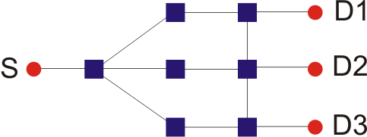
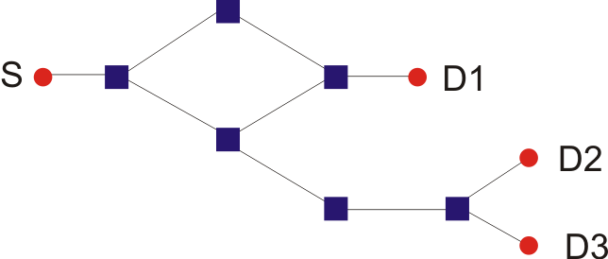
Example Networks:
Network 1
Network 2

Slide 9
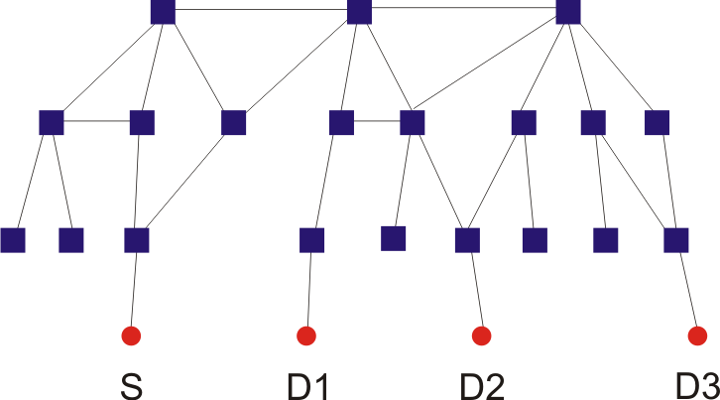
Example Networks
Network 3: A 20 node Internet topology

