Slide 1
Netflix Duration Time

Slide 2

Dataset

Slide 3
Hypothesis
My duration time in my Netflix account has declined over time.

Slide 4
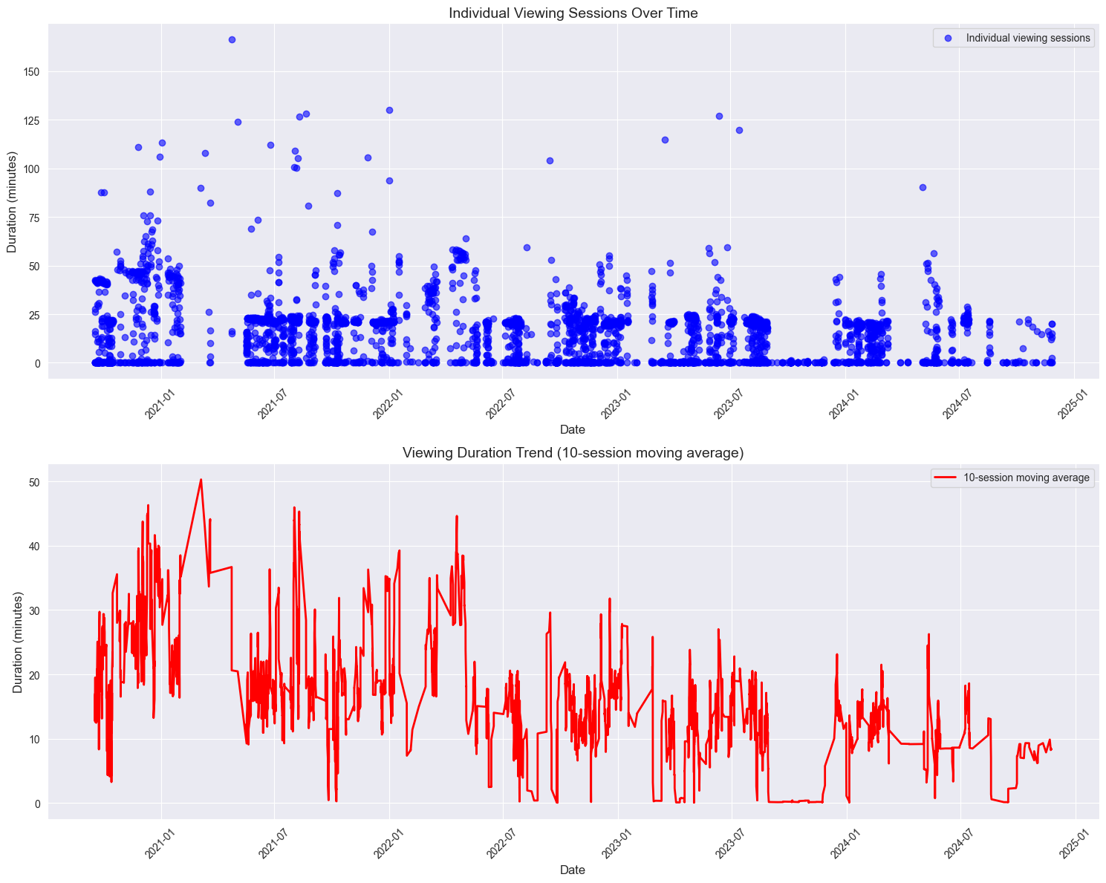
MY VIEWING ACTIVITIES

Slide 5
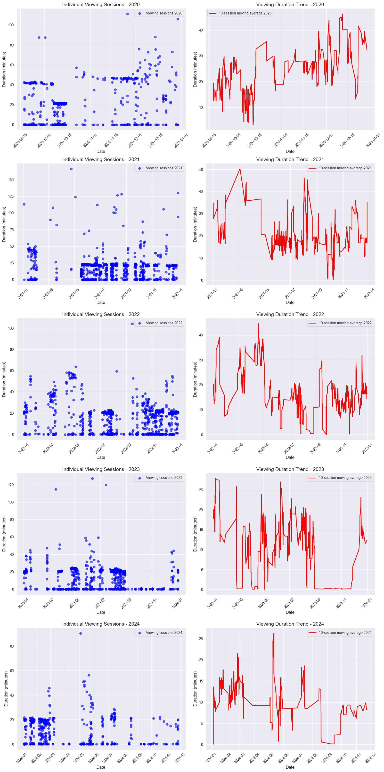
MY VIEWING ACTIVITIES BY YEAR

Slide 6
Both of the graphs imply a decline in my duration time over years.
To prove my hypothesis I calculated its correlation coefficients and I added some extra visuals

Slide 7
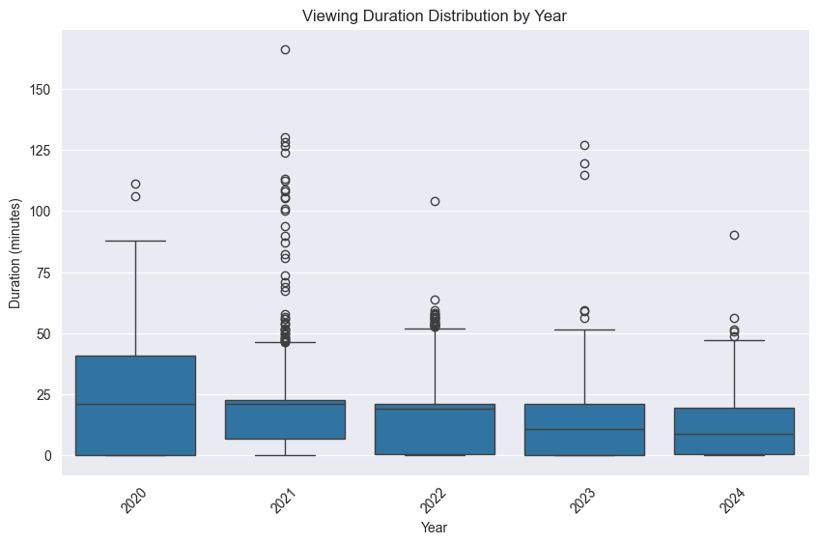
Pearson correlation coefficient: -0.2057
Spearman correlation coefficient: -0.1785
Both imply weak negative correlation

Slide 8
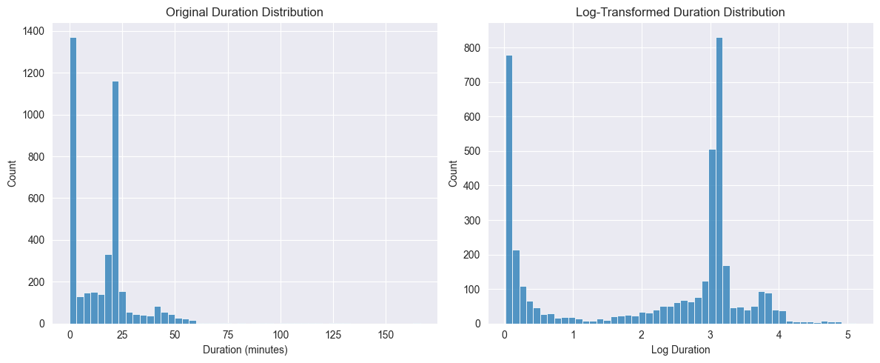
Log Transformation
I made a log transformation to normalize the data but it didn’t have a significant impact

Slide 9
Hypothesis Testing
I applied ANOVA for hypothesis testing on years.
Null hypothesis: Means of the years are same.
Alternative hypothesis: Average duration of the years are same.
p value : 1.1102-e16
Since p < 0.05 I rejected the null hypothesis

Slide 10
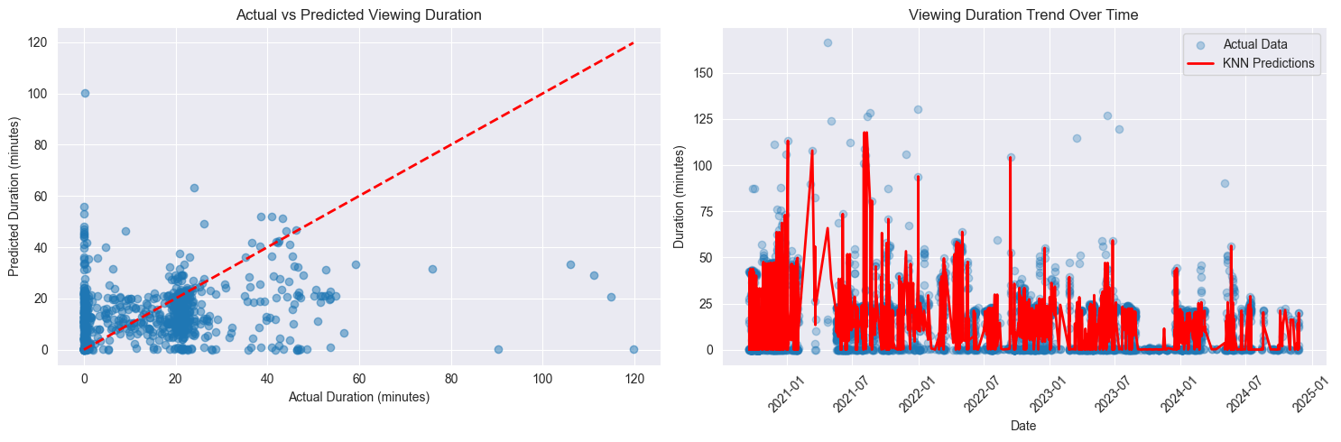
Machine Learning
After I reject the hypothesis I tried to train a knn model.

Slide 11
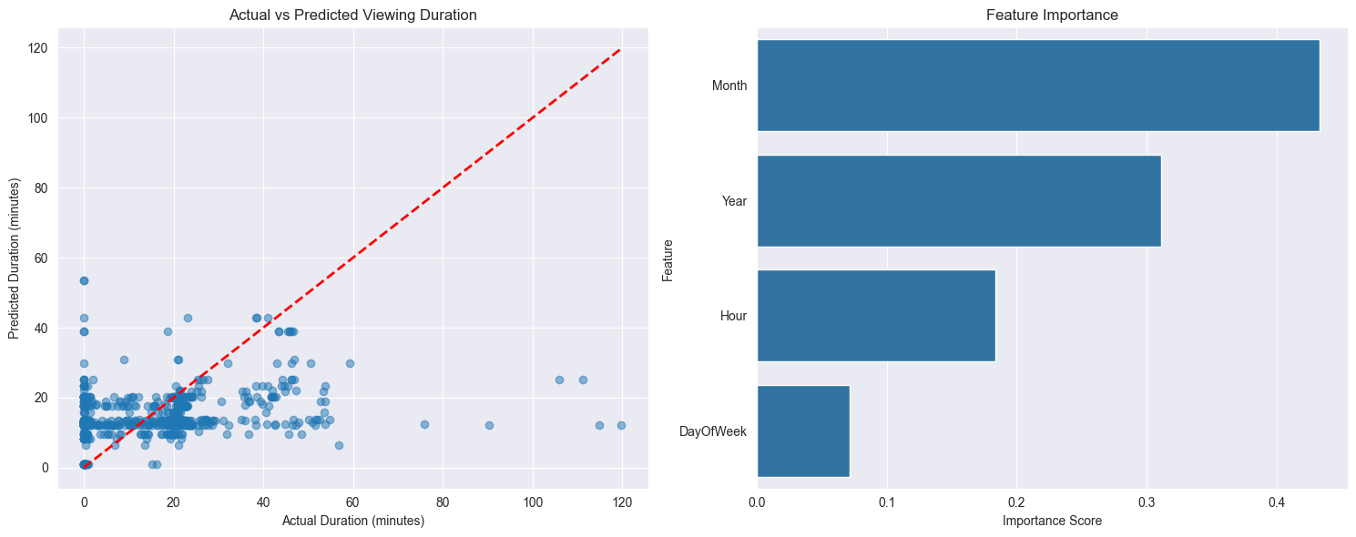
Knn model didn’t fit my model very well, so I tried a tree model which I thought is more suitable for my dataset. Even though it increased the accuracy. It isn’t still a reliable model.

Slide 12
Conclusion
I managed to reject the null hypothesis and I saw my initial hypothesis seems to be true. My real life perception matches with the data.

Slide 13
Further Improvements
More fitting machine learning model could be found or dataset could be the expanded. Adding genres and type of what i watch could be an important factor.
Correlation with other factors could be analysed.
More emphasis on the outliers could be done since there are some extreme outliers and I am curious about their types.

Slide 14
THANKS FOR YOUR TIME
Mehmet Fatih Paksoy
325109

