Slide 1
HL7 v2+ Vocabulary Proposal: HL7 v2+ Base Standard and Profiling
Robert Snelick, NIST
February 18th, 2022
First published on February 18, 2022

Slide 2
Basic Premise
Establish practical principles and specification for implementing HL7 v2 vocabulary requirements
Focus on the requirement specification, not implementation, tools, etc.
Define concepts/representations with existing definitions and terms (i.e., make a clear bridge)
Draw clear boundaries between base standard definition and profiling aspects
Focus on the legacy (inherit) code sets embedded in HL7 v2, not external code sets
Because these code sets are part of the base standard
Keep it simple—at the cost of a complete model (provide a ~90% Solution)

Slide 3
Scope
In:
HL7 v2+ Base Standard
HL7 v2 Profiling
HL7 v2+ Code Sets
Out:
Other HL7 product lines vocabulary
External vocabulary that can be used in v2+
Universal vocabulary model
Legacy HL7 v2.x Tables (e.g., tables in v2.5)

Slide 4
Scope of v2+ Base Standard
In:
HL7 v2+ Code Sets
Concept Domain
Code System
Out:
v2+ Value Sets
Legacy HL7 v2.x Tables
Can be managed elsewhere but not in the v2+ base standard
External code sets

Slide 5
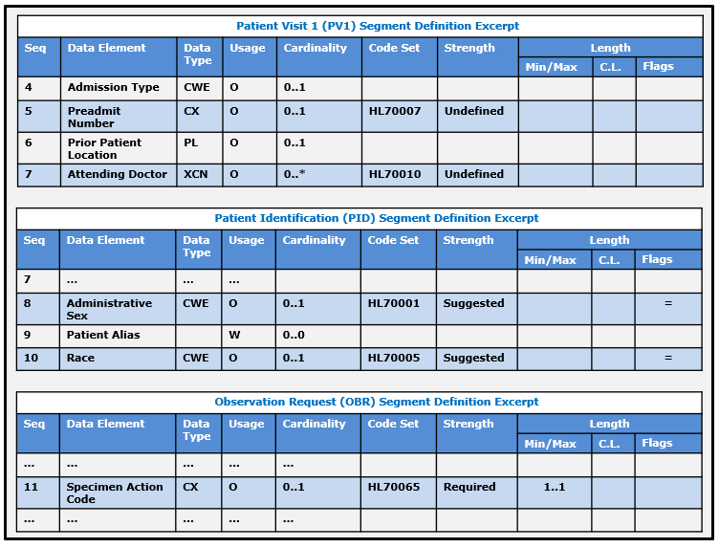
v2+ Base Segment Page

Slide 6
Vocabulary Concepts Summary
Code Set: Generic term of a vocabulary notion that refers to the concept of a set of codes or a concrete set of codes
Concept Domain: is an abstract notion that refers to a set of related ideas (concepts) that serve to help define the meaning of a particular data element
Code System: is a managed collection of codes that represent concepts used in a particular business or technical area and in which often there are relationships between the coded concepts.
Value Set: is a collection of codes targeted for a specific use. A value set draws codes from one (usually) or more code systems; the result is a set of codes that constrains the possible content of a data element.

Slide 7
Code Set
Generic term of a vocabulary notion that refers to the concept of a set of codes or a concrete set of codes.
Depending on the context is used to refer to:
Concept Domain
Code System
Value Set
Using the abstract notion of “code set” helps in explaining the vocabulary transitions that occur from the base standard to an implementation profile

Slide 8
Concept Domain
Is an abstract notion that refers to a set of related ideas (concepts) that serve to help define the meaning of a particular data element (over and above just the name of the data element).
A concept domain does not directly define a particular set of concepts and is independent from a specific and explicit association to a particular vocabulary (code system or value set).
The concept domain of postal code is an example.

Slide 9
Code System
Is a managed collection of codes that represent concepts used in a particular business or technical area and in which often there are relationships between the coded concepts.
Code systems are developed to provide a set of coded concepts for a particular domain, and they are designed for one or many specific or general business uses.
A code system may be a simple list of coded concepts, or it may be designed with one or more explicit relationships between the coded concepts (at least hierarchical, and often many other types of relationships in a multi-dimensional fashion).
As an example, a concept domain of “Administrative Gender” can contain a concept “male” and a code “M” that represents the concept “male” within the context of the code system.
Examples include CVX, NDC, LOINC, etc.

Slide 10
Value Set
Is a collection of codes targeted for a specific use. A value set draws codes from one (usually) or more code systems; the result is a set of codes that constrains the possible content of a data element.
Defines a semantic space for a data element such that interoperating systems can understand each other.
A key distinction between a value set and a code system is that a code system is used as a reference source of coded meaning whereas a value set is a specific constraint for a set of explicit business uses.
Ultimately, binding of data elements to value sets is required for implementation.

Slide 11
HL7 v2 Tables (HL7 and User)
HL7 v2 defines a set of pre-defined tables that contain identifiers and may also contain codes. A table sometimes acts like a code system, value set, and/or a concept domain depending on how it is defined and used.
Tables in HL7 v2 have two types: HL7 Table and User Table.
HL7 Table: includes values that must be used if the concept to be conveyed is contained in the table. HL7 Tables can be extended for inclusion of concepts not pre-defined in the table.
User Table: this kind of table provides a list of suggested values that could be used, or, alternatively, a different set of values could be defined and used. The User Table could be empty with no values suggested, which indicates that this entire set of values must be defined by a specifier.
Tables have a pre-defined identifier—the table number—that helps in managing the tables and in binding them to a data element.
In the context of profiling, the pre-defined set of tables in HL7 v2 can be used as a starting point for defining value sets.
In different cases, a Table might be constrained (like a code system), extended, replaced (acting like a concept domain), or used exactly as-is (acting like a value set).

Slide 12
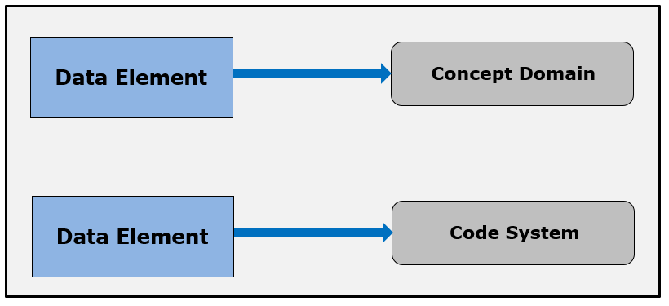
v2+ Base Standard Bindings

Slide 13
Promote HL7 v2 Tables
Promote HL7 v2 Tables to formal code systems defined and maintained by HL7 in v2+
Include both HL7 defined tables and select User defined tables (as “formal” code systems)
i.e., use a code system where it makes sense
Leverage work from code tables project, see e.g., https://terminology.hl7.org/3.1.0/CodeSystem-v2-tables.html
Determine Code System
HL7xxxx_v2+2023.1 (to be determined)
Define attributes/meta data
What should be included from existing work?
Code systems can be used in base standard and in IG/Profile specifications

Slide 14
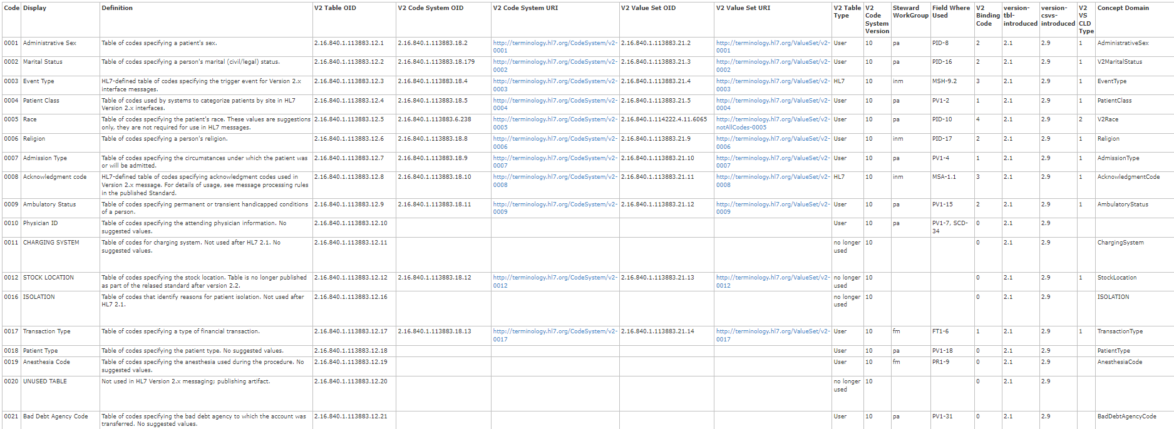
https://terminology.hl7.org/3.1.0/CodeSystem-v2-tables.html
What to include?

Slide 15
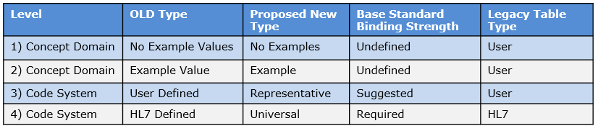
Base Standard Concepts
Concept Domain
1) Semantic Definition – No Example codes
2) Semantic Definition – With Example codes
Code System
3) Code System – Suggested Binding Strength
4) Code System – Required Binding Strength

Slide 16
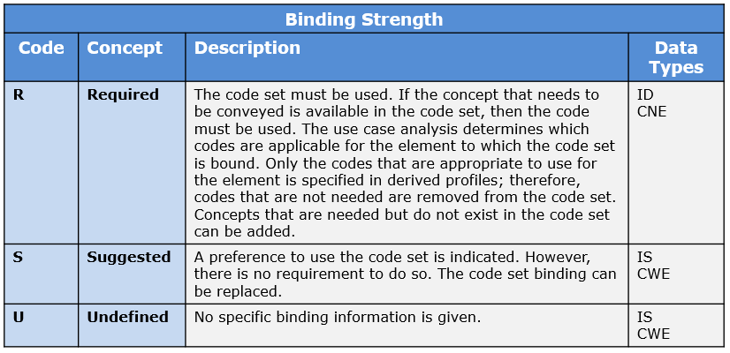
Binding Strength – Base Standard
Need to Add More Coded Element Data Types

Slide 17
v2+ Base Segment Page
2
1
3
4

Slide 18
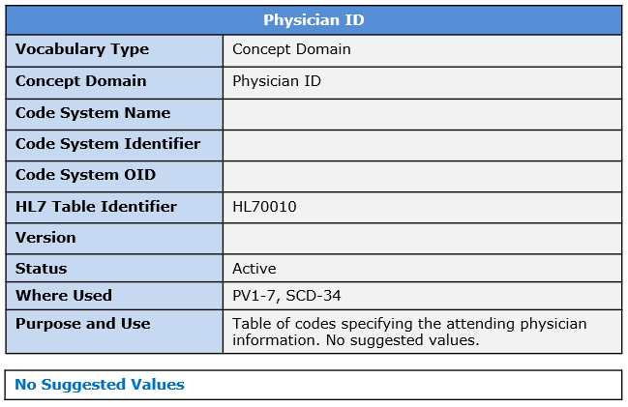
1) Concept Domain – No Example codes
1
Provides only the concept domain. Typical for local defined code sets.
Profiles may use the HL7 Table Identifier or replace.
Link to associated resources

Slide 19
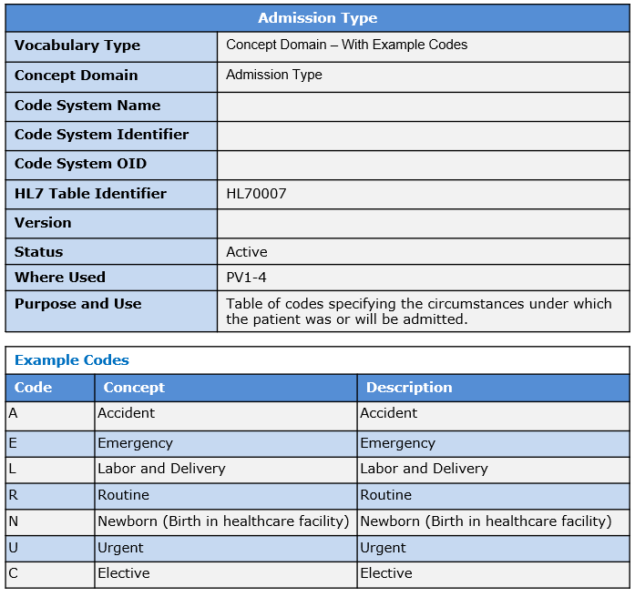
2) Concept Domain – Example codes
2
Provides only the concept domain and example codes, but no a complete set. Examples are given to better define the semantic definition of the element.
Profiles may use the HL7 Table Identifier or replace.
Link to associated resources

Slide 20
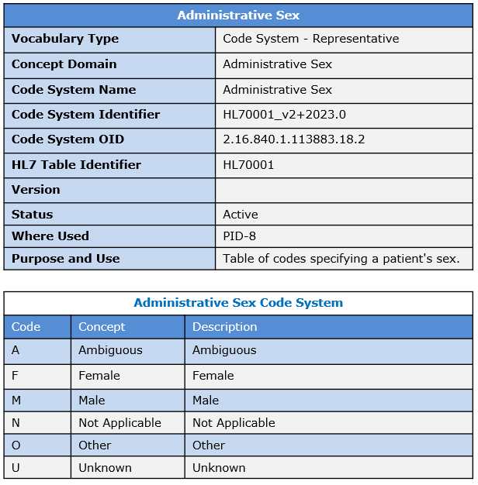
3) Code System – Representative
3
Is a “formal” v2 code system. Can be used to create a value set.
Binding is suggested and thus can be replaced, and handle identifier renamed.
CS 0396 Entry
Link to associated resources

Slide 21
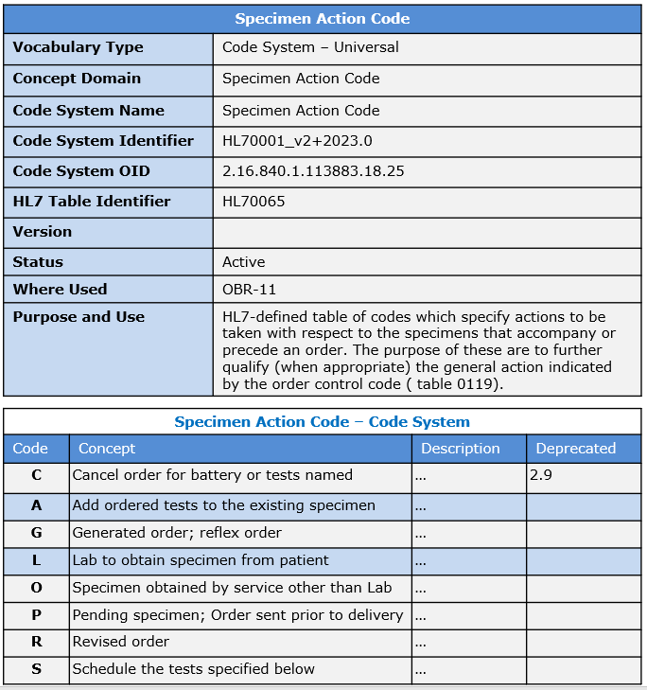
4) Code System – Required
4
Is a “formal” v2 code system.
Must be used to create a value set.
Binding is required and thus codes and their concepts can’t be replaced but the handle identifier can be renamed.
CS 0396 Entry
Link to associated resources

Slide 22
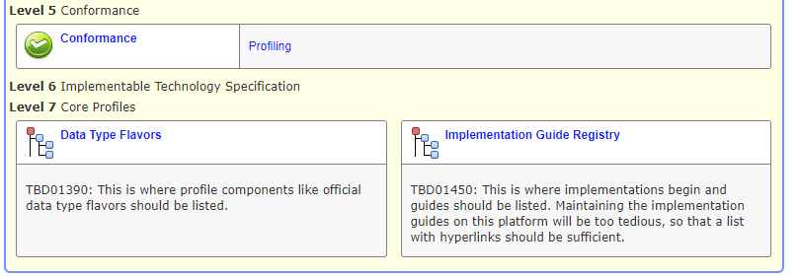
Link to associated resources
Provide vocabulary resources → Gives pointers to references
When on concept domain/code system page, go directly to the resource page for the concept domain
Provide a front page that list all v2 code set bindings
Not part of v2+ base, is applicable for all v2.x versions (like data type flavors)
Maybe call level 7 implementation Support
New. Location to reference vocabulary resources
Implementation Support
Vocabulary Resources
Include UTG Link
Precoordinated Value Sets
From V3 and FHIR
External Code Systems
Etc.

Slide 23
HL7 v2 Tables Review
Promote HL7 v2 Tables to formal code systems defined and maintained by HL7 in v2+
What does this mean?
Review each table and classify as:
Concept Domain
1) Semantic Definition – No Example codes – Don’t
2) Semantic Definition – With Example codes – Don’t
Code System
3) Code System – Suggested Binding Strength – Do
4) Code System – Required Binding Strength– Do

Slide 24
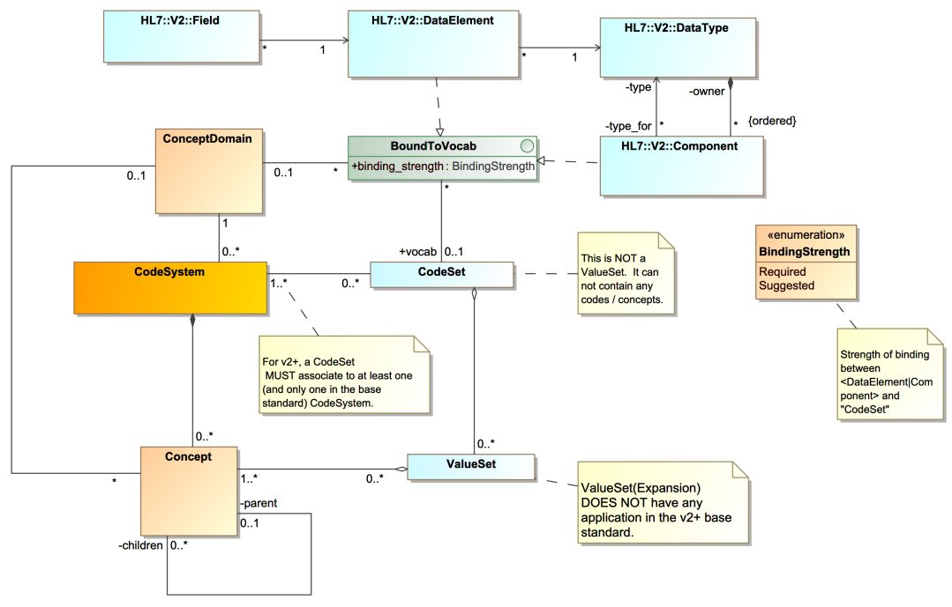
v2+ Tool Implementation Model
M. Faughn

Slide 25
Simplify Coded Elements DTs
V2 Design Issue: The data type should not dictate the binding strength
An explicit binding strength parameter is the correct method
Confusing things in profiling
V2 Design Issue: Profiling in the base standard → CNE
Simplify coded element data type definitions
SCE and CCE
SCE = Simple Coded Element
Replaces ID and IS
CCE = Complex Coded Element
Replaces CWE and CNE (others, CE deprecated?)
Consider only CCE for explicit coded elements
Note SCE need to remain for other data type that include a coded element
Data Type Flavors can be defined to express common uses—but this is part of profiling and not in scope here
Definition of CNE is troublesome—can’t be extended with local codes and there are direct bindings to code systems and tables in the base standard—would have to be able to specify extensibility parameter in base
For another day…

Slide 26
Item Number
Is item number useful? Does anyone actual use it?
For another day…

Slide 27
Profiling and Vocabulary
Out of Scope for v2+ Base

Slide 28
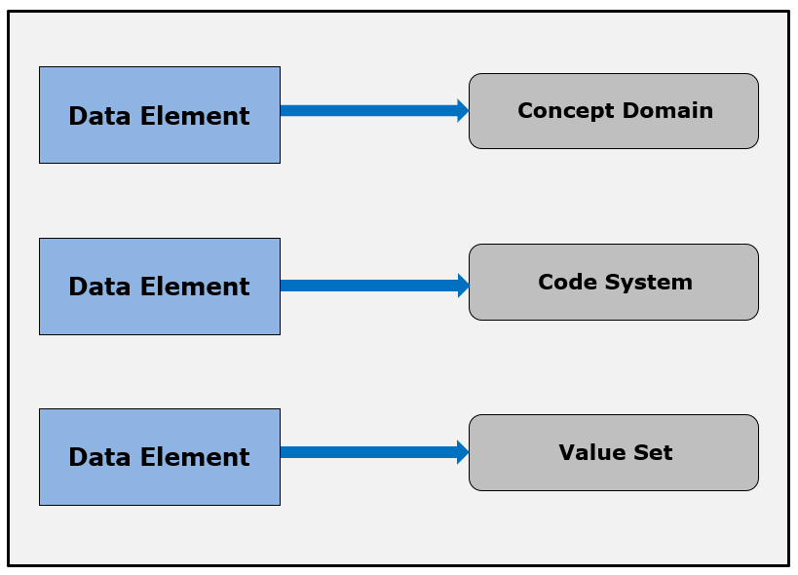
v2 Implementation Guide Bindings

Slide 29
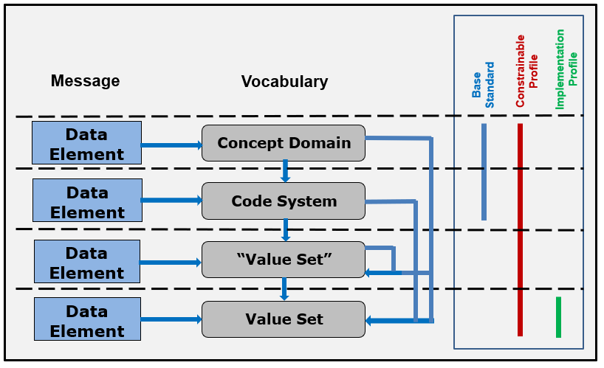
v2+ Base Standard Bindings

Slide 30
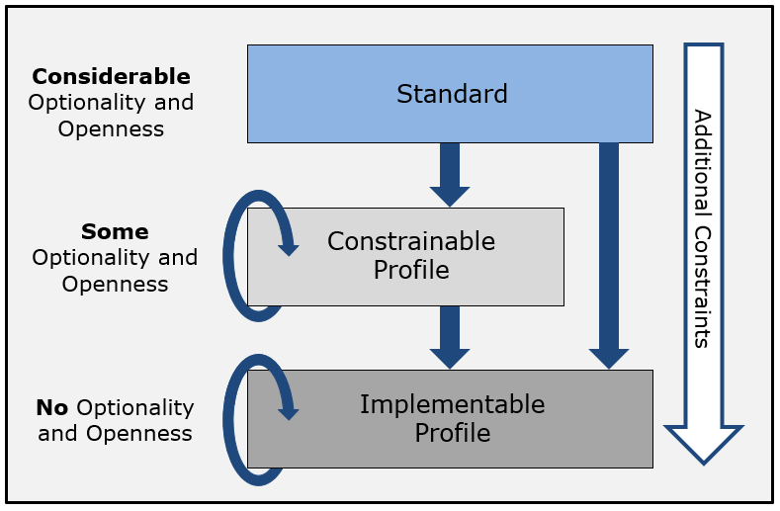
Profile Hierarchy
Multiple levels of profiling—all levels useful and important
Narrows focus to specific use cases
Provides explicit documentation
Computable representation
Profiling is performed one way or the other—why not document!

Slide 31
Profiling is Transitory
Specifications progress from “more generalize” solutions to “more specific” solutions
All specifications are finalized as a specific solution
All implementations implement an exact solution based on a specific solution
Important to keep in mind profiling is a means to an end—therefore provisions in the way the standard is defined supports this notion

Slide 32
Profile Level Definitions
Standard Profile: represents the base standard definitions and constraints as-is and establishes the framework for a specific type of event. The overall structure (“template”), including the data type definitions, is established; however, the full declaration of requirements has yet to be specified, and, therefore, considerable openness still exists.
Constrainable Profile: is derived from either the standard profile or another constrainable profile, and it further constrains the definition attributes in accordance to the profile compliance rules stipulated in this document. Analogous to the standard profile, not all element attributes are fully constrained.
Implementation Profile: defines all elements such that all optionality and openness have been removed. All interfaces deployed in a production setting are implementable profiles whether they are documented (explicitly stated) or not documented (implicitly stated), i.e., the code written.

Slide 33
Profile Hierarchy
Base Standard = Framework
Well-Defined Use Case for General Applicability (e.g., National Specification)
Local Implementations
Note: Multiple instances of constrainable are plausible

Slide 34
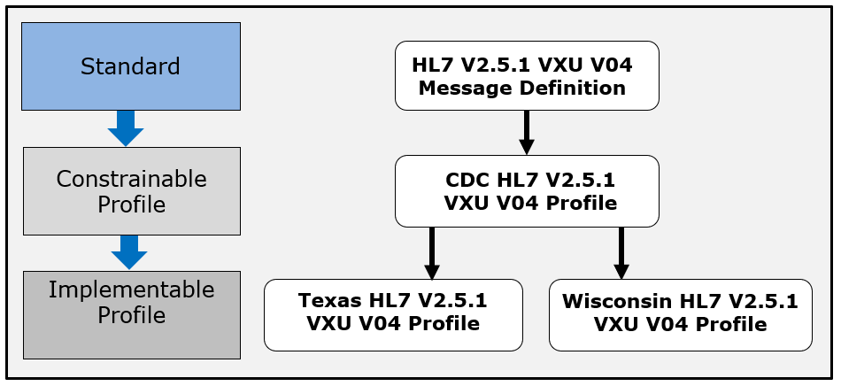
Profile Hierarchy Example

Slide 35
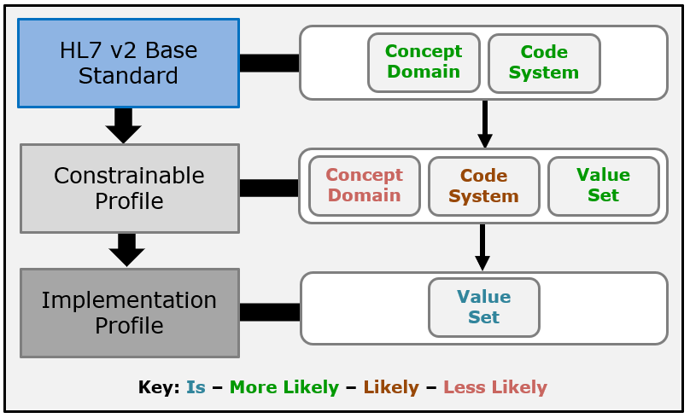
v2 Vocabulary Bindings

Slide 36
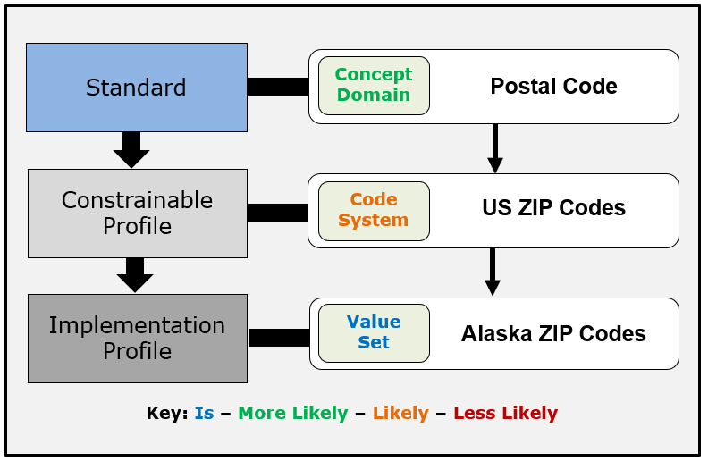
v2 Vocabulary Bindings Example

Slide 37
More Vocabulary Concepts
Binding Strength
Stability
Extensibility

Slide 38
Stability
Stability: indicates whether the content of a value set can change based on the definition of the value set. Often the value set is dependent on an external code system that may be updated or replaced after publication of the interoperability specification. Stability can have one of two values: static or dynamic. Static indicates that for this version of the specification the value set is completely fixed, both its definition and the expanded list of codes. If the value set needs to be modified, then a new value set and an updated version of the specification must be created. Dynamic means that a value set can change outside of the definition of the specification (and thereby becoming, in essence, a new value set that may be managed and referred to in various ways). In some instances, dynamic value sets are entire code systems that periodically are updated. In this case, the value set definition is the same, however, the expanded list of codes has changed.

Slide 39
Extensibility
Extensibility: indicates whether the value set definition can be extended or not in a derived (profiled) version of the specification. The extensibility of a value set definition can be either open or closed. Open means that more values can be added to the value set in a derived specification. Closed means that no more values can be added to the value set in a derived specification.

Slide 40
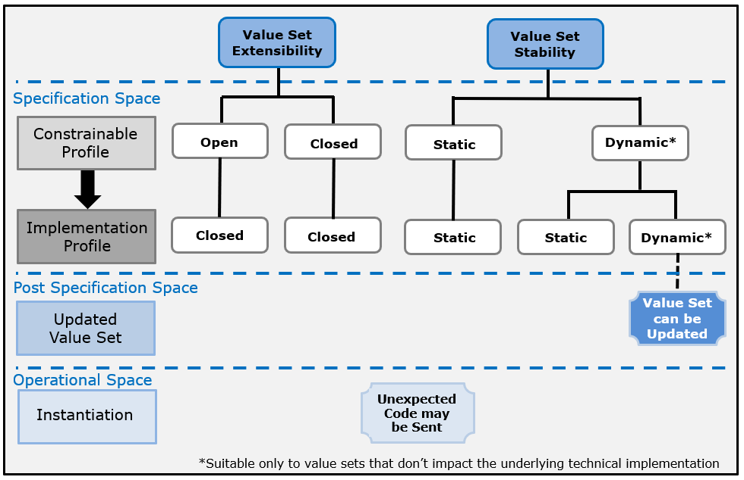
Extensibility and Stability

Slide 41
Binding Parameters Implications
Depending on the level of profiling there are certain things that become evident, e.g., in implementation:
All stability is closed
All binding strength is required
All code usages are required, unless explicit omission from a set is indicated by excluded

Slide 42
Binding Parameter Observations
Scope: Base Standard Level
All bindings have “open” extensibility

Slide 43
Review of Existing Tables
Issues
Table 0007 is made into a code system but is only example values
Table 0292 is HL7 table (check on) and refers to CVX codes, this is not right. This should be external and be only suggested values and should be dynamic
See table 65.HL7-defined table of… The purpose of these are to further qualify (when appropriate) the general action indicated by the order control code ( table 0119). ← Need to clean up?

Slide 44
Observations
Generally constrainable profiles are defined and are known to the community
Implementations create derived profiles from the publish constrainable profiles but are often not documented or if documented, not accessible
Conformance validation is most often performed on implementations but based on constrainable profiles—therefore, there are known, unknowns

Slide 45
Observations
The concept of optional does not exist in an implementation profile (and therefore an implementation)
The concepts of “should”, “should not”, “may”, and the like do not exist in an implementation (and therefore an implementation)

Slide 46
Observations
The HL7 v2+ Standard is a framework—it never defines a specific use case
Profiling for a specific use case makes the standard “real”, applicable

Slide 47
Observations
All implementations have a corresponding implementation profile—explicit or not (implicit by the code written)
All aspects of an implementation are static at a point in-time (operation)
Profiling provides a convenient mechanisms for describing a “final” instantiation of the specification—much like a value set expansion

Slide 48
Observations
Concept domain is not a 1-to-1 with a code system, e.g., SNOMED
But in v2+ our HL7v2 tables (now code systems) will have this 1-to-1 relationship
Works because v2 code systems (tables) are simple-flat and only cover one concept domain
Not pure, but “good-enough”

Slide 49
Assessment of Methodology
Comprehensive → NO (80-90% solution)
But if we can get a majority of specifier to use, we have made a huge improvement
What worries me:
Is it understandable?
Code system versions
How to handle updates to the code sets without publishing—split messaging and code sets (dynamic)
Update code sets independently of v2+ messaging
Value set versions (or new value sets)
Instantiation and proclamation in the real world
But you can only bring the horse to the water
Much more here

Slide 50
Issues List
Code system versions
How to handle updates to the code sets without publishing—split messaging and code sets (dynamic)
Update code sets independently of v2+ messaging

Slide 51
Vocabulary Profiling
Need to expand the type of intermediate “code sets” that can be defined. Including “starter” value sets. So expand the 4 types from the standard to how many necessary ending with a fully defined value set
Need to show the profiling path from all of the starting points (type 1, 2,3,4). Go all the way to value set
Need to show also from elements that don’t have a table assigned to it for the CWEs and CNEs, e.g.,
Also, indicate the name of the code set is not normative, only the codes. For example, specifier can rename the HL7 0292 table to for example CVX or NDC
Also need to describe multiple bindings

Slide 52
Extra Slides Vocabulary

Slide 53
Content: Two Broad Categories
(1) Specific information about an entity
a person’s name (e.g., “Austin”)
a lab result value (e.g., “280”)
(2) Pre-defined concepts about an entity
a person’s name type (e.g., “legal”)
type of the lab test performed (e.g., “Cholesterol”)
usually are codes, within the context of a code system that specifies the meaning of the codes
e.g., “l” for “legal”, and “2093-3” for “Cholesterol”
Usually free data entry field
Notes:
Actual long name for Cholesterol: Cholesterol [Mass/volume] in Serum or Plasma

Slide 54
Vocabulary
A term used to describe, in general, the mechanics of defining, maintaining, and using codes to represent concepts
Includes terms and concepts such as:
Code
Code System
Concept Domain
Value Set
Table

Slide 55
Vocabulary Concepts
Term | Definition | Examples
Code | A unique and discrete “identifier” that represents a concept; typically is (and should be) agnostic to the concept it is representing | “M” “2093-3”
Concept | A notion that conveys semantic meaning | “male” “Cholesterol”
Code System | Managed collection of codes that represent concepts used in a particular business or technical area | LOINC CVX
Concept Domain | An abstract notion that refers to a set of related ideas and is essentially a named Semantic Category that serves to help define the meaning of a particular data element | Postal Code Immunizations Gender
Value Set | A collection of codes targeted for a specific use | US Zip Codes
Table | Similar to a code system; often a simple list of enumerated codes representing a concept; used in older standards such as HL7 v2.x | HL70005 for Race in v2.5.1

Slide 56
Vocabulary Relationships
Concept Domain
Code System
Value Set
Vocabulary
Postal Codes
US ZIP Codes
State of Alaska ZIP Codes
A specific set of codes is given for generally a broader use case. All US ZIP codes. Code → 15846 Concept → ZIP code for Kersey, PA
No specific codes given; the semantics of the concept is given. General postal code concept—the specifics are not given—could be for US, Germany, Canada, etc.
A specific set of codes is given for generally a specific use case. All Alaska ZIP codes. Code → 99829 Concept → ZIP code for Hoonah, AK
Levels of specificity and use—tied to specificity of the specification
Any levels can be bound to a data element
Profiling adds constraints which further defines the semantics of the bound data element
Notes:
Note, US Postal code system could also be a value set.

Slide 57
Creating Value Sets
Value Set
Code System
LOINC Code System
Code | Concept
… | …
27129-6 | Lead in Red Blood Cells
5671-3 | Lead in Blood
10368-9 | Lead in Capillary Blood
30424-6 | Macrocytes in Blood
19123-9 | Magnesium (Methodless)
… | …
30963-3 | Vaccine funding source
30956-7 | Vaccine type
38890-0 | Component vaccine type
31044-1 | Reaction
59785-6 | Indications to immunize
69764-9 | Document type
30979-9 | Vaccines due next
59781-5 | Dose validity
… | …
Concept Domain
NIP Observation Identifiers Value Set
Code | Concept | Code System
30963-3 | Vaccine funding source | LN
30956-7 | Vaccine type | LN
38890-0 | Component vaccine type | LN
31044-1 | Reaction | LN
59785-6 | Indications to immunize | LN
69764-9 | Document type | LN
30979-9 | Vaccines due next | LN
59781-5 | Dose validity | LN
C(R/RE)
A key distinction between a value set and a code system is that a code system is used as a reference source of coded meaning, whereas a value set is a specific constraint for a set of explicit business uses.
A value set “draws” codes from the code system for a specific use.
NIP=National Immunization Program
Notes:
Note, description of LOINC code have been shorten for readability.
Value Set and Code System is referring to the entire table; Concept Domain is referring to the “NIP …” only.

Slide 58
More Vocabulary Terms
Coded Element
Binding
Value Set Binding
Binding Strength
Value Set
Value Set Definition
Value Set Expansion
Content Definition
Extensibility
Stability
Alert: Different terms are used to convey the same concept
Alert: Terms are overloaded in use
Alert: Some use these terms interchangeably

Slide 59
Vocabulary Binding
Term | Definition | Examples
Coded Element | Generic term to describe data elements to which coded concepts are bound | CWE* CodeableConcept*
Binding | General term to describe the association of a data element to a vocabulary (concept domain, code system, or value set) | Associating the concept of “Postal code for area” to the data element “postalCode”
Value Set Binding | Assignment of a set of coded concepts to a particular data element in order to implement the concept domain associated with the data element | Associating the Alaska ZIP codes value set to the data element “postalCode”
Binding Strength | Indicates the conformance of the binding, that is, whether the vocabulary must be used or not (Binding strength should be made explicit) | Required Suggested
*Coded data element example is “administered vaccine”, CWE and CodeableConcept are example data types for coded elements.
Notes:
Note: Example for Coded Element is really the data type for the coded data element.
Binding Strength: All bindings are eventually required in implementations, and a suggested binding can be specified in a constrainable profile (i.e., the specification needs to be further constrained). The bound vocabulary definition with a binding strength of “Suggested” can be used, modified, or replaced by an alternative set. Bindings to concept domains and code systems always have a binding strength of “Suggested”.

Slide 60
Multiple Views (Definitions)
Value Set
Meta Data and Codes
Value Set Definition
Provides meta data and information to determine the codes
Considers a value set as the combination of the value set meta data and the list of codes (Common Interpretation)
Value Set Expansion
Is the realization of the codes in a computable format, such as an enumerated list
1
2
The term “value set” does not have a consistent definition across standards
Two common views are given
Notes:
Vocabulary terms are not harmonized across HL7 product families and other SDO standards. Therefore, there are multiple views of what a value set is.

Slide 61
Content Definition
Extensional
Intensional
Content Definition
Explicit List
of Codes
Algorithm
“all laboratory codes in LOINC”
{M, F, O, U}
The Content Definition of the value set indicates the method used to expand a value set definition into a set of codes
Extensional: value set expansion is an enumerated list
Intensional: value set expansion is derivable by the value set definition

Slide 62
Extensibility
HL7 v2
HL7 V3/CDA
Extensibility
Open/Closed*
CWE/CNE Coding Strength
CWE—local codes or free text allowed
CNE—fixed to codes defined in the specification
Open—local codes allowed in a derived specification
Closed—fixed to codes defined in the specification
HL7 FHIR
Extensible/Required Binding Strength
Extensible—local codes or free text allowed
Required—fixed to the codes defined in the specification
v2 Proposed*: Indicates whether the value set definition can be extended or not in a derived (profiled) version of the specification
V3 and FHIR: Indicates that if the concept that is trying to be conveyed is not available in the value set, another code can be used or free text
Interacts with data type definitions (code required or not)
Issue: Generally NOT expressive enough to convey range of intent
* Proposed (appearing in recent implementation guides). See hl7v2tools.nist.gov publications
Notes:
The HL7 conformance working group is working on formalizing the v2 vocabulary mechanics methodology.

Slide 63
Stability
Dynamic
Static
Stability
Can change w/r to the published specification
Fixed w/r to the published specification
Indicates that for this version of the specification the value set is completely fixed, both its definition and the expanded list of codes
The value set can change outside of the definition of the specification. Generally linked to a code system and maintained by an external steward.
Indicates whether the content of a value set can change outside of the definition of the value set or the specification
Dynamic→Clinical→e.g., CVX, LOINC, ICD-10
Static→workflow/functional→e.g., Order status codes, Observation result status
Notes:
Dynamic is generally for orthogonal (independent) concepts such as clinical observations—meaning codes could be added that doesn’t affect general processing (e.g., add more immunization vaccine codes). Static is generally associated with underlying technical specification (workflow/functional aspects) such as a workflow state machine. Changes to static value sets implies functional/use case changes (e.g., in lab Preliminary→Final→Corrected, adding a code has functional ramifications).
Dynamic value sets are typically external value sets and static are typically internal (such as HL7 v2 tables).

Slide 64
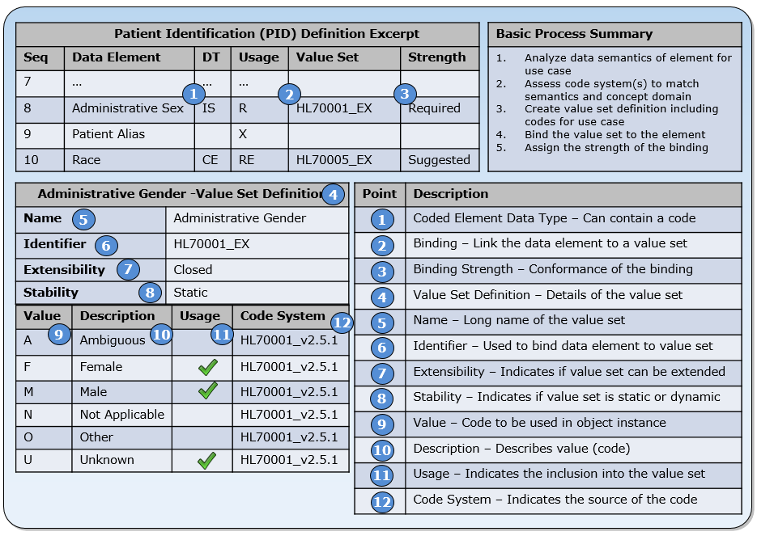
Vocabulary Mechanics
Representative methodology (most closely proposed v2.x approach)
In general, concepts apply to all data exchange standards (although the terms differ)
Notes:
#5: Is the Concept Domain as well.
#2 and #6 are used to bind the value set to the data element (model element)
#10: Is also the Concept
#12: Code System of HL70001_v2.5.1 → a little loose with the facts here since this is a table and not really a code system (but acts as one)

Slide 65
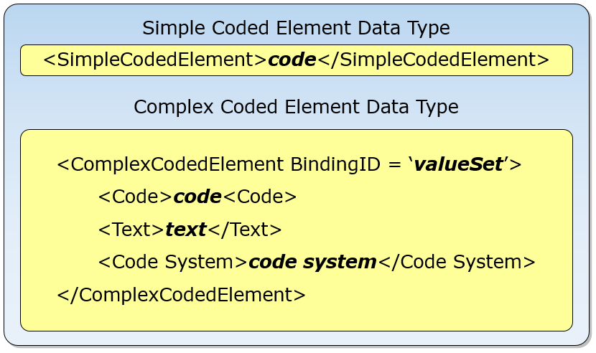
Coded Elements Structures
Value set may include codes from multiple codes systems
It is essential that the association between the code and source code system is maintained
This connection is accomplished in two ways: directly in the object instance (e.g., message) or derived from the specification (i.e., the binding of the data element to the value set specified in the profile).
Code | Description | Code System
F | Female | HL70001 v2.5.1
M | Male | HL70001 v2.5.1
X | X-gender | 99_My_Code_System
U | Unknown | HL70001 v2.5.1
Notes:
This is a pseudo representation to illustrated a point and does not directly map to any one given standard.

Slide 66
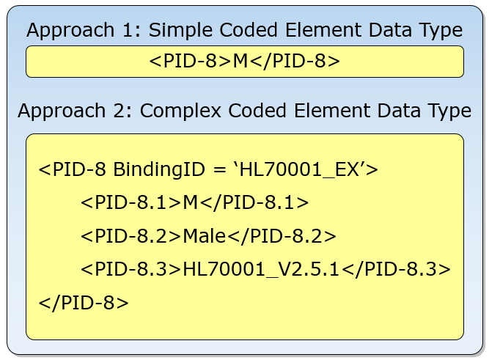
Example Instances
For simple coded element data types, additional information is necessary to understand the context
For complex coded elements, the context in which the code is defined is carried in the instance
Code | Description | Code System
F | Female | HL70001 v2.5.1
M | Male | HL70001 v2.5.1
X | X-gender | 99_My_Code_System
U | Unknown | HL70001 v2.5.1
Notes:
This is a pseudo representation to illustrated a point and does not directly map to any one given standard.

Slide 67
Code and Code System Link
Code System X
Code “1” is used to represent both “female” and “male”
Meaning still can be determined because of the association with a code system (code system must be conveyed in instance)
In some cases codes from different code systems are combined to create value sets
This approach is often more desirable than creating local codes
Concept | Code | Code System
Female | 1 | X
Male | 2 | X
Code System Y
Concept | Code | Code System
Female | 0 | Y
Male | 1 | Y
Contrived Value Set
Concept | Code | Code System
Female | 1 | X
Male | 1 | Y
This is a valid value set definition, albeit a poor one (aesthetically).
Notes:
Even though the code “1” is used for both concepts, the meaning can be determined because of the association to the code system; however, if only the code is sent in the object (e.g., message), as is the case for a simple coded element data type, then the concept can’t be determined. This example illustrates the need for clean code system management, because combining specific values from different code systems into a value set may be more reasonable than arbitrarily defining some local codes.

Slide 68
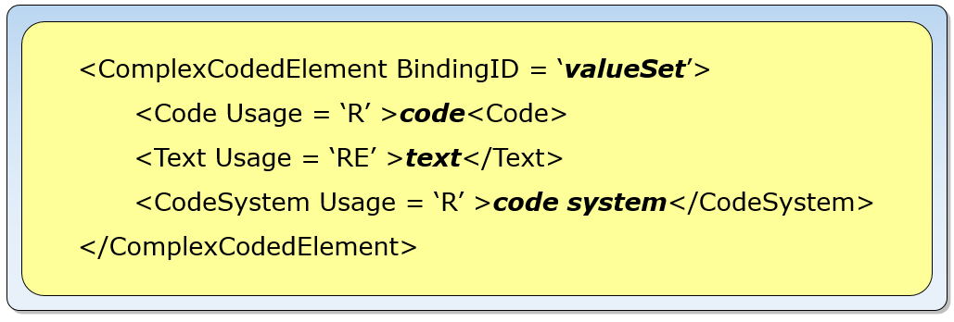
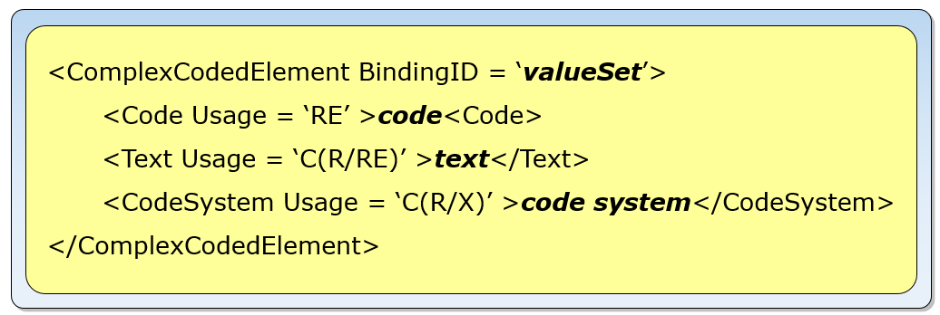
Text Exceptions
Coded with No Exceptions
Often standard conflate the binding and binding strength with allowing for text exceptions (see coding or binding strength)
Is more precise using the data type definition
Some standards provide predefined data type definitions—which are often too limited
Profiling can more precisely define requirements with the use of “data type flavors”
Coded with Exceptions
Notes:
V3 using coding strength to convey this notion, FHIR uses binding strength. Better to specify using the data type because of conflation of the value set binding and the ability to use text instead.
This

Slide 69
Vocabulary Binding Strengths
Binding | Explanation | Replacement
Implementable | Definitive requirement to use the value set as provided. | Not allowed (Required)
Universal | Term used with HL7 v2.x as a replacement for HL7-defined tables.
Illustrative | The value set is only a suggestion for this use case to illustrate how vocabulary may be chosen for implementation. | Allowed (Suggested)
Preferred | Preferred (or recommended) is an indication that the authors strongly suggest use of this vocabulary. Although there is a strong preference to implement, the vocabulary is not a requirement unless the binding strength is explicitly made required in an implementable profile.
Representative | The value set has been used in at least one normative implementation in the past, and is available as a reusable component if desired.
Example | The value set contains only a few codes to explain the intent of the value set.
Binding are either Normative or Informative
Various “flavors” of Informative are used in standards
Notes:
At the implementation level, all vocabulary binding specification are normative whether expressed explicitly or not.

Slide 70
NULL Flavors (Values)
Use to express why content is not available
Approaches
Part of a value set (HL7 v2)
Built-in to the standard framework (HL7 V3)
Not-supported
HL7 V3 NULL FLAVORS
Concept Code | Print Name | Level
NI | No Information | 0
INV | Invalid | 1
DER | Derived | 2
OTH | Other | 2
NINF | negative infinity | 3
PINF | positive infinity | 3
UNC | un-encoded | 2
MSK | masked | 1
NA | not applicable | 1
UNK | unknown | 1
ASKU | Asked but unknown | 2
NAV | temporarily unavailable | 3
NASK | not asked | 2
QS | Sufficient Quantity | 2
TRC | Trace | 2
HL7 v2 NULL FLAVORS in Value Set
Code | Description | Code System
F | Female | HL70001 v2.5.1
M | Male | HL70001 v2.5.1
N | Not Applicable | HL70001 v2.5.1
U | Unknown | HL70001 v2.5.1
NULL FLAVORS

Slide 71
Extra Slides
Vocabulary Profiling and Conformance

Slide 72
Vocabulary Profiling
Constrains the coded values allowed for use in a data element
Varies significantly across standards
Most standards don’t provide sufficient guidance on how to constraint and bind value sets
Most Implementation Guides are not specific enough
Specific value sets for each data element
For example, HL70203 Identifier Type (in HL7v2) is rarely constrained for use for each data element where it is used

Slide 73
Common HL7v2 Specification
Under specified
HL70001 (Administrative Sex)
User-defined table codes include (2.5.1): A, F, M, N, O, and U
Implementation guide
Defines constrainable conformance profile from base standard with table named HL70001 including codes F, M, and U
Indicates HL70001 for PID.8 with data type “IS” (User-defined table)
Possible interpretations by the user include:
Possible Requirements Interpretations
1 | None. Since PID.8 has the data type of “IS” and table HL70001 is a User defined table, the values are “suggested” values and place no requirements on the implementation. An application could support and send the values of X, Y, and U and still would be considered conformant; i.e., the application would not violate any conformance rules since there weren’t any.
2 | An implementer supports F, M, U, and J. Following the same logic described in option 1 above, per the written standard this would be an acceptable interpretation. In this case, the implementer supports the three codes given in the implementation guide, but is it alright for them to add a code? Was this the intent of the IG authors or not (note that adding this code changes the semantics of the other codes)? There is no indication as to whether or not the value set can be extended.
3 | An implementer supports F, M, and U and only these values.
What was the authors’ intent? Can this value be modified in a derived profile?

Slide 74
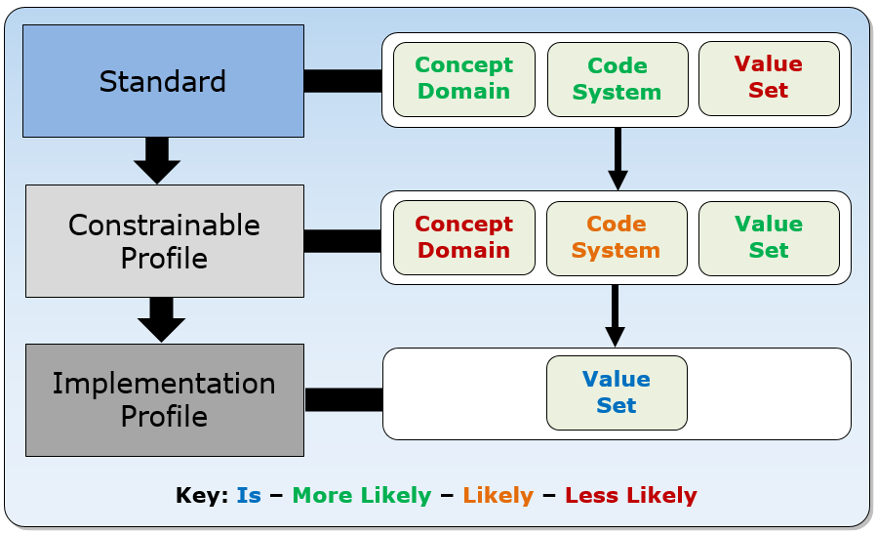
Typical Vocabulary Bindings

Slide 75
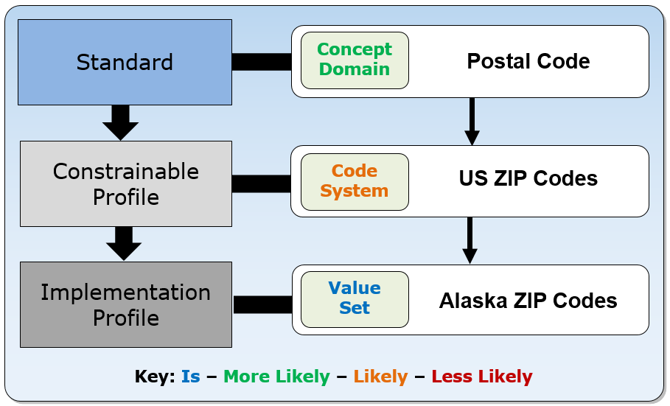
Typical Vocabulary Bindings
Base Standard
National IG
Local IG
Notes:
Although in many cases at the implementation level documentation does not exist. Even in the cases where a constrainable profile

Slide 76
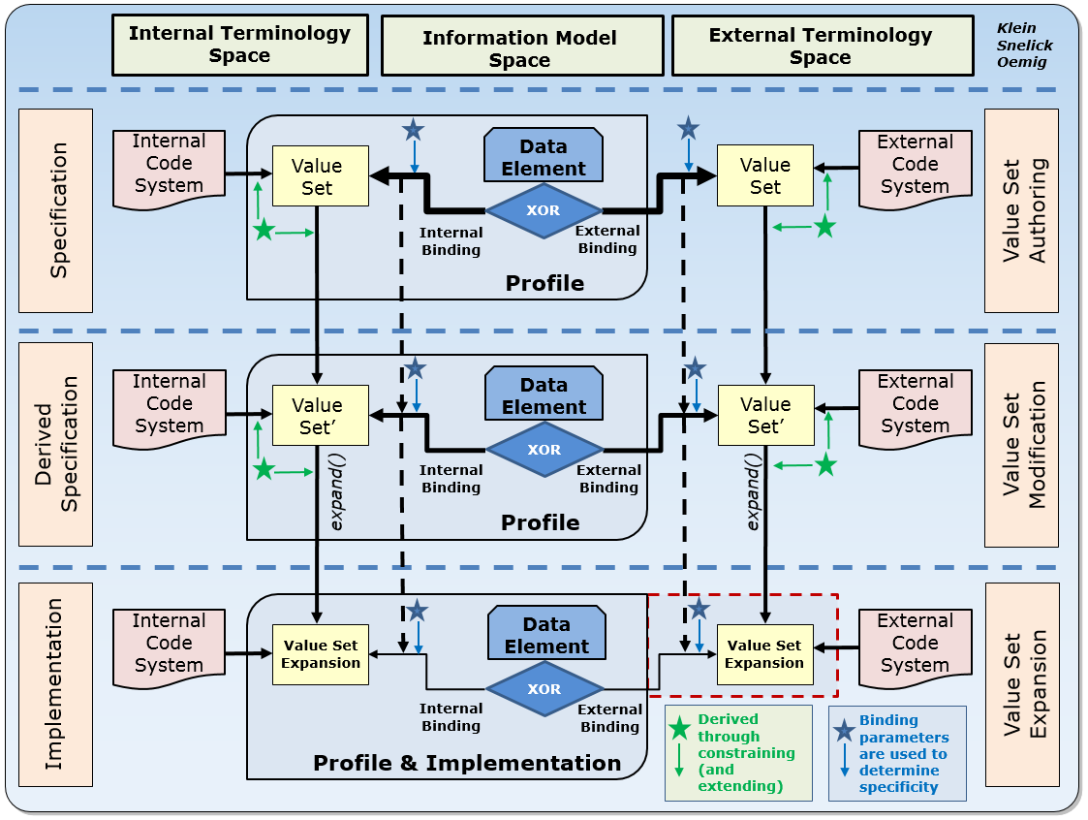
A High-level Perspective

Slide 77
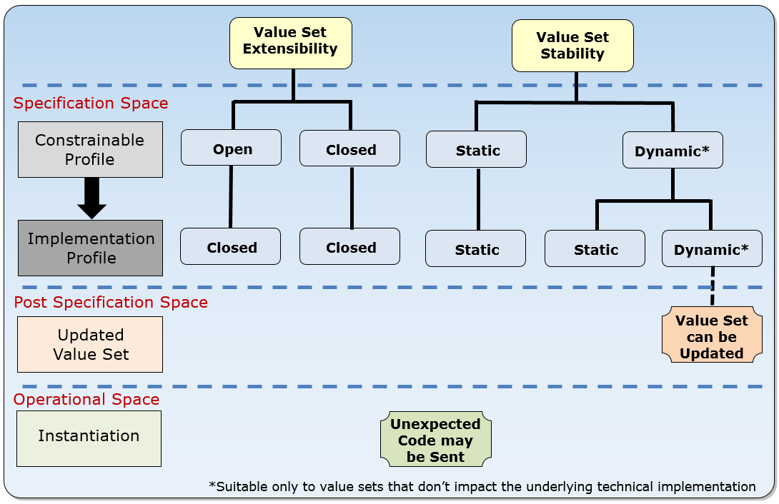
Extensibility and Stability Use

Slide 78
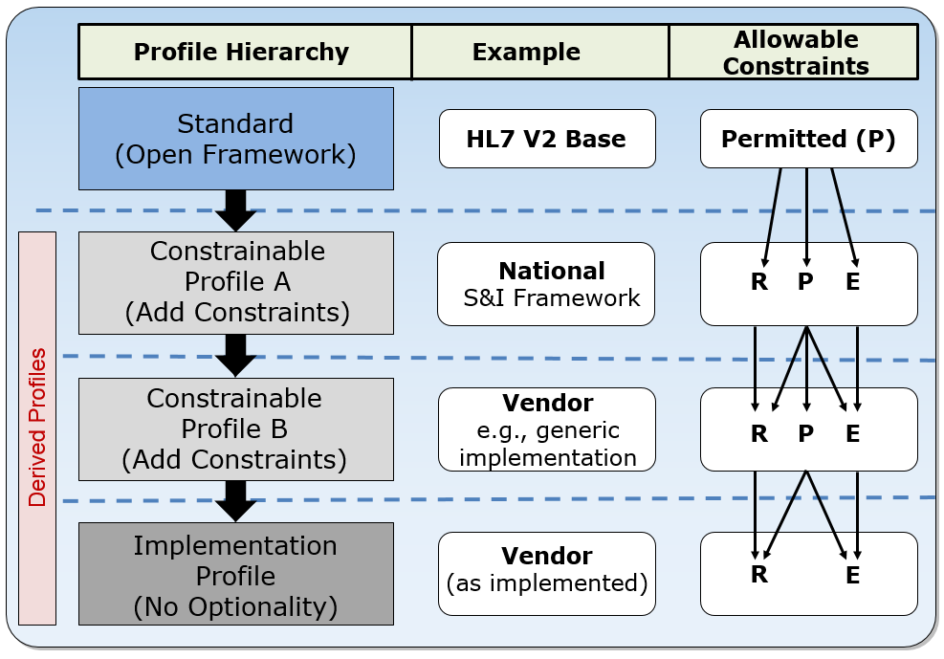
Vocabulary Usage - v2 Proposal
Profiling to create value sets
Vocabulary usage indicators can be used to narrow code sets (i.e., create value sets)
V3 uses min/max/ignore
Value sets are defined for a particular use and data element
Usage | Name | Conformance | Allowable Usage
R | Required | The code SHALL be supported | R
P | Permitted | None; to be specified | R, P, E
E | Excluded | The code SHALL not be supported. | E
Permitted (P) applicable to constrainable profiles only; not allowed in an implementation profile

Slide 79
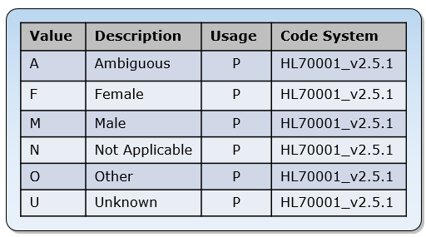
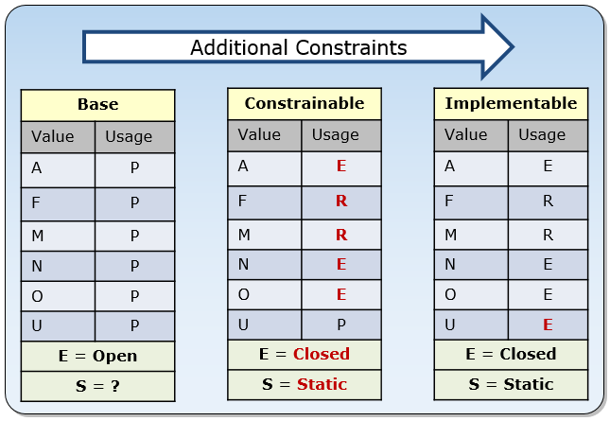
Vocabulary Profiling: Example 1
Initial code system (HL7 v2 table)
Profile for a specific use
IG Authors “Closed” the value set at constrainable level
Becomes fully specified at implementation level

Slide 80
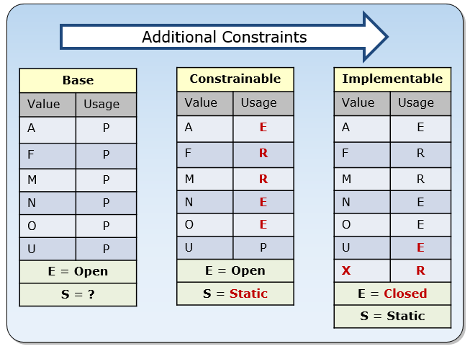
Vocabulary Profiling: Example 2
Initial code system (HL7 v2 table)
Profile for a specific use
Value set is “open” at constrainable level
Local code added at implementation level
Becomes fully specified at implementation level

Slide 81
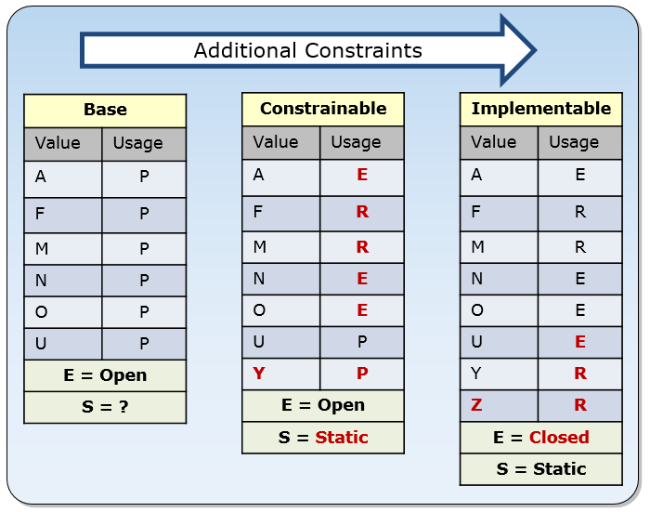
Vocabulary Profiling: Example 3
Initial code system (HL7 v2 table)
Profile for a specific use
Value set is “open” at base and constrainable level
Local code added at constrainable and implementation level
Becomes fully specified at implementation level

Slide 82
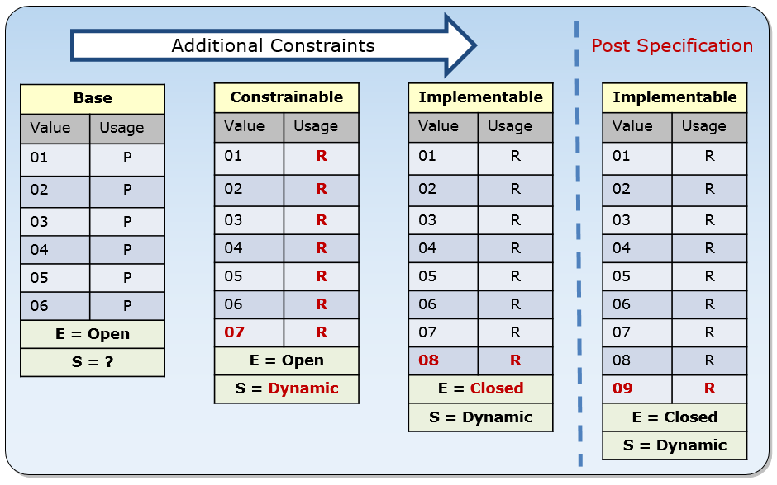
Vocabulary Profiling: Example 4
Dynamic Value Set
Profiling adds codes at the constrainable and implementable levels
The code system steward adds a code post specification
Implementers must be aware that such updates can be made

Slide 83
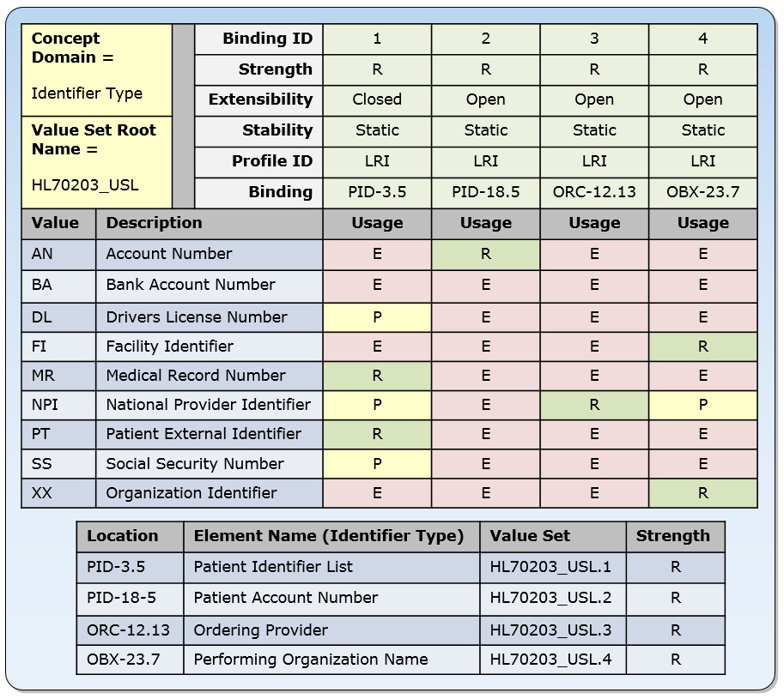
Value Set Collection
Most IGs assign the entire code system to the data element
This method indicates a precise value set definition and binding specification
Provides implementers the tools to be specific

Slide 84
Compatibility (Vocabulary)
Value sets can be created for senders and receivers independently. Since this is the case, under what circumstances are the value sets compatible?
In general, if the sender is only sending a subset of the codes that are supported by the receiving application (Top Figure), then the profiles are compatible. If the sender uses a code the receiver does not support, however (see element “D” in Bottom Figure), a compatibility issue occurs.
Both derived profiles are compliant, because they specify valid constraints.
The sender and receiver are not compatible, however, because the sender specifies code “D” as R-required while the receiver has specified code “H” as E-excluded.
Thus, even if both sender and receiver implement their specified profiles correctly (that is, they are conformant), they are not interoperable.
This example stresses the importance of trading partner agreements to address specific use case needs. In this case, the sender has an expectation about a code that is not supported by the receiver.
Notes:
Value sets can be created for senders and receivers independently. Since this is the case, under what circumstances are the value sets compatible? The top figure shows how a sender and receiver might profile a value set differently in a constrained profile. The sender excludes both D and H, while the receiver excludes D but includes H. In this case, the derived profiles (and therefore implementations) are compatible.
In general, if the sender is only sending a subset of the codes that are supported by the receiving application (Top Figure), then the profiles are compatible. If the sender uses a code the receiver does not support, however (see element “D” in Bottom Figure), a compatibility issue occurs.
According to the implementation guide, both derived profiles are compliant, because they specify valid constraints. The sender and receiver are not compatible, however, because the sender specifies code “D” as R-required while the receiver has specified code “H” as E-excluded. Thus, even if both sender and receiver implement their specified profiles correctly (that is, they are conformant), they are not interoperable. This example stresses the importance of trading partner agreements to address specific use case needs. In this case, the sender has an expectation about a code that is not supported by the receiver.

Slide 85
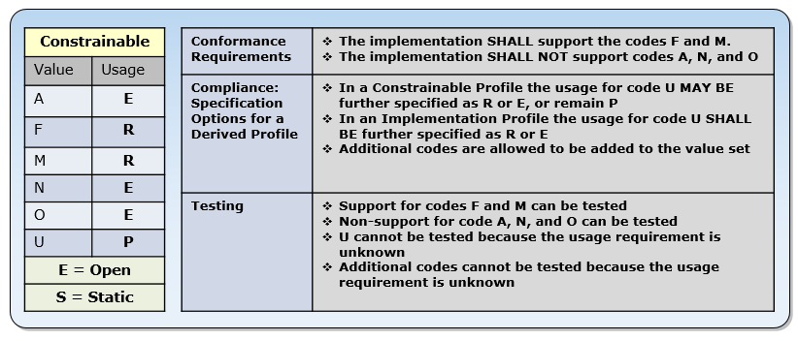
Vocabulary Conformance
Vocabulary Specification Implications – Example 1

Slide 86
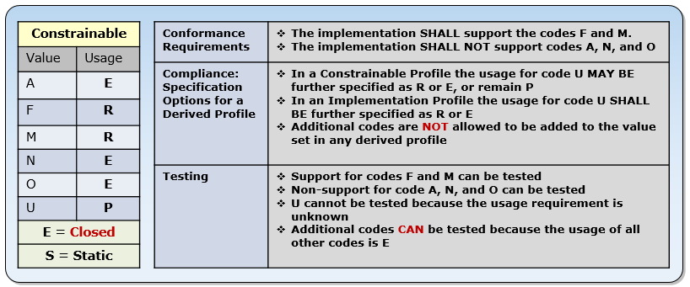
Vocabulary Conformance
Vocabulary Specification Implications – Example 2

Slide 87
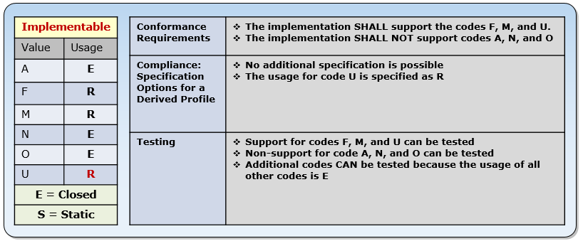
Vocabulary Conformance
Vocabulary Specification Implications – Example 3

Slide 88
Vocabulary Conformance
Vocabulary Conformity Assessment – Sender
Usage Indicator | Data In Message | Constrainable Open | Constrainable Closed | Implementation Closed
R | F, M | Conformant | Conformant | Conformant
E | A, N, O | Non-Conformant | Non-Conformant | Non-Conformant
P | U | Non-deterministic | Non-deterministic | Not-Possible
? * | Any other code | Non-deterministic | Non-Conformant | Non-Conformant
* “?” indicates that the usage indicator is unknown for any other code in the case of “open” extensibility.

Slide 89
Vocabulary Conformance
Vocabulary Conformity Assessment – Receiver – Open Extensibility
Usage Indicator | Test Data Sent | Conformity Assessment Indicator | Receiver Action | Conformity Assessment | Comments
R | F, M | Process | Processed | Conformant
 |  |  | Not-processed | Non-Conformant | Should raise an exception
E | A, N, O | Don’t Process | Processed | Non-Conformant | Processed or no exception raised
 |  |  | Not-processed | Conformant | Should raise an exception
P | U |  |  |  | Not meaningful to test
? Static | Any other code | Don’t Process | Processed | Non-conformant | Processed or no exception raised
 |  |  | Not-processed | Conformant | Should raise an exception
? Dynamic | Any other code | Don’t Process | Processed | Non-Conformant
 |  |  | Not-processed | Conformant | Should raise an exception
Unexpected Code (Documented) | Any other code | Process | Processed | Conformant
 |  |  | Not-processed | Non-conformant
* “?” indicates that the usage indicator is unknown for any other code in the case of “open” extensibility.

Slide 90
Thank You Questions
Contact: robert.snelick@nist.gov

