Slide 1

NFL Big Data Bowl 2026

Slide 2
Deadlines
September 25, 2025 - Competition Start
November 26, 2025 - Team Merger deadline. This is the last day participants may join or merge teams.
November 26, 2025 - Entry deadline. You must accept the competition rules before this date in order to compete.
December 3, 2025 - Final submission deadline.

Slide 3
Prompt
The 2026 Big Data Bowl is designed to help the National Football League better understand player movement during the pass play, starting with when the ball is thrown and ending when the ball is either caught or ruled incomplete.
For the offensive team, this means focusing on the targeted receiver, whose job is to move towards the ball landing location in order to complete a catch.
For the defensive team, who could have several players moving towards the ball, their jobs are to both prevent the offensive player from making a catch, while also going for the ball themselves. This year's Big Data Bowl asks our fans to help track the movement of these players.

Slide 4
Competition specifics
In the NFL's tracking data, there are 10 frames per second. As a result, if a ball is in the air for 2.5 seconds, there will be 25 frames of location data to predict.
Quick passes (less than half a second), deflected passes, and throwaway passes are dropped from the competition.
Evaluation for the training data is based on historical data. Evaluation for the leaderboard is based on data that hasn't happened yet. Specifically, we will be doing a live leaderboard covering the last five weeks of the 2025 NFL season.
Submissions are evaluated using the Root Mean Squared Error between the predicted and the observed target.

Slide 5
Forecasting Timeline:
December 4, 2025 - January 5, 2026 - Watch your results play out! The Kaggle Team will refresh the leaderboard throughout the competition at the conclusion of the prior week's NFL games (NFL games are typically played on Thursdays, Sundays, and Mondays). The first week of games scored begins with those played on December 4, December 7, and December 8. The final scheduled NFL game of the 2025-2026 regular season is Sunday, January 4, 2026.
January 6, 2026 - Competition end, results published

Slide 6
Prizes
1st Place - $25,000
2nd Place - $15,000
3rd Place - $10,000

Slide 7
Requirements
Submissions to this competition must be made through Notebooks. In order for the "Submit" button to be active after a commit, the following conditions must be met:
CPU Notebook <= 9 hours run-time
GPU Notebook <= 9 hours run-time
Internet access disabled
External data is not allowed.
Submission file must be named submission.csv

Slide 8
Data
In the Prediction Competition of the Big Data Bowl, participants are tasked with predicting player movement with the ball in the air. Specifically, the NFL is sharing data before the ball is thrown (including the Next Gen Stats tracking data), and stopping the play the moment the quarterback releases the ball. In addition to the pre-pass tracking data, we are providing participants with which offensive player was targeted (e.g, the targeted receiver) and the landing location of the pass.
generate prediction models for player movement during the frames when the ball is in the air.
https://www.kaggle.com/competitions/nfl-big-data-bowl-2026-prediction/data
https://github.com/cottonjenn/NFL-Big-Data-Bowl-2026

Slide 9
Other’s current scores
0.6 bidirectional GRU neural network to model player movement sequences, leveraging temporal tracking data to predict post-pass positions
  Looks both forward and backward in the sequence
  Captures movement trends
  Mimics real-world decision-making
Leaderboard = 0.501 (idk what he did but he’s a software engineer at google)
Notes:
Auto regressive model (previous pos, deriv of previous pos, accel)
1 player in 1 game ^ (4 betas)
Multiple regression with everything ^ (compute derivatives)
X1 x2 …. Predict y (get data in right format)

Slide 10
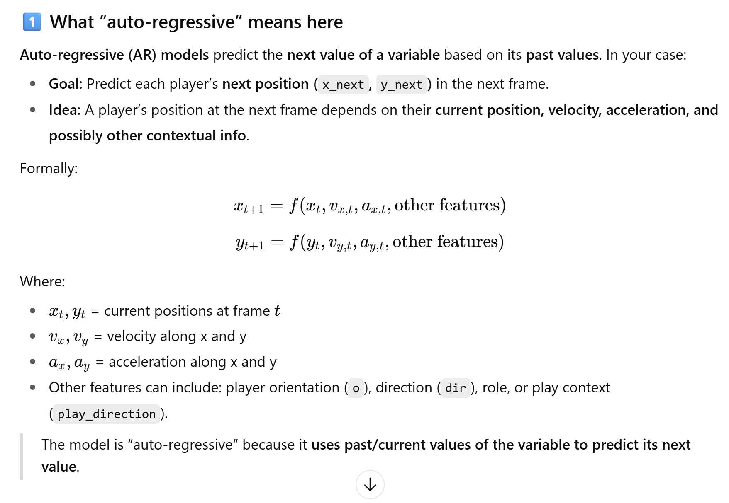
The auto-regressive model “looks backwards” one frame (or more) and says: “Given where I am now, how fast I’m going, and how I’m accelerating, where will I be in the next frame?”

Slide 11
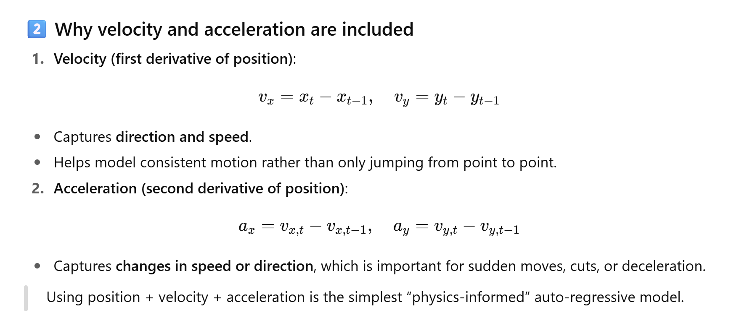

Slide 12
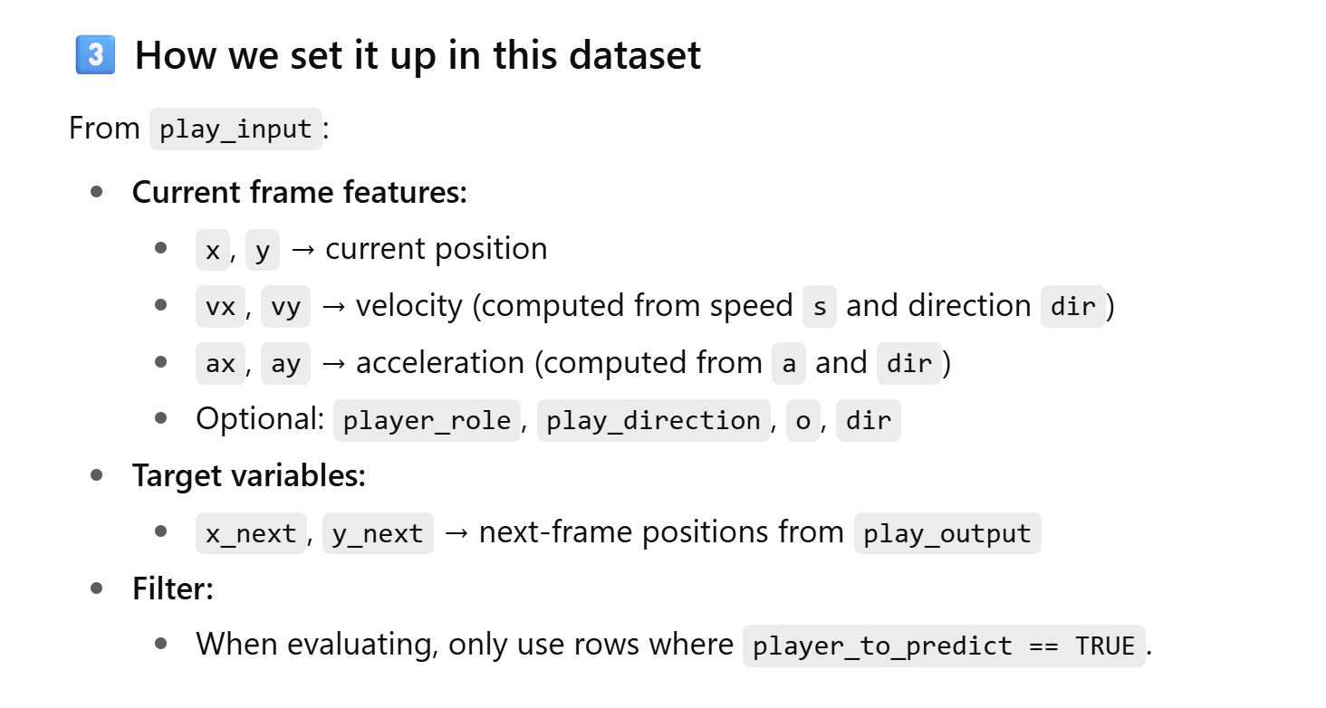

Slide 13
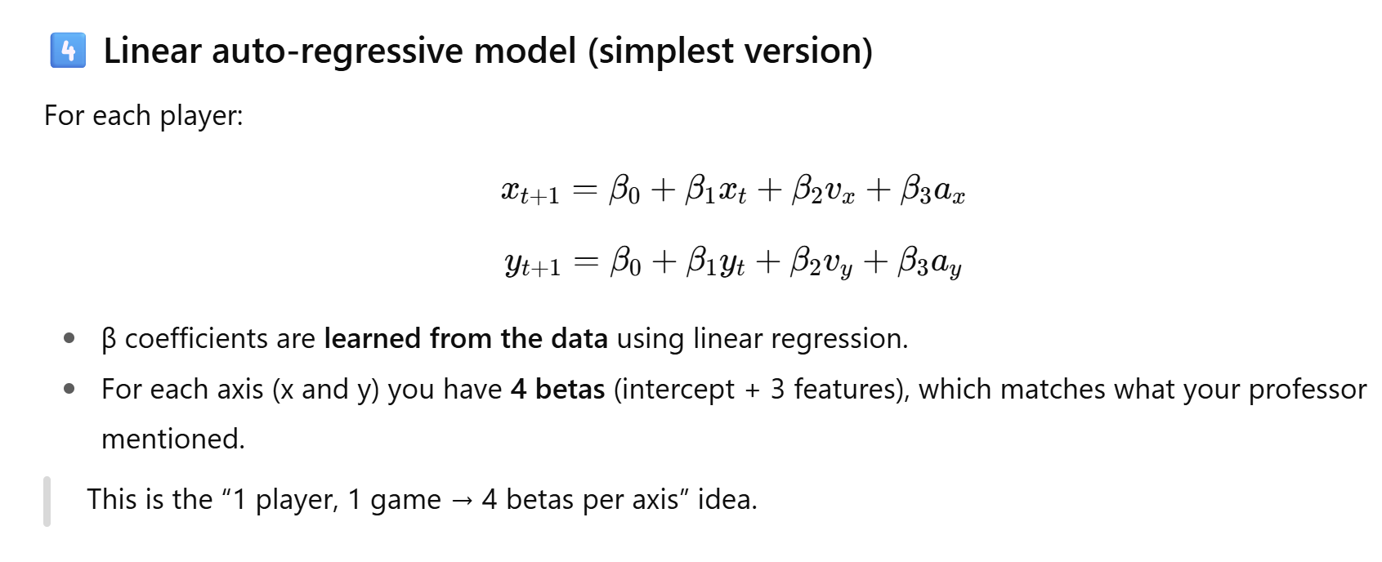

Slide 14
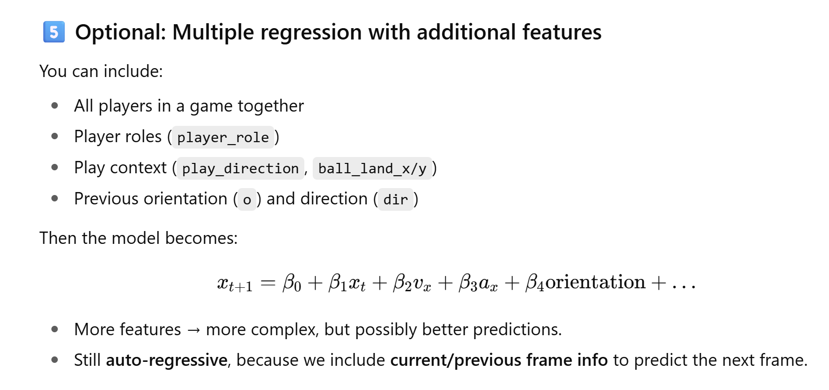

Slide 15
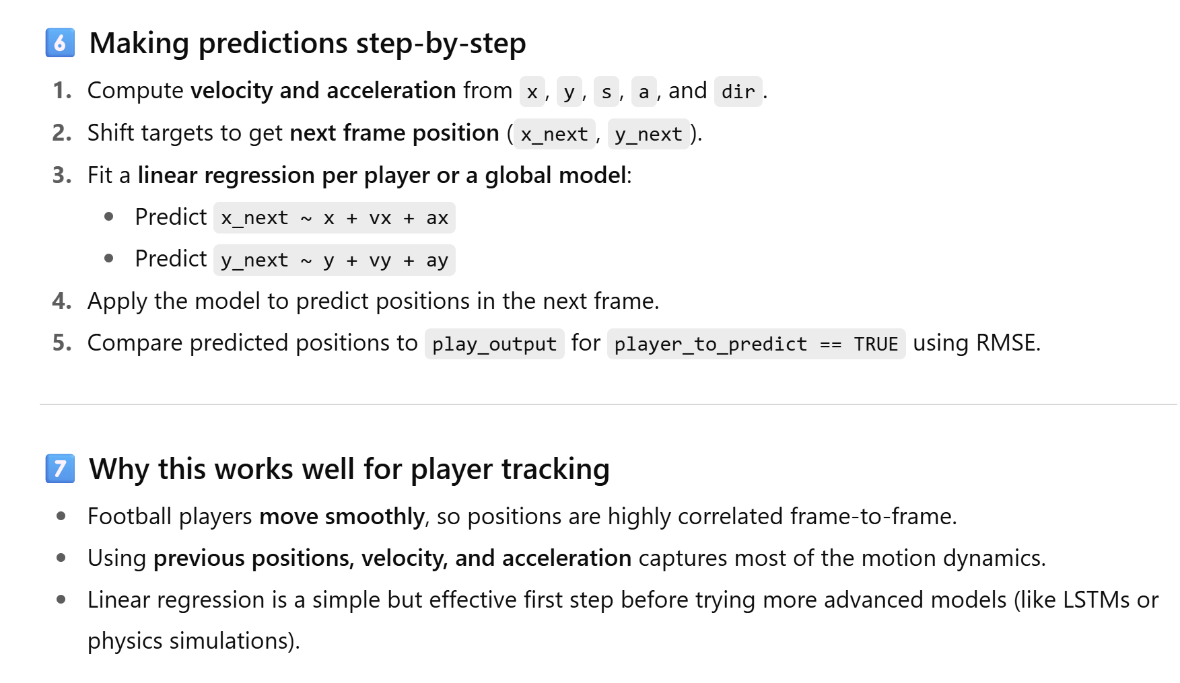

Slide 16
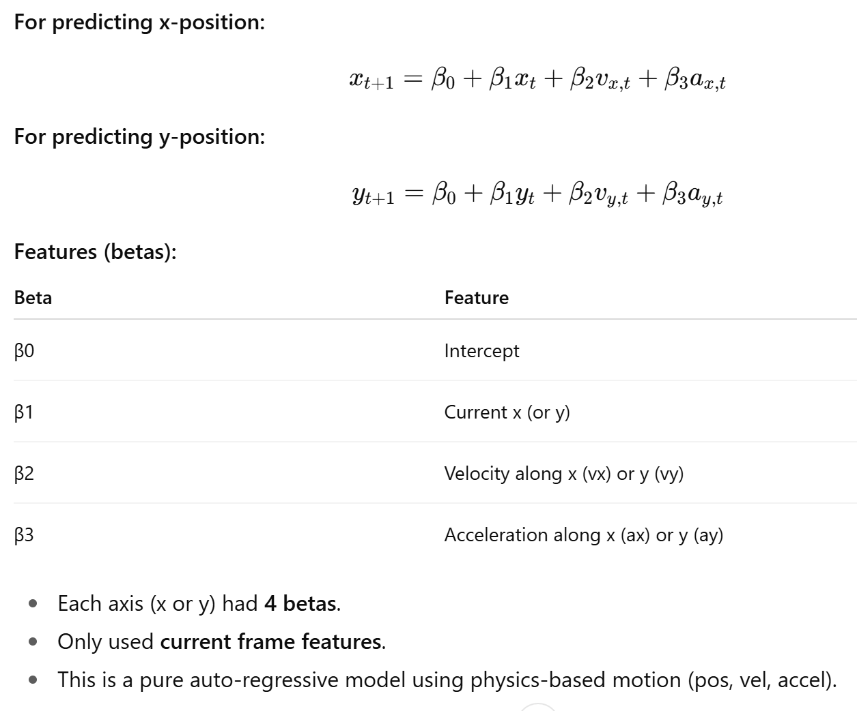
First simple linear model:
RMSE x: 7.445942 yrds
RMSE y: 4.636064
Overall RMSE: 8.771268

Slide 17
Based on your dataset (play_input), useful additional features include:
Player orientation & direction: o, dir
Player role/position: player_role, player_position (categorical)
Play context: play_direction
Ball landing position: ball_land_x, ball_land_y
Previous velocities/accelerations: vx, vy, ax, ay (already included)
We will also include lagged features from previous frames (t-1, t-2) to capture motion history.

Slide 18
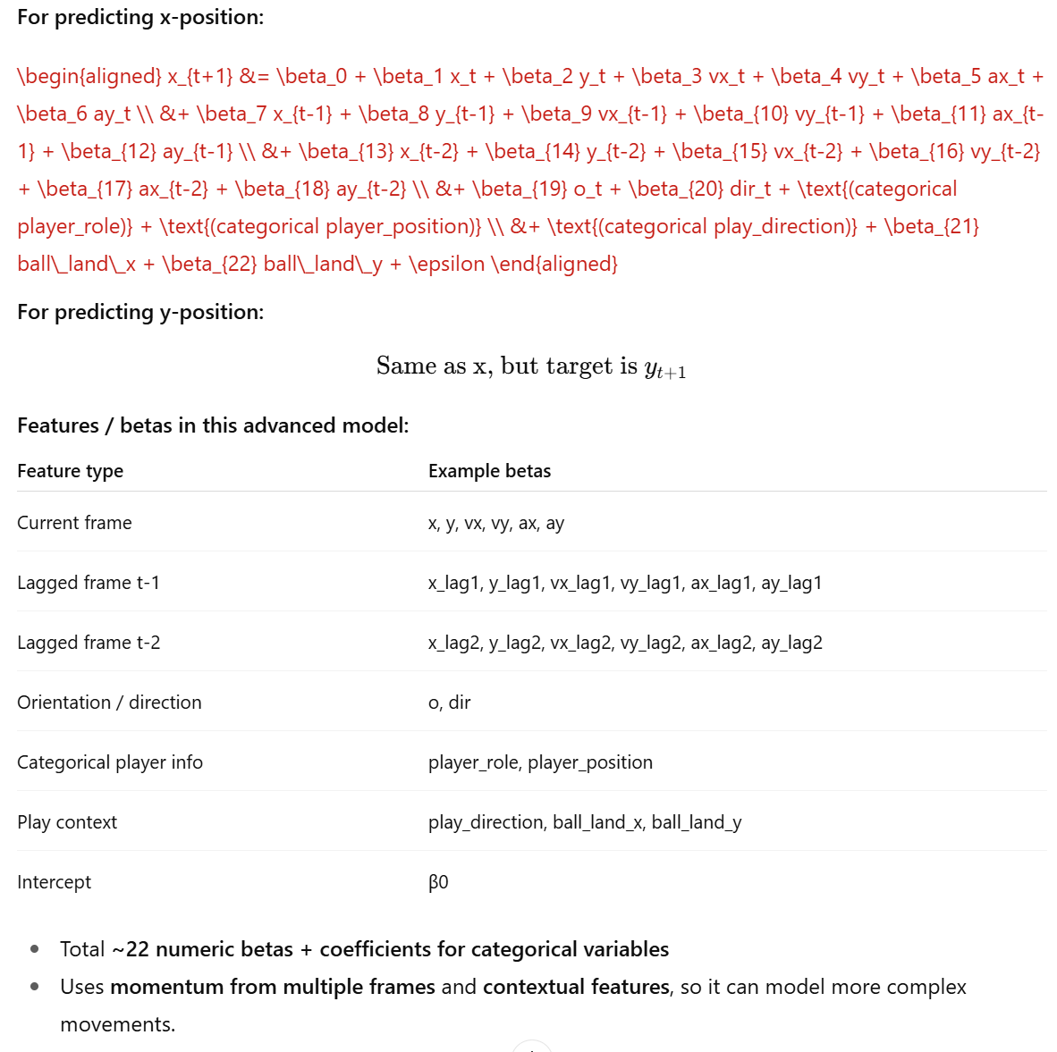
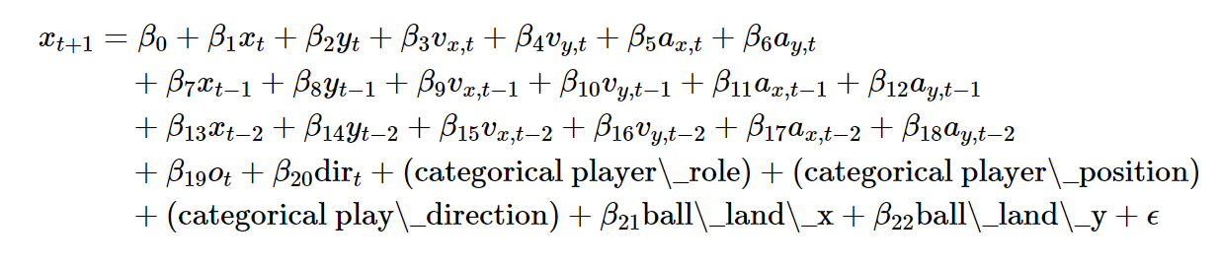
Second advanced model:
RMSE x: 7.44558 yrds
RMSE y: 4.634004
Overall RMSE: 8.769872
Test more lag frames (3 or 4 to see if momentum over longer sequences helps
Try non-linear models like random forests or gradiant boosting for potentially better predictions
Visualize predictions vs actual to see if certain positions or play types have larger errors
Frame 1 predictions don’t rely on lag features
Frame 2 predictions only use lag -1
Frame 3+ predictions use lag -1 and lag -2 all categorical variables and momentum features are included

Slide 19
Important note!
We are just fitting per-play models, so play_direction, player_role, and player_position are all the same BUT this is so crucial and will need to be added for the across player models.
Instead of fitting per-player models, fit one model for all players and include these categorical variables as global predictors. They now influence all players’ trajectories appropriately:
Ex code:
x_next ~ x + y + vx + vy + ax + ay + x_lag1 + ... + o + dir + player_role + player_position + play_direction + ball_land_x + ball_land_y

Slide 20
Additional prompt ideas
1️⃣ Expanding Lag Frames
Prompt idea:
"I have a dataset of player positions with x, y, vx, vy, ax, ay, frame_id, player_id, and play_id. I am currently using 2 lag frames to predict the next x and y positions with a linear auto-regressive model. How can I modify the pipeline to include 3, 4, or more lag frames dynamically? Please provide an example in R that avoids NA values and works for the first few frames."
Variation for Python:
"I am predicting player movement in Python using Pandas. How can I automatically create features for n lag frames (positions, velocity, acceleration) for each player and play, without introducing NaNs for the first frames? Please show code using Pandas."
2️⃣ Non-Linear Models (Random Forest, Gradient Boosting)
Prompt idea:
"I want to predict the next x and y positions of players in a football play. Currently, I use a linear model with lagged positions, velocities, accelerations, and categorical variables like player_role and player_position. How can I implement a non-linear model using random forests or gradient boosting in R (or Python), making sure to handle lag features and categorical variables? Please include prediction and evaluation with RMSE."
Variation for experimentation:
"Show me how to train a gradient boosting model to predict the next frame's x and y positions using lagged features and contextual features. Include splitting by player or play, feature engineering, and evaluation using RMSE."
3️⃣ Combining More Lag Frames + Non-Linear Models
Prompt idea:
"I want to build an advanced player tracking model that uses multiple past frames (lags 1–4) for position, velocity, and acceleration, and predicts future x and y. I also want to use a non-linear algorithm like XGBoost or random forest. Can you provide a full R or Python pipeline: feature creation, model training, per-player prediction, and RMSE evaluation?"
4️⃣ Visual Analysis Prompts
Prompt idea:
"After predicting player positions with multiple lag frames and a non-linear model, I want to visualize predicted vs actual trajectories on a football field using ggplot2 (R) or matplotlib/plotly (Python). Can you give a template that shows each player’s path and highlights prediction errors?"

Slide 21
Use quarterback drop back (s,a,o,d) to predict WR and S + other pos
Use all frames in linear model and see how much it helps

