Slide 1







Data Acquisition
Data Preparation
Data Preprocessing
Improvements
Results
Data Analysis

Slide 7
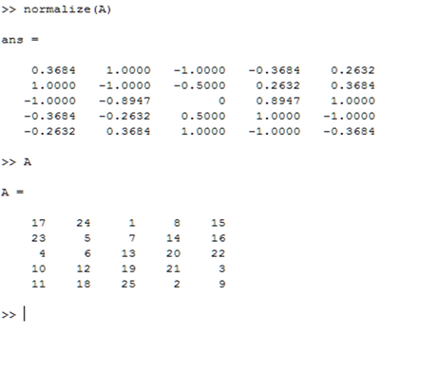
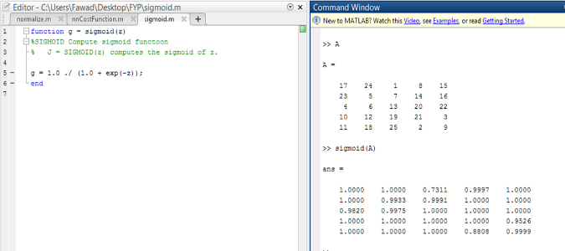
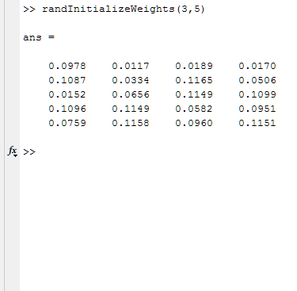

Slide 8
Avg. Flow of Water during summer (cusec)
Avg. Flow of Water during winter (cusec)
Monthly Tariff /Unit
Success Rate
Failure Rate
Accidents
Political conflicts
Operators or other staff salaries satisfactions

