Slide 1
CI/CD
Life is short!
Reality is what you can count on
Continuous Integration
Combine our developers contribution to build our software
Benefits
To build high quality artifacts

Slide 2
Continuous Integration
Combine our developers contribution to build our software
Benefits
To build high quality artifacts
Continuous Deployment
It’s a value adding delivery framework by automated frequently deployments
Benefits
Value realization and get revenue

Slide 3
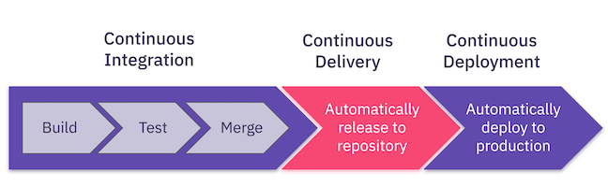
CI/CD

Slide 4
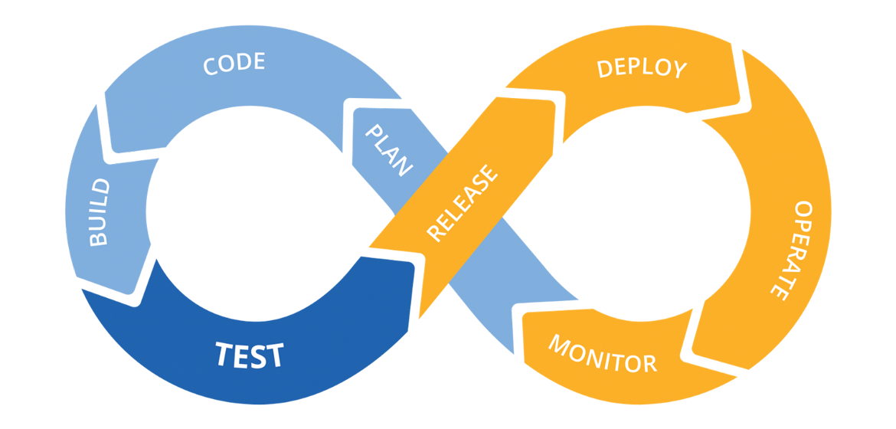
Benefits of CI/CD
Reduce Cost : Less developer time on issues from new developer code
and Less infrastructure costs from unused resources.
Avoid Cost : Less bugs, human error, testing time and faster deployments in production.
Increase Revenue : Value adding more quickly in less time.
Protect Revenue : Less downtime and rollback to normal state.

Slide 5
THANK YOU

