Slide 1
Opentron
08/19/2023

Slide 2
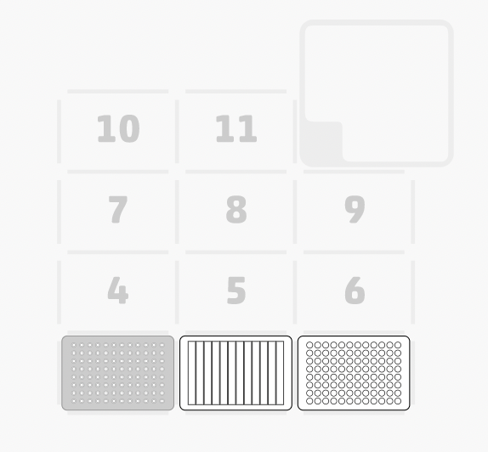
Dock landscape
disposal
Workflow for avoiding contamination?
Tip rack
reservoir
Destination plate

Slide 3
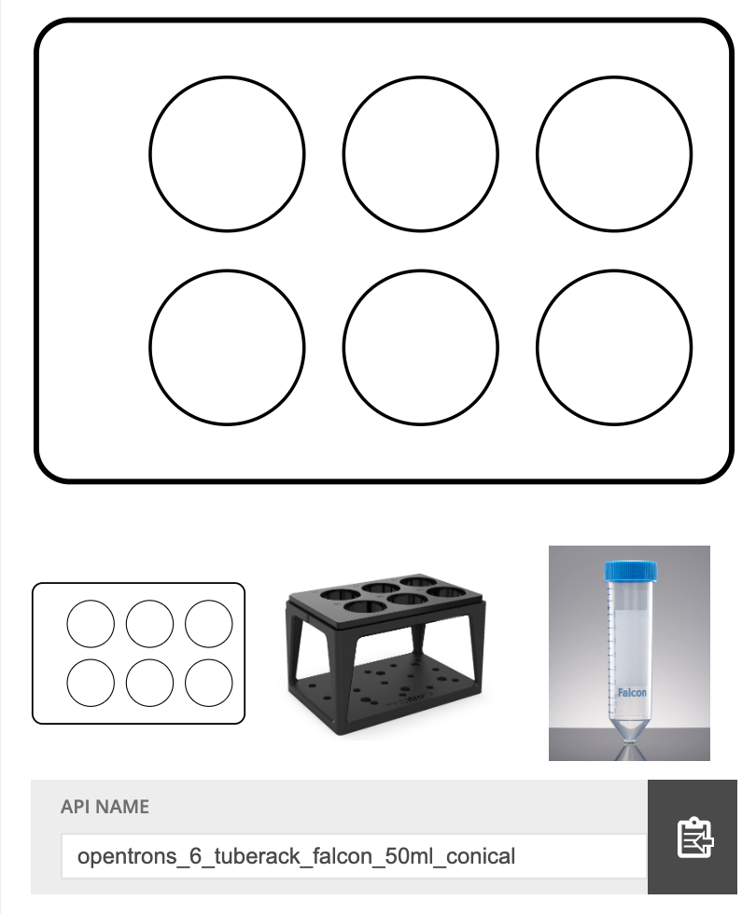
Reservoir position naming?
A1?
A2?
A3?
Does the naming for reservoir/stock is correspond to what I have labeled(red) here?
A4?
A5?
A6?

Slide 4
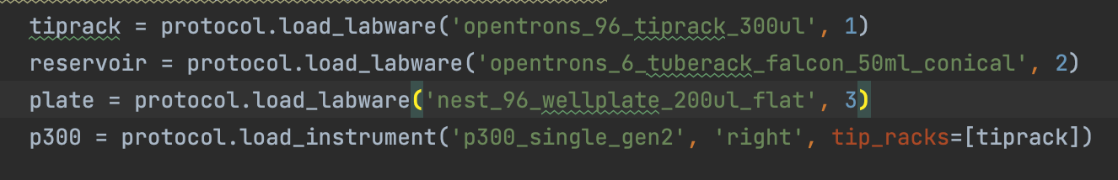
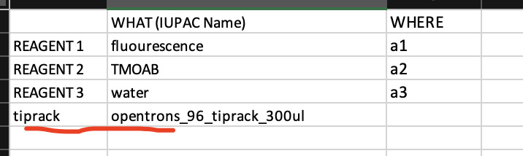
Suggestions
Including this informations in sheet2 in excel file?
So it can automate the experiment design

