Slide 1
Group 9
Solver: Kevin McCormack
Listener/Coordinator: Mykayla Fernandes
Listener/Presenter: Mykayla Fernandes
Scribe: Carter Tat

Slide 2
Problem statement

Slide 3
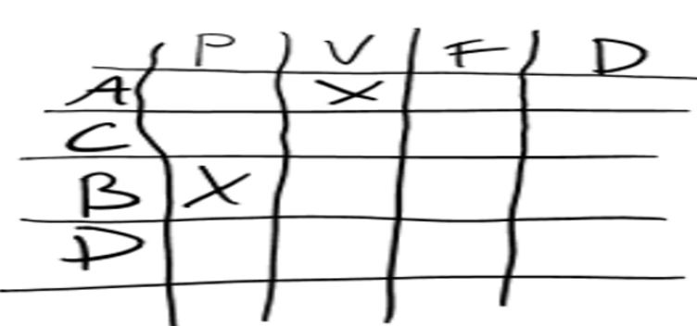
Step 1: decide how to structure the information
Process of Elimination Chart

Slide 4
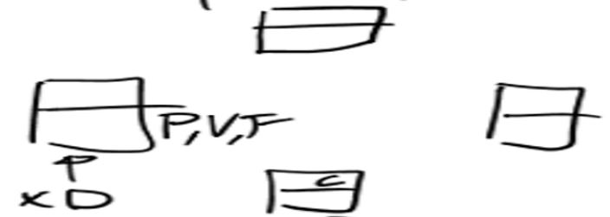
Step 2: new information structure
Table Seating Diagram

Slide 5
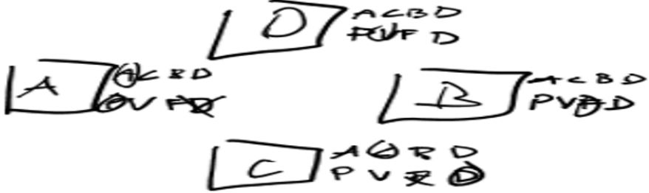
Step 3: combine two information structures
Process of Elimination Charts in a Seating Diagram

Slide 6
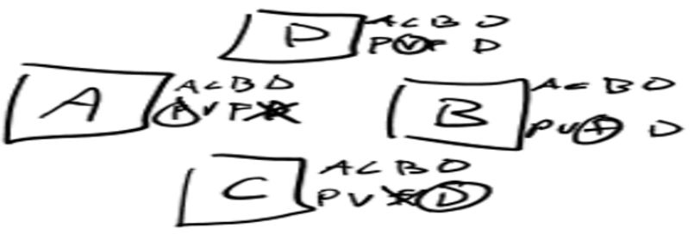
Step 4: trial and error
Try multiple possibilities using the combined structure until a feasible answer is reached.

Slide 7
solution
Burton was the flutist, Cheryl was the drummer, Arlene was the pianist, and Donald was the violinist.

