Slide 1
Benchmarking Transmission Inference Methods Using Simulated Genomic Data
A Plasmodium falciparum simulation and evaluation framework for IBS – IBD – phylogenetic distances
Mouhamadou Fadel DIOP

Slide 2
Rationale for Simulation
Evaluate the reliability of transmission inference methods under varying biological and sampling conditions.
These methods include:
Identity-by-descent (IBD)
Identity-by-state (IBS)
Phylogenetic Patristic distance
Objective:
Identify “who infected whom”
Determine under which conditions these methods can accurately recover malaria transmission links from genomic data.

Slide 3
Simulation Design
Simulate scenarios for evolving P.f populations with different parameters:
Forward-time, individual-based simulations of Plasmodium falciparum using SLiM
Explicit infection-to-infection transmission pedigrees (ground truth known)
Whole-genome data generated from tree sequences
Genomic inference methods evaluated against true transmission histories
Track pedigree
Recombination rate (r): controls genetic reshuffling per generation
Tree sequences were recorded with pedigree and mutation information and exported as VCF for downstream analysis.

Slide 4
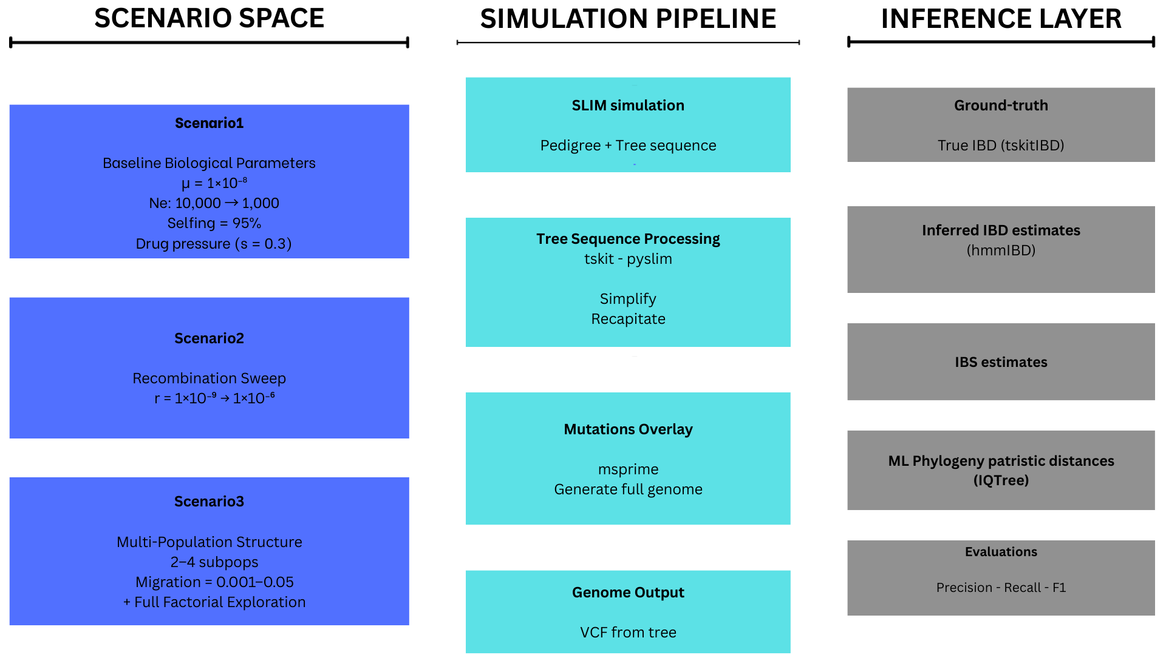
Figure 1: Overview of Pf simulation framework

Slide 5
Evaluation Framework
Extract true IBD segments from tree sequences using tskitIBD.
Each pair of individuals sharing IBD segment with TMRCA ≤ G generations defines a true transmission proxy.
Predicted metrics were derived from the generated VCF:
IBS estimates
IBD estimates (hmmIBD, isoRelate, …)
Phylogenetic cophenetic distance
Computed Precision-Recall curves comparing predicted vs. true relatedness to assess recoverability.

Slide 6
SCENARIO 1
Single, well-mixed parasite population
Biologically realistic mutation and recombination rates
Dense sampling of infections from a single outbreak
Represents an optimistic upper bound for genomic transmission inference
Fixed all biological and epi parameters
Mutation rate: 1.0e-08
Recombination rate: 6.666667e-07
Sample size: 1000
Population size: 10.000
Effective population size: 10.000

Slide 7
The problem is highly imbalanced data
In a transmission network, the number of true transmission pairs (or recent co-transmission links) is tiny compared to the number of all possible pairs.
For N samples, there are N(N−1)/2 possible pairs — and maybe <1% correspond to true transmission or close kinship.
ROC curves (which plot True Positive Rate vs False Positive Rate) can look deceptively good even when a classifier is mostly wrong, because the False Positive Rate barely changes in imbalanced settings.
PR curves (Precision vs Recall) focus on the positive class (true transmission pairs). They’re sensitive to how many predicted links are truly correct, which is what you care about.
Hence: → Use PR-AUC (area under the precision–recall curve) for comparing methods (IBD vs IBS vs phylogenetic).
PR-AUC directly reflects “usefulness for inference”
A high PR-AUC means: when the method thinks two samples are closely related (precision), they usually are — and it recovers many of the true links (recall).

Slide 8
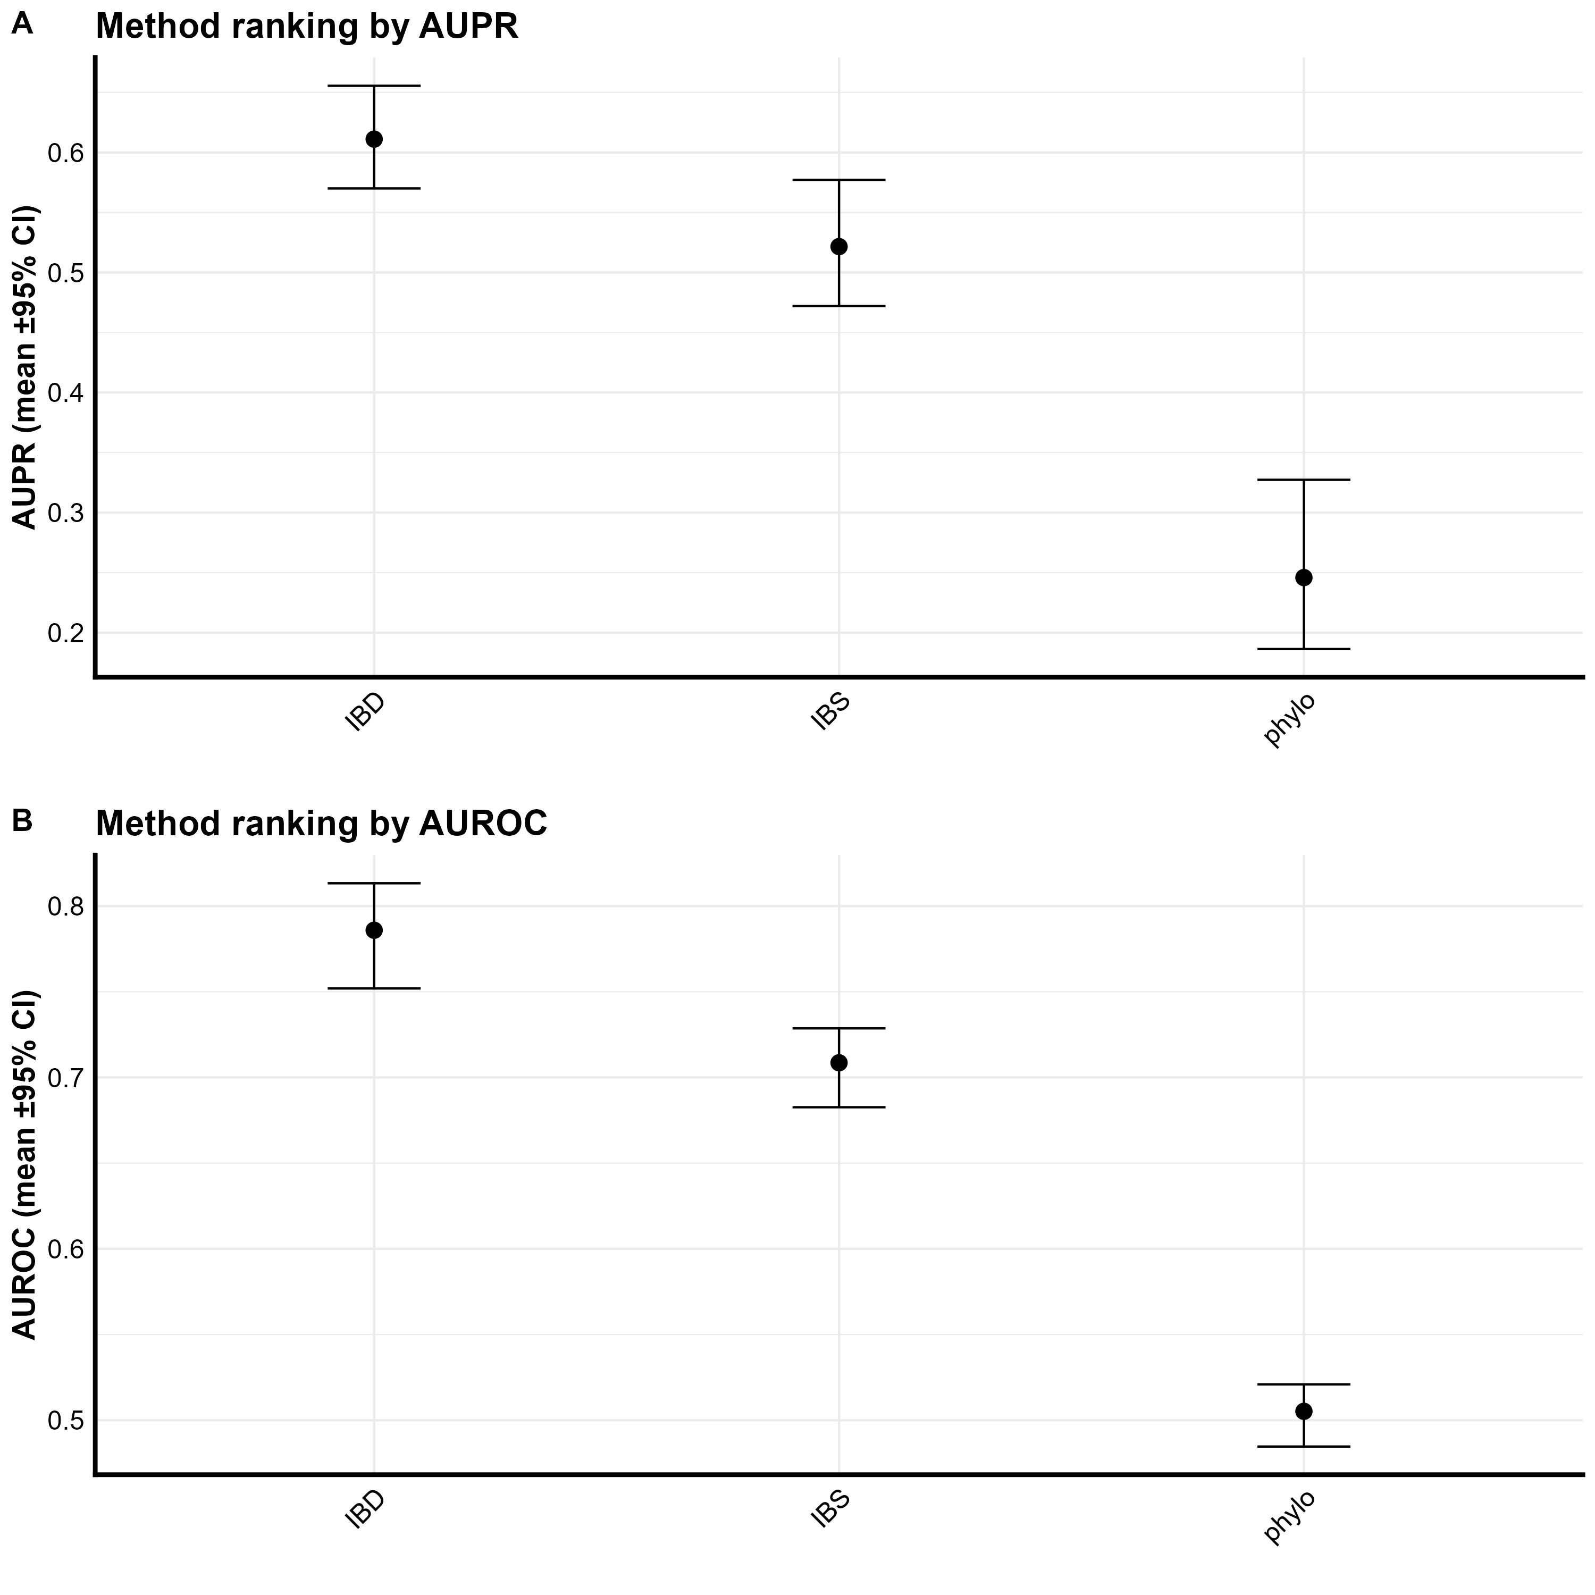
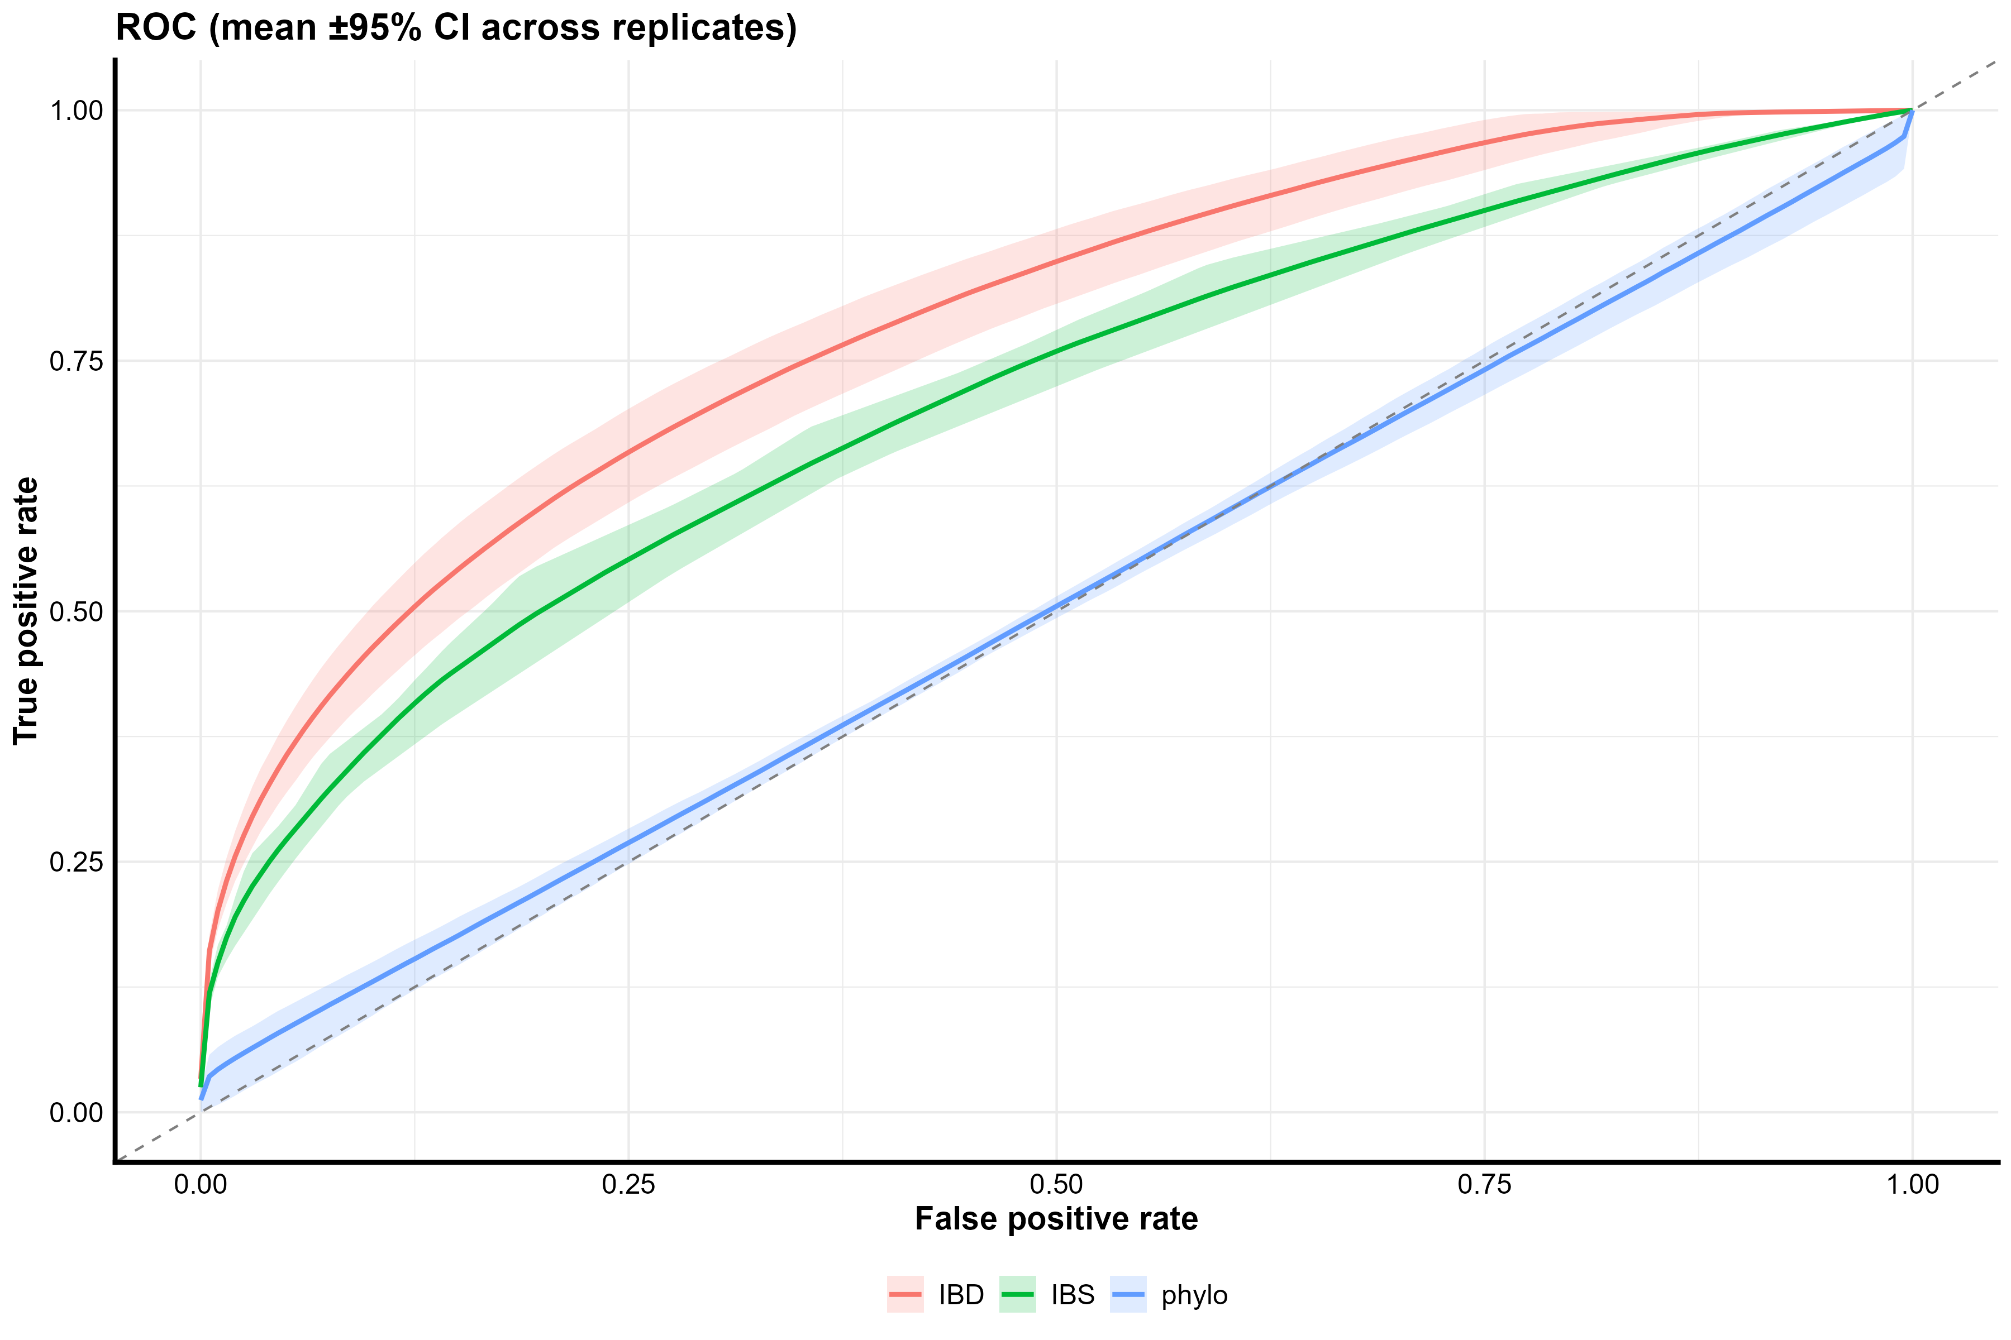
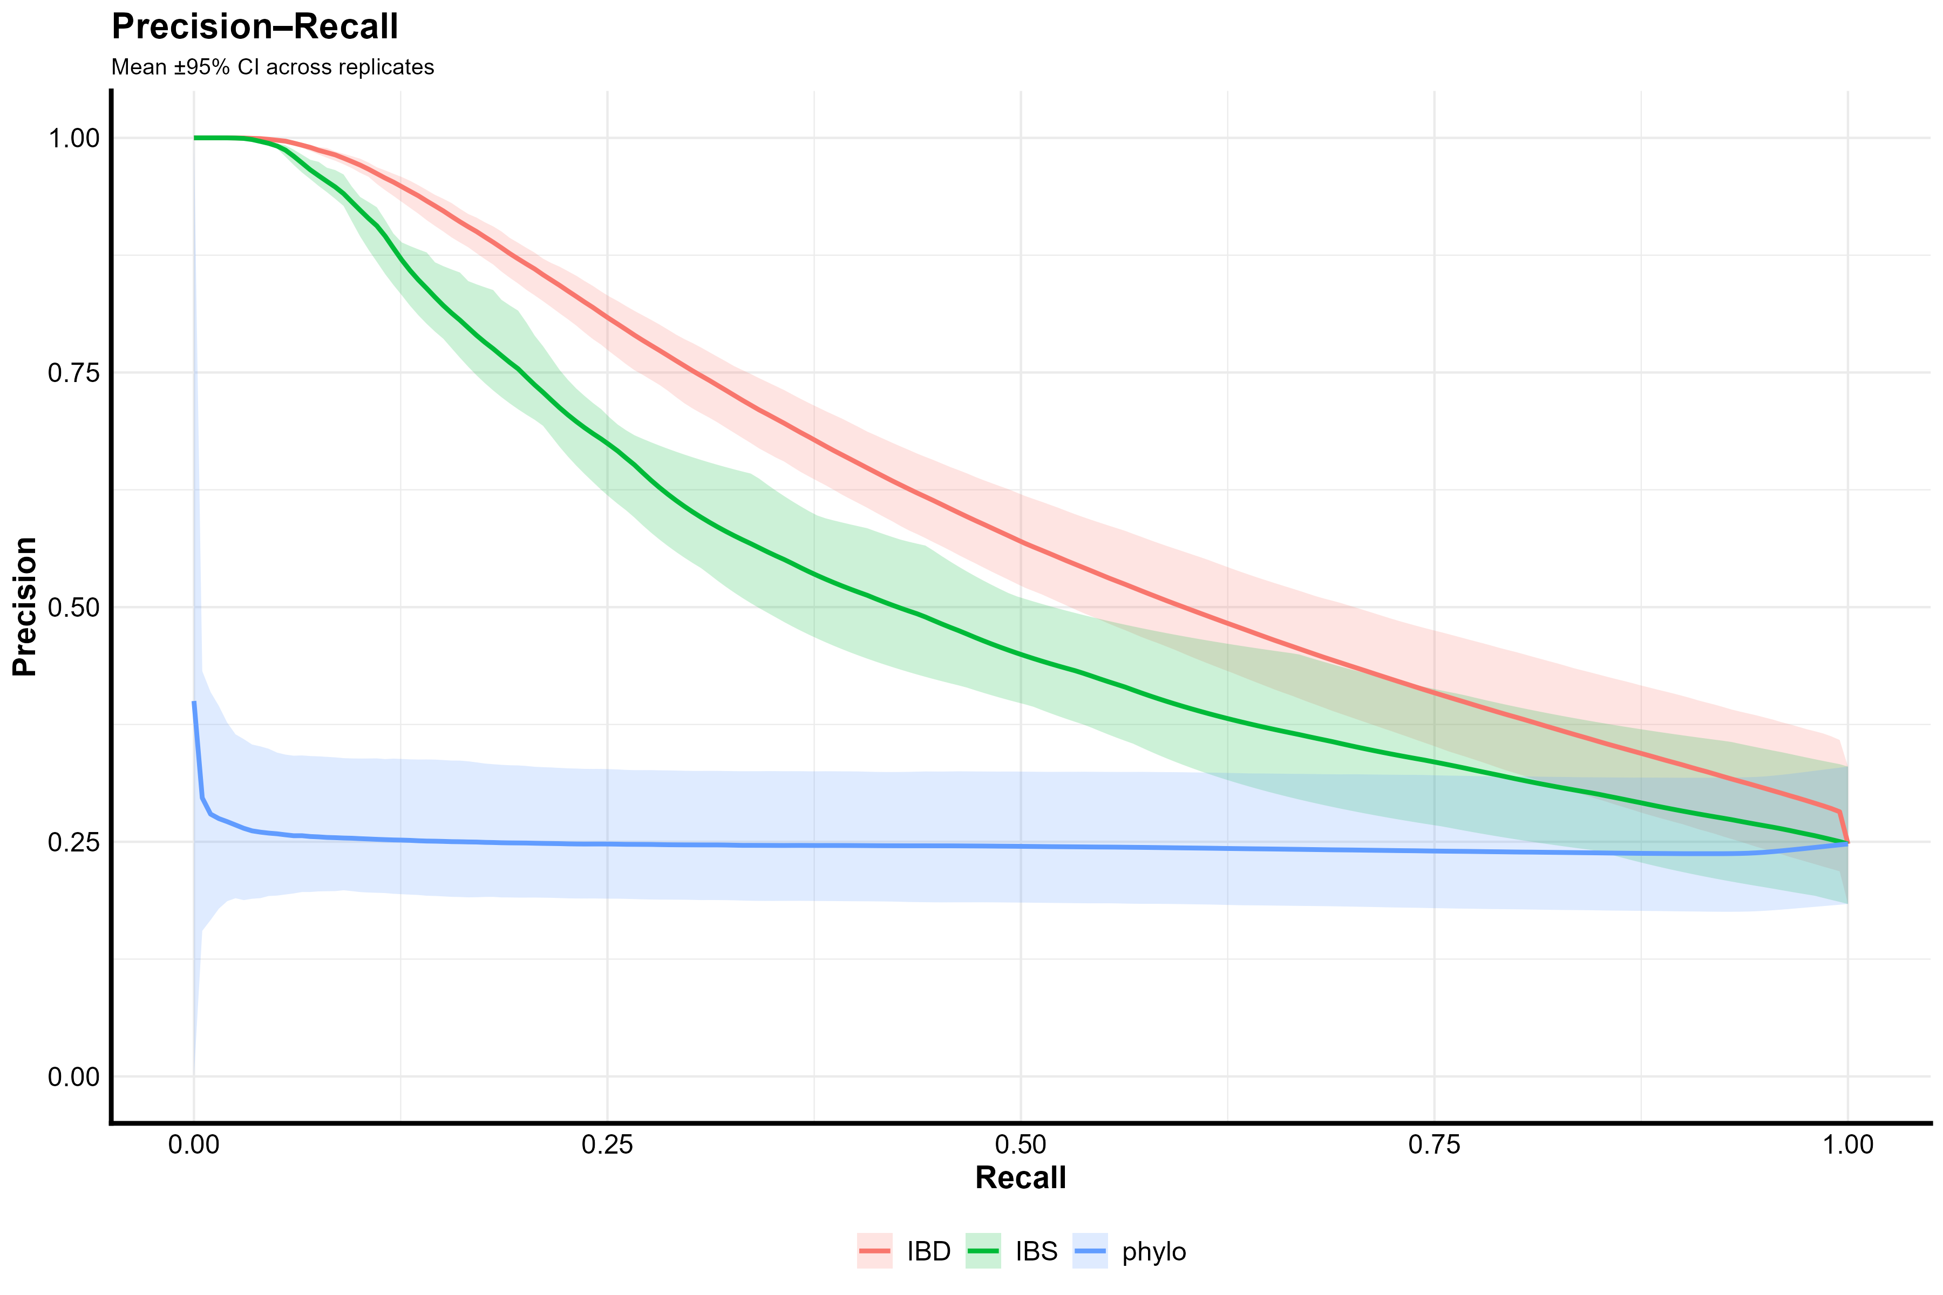

Slide 11
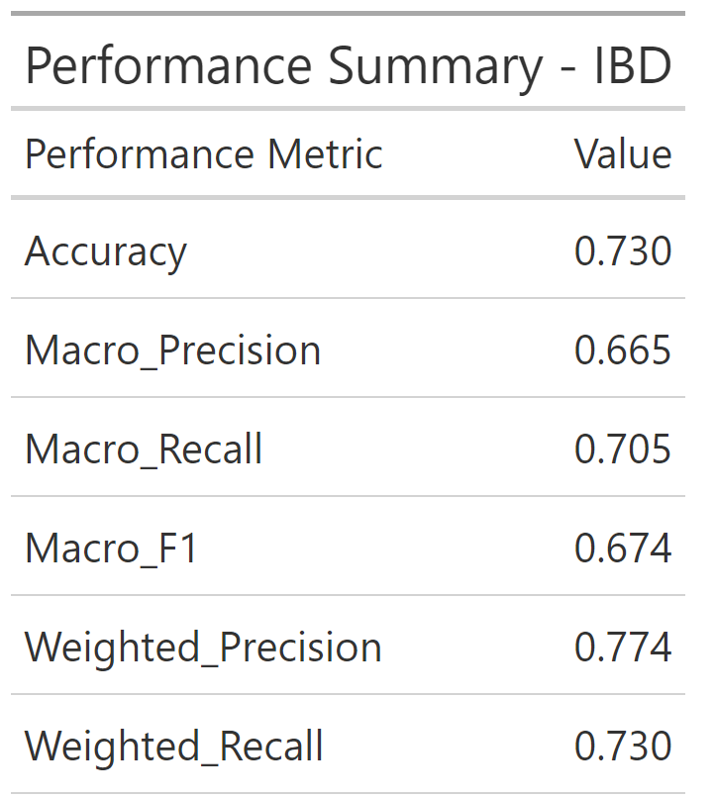

Slide 12
Essentially random, IBS has almost no predictive power
IBS cannot distinguish between recently transmitted pairs and unrelated pairs.
AUC = 0.588 indicates moderate but suboptimal performance for detecting transmission pairs.
Not reliable enough for high-confidence predictions

Slide 13
SCENARIO 2
Single population, identical demography and sampling
Recombination rate varied across four orders of magnitude
Range spans near-clonal to highly recombining parasite populations
Multiple replicates per recombination level
Purpose: Isolate the effect of recombination on genomic signal and identify thresholds where transmission inference breaks down.

Slide 14
Why Vary Recombination Rate?
Recombination determines how quickly genetic linkage decays between loci.
Low r: longer shared IBD tracts, easier detection of close transmission links.
High r: shorter tracts, increased difficulty in inferring direct ancestry.
Assess the robustness of each inference method across different recombination rates (10⁻⁹ – 10⁻⁶).

Slide 15
Figure 2: Overview of Pf simulation framework

Slide 17
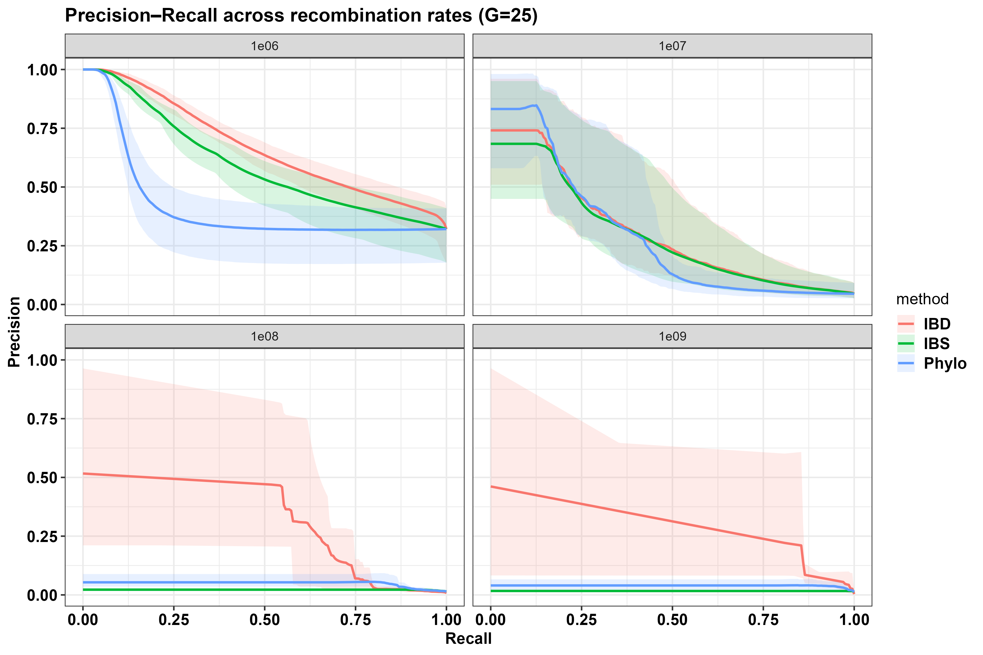
The PR-AUC quantifies how well predicted relatedness identifies true transmission pairs.
Results show …….. with increasing recombination rate:
- r = 10⁻⁹ → PR-AUC ≈
- r = 10⁻⁸ → PR-AUC ≈
- r = 10⁻⁷ → PR-AUC ≈
- r = 10⁻⁶ → PR-AUC ≈

Slide 18
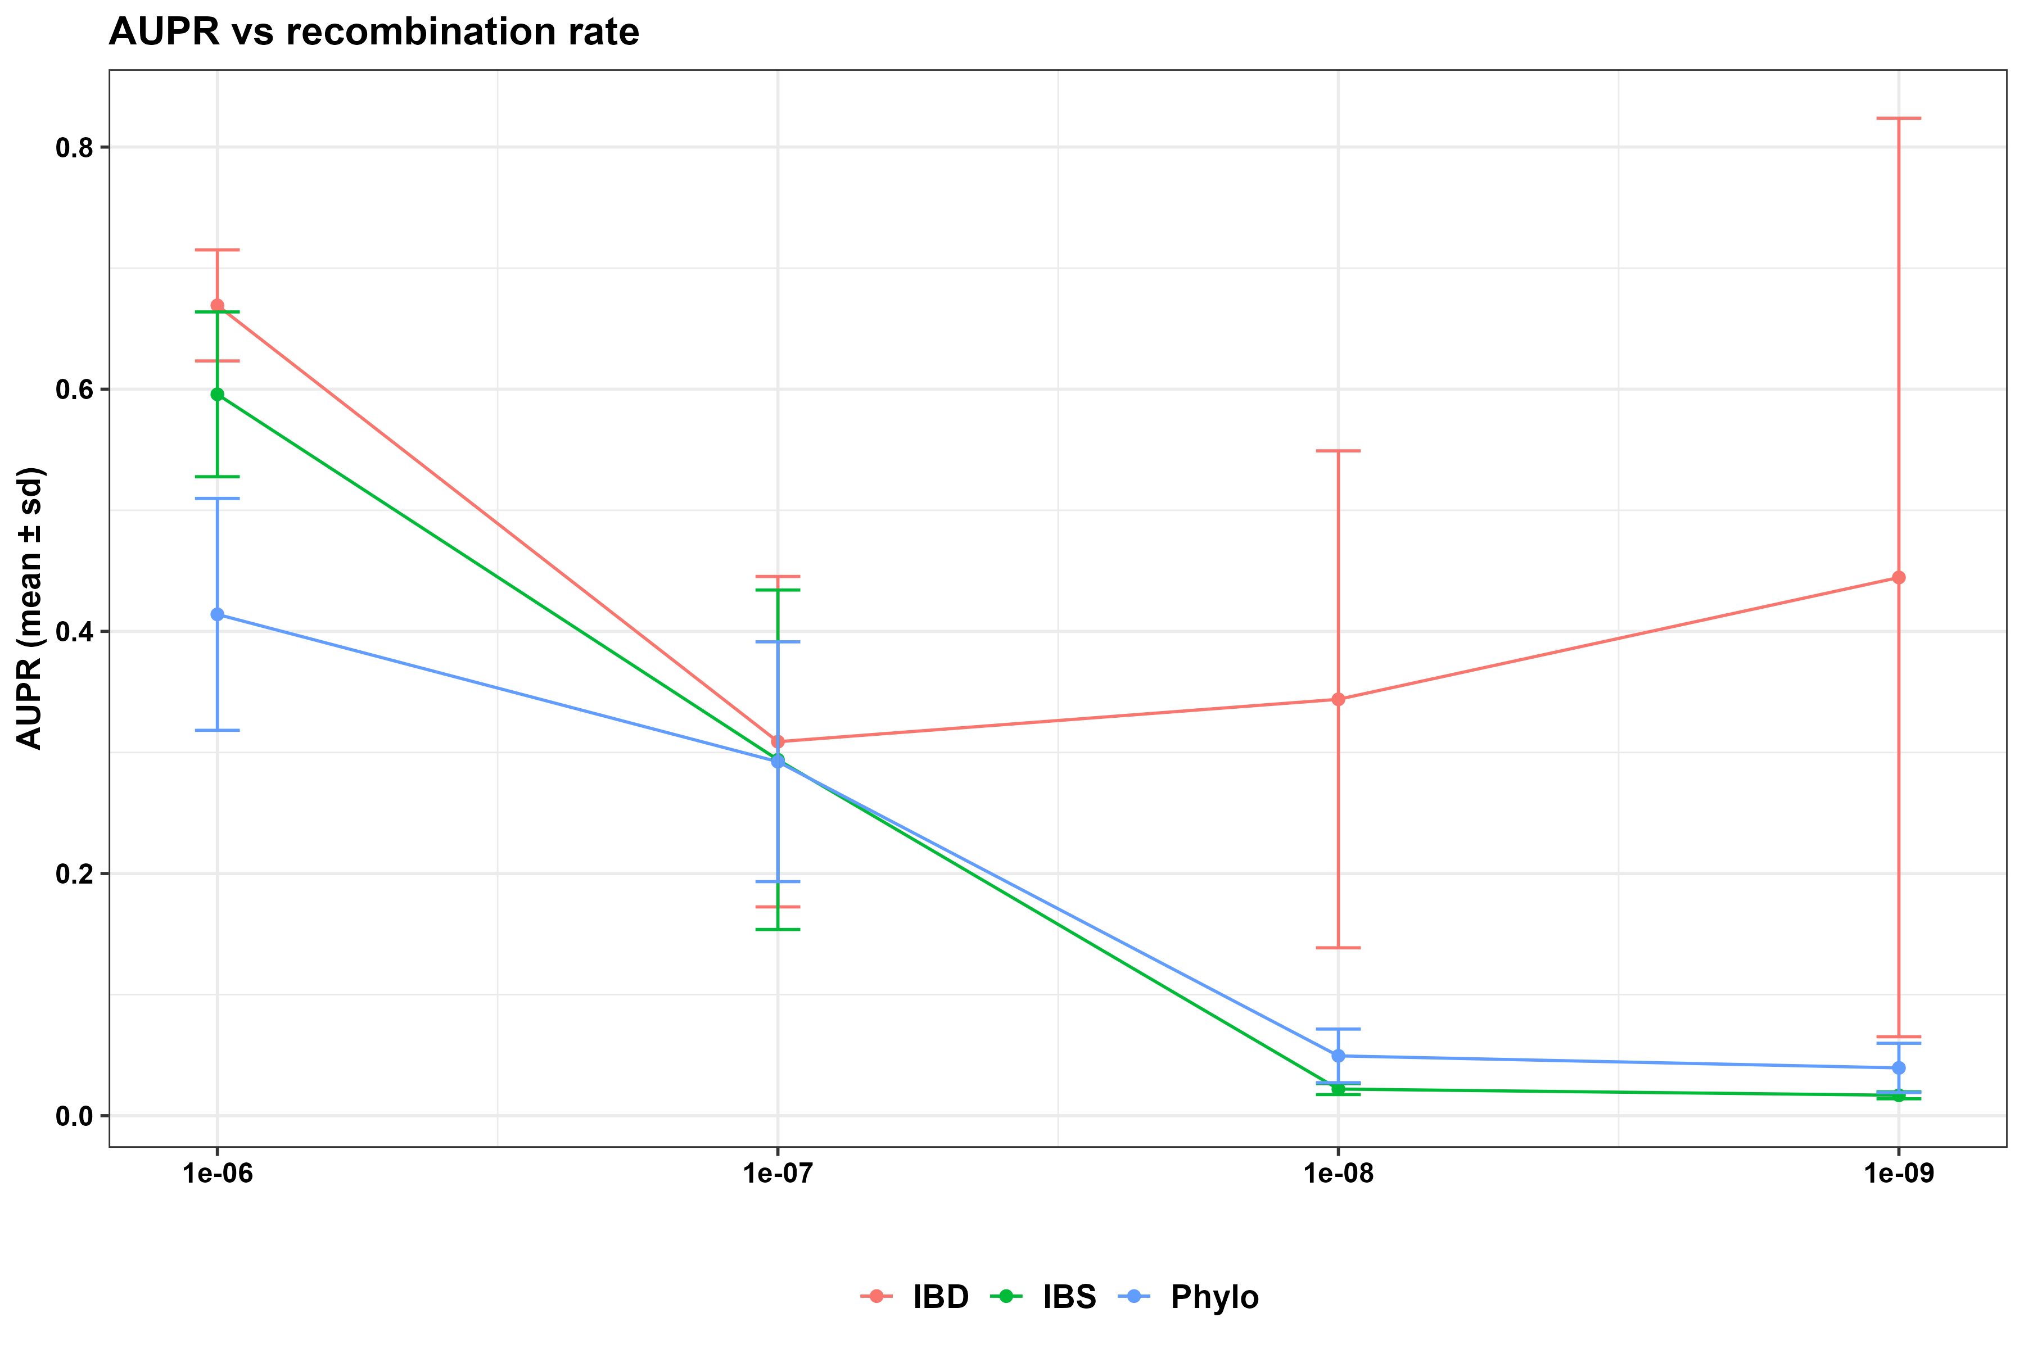
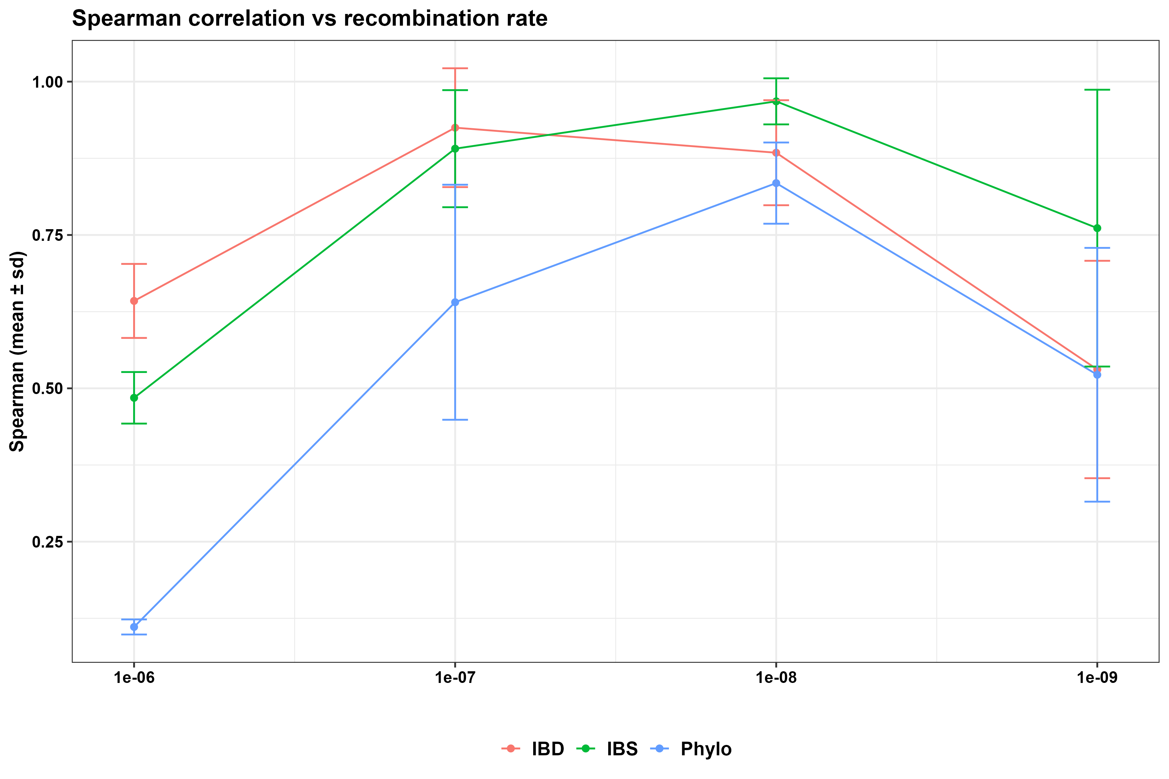
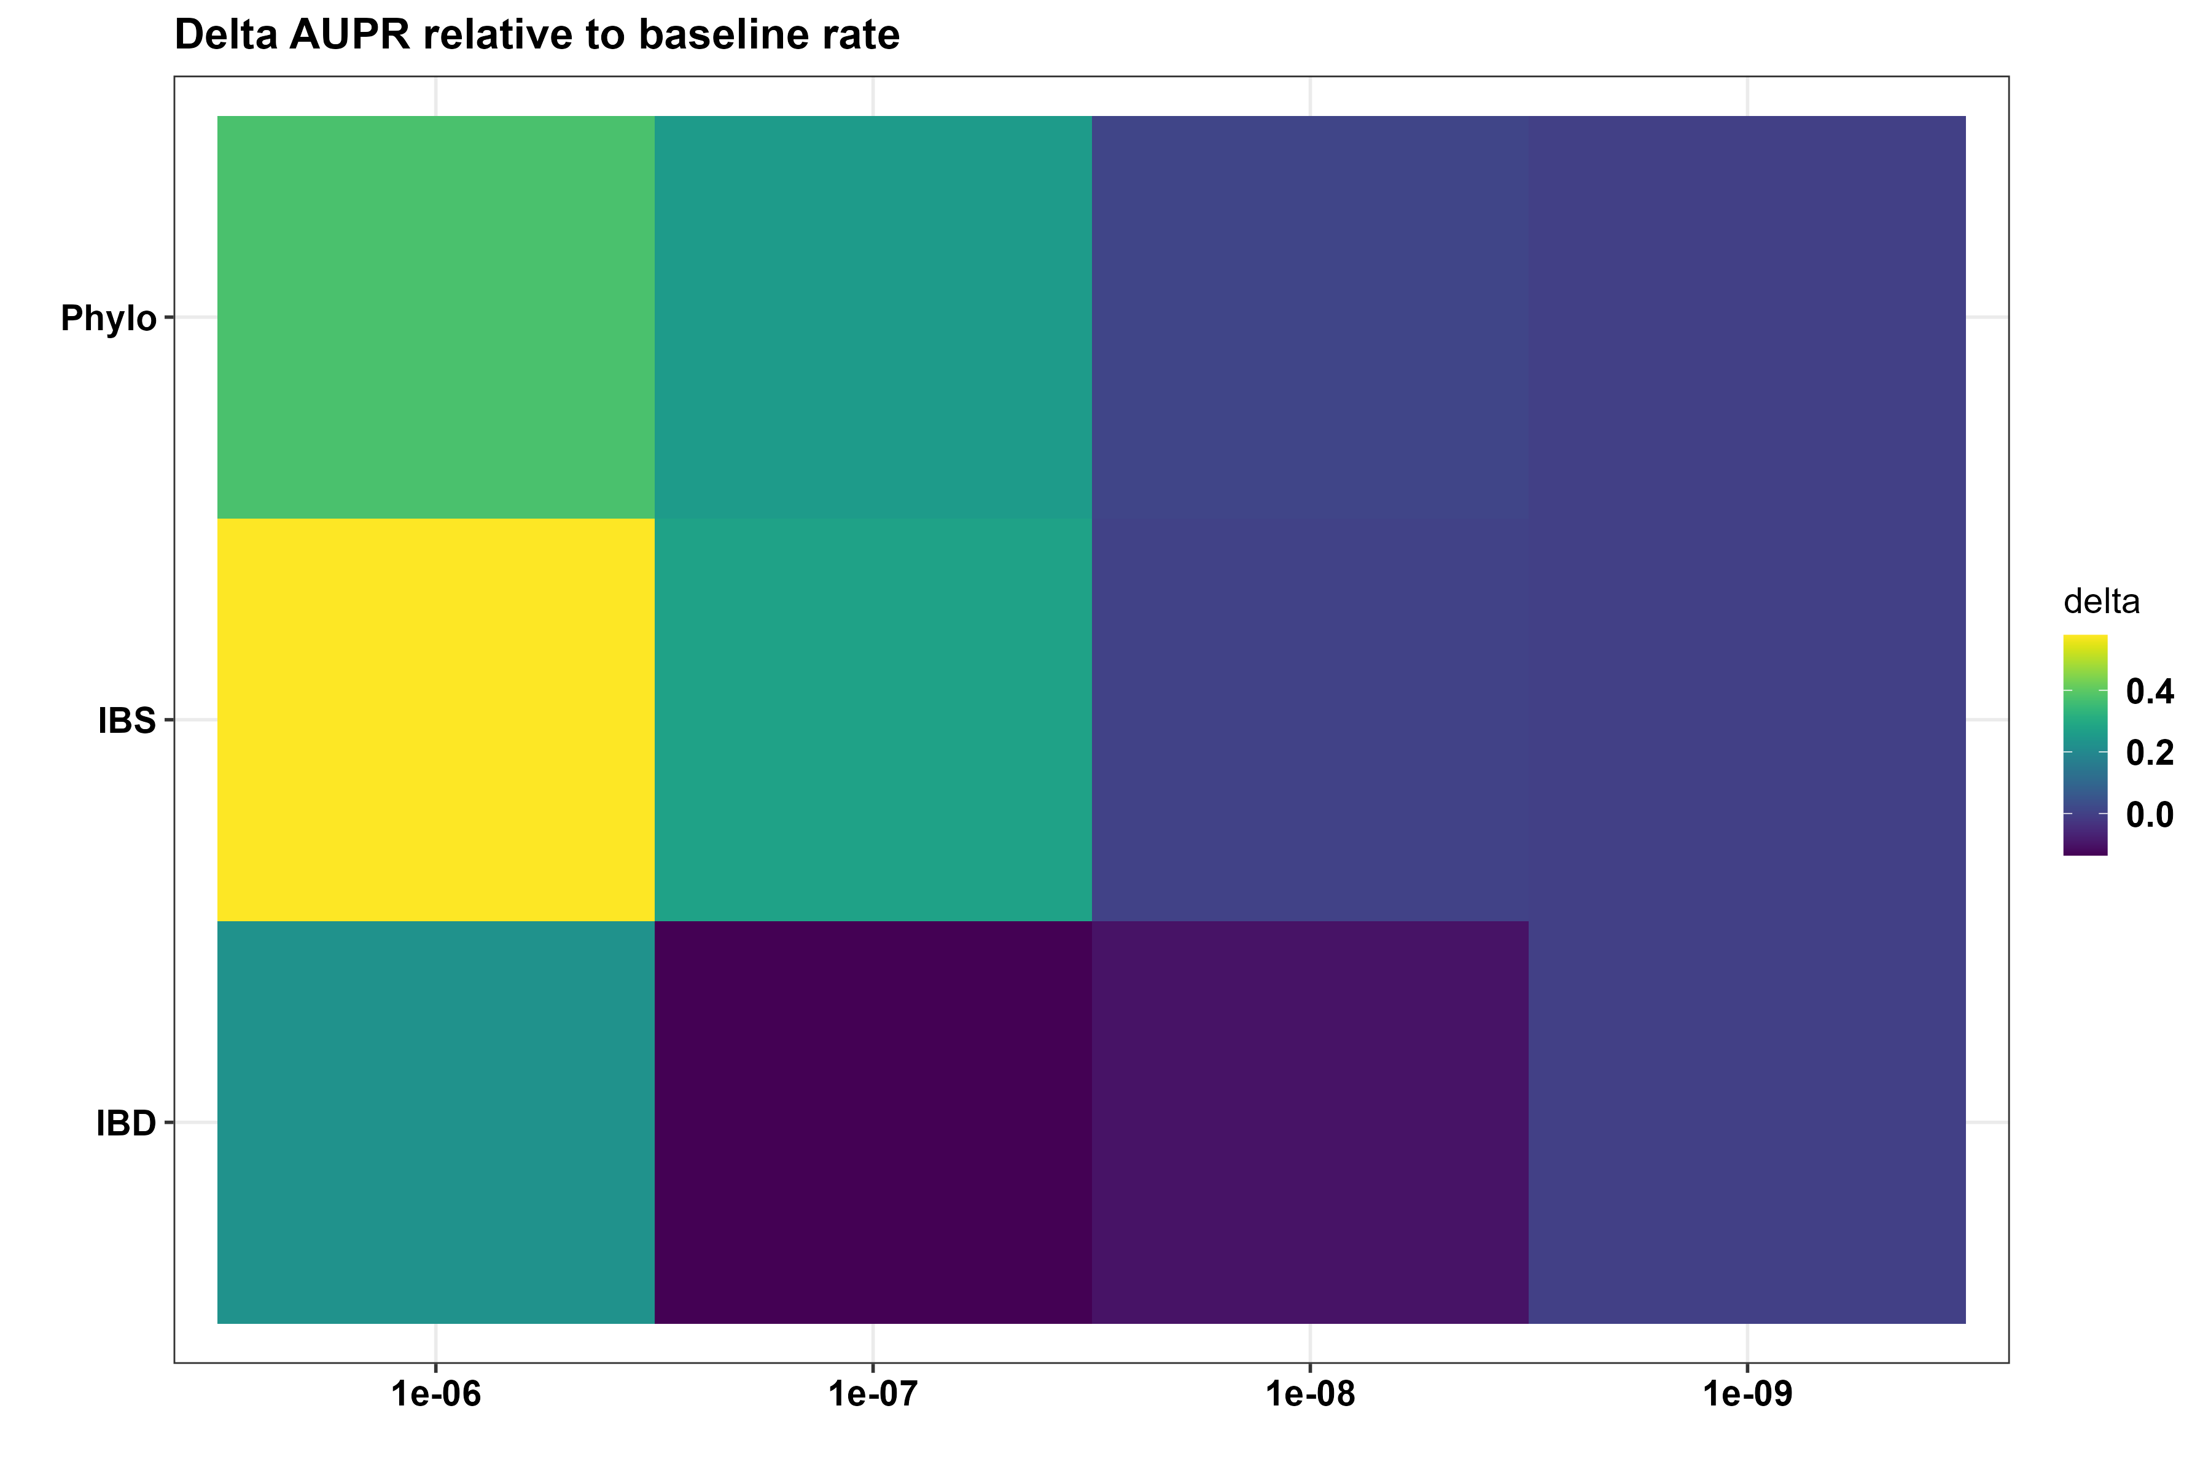
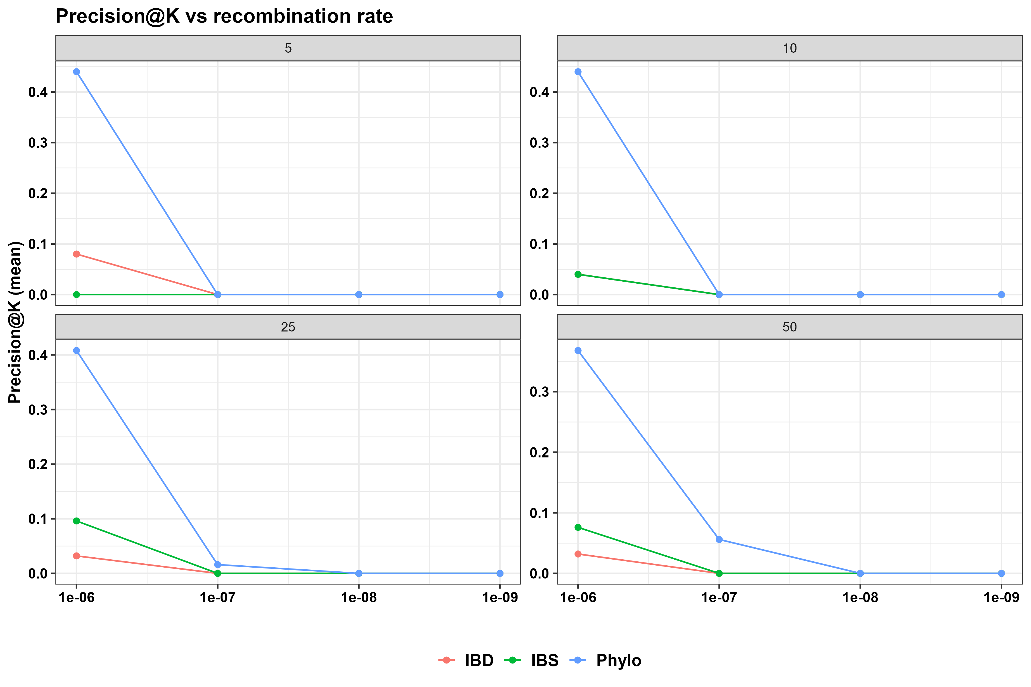

Slide 19
Figure 4:

Slide 21
SCENARIO 3
Multi-Population Structure and Migration
Two to four subpopulations representing geographically distinct foci
Migration rates ranging from low to high connectivity
Transmission chains allowed to cross population boundaries
Sampling performed within and across subpopulations
Recombination rate
Migration rate
Sampling proportion
Transmission bottleneck size
Dozens of biologically plausible parameter combinations
Replicated simulations for each parameter set
Purpose: Assess how spatial structure and parasite movement distort transmission inference and inflate false positives
Map the full inference landscape and identify regions where genomic transmission reconstruction is feasible, unstable, or impossible.

Slide 22
Inference methods relying on genetic relatedness are sensitive to recombination dynamics.
Hence, realistic modeling of recombination and infection complexity is essential for evaluating genomic transmission studies.

Slide 23
Chromosome | 1e-9 | 1e-8 | 1e-7 | 1e-6
Pf3D7_01_v3 | 696 | 592 | 1003 | 1269
Pf3D7_02_v3 | 1523 | 1326 | 1676 | 1803
Pf3D7_03_v3 | 1674 | 1346 | 1809 | 2070
Recombination rate increases the number of variants

Slide 24
https://www.facebook.com/share/r/17fHU8Ujja/

