Slide 1
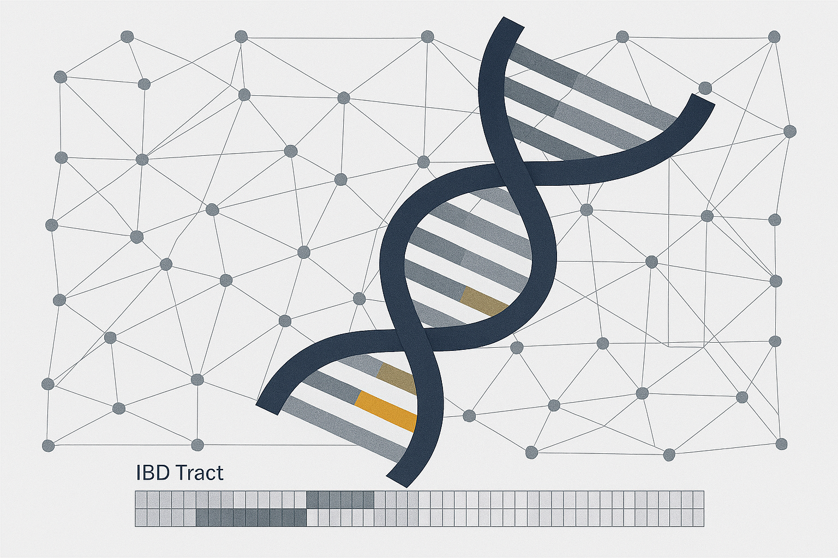
Benchmarking Transmission Inference Methods Using Simulated Genomic Data
A Plasmodium falciparum simulation and evaluation framework for IBS – IBD – phylogenetic distances
Mouhamadou Fadel DIOP

Slide 2
Rationale for Simulation
Evaluate the reliability of transmission inference methods under varying biological and sampling conditions.
These methods include:
Identity-by-descent (IBD)
Identity-by-state (IBS)
Phylogenetic Patristic distance
Objective:
Identify “who infected whom”
Determine under which conditions these methods can accurately recover malaria transmission links from genomic data.
Under what conditions does transmission inference become identifiable?

Slide 3
Simulation Design
Simulate scenarios for evolving P.f populations with different parameters:
Forward-time, individual-based simulations of Plasmodium falciparum using SLiM
Explicit infection-to-infection transmission pedigrees (ground truth known)
Whole-genome data generated from tree sequences
True shared IBD from the tree sequences (proxy to transmission)
Genomic inference methods evaluated against true transmission histories

Slide 4
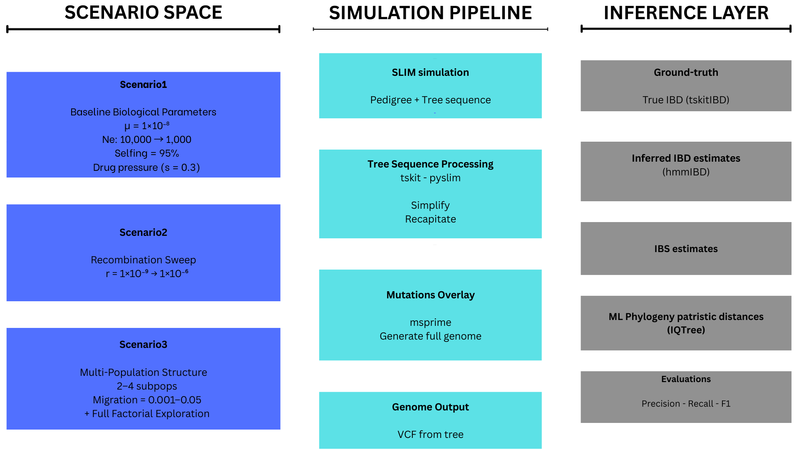
Figure 1: Overview of Pf simulation framework

Slide 5
Evaluation Framework
Extract true IBD segments from tree sequences using tskitIBD.
Each pair of individuals sharing IBD segment with TMRCA ≤ G generations defines a true transmission proxy.
Predicted metrics were derived from the generated VCF:
IBS estimates
IBD estimates (hmmIBD, isoRelate, …)
Phylogenetic cophenetic distance
Computed Precision-Recall curves comparing predicted vs. true relatedness to assess recoverability.

Slide 6
SCENARIO 1
Single, well-mixed parasite population
Biologically realistic mutation and recombination rates
Dense sampling of infections from a single outbreak
Represents an optimistic upper bound for genomic transmission inference
Fixed all biological and epi parameters
Mutation rate: 1.0e-08
Recombination rate: 1/15000 (~ 6.67e-07)
Sample size: 1000
Population size: 1000
Effective population size: 10.000

Slide 7
SCENARIO 2
Single population, identical demography and sampling
Recombination rate varied across four orders of magnitude
Range spans near-clonal to highly recombining parasite populations
Multiple replicates per recombination level
Purpose: Isolate the effect of recombination on genomic signal and identify thresholds where transmission inference breaks down.

Slide 8
Why Vary Recombination Rate?
Recombination determines how quickly genetic linkage decays between loci.
Low r: longer shared IBD tracts, easier detection of close transmission links.
High r: shorter tracts, increased difficulty in inferring direct ancestry.
Assess the robustness of each inference method across different recombination rates (10⁻⁹ – 10⁻⁶).

Slide 9
SCENARIO 3
Multi-Population Structure and Migration
Two to four subpopulations representing geographically distinct foci
Migration rates ranging from low to high connectivity
Transmission chains allowed to cross population boundaries
Sampling performed within and across subpopulations
Recombination rate
Migration rate
Sampling proportion
Transmission bottleneck size
Dozens of biologically plausible parameter combinations
Replicated simulations for each parameter set
Purpose: Assess how spatial structure and parasite movement distort transmission inference and inflate false positives
Map the full inference landscape and identify regions where genomic transmission reconstruction is feasible, unstable, or impossible.

Slide 11
Recombination destroys genomic signal
Recombination strongly erodes the genomic signal needed for identifying transmission links. As recombination rate increases, IBD patterns degrade, making it much harder to detect who‑infected‑whom using genomic data.
higher recombination destroys the IBD signalrequired for accurate inference.
Figure 2: Recombination vs IBD signal: Impact of Recombination on IBD Distributions

Slide 12
🧬 1. What is IBD (Identity‑By‑Descent) in simple terms?
Think of IBD as “genetic footprints” inherited from the same recent ancestor.
👉 Simple definition
IBD = long chunks of DNA that two individuals share because they both inherited them from the same ancestor. Not “similar by coincidence,” but literally the same piece copied down through generations.
👉 An analogy
Imagine two people owning pages from the same original book. If their pages still match almost word‑for‑word, it means they came from the same recent printing. As time and copying proceed, the pages get more edited, mixed, or torn.
👉 Why IBD matters for transmission
In infectious disease genomics (like Plasmodium falciparum), when two infections share long IBD tracts, it often means:
they are recently connected in the transmission chain
possibly linked through the same mosquito bite or recent co‑transmission
or share a close ancestor parasite from just a few generations back
So IBD is like a signal of genetic closeness, useful for asking: “Who is linked to whom, and how recently?”

Slide 13
🔄 2. How does recombination affect genomic analysis?
Recombination is the mixing and shuffling of genetic material.
Imagine shuffling two decks of cards into a new deck — the original sequences become mixed.
👉 What recombination does biologically
Every time recombination occurs:
long inherited DNA segments are broken into smaller pieces
shared ancestry becomes harder to see
IBD segments become shorter, fewer, or disappear
Your slide shows exactly this pattern — higher recombination destroys IBD signal.
🚨 Why this matters for genomic transmission inference
1. It erodes the IBD signal
High recombination breaks up ancestral DNA rapidly, so:
IBD tracts become too short to detect
parasites look genetically unrelated even when they are connected
transmission links become hard or impossible to identify
2. It “blurs” genetic similarity
Genomes become so shuffled that individuals no longer show clear patterns of relatedness.
3. It reduces the power of all genomic inference methods
As your slide highlights:
IBD patterns degrade
This makes it much harder to detect who infected whom
Genomic methods lose strength as recombination increases
4. But… recombination can also sometimes help
At very high levels, recombination makes genomes more independent, increasing the number of different genealogies. This can help phylogenetic methods slightly at the highest recombination rates (from slide 13), but only because the signal is no longer dominated by a few long haplotypes.

Slide 14
Concept | Simple Explanation
IBD | Long DNA pieces shared because they came from the same recent ancestor.
Effect of recombination | Breaks up these shared pieces, making genomic relationships harder to detect.
Why you care | High recombination destroys the genetic footprints needed to reconstruct transmission chains.

Slide 15
Review classification for recombination sweep
Sensitivity declines sharply under realistic recombination
False Discovery Rate inflates under migration and high recombination
Precision–Recall curves reveal no reliable threshold for identifying direct transmission
IBD-based methods never dominate across all conditions
Figure 3: Performance of genomic inference methods across realistic transmission conditions

Slide 16
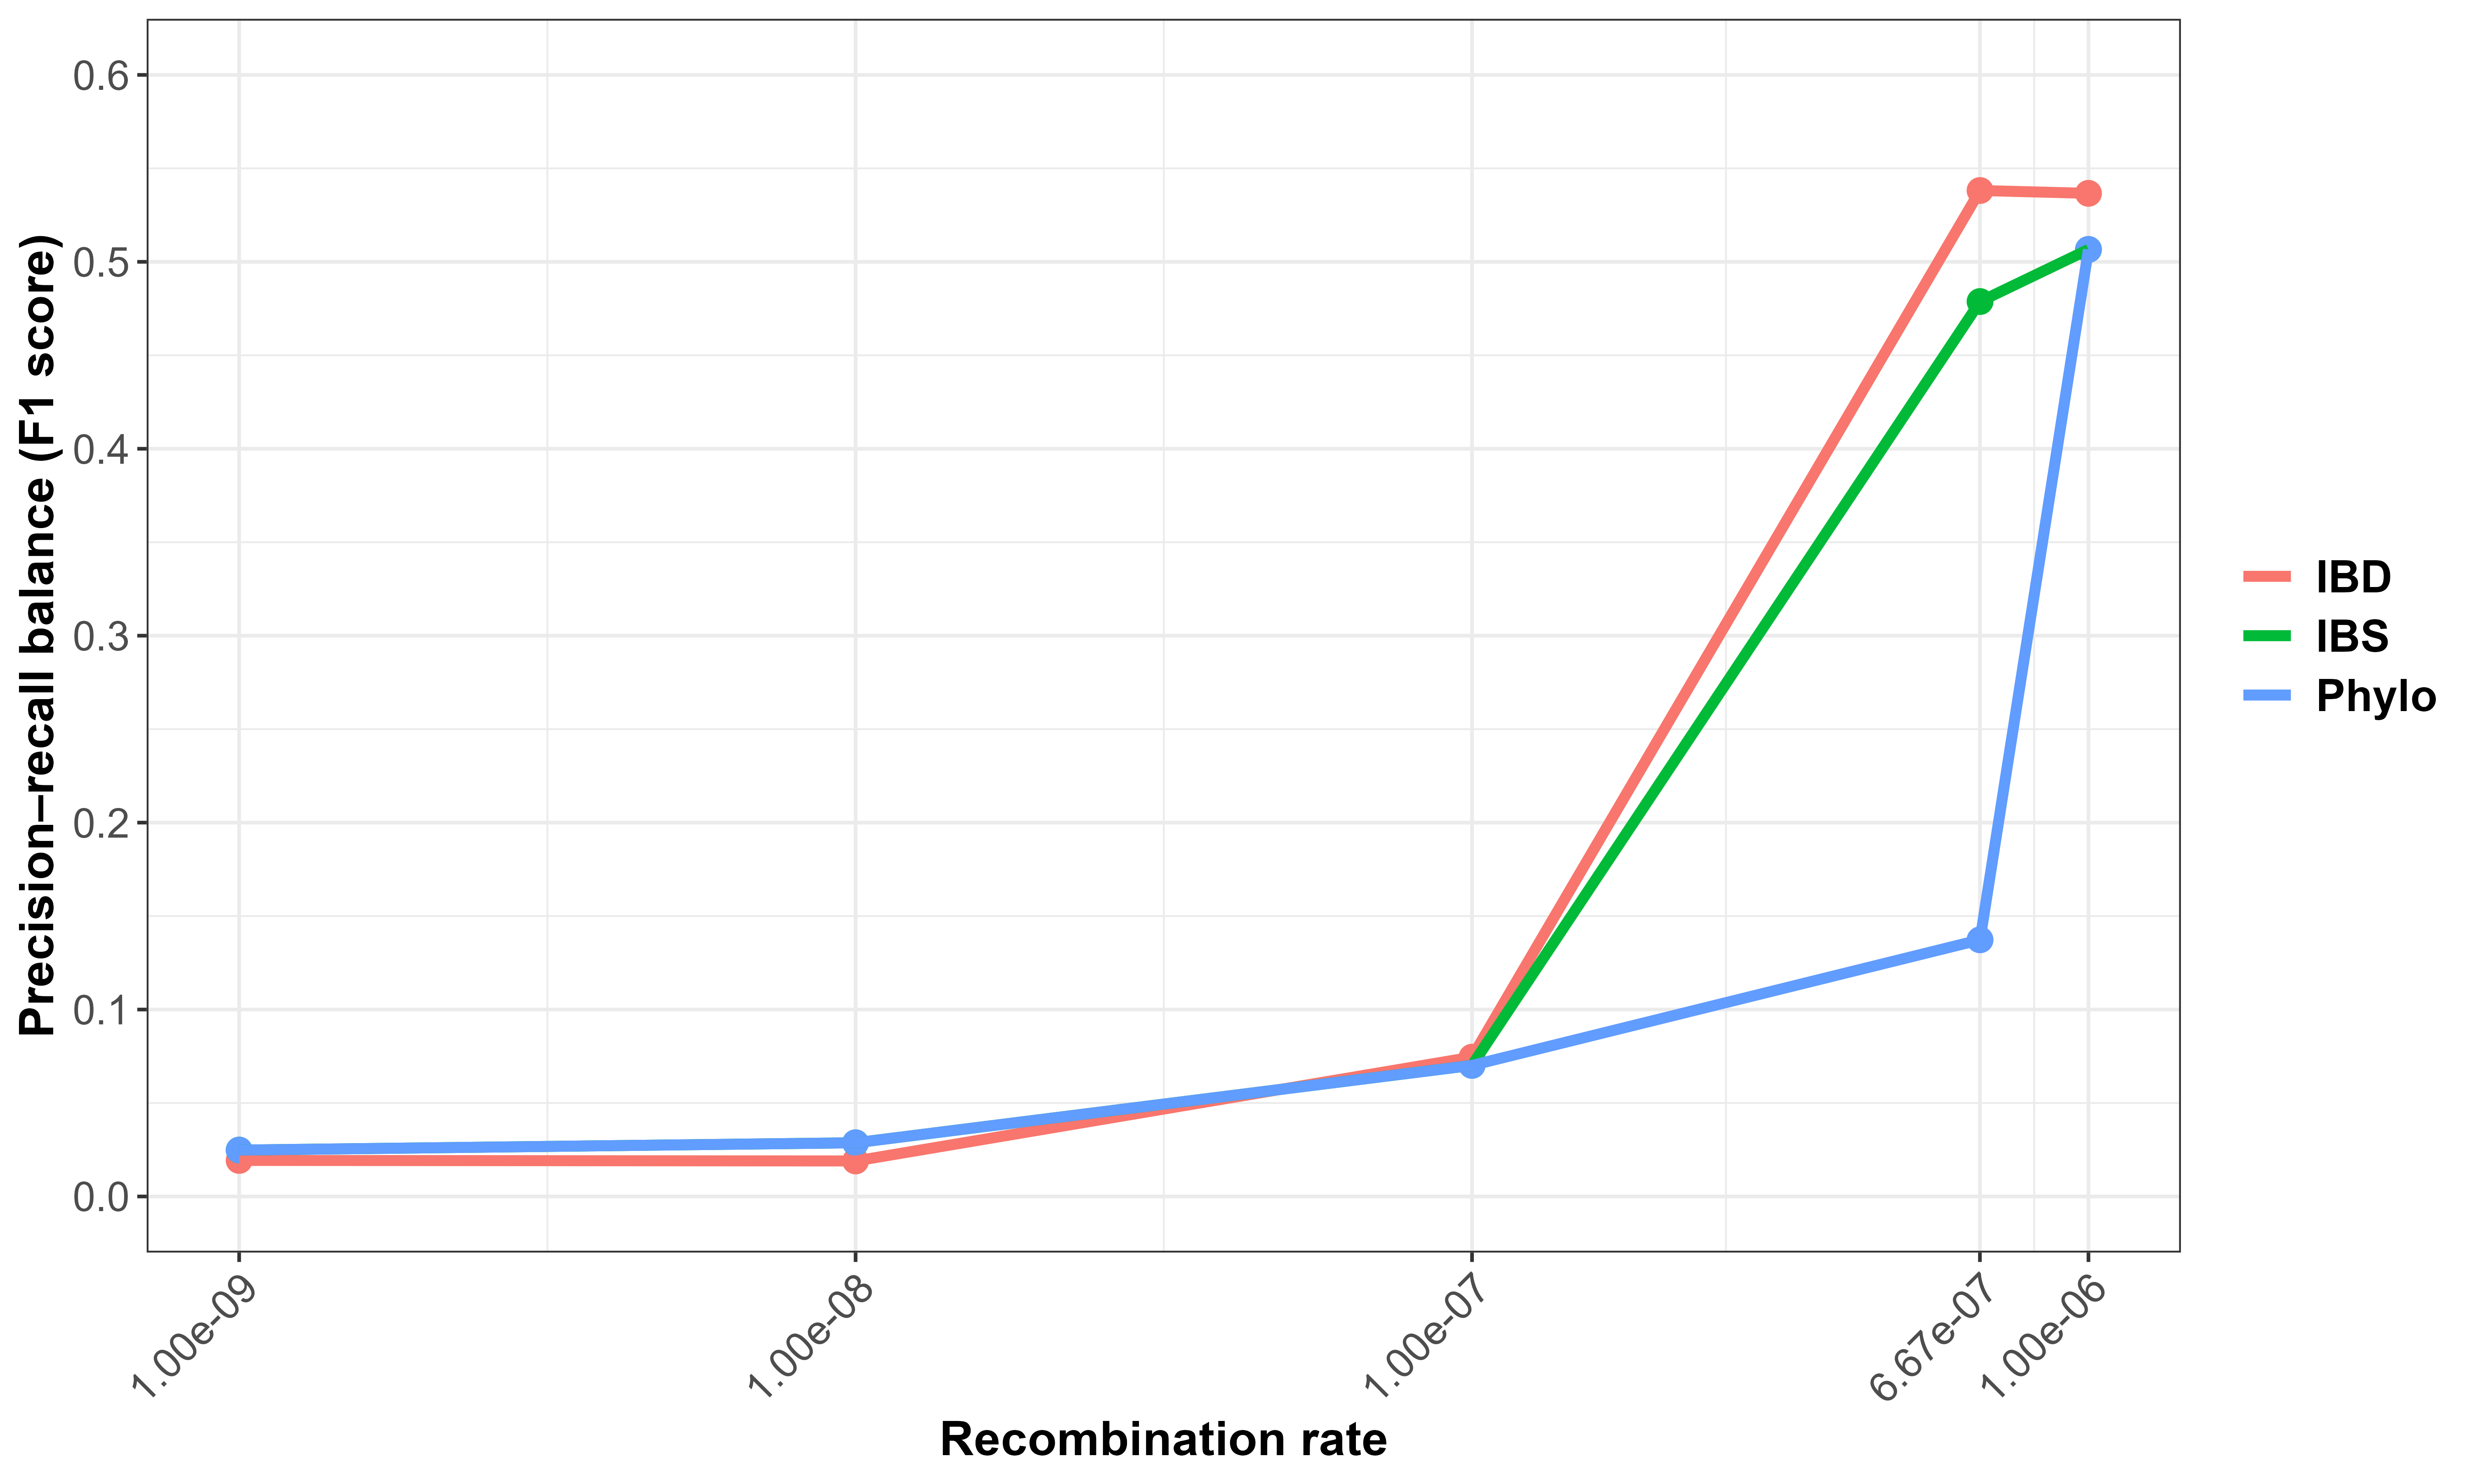
Format x-axis
Precision–recall balance (F1) for recovering direct transmission links
Methods perform extremely poorly at low rec rate and differences are negligible
ancestral signal, not just recent transmission signal.
IBD and IBS show a sharp increase in F1 while phylogenetic only improves substantially at the highest rate.
Only very recent transmission retains detectable IBD
Recombination reduces the detectability of IBD but increases the identifiability of direct transmission.
Figure 4: Sensitivity to recombination heterogeneity

Slide 17
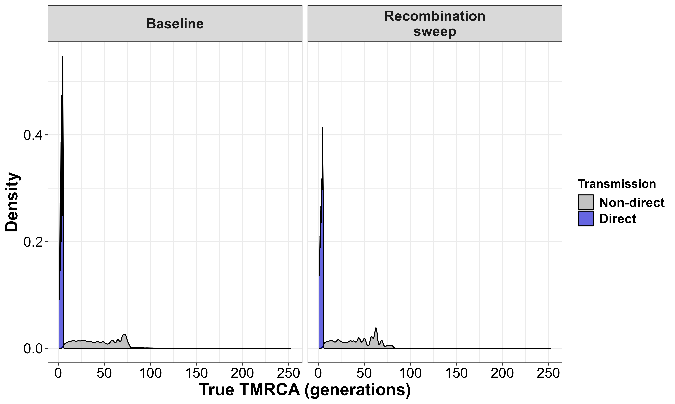
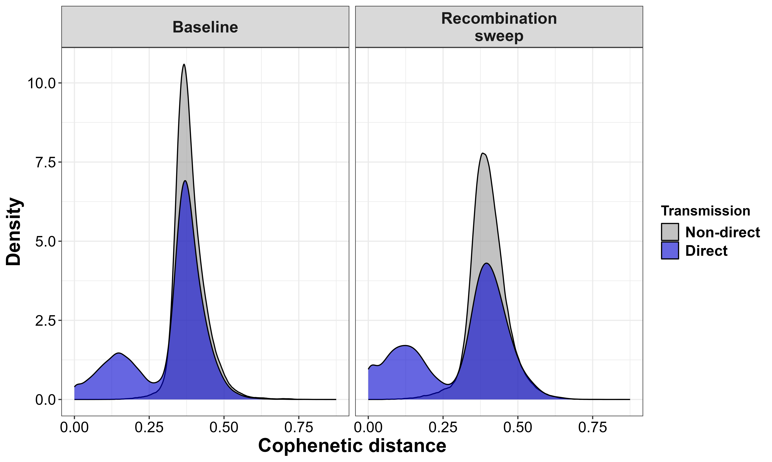
Direct transmission pairs concentrate very strongly at extremely small TMRCA
Direct pairs shift toward smaller distances
Multiple local genealogies, increasing the number of independent mutational signals.
Phylogenetic distances are no longer dominated by a single shared haplotype
Figure 5: Phylogenetic misrepresentation of true transmission

Slide 18
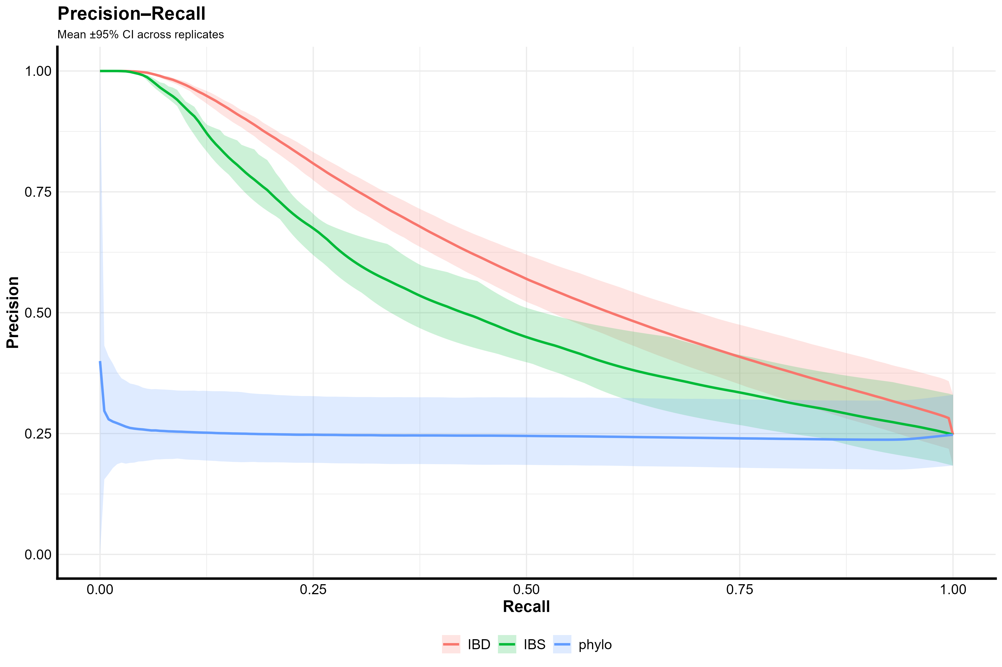
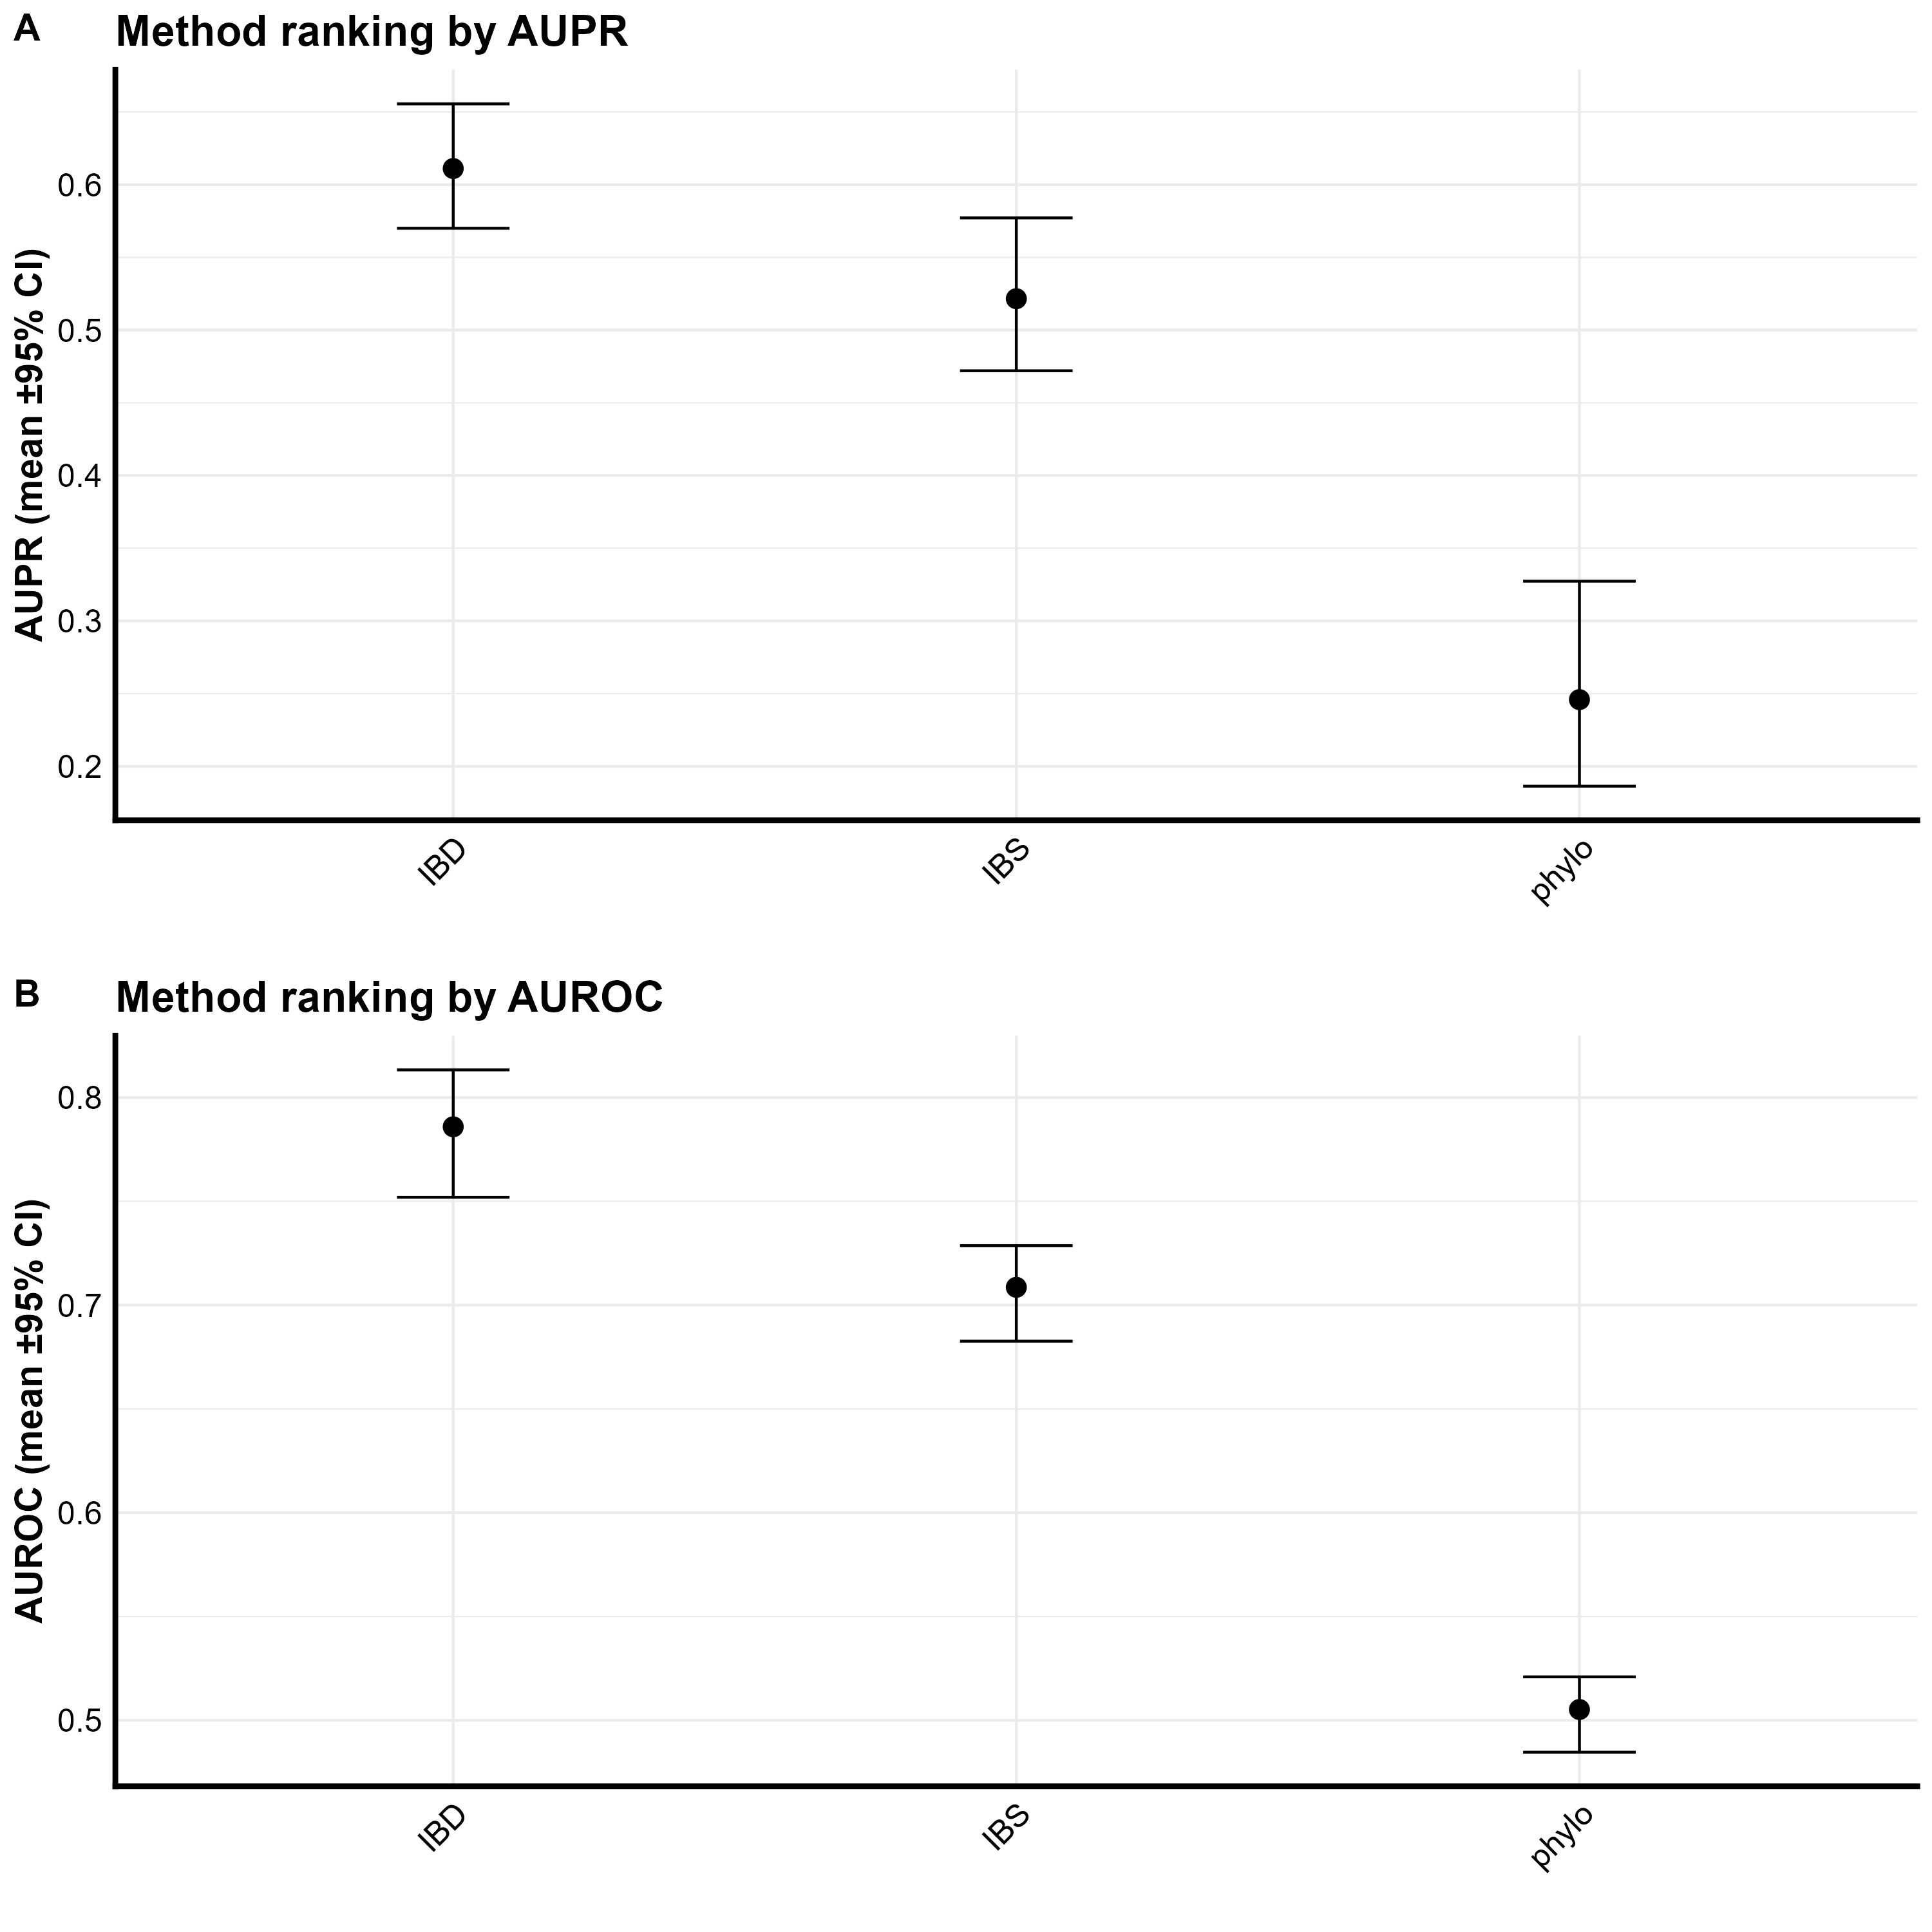

Slide 21
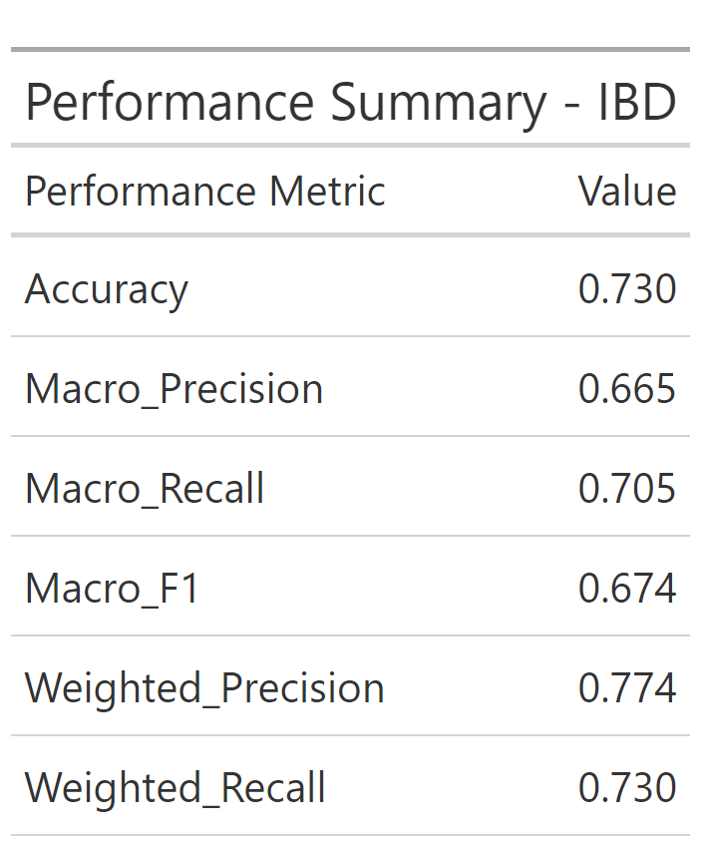

Slide 22
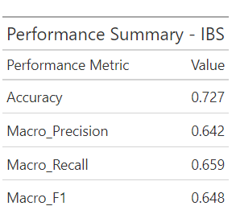

Slide 23
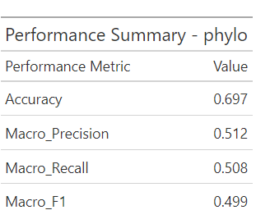

Slide 24
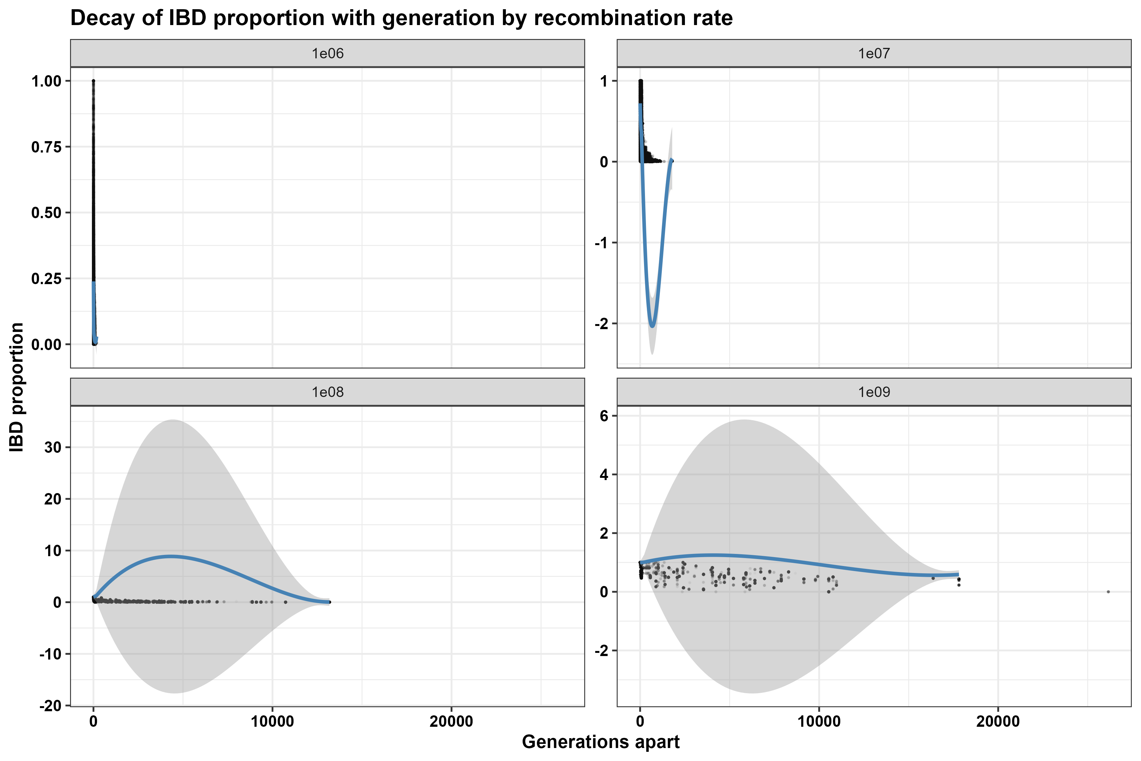

Slide 25
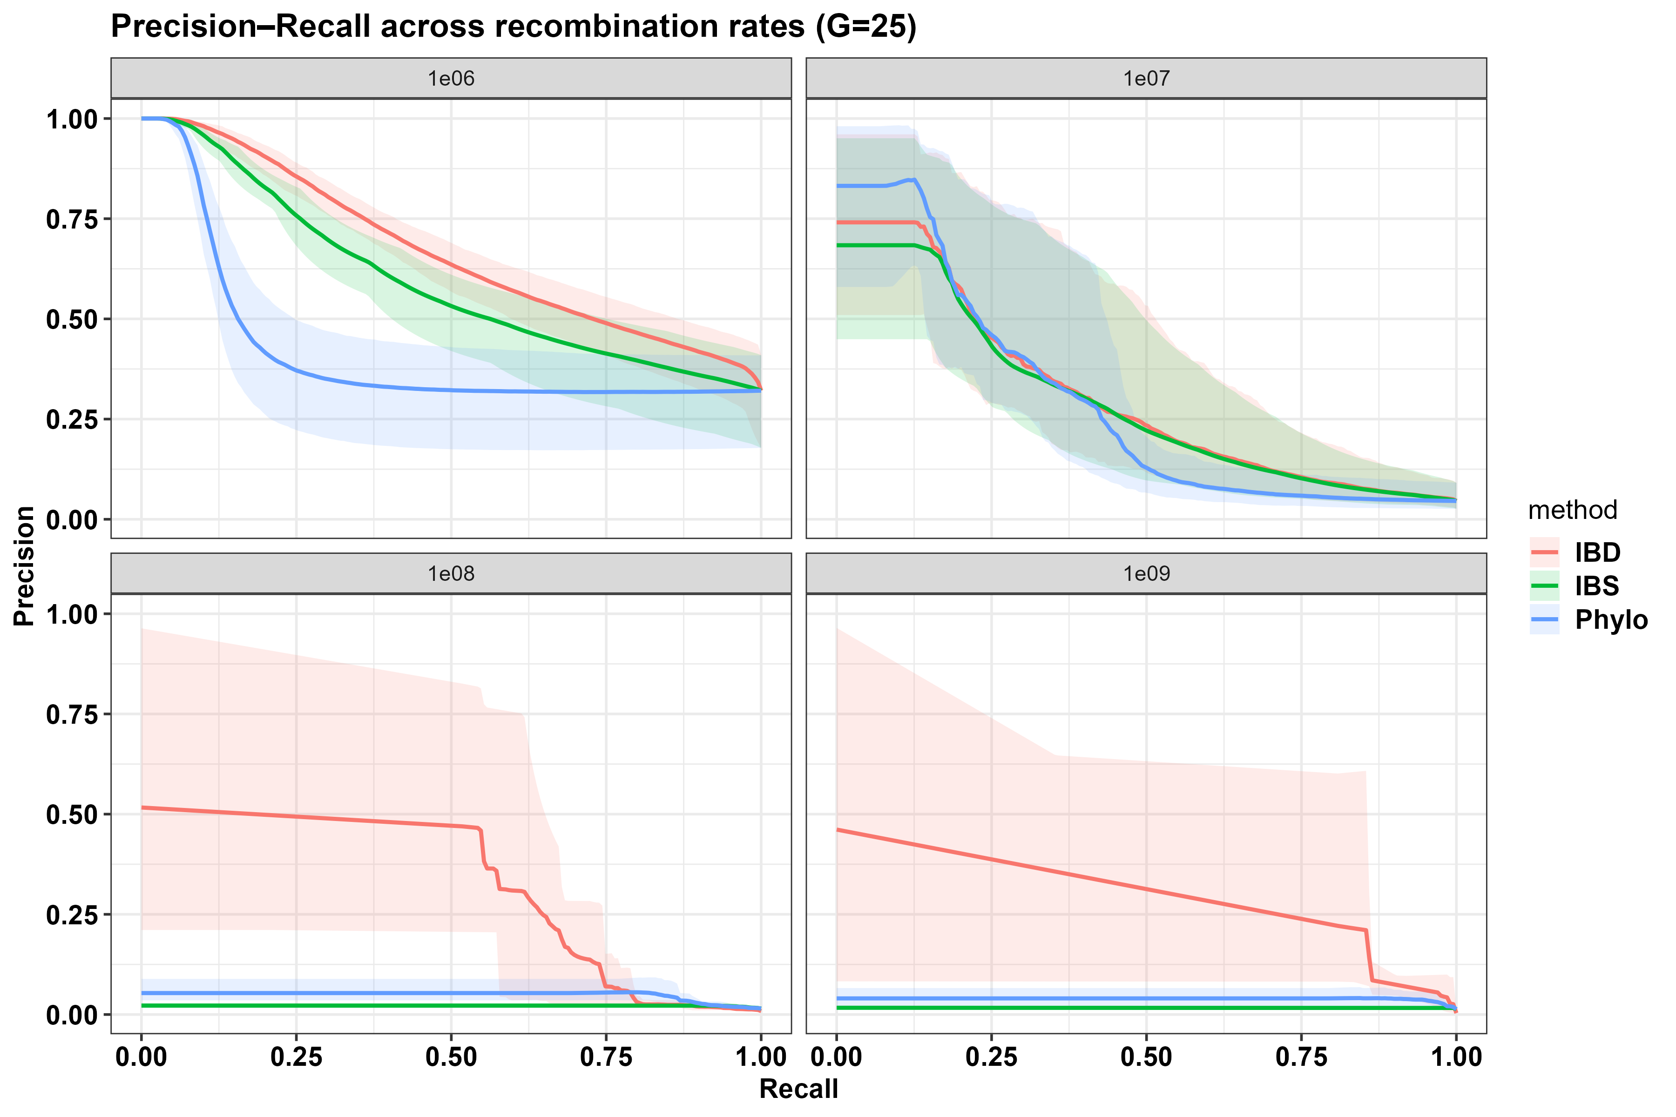
The PR-AUC quantifies how well predicted relatedness identifies true transmission pairs.
Results show …….. with increasing recombination rate:
- r = 10⁻⁹ → PR-AUC ≈
- r = 10⁻⁸ → PR-AUC ≈
- r = 10⁻⁷ → PR-AUC ≈
- r = 10⁻⁶ → PR-AUC ≈

Slide 26
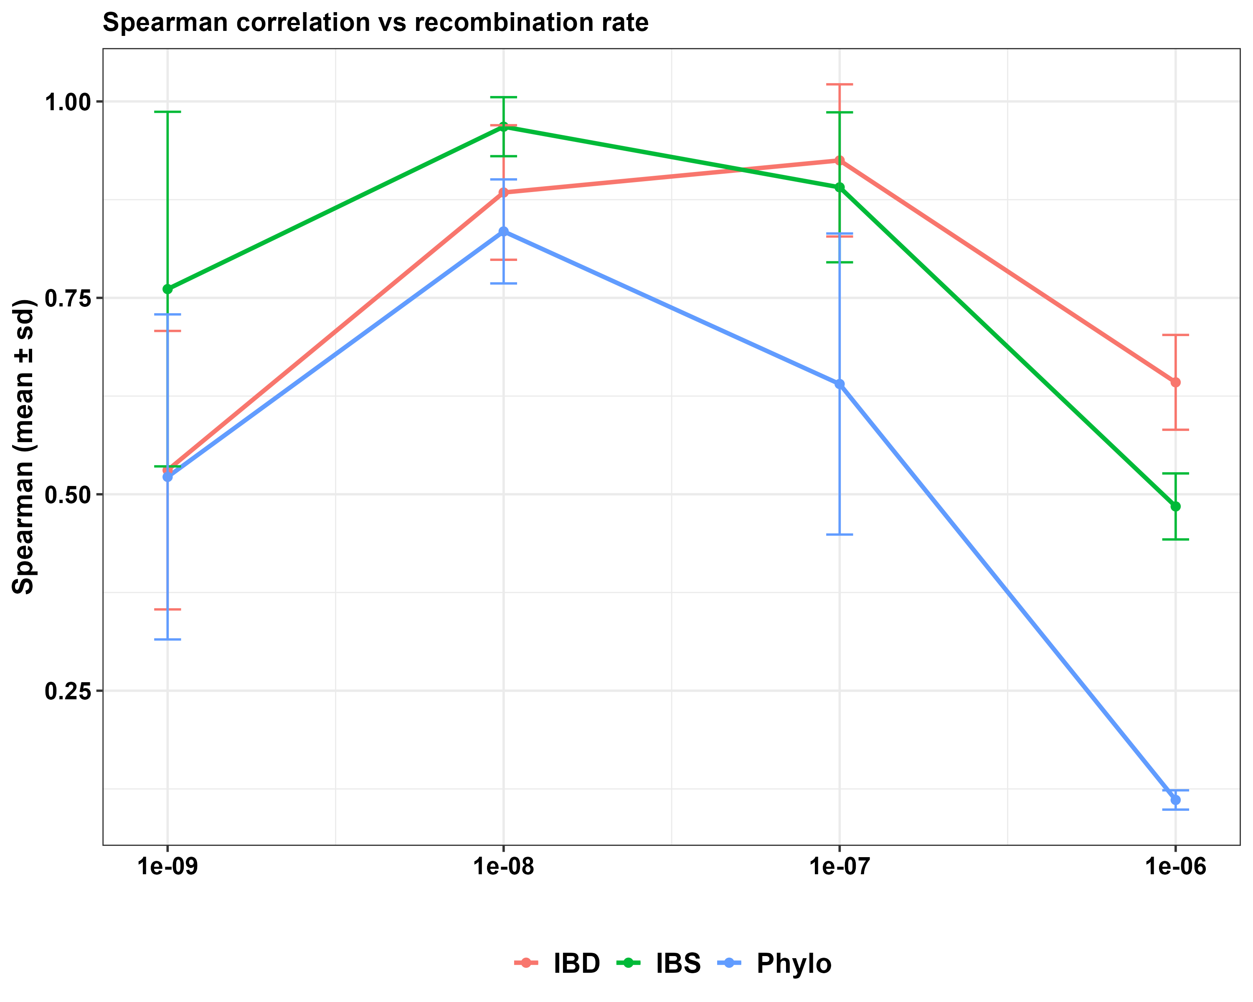
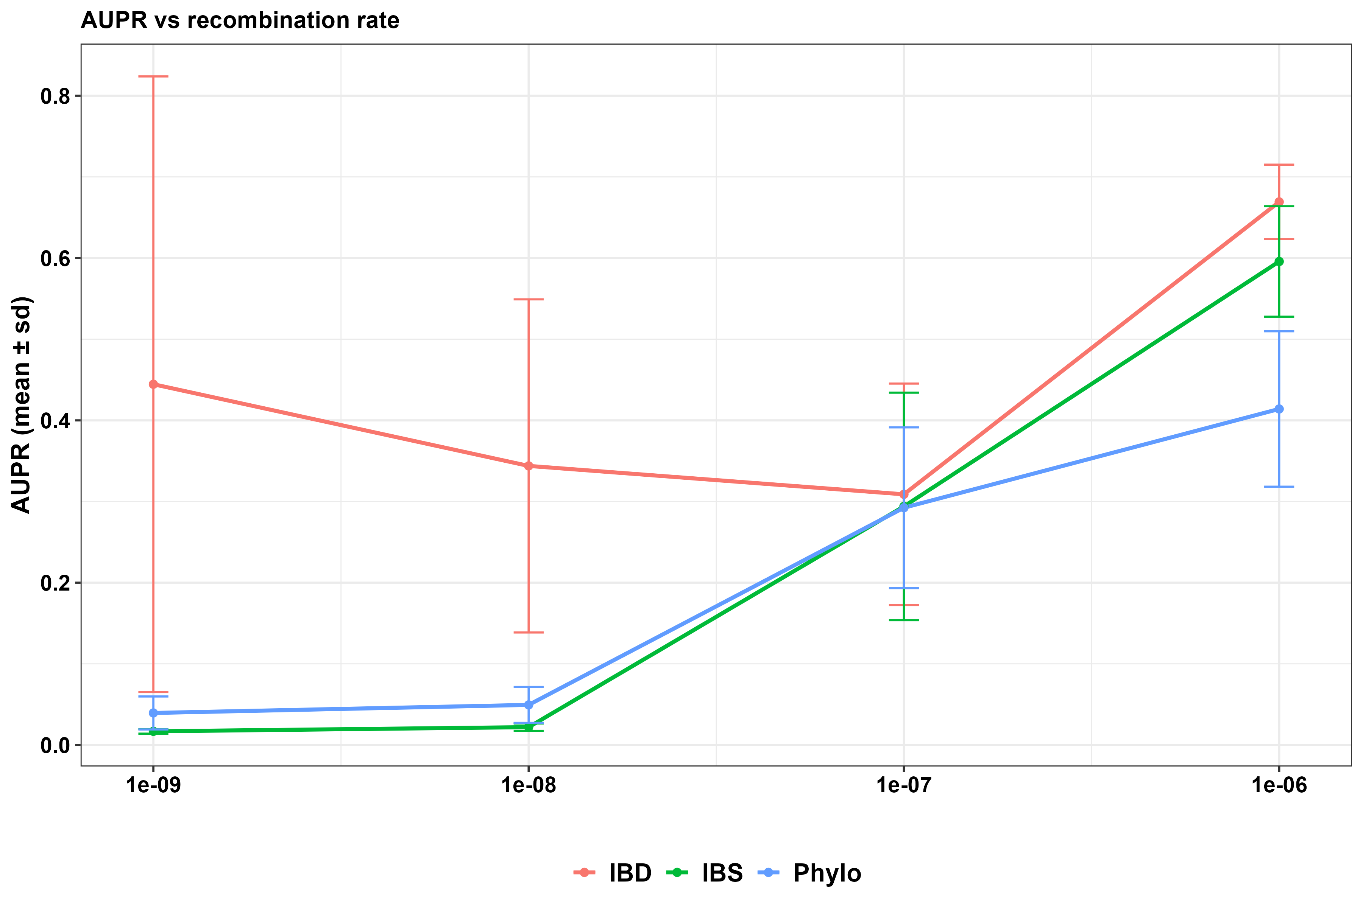
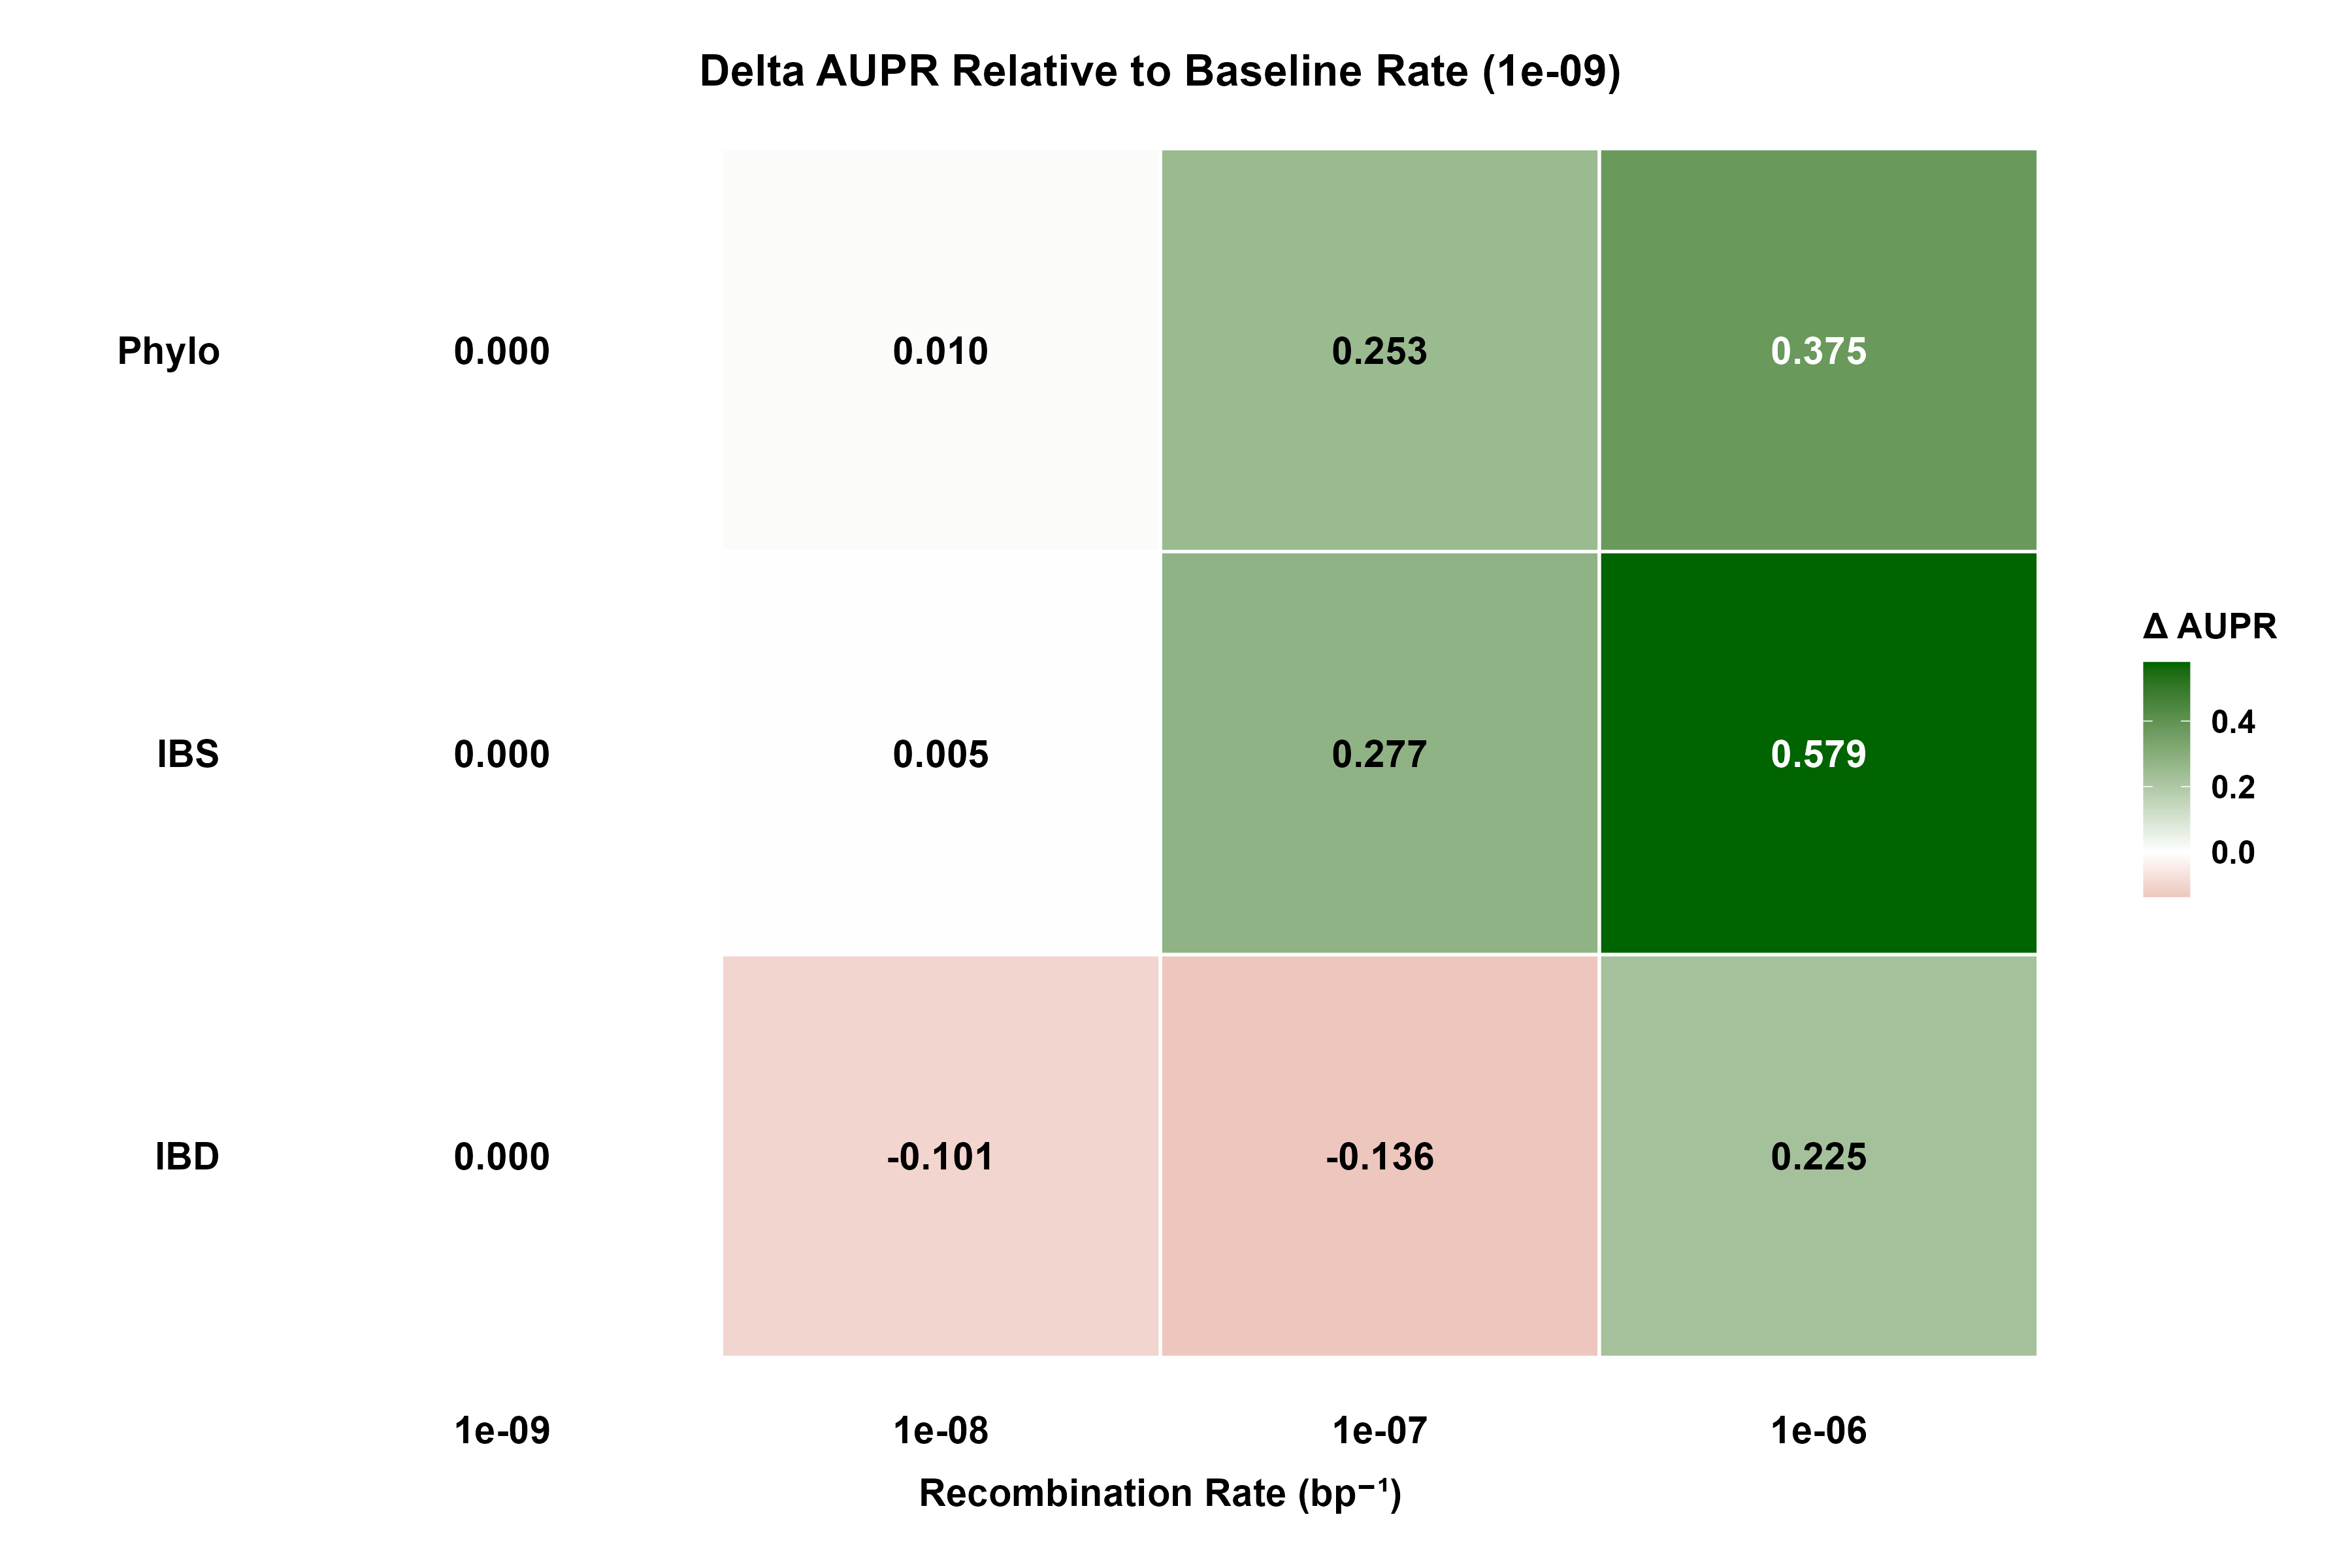

Slide 28
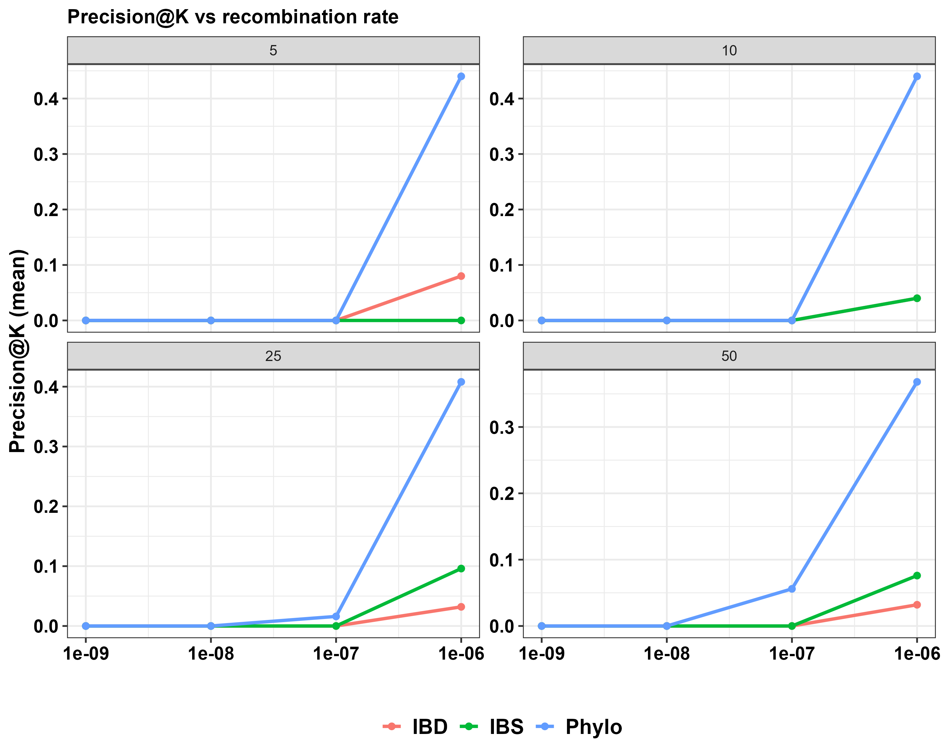

Slide 29
Inference methods relying on genetic relatedness are sensitive to recombination dynamics.
Hence, realistic modeling of recombination and infection complexity is essential for evaluating genomic transmission studies.
Beyond this regime, who-infected-whom is not identifiable for malaria transmission dynamics.

Slide 30
The problem is highly imbalanced data
In a transmission network, the number of true transmission pairs (or recent co-transmission links) is tiny compared to the number of all possible pairs.
For N samples, there are N(N−1)/2 possible pairs — and maybe <1% correspond to true transmission or close kinship.
ROC curves (which plot True Positive Rate vs False Positive Rate) can look deceptively good even when a classifier is mostly wrong, because the False Positive Rate barely changes in imbalanced settings.
PR curves (Precision vs Recall) focus on the positive class (true transmission pairs). They’re sensitive to how many predicted links are truly correct, which is what you care about.
Hence: → Use PR-AUC (area under the precision–recall curve) for comparing methods (IBD vs IBS vs phylogenetic).
PR-AUC directly reflects “usefulness for inference”
A high PR-AUC means: when the method thinks two samples are closely related (precision), they usually are — and it recovers many of the true links (recall).

