Slide 1
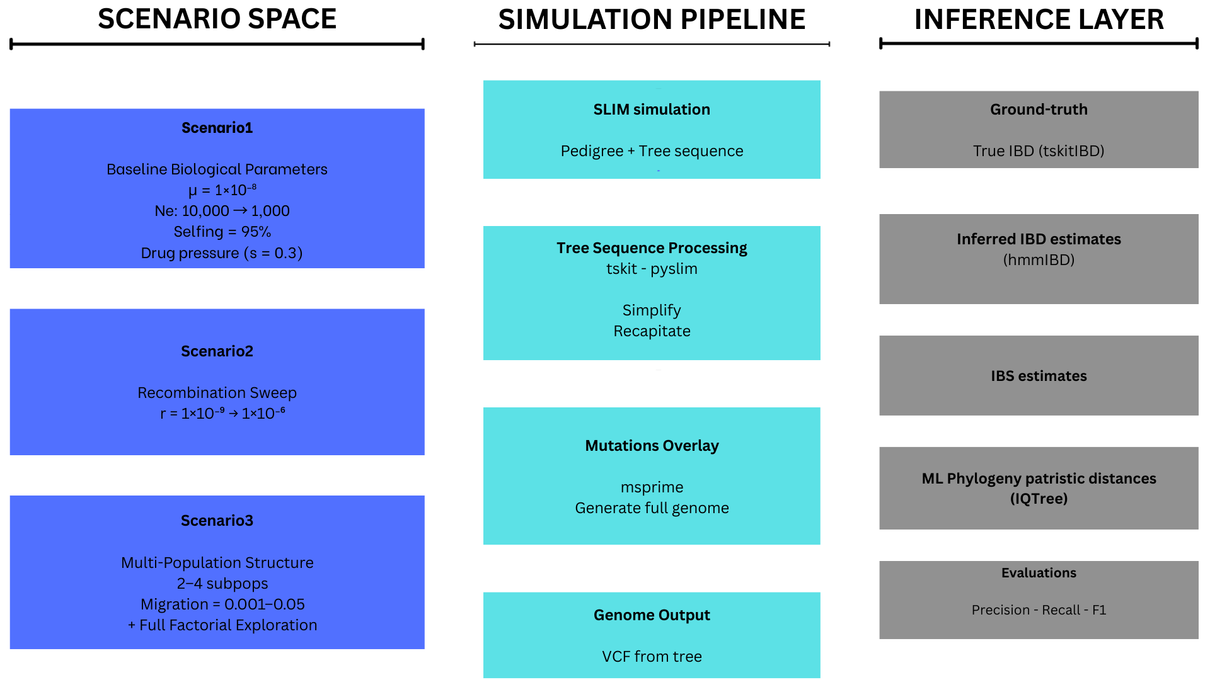
Figure 1: Simulation framework

Slide 2
Figure 2:

Slide 3
Figure 3:

Slide 4
Figure 4:

Slide 5
Figure 5:

Slide 6
Figure 6:

Slide 7
Figure 7:

Slide 8
Figure 8:

Slide 9
Figure 9:

Slide 10
SUPPLEMENTARY FIGURES

Slide 11
Supplementary Figure S1. Pairwise IBD fraction distributions at baseline simulation parameters, shown as overlaid density plots for directly and non-directly transmitted pairs. Both true (tree-sequence genealogy) and hmmIBD-inferred IBD fractions are displayed. Related to Sections 1 and 2.

Slide 12
Supplementary Figure S2. AUPRC as a function of recombination rate for five transmission bottleneck sizes (Ne = 1,000–20,000) at baseline migration (m = 0.001), shown separately for each inference approach. AUPRC differences attributable to Ne ranged from 0.011 to 0.014 across the values tested. Related to Section 2.

Slide 13
Supplementary Figure S3. Sensitivity at 90% specificity as a function of recombination rate and migration condition for IBD, IBS, and Phylo. Three lines per panel correspond to m = 0.001, 0.01, and 0.05. Provides fixed-specificity complement to the AUPRC characterisation in Figure 5.

Slide 14
Supplementary Figure S5. IBD advantage over the next-best method (AUPRC gap) as a heatmap over recombination rate × sample size. Gap values: 0.158–0.176 at r = 10^-9; 0.049–0.081 at intermediate rates; 0.085–0.095 at r = 10^-6. Non-monotonic profile across the recombination range. Related to Section 6.1.

Slide 15
Supplementary Figure S6. Mean AUPRC with 95% confidence intervals as continuous line plots across recombination rates, for each of the three migration conditions and all three inference approaches. Provides full numerical detail complementing Figures 5 and 4. Related to Sections 4 and 5.

Slide 16
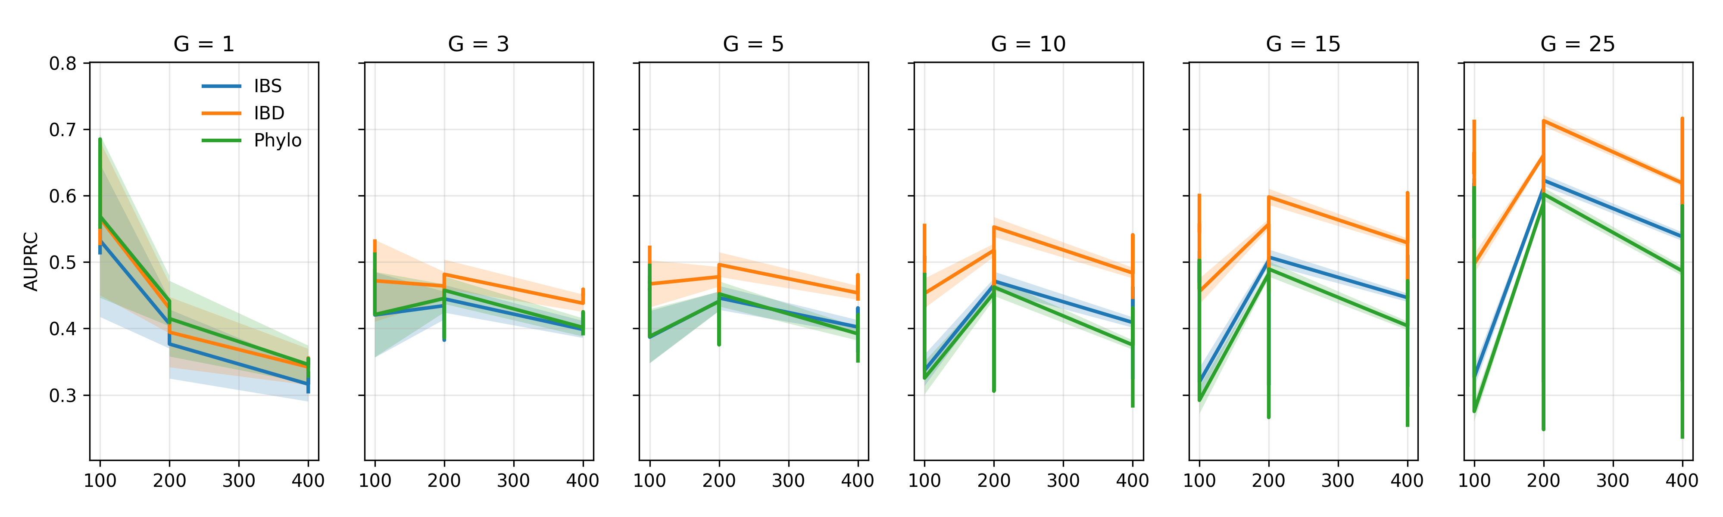
Supplementary Figure S9. G-threshold × sample size interaction. AUPRC as a function of generational window depth, presented separately for n = 100, 200, and 400 at each recombination rate, for all three inference approaches. Related to Section 6.2.

Slide 19
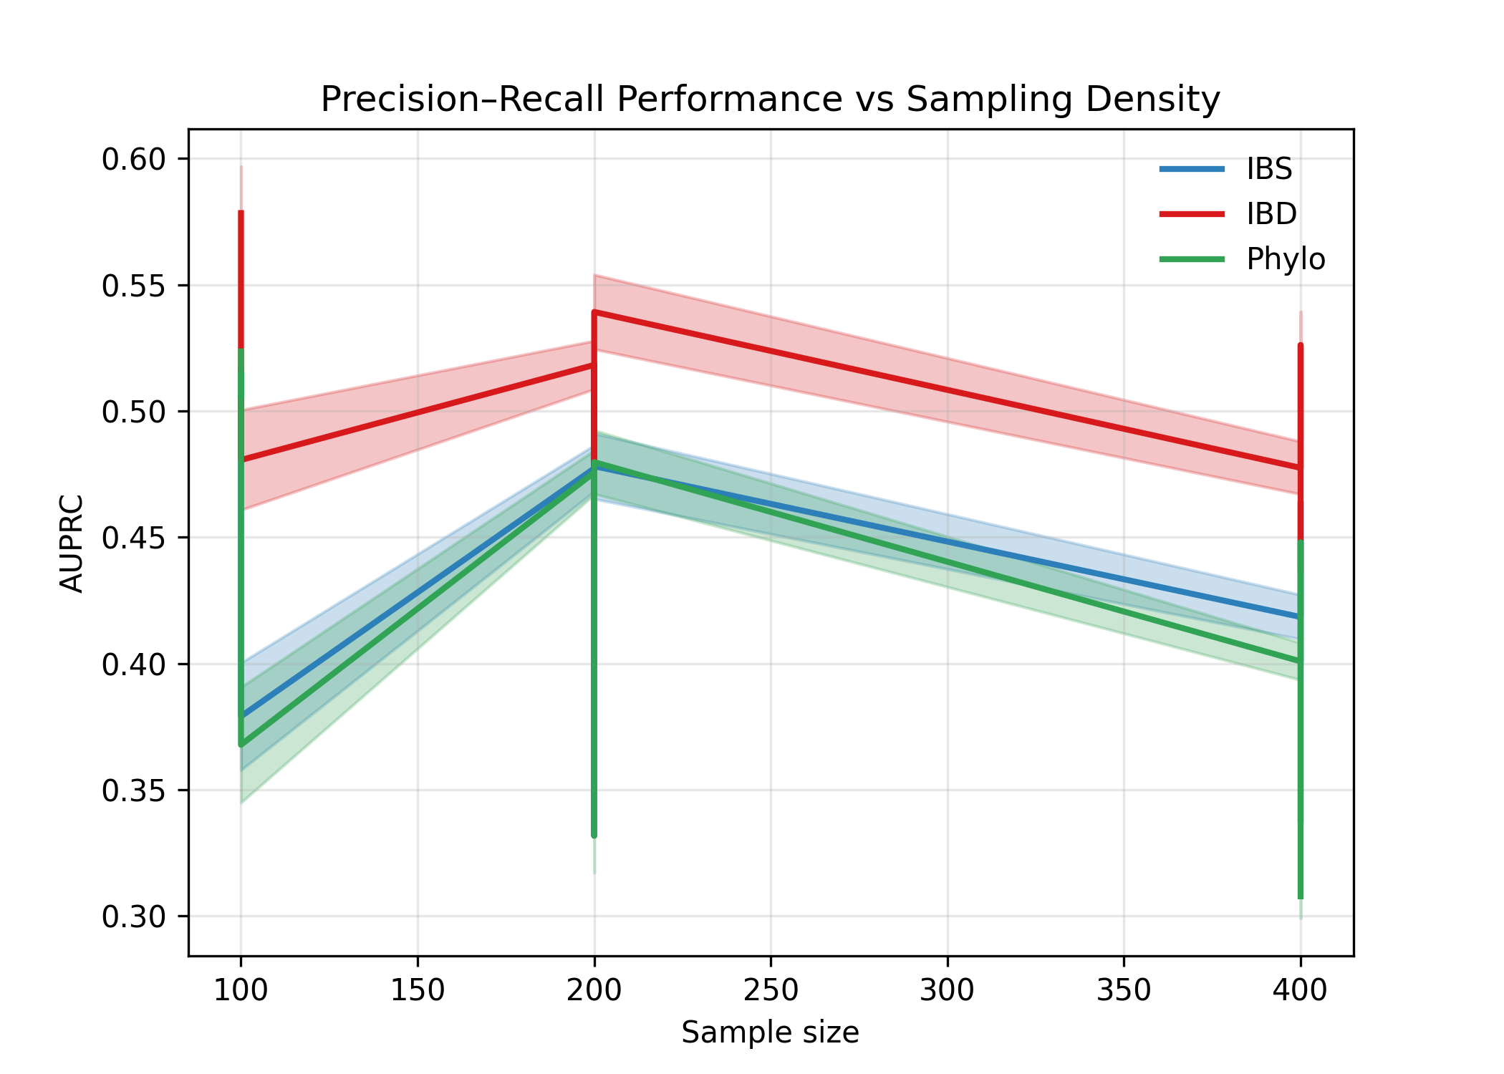
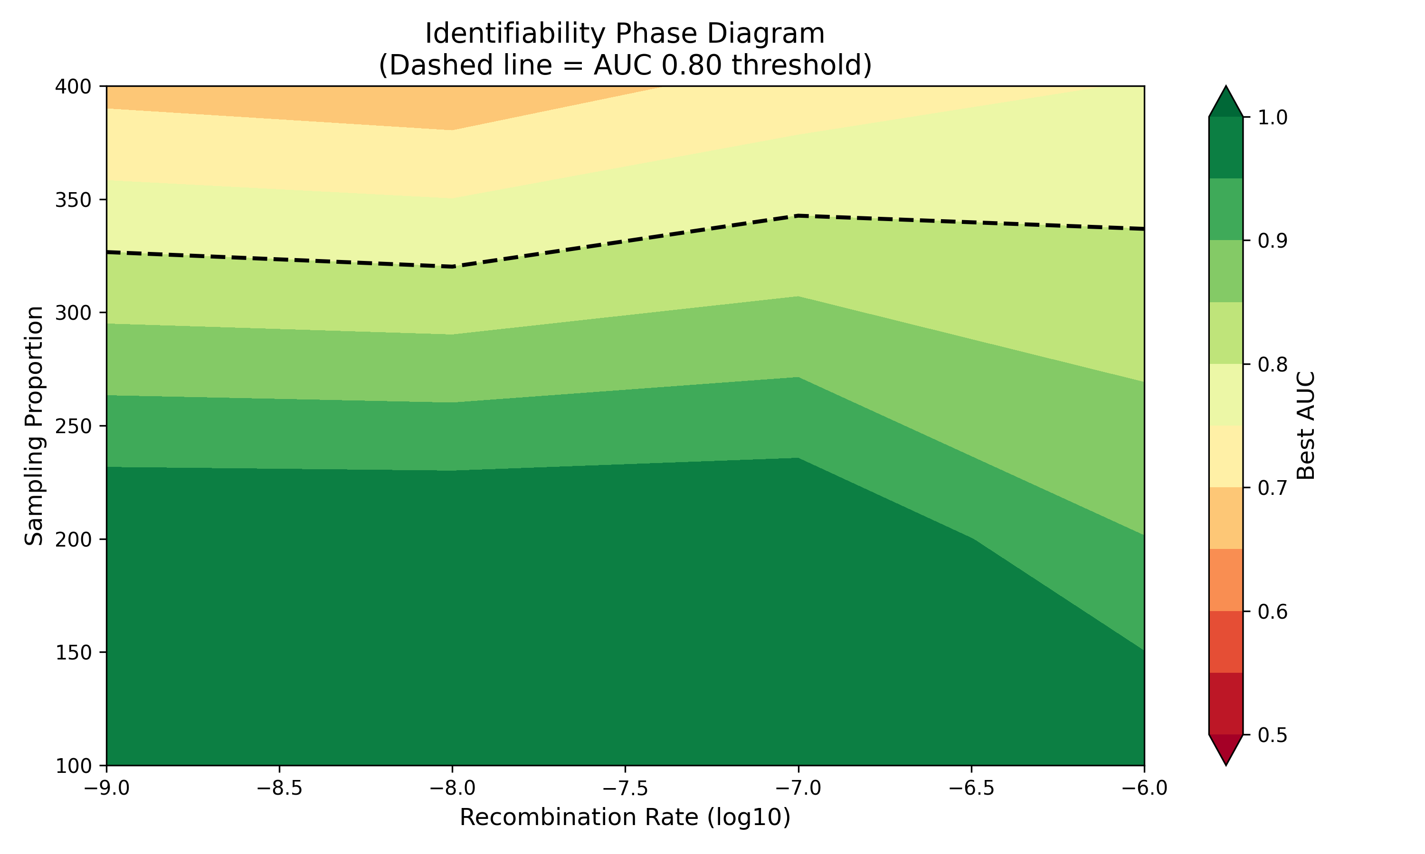

Slide 20
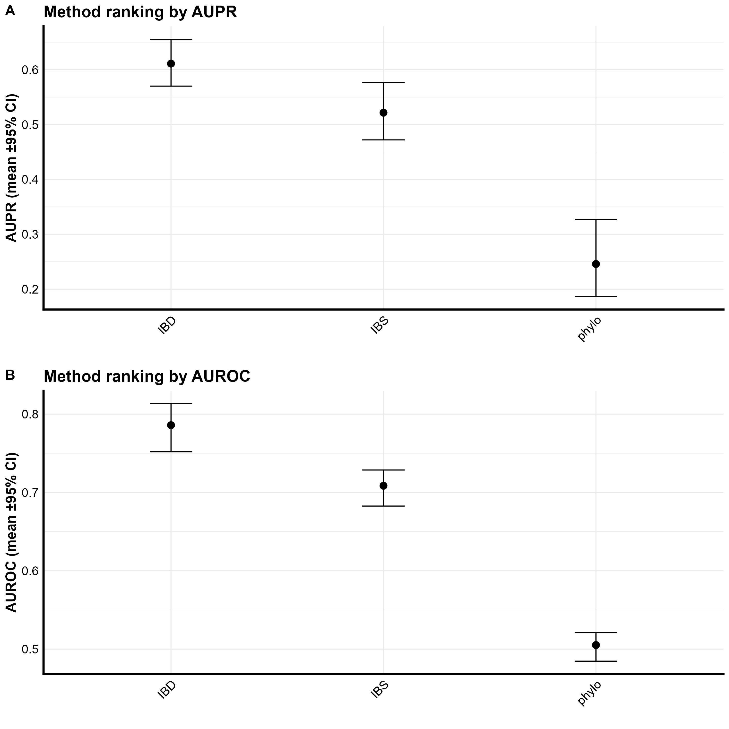
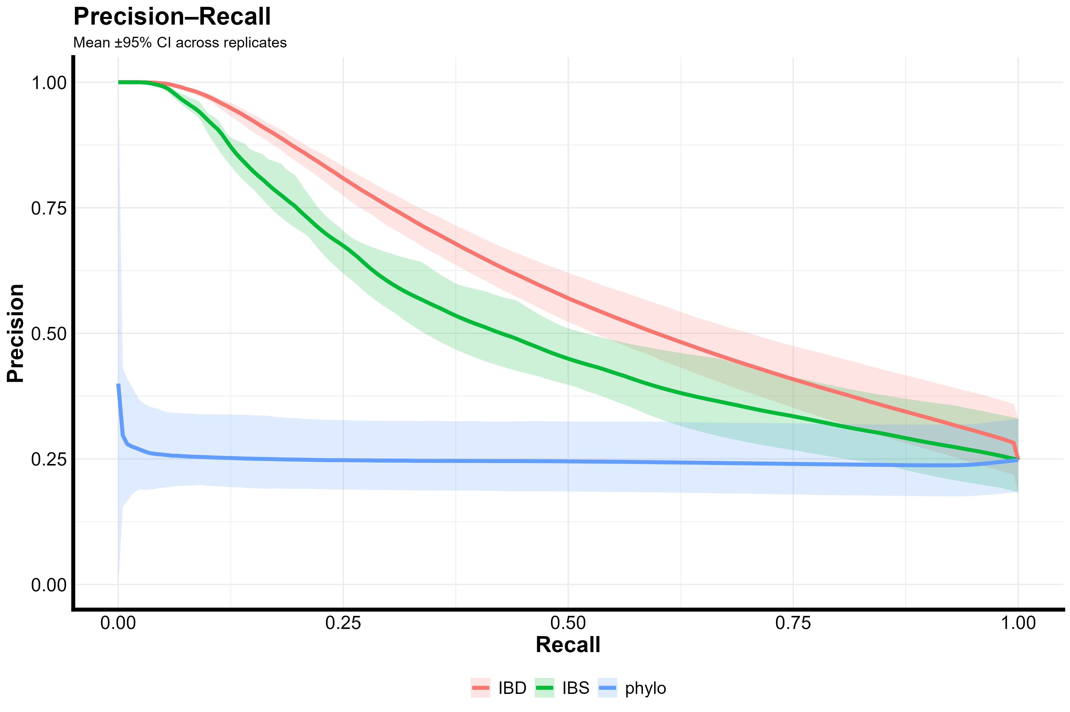

Slide 21
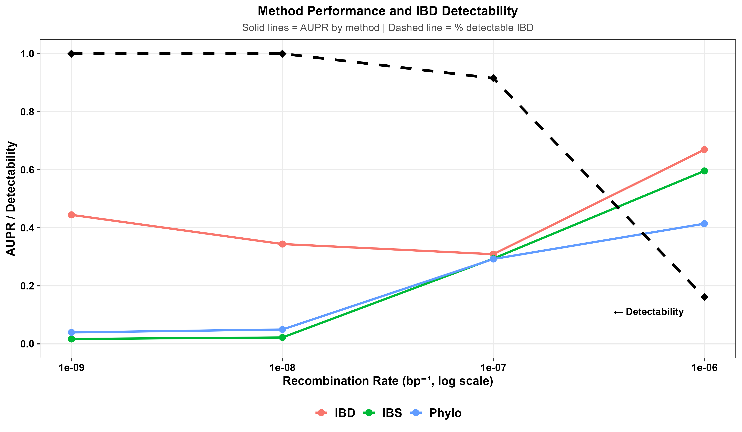

Slide 22
