Slide 1
Classifying Federal Register Documents by Type
Mark Febrizio
June 22, 2022
DATS 6103 – Summer 2022

Slide 2

What is the Federal Register?
Daily journal of the U.S. government
Print and online
4 main sections
4 document types:
Notices
Proposed Rules
Final Rules
Presidential Documents

Slide 3
The Problem: Uncategorized Documents
Particularly an issue in the 1990s data
Available data from 1994–1999:
201,591 total documents
166,031 categorized as 1 of 4 main types
32,468 lack “type” labels
Problem: Severe undercounting for analysis
Solution: use labeled documents to build classifier for document type

Slide 4
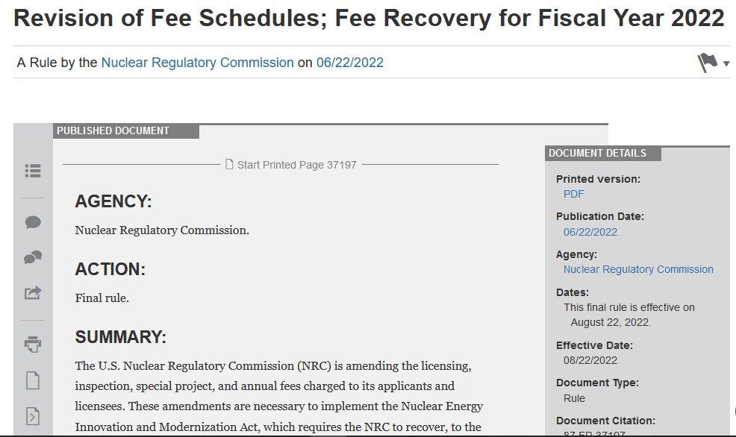

Slide 5
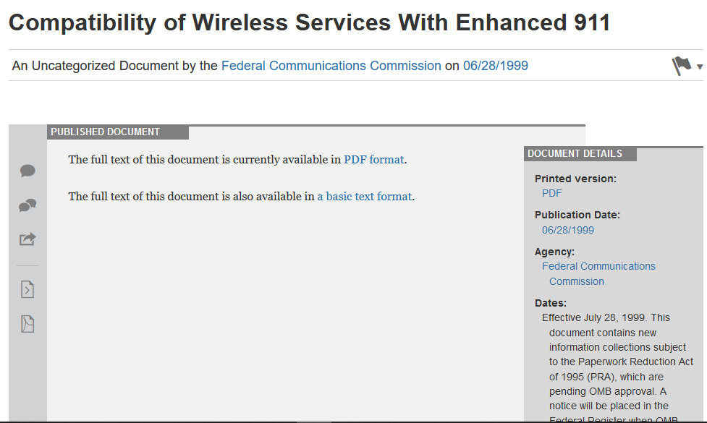

Slide 6
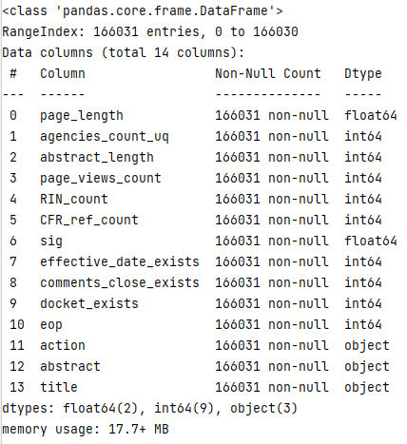
Data
Processed dataset:
166,031 documents
6 numeric variables
5 categorical variables
3 text variables

Slide 7
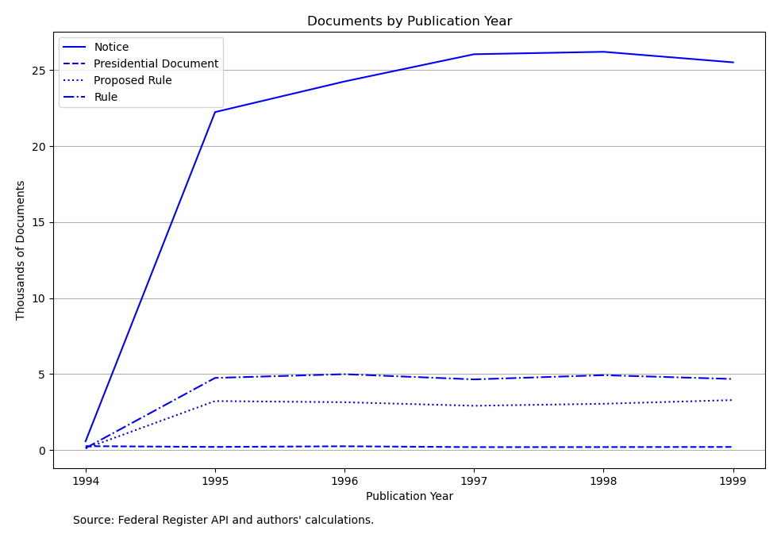

Slide 8
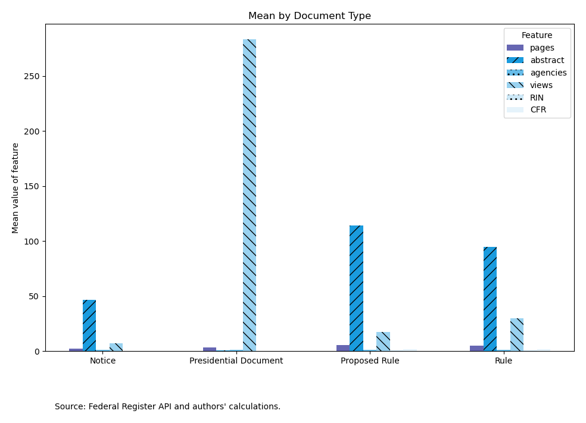

Slide 9
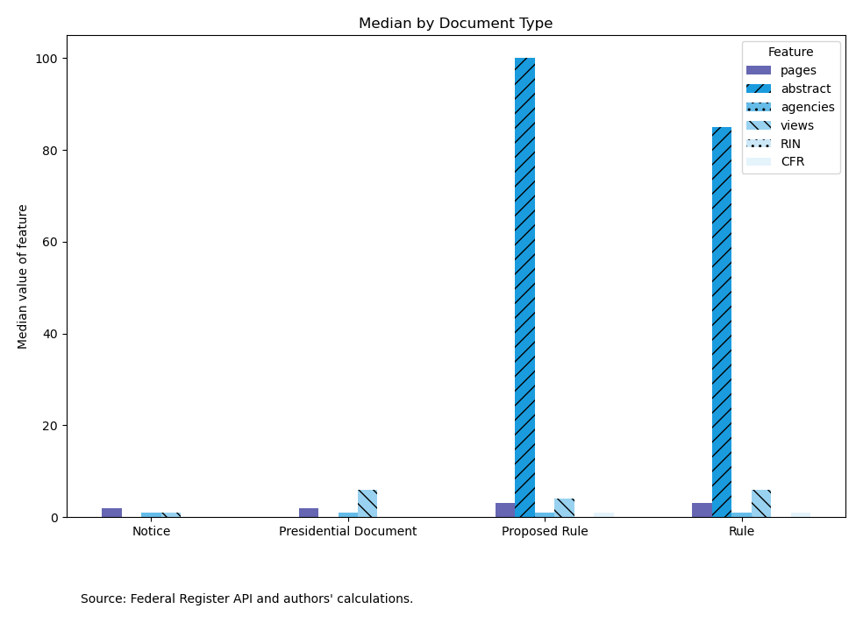

Slide 10
Preprocessing
Data cleaning
Imputing missing values
Create/extract new variables from document metadata
Numeric transformer (min-max scaler)
Categorical transformer (one-hot encoder)
Label encoder for target
Text feature extraction (tf-idf vectorizer)
Train-test split: 70%-30% (116,221 vs. 49,810)

Slide 11
Modeling
Complement Naïve Bayes (categorical and numeric)
AdaBoost (categorical and numeric)
1000 Complement NB estimators
Voting Classifier (categorical and numeric)
Complement NB
Logistic Regression (balanced weights)
KNN → grid search for k == [5, 99, 341]
Complement NB (text)
tf–idf: term-frequency * inverse document-frequency

Slide 12
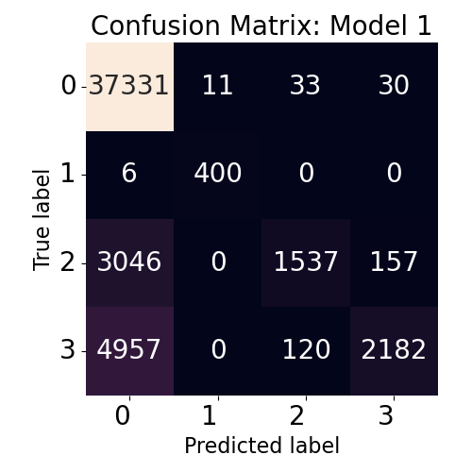
Complement NB
(categorical/numeric)

Slide 13
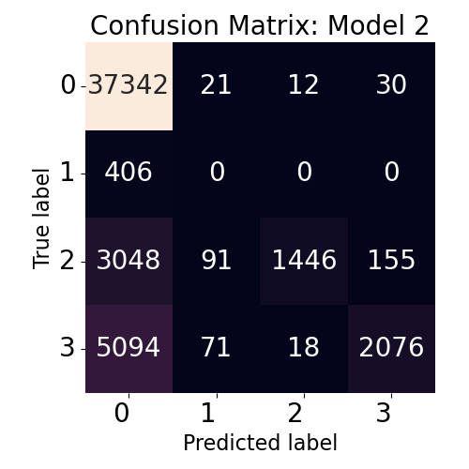
AdaBoost
(1000 NB estimators)

Slide 14
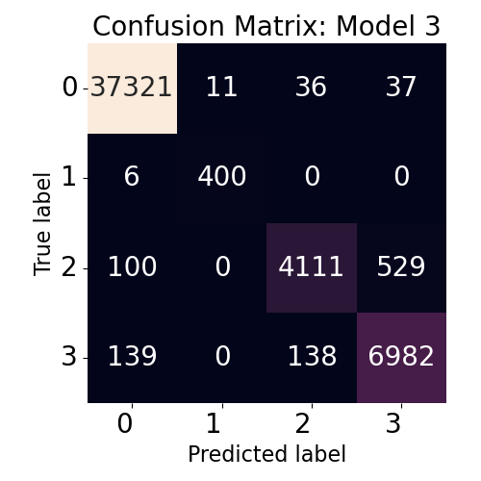
Voting Classifier
(NB, Logit, KNN)

Slide 15

Complement NB
(tf-idf vectors)

Slide 16
Model | Classifiers | Features | Accuracy | F1-Score
1 | NB | 5 categorical 6 numeric | 0.832 | 0.797
2 | Boost 1000 * NB | 5 categorical 6 numeric | 0.820 | 0.781
3 | Hard voting NB, Logit, KNN | 5 categorical 6 numeric | 0.980 | 0.979
4 | NB | 1 text | 0.969 | 0.969

Slide 17
Improvements
Consider different hyper-parameters for AdaBoost (1000x too high?)
Integrate text features with categorical/numeric features
Analyze full text of documents → tf-idf vectorizer
Clean up my code…
Any other suggestions?

Slide 18
Thank you for listening!
Questions?

