Slide 1
Exploring Diabetes and Chronic Disease Rates Across U.S. States
Maria Febus, Dung Hoang, & Sara Jahanian | Winter 2026
Background
According to the Centers for Disease Control and Prevention (2024), approximately 38 million people in the United States have diabetes, which is frequently observed alongside other chronic diseases such as cardiovascular disease and COPD. These co-occurring rates differ between states.
Motivation
The purpose of this project is to conduct an exploratory data analysis (EDA) to:
Evaluate relationships and uncover patterns between diabetes and other chronic diseases at the state level.
Provide insight into groups that are disproportionately affected and the factors driving this disparity.
Our aim is to inform and guide data scientists onboarding to this project about how we utilize data science methods to discover and share insights that can lead to the development of more effective and efficient healthcare strategies and policies to better serve the individuals in our society.
Questions
What chronic diseases are associated with higher diabetes prevalence at the state level?
Which state-level socioeconomic factors ( such as income, employment, and insurance access), and local characteristics are most strongly associated with diabetes prevalence across U.S. states?
Scope
Population: Adults 18 and over
Timeframe: 2022
Location: U.S. States
State-Level Metrics: 2022 U.S. Census Data
Chronic Diseases Covered: Diabetes, obesity, asthma, arthritis, and chronic obstructive pulmonary disease (COPD) rates
Granularity: One row per U.S. State
Notes:
which state-level socioeconomic factors (such as income, emploiyment, and insurance access) are most

Slide 2
Data Sources
Primary Dataset: US Chronic Disease Indicators
The primary dataset is the CDC’s 2022 Chronic Disease Indicators. This dataset is hosted by the Division of Population Health in the US Centers for Disease Control and Prevention (CDC) and contains indicators and metrics that are related to chronic disease.
“These indicators allow states and territories to uniformly define, collect, and report chronic disease data that are important to public health practice in their area.” (CDC, 2025)
Important Variable: a question (or indicator) and measure (such as mean, count, or proportion) for each chronic disease, U.S. state, and a stratification category to split by sex or race/ethnicity.
Secondary Dataset: Census Demographic Data- ACS
The American Community Survey is a census that provides annual data on US people and households. The United States Census Bureau offers an interface containing census data where users can select measures of interest and download the Data Profiles. The dataset includes only responses from the 2022 Census survey.
“Data Profiles contain the most popular social, economic, housing, and demographic data for a single geographic area.“ (US Census, 2022)
Important Variables: U.S. state and estimate values of socioeconomic metrics (population, income, insurance status, employment status, and work transportation method).
Location | https://catalog.data.gov/dataset/u-s-chronic-disease-indicators
Format | Comma-separated values (CSV)
Access Method | The data is available for download in different formats. We have chosen to download CSV formatted data.
Records | ~84.0 MB (309,215 rows)
Location | https://data.census.gov/table
Format | Comma-separated values (CSV)
Access Method | The data is available for download in different formats. We have chosen to download CSV formatted data.
Records | ~1 MB (150,000 rows)

Slide 3
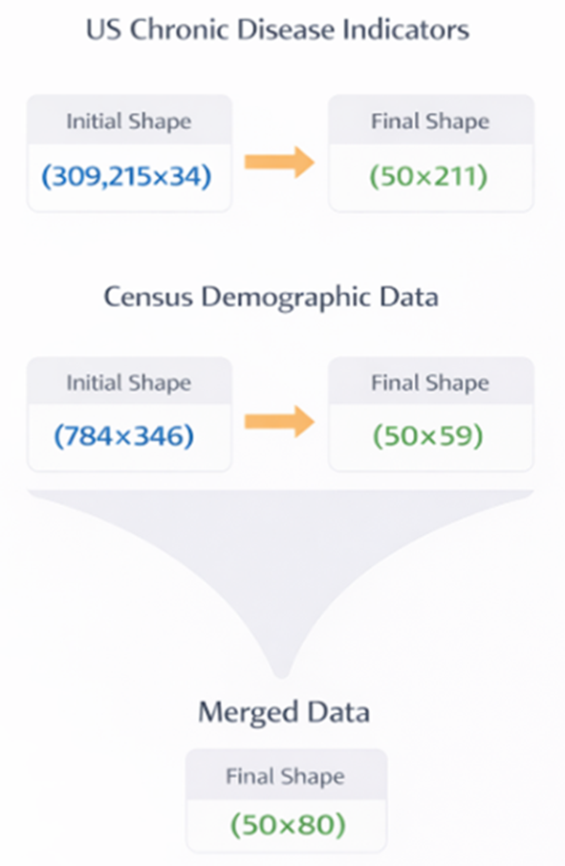
Data Cleaning & Manipulation
US Chronic Disease Indicators - CDC
Filter values to year, chronic diseases, data type, and U.S. states of interest.
Update the values in the 'Question' column to readable names that reflect each chronic disease.
Select the chronic disease columns of interest.
Rename the 'State' column for the future join.
Process each stratification (overall, sex, race/ethnicity) by pivoting the data so each chronic disease has a single column.
Merge processed data frames together.
Census Demographic Data - ACS
Census Data is from the Year 2022 survey.
Add and populate a “State” column with the appropriate state names.
Remove all empty columns (37) and rows (392).
Split the dataset into state-level and city-state-level data, retaining only the state-level dataset for further processing.
Separate the state-level data into Estimate and Margin of Error datasets and retain only the estimate data.
Removed Census locations that do not align with the scope of the project.
Guam, District of Columbia, Puerto Rico, United States, and Virgin Islands
Filtered the dataset to include only columns of interest (59)
Convert all values to numeric data types.
Merge Data
Perform a merge on the Final U.S. Chronic Disease Indicator and Census Demographic datasets on “State” with an outer join. Each row represents one U.S. state and the corresponding chronic disease and census metrics.
Notes:
For this project we used design a modular Jupyter notebook structure. The notebook main.ipynb is used to run the workflow and connect everything together.
In this setup, data_loader.py handles data input/output, data_wrangler.py performs data clearing and transformations, and visual.py contains plotting and visualization functions.
This approach makes the notebooks cleaner, improves code reuse, and makes the project easier to maintain and test.

Slide 4
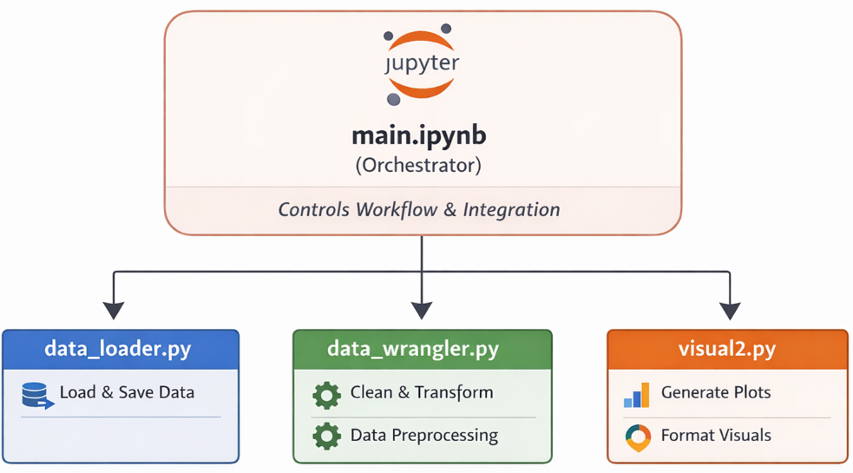
Data Cleaning & Manipulation
Data Transformations
Incomplete Data
Fields with missing data were identified and removed. The majority of these fields were estimates for underrepresented populations of specific races and ethnicities such as (but not exclusive to) Hispanic, Asian, and Pacific Islander. We made the decision to continue with the analysis without splitting by race and ethnicity and removed the corresponding columns. However, this observation uncovered potential bias in the data, as specific groups of individuals are systematically excluded.
Filtering and Structuring Data
To focus the analysis on the six subgroups of interest for each diabetes-social factor metric, we created a column-selection that subsets the master combined DataFrame to only the relevant fields. This transformation reduces the dataset to the targeted subgroup and specific measures by filtering out nonessential columns.
Adjusting Metrics with Total Population Fields
In order to maintain a consistent population of adults only and monitor the relative percentages, population fields within the census data were leveraged to calculate total populations for certain metrics that started as percentages of a subgroup. This standardizes the relative metrics and allows each metric to be directly compared to diabetes prevalence across states.
Modular Structure
This approach makes the notebooks cleaner, improves code reuse, and makes the project easier to maintain and test.

Slide 5
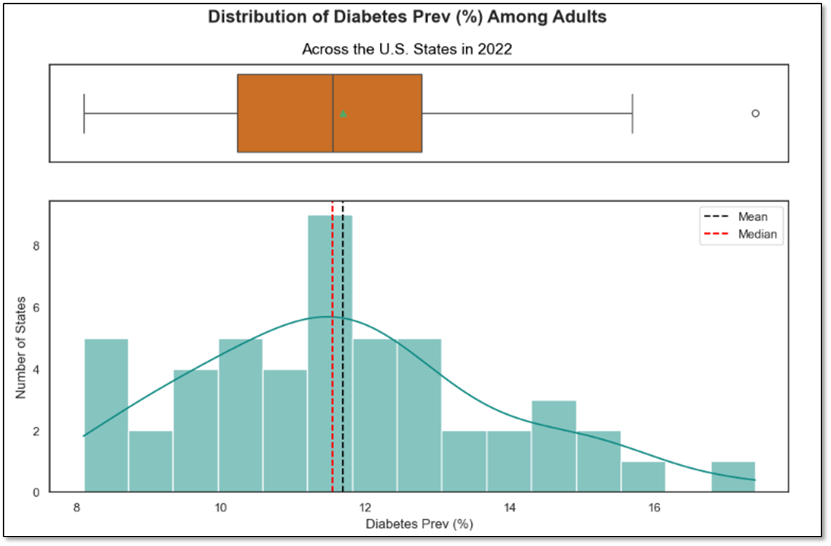
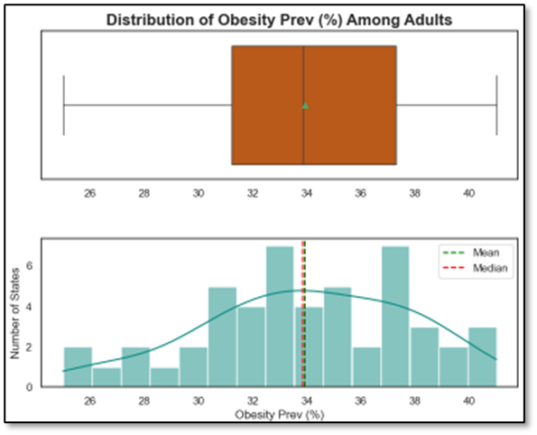
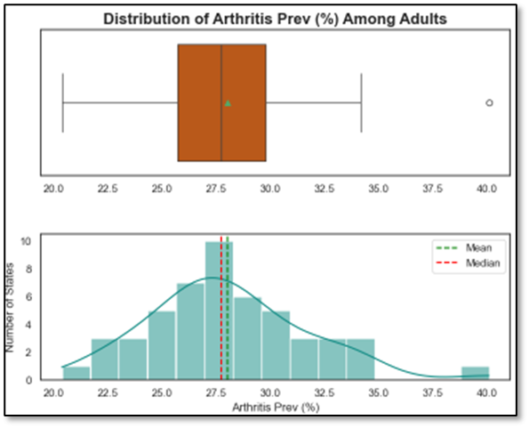
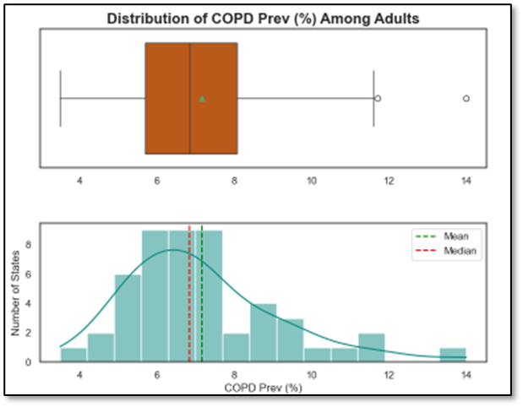
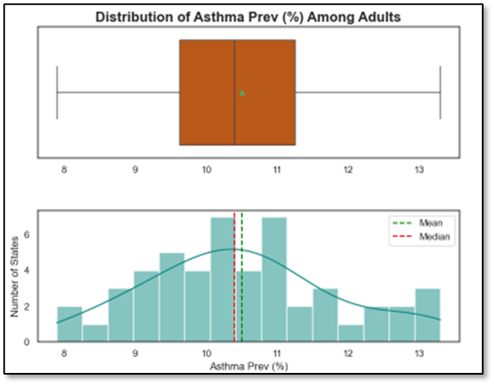
Univariate Insights - Diabetes and Other Chronic Diseases
Diabetes Prevalence
The boxplot illustrates that approximately 75% of states have a diabetes rate higher than 10%. The histogram depicts the distribution is slightly right-skewed, suggesting that while most states cluster around similar prevalence levels, a small number of states exhibit substantially higher diabetes rates.
Outliers
Univariate analyses of other chronic diseases compared with diabetes prevalence showed that some distributions are skewed and contain outliers. These outliers are critical points in the data because they indicate there are states with anomalies; these particular states may be of interest in future research, so they are included in the EDA.

Slide 6
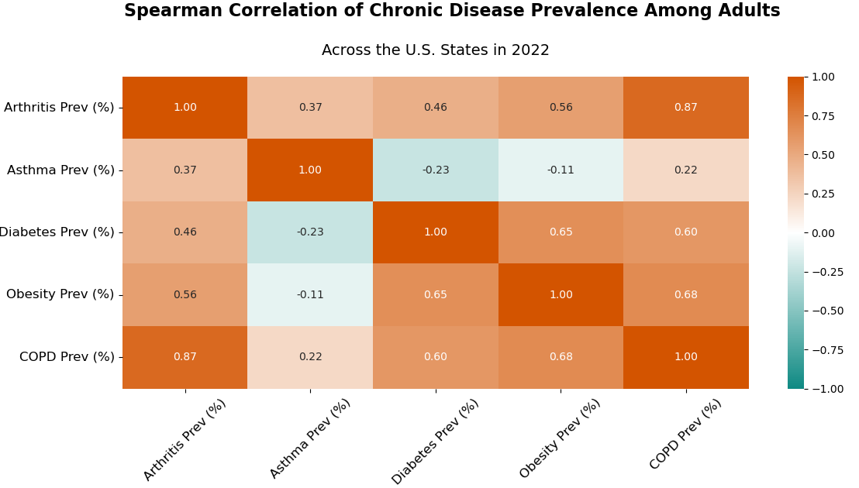
Diabetes and other Chronic Disease Correlations
Observations
The heatmap displays the correlations between each chronic disease. The scope of this project focuses on specifically the correlations with diabetes prevalence (middle column). This investigates our first research question regarding chronic disease rates that are observed with higher diabetes prevalence.
The Spearman Correlation Coefficient was used to account for the monotonic relationship between diabetes and other chronic diseases. In addition, Spearman is more robust to skewed distributions and outliers, which we observed during our univariate analysis.
Obesity and COPD have moderate to strong correlations with diabetes, indicating states with higher obesity or COPD prevalence also tend to exhibit higher diabetes prevalence.
Asthma and arthritis have weak to no correlations with diabetes prevalence. Further analyses may show these relationships change in different subgroups; for the purpose of this project, we will continue our investigation into diabetes trends by including only obesity and COPD prevalence.

Slide 7
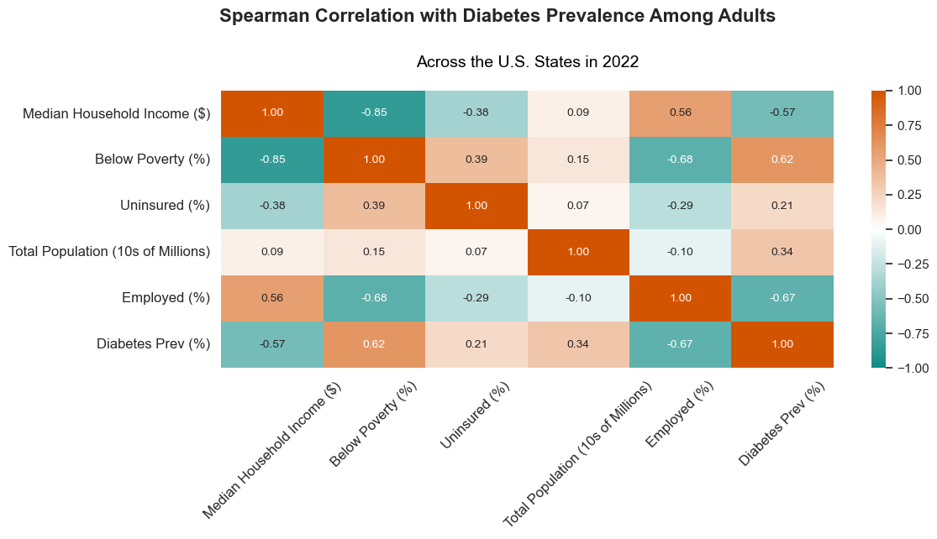
Diabetes and Socioeconomic Metric Correlations
Observations
The correlations between socioeconomic metrics and diabetes prevalence are displayed in the bottom row.
The Spearman Correlation Coefficient was used again for these comparisons.
This begins to investigate our second research question regarding chronic disease rates and the socioeconomic metrics that are observed in tandem.
Percent of individuals employed has a moderate to strong negative correlation with diabetes prevalence. This indicates that states with a higher percentage of employed individuals tend to have a lower diabetes prevalence.
Percent of individuals below poverty has a moderate to strong positive correlation with diabetes prevalence. A state with a higher percentage of individuals below poverty also tends to have a high diabetes prevalence.
This suggests that states where the average individual makes more money may have better diabetes and COPD outcomes.

Slide 8
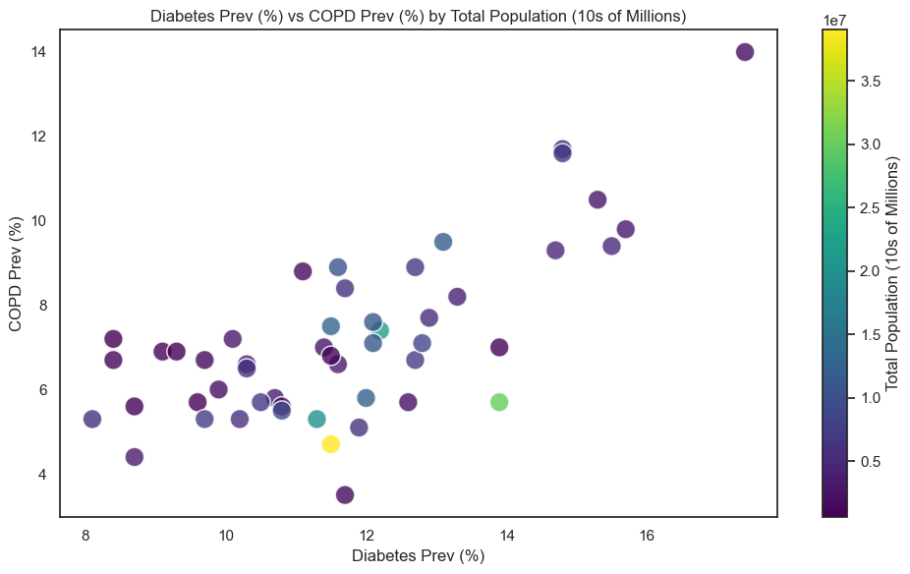
Diabetes and COPD Trends Across Population
Observations
The scatterplot shows diabetes prevalence vs COPD prevalence and colors by state population in tens of millions.
States with higher populations are indicated with lighter colors. These observations are not clustered in a specific space, and the varying populations are scattered across the chart.
Conclusion
Overall, the scatter plot indicates that diabetes and COPD have a consistent correlation across states. States with bigger population have a similar diabetes and COPD prevalence trend to smaller states. This implies that that population size does not strongly change the relationship between these two conditions.

Slide 9
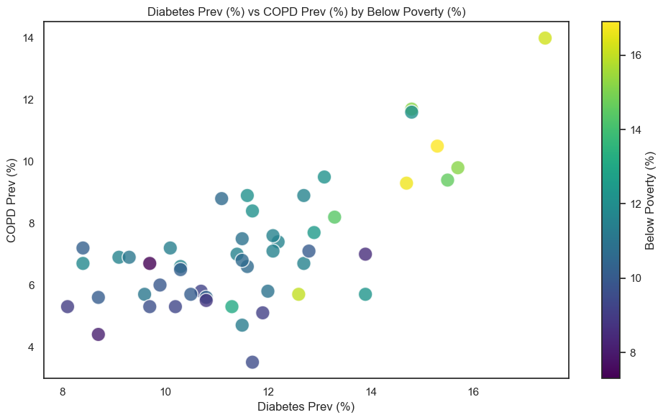
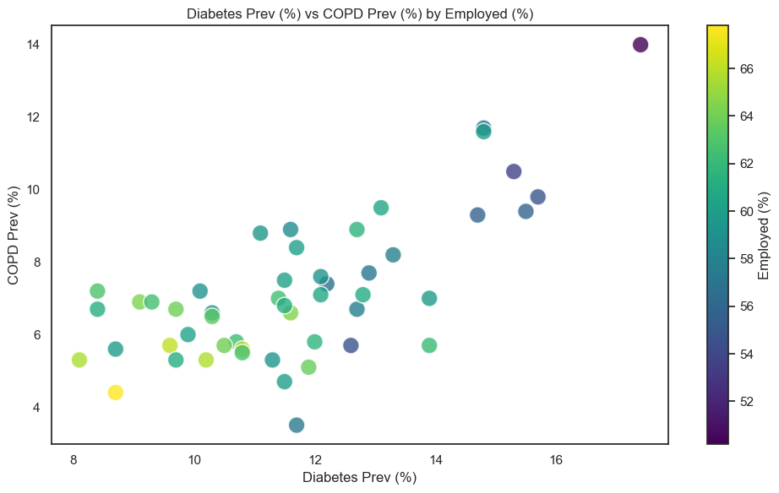
Diabetes and COPD Trends Across Employment and Poverty Rates
Observations
The two scatter plots show diabetes vs COPD prevalence. The top plot is colored by percent below poverty, and the bottom plot is colored by percent employed.
States with a higher percentage of employed individuals are clustered in the bottom left corner showing low rates of diabetes at the same time as low rates of COPD. The opposite trend is displayed for percentage below poverty; states with lower percentage of individuals below poverty tend to have lower prevalence of diabetes and COPD.
Conclusion
Diabetes and COPD tend to increase together across states. This pattern stays consistent when we add socioeconomic factors like employment and poverty. States with higher employment rates generally have lower levels of both diabetes and COPD, while states with higher poverty levels tend to have higher rates of both conditions. This suggest that the socioeconomic conditions play an important role in where diabetes and COPD are more common.

Slide 10
Ethical Considerations
Representative Data Bias
The chronic disease data from the CDC reports on cases of particular diagnoses, but not all cases are documented. Certain demographics may be systematically excluded from the data;
Low-income individuals may be less likely to see a doctor to receive a diagnosis because they cannot afford it, or households in rural areas may not have healthcare close enough.
The census data is survey-based; only individuals and households who responded to the survey are included. While the bureau makes an effort to reach as much of the population as possible, not everyone is counted and not all questions are answered.
The limitations regarding disproportionate representation in both of these datasets will have to be accounted for with methods such as the use of confidence intervals, splitting into subsets of more complete populations, or narrowing the scope of the project.
Risk of Resulting Decisions
When decisions are made in the interest of providing access to quality healthcare, policy makers and medical professionals need to thoroughly understand the scope of the data, who is represented, and who will be impacted positively or negatively. By performing exploratory data analysis on healthcare data, we run the risk of these administrators making decisions about healthcare systems based on the results, without addressing the existing bias and variance as listed above. In order to avoid the chance of discrimination, we need to be clear about what the data and resulting analyses represent, especially if it will be used for predictive modeling and additional research questions in the future.
Metric Estimations
The sources of both datasets use models to estimate the metrics. While some metrics include confidence intervals in the data that can be utilized for more accurate results, the modeling behind the estimates is unknown.
Protected Attributes
Some of the fields we are including in our exploratory data analysis are protected attributes, such as race and sex. This means they are legally guarded against discrimination, and we are required to take precautions to eliminate the risk. We can use tools such as the FairLens package in python to assess and visualize bias related to these protected classes and where it exists in our data. The results of the assessment can guide our understanding and impact regarding these attributes in our data.
Personal Health Records
Health records contain exceptionally sensitive data, even if they are de-identified. While our health and diagnoses data is aggregated to the state-level, it still originated from personal health records. Our data contains little to no risk of systematically identifying individuals because it is not granular, but it is still necessary to continue the conversation about the patients that the data represents, even on a high-level.
Notes:
Limitations
I’d suggest highlighting the limitations around having state level data only
State-Level Granularity
Metric Estimations
The sources of both datasets use models to estimate the metrics. While some metrics include confidence intervals in the data that can be utilized for more accurate results, the modeling behind the estimates is unknown.
Unbiased Data
Conclusion
Answers question and next steps

Slide 11
Statement of Work and References
Maria Febus
Conducted exploratory data analysis (EDA), including univariate, bivariate, and multivariate analysis. Developed visualizations, such as bar plots and histograms, to analyze distributions, and heatmaps, to identify correlations between chronic disease outcomes and state-level attributes. Performed data cleaning, handling missing values, and ensuring data quality for reliable analysis. Managed project activities by developing timelines and tracking progress against milestones.
Dung Hoang
Established the GitHub repository and designed the Python-based workflow, including a primary main.ipynb notebook supported by modular .py files for data ingestion, wrangling, and visualizations. He also developed the end-to-end data cleaning scripts for the US Census data, created the data merger script integrating the U.S. Census and Chronic Disease data, and defined the overall data processing flow.
Sara Jahanian
Identified the two datasets required for the project (U.S. Census and Chronic Disease) and applied her domain expertise to determine the appropriate data subsets needed to meet project objectives. She also developed scripts to clean and transform the U.S. Chronic Disease dataset, preparing it for a format suitable for integration with the U.S Census data and visual creation.
References
U.S. Census Bureau. American Community Survey (ACS) 2022, Data Profile DP03. Retrieved January 26, 2026, from https://data.census.gov/table .
Centers for Disease Control and Prevention. 2025. U.S. Chronic Disease Indicators (CDI). Retrieved January 26, 2026, from https://catalog.data.gov/dataset/u-s-chronic-disease-indicators.
Centers for Disease Control and Prevention. (2024). A report card: Diabetes in the United States. https://www.cdc.gov/diabetes/communication-resources/diabetes-statistics.html

