Slide 1
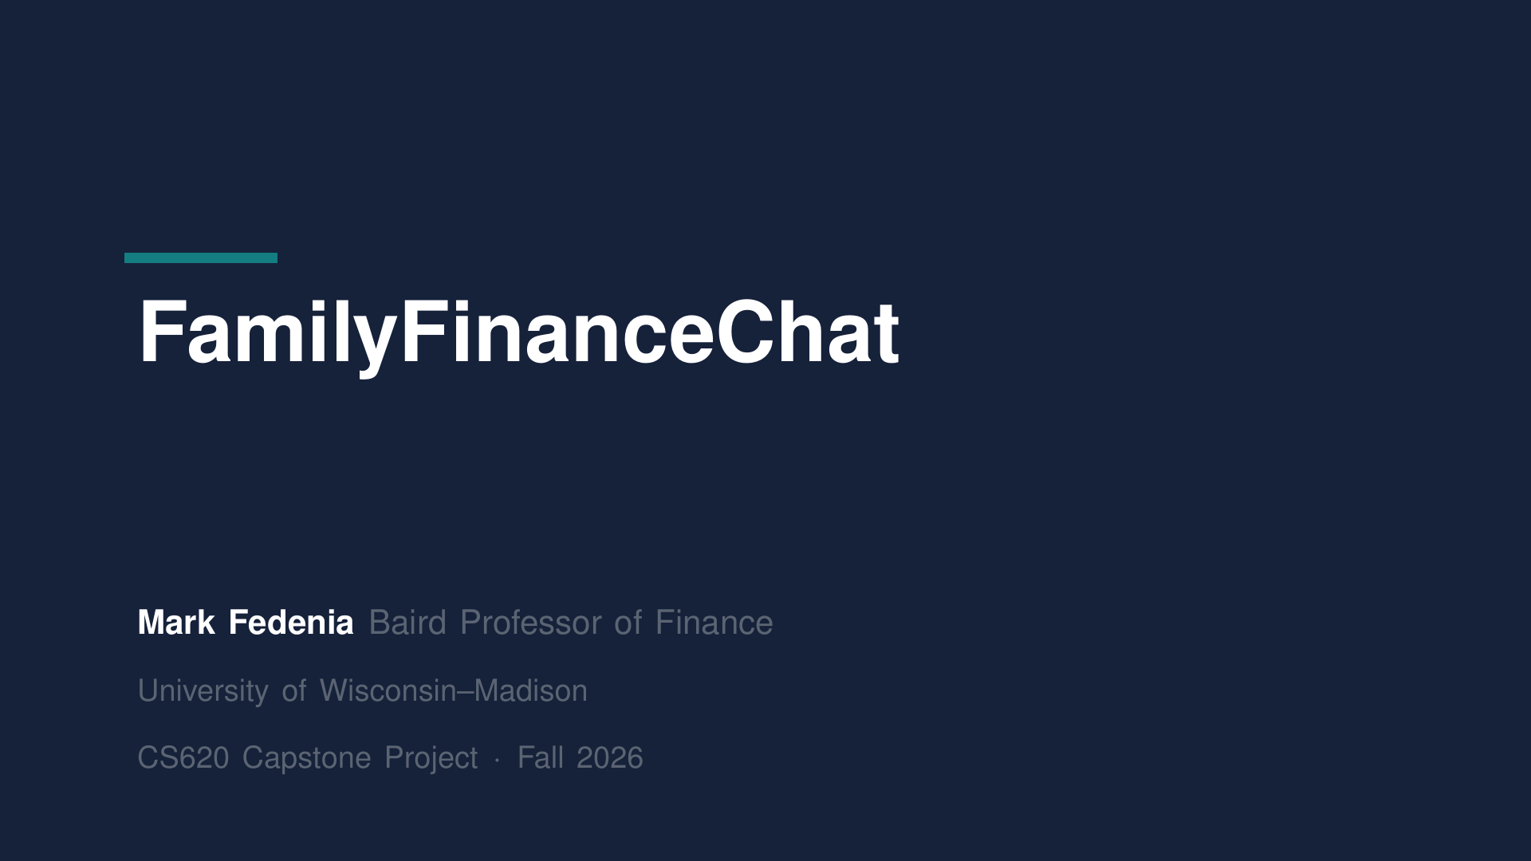
Notes:
Hi there.

Slide 2
Notes:
I'm Mark Fedeenia. I teach finance at Wisconsin, and I want to show you something my students use, and where I'd like to take it next.

Slide 3
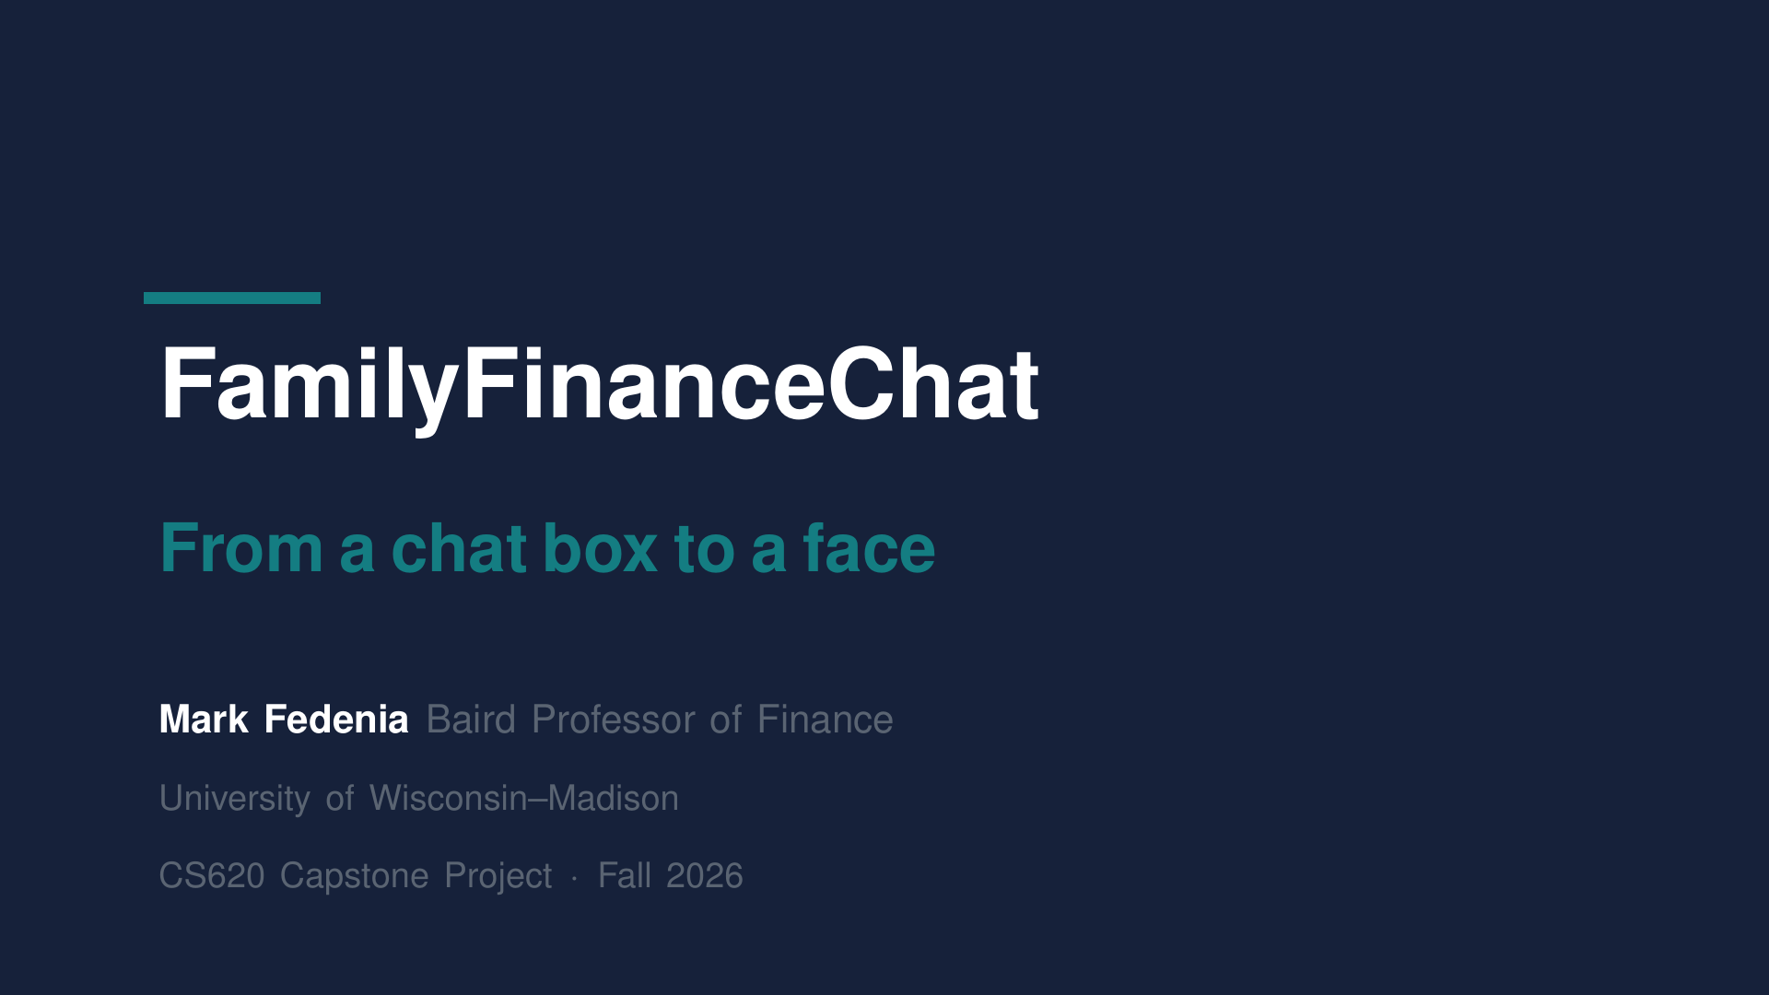
Notes:
It's called Family Finance Chat, and right now it's a chat box. By the end of this project, I want it to be a face you talk to.

Slide 4
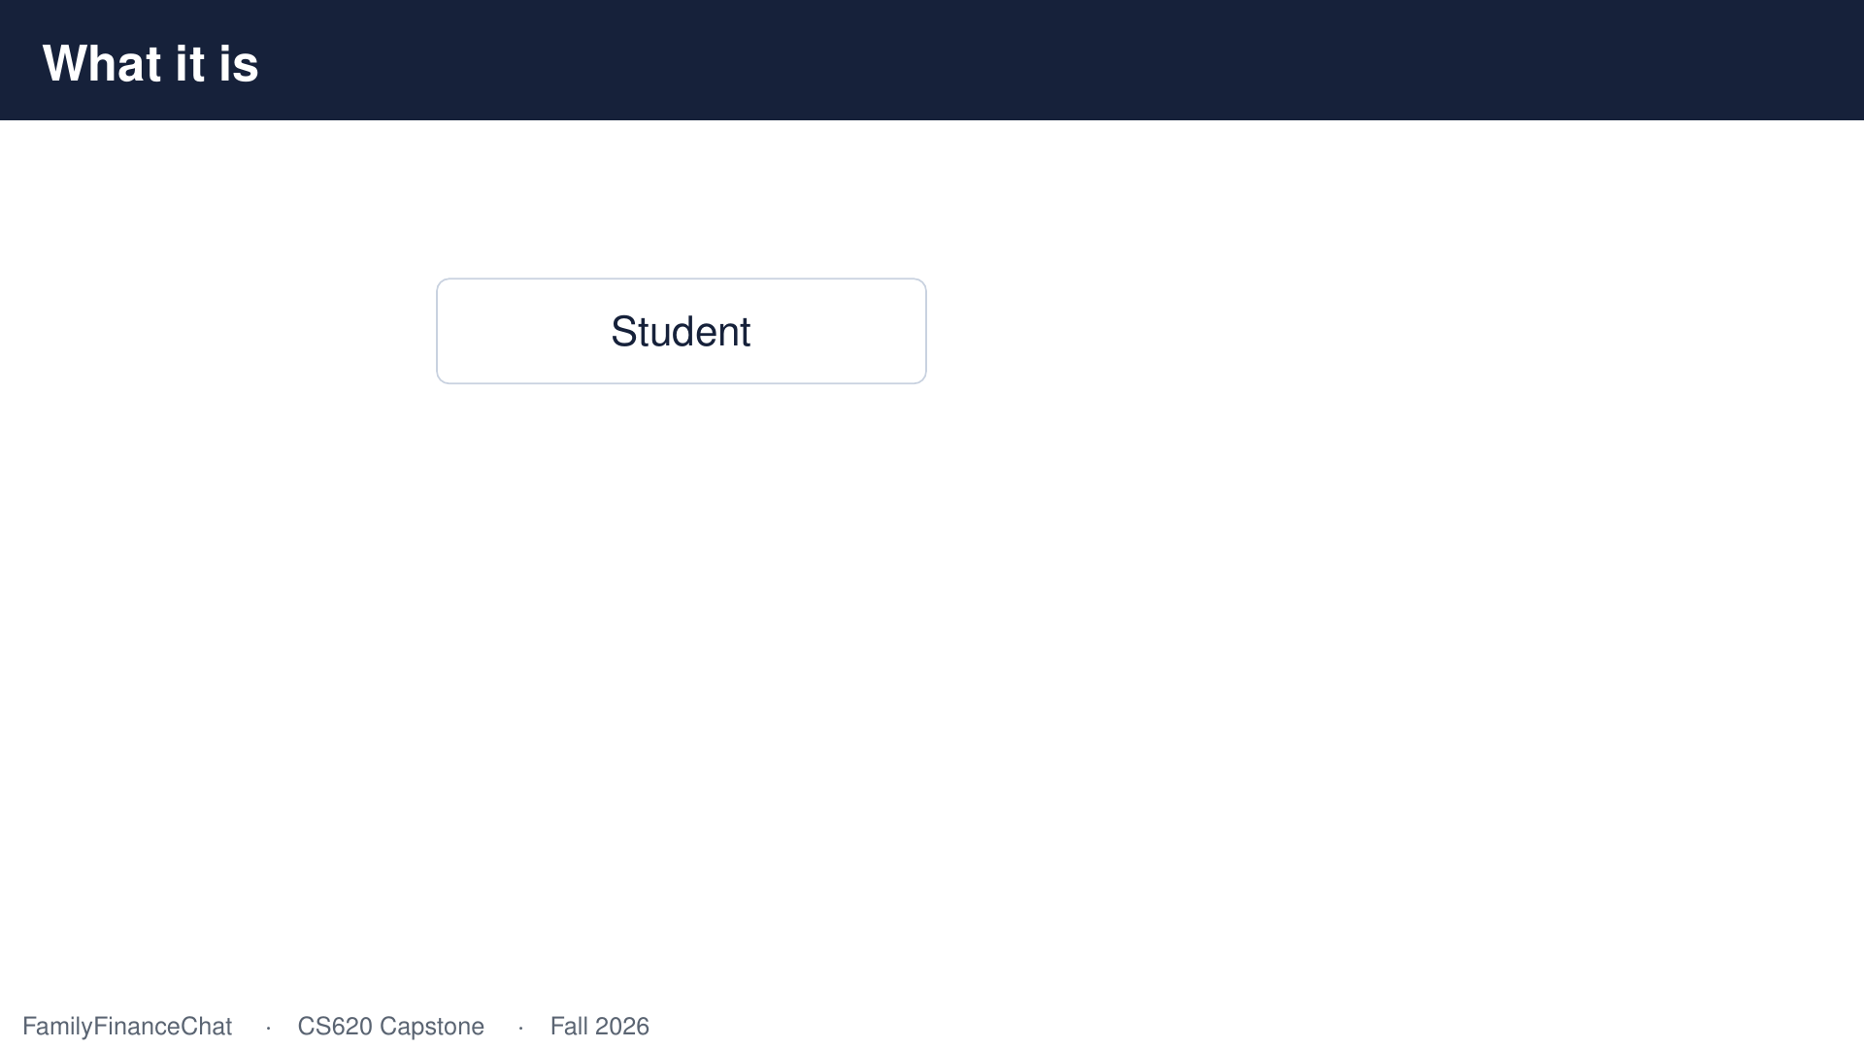
Notes:
Here's the problem I'm trying to solve. My students are learning to advise families about money, and the hard part isn't the arithmetic.

Slide 5
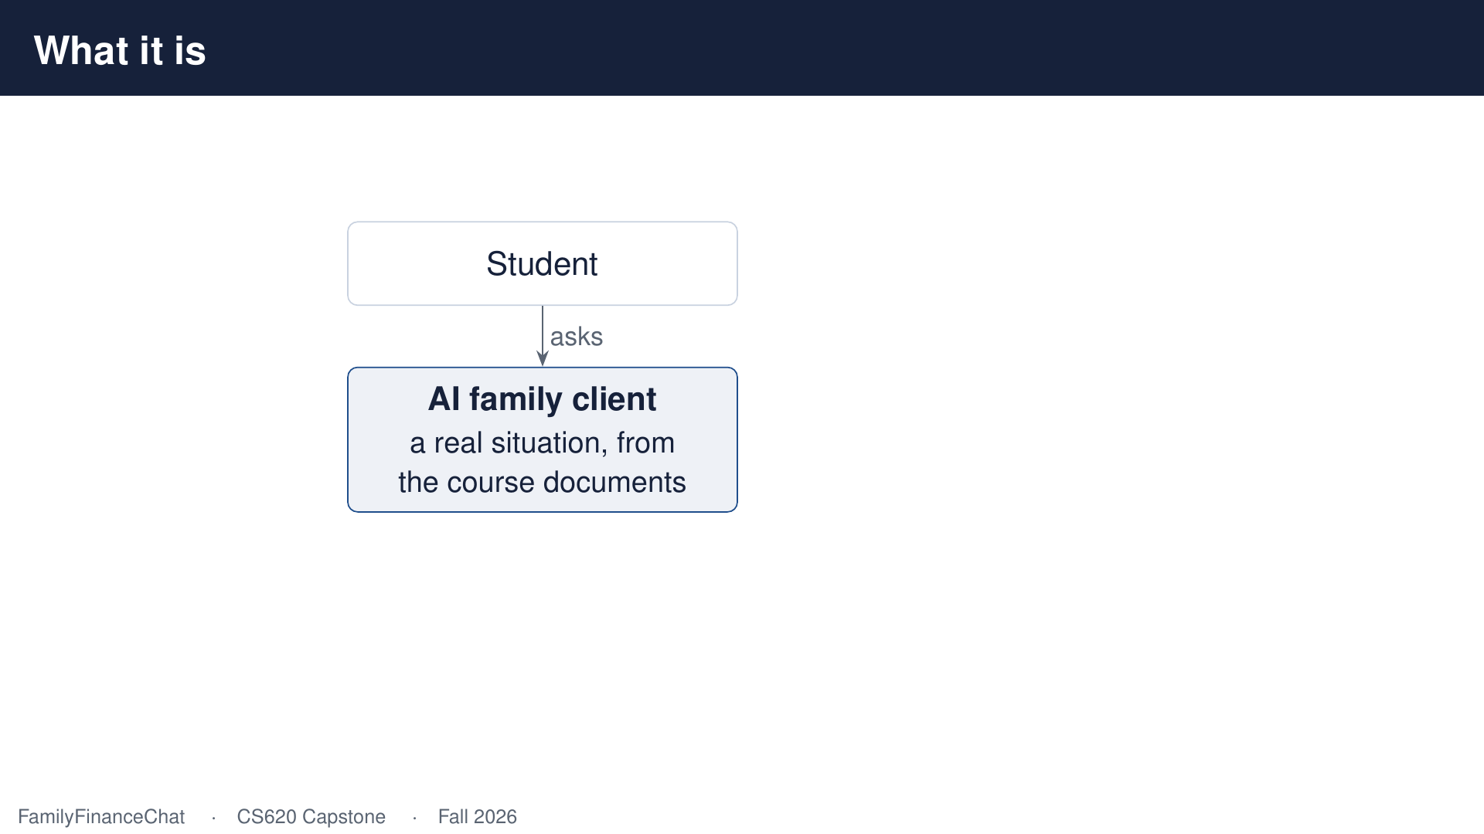
Notes:
It's sitting across from people and asking uncomfortable questions well. So we built them somebody to practise on. An A-I family with a real financial situation, taken from the course material, so it doesn't make things up.

Slide 6
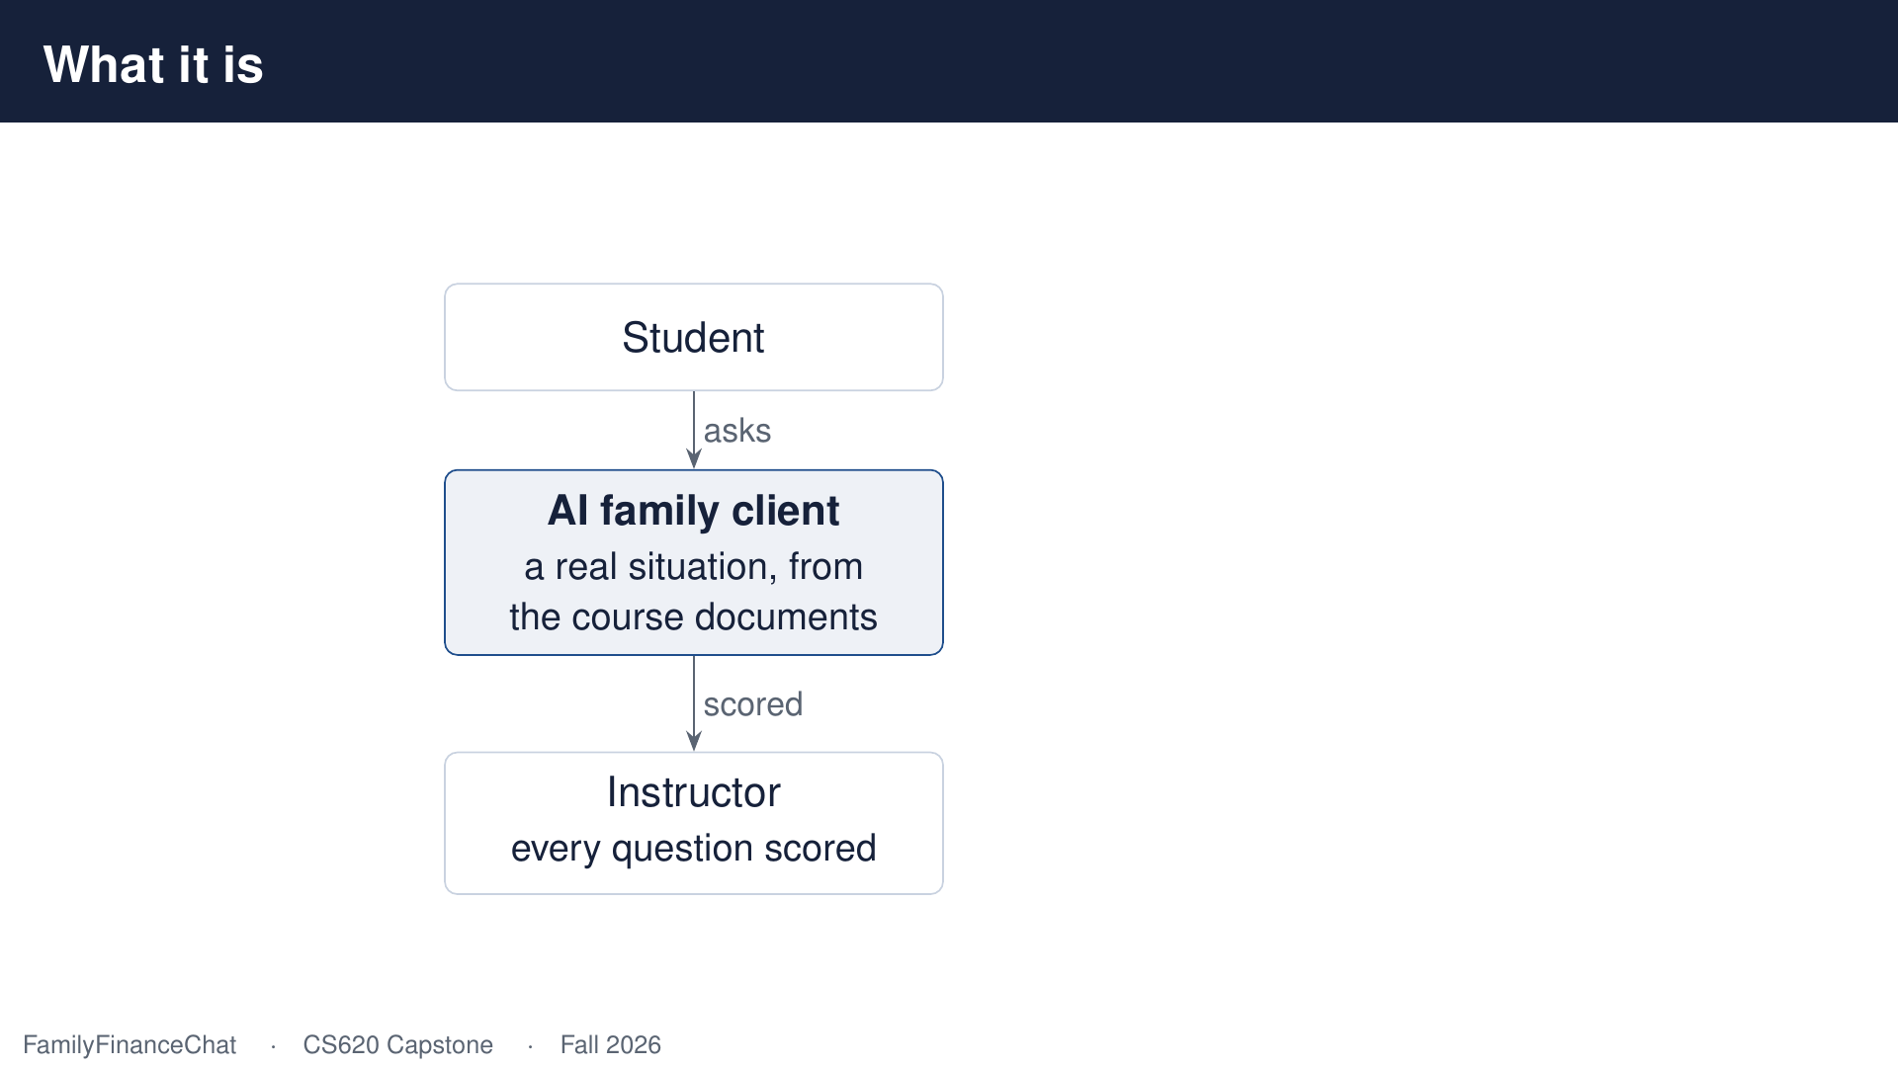
Notes:
And because every question gets scored automatically, I can see how forty students are doing without reading forty transcripts.

Slide 7
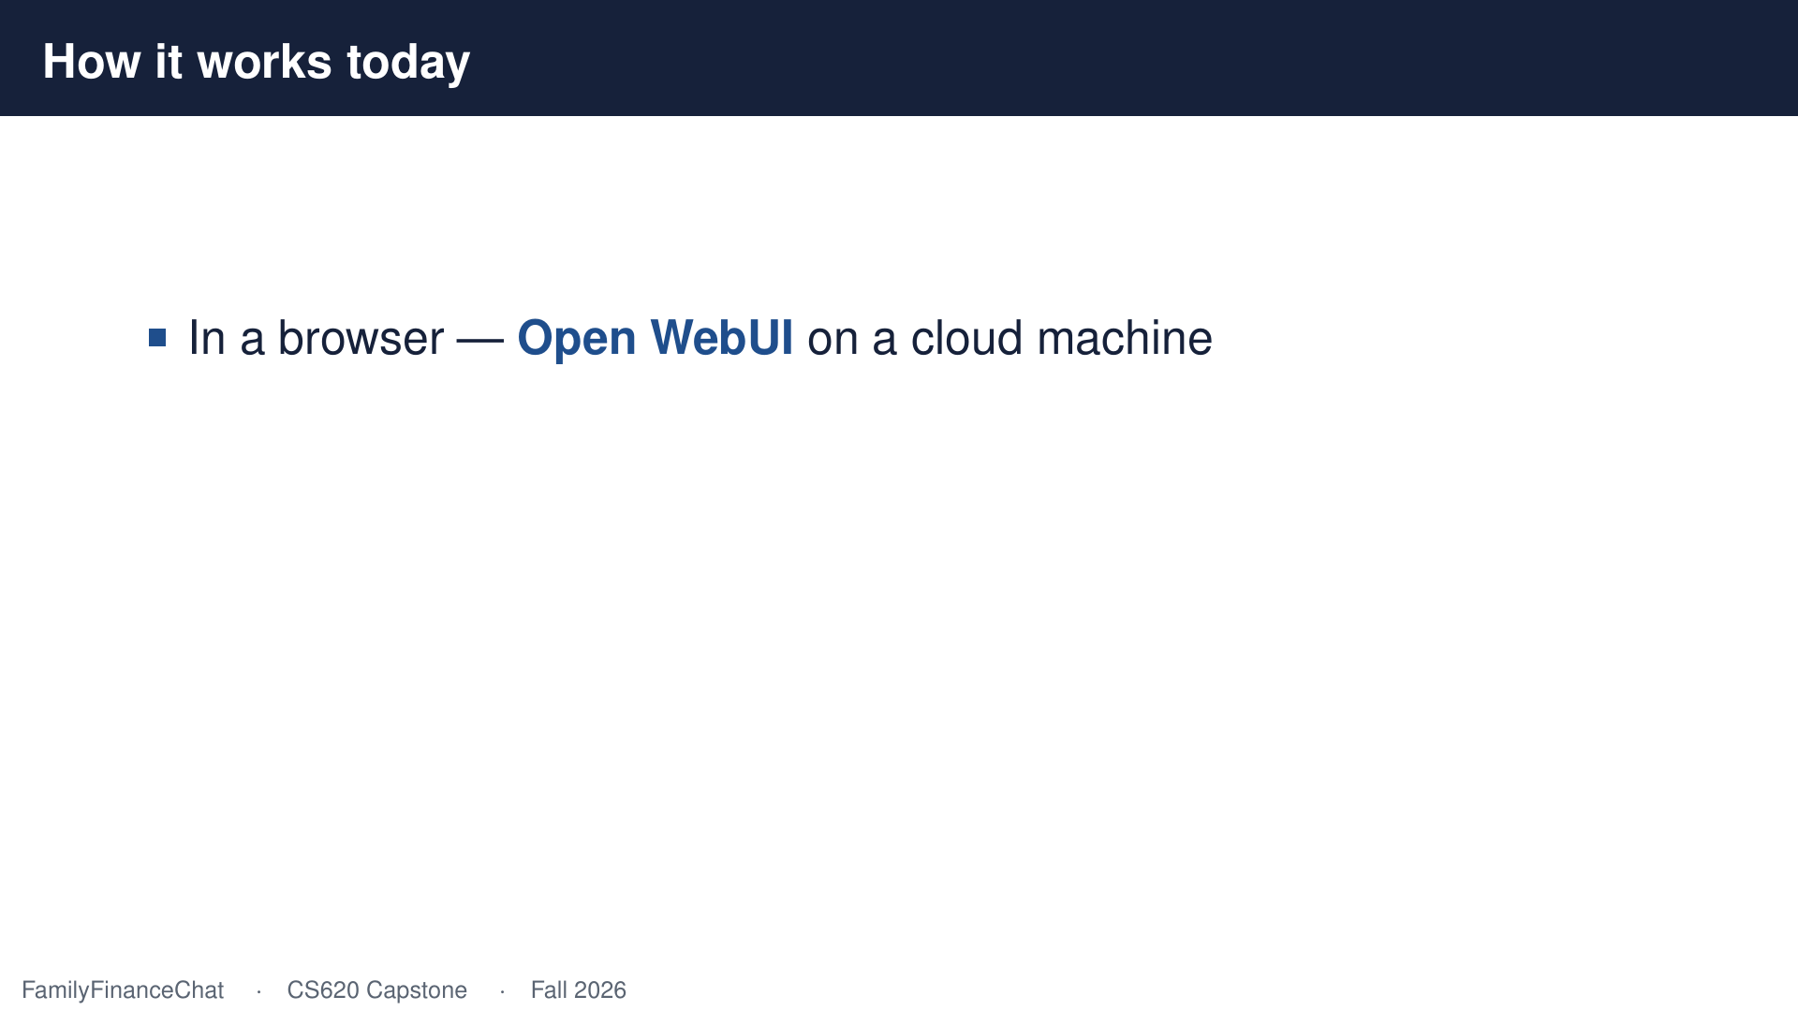
Notes:
Today the whole thing lives in a browser, on a cloud machine, built on an open source platform called Open Web U-I.

Slide 8
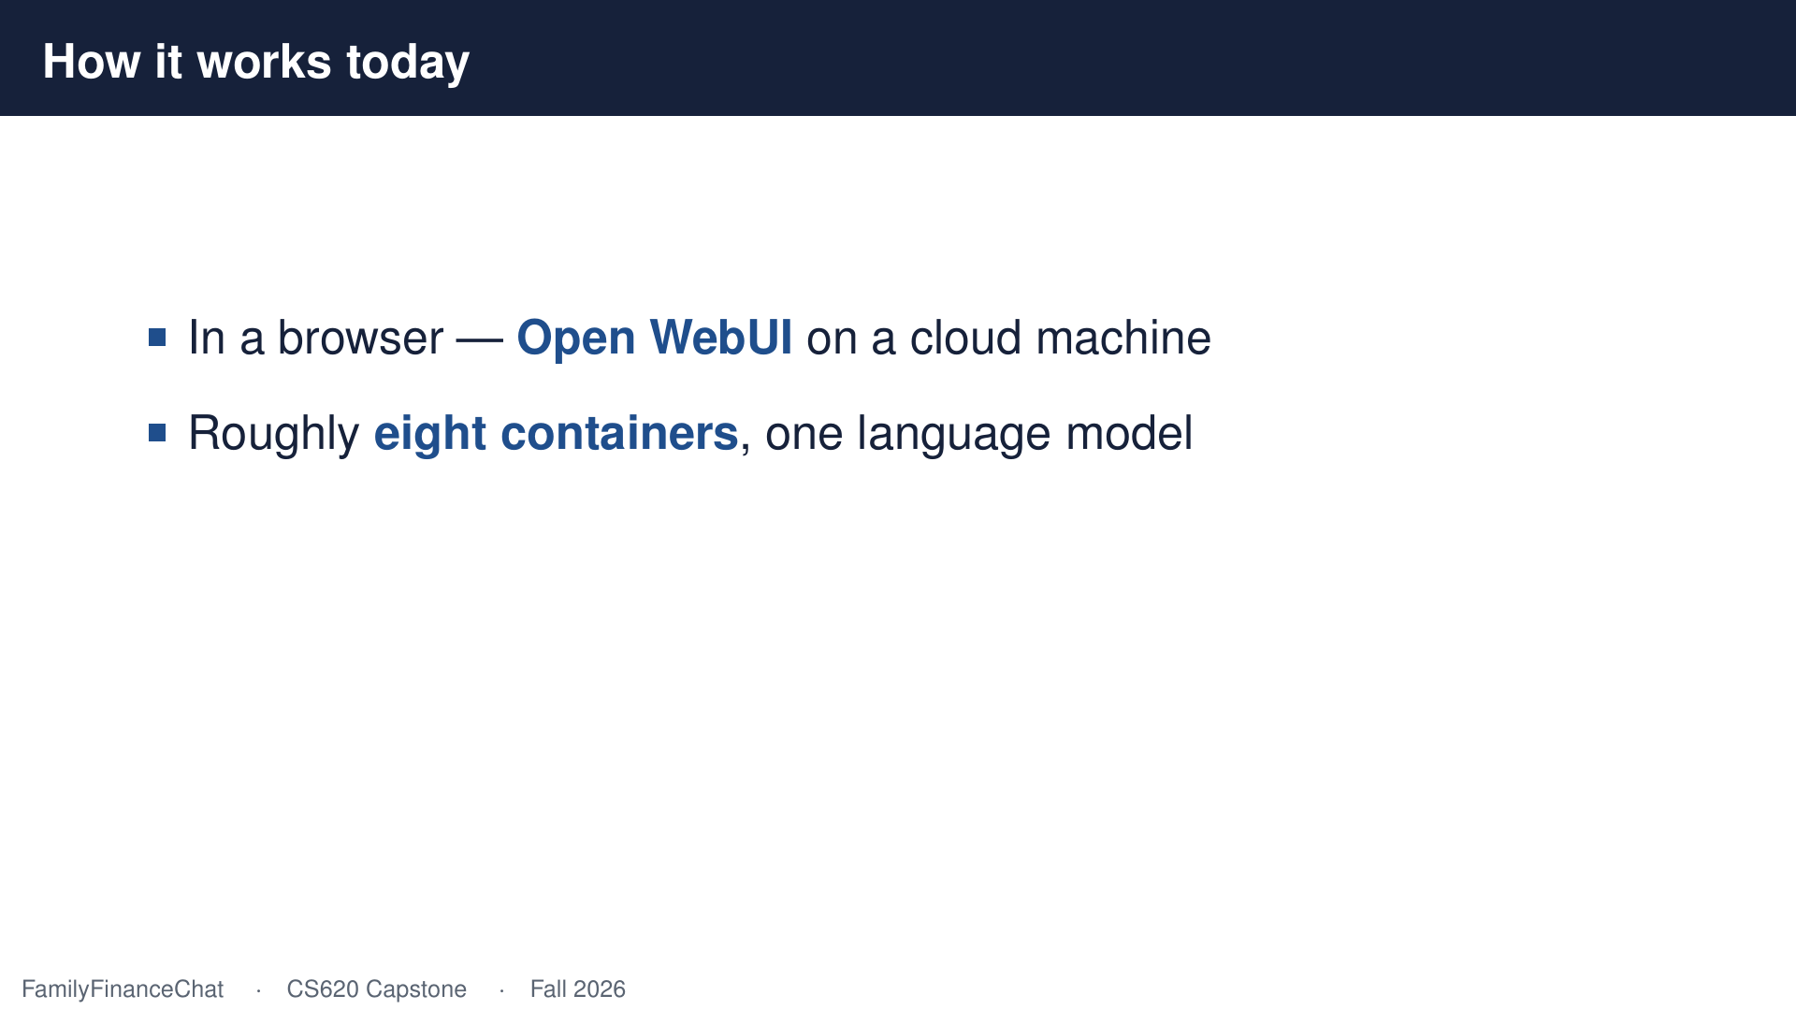
Notes:
Underneath there are about eight moving parts, and one language model doing the talking.

Slide 9
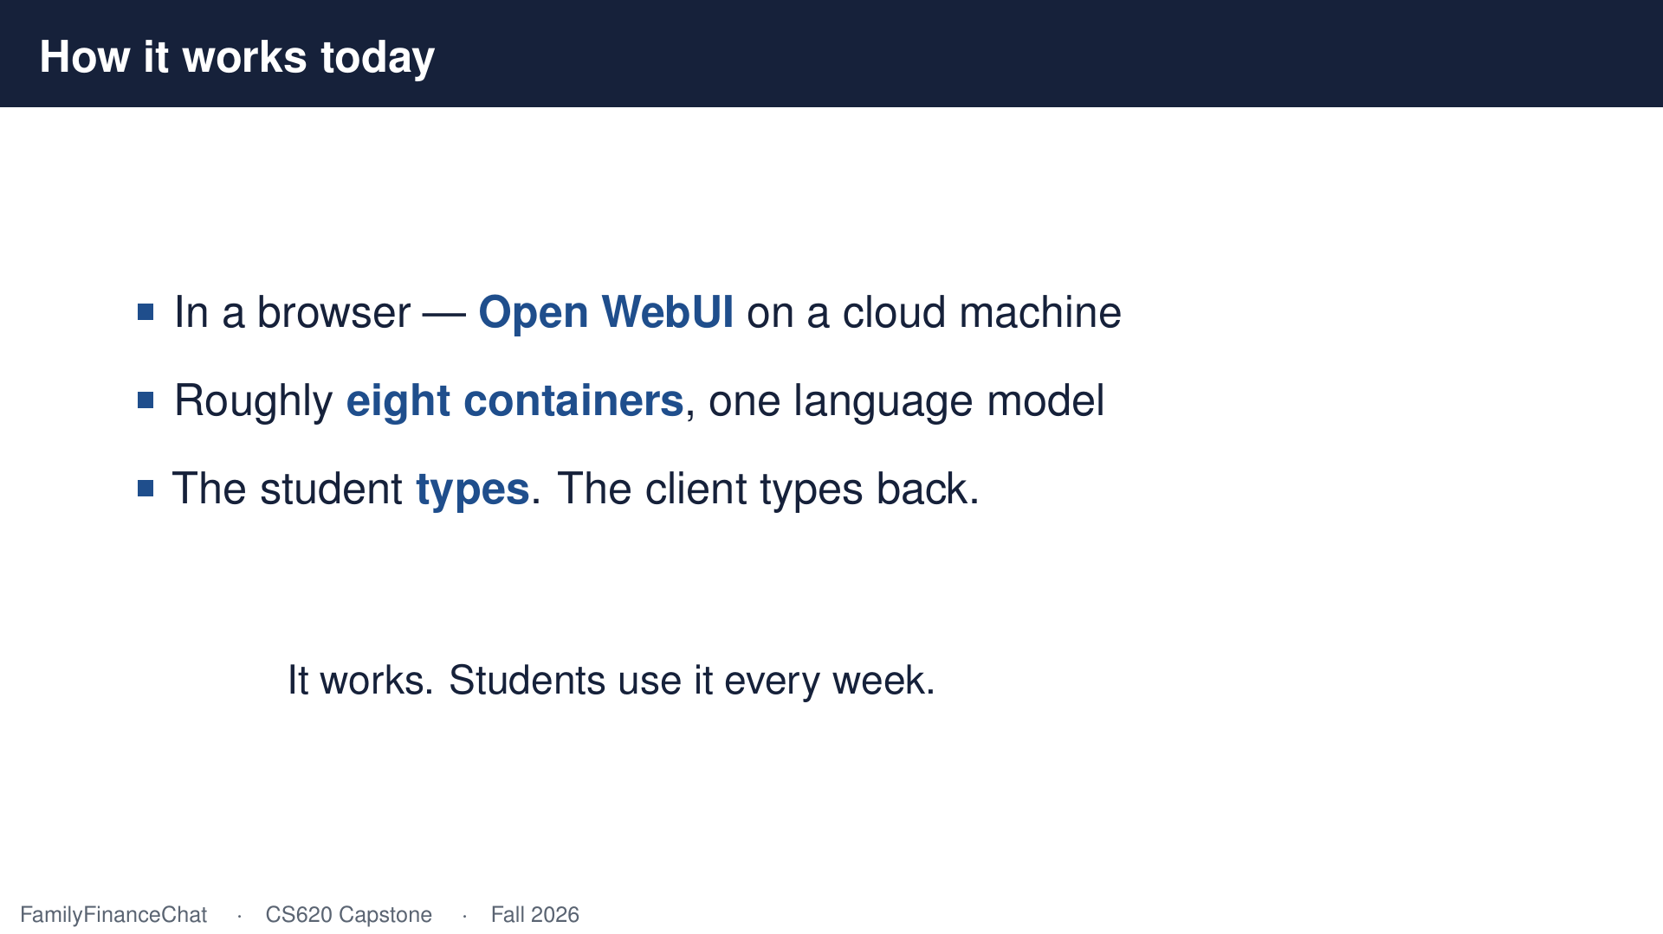
Notes:
It works. Students use it every week, and that's exactly why the next step is worth taking seriously.

Slide 10
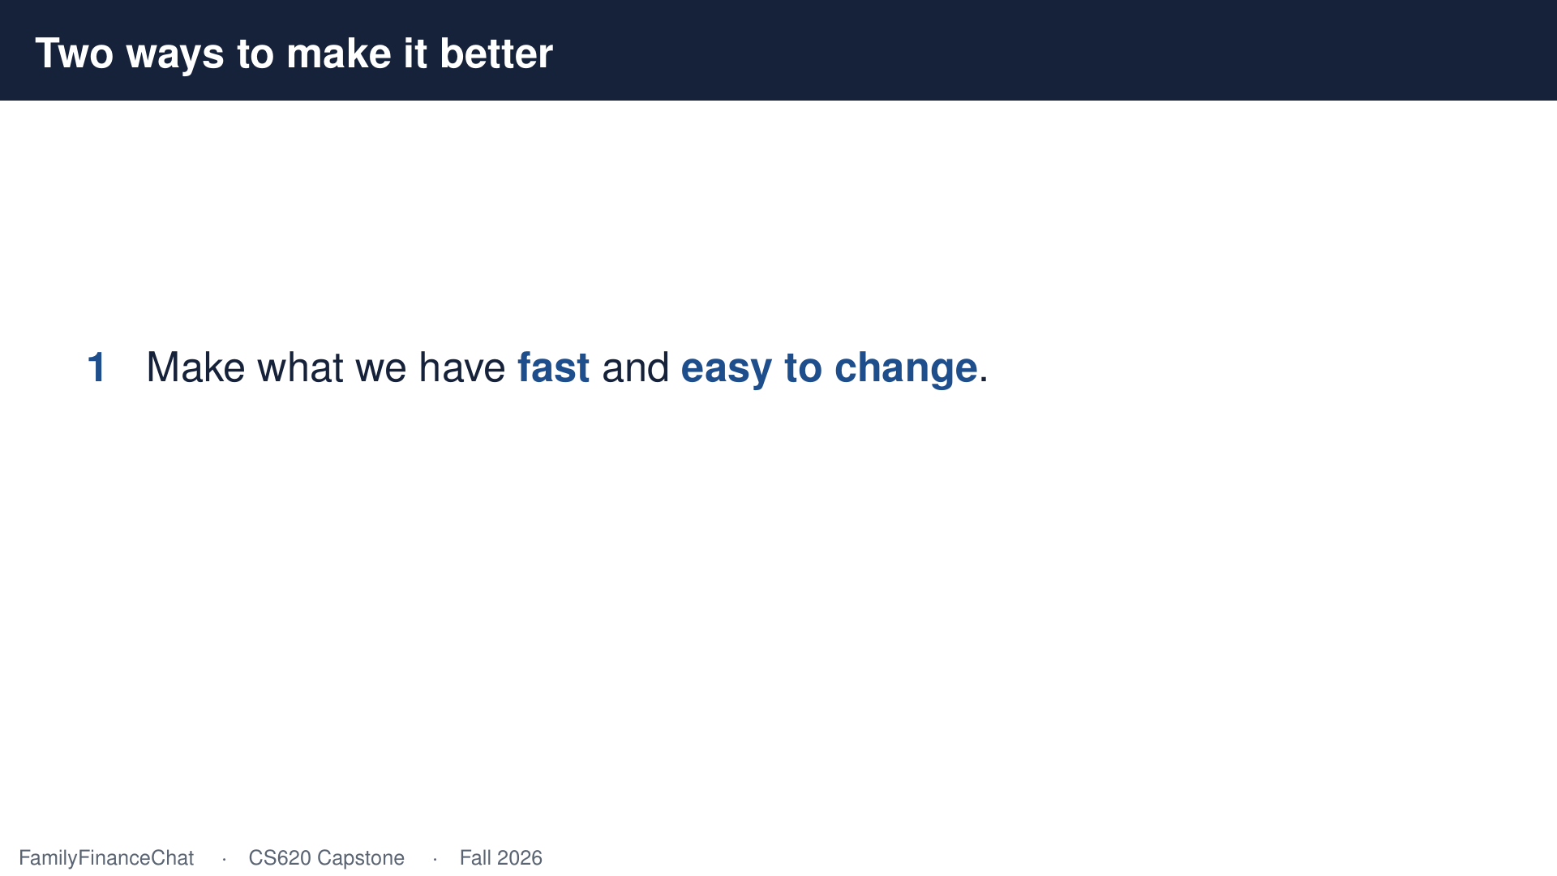
Notes:
There are two things I want to fix. The first isn't glamorous. We've drifted behind the software underneath us, and every update takes somebody who knows where everything is.

Slide 11
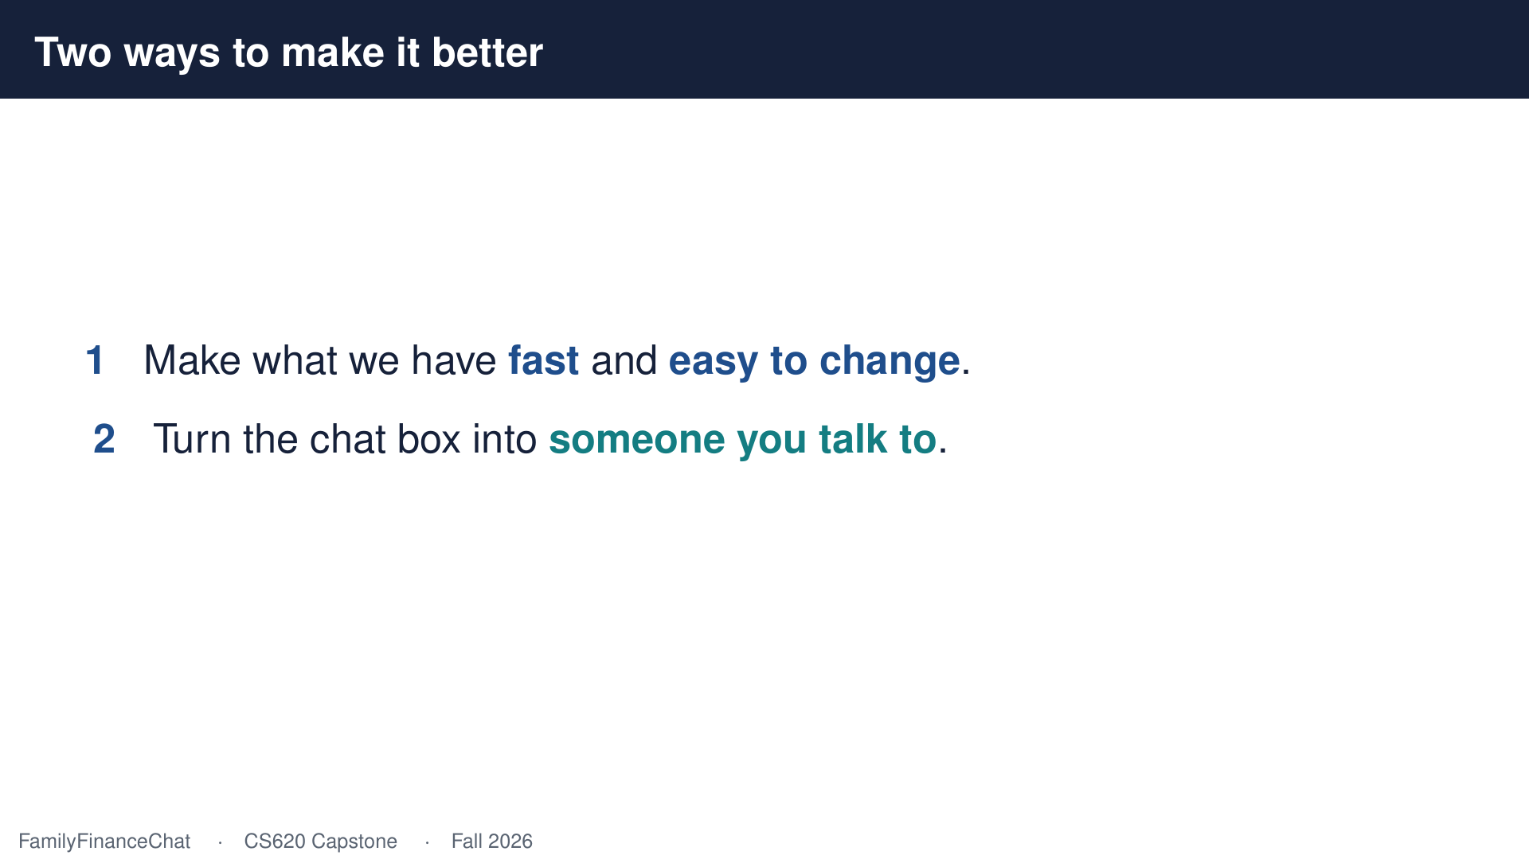
Notes:
The second is the one I'm excited about. I want the student to stop typing.

Slide 12
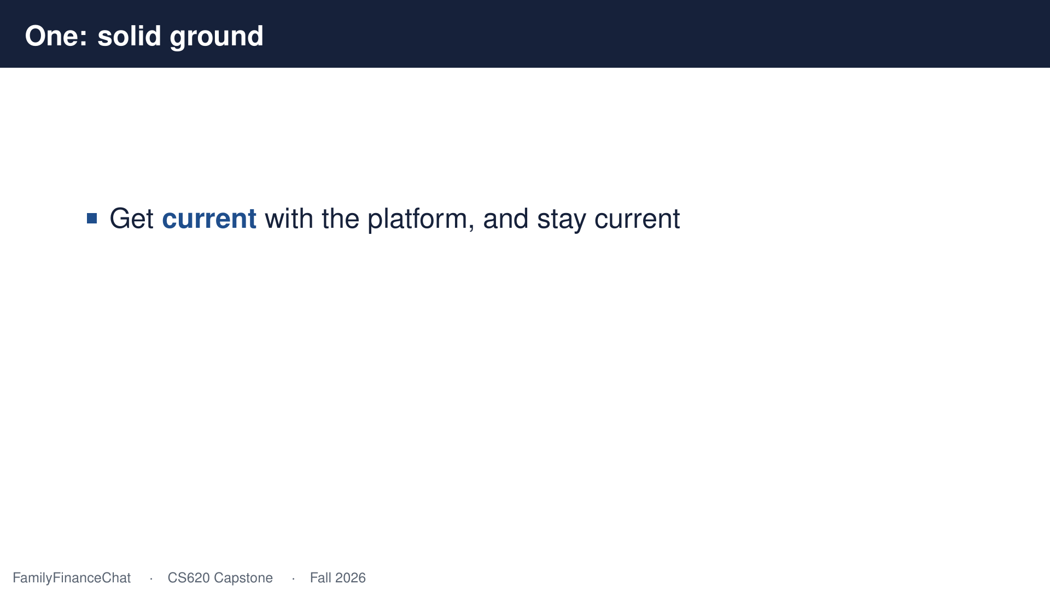
Notes:
So, the groundwork. Get current with the platform, and stay current, so upgrades stop being frightening.

Slide 13
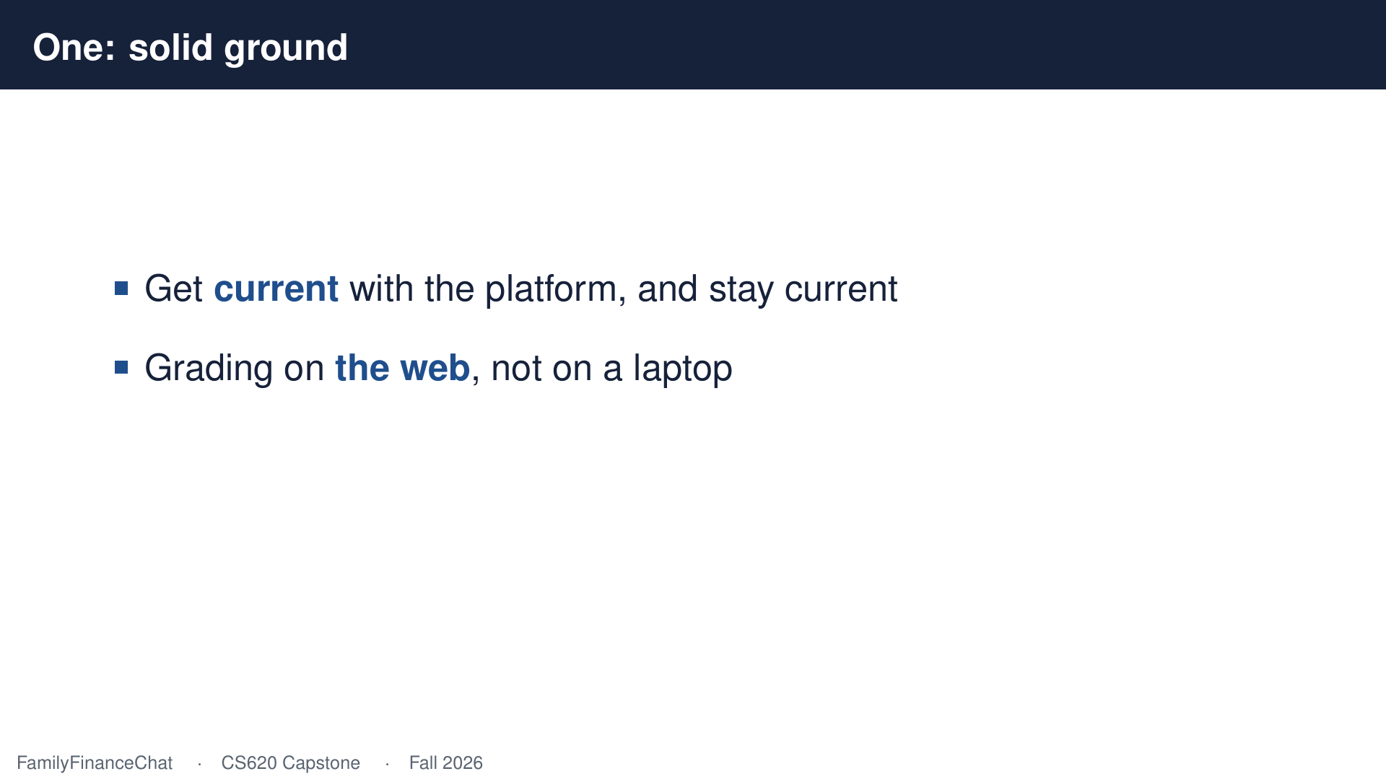
Notes:
Put the grading on the web where any instructor can open it, instead of on one laptop in my office.

Slide 14
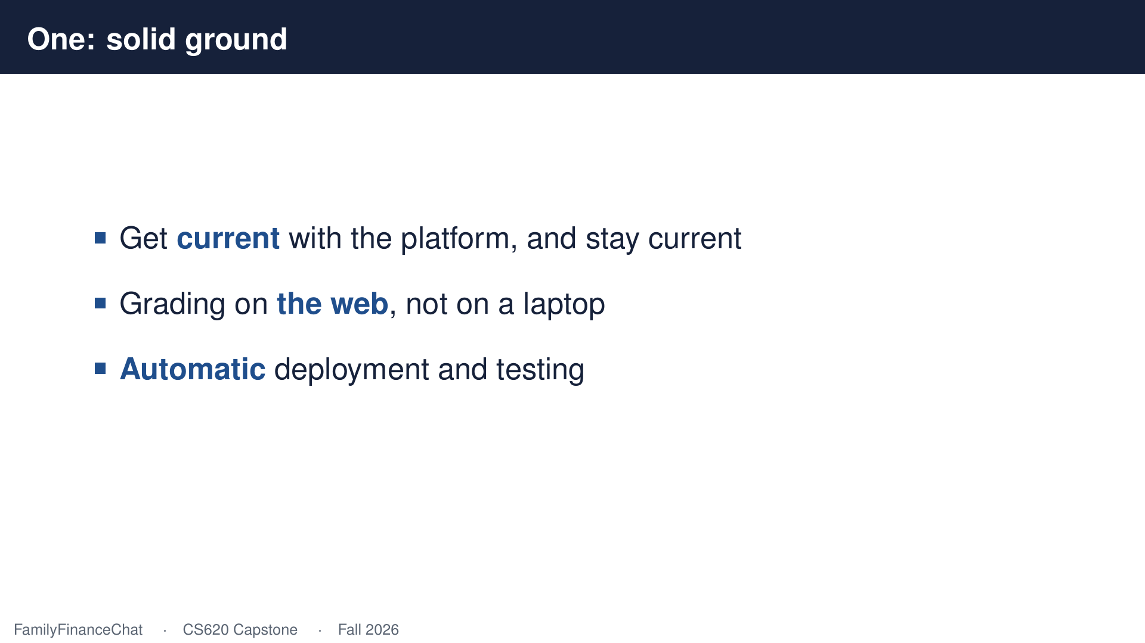
Notes:
And make deployment automatic, so improving this thing doesn't depend on one person remembering the steps.

Slide 15
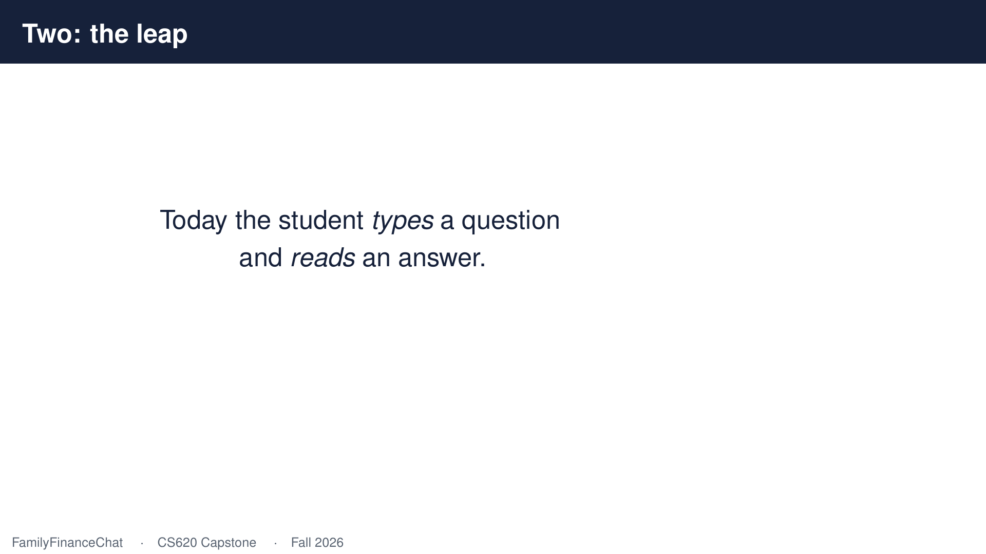
Notes:
Now the interesting part. Right now a student types a question and reads an answer, which is nothing like the job.

Slide 16
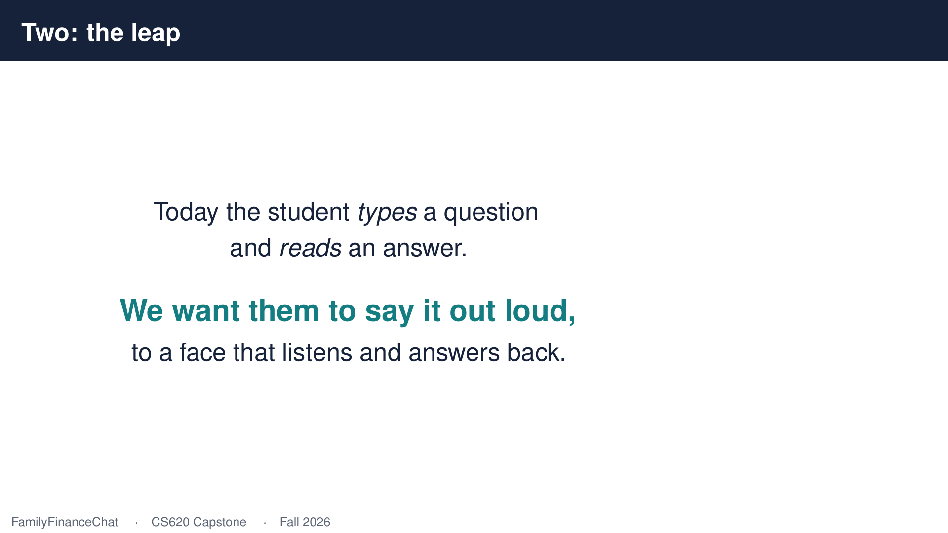
Notes:
I want them to say it out loud, to a face that listens, waits, and answers back in character.

Slide 17
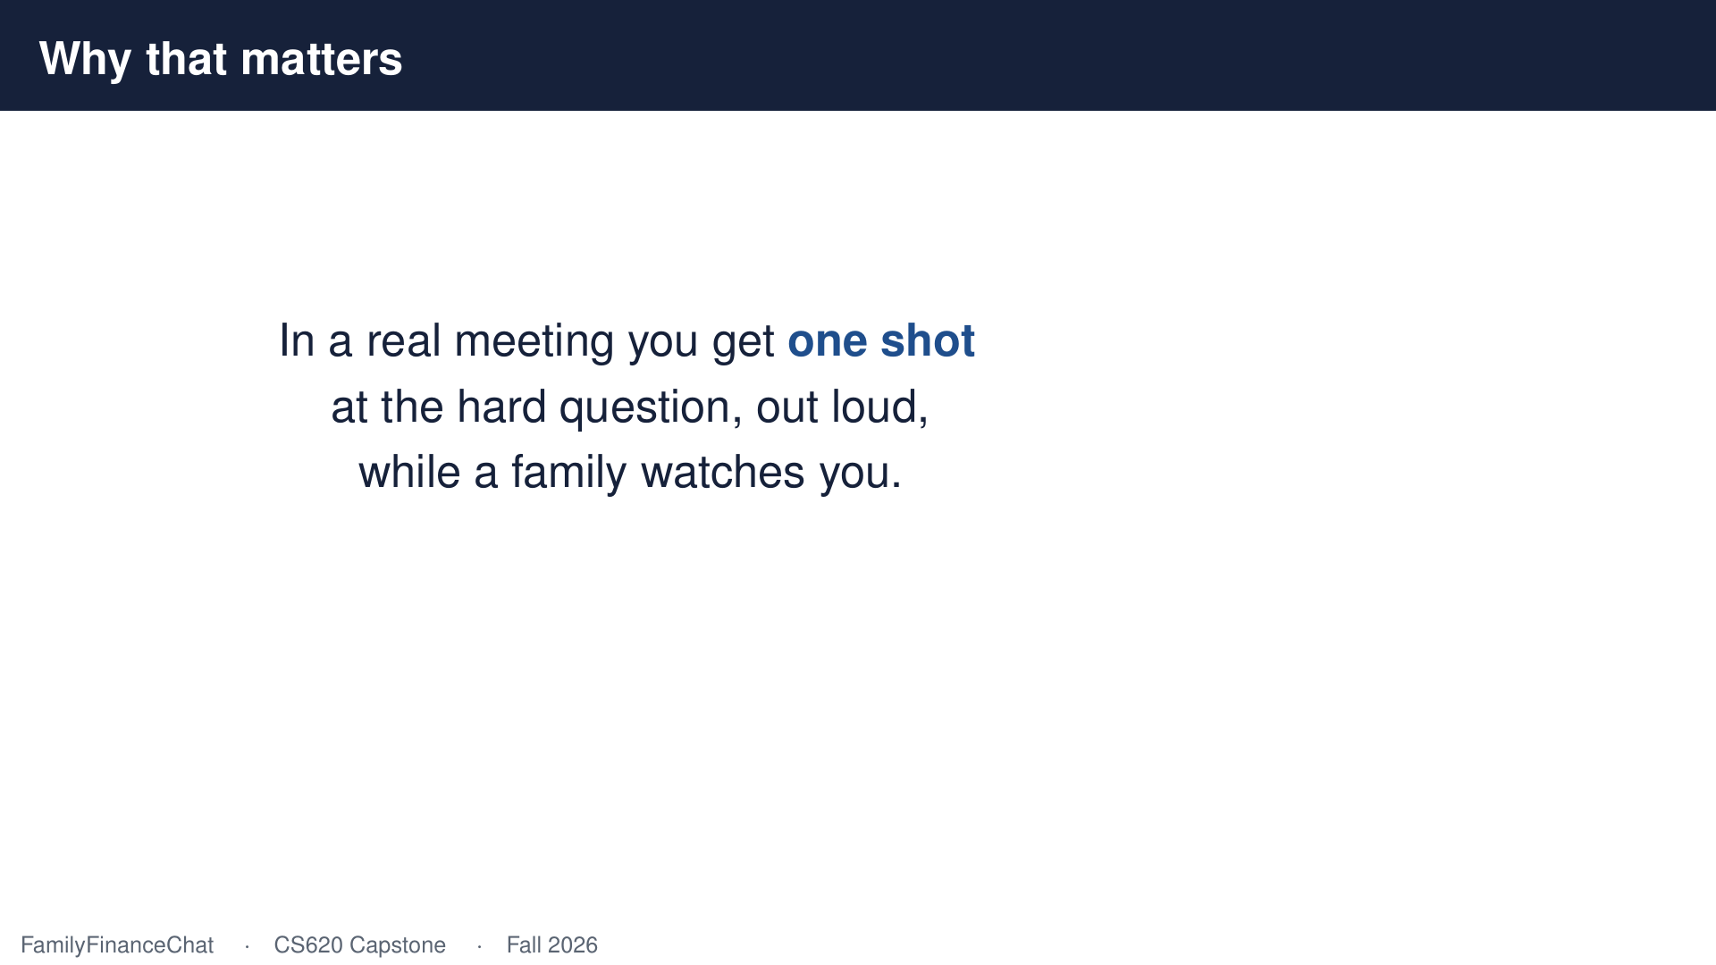
Notes:
Because in a real meeting you get one shot. You ask the hard question out loud, once, while a family watches your face.

Slide 18
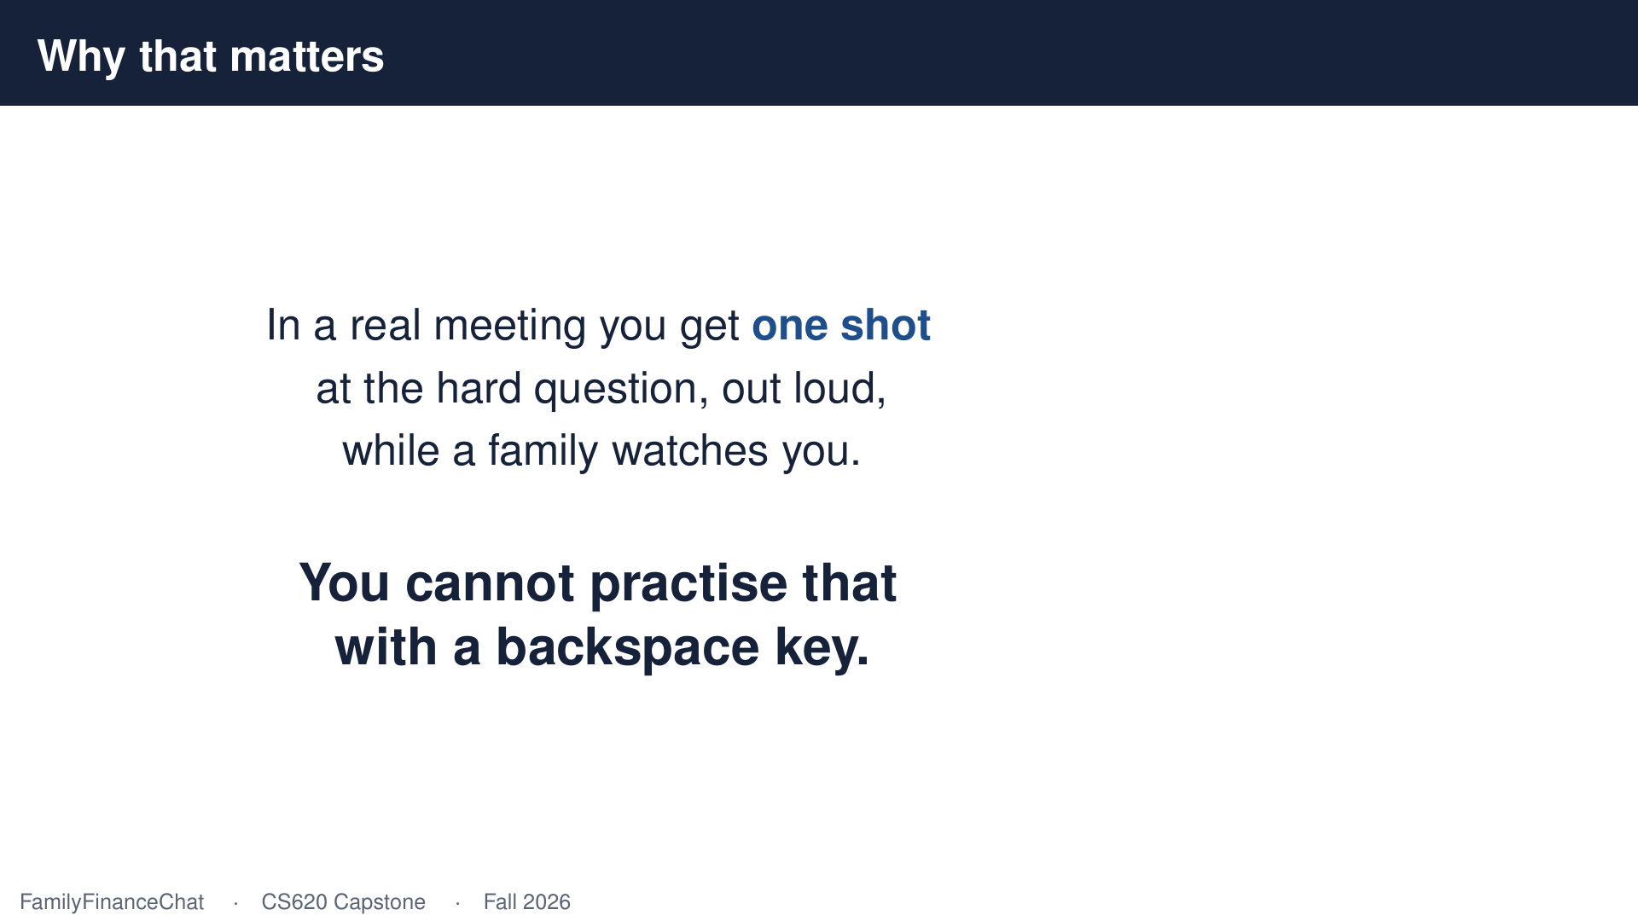
Notes:
You can't practise that with a keyboard. There's no backspace key in that room.

Slide 19
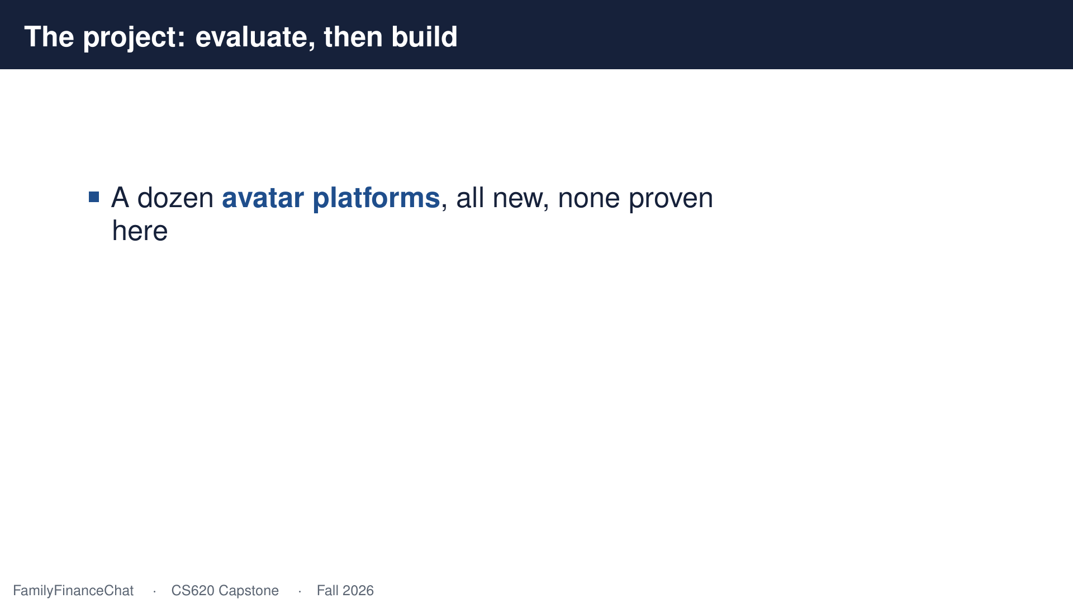
Notes:
So here's the actual project. There are a dozen companies now doing real time avatars, and none of them have been tested for something like this. Somebody has to find out which one holds up.

Slide 20
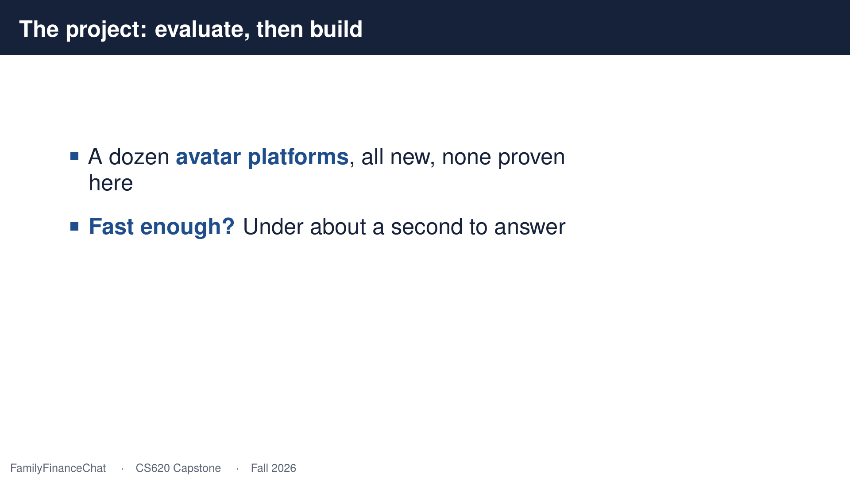
Notes:
Speed matters most. If it takes longer than about a second to answer, it stops feeling like a conversation and starts feeling like a machine.

Slide 21
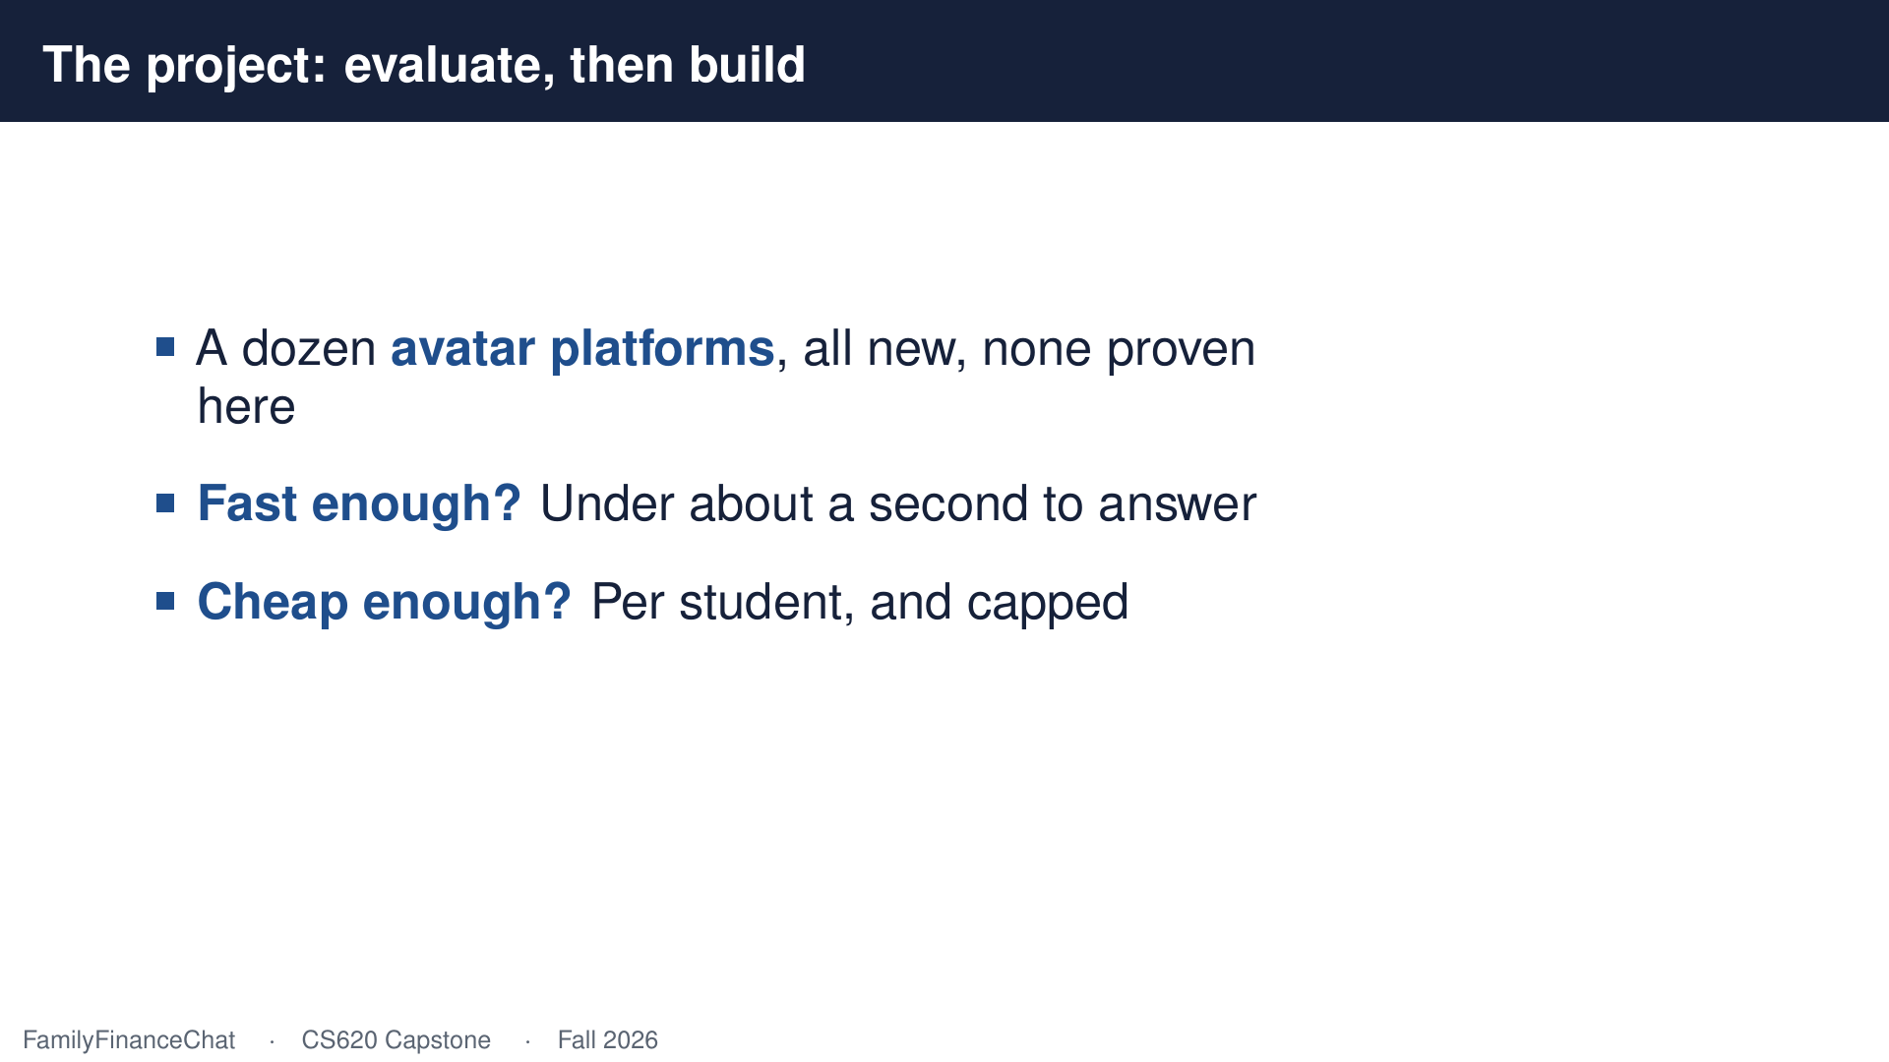
Notes:
Then cost, per student, per semester, with a ceiling we can actually live with.

Slide 22
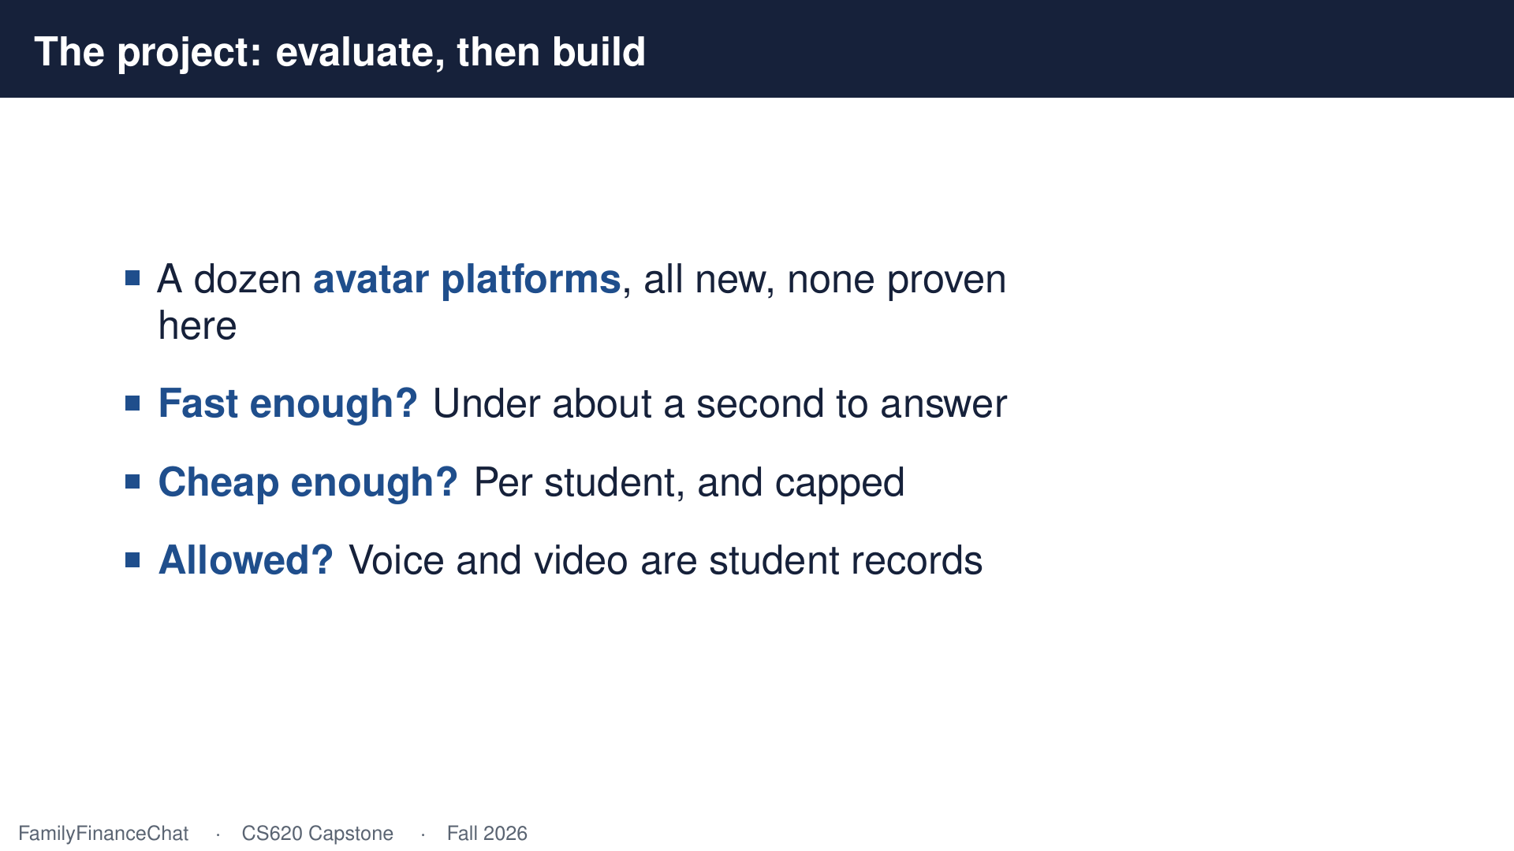
Notes:
And permission, because a student's voice and face are protected records, and that gets settled before anyone records anything.

Slide 23
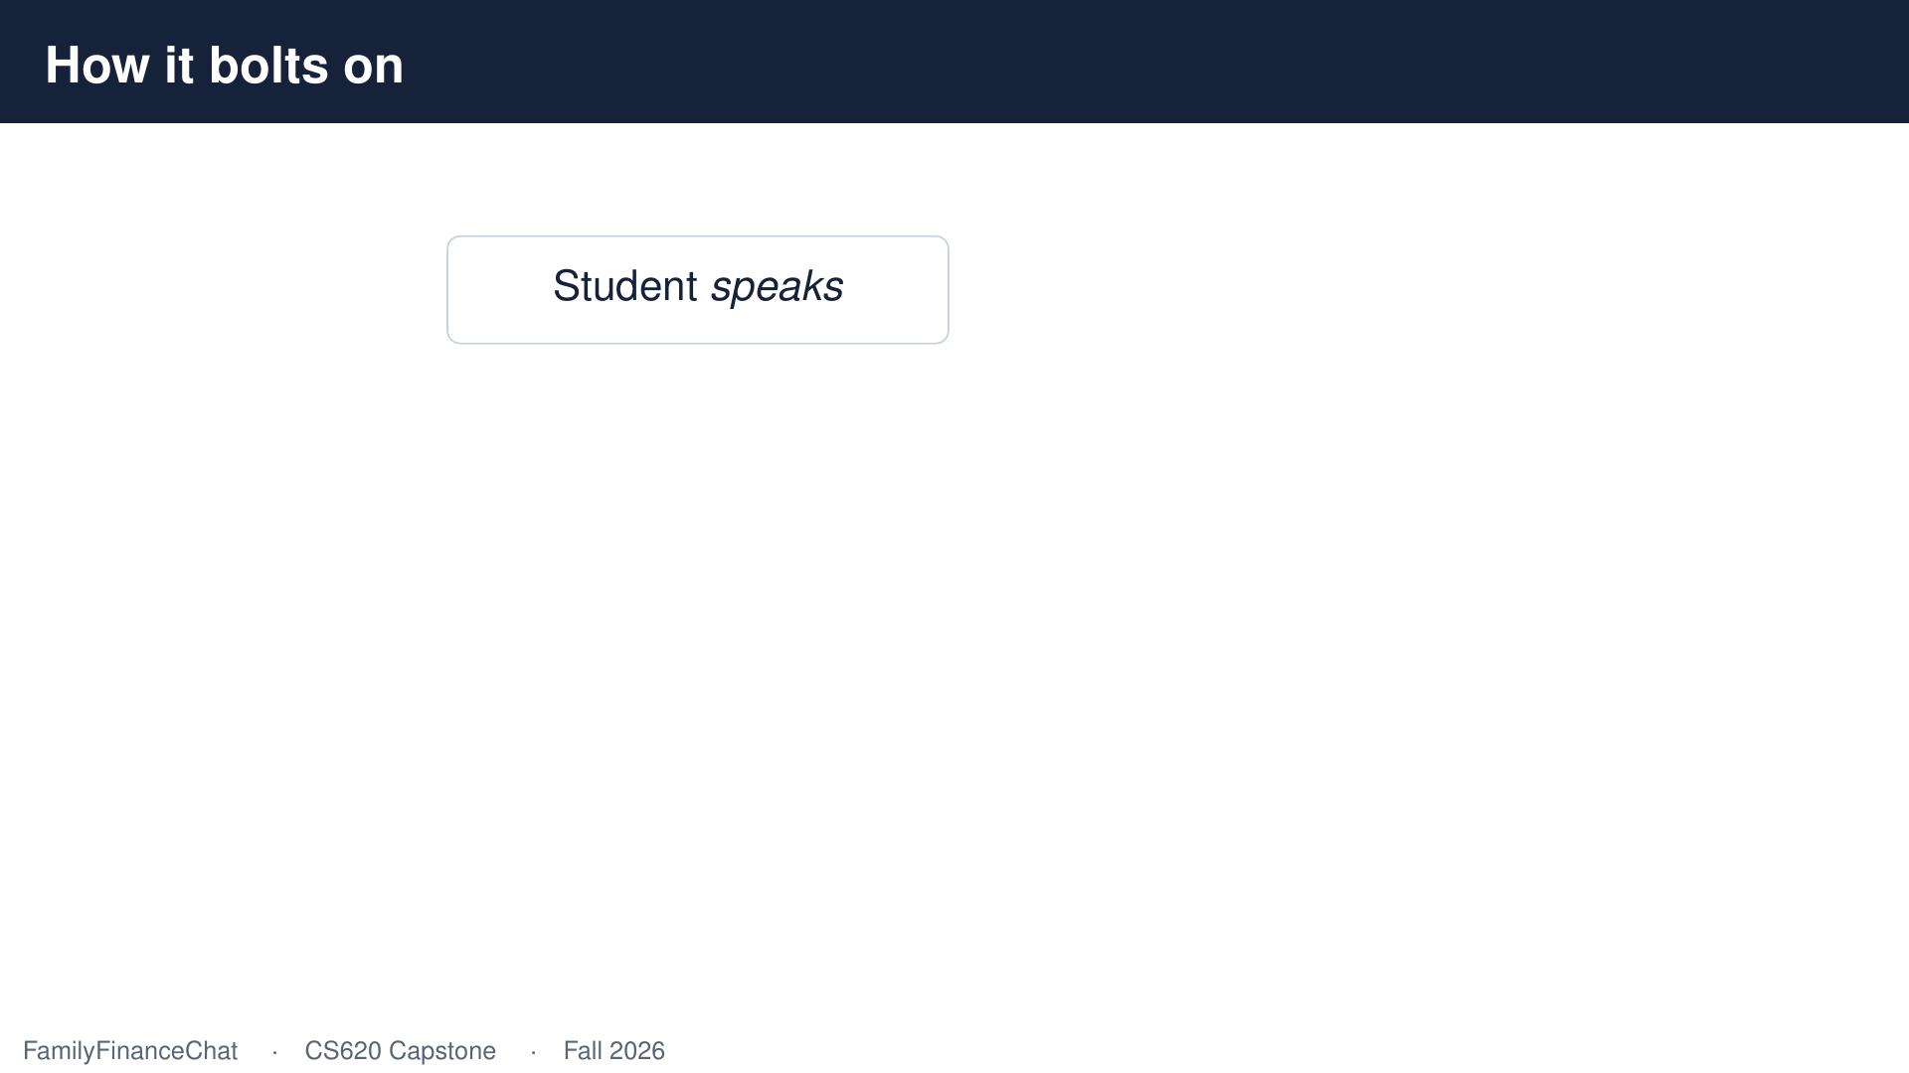
Notes:
Whatever wins has to bolt on beside what we already have, not replace it.

Slide 24
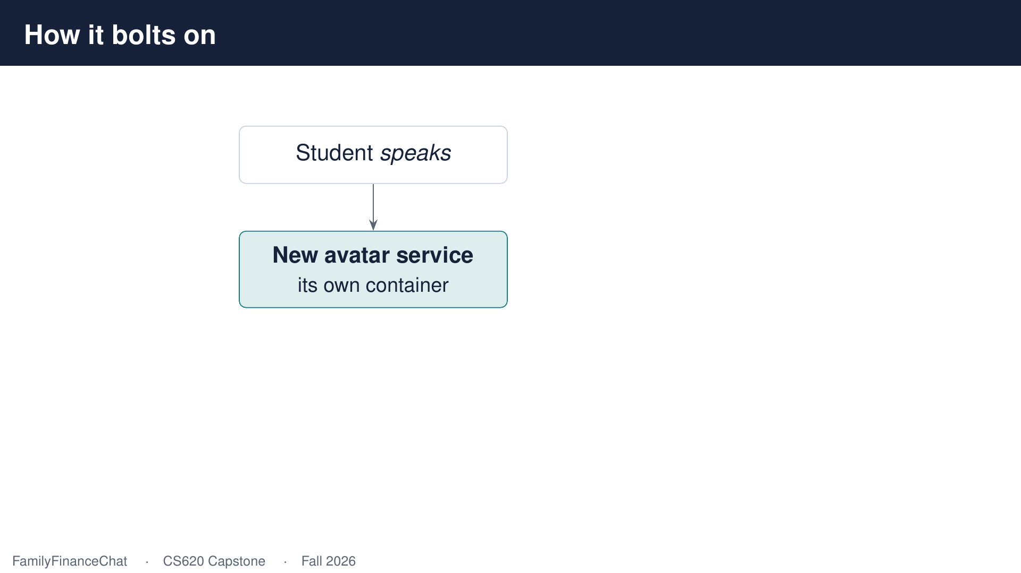
Notes:
A separate service that handles the talking.

Slide 25
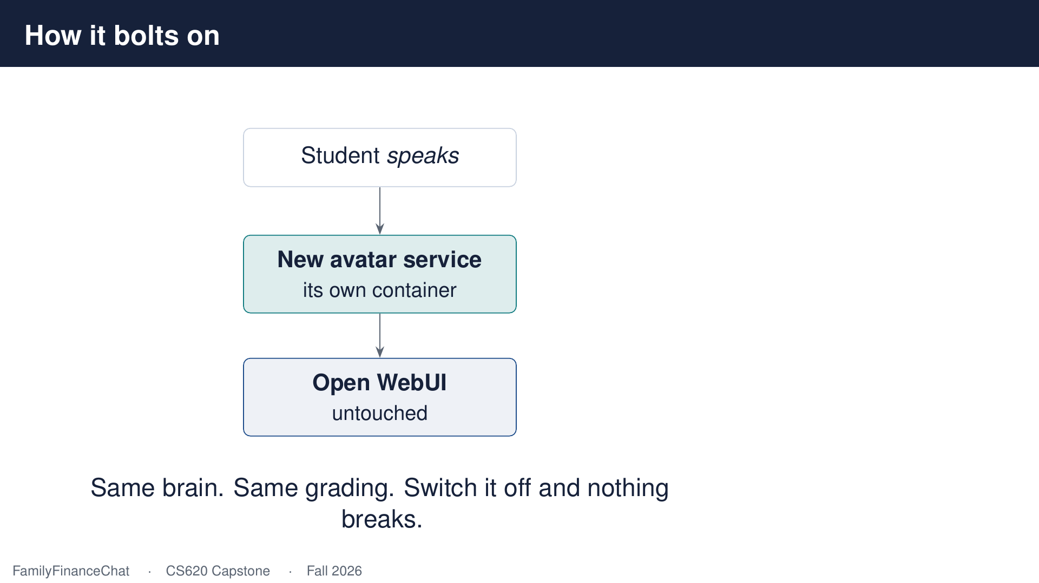
Notes:
It asks the existing system for the answer, so the grading and the course material keep working exactly as they do now. And if it turns out not to be worth it, we switch it off and lose nothing.

Slide 26
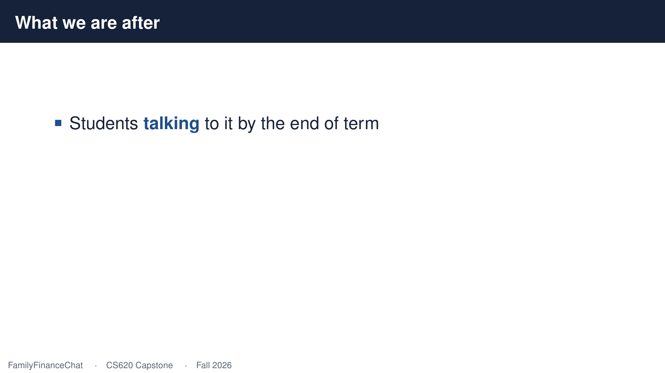
Notes:
What I want by the end of the term is students actually talking to this thing.

Slide 27
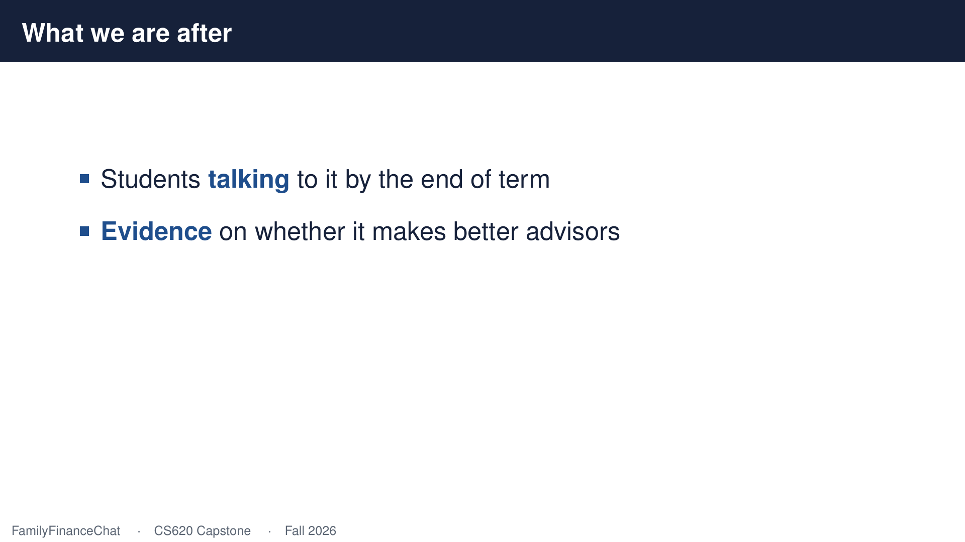
Notes:
And I want to know whether it makes them better at the job. Measured, not guessed.

Slide 28
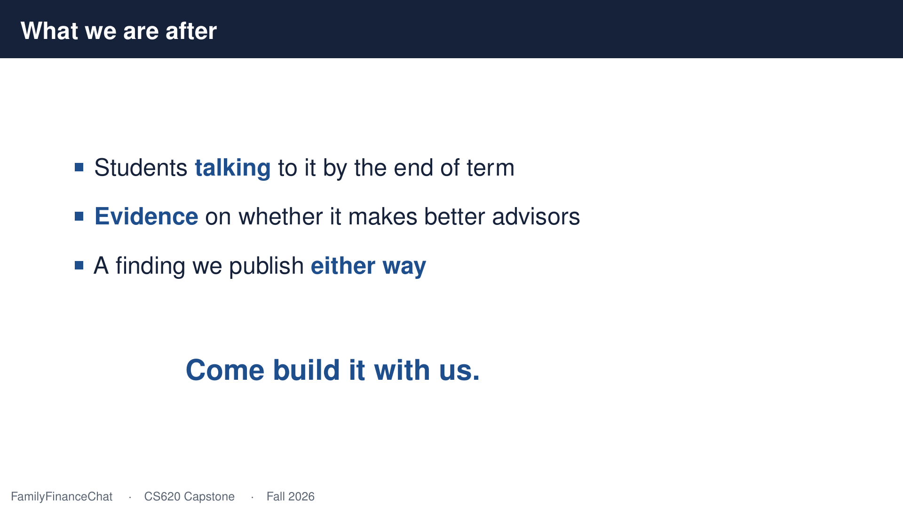
Notes:
It might turn out that it doesn't, and that's a finding worth publishing too. If that sounds like a semester well spent, come build it with us.

