Slide 1

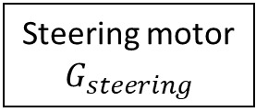
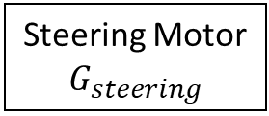
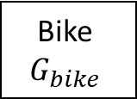



Steering motor
$$G_{steering}$$
Bike
$$G_{bike}$$
$$\dot{δ}$$
$$\dot{φ}$$
-1
PD Controller
Steering Motor
$$G_{steering}$$
Bike
$$G_{bike}$$
$$\dot{φ}$$

