Slide 1
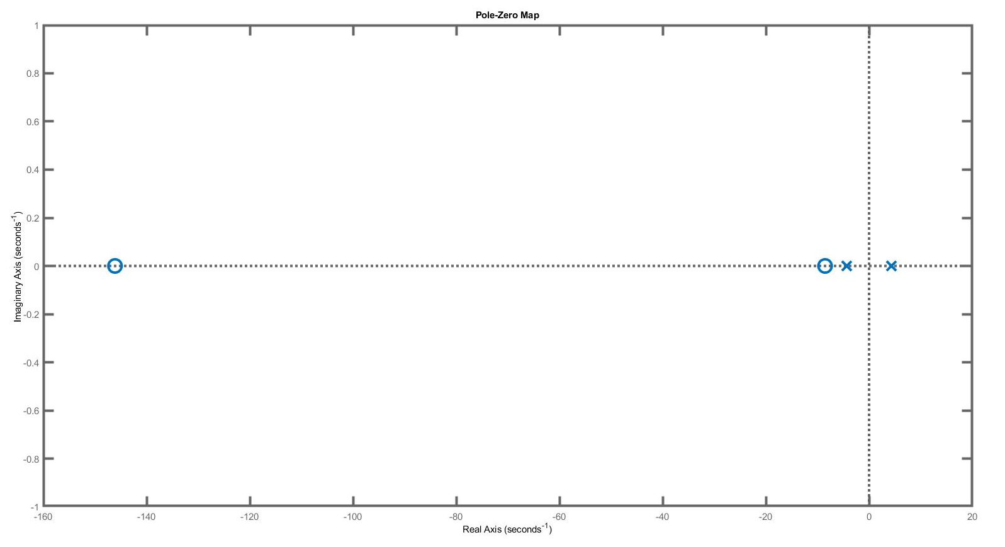



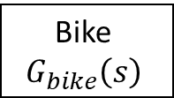
Bike model :
$$G_{bike}\left(s\right)=\frac{\dot{φ}\left(s\right)}{\dot{δ}\left(s\right)}=\frac{\frac{I_{front}b}{mh}s^{2}+aVs+V^{2}}{bhs^{2}−bg}$$
Poles : $±\sqrt{\frac{g}{h}}≈±4.35$
$$\dot{δ}$$
Bike
$$G_{bike}\left(s\right)$$
$$\dot{φ}$$

Slide 2
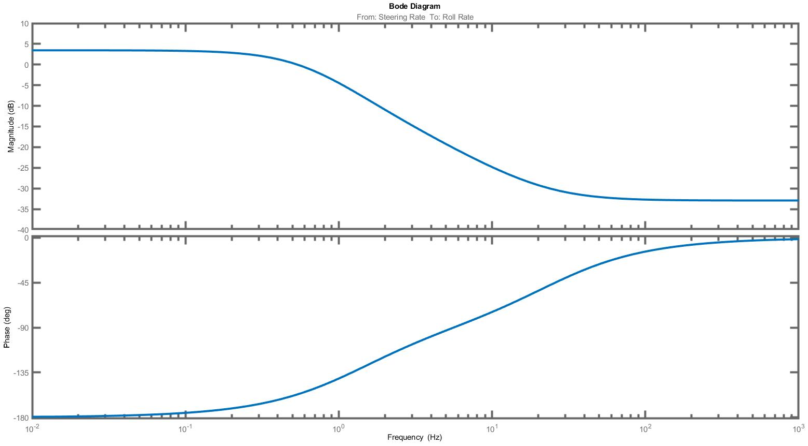

Slide 3
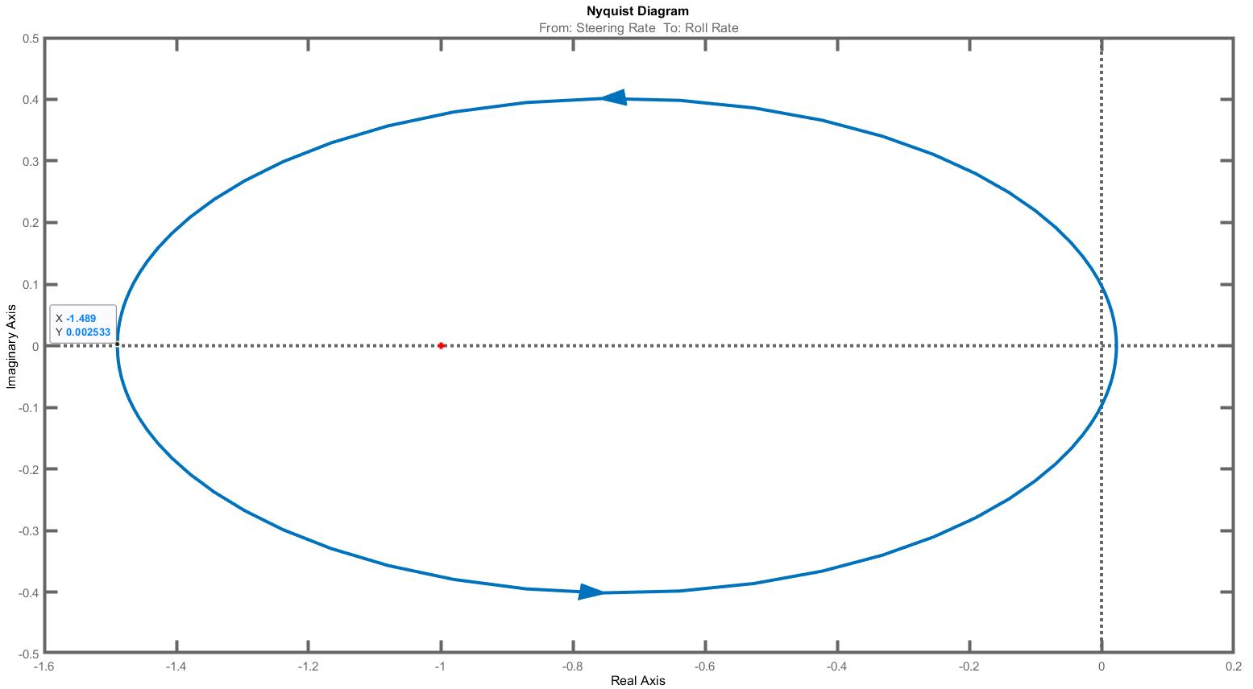
The bike can be balanced with a continuous-time proportional feedback such that $K_{P}>\frac{1}{1.489}=0.6716$

Slide 4
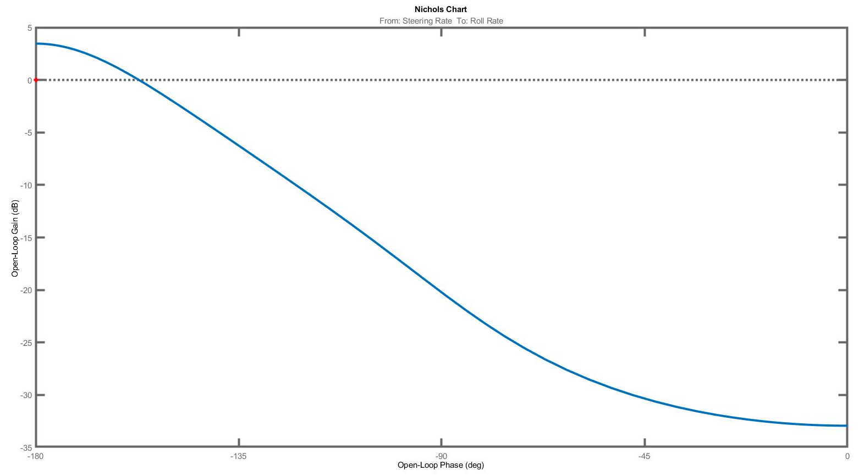

Slide 5









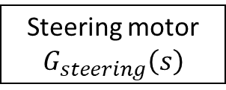







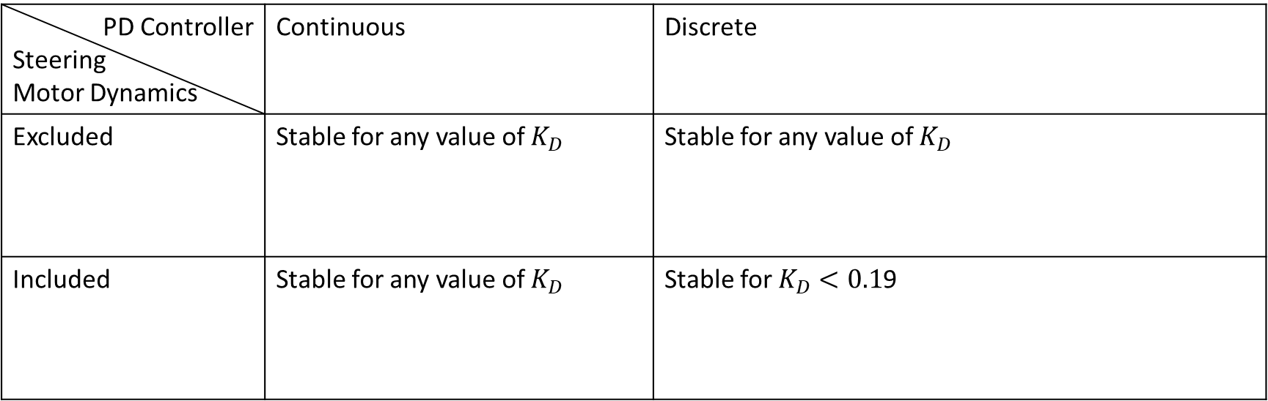



Comparison of 4 models :
All simulations are done for $K_{P}=1$.
Changing either the PD controller to discrete or including the steering motor dynamics does not lead to instability of the closed-loop and the closed-loop remains stable for any value of $K_{D}$.
When both changes are included, the closed-loop is stable for $K_{D}<0.19$.
The stability analysis of the controller must to include the steering motor dynamics and a discrete controller
PD Controller Steering Motor Dynamics | Continuous | Discrete
Excluded | Stable for any value of $K_{D}$ | Stable for any value of $K_{D}$
Included | Stable for any value of $K_{D}$ | Stable for $K_{D}<0.1$9
$$Δ\dot{φ}$$
$$\dot{δ}$$
Bike
$$G_{bike}\left(s\right)$$
$$\dot{φ}$$
$$Δ\dot{φ}$$
$${\dot{δ}}_{PID}$$
$$\dot{δ}$$
$${\dot{φ}}_{ref}$$
+
$$PD\left(s\right)$$
Steering motor
$$G_{steering}\left(s\right)$$
Bike
$$G_{bike}\left(s\right)$$
-
$${\dot{φ}}_{ref}$$
+
$$PD\left(s\right)$$
$$\dot{φ}$$
-
$$Δ\dot{φ}$$
$$\dot{δ}$$
Bike
$$G_{bike}\left(s\right)$$
$$\dot{φ}$$
$$Δ\dot{φ}$$
$${\dot{δ}}_{PID}$$
Steering motor
$$G_{steering}\left(s\right)$$
$$\dot{δ}$$
Bike
$$G_{bike}\left(s\right)$$
$${\dot{φ}}_{ref}$$
+
$$PD\left(z\right)$$
$${\dot{φ}}_{ref}$$
+
$$\dot{φ}$$
-
-
$$PD\left(z\right)$$

Slide 6
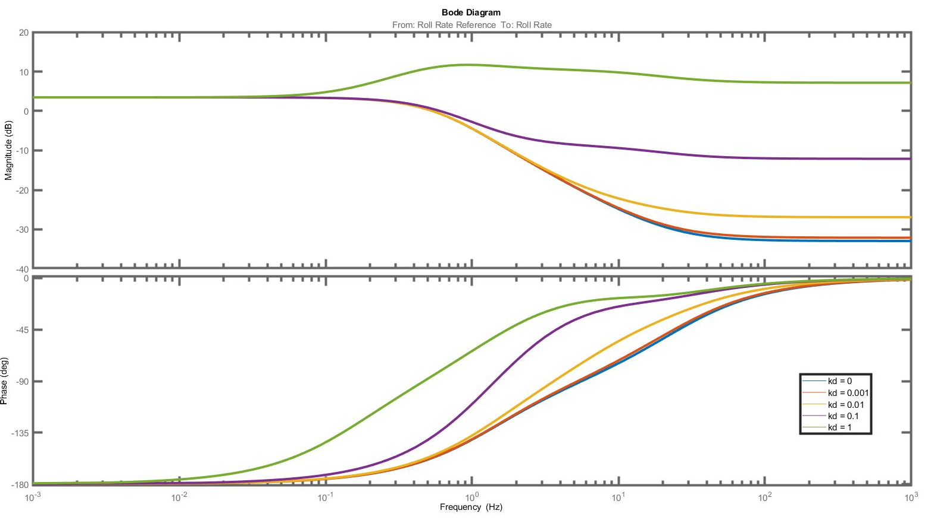
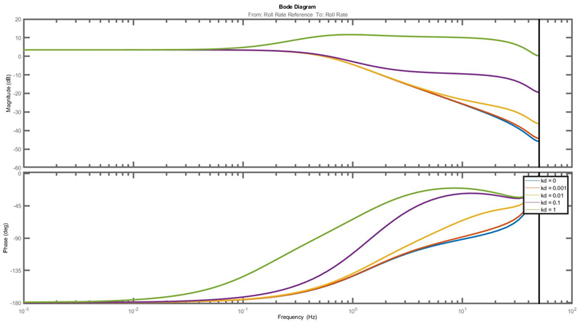
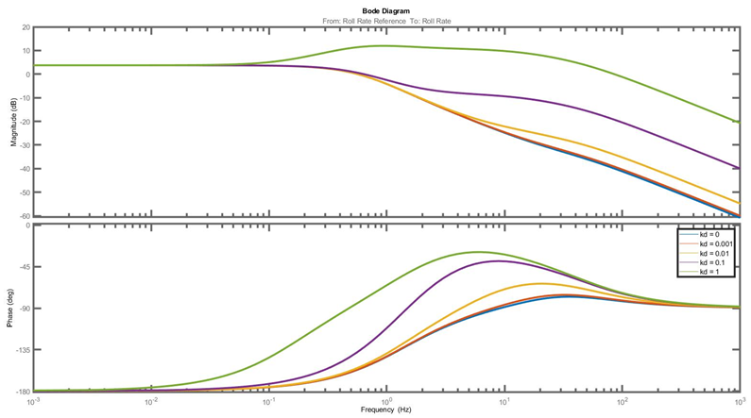
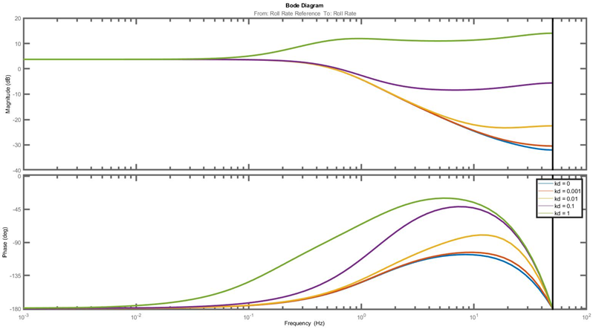
Open-loop Bode plot
 | Continuous | Discrete
Excluded
Included

Slide 7
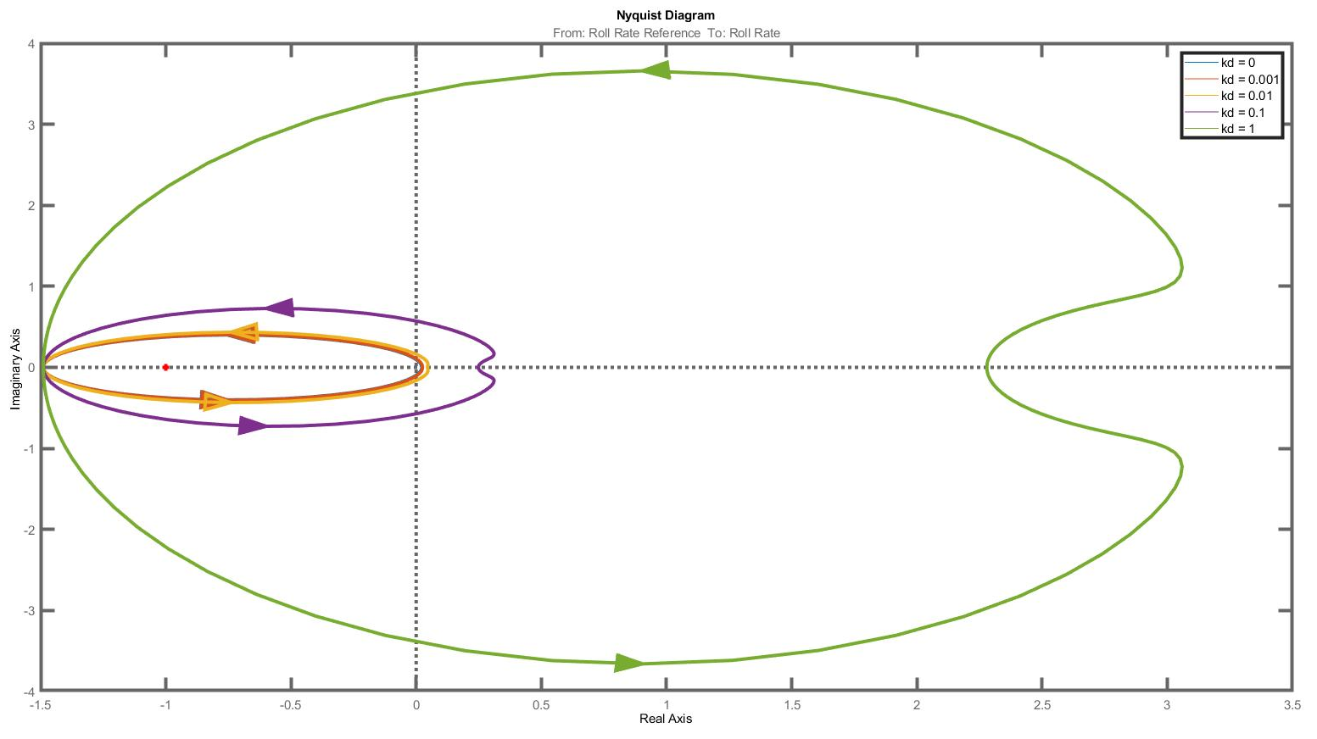
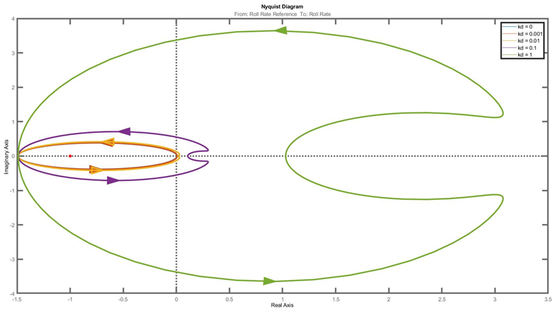
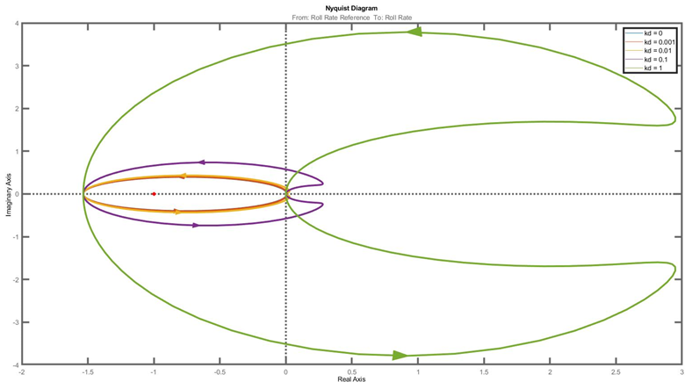
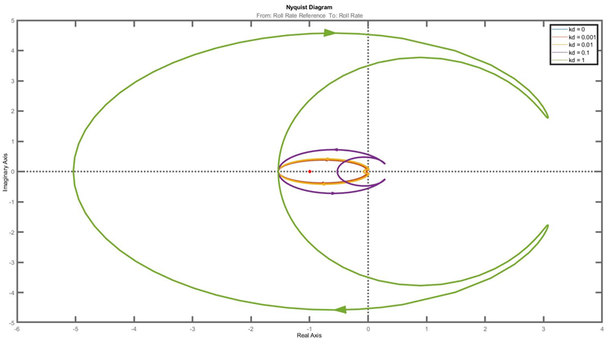
Open-loop Nyquist plot
 | Continuous | Discrete
Excluded
Included

Slide 8
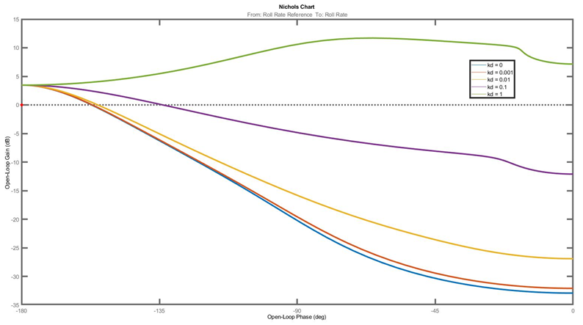
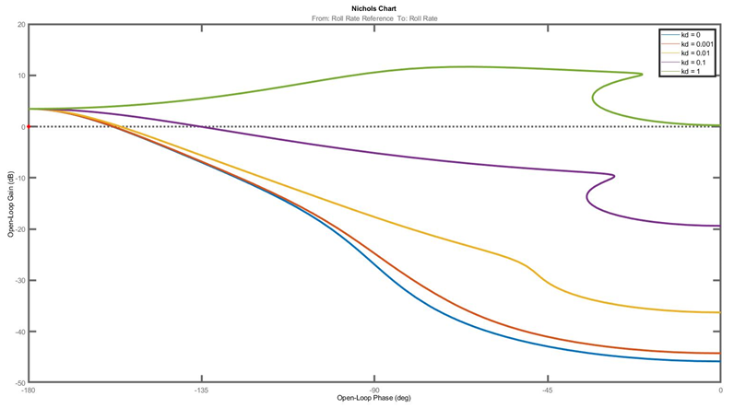
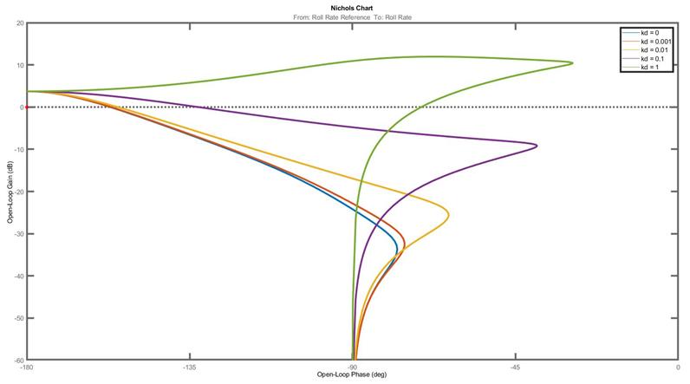
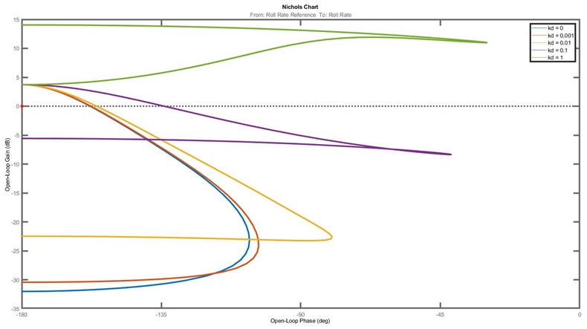
Open-loop Nichols plot
 | Continuous | Discrete
Excluded
Included

Slide 10
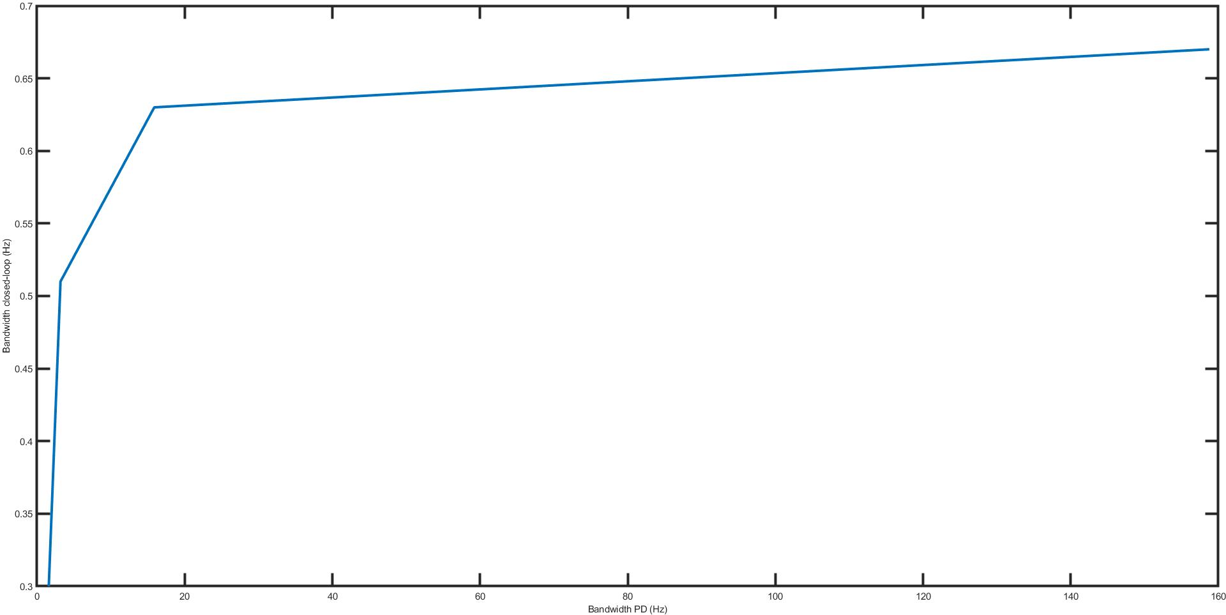

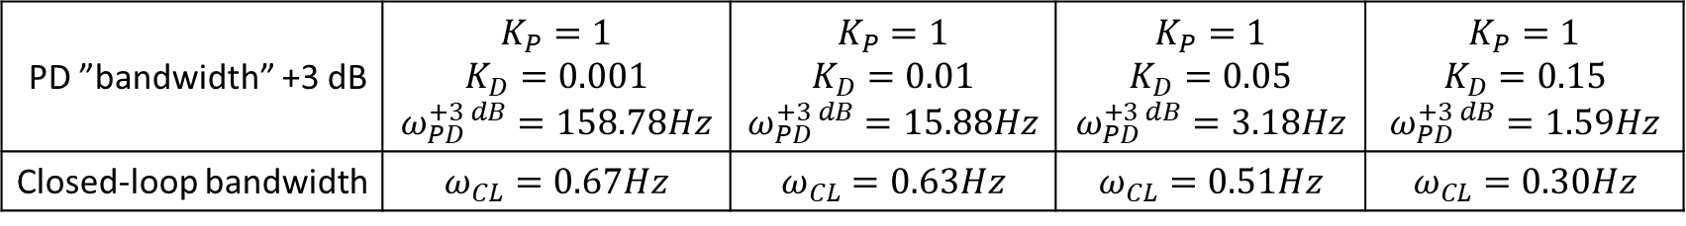
“Bandwidth” of PD controller at +n dB:
$$ω_{PD}^{+n dB}=\frac{\sqrt{{10}^{\frac{n}{10}}−K_{P}^{2}}}{K_{D}}$$
PD ”bandwidth” +3 dB | $$K_{P}=1$$ $$K_{D}=0.001$$ $$ω_{PD}^{+3 dB}=158.78Hz$$ | $$K_{P}=1$$ $$K_{D}=0.01$$ $$ω_{PD}^{+3 dB}=15.88Hz$$ | $$K_{P}=1$$ $$K_{D}=0.05$$ $$ω_{PD}^{+3 dB}=3.18Hz$$ | $$K_{P}=1$$ $$K_{D}=0.15$$ $$ω_{PD}^{+3 dB}=1.59Hz$$
Closed-loop bandwidth | $$ω_{CL}=0.67Hz$$ | $$ω_{CL}=0.63Hz$$ | $$ω_{CL}=0.51Hz$$ | $$ω_{CL}=0.30Hz$$

