Slide 1


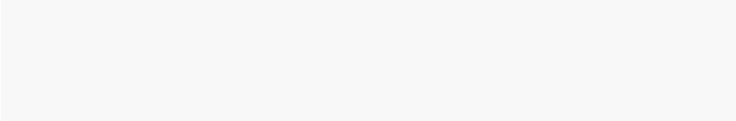
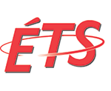

Cloud Defense orchestration (CDO)
Dynamic Orchestration, Adequate & Elastic Defense
Mohamed fekih ahmed,
Alireza shameli-sendi,
Chamssedine talhi,
mohamed cheriet
École de Technologie Supérieure
Synchromedia Lab.
makan pourzandi,
Yosr jarraya
Ericsson Research, Security,
Canada
Makan.pourzandi@ericsson.com
mohamed.fekih.ahmed@synchromedia.ca

Slide 2

Agenda
[2]
WHY !
[3]
WHAT !
[4]
HOW ?
[5]
DEMO: Workshop
[6]
CONCLUSION & Perspectives
[1]
CONTEXT

Slide 3
CONTEXT

Slide 4
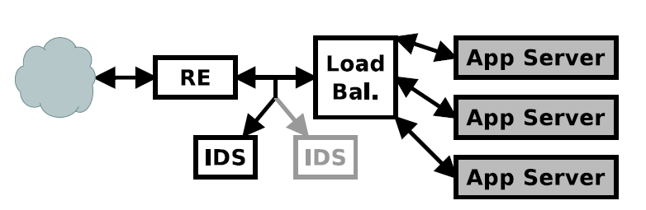
Context …
Security Modules, Security appliances …
A Security Module (SM), Middleboxes (VMbs) or Appliance (SA) : is any security device except for routers and switches. It can be defined as any intermediary device performing functions other than the normal, standard functions of an IP router on the datagram path between a source host and destination host.
=> As an example, traffic may enter the data center through a WAN optimizer or redundancy elimination VMb (RE), be mirrored to an intrusion detection system (IDS), directed to a load balancer, and assigned to one of several application servers.
* V. Sekar, S. Ratnasamy, M. K. Reiter, N. Egi, and G. Shi. The middlebox manifesto: enabling innovation in middlebox deployment. In HotNets, 2011.
Notes:
Middleboxes (VMbs) play a key role in enterprises and private data centers (*) with an application server’s traffic often traversing multiple VMbs appliances to meet security, performance, or other objectives.
=> As an example, traffic may enter the data center through a WAN optimizer or redundancy elimination VMb (RE), be mirrored to an intrusion detection system (IDS), directed to a load balancer, and assigned to one of several application servers.

Slide 5

Context …
Security Modules, Security appliances …
Why do we need them: Security/Performance.
SMs play a key role in enterprises and private DCs with an application server’s traffic often traversing multiple SMs appliances to meet security, performance, or other objectives.
SM can be:
Virtual Firewall :
- Stateless firewalling (L3): 5-tuple, 14-tuple, OpenFlow Slice (e.g., FlowVisor), Telecom specific protocols (e.g. GTP).
- Stateful firewalling (L3-L4)
Application layer firewalling (L7):
- Web Application FW (WAF) (e.g. SQLI mitigation, XSS protection)
- Content filtering.
- Telecom protocol FW (e.g., SIP and H.323 based applications (L7))
virtual VPN
virtual IDS/IPS
virtual DPI
Notes:
Middleboxes (VMbs) play a key role in enterprises and private data centers (*) with an application server’s traffic often traversing multiple VMbs appliances to meet security, performance, or other objectives.
=> As an example, traffic may enter the data center through a WAN optimizer or redundancy elimination VMb (RE), be mirrored to an intrusion detection system (IDS), directed to a load balancer, and assigned to one of several application servers.

Slide 6
WHY ?

Slide 7
Why …
Security & network evolution today: Security appliances !
Type of appliance | Number
Firewalls | 166
NIDS | 127
Media gateways | 110
Load balancers | 67
Proxies | 66
VPN gateways | 45
WAN Optimizers | 44
Voice gateways | 11
Total Security appliances | 636
Total routers | ~900
Data from a large enterprise:
>80K users across tens of sites.
Just network security
$10 billion.
(Sherry et al, SIGCOMM’ 12)
Notes:
Before discussing outsourcing designs, we draw on two datasets
to discuss typical middlebox deployments in enterprise networks
and why their challenges might be solved by the cloud. We conducted
a survey of 57 enterprise network administrators, including
the number of middleboxes deployed, personnel dedicated to them,
and challenges faced in administering them. To the best of our
knowledge, this is the first large-scale survey of middlebox deployments
in the research community. Our dataset includes 19 small
(fewer than 1k hosts) networks, 18 medium (1k-10k hosts) networks,
11 large (10k-100k hosts) networks, and 7 very large (more
than 100k hosts) networks.
We augment our analysis with measurements from a large enterprise
with approximately 600 middleboxes and tens of international
sites; we elaborate on this dataset in §5.3.
Our analysis highlights several key challenges that enterprise administrators
face with middlebox deployments: large deployments
with high capital expenses and operating costs (§2.1), complex
management requirements (§2.2), and the need for overprovisioning
to react to failure and overload scenarios (§2.3). We argue these
factors parallel common arguments for cloud computation, and thus
make middleboxes good candidates for the cloud.
Modern enterprises almost ubiquitously deploy middlebox processing
services to improve security and performance in their networks.
Despite this, we find that today’s middlebox infrastructure is expensive,
complex to manage, and creates new failure modes for the
networks that use them. Given the promise of cloud computing to
decrease costs, ease management, and provide elasticity and faulttolerance,
we argue that middlebox processing can benefit from
outsourcing the cloud. Arriving at a feasible implementation, however,
is challenging due to the need to achieve functional equivalence
with traditional middlebox deployments without sacrificing
performance or increasing network complexity.

Slide 8
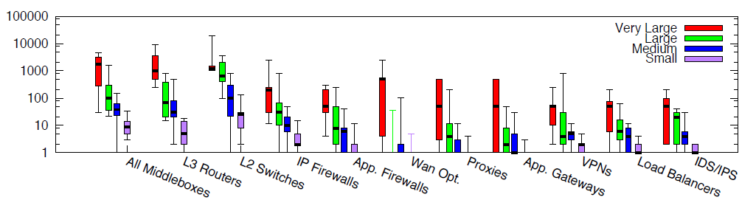
Why …
Number of USED Security appliances !?
Survey across 57 enterprise networks:
Costly Large number of SMs.
(Sherry et al, SIGCOMM’ 12)

Slide 9
Why …
Paradigm shift for network security?
For Traditional Network Security: Security HW boxes such as Firewalls, IDS, WAF etc. are deployed in-between the inside and outside networks.
SDN, NFV and Cloud combination leverage network security from static fix setups into new possibilities.
Orchestration at network layer, dynamic programmable centralized network management open new ways of organizing network security :
Ex: F5 iControl, Checkpoint Smart Management
Trend in the cloud is a shift from few HW-based large boxes installed in central/choke points in the network, implementing a multitude of sec mechanisms, e.g. L3-L7, statefull, IDS, VPN termination etc. into many smaller virtual security appliances distributed through out cloud infrastructure :
VMware talk about running and managing security mechanisms in every hypervisor.
HW boxes are still to be used at natural central points when there is need for high bandwidth and short latency, ex at data center entry point

Slide 10
Why …
Moving to the cloud: New challenges for network security deployment !
These security boxes are facing new challenges in the Cloud Computing environment :
Network boundaries are blurring: physical network limits are replaced by dynamic and virtual logical limits.
More Management complexity: physical security device are replaced by virtual one. Security boxes can be VMs or virtual appliances (e.g., OpenStack FWaaS, LBaaS, VPNaaS).
Elastic and Dynamic environment: VM migration, Collaboration => the need for repositioning.
Security requirements for different tenants are different.
Notes:
Security defense virtualization can be at the hardware, middleware and application level. Creating software
SAs (e.g., vFW, vLB) can be realized as (i) portion of a security hardware commodity, (ii) a managed
kernel process running within the host hypervisor, and (iii) traditional security software on a guest virtual
machine (VM).

Slide 11
Why …
Moving to the cloud: New challenges for network security deployment !
Cloud defense using SMs is very challenging due to the lack of network control and the inherent difficulty in intelligently scaling SMs to cope with application demands.
Many entreprise applications remains locked-in to existing data centers due to a mismatch between cloud capabilities and enterprise requirements.
One major roadblock is the lack of ground-up support for network-based services (e,g., FWs, LB, IDS, IPS, WAN Optimizer) or SMs.
Today’s clouds offer little ability to enrich the network between servers with SMs.
The only solution for cloud tenants desiring to include thirdparty services or SMs with their application must retrofit SM functionality into generic virtual servers, realizing the necessary traffic redirection and splitting SMs using cumbersome configurations.

Slide 12
Why …
Moving to the cloud: New challenges for network security deployment !
Even if tenant can find his own method to place and configure his SMs, the performance offered by individual SMs, and in aggregate by a SM chain, may not meet the application requirements for two as-yet-unresolved reasons:
Tenants may have to reprovision (scale up or down) SMs dynamically, to account for application elasticity and, potentially, to mesh with the “pay-as-you-go” model of cloud computing.
Tenants may experience poor performance due to the provider’s placement of the tenant’s SMs within the cloud data center, which may negate some of the benefits of deploying SMs.
SMs should be distinguished from generic compute resources and the appropriate support infrastructure needs to be developed, akin to cloud providers establishing storage systems as separate service offerings.
SMs deployment should be not restricted to provider-offered services, e.g., Amazon Elastic Load Balancing, or to third-party-offered software, e.g., in the form of VM images;
Gember, Aaron, et al. UW-Madison TR1771 (2012).

Slide 13
Why …
How to Manage All Those Security modules ?
There is urgent needs for :
SIMPLIFICATION: Traditional firewall and load balancer rules/configurations are complex because we force a single box to manage hundreds or thousands of “unique” endpoints, each one identified by its IP address. In a Security Module world, we need simple policies rules to be easy to understand, manage and audit.
TEMPITIZATION: Once you have simple rules for standard application classes, generate configuration templates or golden images. Every time the requirements change, change the template, test it, and deploy hundreds of new SMs instead of manually changing policies rules for every application/host.
AUTOMATION: If you want to roll out thousands of SMs, we need to automate their deployment, change management and monitoring.
DELEGATION: Tenant must take ownership of individual SMs instances – these instances become just another VM in the tenant stack.
ELASTICITY: Add new features for the Cloud Defense such as SPLIT/MERGE and MIGRATION.
LOW COMPLEXITY.

Slide 14
WHAT ?

Slide 15
WHAT …
Moving into chain of small security modules
The opportunity cost of the successful implementation of Cloud Defense Security is to find an alternative design to reduce the complexity of software security application into chain of small applications.
When designing a Cloud security sensitive defense, it is critical to construct the topology carefully in order to minimize the security nodes complexity and find its optimal placement.
We propose Cloud Security Defense Orchestration (CDO), a novel approach Software-Defined Networking (SDN) and Network Functions Virtualization (NFV) based to divide the complex security shield into small SMs that can be orchestrated between distributed security appliances towards better security defense optimization.

Slide 16
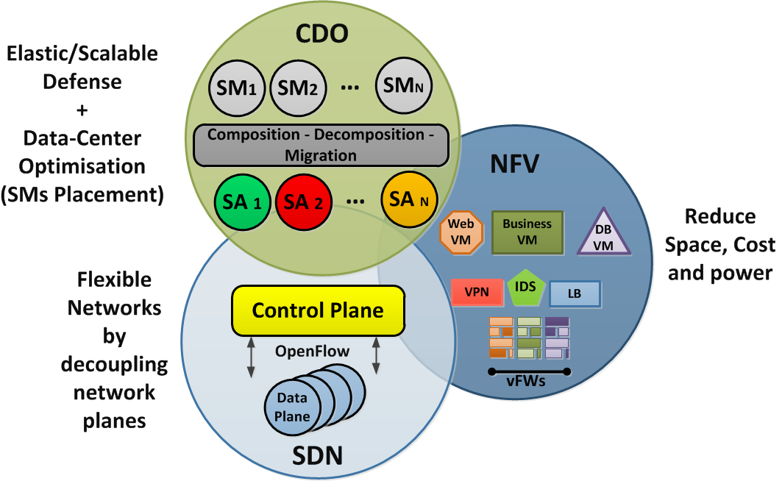
WHAT …
CDO relationship with SDN & NFV

Slide 17
what …
CDO’s Goal
A Framework for Orchestration of virtual security boxes.
Dynamic Orchestration
Due to several factors on the cloud (e.g., non-transparency of network control, security restrictions), tenants are forced to benefit from Overlay Virtual Technology (OVT), install SMs on generic VMs and piece together tunnels, traffic splitters, and other software to forward the desired traffic along the desired paths.
Finding the right third-party tools and correctly configuring these tools and the operating system is hard. For example, implementing a relatively simple set of SMs required several days of trial-and-error to construct a working setup in Amazon EC2. The setup relies on several third-party tools and configurations step across the VMs.

Slide 18
what …
CDO’s Goal
Optimal SMs Placement
The provider must consider at least two issues to ensure optimal support for end-to end tenant performance and enable effective scaling decisions:
How to place a tenant’s initial topology and later SM instances added due to scaling ?
How to distribute traffic among tenant SM instances ?

Slide 19
what …
CDO’s Goal
Adequate Security: Based on the target’s security attribute adequate defense mechanisms are deployed.
Manual, distributed configuration makes managing the deployment (i.e., dynamically add or remove existing or new functionality) challenging. A change in Tenant Defense by adding new functionality or routing around failed SMs requires modifying configurations on several VMs and network nodes (e.g., switches, routers …).
Example: adding a new FW L4-L7 between FW L3 and the WEB application requires configuration changes to the FW L3 (s), WEB App and the forwarding plane (routers, switches). Distributed configurations also fail to provide administrators with a complete view of the implemented SMs topology. This makes it difficult to verify that security policies and optimization objectives are correctly implemented: e.g., is a copy of all traffic being directed to one of the IDSs?

Slide 20
what …
CDO’s Goal
Elastic Defense:
Security mechanisms can scale up and down, in and out according to the attack or bottleneck.
Example : create new instances of virtual FW to scrub the malicious traffic
Imposing traversals on application traffic causes SMs performance to effect end-to-end application performance. In the cloud, where applications are frequently scaled based on load, being aware of and addressing such bottlenecks is essential to realizing the benefits of application elasticity.
Example : Consider a simple setup where a single client generates 300 web requests per second for a web page served by a single web server. Without any SMs between the client and server, the average request latency is 4ms. Forcing traffic to traverse two resource limited SMs an IDS and a L3 FW increases this latency to 838ms, indicating one or both of the SMs is a bottleneck.
Tenants are largely responsible for identifying and addressing SM bottlenecks themselves. Using generic monitoring and healing mechanisms, identifying which SM is bottlenecked is complicated. WHICH SMs TO SCALE ?!

Slide 21
what …
Cdo security Defense deployment in the cloud: high-Level scenario
Cloud Tenant presents a high level logical security architecture (e.g. expressed based on TOSCA) .
HL view is translated into internal CDO mapping.
CDO instructs the creation of SMs and establish the traffic steering at cloud infrastructure :
Instructs Nova, Neutron plugins to create the virtual networks and virtual VMs.
Instruct SDN Controller, Switches to establish connections accordingly.

Slide 22
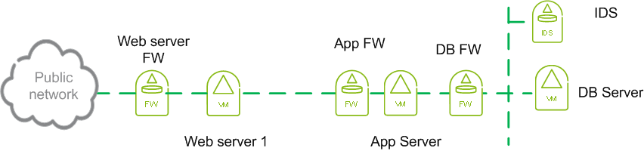
What …
Logical security architecture: High level
Customer presents a high level logical security architecture (TOSCA)

Slide 23
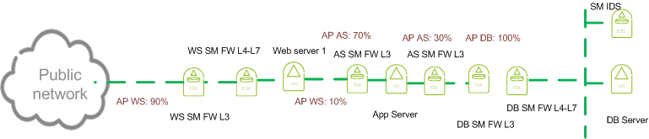
What …
Logical security architecture: detailed
Translated into internal CDO mapping to security appliances
Away from placing rules in the same box for everyone, fine grained security modules (SM) are created, SMs can be dedicated to individual virtual applications
Different SM instances, types, from different vendors can be used, best of breed approach
Resource needs are defined for each SM according to the virtual application characteristics

Slide 24
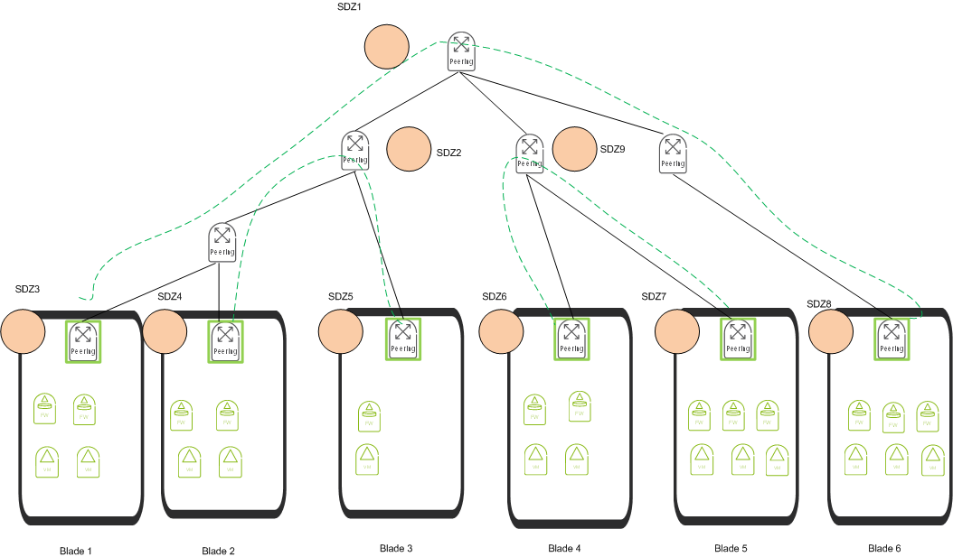
What …
Security domain zone (SDZ)
Security Domain Zones (SDZ) represent the physical nodes where CDO can instantiate necessary SMs
Used in order to map the security logical view into physical resources, computing and networking

Slide 25
What …
Orchestrate optimal security setup in the cloud infrastructure
Optimal setup for SMs in cloud infrastructure is defined
SMs are instantiated (e.g. Openstack Nova) and network connections are established (e.g. Openstack Neutron and SDN ODL)

Slide 26
HOW ?

Slide 27
How … Security modules
placement problem formalization
Security Defense Zone (SDZ) : The first step of security defense is to identify the best security defense zone for SMs placement. We define SDZ respect to both physical and virtual network topology (e.g., multitenancy, multi-path, vApps hosted server) and vApp protection coverage. Each SDZ can host one SM per tenant but may host multiple SMs from different tenants.
Designing cost effective SM that meets the security constraints such as order and correlation between SMs is mandatory to reach the security defense optimization.
Objective : Minimize the overall SMs deployment cost :
Min: ∑ C[SDZᵢ,SDZᵤ] * X[SDZᵢ, SDZᵤ, Tenantᵣ] + ∑ B[SDZᵢ,SM] * Y[SDZᵢ,SMᵥ,Tenantᵣ]
Distance Between Tenant’s SMs
Cost of SM at SDZ
Notes:
Designing cost effective SM that meets the security constraints such as order and correlation between SMs is mandatory to reach the
security defense optimization. For a given network infrastructure and a given SDZs available resources,
we must find the best SM placement that minimizes the overall deployment cost. This cost is the result
of a joint of optimization that minimizes i) the network workload induced by the flows across SMs ii) the
SDZ resources consumption, and iii) the number of SMs by eliminating redundant and similar SMs which
belong to the same tenant and maximizes i) the SM protection coverage, ii) the SDZ hosting capacity,
and the security defense optimization while respecting the order and the correlation between SMs.

Slide 28
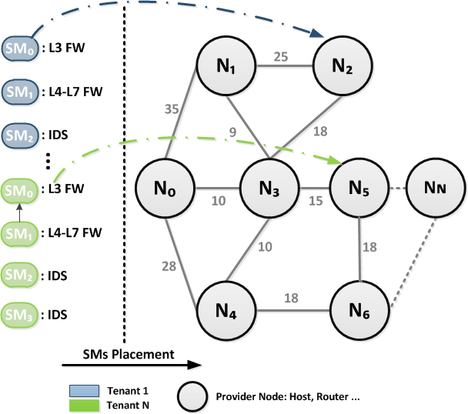
how …
Dynamic orchestration, Optimize SM Placement
How we could orchestrate the resource to optimize the resource consumption when setting up different SMs in the cloud infrastructure?
Make it possible to orchestrate different SMs with least cost
Which is the BEST Placement of those SMs !?
What is the BEST connection path between those SMs and Tenant VMs ?!
Notes:
Placement with Stratos:
UtC deployments of Stratos allow for many more placement options, resulting in substantially more performance and scaling benefits. The key is to consider a tenant’s topology as a whole when making placement decisions. This includes consideration of which VMs traffic flows between and the volume of traffic between them—both of which can be garnered from the tenant-specific chains.
Initial VM Placement: it is important to place carefully VM instances in the beginning. => consider distance cost + some VMbs requires more scaling than others (indices)
Placement of new VMbs:

Slide 29
how …
Problem Statement
Constraints to be considered:
Bandwidth limitation (on the route till SDZ)
SDZ resources limitation (computational resources)
Availability of the SDZ
Ordered visit of SMs
Minimized cost:
Connectivity establishment
Configuration SMs

Slide 30
how …
MOC3
New Multiple Capacitated TPP algorithm has been designed with addition of order to CTPP
GLPK package has been used to find the optimal placement
Several use cases have been successfully tested, need to extend this to more use cases.

Slide 31
how …
Adequate defense
We represent CDO framework which is targeted for immediate deployment over-the-cloud today.
CDO centralized management plane allows a cloud tenant to flexibly compose, manage or dynamically alter virtual topologies that contain arbitrary SMs.
In CDO, tenants specify rich SMs and application topologies using high-level abstractions, and desired SMs traversals are realized using a novel distributed programmable data plane design.
CDO’s novel programmable data-plane then allows the framework provider (either a third-party vendor or cloud provider) to configure the desired functionalities for the tenant.
Gember, Aaron, et al. UW-Madison TR1771 (2012).

Slide 32
how …
Adequate defense
Tenants define logical topologies using a set of high-level abstractions: chain
These topologies are then automatically transformed into a set of forwarding rules that define how application traffic flows between server and SM instances. The rules are installed into a programmable virtualized data plane that ensures traffic follows the correct paths.
Through this combination of high-level abstractions, a virtualized data plane, and centralized control, tenants are able to deploy rich application and SM topologies with even less effort than would be required in a private data center.
Gember, Aaron, et al. UW-Madison TR1771 (2012).

Slide 33
how …
Adequate defense
Chains are defined using four types of elements: external (host outside the cloud), service (server inside the cloud), SMs (one or set of VMs), and select (packet header field and value).
Chains may be specified as bi-directional or unidirectional, to allow requests and replies to traverse the same or different sequences of SMs.
Gember, Aaron, et al. UW-Madison TR1771 (2012).

Slide 34
how …
elastic defense
To avoid degradation in SMs performance, SMs can be automatically scaled using a CDO heuristic to meet application demands. Over-the-cloud deployments using network aware flow distribution and placement provide further performance and scaling benefits.
CDO incorporates a novel CDO heuristic to dynamically scale tenant defense by deploying the appropriate number of SMs replicas that optimize the tenant’s performance at low cost. When application elasticity causes SMs to become bottlenecks, the heuristic identifies and removes bottlenecks by “scaling up”, based on a controlled exploration of the scaling space with decisions based solely on application reported performance; knowing the low-level details of the functions of individual SMs is not necessary. Similarly, when demand is low, the heuristic scales down.
Gember, Aaron, et al. UW-Madison TR1771 (2012).

Slide 35
how …
elastic defense
Scaling heuristic: We design a CDO heuristic that leverages both an application reported metric and the tenant-specified chains to efficiently examine the space of potential SMs scaling. The scaling process can be initiated by a significant change in application performance for a sustained period of time.
Our heuristic performs a set of scaling trials, scaling bottlenecked SM in a tenant-specified chain by:
Trial 1 -- Vertical Scaling: Scale UP by Adding more resources for SMs (Try to reach the maximal size offered (xL) if there is available resources in SDZ. Scale DOWN by eliminating a SM/resources unnecessary.
Trial 2 -- Horizontal Scaling: If there is no more resources at SDZ hosting bottlenecked SM, Scale UP by adding one SM replica into the chain with the maximum available size. Scale down by eliminating a SM replica ‘s resources unnecessary in the chain or removing the old bottlenecked SM.
Traffic must be redistributed at each scale accros old SM and its replica.
Gember, Aaron, et al. UW-Madison TR1771 (2012).

Slide 36
DEMO

Slide 37
DEMO Agenda
[2]
Basic architecture
[3]
DETAILED FRAMEWORK
[4]
DEMO: 3-tier Architecture
[1]
Overview

Slide 38
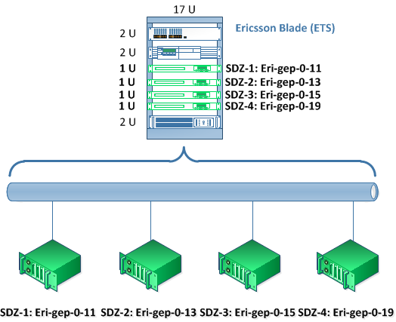
Demo … Overview
Lab Setup :
4 GEPs : Ericsson Blade System.
Running KVM, Libvirt.
Open vSwitches v2.3.90
Tenants 3-Tier application:
Web App, Buiss App, DB App
OpenDaylight Controller + OVSDB Plugin + OF13 Plugin
OpenStack Icehouse.
Ubuntu 12.04/Fedora 20
Virtual DCNs Initialization :
Creation of Neutron Network:
VXLAN, GRE
Creation of 5 instances.

Slide 39
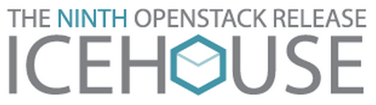
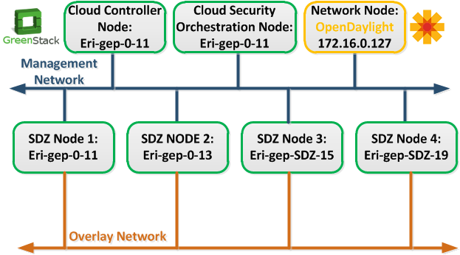
Demo … Basic architecture
Cloud Controller Node:
IP Address: 172.16.1.11.
Hostname: eri-gep-0-11.
Orchestration Node:
IP Address: 172.16.1.11.
Hostname: eri-gep-0-11.
OpenDaylight Controller Node:
IP Address: 172.16.0.127.
Hostname: cdo_controller
Compute Nodes:
IP Address: 172.16.0.11 Hostname: eri-gep-0-11
SDZ Nodes:
IP Address: 172.16.0.13 Hostname: eri-gep-SDZ-13
IP Address: 172.16.0.19 Hostname: eri-gep-SDZ-19
IP Address: 172.16.0.15 Hostname: eri-gep-SDZ-15
IP Address: 172.16.0.11 Hostname: eri-gep-SDZ-11

Slide 40
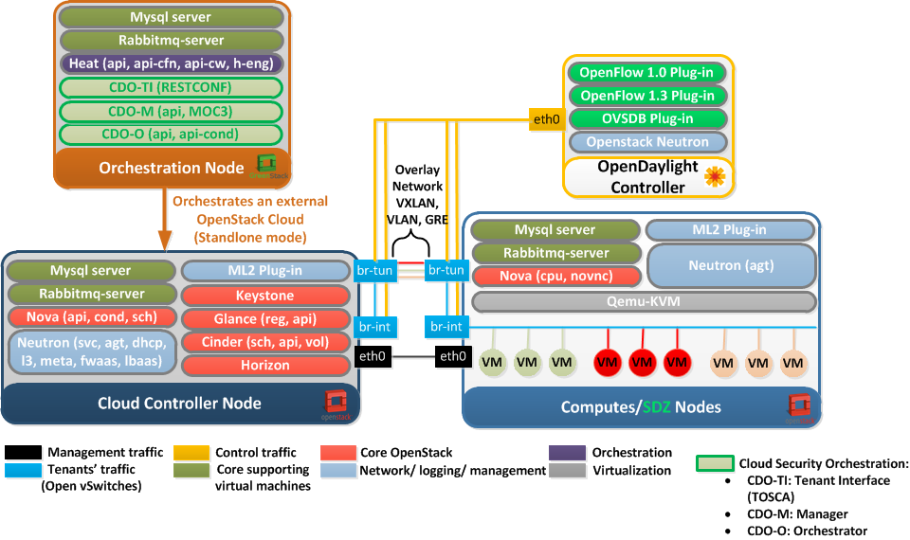
Demo … CDO Detailed
Framework

Slide 41
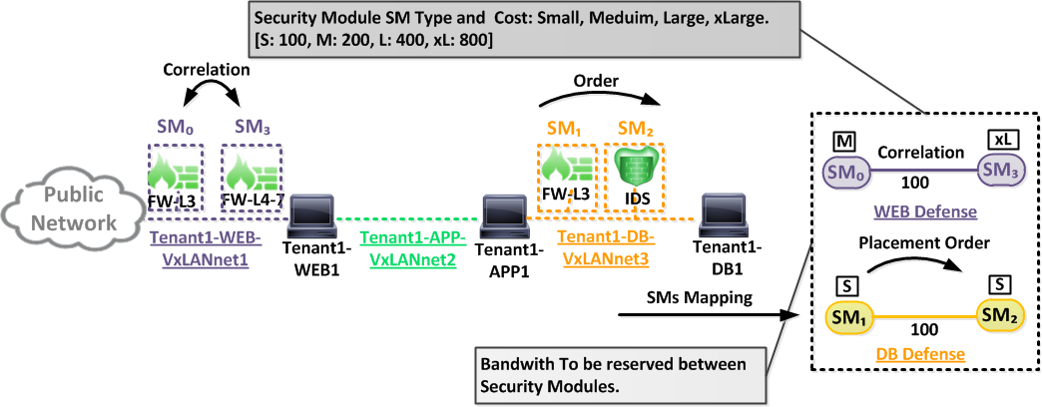
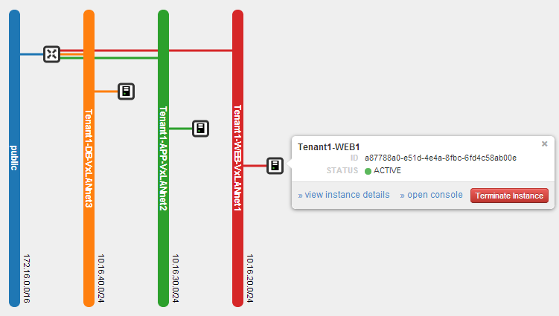
Demo … 3-tier Architecture
CDO Dashboard: NETWORK TOPOLOGY

Slide 42

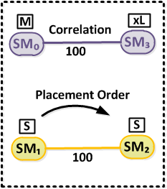
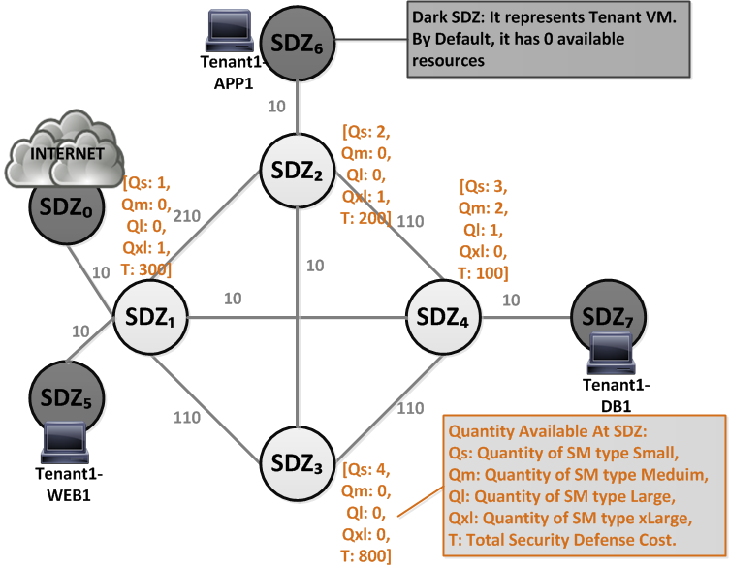
Demo … SDZ GRAPH …
SM PLACEMENT USING MOC3
NEW DEFENSE
CDO
MANAGER
CDO
Orch.
MOC3
PLACE NEW SM

Slide 43
START DEMO

Slide 44
DEMO EPICS
EPIC 2
ADEQUATE DEFENSE
EPIC 3
ELASTIC DEFENSE
EPIC 1
DYNAMIC ORCHESTRATION

Slide 45
EPIC 1: Dynamic Orches.
STORY 1: SM Placement

Slide 46

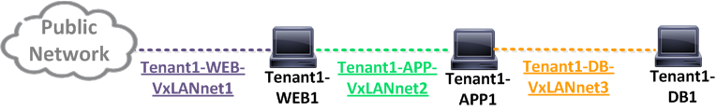
Demo … EPIC 1: Dynamic orch.
Objective: Instantiate a SM FW-L3 in the tenant topology at the optimal place to protect the web server (Tenant1-WEB1).
Step1: Present traffic for Tenant 1 (Tenant1-WEB-VxLANnet1) in initial state on CDO Dashboard.
Step2: Choose new SM FW-L3 characteristics via “new defense option”.
Step3: Find the best SM Placement Optimization using MOC3 algorithm.
Step4: Instantiate new SM at SDZ.
Step5: Complete the required network configuration.
Story 1: SM Placement

Slide 47
EPIC 1: Dynamic Orches.
STORY 2: CHAIN Placement

Slide 48


Demo … EPIC 1: Dynamic orch.
Objective: Instantiate a SM FW-L3 and SM IDS in the tenant topology at the optimal place to protect the data base (Tenant1-DB1).
Step1: Present traffic for Tenant 1 (Tenant1-DB-VxLANnet2) in initial state on CDO Dashboard.
Step2: Choose new SMs characteristics via “new defense option”.
Step3: Find the best SMs Placement Optimization using MOC3 algorithm.
Step4: Instantiate new SMs at SDZ.
Step5: Complete the required network configuration.
Story 2: Chain Placement

Slide 49
EPIC 2: ADEQUATE DEFENSE

Slide 50
Demo … EPIC 2: Adequate Defense
Objective: Instantiate a SM FW-L4-7 in front of web server (Tenant1-WEB1) and add it to the defense chain: Internet -> FW-L3 -> FW-L4-7-> Tenant1-WEB1.
Step1: Present traffic for Tenant 1 (Tenant1-WEB-VxLANnet1) in initial state on CDO Dashboard.
Step2: Choose new SM FW-L4-7 characteristics via “new defense option”.
Step3: Find the best SM Placement Optimization using MOC3 algorithm.
Step4: Instantiate new SM at SDZ.
Step5: Complete the required network configuration.

Slide 51
EPIC 3: ELASTIC DEFENSE

Slide 52
Demo … EPIC 3: Elastic Defense
Objective: Instantiate a SM FW-L4-7 in front of web server (Tenant1-WEB1) and add it to the defense chain: Internet -> FW-L3 -> FW-L4-7-> Tenant1-WEB1.
Step1: Present traffic for Tenant 1 (Tenant1-WEB-VxLANnet1) in initial state on CDO Dashboard.
Step2: Stress CPU WEB service FW-L3-SM-0.
Step3: Horizontal Scale UP for Tenant Defense with new FW-L3
Step4: Find the best SM Placement Optimization using MOC3 algorithm.
Step5: Instantiate new SM at SDZ & Complete the required network configuration.

Slide 53
CONCLUSION

Slide 54
Conclusion
CDO proposes new technique for SMs placement with the optimal location and the best path connection between them (MOC3) considering almost all existing security constraints.
CDO minimizes tenant’s SMs cost and the overall DC cost.
CDO find the best optimal path between SMs.
Our demo shows arbitrarily rich tenant deployments which is realized using distributed programmable data plane without performance degradation under modest loads.
Our scaling heuristic adequately eliminates SMs bottlenecks providing suitable end-to-end performance in a more cost-effective manner compared to naive scaling approaches.
Notes:
Our scaling heuristic adequately eliminates SMs bottlenecks providing suitable end-to-end performance in a 45% more cost-effective manner compared to naive scaling approaches.

Slide 55
Conclusion
Network-aware flow distribution and SM instance placement can enable more tenants to have their demands fully served, allow tenants to use the optimal number of SM instances, and leave up additional VM slots unused for providers to support future tenants.
Notes:
Network-aware flow distribution and SM instance placement in UtC deployments enables up to 30% more tenants to have their demands fully served, allows 45% of tenants to use the optimal number of VMbs instances, and leaves up to an additional 20% of VM slots unused for providers to support future tenants.

Slide 56
Next steps
CDO will introduces: An elastic mechanism to mitigate hybrid attacks and new features of defense: Composition, Decomposition and Migration.
CDO will provides not only a self-healing and self-optimisation of the security instances for high reliability and availability, but also the elasticity for the cloud security defense and complete central visibility of the virtual software-defined infrastructure.
Consolidate SMs in different SDZs
CDO PoC implementation.

Slide 57
Thanks for your
attention !

Slide 58
Backup SLIDES

Slide 59
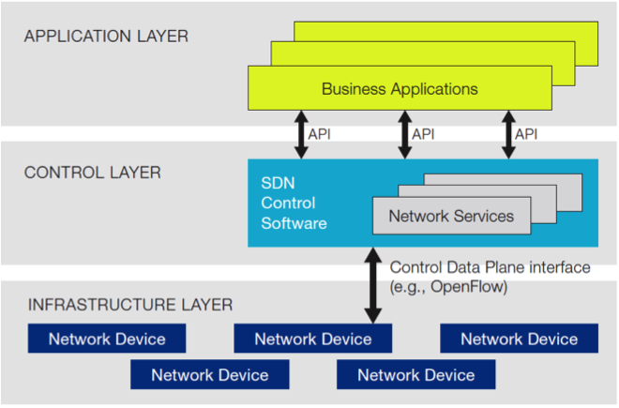
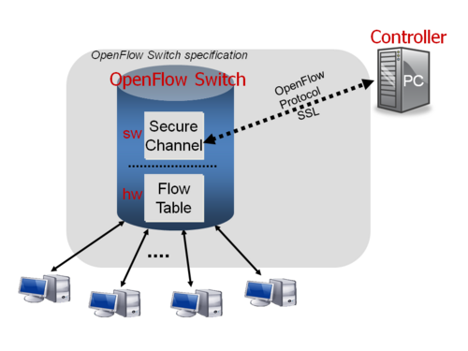
WHAT …
SDN, Open daylight, OpenStack Context
Software-Defined Networking : One of the promises of SDN is to enable the network operator have fine grained control over traffic patterns. Such fine grained control, especially at a Layer 2-4 flow level, could lead to more efficient network designs and enable network operators to offer value added services to their customers.
OpenFlow Protocol

Slide 60
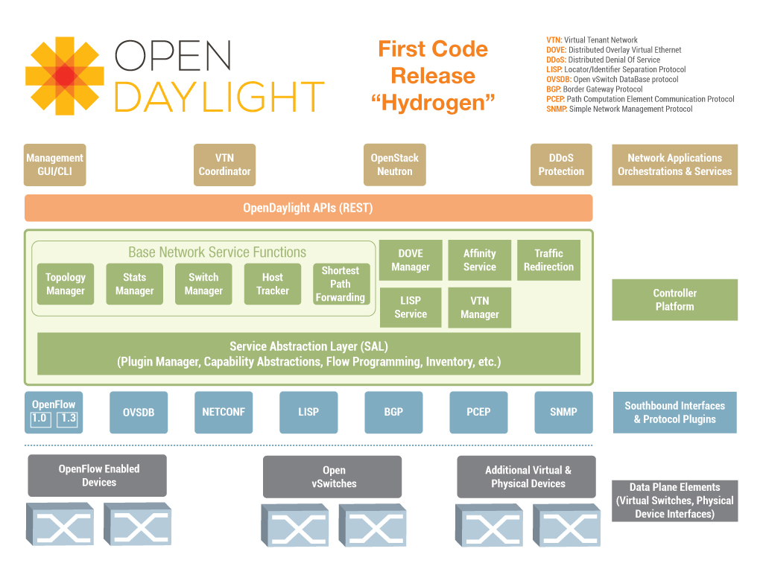

WHAT …
SDN, Open daylight, OpenStack Context
Open Daylight : Aims to innovate and create an open and transparent approach to SDN by providing network applications, orchestration and services under an open source Controller. It will be used to change dynamically to policy rules on virtual vSwitches to chain between tenant’s security modules.

Slide 61
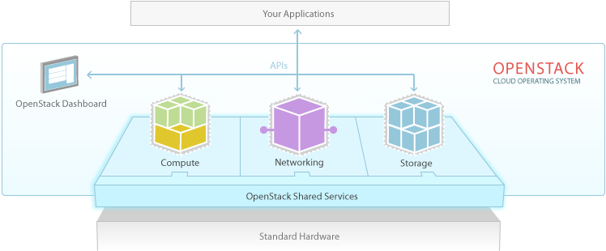
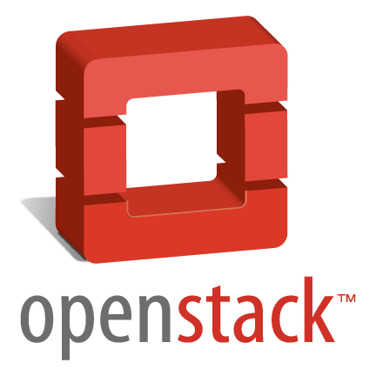
WHAT …
SDN, Open daylight, OpenStack Context
OpenStack :
Delivers a massively scalable cloud OS and controls large pools of compute (Nova), storage (Swift), networking (Neutron) and Orchestration (Heat).

Slide 62
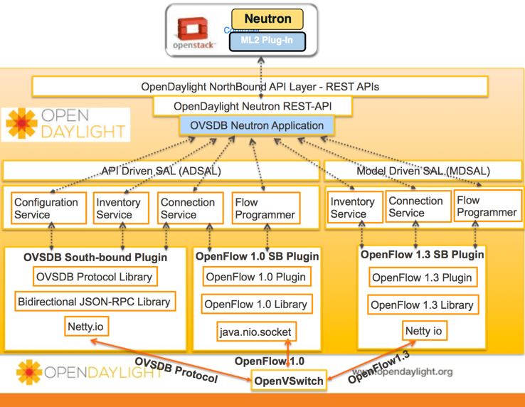
WHAT …
Open daylight, OpenStack Integration

