Slide 1
SEC 595: Special Topics in Information Assurance & Security
Secure Computing
(or Computing on Encrypted Data)
Lecture 1: Introduction
Instructor: Muhamad Felemban

Slide 2
What Is Security?
Security is about protecting data/systems from external or internal forces by preserving the three “pillars” of security
  Confidentiality
    Access to systems or data is limited to
    authorized parties
  Integrity
    When you receive data, you get the
    “right” data
  Availability
    The system (or data) is “available” when you need it

Slide 3
Security Vs. Privacy
What Is Privacy?
The terms are often used interchangeably
  In this course, hopefully you will be able to distinguish between the two
Two widely accepted definitions of privacy
  "The right to be let alone"
  "The fair use of information“
Privacy is relative to individuals, families, societies, countries, etc.

Slide 4

“The ability to compute on encrypted data is fast becoming a practical reality. We discuss the progress in four technologies which enable this:”
Trusted Execution Environments
Fully Homomorphic Encryption
Multi-Party Computation
Zero-Knowledge Proofs.
https://www.computer.org/csdl/magazine/sp/2023/04/10194492/1P4BEqduz9C

Slide 5


Homomorphic Encryption
Name inspired by ring-homomorphism
Ring of plaintexts
Ring of ciphertexts
Enc
$$+, ×$$
$$⊞, ⊠$$
Ring of plaintexts
Ring of ciphertexts
Enc

Slide 6
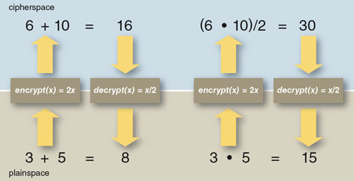
A Toy HE Scheme
Encryption: Double the plaintext. x → 2x
Decryption: Halve the ciphertext. x → x/2
https://www.americanscientist.org/article/alice-and-bob-in-cipherspace

Slide 7



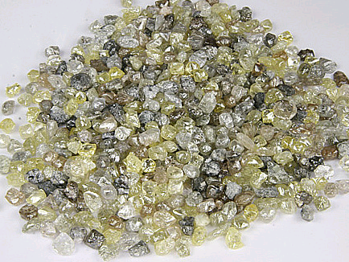

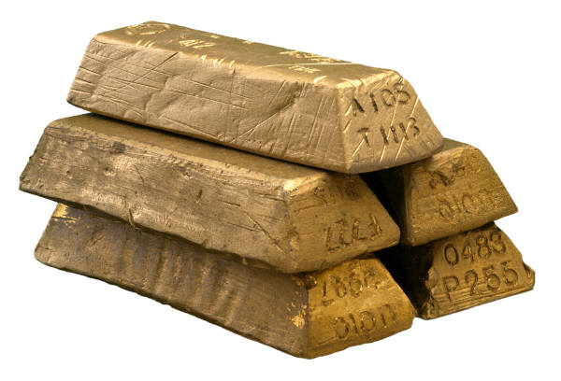

An Analogy
Alice wants workers to assemble raw materials into jewelry
But Alice is worried about theft:
  She wants workers to process raw materials without having access.
Alice puts raw materials in locked glovebox.
Workers assemble jewelry inside glovebox, using the gloves.
Alice unlocks box to get “results”.

Slide 8
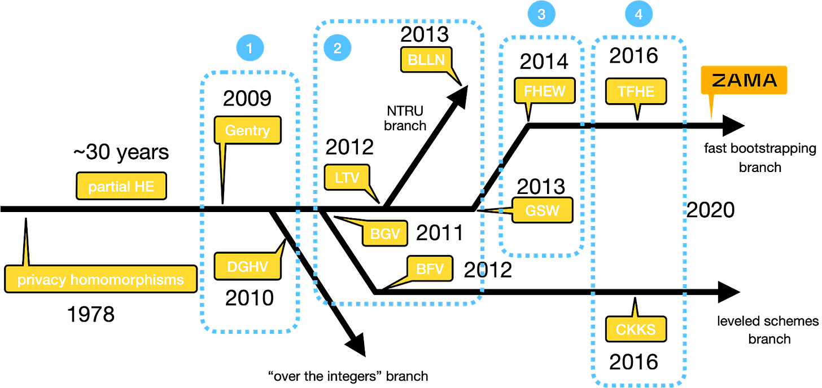
Evolution of FHE Schemes

Slide 9
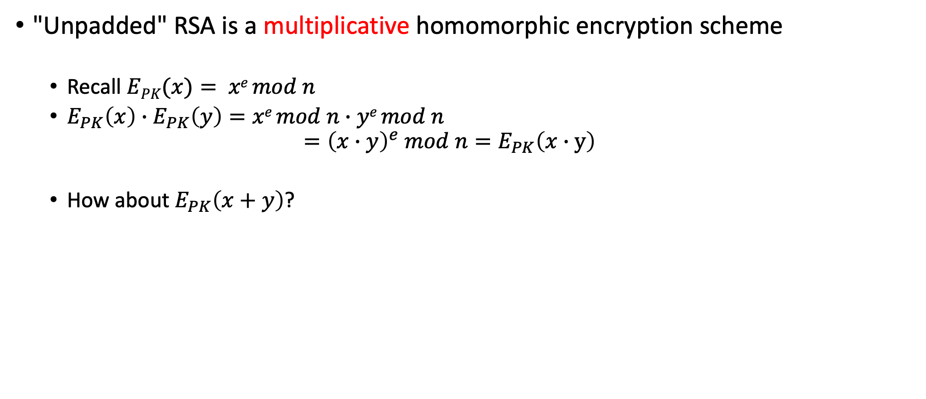
Examples of Homomorphic Encryption
"Unpadded" RSA is a multiplicative homomorphic encryption scheme
  Recall $EPK(x)= xe mod n$
  $E_{PK}\left(x\right)∙E_{PK}\left(y\right)=xe mod n∙ye mod n$
  $={\left(x∙y\right)}^{e} mod n=E_{PK}\left(x∙y\right)$
  How about $E_{PK}\left(x+y\right)$?

Slide 10
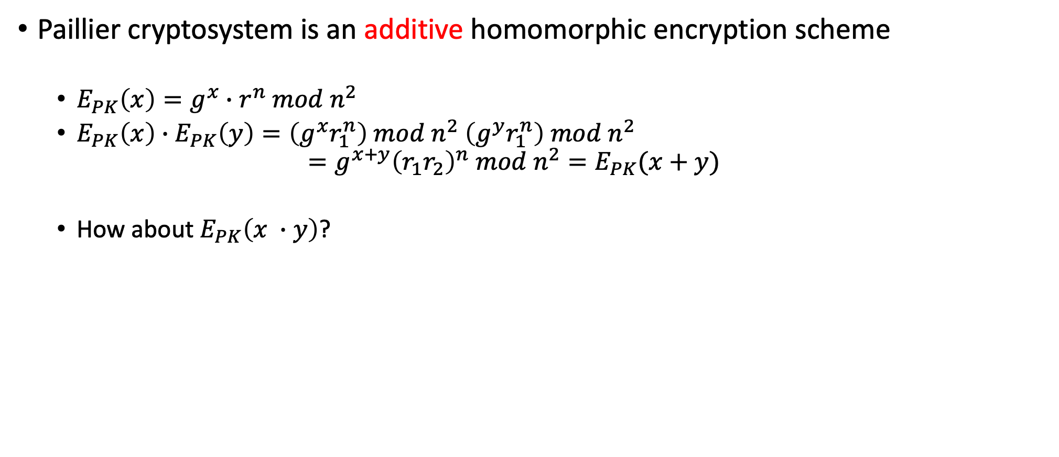
Examples of Homomorphic Encryption
Paillier cryptosystem is an additive homomorphic encryption scheme
  $E_{PK}\left(x\right)=g^{x}∙r^{n} mod n^{2}$
  $E_{PK}\left(x\right)∙E_{PK}\left(y\right)=\left(g^{x}r_{1}^{n}\right) mod n^{2} \left(g^{y}r_{1}^{n}\right) mod n^{2}$
  $=g^{x+y}{\left(r_{1}r_{2}\right)}^{n} mod n^{2}=E_{PK}(x+y)$
  How about $E_{PK}\left(x ∙y\right)$?

Slide 11
Homomorphic Encryption Types
Partially Homomorphic Encryption (PHE)
  Can evaluate functions with very limited operations (+ or *)
Fully Homomorphic Encryption (FHE)
  Arbitrary functions with any operations

Slide 12
Towards FHE
Genrty09: A bootstrapping technique
  Somewhat homomorphic → Fully homomorphic
Gentry also described a candidate “bootstrappable” scheme
  Based on ideal lattices
  Then extended to integer values
Scheme E can evaluate its own decryption circuit
Scheme E* can evaluate any circuit

Slide 13
A homomorphic symmetric encryption
Shared secret key: odd number p
To encrypt a bit m:
  Choose at random large q, small r
  Output c = pq + 2r + m
    Ciphertext is close to a multiple of p
    m = LSB of distance to nearest multiple of p
To decrypt c:
  Output m = (c mod p) mod 2
    m = c – p • [c/p] mod 2
    = c – [c/p] mod 2
    = LSB(c) XOR LSB([c/p])
2r+m much smaller than p

Slide 14
Why is this homomorphic?
c₁=q₁p+2r₁+m₁, c₂=q₂p+2r₂+m₂
c₁+c₂ = (q₁+q₂)p + 2(r₁+r₂) + (m₁+m₂)
  2(r₁+r₂)+(m₁+m₂) still much smaller than p
  ➔c₁+c₂ mod p = 2(r₁+r₂) + (m₁+m₂)
c₁ x c₂ = (c₁q₂+q₁c₂−q₁q₂)p
+ 2(2r₁r₂+r₁m₂+m₁r₂) + m₁m₂
  2(2r₁r₂+…) still much smaller than p
  ➔c₁xc₂ mod p = 2(2r₁r₂+…) + m₁m₂
Distance to nearest multiple of p

Slide 15
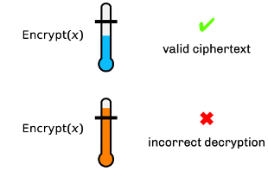
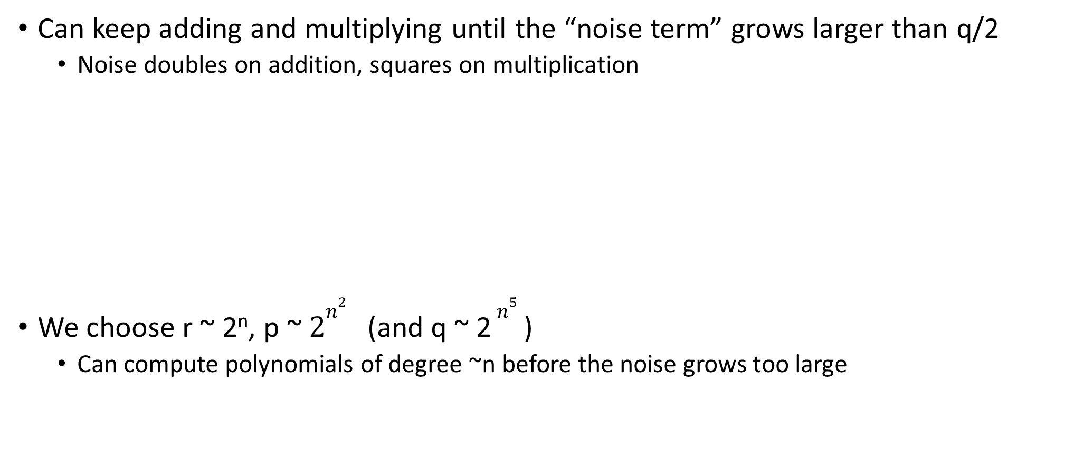
How homomorphic is this?
Can keep adding and multiplying until the “noise term” grows larger than q/2
  Noise doubles on addition, squares on multiplication
We choose r ~ 2^{n}, p ~ $2n^{2}$ (and q ~ 2 $n^{5}$ )
  Can compute polynomials of degree ~n before the noise grows too large

Slide 16
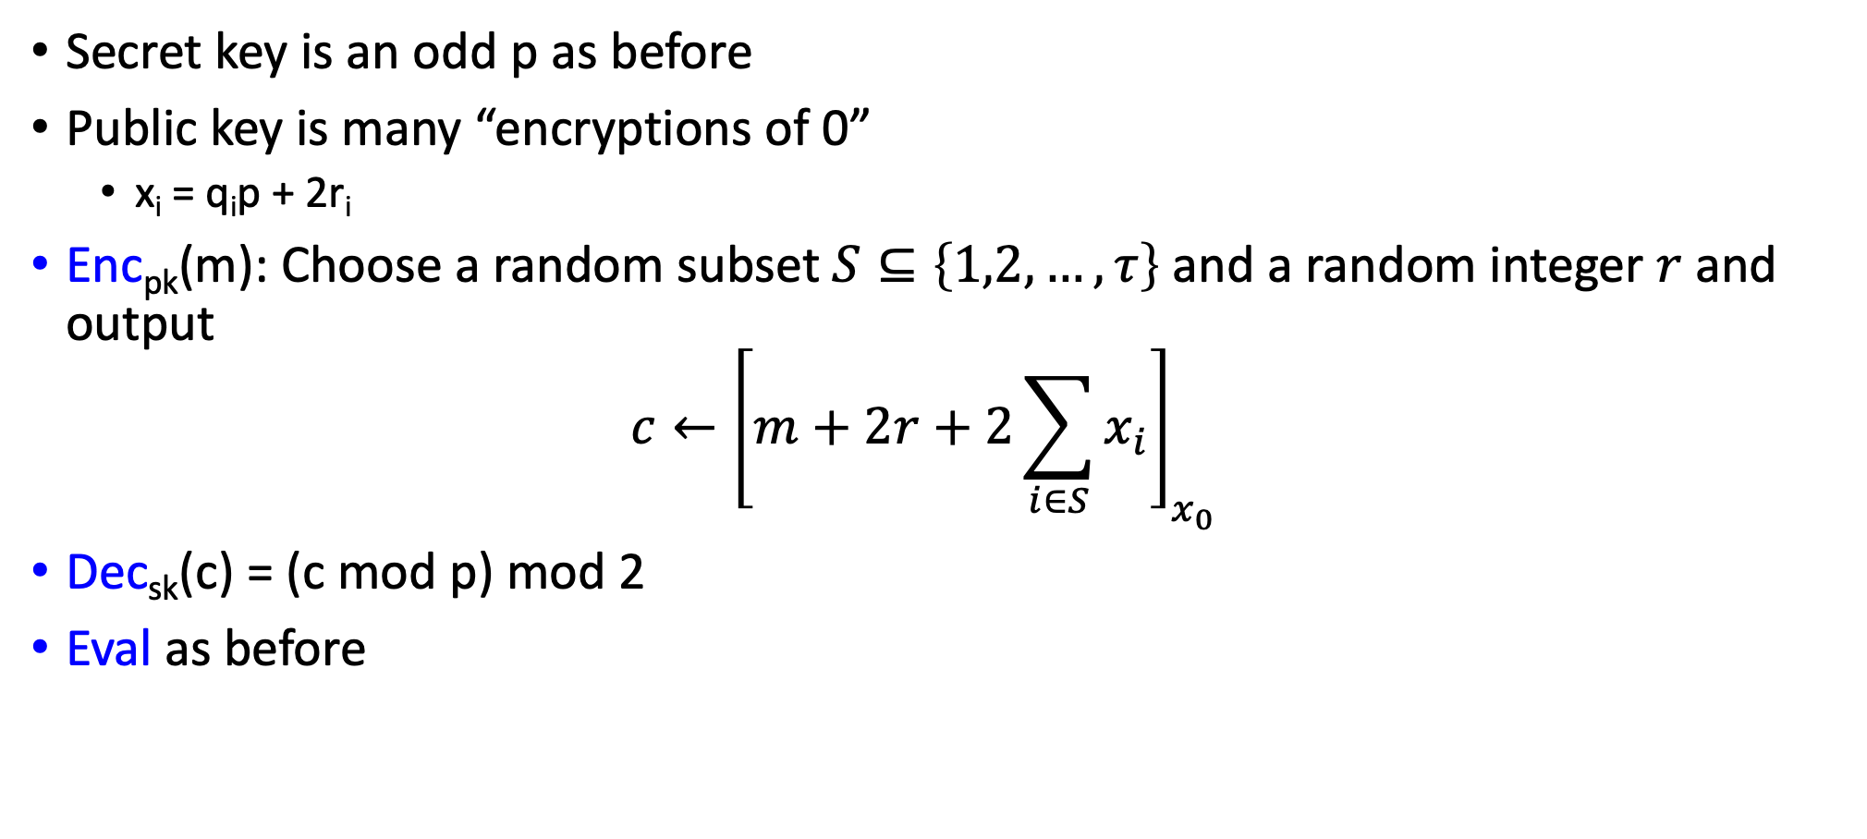
Homomorphic Public-Key Encryption
Secret key is an odd p as before
Public key is many “encryptions of 0”
  x_{i} = q_{i}p + 2r_{i}
Enc_{pk}(m): Choose a random subset $S⊆\left\{1,2,…,τ\right\}$ and a random integer $r$and output
$c←{\left[m+2r+2\sum_{i∈S}{x_{i}}\right]}_{x_{0}}$
Dec_{sk}(c) = (c mod p) mod 2
Eval as before
[ ]_{x0} for i=1,2,…,n

Slide 17
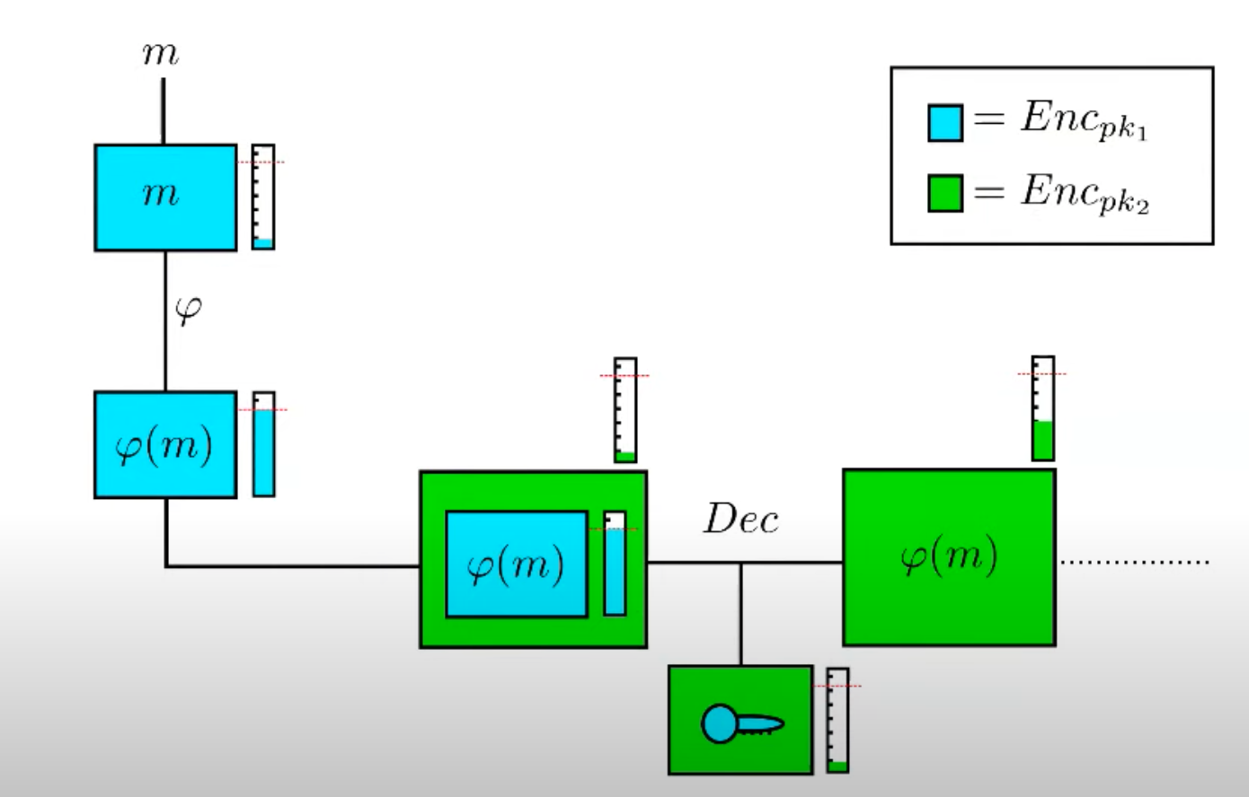
Bootstrapping

Slide 18
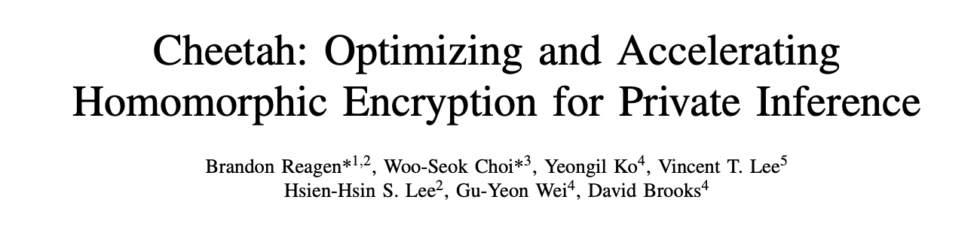

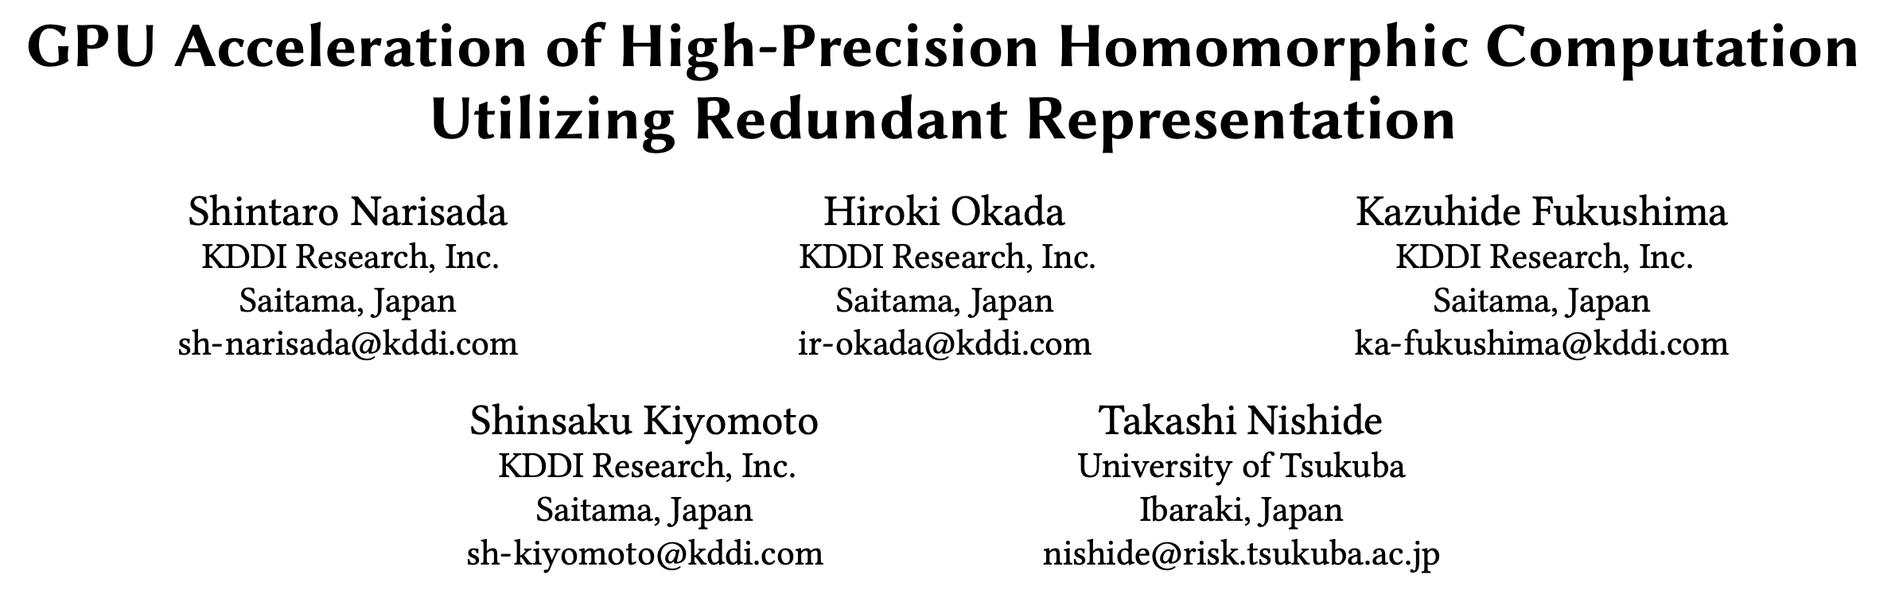
Speeding Up Bootstrapping

Slide 19
FHE Application Space
Secure machine learning
Cross-domain Networking
Many
Secure document sharing
Secure mission tasking
Encrypted Analysis
Number of data owners or users
Autonomous interdiction
1
Encrypted query
Autonomous recon
Cooperative
Adversarial
*Source: DARPA DPRIVE presentation

Slide 20
“The ability to compute on encrypted data is fast becoming a practical reality. We discuss the progress in four technologies which enable this:”
Trusted Execution Environments
Fully Homomorphic Encryption
Multi-Party Computation
Zero-Knowledge Proofs.
https://www.computer.org/csdl/magazine/sp/2023/04/10194492/1P4BEqduz9C

Slide 21
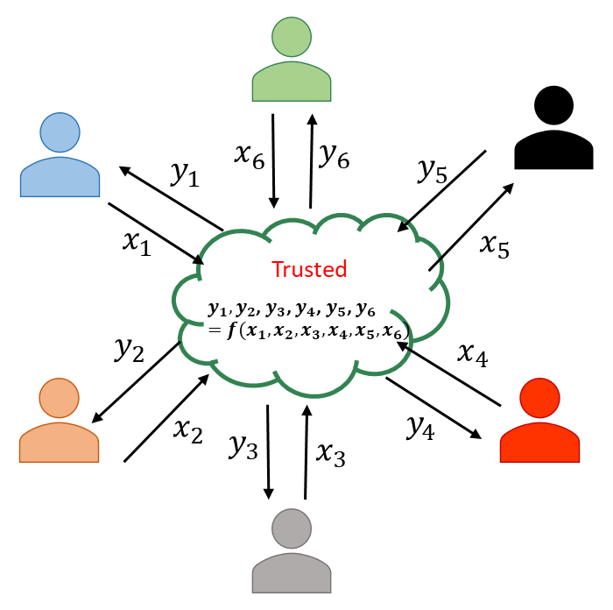
Secure Multiparty Computation (SMPC or MPC)
Secure multiparty computation is a subfield of encrypted computation
MPC involves multiple parties (who do not trust each other) agreeing to compute a joint function of their inputs but only if the data is encrypted
Parties wish to preserve
  Privacy: parties can’t observe each others’ inputs
  Correctness: the function gives the correct results
Privacy must be preserved in the face of adversarial behavior by
  One (or some) of the participants, or
  An external party

Slide 22
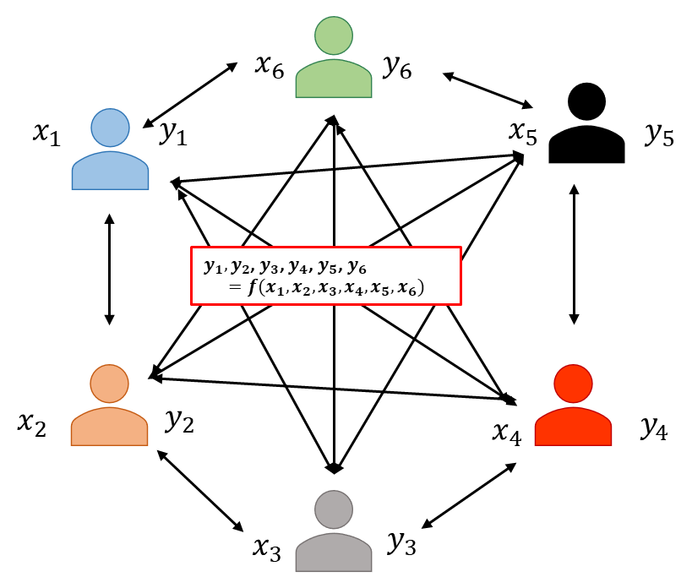
A Couple of Observations
In all cases, we are dealing with distributed multi-party protocols
  A protocol describes how parties are supposed to exchange messages on the network
All these tasks can be easily computed by a trusted third party
The goal of secure multi-party computation is to achieve the same result without involving a trusted third party

Slide 23


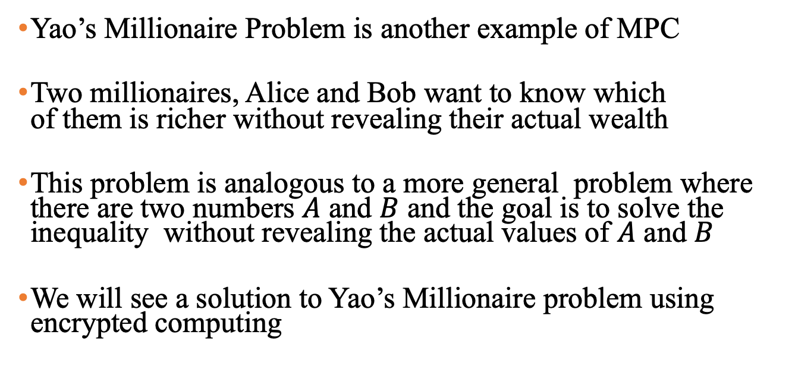
Yao’s Millionaire Problem
I am more
rich
Yao’s Millionaire Problem is another example of MPC
Two millionaires, Alice and Bob want to know which
of them is richer without revealing their actual wealth
This problem is analogous to a more general problem where there are two numbers $A$ and $B$ and the goal is to solve the inequality without revealing the actual values of $A$ and $B$
We will see a solution to Yao’s Millionaire problem using encrypted computing
I am rich

Slide 24




Use case: Private Set Intersection
Ahmed
Bader
Ahmed
Abdullah
Bader
Muhamad
Khalid
Ahmed
Abdulaziz
Bader
Mahmood
Saleh
Notes:
SFE: Great result from theory of crypto that allows 2 parties to jointly compute some function, without either learning anything other than the result.

Slide 25
Practical Multi-Party Private Set Intersection Protocols
Ahmed
Abdullah
Bader
Muhamad
Khalid
Ahmed
Abdullah
Bader
Muhamad
Khalid
0 | 0 | 1 | 0 | 1 | 0 | 1
1 | 1 | 1 | 0 | 1 | 0 | 1
1 | 1 | 0 | 0 | 1 | 1 | 1
1 | 1 | 1 | 0 | 1 | 0 | 1
Ahmed
Abdullah
Bader
Muhamad
Khalid
Ahmed
Abdullah
Bader
Muhamad
Khalid
Bay, Aslı, et al. "Practical multi-party private set intersection protocols." IEEE Transactions on Information Forensics and Security 17 (2021): 1-15

Slide 26

Practical Multi-Party Private Set Intersection Protocols
Ahmed
Abdullah
Bader
Muhamad
Khalid
Ahmed
Abdullah
Bader
Muhamad
Khalid
What if sets are updated?
Ahmed
Abdullah
Bader
Muhamad
Khalid
Ahmed
Abdullah
Bader
Muhamad
Khalid
Decrypt to find set intersection
Bay, Aslı, et al. "Practical multi-party private set intersection protocols." IEEE Transactions on Information Forensics and Security 17 (2021): 1-15

Slide 27
"Updatable" Multi-Party Private Set Intersection Protocols
Ahmed
Abdullah
Bader
Muhamad
Khalid
Ahmed
Abdullah
Bader
Muhamad
Khalid
0 | 0 | 1 | 0 | 1 | 0 | 1
1 | 1 | 1 | 0 | 1 | 0 | 1
1 | 1 | 0 | 0 | 1 | 1 | 1
1 | 1 | 1 | 0 | 1 | 0 | 1
Ahmed
Abdullah
Bader
Muhamad
Khalid
Ahmed
Abdullah
Bader
Muhamad
Khalid

Slide 28
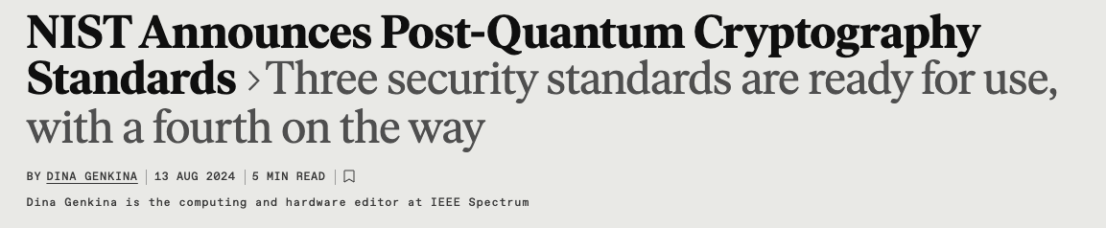
Exciting News!!

Slide 29
Course Objectives
The objective of this course is to
Introduce the students to the emerging field of encrypted computing.
Expose students to the state-of-the-art algorithms in homomorphic encryption and secure multiparty computation

Slide 30
Course Learning Outcomes
After taking this course, you will be able to
Explain various encrypted computing techniques and algorithms.
Identify the advantages and challenges of different encrypted computing algorithms.
Apply appropriate encrypted computing techniques based on the application’s requirements.
Design new encrypted computing techniques and protocols.

Slide 31
Logistics
Lectures: Sunday & Tuesday, 8:10-9:25 PM
Office hours: UT 1:00-2:00 PM
  Office# 22-214
  Teams (or send me on Teams and I will try to accommodate your Qs online )
Web page:
  Blackboard page

Slide 32
Logistics
Evaluation
  Paper Presentation 10 %
  Term Project 50%
  Major Exam 20%
  Final Exam 20%

Slide 33
Logistics
Course Project:
  Teams of 2-3 (if you want to work alone, please let me know ahead of time)
  Project proposal: 0.5-1 page (TBA)
  Deliverable Part I: 1-2 page Progress report (TBA)
  Deliverable Part II: Written report: 4-8 pages (TBA)
  In-class presentations (Week 15)

