Slide 1
Socially Responsible Software Development
Matthias Felleisen, PLT

Slide 2
I, Me, Myself
programming language researcher
… who cares about programming
founded PLT, which is behind the Racket language
maintained student-facing sw (appr. 50-100 Kloc) for ~30 years
developed a software development curriculum for ~25 years
.. starting with an alternative programming curriculum for K12 and freshmen

Slide 3
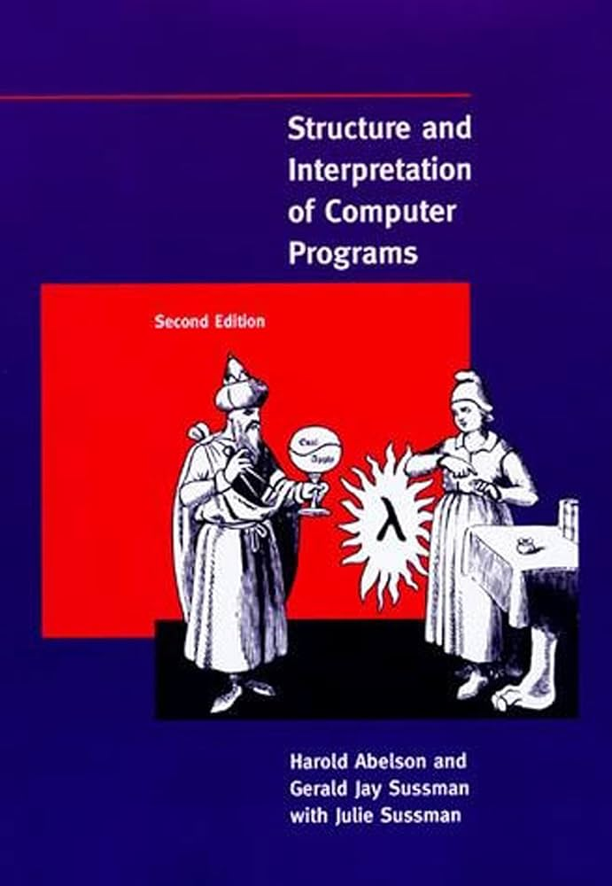
Software Development
… a violent psychopath who knows where you live. John F. Woods
Older version of you or your friend or …
Older version of you or your friend or …
The maintainer.
Another maintainer.
The maintainer.
write code
writes
code
read
comprehend
modify
code
read
comprehend
modify
code
read
comprehend
modified
code
cost centers
cost centers
cost centers
cost centers
cost centers
Structure & Interpretation
of Computer Programs

Slide 4
Socially Responsible Software Development
reduced cost
happier developers
The maintainer.
Another maintainer.
The maintainer.
write code
writes
code
read
comprehend
modify
code
read
comprehend
modify
code
read
comprehend
modified
code
must think of recipient
must think of recipient
must think of recipient

Slide 5
Socially Responsible Software Development
How do we get there?
Social (“Soft”) Skills
Us
I
Technical (“Hard”) Skills

Slide 6

The Big Picture: How to turn novices into basic sw devs
Fundamentals IV
very large, distr.
inspections
five core courses (plus one 6-month co-op)
key ideas across all courses, scaled from 5-liners to 15Kloc per semester:
fundamentals are more important than currently fashionable industry ideas
design code systematically (techn. or “hard” skills)
programming is a people discipline (social or “soft” skills)
final course is about “grace under pressure”
6-mo co-op
Fundamentals III
code that does not fit into your head
Fundamentals II
sys. design w/ typed OO;
pair prog.
Logic
stating properties
run-time checks
static checks
Fundamentals I
sys. design
pair prog.
How to Design Programs

Slide 7
Let’s talk about “Us”

Slide 8


Us
interface IDirection {
// the starting point for sliding this row
public int start();
// are there hasNext tiles to slide in this row?
public boolean hasNext(int i);
// the index of the next tile to slide in this row
public int next(int i);
}
A Human Partner !!
create code
AI !
what is sufficiently intelligent to check my thinking while I create code?
LATER

Slide 9

Us
create code
what?
how?
why?

Slide 10
Us, Pair Programming
create code
what?
What: All code is created by pairs of software developers.
how?
why?

Slide 11
Us, Pair Programming
create code
How: One developer drives the development, the other questions the code.
what?
how?
why?
How: Every so often the developers switch roles.

Slide 12
Us, Pair Programming
create code
what?
Why? Oh why are two people being paid to develop one piece of code?
how?
why?

Slide 13
Us, Pair Programming
represents the future receipient of this code:
— is is readable?
— does it work properly?
— are we designing it systematically?
two people
create code
shared knowledge: one is here
— when the other quits, moves to another company
— when one person is out sick for a week
— when someone travels
pair programming spreads coding skills and habits
— I like to learn from others
— when I teach, I learn because I have to justify ideas
some programming tasks are dull; par programming can reduce the dull part and avoid bugs due to carelessness

Slide 14
Let’s talk about “Us” some more

Slide 15
Us, Pair Programming
two people
create code
rotate through pairs in a team
Echo Chamber

Slide 16
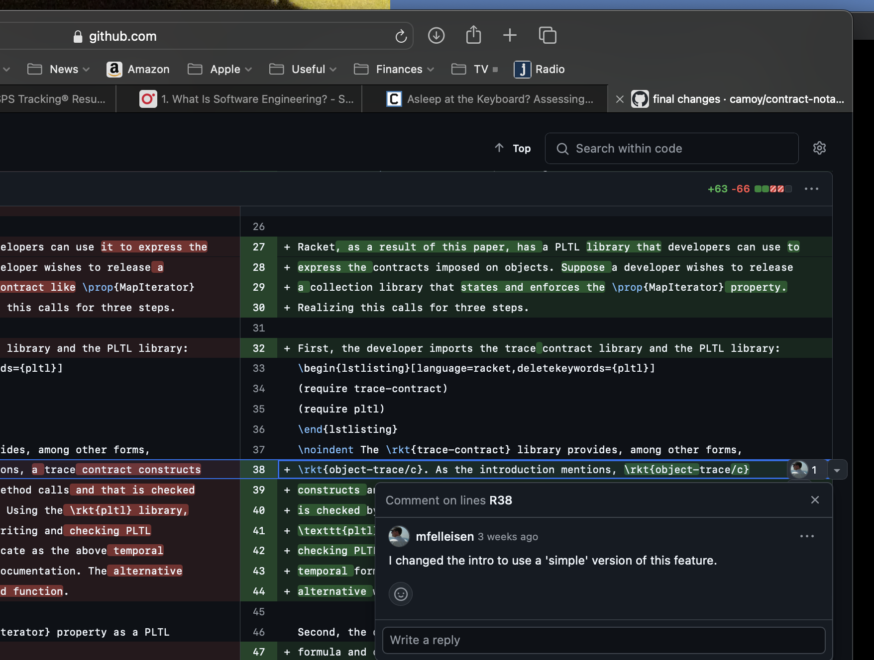
Us, Pair Programming
two people
create code
use github to review PRs
Echo Chamber

Slide 17
Us, Pair Programming
useful? yes!
stress? it is a social network.
bad patterns? very much so.
big picture idea? usually not!
teaching moments? no.
use github to review PRs

Slide 18
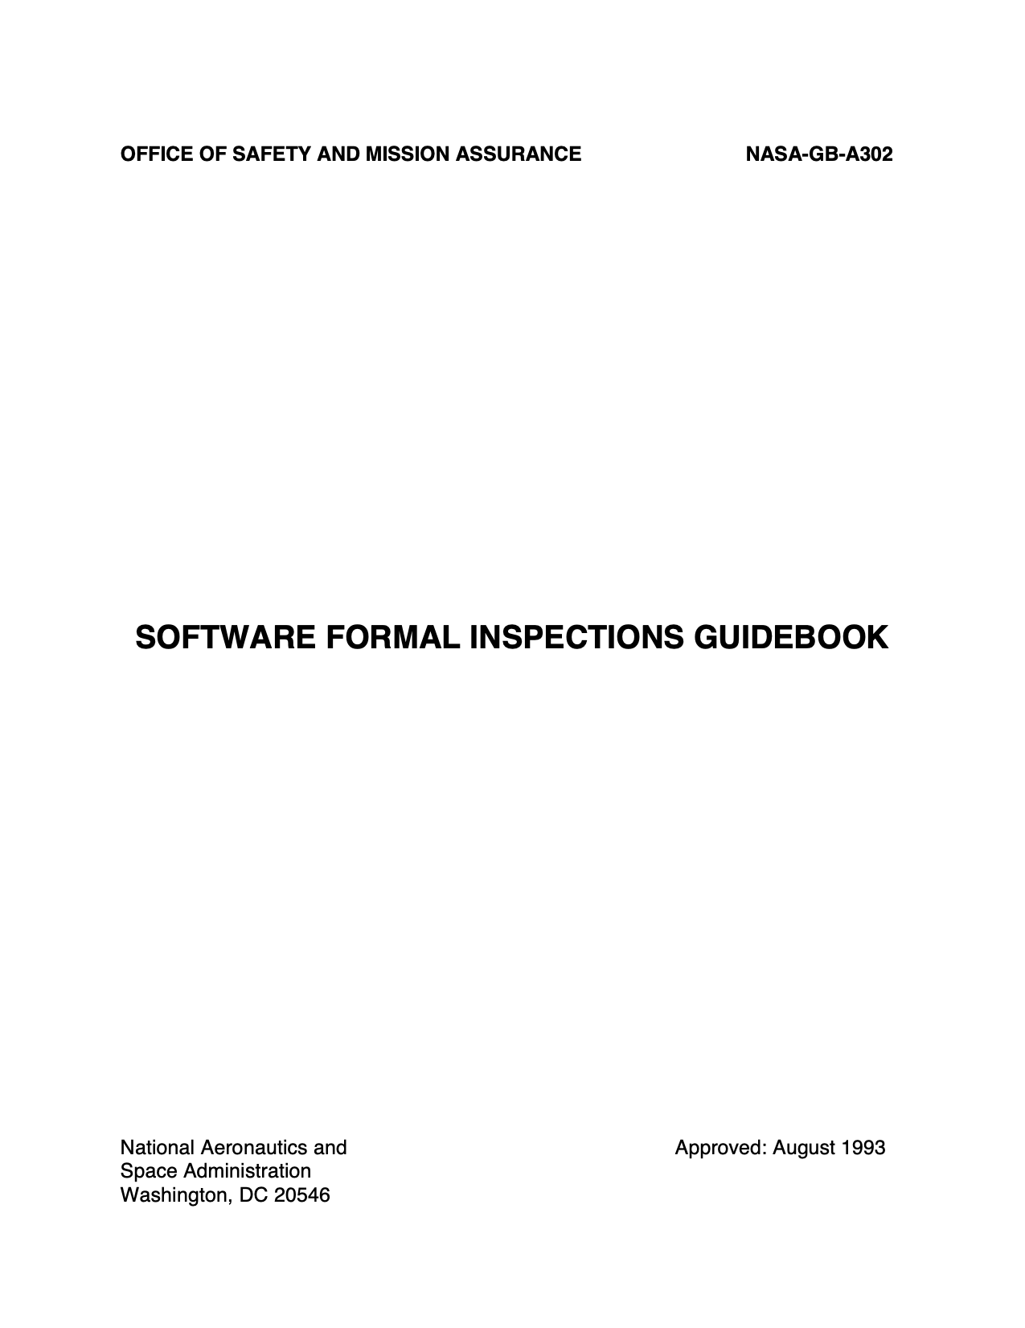
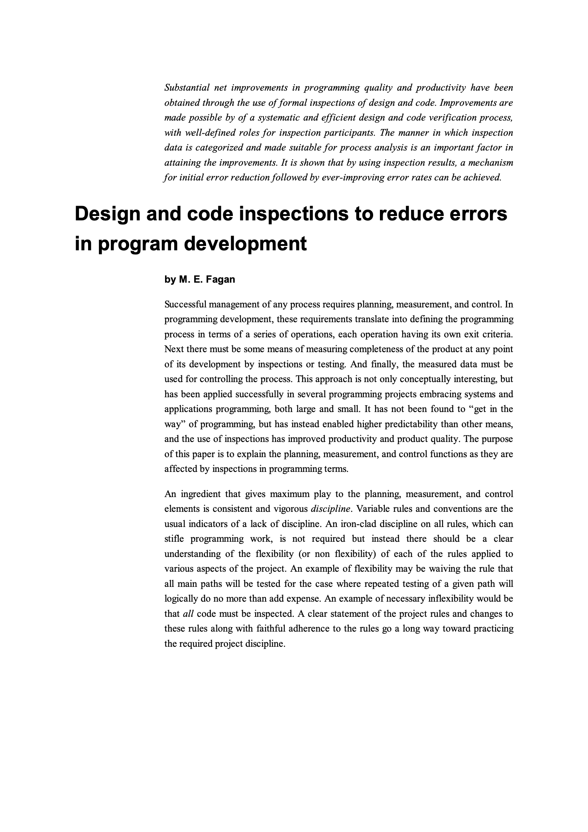
Us, Pair Programming
NASA:
Formal Code Inspection
two people
create code
in person code inspections
Fagan:
Code Inspections
Echo Chamber

Slide 19
Us, Pair Programming
How: small panels
— head (moderator)
— reader (1 or 2)
— secretary?
two people
create code
in person code inspections
Echo Chamber

Slide 20
Us, Pair Programming
two people
create code
What:
creators present
readers inspect
in person code inspections
— readability
— bugs
— design flaws
Echo Chamber

Slide 21
Us, Pair Programming
Why:
— presenting forces focus
— real-time conversations
— develop human resources
two people
create code
in person code inspections
Echo Chamber

Slide 22
Us, Pair Programming
is this really a cost?
two people
create code
Cost:
— training
— time for reviews
— stress of facing people
with not-so-great code
code inspections
Echo Chamber

Slide 23
Let’s talk about “I” or really “Ego”

Slide 24
I, Ego
create code
Creators
who fail
authors
composers
painters
…
developers
bad reviews, no sales
booed at premier
“ouch” at vernissage
gets paid

Slide 25
I, Ego
be satisfied & happy with out “output”
ill-designed!
buggy!
incomprehensible
ego
thank you

Slide 26
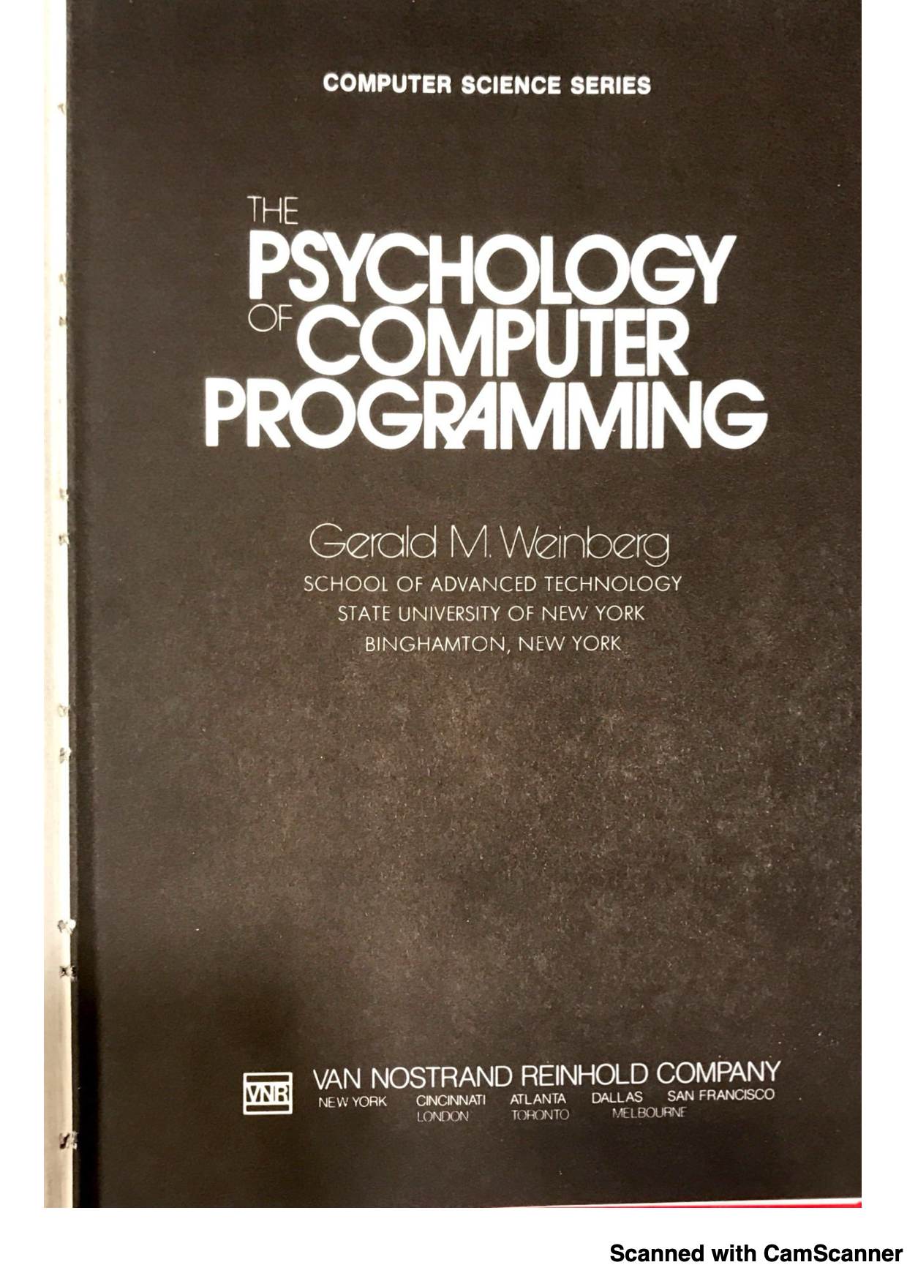
I, Ego
be satisfied & happy with out “output”
ill-designed!
buggy!
Incomprehensible
egoless programming:
ego
critique doesn’t hurt our ego, it improves our creation

Slide 27
I, Ego
egoless programming taken seriously:
create code that you are happy about, put some “ego” into it
solicit feedback, often
take negative feedback for help to improve this product of yours
improve code, rinse and repeat

Slide 28
Social Skills
to develop software in a socially responsible manner, we need
a mental state of ``egoless’’ programming
welcome critique
continuous feedback to our thinking while we code
read code aloud to a partner
active milestone reviews
github at a minimum
presentations to the team
formal panel reviews at a maximum

Slide 29
Let’s talk about Technical Skills

Slide 30
The Big Picture: How to turn novices into basic sw devs
Fundamentals IV
very large, distr.
imspections
five core courses (plus one 6-month co-op)
key ideas across all courses, scaled from 5-liners to 15Kloc per semester:
fundamentals are more important than currently fashionable industry ideas
design code systematically (techn. or “hard” skills)
programming is a people discipline (social or “soft” skills)
final course is about “grace under pressure”
6-mo co-op
Fundamentals III
code that does not fit into your head
Fundamentals II
sys. design w/ typed OO;
pair prog.
Logic
stating properties
run-time checks
static checks
Fundamentals I
sys. design
pair prog.
How to Design Programs

Slide 31
Technical Skills: The Purpose
Every unit of code needs a
focused purpose statement:
method
class
module
package
write code
writes
code
read
comprehend

Slide 32
Technical Skills: The Purpose
Every method needs a
focused purpose statement:
what it computes relative to the class
`this`
clarifies whether
it is atomic.
it is composite.
write code
writes
code
read
comprehend

Slide 33
Technical Skills: The Purpose
Every class (collection) needs a
focused purpose statement:
data represents information
abstraction!
clarifies how to turn
an actual car into an instance of Car
interpret an instance of Car in the real world
class Car {
…
}
the thing in itself
(“das Ding ansich”)

Slide 34
Technical Skills: The Purpose
To what?
class Car {
int shortest_Distance;
int move_Car() {
... }
}
To where?

Slide 35
We know we need GREAT NAMES for methods and fields and so on.
Technical Skills: The Purpose

Slide 36
Technical Skills: The Purpose
class Car {
int shortest_Distance_To_Car_On_The_Left_From_Front_Left_In_CM;
int move_x_CM_to_the_Right_Relative_to_Front_Right_of_Car() {
... }
}

Slide 37
Technical Skills: The Purpose
class Car {
int shortest_Distance_To_Car_On_The_Left_From_Front_Left_In_CM;
int move_x_CM_To_The_Right_Relative_To_Front_Right_of_Car() {
... }
}
F# to the Rescue
F# to the Rescue

Slide 38
Technical Skills: The Purpose
Every reader must parse names such as these.
class Car {
int shortest_Distance_To_Car_On_The_Left_From_Front_Left_In_CM;
int move_x_CM_To_The_Right_Relative_To_Front_Right_of_Car() {
... }
}
Other than `cm` little about this name can be enforced.
Where do we stop with this name game?

Slide 39
Technical Skills: The Purpose
class Car {
// shortest_distance to car on the left from front left
int distance_To_Left; // in cm
// determine how many CM THIS car’s front must move to the right
int moveTo_The_Right() {
... }
}

Slide 40
Technical Skills: The Method
Every method must convey the
“how” in a concise manner. It
is either atomic or composite.
An atomic method comes with
a purpose statement that explains
what it computes (and occasionally
how it computes).
write code
writes
code
read
comprehend
A composite method comes with
a purpose statement that enumerates
the tasks it composes.
(And if the names of the “subroutines” are well-chosen, we can erase the purpose statement.)

Slide 41
Technical Skills: The Method
Squeak [2020] consists of 600,000 lines of code.
How long is the average method?
write code
Six lines.
writes
six lines
reads
six lines

Slide 42
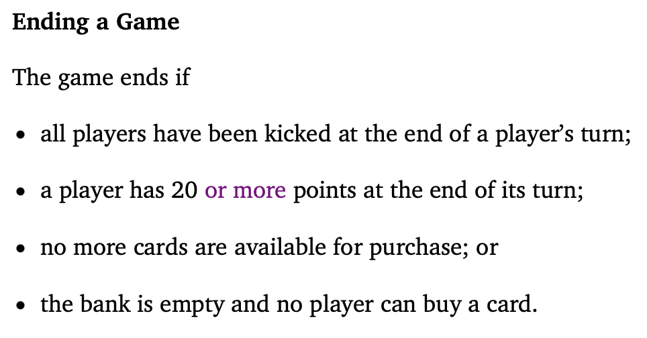
Technical Skills: The Method
class GameState {
// is the game over according to the rules?
public boolean gameOver() {
return
this.allPlayersEliminated()
|| this.aPlayerHasGoodScore()
|| this.allCardsBought()
|| this.noPebblesOrBuyers();
}
}

Slide 43
Technical Skills: The Method
class GameState {
// is the game over according to the rules?
public boolean gameOver() {
return
this.allPlayersEliminated()
|| this.aPlayerHasGoodScore()
|| this.allCardsBought()
|| this.noPebblesOrBuyers();
}
}
passes the exact same tests
passes the exact same tests
class GameState {
// is the game over according to the rules?
public boolean gameOver() {
if (this.players.isEmpty())
return true;
if (this.cards.isEmpty())
return true;
for(Player p : this.players) {
if (p.score >= PlayerWins)
return true;
for(Player p : this.players) {
if (! p.canBuy(this.cards))
return false;
return true;
}
}

Slide 44
Technical Skills: The Tests
Every method needs tests.
unit tests encode examples
… that help comprehension
unit tests discover simple bugs
… and sometimes complex ones
have you considered property tests?
how good are your test suites?
mutation testing helps answer this question
write code
writes
code
&
tests
reads
comprehends
because of
examples

Slide 45
Technical Skills: Mutation
Object-oriented programming is not C with class and extends sprinkled over the code.
write code
writes
code
with
=
reads
comprehends
Aliasing

Slide 46

Technical Skills: Mutation
“OOP came from many motivations, two were central. … the small scale one was to find a more flexible version of assignment, and then to try to eliminate it altogether.”
Alan Kay.
The Early History of SmallTalk.

Slide 47
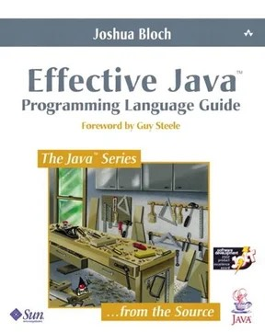
Technical Skills: Mutation
“Favor Immutability.”
(chapter 4)

Slide 48
Technical Skills
to develop software in a socially responsible manner, we need
learn to write focused purpose statements
learn to check focused purpose statements
distinguish between atomic and composite units of code
challenge any method that is longer than 10 lines
use mutation when needed
avoid it whenever possible

Slide 49
I wish you could …
AI
.. read
.. write
.. stop, drop, …

Slide 50
I wish you could read & write.
Write “code” in English.
Spits out Python.
Reads Python “code” and
checks whether it has something to do with the English.
AI
What if the co-worker is an AI?

Slide 51
I wish you could write.
What does it take to get an AI
to create the code that we want?
precise, focused purpose statements
with a clear distinction between
atomic units of code
composite units of code
a properly organized plan
AI
What if the co-worker is an AI?

Slide 52
I wish you could read.
What does it take to get an AI
to create code?
good
Why should we doubt AI-generated code?
bugs and git-reverts
safety holes
security holes
AI
What if the co-worker is an AI?

Slide 53
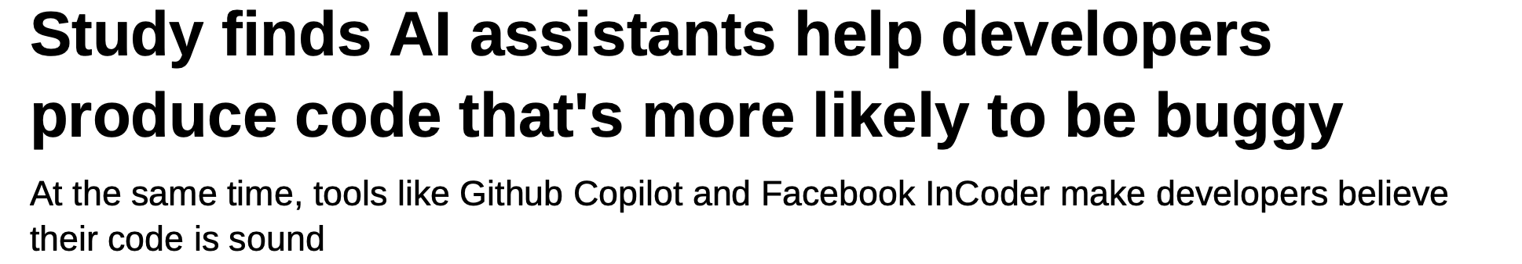
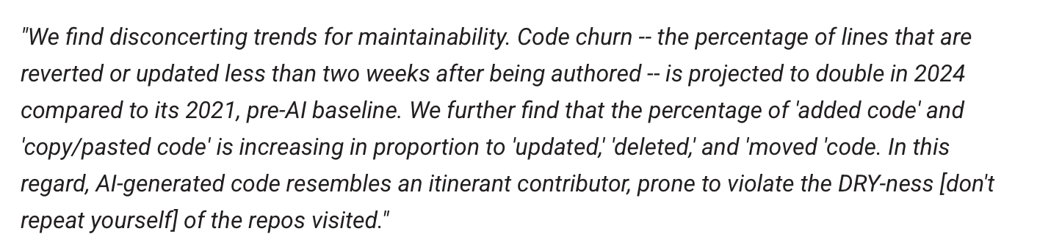
I wish you could read.
https://www.theregister.com/2022/12/21/ai_assistants_bad_code/
New GitHub Copilot Research Finds 'Downward Pressure on Code Quality’
Visual Studio Magazine, 25 Jan 2024

Slide 54
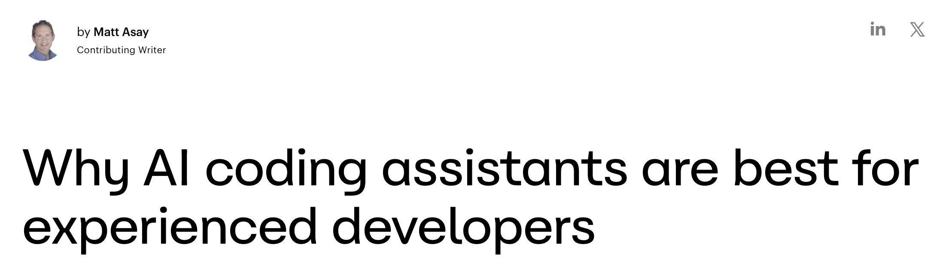
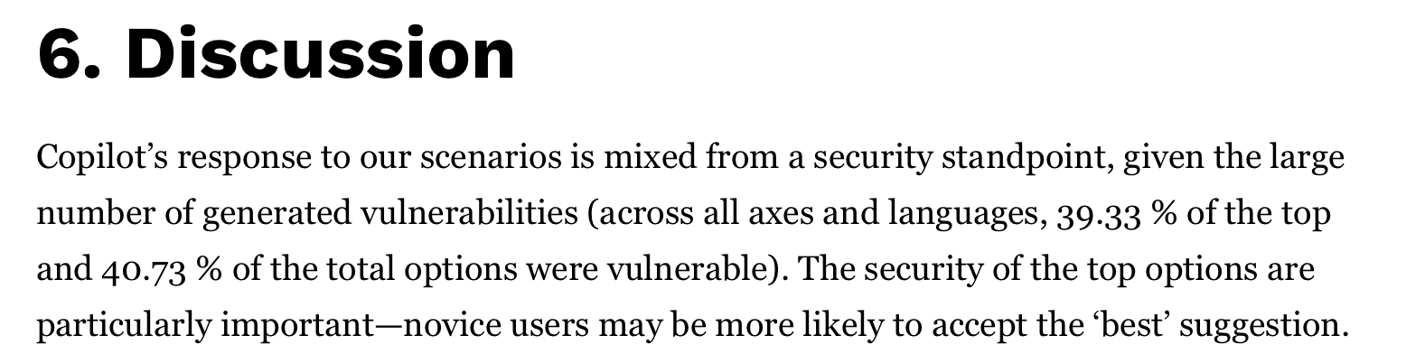
I wish you could read.
“Google’s Chrome team, writes, “AI tools help experienced developers more than beginners.”
Asleep at the Keyboard?
CACM 21 Jan 2025

Slide 55



How do I learn to read and write?
Books.

Slide 56
I wish you would stop, drop, …
… and reflect.

Slide 57
The End
Thanks for listening.

Slide 58
Technical Skills: Classes
Every class must convey the
“how” in a concise manner. It
is either atomic or composite.
An atomic class comes with
a purpose statement that explains
what unique information it represents.
A composite class comes with
a purpose statement that indicates
to which classes it delegates.
Favor Composition
Over Inheritance.
(chapter 4)

