Slide 1

Functional Programming is Easy, and Good for You
Matthias Felleisen (PLT)
Northeastern University

Slide 2

I am not a salesman.

Slide 3
Functional Programming

Slide 4
Functional Programming
Functional Programming Languages

Slide 5
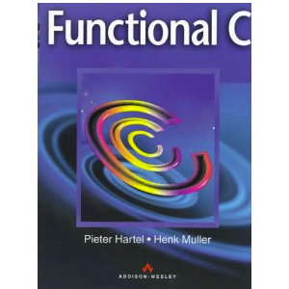
Theorem
Functional Programming
!=
Functional Programming Languages
Proof:

Slide 6










untyped
Scheme
higher-order
all others
pure
Clean
strict
all others
parallel
Clojure
standard VM
F#, Scala
Functional Programming
Functional Programming Languages
lazy
Haskell
distributed
Erlang
special VM
Racket
typed
SML
mostly
OCaml
first-order
ACL2

Slide 7
If all of this is functional programming (languages),
isn’t it all overwhelming and difficult?
{
what
why
+/-
Not at all. And I am here to explain

Slide 8
What is Functional Programming?
What is a Functional Programming Language?

Slide 9
Pop Quiz
: Who said this?
Though [it] came from many motivations, ... one was to find a more flexible version of assignment, and then to try to eliminate it altogether.
Favor immutability.
Use value objects when possible.

Slide 10
Answer: The OO Experts
Though [it] came from many motivations, ... one was to find a more flexible version of assignment, and then to try to eliminate it altogether.
Alan Kay,
History of Smalltalk (1993)
Favor immutability.
Joshua Bloch,
Effective Java (2001)
Use value objects when possible.
Kent Beck,
Test Driven Development (2001)

Slide 11
One Definition of Functional Programming
same input
same input
So one definition of functional
programming is
no (few) assignment statements
no (few) mutable objects.
some method
same output
(most of the time)

Slide 12
Another Definition
your program
some method
implicit
communication
another method

Slide 13
Another Definition
your program
some method
explicit
composition
another method

Slide 14
What does this mean concretely?

Slide 15




traffic light simulator
`click’
midnight
`click’
initial
states
intermediate
states
final
states

Slide 16
imperative OOPL
initial: setToRed
onTick: setTime
onClick: nextColor
stopWhen:atMidnight,renderWarning
toDraw: renderTrafficLight
type State = Color x Time
State current = ...
void setToRed() { ... }
void nextColor() { ... }
void renderTrafficLight() { ... }
void setTime() { ... }
boolean atMidnight() { ... }
void renderWarning() { ... }

Slide 17
functional
explicit state transformations allow local reasoning
initial: setToRed
onTick: setTime
onClick: nextColor
stopWhen: atMidnight,renderWarning
toDraw: renderTrafficLight
type State =
Initial U Intermediate U Final
Initial setToRed()
State nextColor(State current)
Image renderLight(State current)
State setTime(State current)
boolean atMidnight(State current) : Final
Image renderWarning(Final current)

Slide 18
Imperative Programming
Functional Programming
setToRed();
renderLight();
nextColor();
nextColor();
setTime();
renderLight();
nextColor();
if atMidnight()
renderWarning()
else
renderLight();
State s1 = setToRed()
Image i1 = renderLight(s1)
State s2 = nextColor(s1)
State s3 = nextColor(s2)
State s4 = setTime(s3)
Image i4 = renderLight(s4)
State s5 = nextColor(s4)
Image i5 =
atMidnight(s5) ?
renderWarning(s5),
renderLight(s5)

Slide 19


It all looks easy.
So what’s the catch?

Slide 20
Imagine a state that uses a record,
which contains vector in each slot,
and each record contains maps that
map names to lists of immutable data.
And imagine that you want to equip the monster with a dagger.
State
type State =
{ monsters : Vector<Monster>,
fighter : Status,
turns : Natural }
type Monster =
Map<String,List<Weapon>>
type Weapon = ...

Slide 21
type State =
{ monsters : Vector<Monster>,
fighter : Status,
turns : Natural }
type Monster =
Map<String,List<Weapon>>
type Weapon = ...
Imperative Programming
state.monsters[i][“orc”].addList(“dagger”);

Slide 22
type State =
{ monsters : Vector<Monster>,
fighter : Status,
turns : Natural }
type Monster =
Map<String,List<Weapon>>
type Weapon = ...
complex
operations
Functional Programming
Context x List<Weapon> <c,w> = unzip(state);
List<Weapon> new_list = addList(“dagger”);
zip(c,new_list);

Slide 23
going in
State
coming out
Functional Programming
Context x List<Weapon> <c,w> = unzip(state);
List<Weapon> new_list = addList(“dagger”);
zip(c,new_list);

Slide 24





a problem of
algorithmics
(“slow” performance)
a problem of
expressiveness
(“notational” overhead)
solution 1: zip/unzip & functional data structures
solution 2: monads
and other fancy constructs
solution 3: “bite the bullet” --
allow mutation in FP and FPLs

Slide 25




a problem of
expressiveness
solution 1: functional data
structures do not truly
eliminate notational overhead
solution 2: monads
gets close. The remaining
type overhead is arguably
an advantage. It helps
tame side effects.
solution 3: mutation in FP and FPLs
eliminates the problem as much as
desired. Danger: it opens the flood gate for careless programmers.

Slide 26



a problem of
algorithmics:
theory
functional data structures: we have no proof that functional data structures are as efficient as imperative programming.
monads: they
are implemented imperatively.
Period.
assignments in FPLs: they eliminates the problem as much as desired. Danger: it tempts programmers to use mutation too much.

Slide 27


a problem of
algorithmics:
in practice
mix and match: people tend to combine monads or mutation with functional data structures.
measuring end-to-end performance: efficiency is in practice indistinguishable from imperative programming.
catch: it takes experience to reach this point.

Slide 28





About Myself
I am not neutral.
I am not a purist.
research: objects, assignment statements, design patterns, web servlets, continuations, modules, functional I/O, etc.
teaching: start with functional programming in purely functional, strict languages
for 10,000s of students, starting
in 7th grade all the way to M.S.
programming: mostly functional, but OO and imperative as neede

Slide 29
Why Functional Programming?
Why a Functional Programming Language?

Slide 30


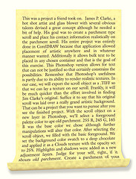




Programs must be written for people to read, and only incidentally for machines to execute. from: Abelson & Sussman, SICP
create
test
program
run
maintain
port

Slide 31


The cost of software is a function of the cost of programmer communication.
Functional programming and better functional programming languages
greatly reduce the cost of communication and thus the cost of software.

Slide 32

There are many sides to the cost story:
human, training, technical.

Slide 33
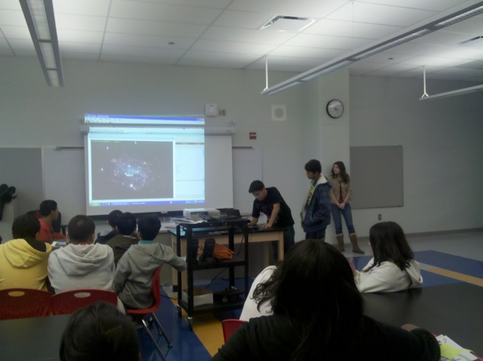

If these students
can do FP, it is easy
Interactive Games
1995:
DrScheme
15 yrs of FP
in high schools
2005: Bootstrap
for grades 6-8
Distributed Games,
Chat Rooms
Animations
Why did these students
improve so much in math?
Why do they pass the state test?

Slide 34
Northeastern University:
5 year programs, including three 6-month supervised co-op positions in industry
Graduate dean: “Industry asks, why can’t
your MS students program as well as your undergraduates?”
2001:
conventional first-year introduction to OO (Java) programming and discrete math
2006:
functional-then-OO first-year introduction to programming and discrete math
only 1/3 of the students get co-op positions that involve programming
over 2/3 of the students get co-op positions that involve programming

Slide 35

Northeastern University:
2 year MS programs (one co-op)
now comes with a 4-month introduction to Functional Program Design
called “Bootcamp”

Slide 36

Teaching FP has a highly beneficial effect on programmers
even if they don’t end up programming that way.
Time to look at some technical points.

Slide 37

From mathematical models to programs
Mathematics
Yes, they basically look
the same and it is easy
to convince yourself that
they mean the same.
f(x,y,z) =
...⎰ f(g(x), h(y), i(z,x)) dx ...
Program
f(x,y,z) =
...integrate(f(g(x), h(y), i(z,x)))...

Slide 38

From algebraic types to functions
type Contract =
zero
| scale of Contract * Double
| and of Contract * Contract
| until of Contract * Observation
| ...
Imagine all the OO design patterns you need in Java.
algebraic types translate directly into a function outline
fun Number value(Contract c, Model m) =
case c
zero -> ...
| scale(base,fac) -> . value(base,m) .
| and(c1,c2) -> . value(c1,m) ...
. value(c2,m) ...
| until(base,obs) -> . value(base,m) ...
| ...

Slide 39



From function signatures to understanding
Imperative
type State = Color x Time
void setToRed() { ... }
void nextColor() { ... }
void renderTrafficLight() { ... }
void setTime() { ... }
boolean atMidnight() { ... }
void renderWarning() { ... }
VOID conveys nothing.
Subtract $10 for every VOID return
type in your programmers code.
Functional
type State = Initial U Intermediate U Final
Type signatures convey a lot of information.
Initial setToRed()
State nextColor(State current)
Image renderLight(State current)
State setTime(State current)
boolean atMidnight(State current) : Final
Image renderWarning(Final current)

Slide 40

From functions to testing
Imperative
test case {
setUpForSetTime();
setTime();
testCurrentState(expectedState);
testFrameConditions();
tearDownSetTime()
}
Tests in the functional world become
“one liners”. And that works for
compositions, too.
Functional
test case {
compare(setTime(someState),expectedState);
}
state is transferred explicitly
and can be understood in isolation

Slide 41
Function Composition in Action
search_good_solution(
criteria,
generate_all_solutions(model, state0));

Slide 42
Yes, on demand.
Lazy data structures enable
a powerful, yet simple
compositional style
search_winning_move(
improve_likelihood(current_state),
generate_all_moves(model, state0));
all?

Slide 43
game tree
search_winning_move(
improve_likelihood(current_state),
generate_all_moves(model, state0));

Slide 44

Imperative OOP can express this idea,
but only in extremely ugly ways,
too ugly for this slide.
game tree
search_winning_move(
improve_likelihood(current_state),
generate_all_moves(model, state0));
evaluate some nodes, not all

Slide 45

Function composition is pervasive,
even in the strict world.

Slide 46

Financial Contracts as Functional Compostion
Combinator DSL
type Contract ... Observation ... Currency
fun Contract zero() ...
fun Contract one(Currency c) ...
fun Contract when(Obs t, Contract c) ...
fun Contract scale(Double s, Contract c)...
fun Observation at(Date d) : Obs ...
Simon Peyton Jones
One Contract
fun zero_coupon_discount_bond(t,x,k) =
when (at t) (scale (konst x) (one k))

Slide 47


Simple functions represent basic ideas.
Combinator functions combine ideas.
With function composition programmers create and communicate programs in combinator DSLs.

Slide 48

Functional programming languages in the LISP tradition use a “template” approach to DSLs in addition to combinators
(Scheme, Clojure, Racket, Template Haskell).

Slide 49


The last part of the functional story:
parallelism.
Compilers think, too.

Slide 50
Remember the Definition
your program
some expression
implicit
communication
another expression

Slide 51
your program
implicit
communication
(
,
)
aFun
some expression
another expression

Slide 52

In the purely functional world,
the compiler does not need proof
of non-interference. It is built into
the programming language.
your program
(
,
)
aFun
some expression
another expression
run in parallel

Slide 53

Implicit parallelism is free
in functional programming languages.

Slide 54





Sadly, this story is naive and unrealistic,
and yet it contains the key to a parallel future.
In the imperative world mutation creates too few opportunities for automatic parallel execution.
In the functional world a lack of dependencies means too many opportunities for automatic parallel execution.
The imperative world will see explicit parallel programming and the big battle against race condition bugs.
The functional world will provide explicit parallel programming with fewer race conditions.

Slide 55



25 years of research on parallelism for FORTRAN calls for mostly functional intermediate compiler representations (PDGs, SSAs).
Functional programming languages make the dependencies explicit and thus facilitate the compiler’s reasoning task.
Explicit parallelism is easy
in functional programming languages.

Slide 56

So what is my favorite functional language?

Slide 57
What is my favorite
functional programming language?

Slide 58

The Web language
The Typed Racket language
- union types & subtyping
- first-class polymorphism
- accommodates existing idioms
The FrTime language
- functional reactive programming
The Lazy Racket language
- streams
- lazy trees
The Racket language
- pattern matching et al.
- classes
- cross-platform GUIs
- extensive libraries
- rich web programming
The Scribble language
The Slideshow language
powerful DSL Framework
Matthew Flatt, UUtah
The Foundation (10 core constructs)

Slide 59

Summary

Slide 60



Functional programming is about clear, concise communication between programmers.
Functional programming languages keep you honest about being functional.
A good transition needs training, but training pays off.

Slide 61




Thank You
Favor immutability.
Joshua Bloch,
Effective Java (2001)
Though Smalltalk came from many motivations, ... one was to find a more flexible version of assignment, and then to try to eliminate it altogether.
Alan Kay,
History of Smalltalk (1993)
Use value objects when possible.
Kent Beck,
Test Driven Development (2001)

