Slide 1
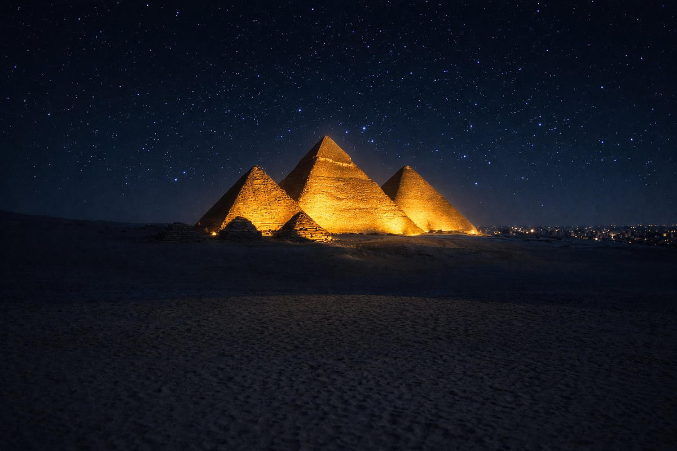
MOHAMED AYOUB GROUP PRESENTS
TRIUMPH
PYRAMIDS LUXURY PLAZA HOTEL
OFFICIAL LAUNCH EVENT
6th May 2026 | 7:00 PM | Pyramids Panorama 4, Giza
POWERED BY STRIKE MEDIA

Slide 2
TRIUMPH LUXURY HOTEL × MOHAMED AYOUB GROUP
EVENT DETAILS
تفاصيل الحدث
DATE
TIME
VENUE
GUESTS
6th May 2026
7:00 PM
Pyramids Panorama 4, Giza
1,000 VIP
DRESS CODE
DEVELOPER
OPERATOR
Black Tie / Luxury Formal
Mohamed Ayoub Group
Triumph Luxury Hotels
STRIKE MEDIA © 2026

Slide 3
TRIUMPH LUXURY HOTEL × MOHAMED AYOUB GROUP
TENTATIVE AGENDA
جدول الأمسية
Registration Opens
بدء التسجيل
7:00 PM
Event Begins
بداية الحفل
8:30 PM
Presentations & Talks
العروض التقديمية والكلمات
9:30 PM
Dinner
العشاء
9:30 PM
Entertainment — Ahmed Saad
أحمد سعد
10:30 PM
Closing
الختام
12:00 AM
STRIKE MEDIA © 2026

Slide 4
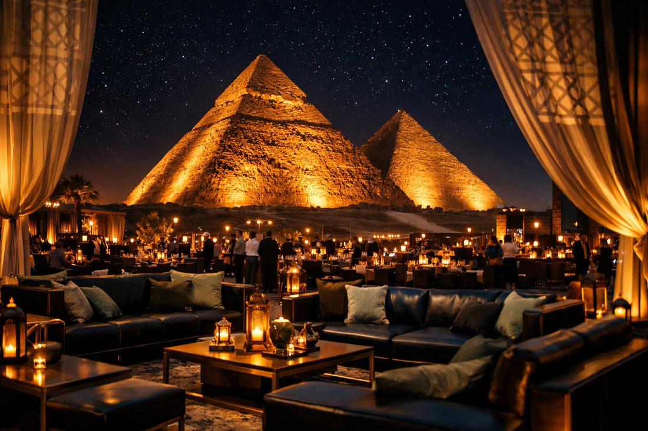
CONCEPT 01
Royal Heritage Meets Modern Luxury
التراث الملكي يلتقي بالفخامة الحديثة
The event draws from the timeless grandeur of the Pyramids — reinterpreted through a contemporary luxury lens.
CREATIVE DIRECTION
STRIKE MEDIA © 2026

Slide 5
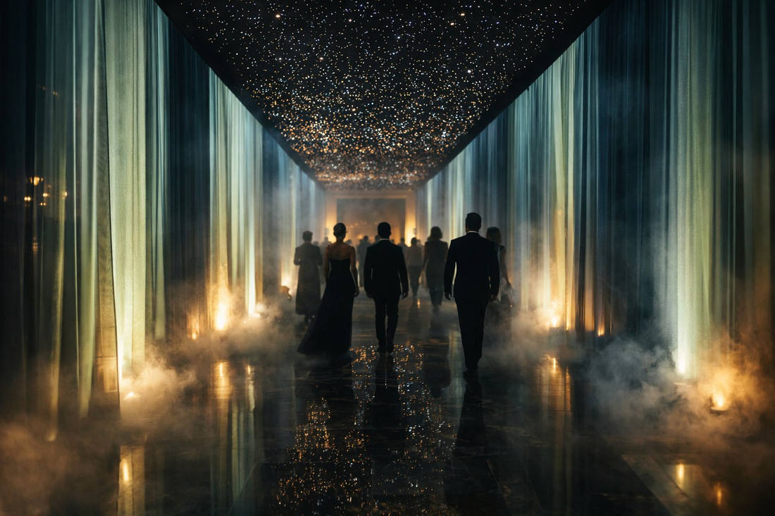
CONCEPT 02
Sensory Architecture
هندسة الحواس
From the moment guests arrive, every sense is activated. Curated lighting, bespoke scent design, immersive soundscapes.
CREATIVE DIRECTION
STRIKE MEDIA © 2026

Slide 6

CONCEPT 03
Brand Theatre
مسرح الإطلاق التاريخي
This is not a launch event — it is a declaration. The Triumph brand manifests in every material, every sightline, and every moment.
CREATIVE DIRECTION
STRIKE MEDIA © 2026

Slide 7

ENTERTAINMENT
MEGA STAR
AHMED SAAD
أحمد سعد
STRIKE MEDIA © 2026

Slide 8
PYRAMIDS PANORAMA 4 — GIZA, EGYPT
بانوراما الأهرامات ٤
STRIKE MEDIA © 2026

Slide 9
TRIUMPH LUXURY HOTEL × MOHAMED AYOUB GROUP
POWERED BY STRIKE MEDIA
01
EVENT MASTER PLAN
المخطط العام للحدث
Top-view layout of all event zones
TRIUMPH PYRAMIDS LUXURY PLAZA HOTEL — 6TH MAY 2026
CONFIDENTIAL — STRIKE MEDIA © 2026

Slide 10
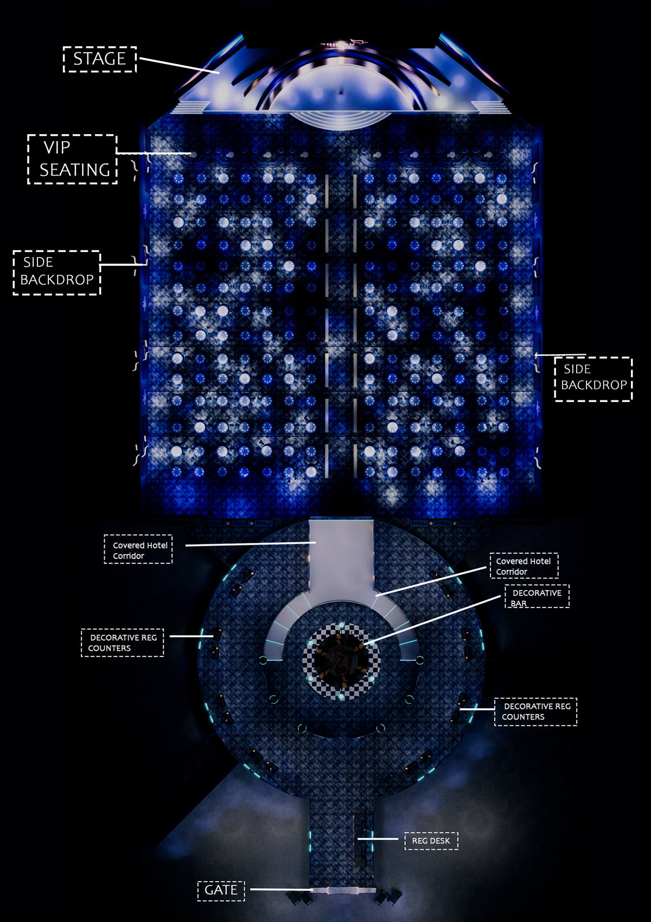
MASTER PLAN — TOP VIEW
المخطط العام
STRIKE MEDIA © 2026

Slide 11
TRIUMPH LUXURY HOTEL × MOHAMED AYOUB GROUP
POWERED BY STRIKE MEDIA
02
THE FOYER
الردهة
The gateway to the experience
TRIUMPH PYRAMIDS LUXURY PLAZA HOTEL — 6TH MAY 2026
CONFIDENTIAL — STRIKE MEDIA © 2026

Slide 12
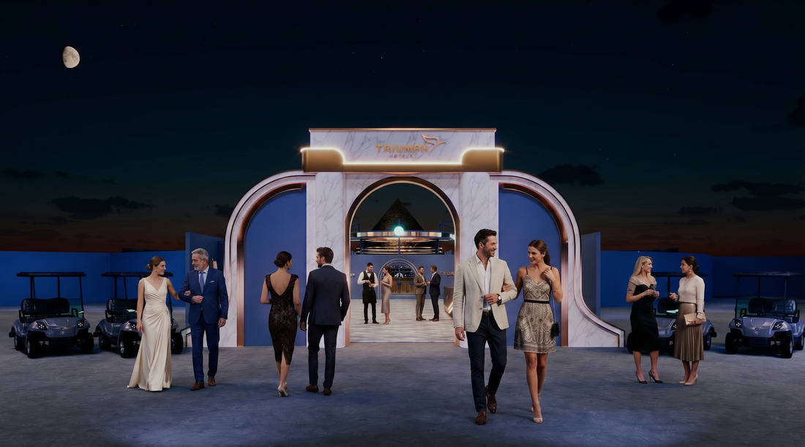
FOYER — GATE ENTRANCE
بوابة الدخول
STRIKE MEDIA © 2026

Slide 13
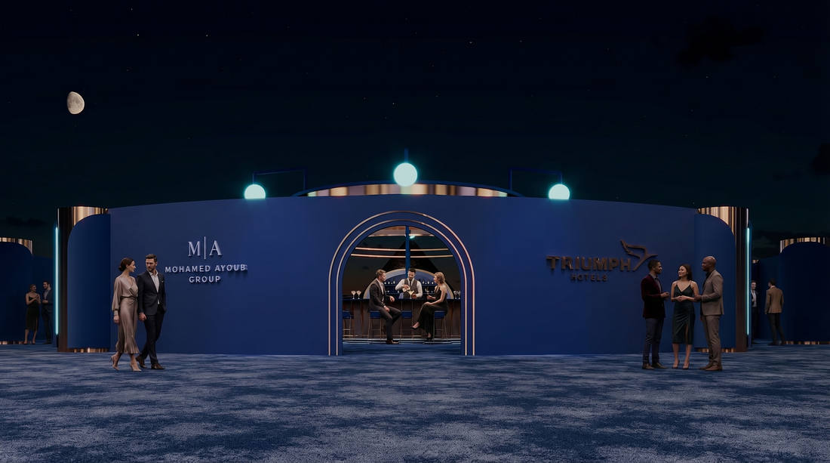
FOYER — ENTRANCE VIEW 1
مدخل ١
STRIKE MEDIA © 2026

Slide 14
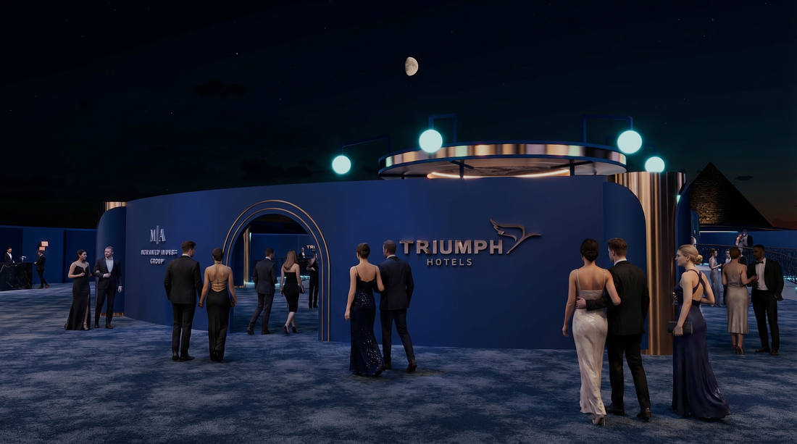
FOYER — ENTRANCE VIEW 2
مدخل ٢
STRIKE MEDIA © 2026

Slide 15
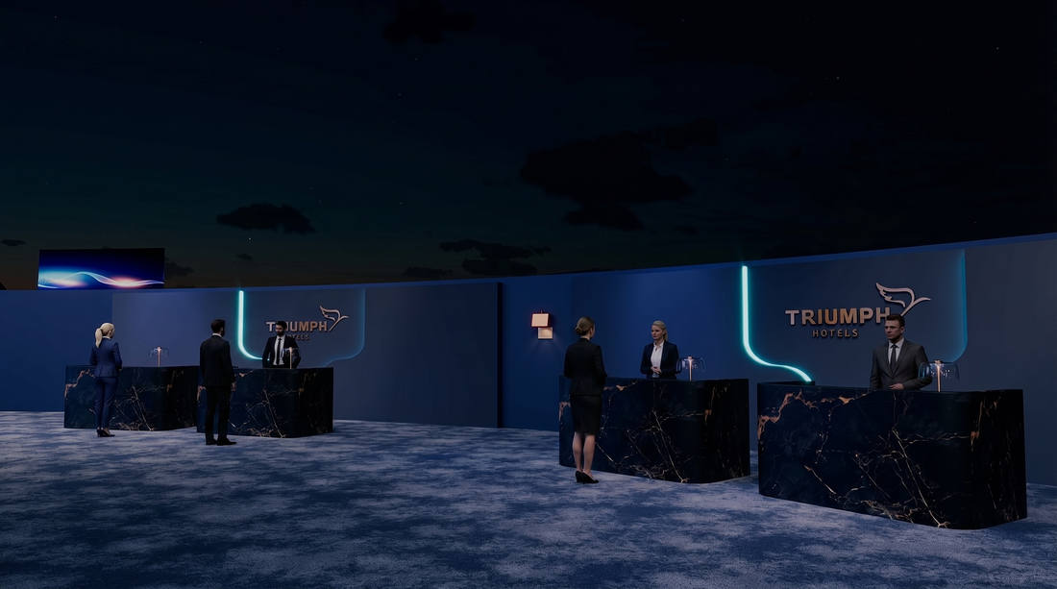
FOYER — COUNTER AREA 1
منطقة الاستقبال ١
STRIKE MEDIA © 2026

Slide 16
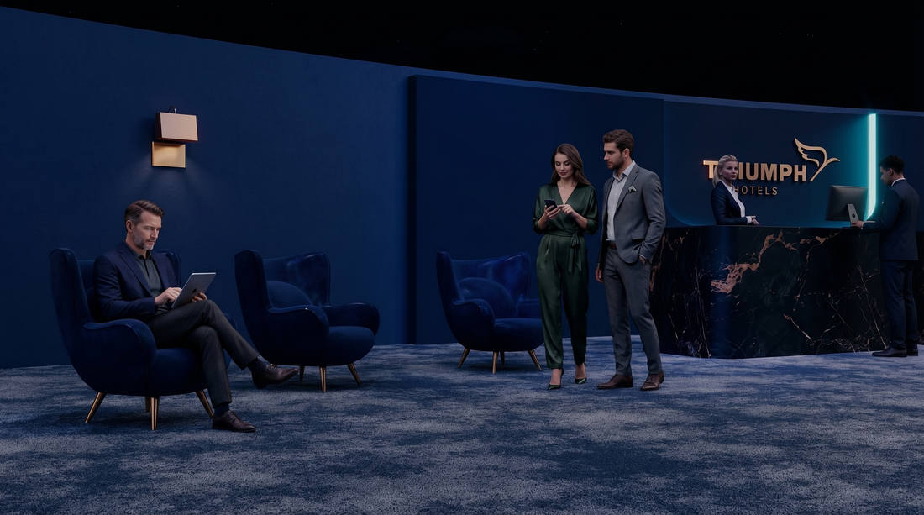
FOYER — COUNTER AREA 2
منطقة الاستقبال ٢
STRIKE MEDIA © 2026

Slide 17
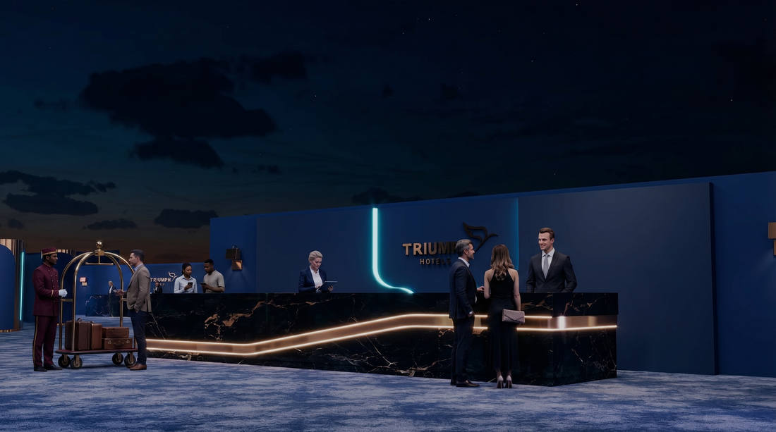
FOYER — REGISTRATION DESK
مكتب التسجيل
STRIKE MEDIA © 2026

Slide 18
TRIUMPH LUXURY HOTEL × MOHAMED AYOUB GROUP
POWERED BY STRIKE MEDIA
03
THE BAR
البار
An intimate sanctuary within the spectacle
TRIUMPH PYRAMIDS LUXURY PLAZA HOTEL — 6TH MAY 2026
CONFIDENTIAL — STRIKE MEDIA © 2026

Slide 19
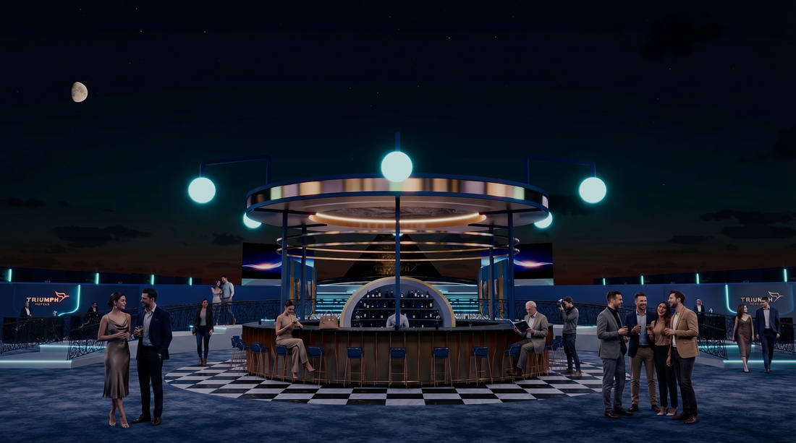
BAR — VIEW 1
البار — منظر 1
STRIKE MEDIA © 2026

Slide 20
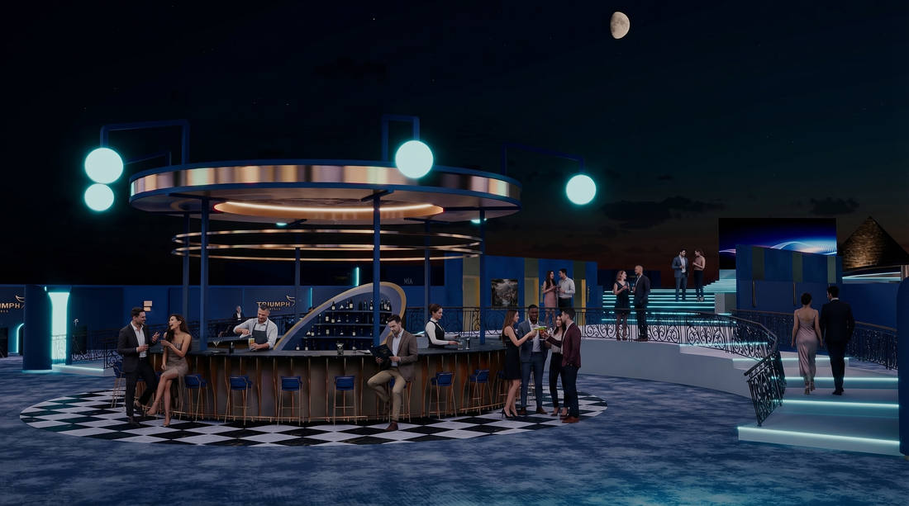
BAR — VIEW 2
البار — منظر 2
STRIKE MEDIA © 2026

Slide 21
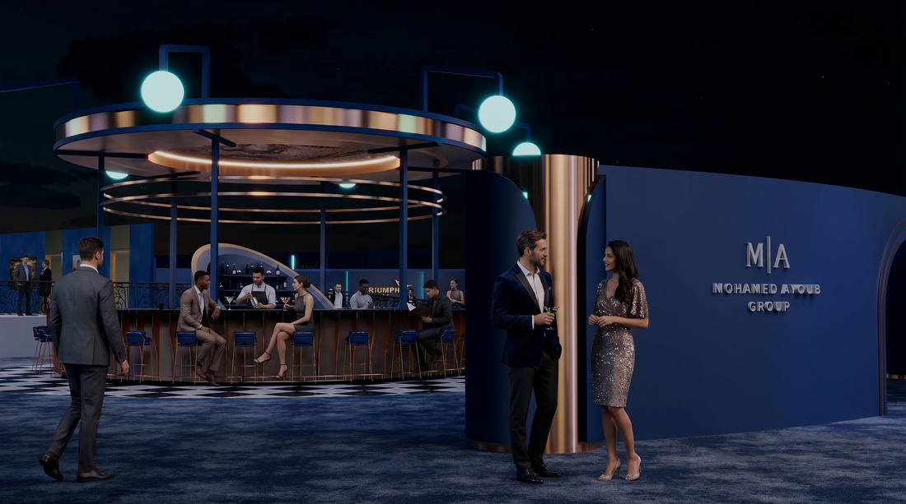
BAR — VIEW 3
البار — منظر 3
STRIKE MEDIA © 2026

Slide 22
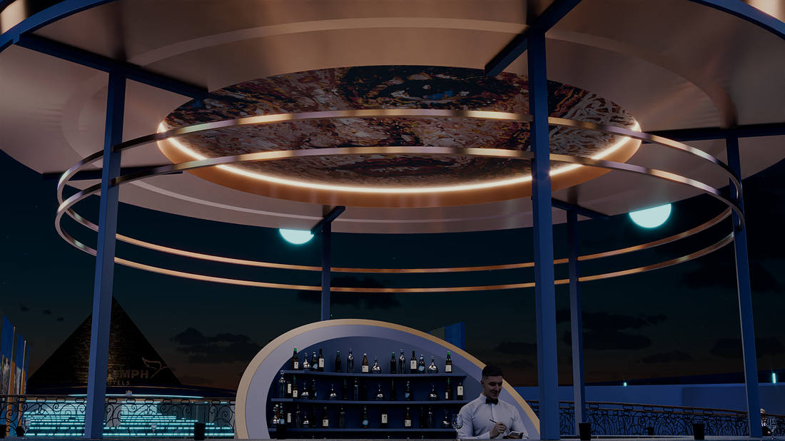
BAR — VIEW 4
البار — منظر 4
STRIKE MEDIA © 2026

Slide 23
TRIUMPH LUXURY HOTEL × MOHAMED AYOUB GROUP
POWERED BY STRIKE MEDIA
04
VIP AREA
منطقة كبار الضيوف
Reserved for the inner circle
TRIUMPH PYRAMIDS LUXURY PLAZA HOTEL — 6TH MAY 2026
CONFIDENTIAL — STRIKE MEDIA © 2026

Slide 24
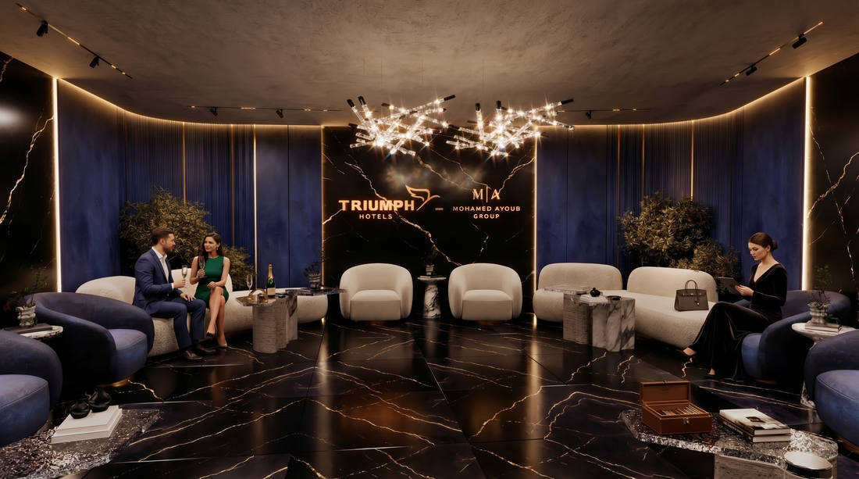
VIP ROOM — VIEW 1
غرفة كبار الضيوف ١
STRIKE MEDIA © 2026

Slide 25
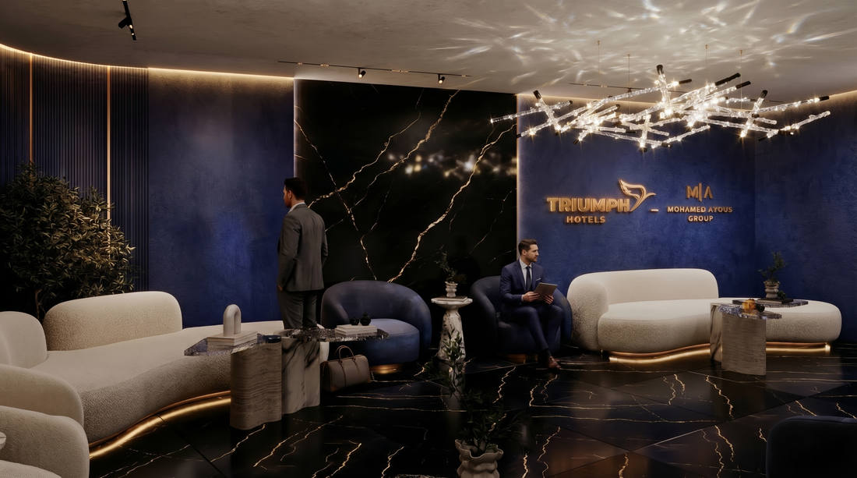
VIP ROOM — VIEW 2
غرفة كبار الضيوف ٢
STRIKE MEDIA © 2026

Slide 26
TRIUMPH LUXURY HOTEL × MOHAMED AYOUB GROUP
POWERED BY STRIKE MEDIA
05
MINI TRIUMPH
تجربة ترايمف المصغّرة
A tangible preview of the Triumph vision
TRIUMPH PYRAMIDS LUXURY PLAZA HOTEL — 6TH MAY 2026
CONFIDENTIAL — STRIKE MEDIA © 2026

Slide 27
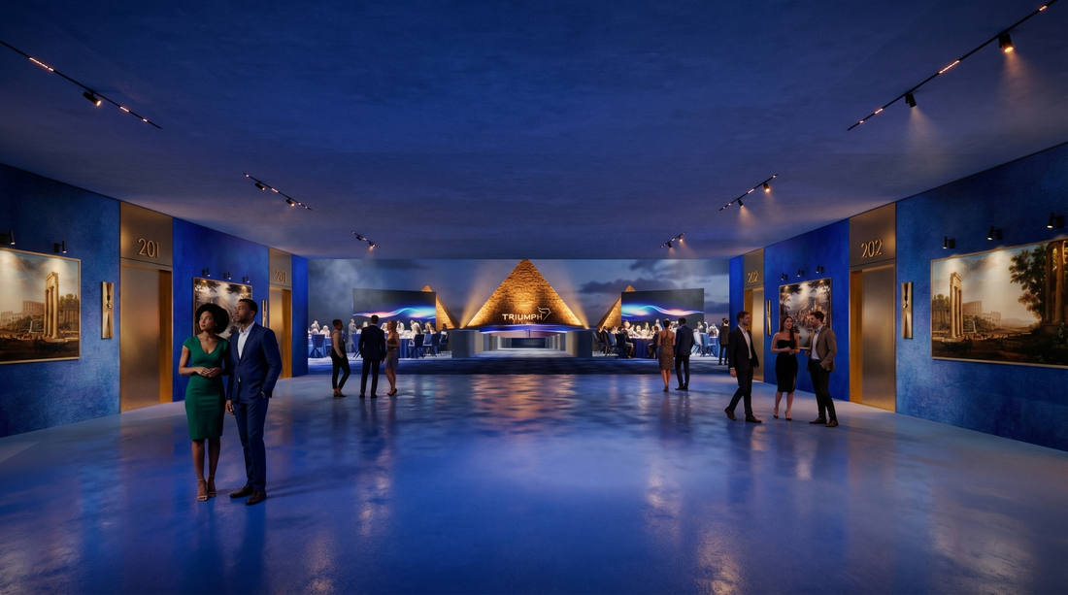
HOTEL CORRIDOR EXPERIENCE
ممر الفندق
STRIKE MEDIA © 2026

Slide 28
TRIUMPH LUXURY HOTEL × MOHAMED AYOUB GROUP
POWERED BY STRIKE MEDIA
06
MAIN VENUE
موقع الحفل الرئيسي
The heart of the evening
TRIUMPH PYRAMIDS LUXURY PLAZA HOTEL — 6TH MAY 2026
CONFIDENTIAL — STRIKE MEDIA © 2026

Slide 29
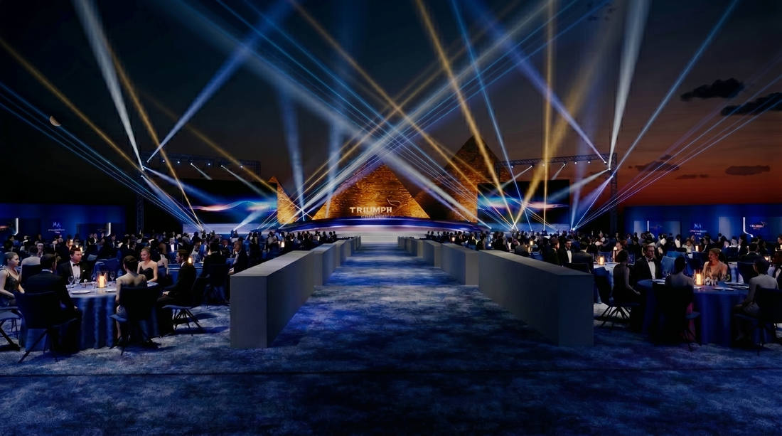
MAIN VENUE — STAGE VIEW 1
المسرح ١
STRIKE MEDIA © 2026

Slide 30
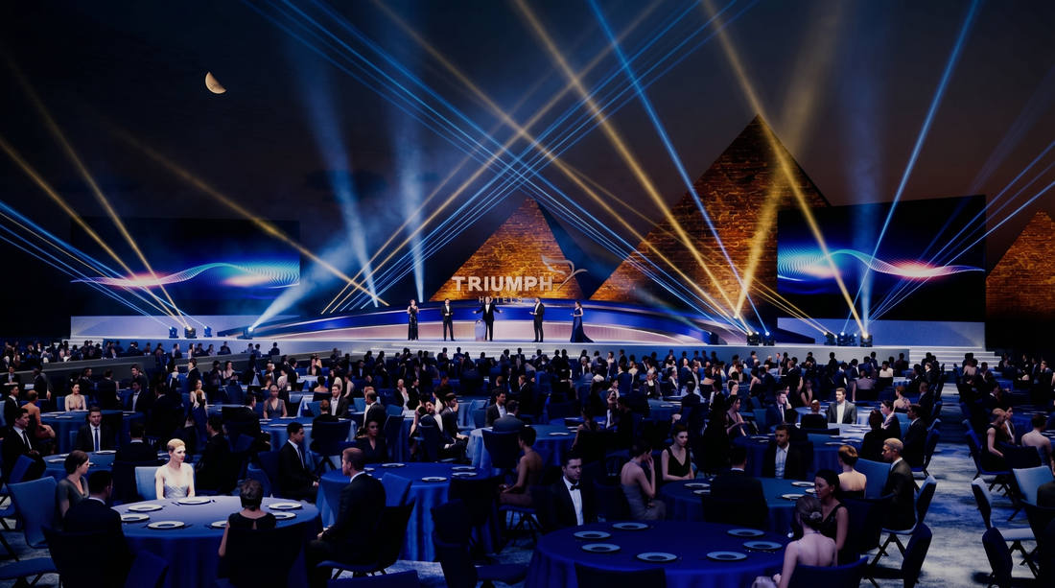
MAIN VENUE — STAGE VIEW 2
المسرح ٢
STRIKE MEDIA © 2026

Slide 31
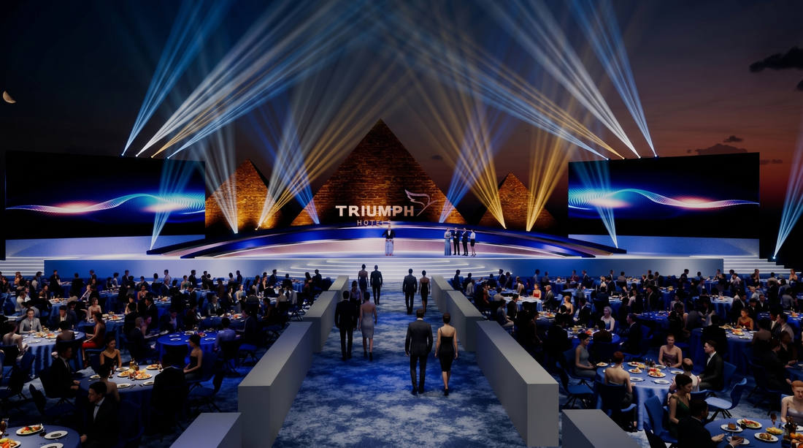
MAIN VENUE — STAGE VIEW 3
المسرح ٣
STRIKE MEDIA © 2026

Slide 32
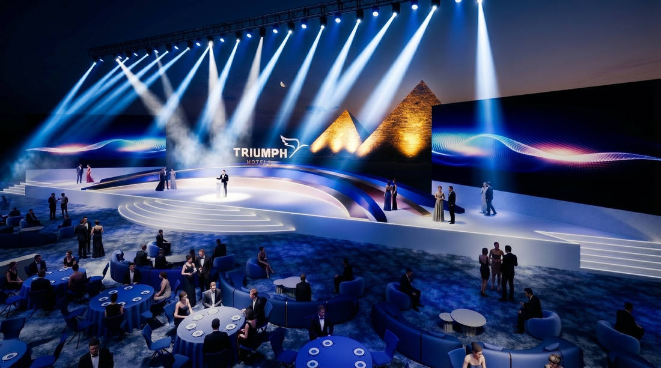
MAIN VENUE — STAGE VIEW 4
المسرح ٤
STRIKE MEDIA © 2026

Slide 33
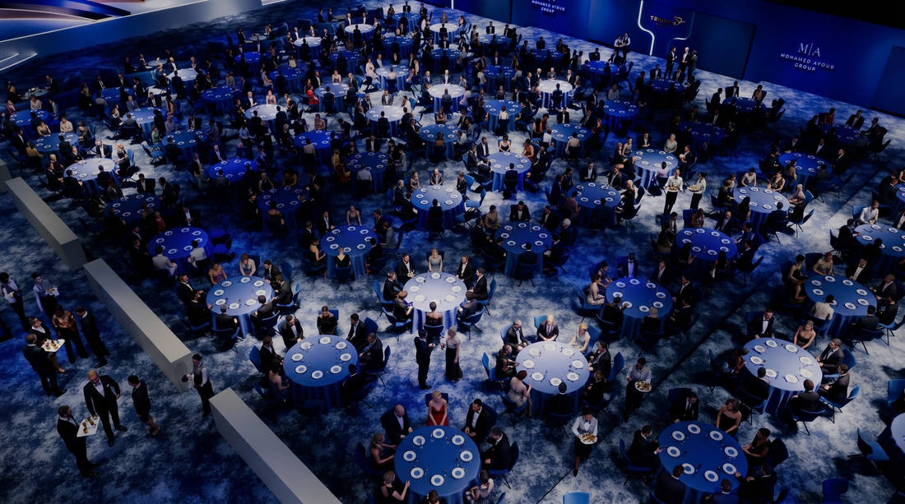
MAIN VENUE — SEATING AREA 1
منطقة الجلوس ١
STRIKE MEDIA © 2026

Slide 34
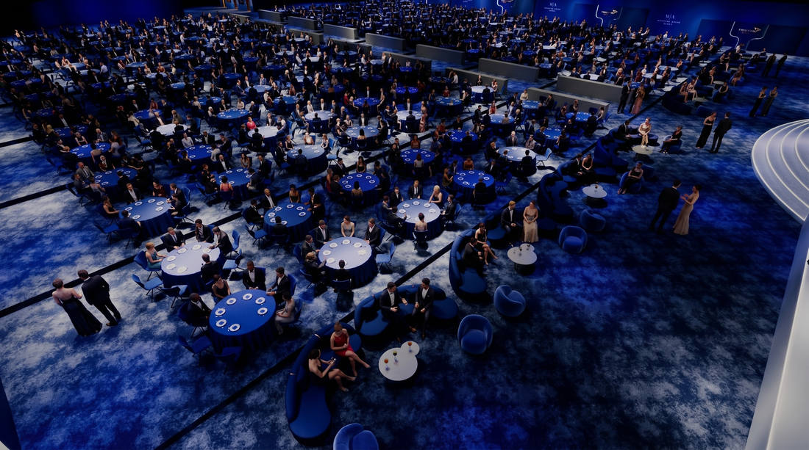
MAIN VENUE — SEATING AREA 2
منطقة الجلوس ٢
STRIKE MEDIA © 2026

Slide 35
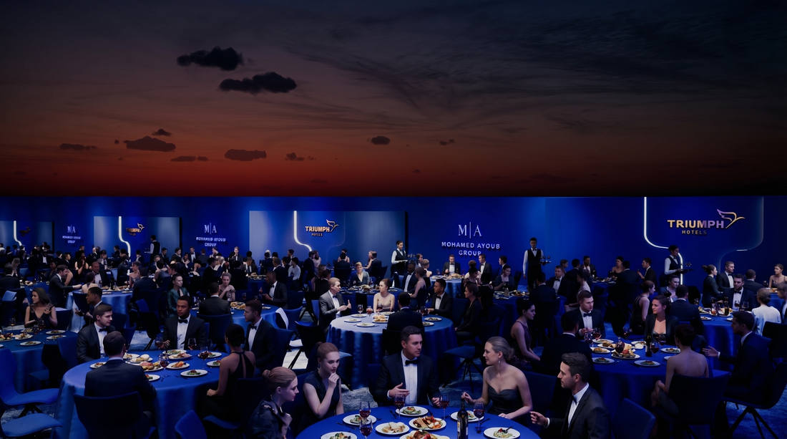
MAIN VENUE — SIDE BACKDROP
الخلفية الجانبية
STRIKE MEDIA © 2026

Slide 36
TRIUMPH LUXURY HOTEL × MOHAMED AYOUB GROUP
POWERED BY STRIKE MEDIA
07
FIREWORKS & REVEAL
لحظة الكشف والألعاب النارية
The pinnacle of the evening
TRIUMPH PYRAMIDS LUXURY PLAZA HOTEL — 6TH MAY 2026
CONFIDENTIAL — STRIKE MEDIA © 2026

Slide 37

FIREWORKS & REVEAL MOMENT
لحظة الكشف والألعاب النارية
STRIKE MEDIA © 2026

Slide 38
TRIUMPH
PYRAMIDS LUXURY PLAZA HOTEL
6th May 2026 | Pyramids Panorama 4 | Giza, Egypt
DEVELOPED BY MOHAMED AYOUB GROUP | OPERATED BY TRIUMPH LUXURY HOTELS
POWERED BY STRIKE MEDIA
Strike Media April © 2026 All rights reserved.

