Slide 1
HR ANALYTICS DASHBOARD
Capstone Project - Datamites
Prepared By:
M FERDOUNE
Course: Certified Data Analyst(CDA)
Batch: Jan 5
Candidate Register No: CA12202596950

Slide 2
PROJECT OVERVIEW
This project focuses on analyzing employee workforce data using Power BI. The objective of the project is to analyze employee demographics, workforce distribution, hiring trends, department-wise distribution, and employee diversity using interactive dashboards and visualizations. The dashboard helps organizations make data-driven HR decisions and improve workforce planning.

Slide 3
PROBLEM STATEMENT
The objective of this project is to analyze HR employee data and derive meaningful insights related to employee distribution, hiring trends, remote working percentage, employee diversity, and departmental workforce structure. The project also aims to visualize HR data effectively using Power BI dashboards.

Slide 4
Dataset information
Dataset Name: HR Analytics Dataset
Total Records: 22,214
Total Columns: 13
Important Attributes:
Employee ID
First Name
Last Name
Birthdate
Age
Gender
Race
Department
Job Title
Location
Hire Date
Location City
Location State

Slide 5
TOOLS AND TECHNOLOGIES
Power BI
MySQL Database
DAX Functions
Data Visualization
Data Cleaning & Transformation

Slide 6
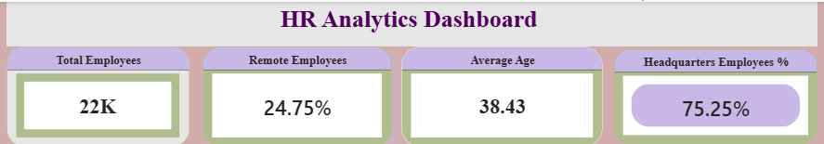
Key performance indicator (kpi)

Slide 7
KPI Explanation
The KPI section provides an overview of the organization’s workforce statistics. The company currently has approximately 22K employees. Around 24.75% of employees are working remotely, while 75.25% are working from headquarters locations. The average employee age is 38.43 years, indicating a balanced workforce consisting of experienced professionals and mid-level employees.
These KPIs help the HR department monitor workforce distribution, employee demographics, and remote working trends effectively.

Slide 8
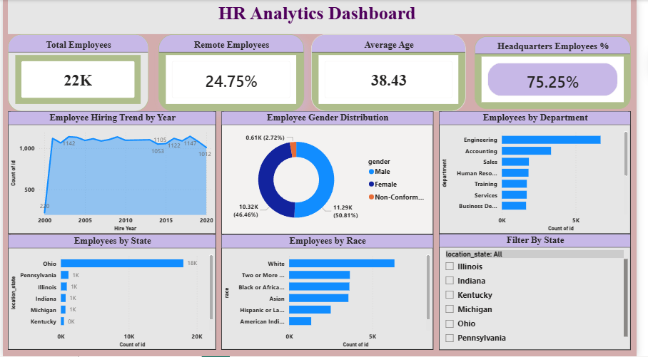
Dashboard visualization

Slide 9
Dashboard explanation
The HR Analytics Dashboard provides a complete overview of employee workforce distribution and hiring trends using interactive visualizations. The line chart represents employee hiring trends over the years, showing stable hiring growth across the organization. The donut chart illustrates gender distribution among employees, while the bar charts represent employee distribution by department, state, and race.
The dashboard also includes interactive filters that allow users to analyze workforce data dynamically by state. These visualizations help HR teams understand workforce diversity, employee allocation, and departmental structure effectively.

Slide 10
Key insights
The majority of employees work from Headquarters
The engineering department has the highest number of employees
Male employees are slightly higher than female employees
Ohio has the highest workforce distribution
Hiring remained stable over the years

Slide 11
suggestions
Improve workforce diversity
Increase remote workforce flexibility
Maintain balanced hiring strategy
Improve employee engagement programs

Slide 12
conclusion
The HR Analytics Dashboard successfully analyzed employee workforce data and generated meaningful business insights using Power BI. The dashboard helps organizations understand workforce distribution, employee diversity, hiring trends, and departmental structure. This project demonstrates how data visualization can support effective HR decision-making.

