Slide 1
SUPPLY CHAIN ANALYSIS USING POWER BI
Client Project Report
Submitted by
M. FERDOUNE
Certified Data Analyst (CDA)
Submitted to:
Datamites
2026
Jan -5 Batch

Slide 2
Project Overview
Overview
Supply Chain Analysis is the process of monitoring and optimizing the flow of products, inventory, suppliers, transportation, manufacturing, and quality operations.
Purpose
Improve operational efficiency
Monitor supplier performance
Optimize inventory management
Reduce transportation costs
Enhance product quality

Slide 3
Problem Statement
Problem Statement
Organizations face challenges in managing inventory, supplier performance, transportation costs, manufacturing efficiency, and product quality.
Without proper analytics:
Inventory shortages may occur
Transportation costs increase
Supplier performance is difficult to monitor
Manufacturing delays impact production
Product defects affect customer satisfaction
Power BI dashboards help provide data-driven solutions.

Slide 4
Project Objectives
Objectives
Analyse supply chain performance
Monitor inventory availability
Evaluate supplier performance
Analyse logistics and transportation costs
Monitor manufacturing efficiency
Assess product quality metrics
Generate business insights for decision-making

Slide 5
Dataset Description
The dataset contains information related to:
Product Types
Suppliers
Inventory Levels
Order Quantities
Transportation Modes
Shipping Costs
Manufacturing Costs
Lead Times
Defect Rates
Inspection Results
Dataset Size
Total Revenue: 577.60K
Total Products Sold: 46K
Production Volume: 57K

Slide 6
Tools and Technologies used
Tools Used
Microsoft Power BI
Power Query
DAX
MySQL Database
Data Visualization
Key Features
Data Cleaning
Data Transformation
KPI Creation
Dashboard Design
Business Insights Generation

Slide 7
Methodology
Project Workflow
Data Collection
Data Understanding
Data Cleaning
Data Transformation using Power Query
Data Modeling
DAX Measure Creation
Dashboard Development
Business Insights Generation
Reporting and Documentation

Slide 8
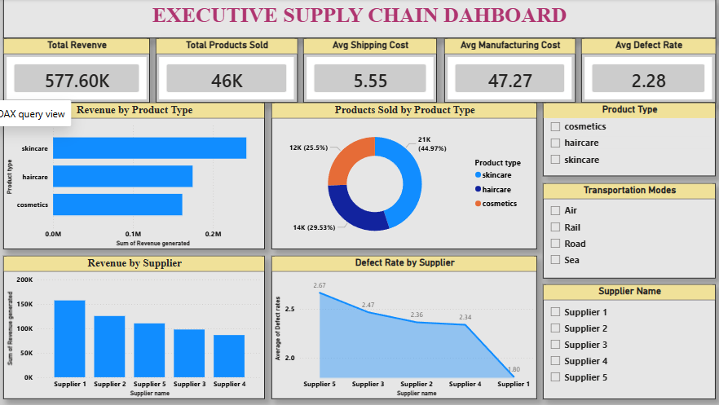
Executive Supply Chain Dashboard

Slide 9
Key KPIs
Total Revenue: 577.60K
Products Sold: 46K
Avg Shipping Cost: 5.55
Avg Manufacturing Cost: 47.27
Avg Defect Rate: 2.28
Insights
Skincare products generated the highest revenue.
Supplier 1 contributed the maximum revenue.
Defect rates vary among suppliers.
Transportation mode impacts operational cost.

Slide 10
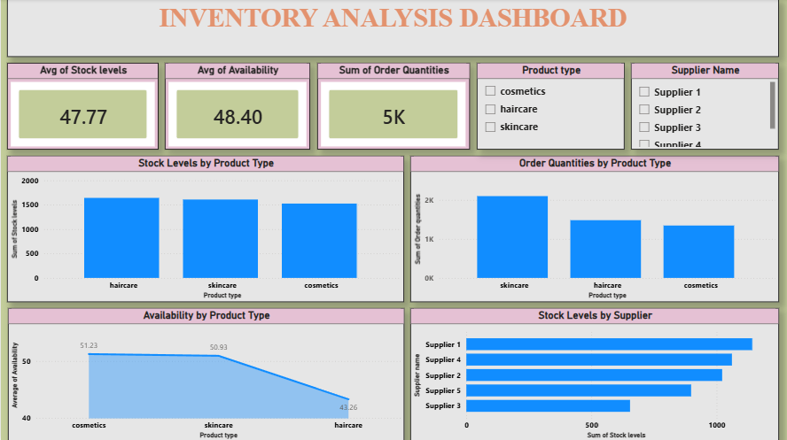
Inventory Analysis Dashboard

Slide 11
Key Metrics
Average Stock Levels
Average Availability
Order Quantities
Insights
Skincare products have highest order quantities.
Stock levels remain balanced across products.
Availability differs among product categories.
Supplier inventory contribution varies.

Slide 12
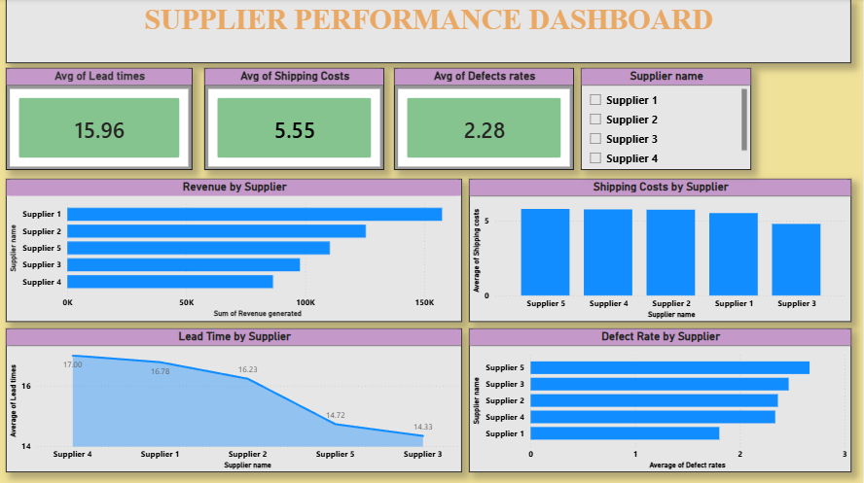
Supplier Performance Dashboard

Slide 13
Metrics Analyzed
Lead Time
Shipping Cost
Defect Rate
Revenue Contribution
Insights
Supplier 1 generated the highest revenue.
Supplier 3 has the lowest lead time.
Supplier 5 shows a higher defect rate.
Supplier performance significantly impacts operations.

Slide 14
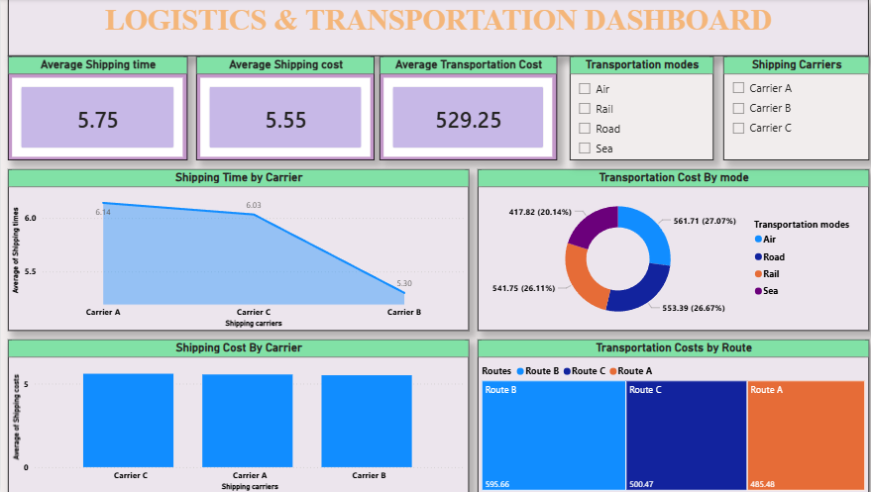
Logistics & Transportation Dashboard

Slide 15
Metrics Analyzed
Shipping Time
Shipping Cost
Transportation Cost
Transportation Routes
Insights
Carrier A has the highest shipping time.
Transportation costs vary by mode.
Route B incurs the highest transportation cost.
Transportation optimisation can reduce expenses.

Slide 16
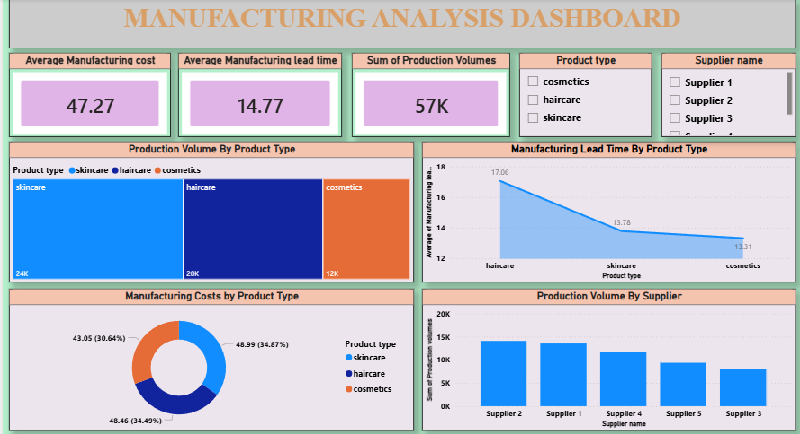
Manufacturing Analysis Dashboard

Slide 17
Metrics Analyzed
Manufacturing Cost
Manufacturing Lead Time
Production Volume
Insights
Skincare products have the highest production volume.
Manufacturing costs vary by product category.
Supplier 2 contributes the highest production volume.
Lead times differ across products.

Slide 18
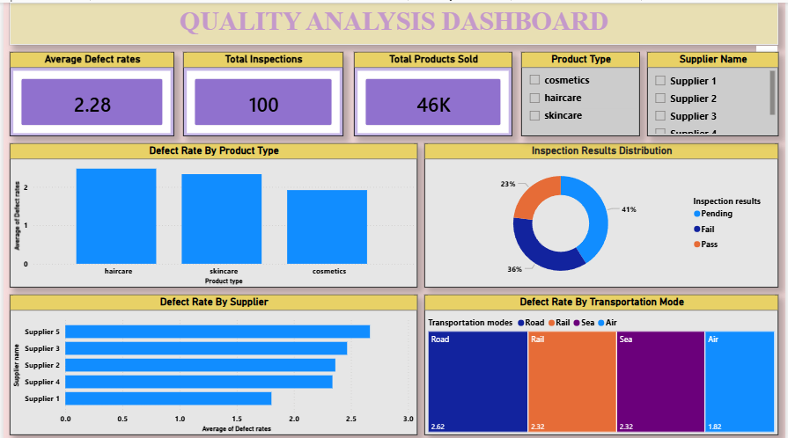
Quality Analysis Dashboard

Slide 19
Metrics Analyzed
Defect Rates
Inspection Results
Product Quality
Insights
Haircare products show the highest defect rates.
Pending inspections account for 41%.
Supplier defect rates require monitoring.
Transportation modes impact product quality.

Slide 20
Business Insights & Recommendations
Key Insights
Skincare products generate maximum revenue.
Supplier performance directly impacts profitability.
Transportation costs can be optimized.
Manufacturing efficiency affects production output.
Product quality monitoring reduces defects.
Recommendations
Strengthen supplier evaluation.
Optimize transportation routes.
Improve quality control processes.
Monitor inventory regularly.
Reduce manufacturing lead times.

Slide 21
Conclusion
Conclusion
The Supply Chain Analysis Dashboard provides a comprehensive view of supply chain operations through Power BI visualizations.
Benefits
Better decision-making
Improved operational efficiency
Reduced transportation costs
Enhanced supplier management
Improved product quality

