Slide 1
An introduction to solving biological problems with Python
Gordon Brown, CRUK Cambridge Institute
Henry Farmery, CRUK Cambridge Institute
Anne Pajon, CRUK Cambridge Institute

Slide 2
This course
Split into 4 sections introducing programming with the Python language and going into some biological examples
We’d like you to follow along with the example code as we go through the material, and attempt the exercises to practice what you’ve learned
Questions are welcome at any point!
If you have specific projects/problems you like to use Python for we are happy to (try to) help during the exercises

Slide 3
Course structure
Day 1:
Morning: running the Python interpreter, variables and types, arithmetic, basic data structures
Afternoon: logic & flow control, loops, exceptions, importing libraries
Day 2:
Morning: custom functions, variable scope, some biological examples
Afternoon: dealing with files, parsing file formats, introduction to BioPython

Slide 4
Materials
There is a course webpage with links to the materials, example solutions to the exercises etc.:
http://pycam.github.io
You are encouraged to follow along with the materials

Slide 5
Getting started
Python is an interpreted language, this means that your computer does not run Python code natively, but instead we run our code using the Python interpreter
2 ways to run Python code
Directly typing commands into the interpreter
Typing code into a file and telling the interpreter to run the code from this file

Slide 6
How to start the Python interpreter?
Start a terminal and just type the command python in it (on a Mac or Linux machine)
This will print out some information about your installation of python and then leave you with a command prompt which looks like >>>
If you want to exit the interactive interpreter you can type the command quit() or type Ctrl-D

Slide 7
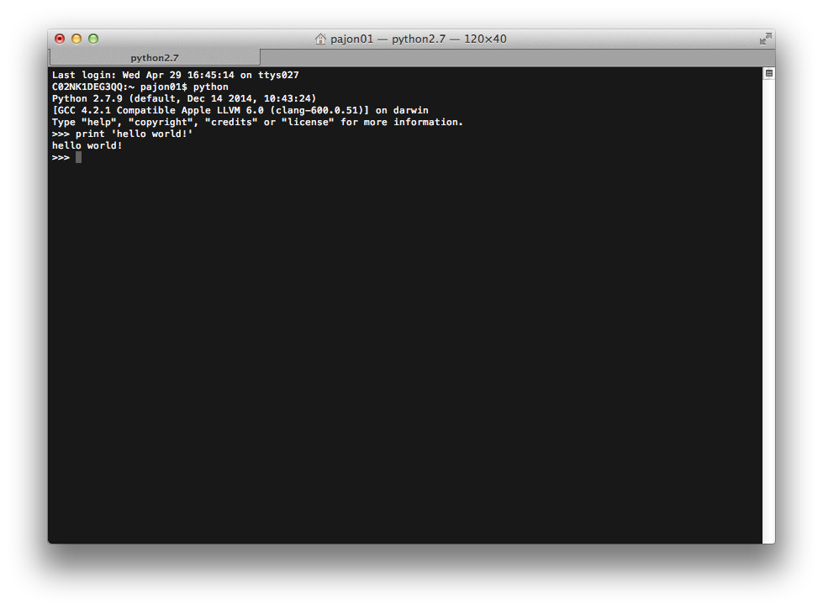

Slide 8


Jupyter provides a rich architecture for interactive computing with:
Powerful interactive shells (terminal and Qt-based).
A browser-based notebook with support for code, rich text, mathematical expressions, inline plots and other rich media.
Support for interactive data visualization and use of GUI toolkits.
Flexible, embeddable interpreters to load into your own projects.
Easy to use, high performance tools for parallel computing.

Slide 9
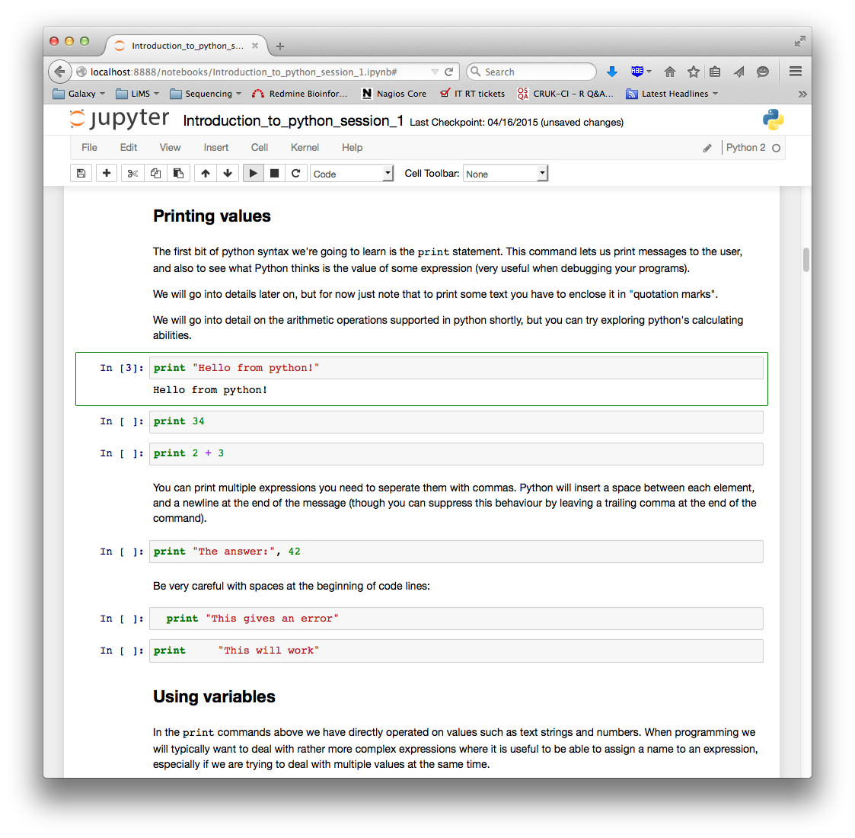
Run selected cells

Slide 10
Assignment
Names
Objects
x = 5
x
5
garbage collection
x = “foo”
x
5
foo

Slide 11
Assignment
Names
Objects
x = 5
x
5
y = 5
x
y
5
5
x = y
x
y
5
5

Slide 12
Assignment
Names
Objects
x = 5
x
5
x = None
x
5
del x

Slide 13
Tuple and List element numbering
x = [123, 54, 92, 87, 33]
Index | 0 | 1 | 2 | 3 | 4
Element | 123 | 54 | 92 | 87 | 33
Negative Index | -5 | -4 | -3 | -2 | -1
List length is 5

