Slide 1

Note: The data and information in this document is reflective of a hypothetical situation and client. This document is to be used for KPMG Virtual Internship purposes only.
Sprocket Central Pty Ltd
Data analytics approach
Analyst: Martin Fernandez Cean
Email: mfernandezcean@gmail.com

Slide 2
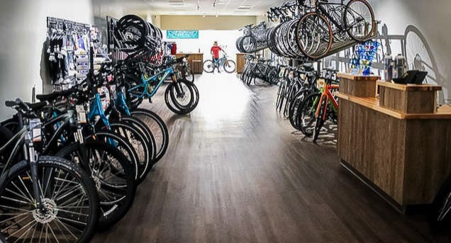
Note: The data and information in this document is reflective of a hypothetical situation and client. This document is to be used for KPMG Virtual Internship purposes only.
Introduction
1-Geo
2-Wealth Segment
3-Age
4-Product type
5-Nyche approach
Appendix

Slide 3
Note: The data and information in this document is reflective of a hypothetical situation and client. This document is to be used for KPMG Virtual Internship purposes only.
Data Exploration- Geo
New South Wales Represents the 53% of the Total Revenue. Victoria 25% and Queensland 21%
NSW | $ 5,790,340.85
QLD | $ 2,341,816.45
VIC | $ 2,781,600.10
Total | $ 10,913,757.40

Slide 4
Note: The data and information in this document is reflective of a hypothetical situation and client. This document is to be used for KPMG Virtual Internship purposes only.
Data Exploration- Wealth
The Mass Customer segment represent the 50.1% of the Total Revenue. High Net Worth 25.4% and Affluent Customer 24.3%

Slide 5
Note: The data and information in this document is reflective of a hypothetical situation and client. This document is to be used for KPMG Virtual Internship purposes only.
Data Exploration- Age
Customers between 40-49 years tend to be more profitable than other ages. 50’s and 30’s combined reach a 34.16%

Slide 6
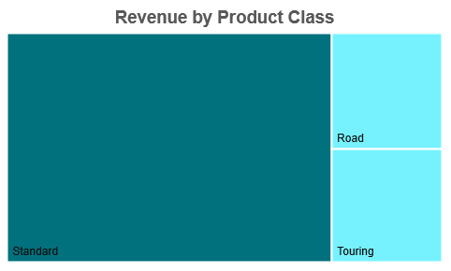
Note: The data and information in this document is reflective of a hypothetical situation and client. This document is to be used for KPMG Virtual Internship purposes only.
Data Exploration- Product Type
By far, Standard Product is the most Popular in the market. Mountain Type Revenue is almost zero (could be revised its continuity).
Standard | $ 8,138,860
Road | $ 1,400,218
Touring | $ 1,350,158
Mountain | $ 40,779
Total general | $ 10,930,014

Slide 7
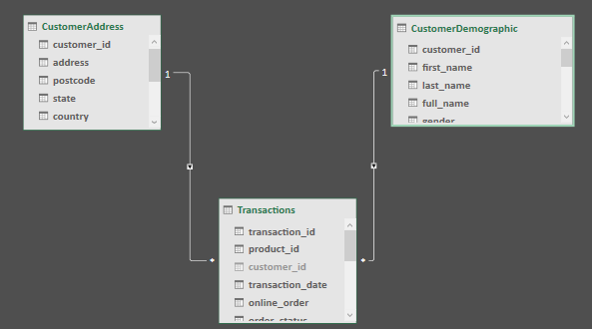
Note: The data and information in this document is reflective of a hypothetical situation and client. This document is to be used for KPMG Virtual Internship purposes only.
Data Model
The Model has 3 tables. One lookup (Transactions) and two Data (CustomerAddress, CustomerDemographic)
CustomerAddress |  | Transactions
Primary Key: customer_id | One-To-Many | Foreing Key: customer_id
CustomerDemographic |  | Transactions
Primary Key: customer_id | One-To-Many | Foreing Key: customer_id

Slide 8
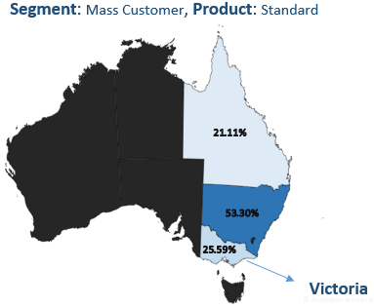
Note: The data and information in this document is reflective of a hypothetical situation and client. This document is to be used for KPMG Virtual Internship purposes only.
Victoria possible Niche
In order to expand, finding a niche in the market to work is an attractive possibility. Costumers from Victoria State, Mass Customer Segment and that buys Standard type product seem to have potential.
Mass Customer & Standard
New South Wales | $ 2,158,771
Victoria | $ 1,036,623
Queensland | $ 854,816
Total | $ 4,050,211

Slide 9
Note: The data and information in this document is reflective of a hypothetical situation and client. This document is to be used for KPMG Virtual Internship purposes only.
Appendix

Slide 10
Note: The data and information in this document is reflective of a hypothetical situation and client. This document is to be used for KPMG Virtual Internship purposes only.
Data Exploration- Wealth
54.8% of the Revenue comes from 3 industries: Manufacturing, Financial Services & Health

Slide 11
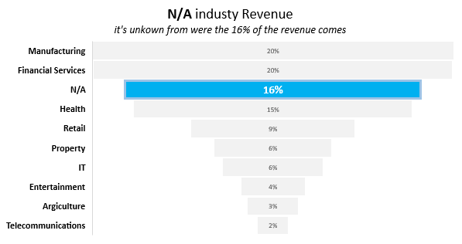
Note: The data and information in this document is reflective of a hypothetical situation and client. This document is to be used for KPMG Virtual Internship purposes only.
Appendix
Missing important information: To improve the accuracy of the marketing campaign, it would be wise to learn from were this 16% of revenue is coming.

