Slide 1
Marketing campaign data analysis
Matheus Ferraciolli

Slide 2
Contents
The data
1
Client segmentation & Response prediction
2
Proposals & Closing remarks
3
Campaign data exploration and insights
How to improve our perception on client data and use machine learning to drive decision making
How we can previous campaigns’ data to improve advertising efficiency

Slide 3
The data
Can we use our data
to
increase
profit?
Marketing campaign to sell a new gadget
Data from 2240 respondents
15% success rate
Campaign cost was 6720 MU
Campaign revenue was 3674 MU
3046MU

Slide 4
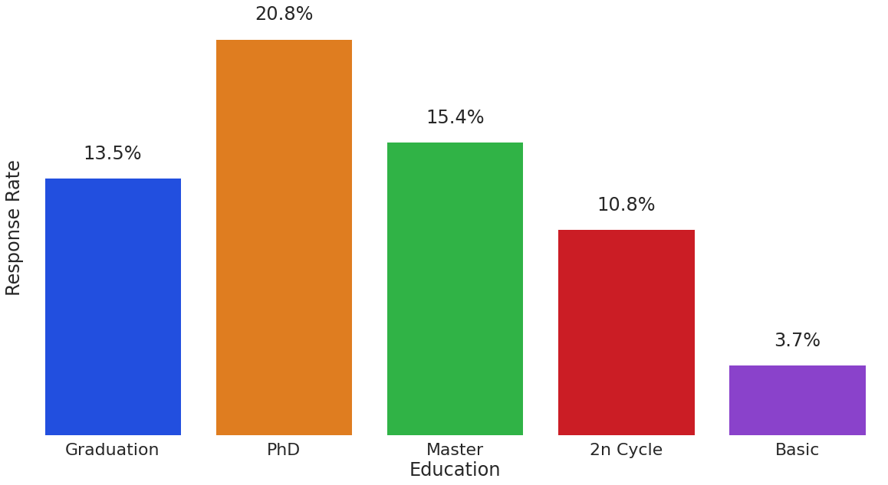
Visual insights
Higher education has above average acceptance rate
Basic education has a very low acceptance rate
Who would we advertise to?
People with higher education

Slide 5
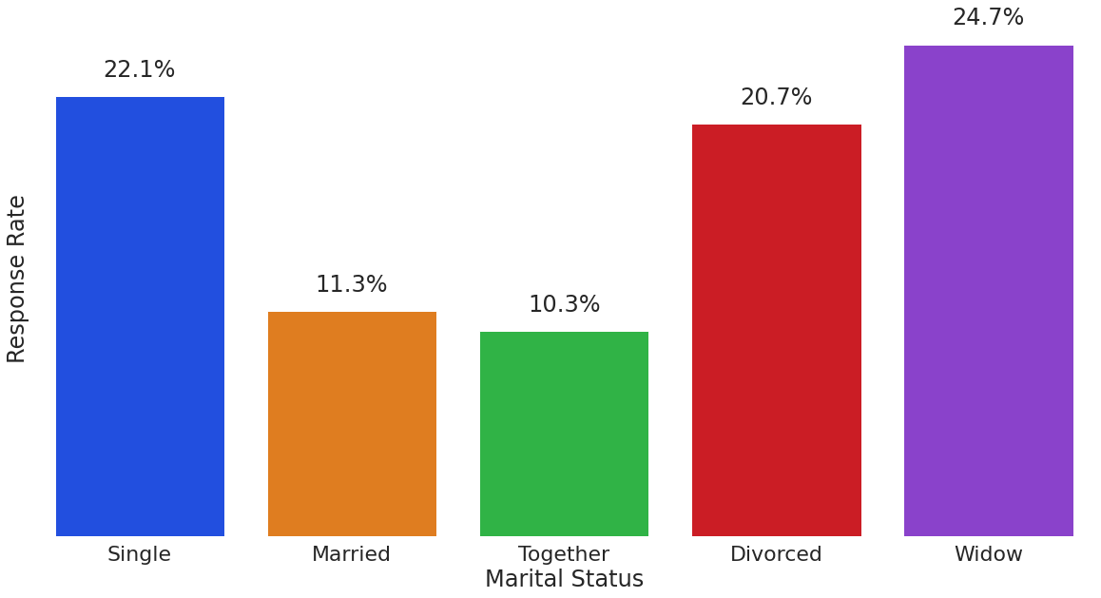
Visual insights
Single people have a higher acceptance rate
Married and together have a lower acceptance rate
Who do we advertise to?
higher education
single status

Slide 6
Visual insights
What to do next?
Client segmentation
Machine learning to predict respondent acceptance
Pros:
Are useful for initial exploration
Provide better understanding of data
Help formulate hypothesis to drive further analysis
Cons:
Are limited for big datasets
Require a lot of time

Slide 7
Client segmentation
We used:
Recency: How many days since the last purchase
Frequency: How many purchases a client made
Monetary value: How much a client spent
To segment clients in 3 categories:
Need Focus: Clients with bad values on the metrics above
Make happier: Client with average values on the metrics above
Keep happy: Clients with good values on the values above

Slide 8
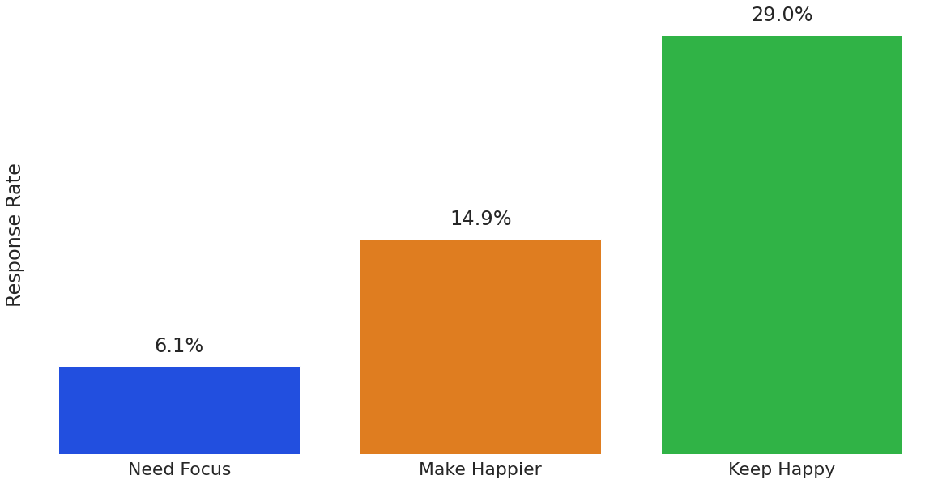
Client segmentation
New categories based on client data
Quantitative metric
Different response rate per category
What to do?
Understand the differences between categories
Find more characteristics from the “Keep happy” group
Find ways to bring people from the other groups to the 3rd

Slide 9
Response prediction
1500 client data used to train
739 clients used to test the model
Study model parameters to interpret how it makes predictions
To further expand the use of our data we can build a model to predict marketing response:
Train a machine learning model to predict probabilities of buying
Test on unseen data
Compare the results
Calculate scenarios

Slide 10
Response prediction
What we answered?
“If we only called respondents which the model predicts a 5% or more, probability of accepting, how would the campaign fare?”
We used a logistic regression classifier:
Easy to interpret model output
Similar performance than more advanced techniques (for this dataset)
For the test set, for the 739 test clients, we had:
100 positive responses
13.5% (100/739) positive response rate

Slide 11
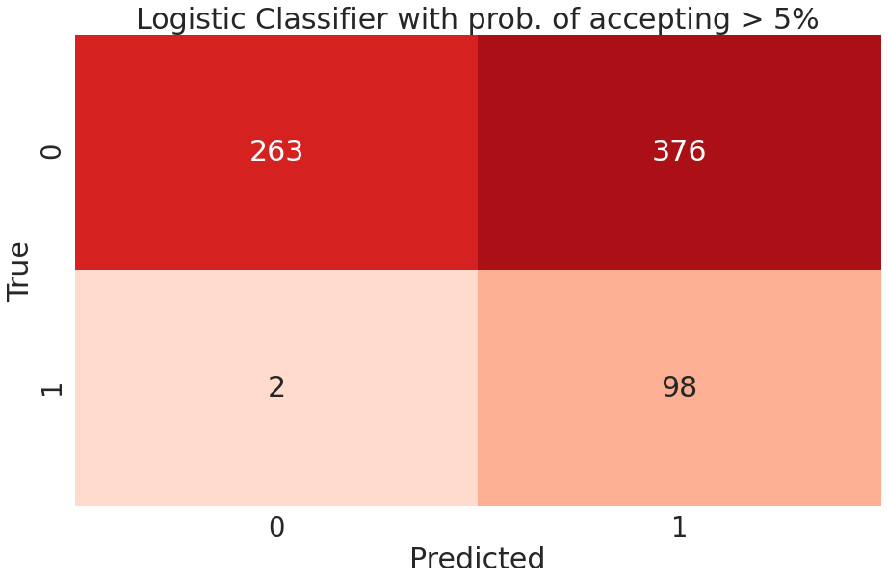
Response prediction
False positives (model says 5% or more chance of buying and does not buy) : 376
True positives (model says 5% or more chance of buying and buys): 98

Slide 12
Response prediction
Model sample acceptance rate:
98/(98+376) = 20.6%
IN NUMBERS
 | Cost | Revenue
739 sample with 100 success | 2217 | 1100
474 sample with 98 sucess | 1422 | 1078
Original sample acceptance rate:
100/739 = 13.5%
20.6/13.5 = ~50% increase in acceptance rate
36% decrease in cost with 2% decrease in revenue

Slide 13
Closing remarks
Next steps:
Apply the same logic to other campaigns data to see if the conclusions still hold
Develop category specific models to predict customer segment behavior
Based on this analysis we:
Should segment our customer data to find characteristics and behaviors for each category and drive decision making to increase the number of people in our ideal group
Can use machine learning models to, in a realistic scenario, substantially reduce campaign costs with small effect on revenue

