Slide 1
Fostering Automation in Chemical Kinetics:
Bond Energy Computation and Implementation of a Hierarchical Approach for Thermochemistry
Marcello Ferraro
Advisor: Prof. Carlo Cavallotti
Co-advisor: Dott. Andrea Della Libera
Master degree in Chemical engineering
Milano, 5th October 2023

Slide 2
Outline
Introduction – state of the art in chemical kinetics
Aim of the work
Software development:
CHEMTP – thermochemical parameters
InChI2data – automatic input files
FragsGen – bond energies
Results
Conclusions

Slide 3
State of art in chemical kinetics
Chemical kinetics knowledge is fundamental for reactor design and CFD studies
1900
2018
2023
Postdictive kinetics
Predictive kinetics
time
Predictive kinetics is based on Potential Energy Surface (PES) exploration and Transition State Theory (TST) rate constants estimation
Powerful chemical kinetics software like EStokTP and Reaction Mechanism Generator (RMG) automatize this calculations

Slide 4
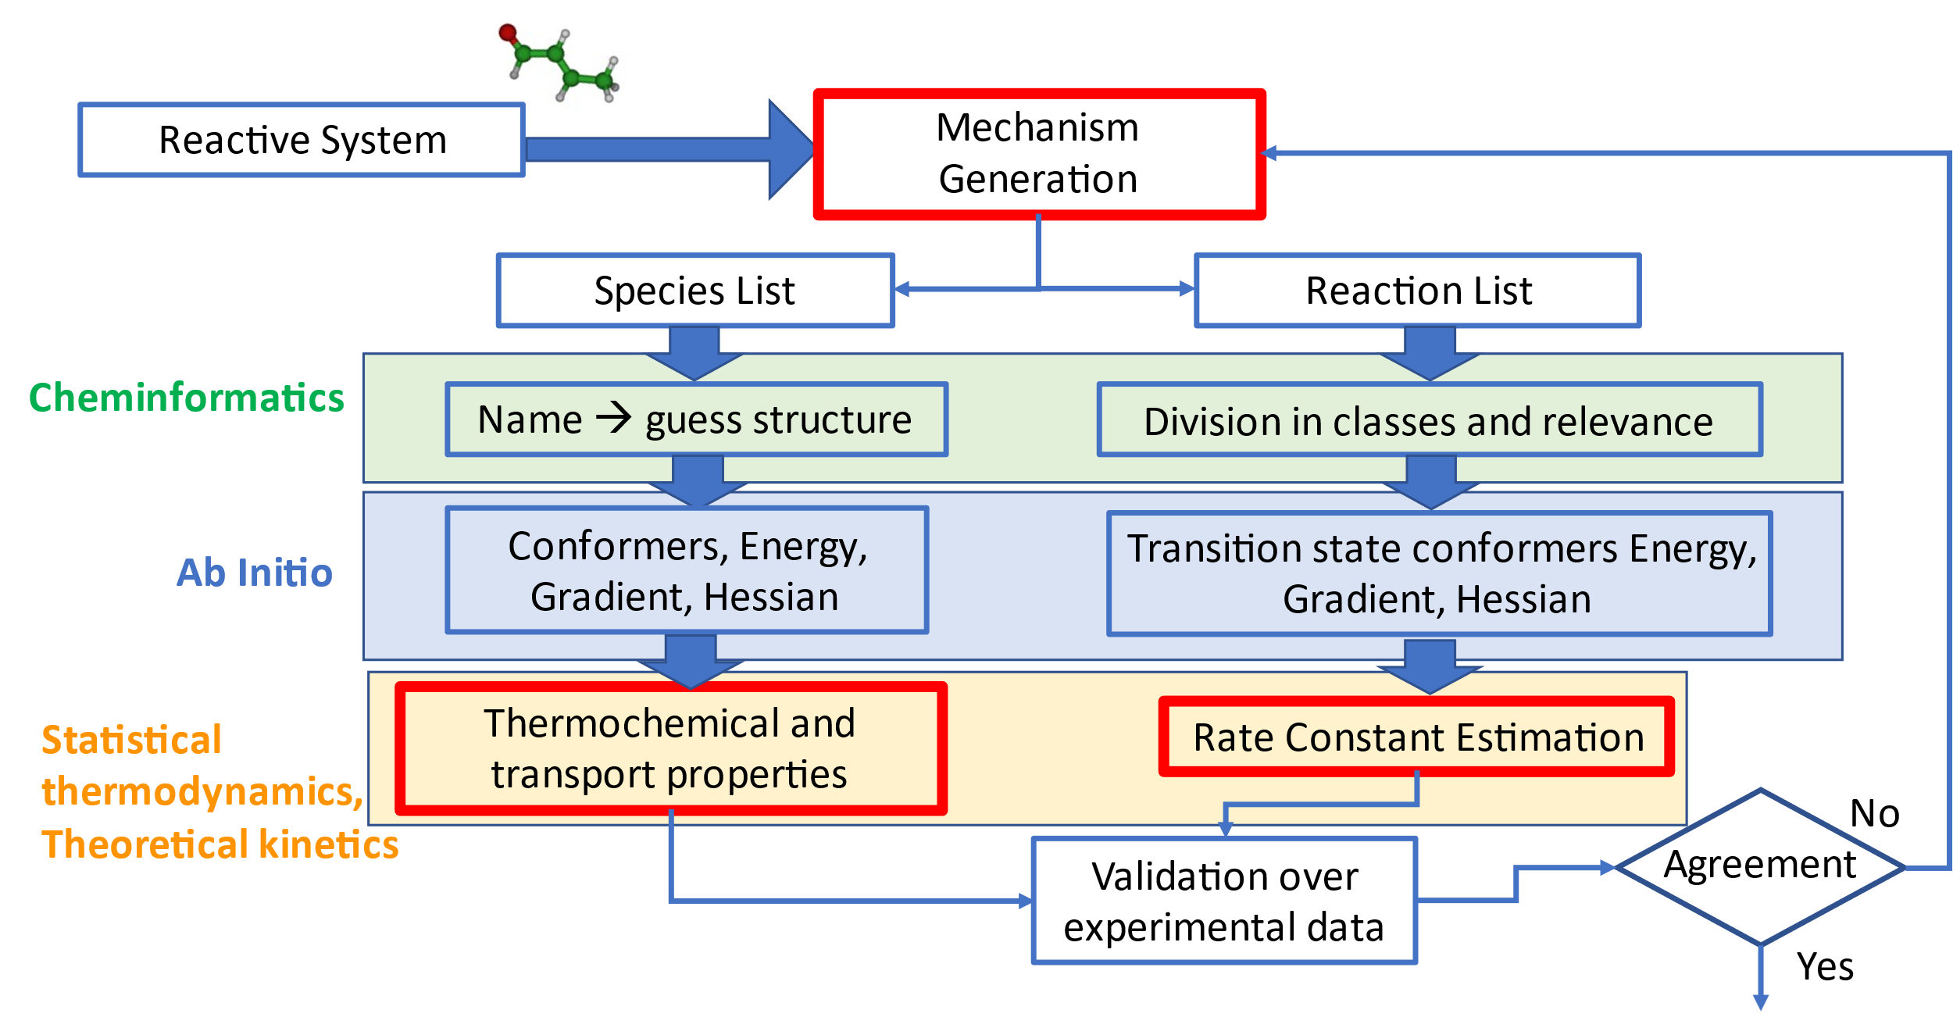
How to determine rate and thermodynamic parameters accurately and efficiently?

Slide 5
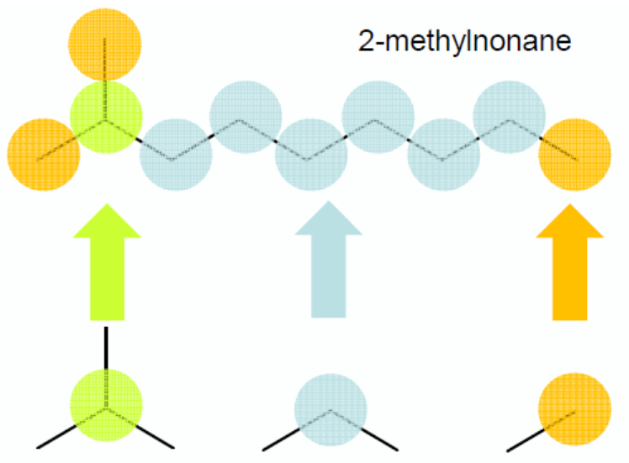
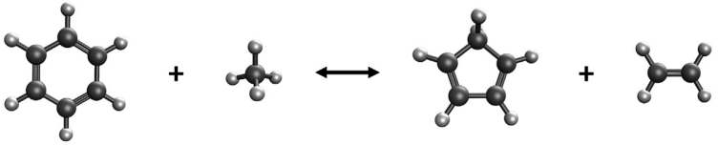
Thermochemical parameters
Thermochemical parameters are necessary to describe the evolution of energy distribution in reacting environments
Two main possibilities for thermochemical parameters estimation:
Group contribution methods
(Benson - THERM, RMG)
Molecular partition functions +
atomization schemes
(CHEMTP, based on EStokTP)

Slide 6
Aim of the work
CHEMTP: algorithm for thermochemical parameters estimation
InChI2data: protocol for automatic generation of EStokTP input files
FragsGen: automatic method for bond energies estimation

Slide 7
Aim of the work
Generation of new software:
Thermochemical parameters estimation
CHEMTP
Generation of EStokTP input files
InChI2data
Bond enegies estimation
FragsGen

Slide 8

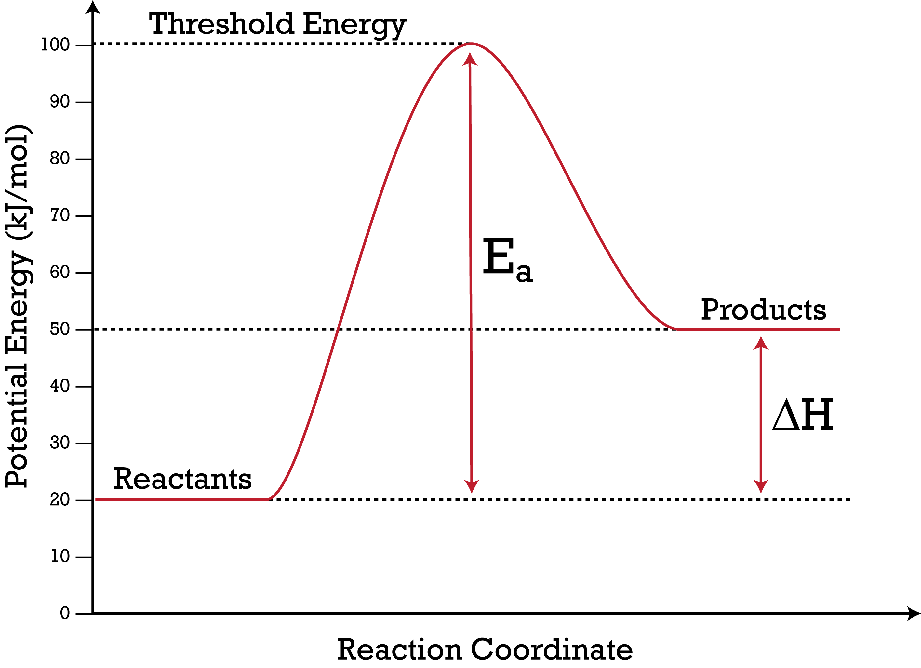

CHEMTP: Connectivity Hierarchy Estimation Model for Thermochemical Parameters
$C_{P}^{0}(T)$ and $S^{0}(T)$ are calculated exploiting molecular partition functions
$H^{0}(T)$ is calculated using atomization schemes
CBH-2
Atomization schemes preserve atomic or bond vicinity to construct convenient reactions to calculate ∆H⁰(0 K) (Connectivity Based Hierarchy approach)
Accuracy
CBH-1
CBH-0
${\text{∆}\text{H}}_{R}^{0}$ expressed as:
${\text{∆}\text{H}}_{R}^{0}={\text{∆}\text{H}\text{0}\text{(0 }\text{K}\text{)}}_{Prod}−{\text{∆}\text{H}\text{0}\text{(0 }\text{K}\text{)}}_{React}={\left(E_{el}+ZPE\right)}_{Prod}−$ ${\left(E_{el}+ZPE\right)}_{React}$

Slide 9
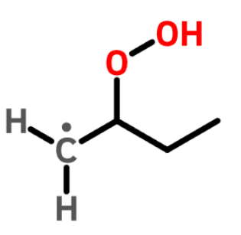
CBH-0: Isogyric scheme on 2-hydroperoxybutyl
The Isogyric scheme represent every non-hydrogen atom with its corresponding saturated form
CBH-2
CBH-1
CBH-0

Slide 10
CBH-0: Isogyric scheme on 2-hydroperoxybutyl
The Isogyric scheme represent every non-hydrogen atom with its corresponding saturated form
Water
O
Methane
C
Methyl
[CH3]
[CH2]C(CC)OO + 5 [H][H] → 3 C + [CH3] + 2 O
CBH-2
C4H9O2 + 5 H₂ → 3 CH₄ + CH₃● + 2 H₂O
CBH-1
CBH-0

Slide 11
CBH-1: Isodesmic scheme on 2-hydroperoxybutyl
The Isodesmic scheme preserves every bond environment formed by non-hydrogen atoms
CBH-0 PRODUCTS
CBH-2
CBH-1
CBH-0

Slide 12




CBH-1: Isodesmic scheme on 2-hydroperoxybutyl
The Isodesmic scheme preserves every bond environment formed by non-hydrogen atoms
Water peroxide
OO
Ethane
CC
Ethyl
[CH3]C
[CH2]C(CC)OO + 3 C + O → 2 CC + [CH2]C + CO + OO
CBH-0 PRODUCTS
CBH-2
C4H9O2 + 3 CH₄ + H₂O → 2 + + +
CBH-1
CBH-0

Slide 13
CBH-2: Homodesmotic scheme on 2-hydroperoxybutyl
The Homodesmotic scheme preserves every atom vicinity in terms of type of non-hydrogen atoms and type of bonds
CBH-1 PRODUCTS
CBH-2
CBH-1
CBH-0

Slide 14
CBH-2: Homodesmotic scheme on 2-hydroperoxybutyl
The Homodesmotic scheme preserves every atom vicinity in terms of type of non-hydrogen atoms and type of bonds
Propane
CCC
CBH-1 PRODUCTS
CBH-2
[CH2]C(CC)OO + CC + CO → CCC + COO + [CH2]C(C)O
CBH-1
CBH-0

Slide 15
CBH-2: Homodesmotic scheme on 2-hydroperoxybutyl
The Homodesmotic scheme preserves every atom vicinity in terms of type of non-hydrogen atoms and type of bonds
Methyl peroxide
COO
CBH-1 PRODUCTS
CBH-2
[CH2]C(CC)OO + CC + CO → CCC + COO + [CH2]C(C)O
CBH-1
CBH-0

Slide 16
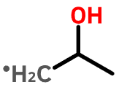


CBH-2: Homodesmotic scheme on 2-hydroperoxybutyl
The Homodesmotic scheme preserves every atom vicinity in terms of type of non-hydrogen atoms and type of bonds
Methyl peroxide
COO
Propane
CCC
[CH2]C(CC)OO + CC + CO → CCC + COO + [CH2]C(C)O
CBH-1 PRODUCTS
CBH-2
C4H9O2 + + → + +
CBH-1
CBH-0

Slide 17

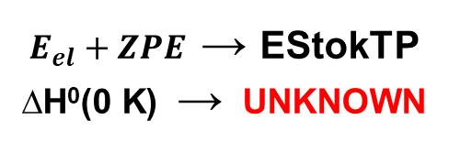
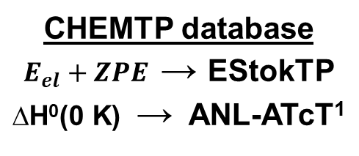
Reference species database
${\text{∆}\text{H}}_{R}^{0}={\text{∆}\text{H}\text{0}\text{(0 }\text{K}\text{)}}_{Prod}−{\text{∆}\text{H}\text{0}\text{(0 }\text{K}\text{)}}_{React}={\left(E_{el}+ZPE\right)}_{Prod}−$ ${\left(E_{el}+ZPE\right)}_{React}$
[CH2]C(CC)OO + CC + CO → CCC + COO + [CH2]C(C)O
$E_{el}+ZPE$ → EStokTP
$\text{∆}\text{H}\text{0}\text{(0 }\text{K}$) → UNKNOWN
CHEMTP database
$E_{el}+ZPE$ → EStokTP
$\text{∆}\text{H}\text{0}\text{(0 }\text{K}$) → ANL-ATcT¹
of
The database contains 102 reference species $\text{∆}\text{H}\text{0}\text{(0 }\text{K}$) and $E_{el}+ZPE$ at four levels of theory Every reference species pre-selected and optimized
InChI2data used for the automatic generation of EStokTP input files
[1]: Argonne National Laboratory – Active Thermochemical Tables

Slide 18
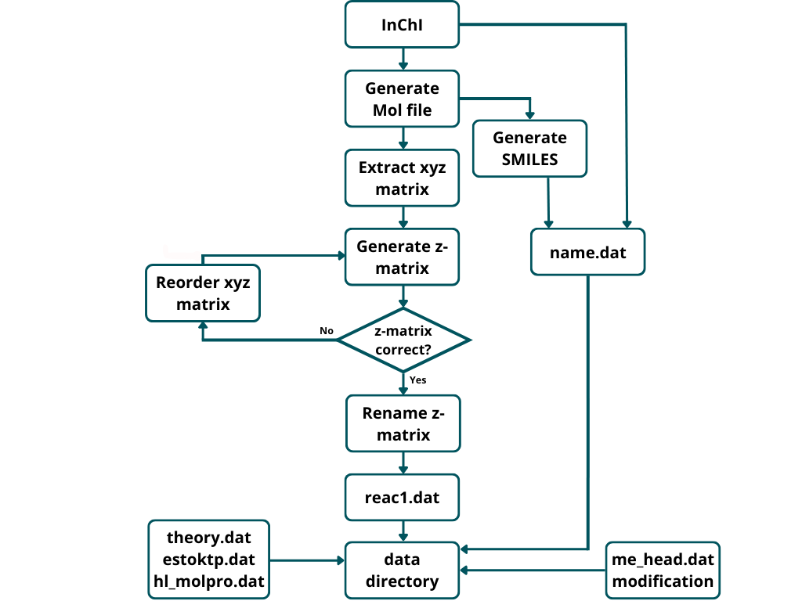
InChI2data flowchart

Slide 19
InChI2data flowchart
InChI=1S/C2H6/c1-2/h1-2H3
c1
c2 c1 cc2
h3 c1 hc3 c2 hcc3
h4 c1 hc4 c2 hcc4 h3 dih4
h5 c1 hc5 c2 hcc5 h3 dih5
h6 c2 hc6 c1 hcc6 h3 dih6
h7 c2 hc7 c1 hcc7 h6 dih7
h8 c2 hc8 c1 hcc8 h6 dih8

Slide 20
InChI2data flowchart
Ready for EStokTP simulation!

Slide 21
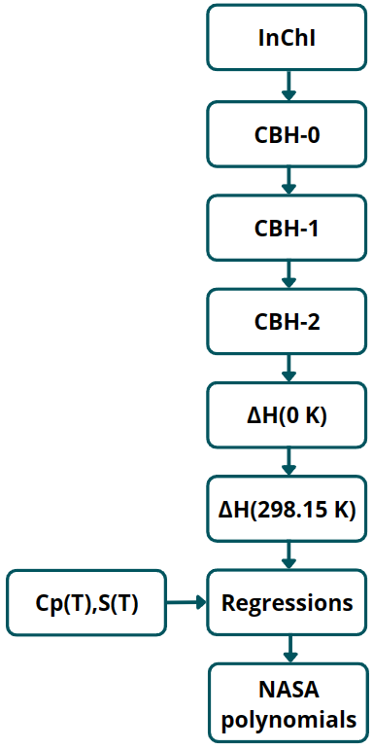
CHEMTP flowchart

Slide 22
CHEMTP flowchart
[CH2]C(CC)OO + 5 [H][H] → 3 C + [CH3] + 2 O
Klippenstein et al.²: 4.47 [kcal mol⁻¹]
CHEMTP, CBH-0: -14.69 [kcal mol⁻¹]
CHEMTP, CBH-1: 18.87 [kcal mol⁻¹]
CHEMTP, CBH-2: 4.66 [kcal mol⁻¹]
[CH2]C(CC)OO + 3 C + O → 2 CC + [CH2]C + CO + OO
[CH2]C(CC)OO + CC + CO → CCC + COO + [CH2]C(C)O
[2]: Klippenstein, S.J. et al., Journ Phys Chem A, 127-6 1512-1532

Slide 23
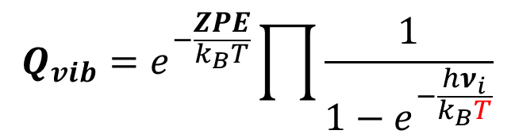
CHEMTP flowchart
Vibrational partition function can not be computed @ 0 K
$$Q_{vib}=e^{−\frac{ZPE}{k_{B}T}}\prod{\frac{1}{1−e^{−\frac{hν_{i}}{k_{B}T}}}}$$
Thermal correction to 298.15 K based on thermal corrections of single atoms

Slide 24
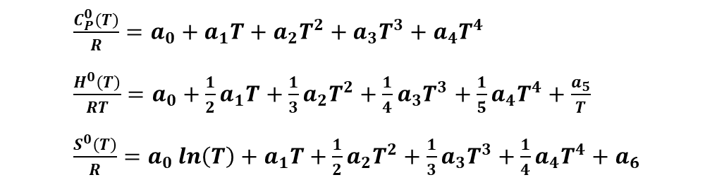

CHEMTP flowchart
NASA polynomials
Fitting on a two set of 7 parameters each over a defined range of temperatures
$\frac{C_{P}^{0}\left(T\right)}{R}=a_{0}+a_{1}T+a_{2}T^{2}+a_{3}T^{3}+a_{4}T^{4}$
$\frac{H^{0}\left(T\right)}{RT}=a_{0}+\frac{1}{2}a_{1}T+\frac{1}{3}a_{2}T^{2}+\frac{1}{4}a_{3}T^{3}+\frac{1}{5}a_{4}T^{4}+\frac{a_{5}}{T}$
$\frac{S^{0}\left(T\right)}{R}=a_{0}\ln\left(T\right)+a_{1}T+\frac{1}{2}a_{2}T^{2}+\frac{1}{3}a_{3}T^{3}+\frac{1}{4}a_{4}T^{4}+a_{6}$
$C_{P}^{0}(T)$, $S^{0}(T)$, $H^{0}(T)$ and
$G^{0}\left(T\right)=H^{0}\left(T\right)−TS^{0}(T)$
CHEMKIN format
C5H8 G 250.000 3000.000 1630.000 1
1.16177281e+01 2.62596289e-02-1.15691725e-05 2.48806136e-09-2.11953159e-13 2
3.62321811e+03-3.45415119e+01-1.80030161e+00 6.93315758e-02-6.40556982e-05 3
3.08708072e-08-5.91217060e-12 7.07276738e+03 3.33132138e+01-1.22550360e+05 4

Slide 25
CHEMTP results: ∆H⁰(0 K) with ωB97X-D/jun-cc-pVTZ level of theory
CHEMTP was tested on 142 species by Klippenstein et al.² database
Average absolute error:
0.39 ± 0.54 [kcal mol⁻¹]
Average relative percentage error:
3.39 ± 5.09
Error caused by:
Different levels of theory used
Different number of sampling points
[2]: Klippenstein, S.J. et al., J. Phys Chem A, 127-6, 1512-1532

Slide 26
CHEMTP results: ∆H⁰(0 K) at different levels of theory
A subset of 8 molecules was used to study the influence of the level of theory on the estimations
ωB97X-D-HL and B2PLYP-D3-HL are CCSD(T) with core electrons correlations and extrapolation to basis set limit, based on ωB97X-D and B2PLYP-D3 results

Slide 27
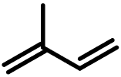
CHEMTP results: $C_{P}^{0}(T)$, $S^{0}(T)$, $H^{0}(T)$, $G^{0}(T)$ of isoprene
Isoprene thermochemical parameters from CHEMTP compared with RMG estimations (Benson group contribution method)
Full RRHO was more in agreement with respect to explicit hindered rotor treatment (RRHO-1DHR)
Discrepancy caused by:
Group contribution method different approach
Failure of RRHO at high temperature
[3]: Green, W.H. et al., Comp Phys Comm, 203, 212-225

Slide 28
CHEMTP results: $C_{P}^{0}(T)$, $S^{0}(T)$, $H^{0}(T)$, $G^{0}(T)$ of isoprene
Isoprene thermochemical parameters from CHEMTP compared with RMG estimations (Benson group contribution method)
Full RRHO was more in agreement with respect to explicit hindered rotor treatment (RRHO-1DHR)
Discrepancy caused by:
Group contribution method different approach
Failure of RRHO at high temperature
[3]: Green, W.H. et al., Comp Phys Comm, 203, 212-225

Slide 29
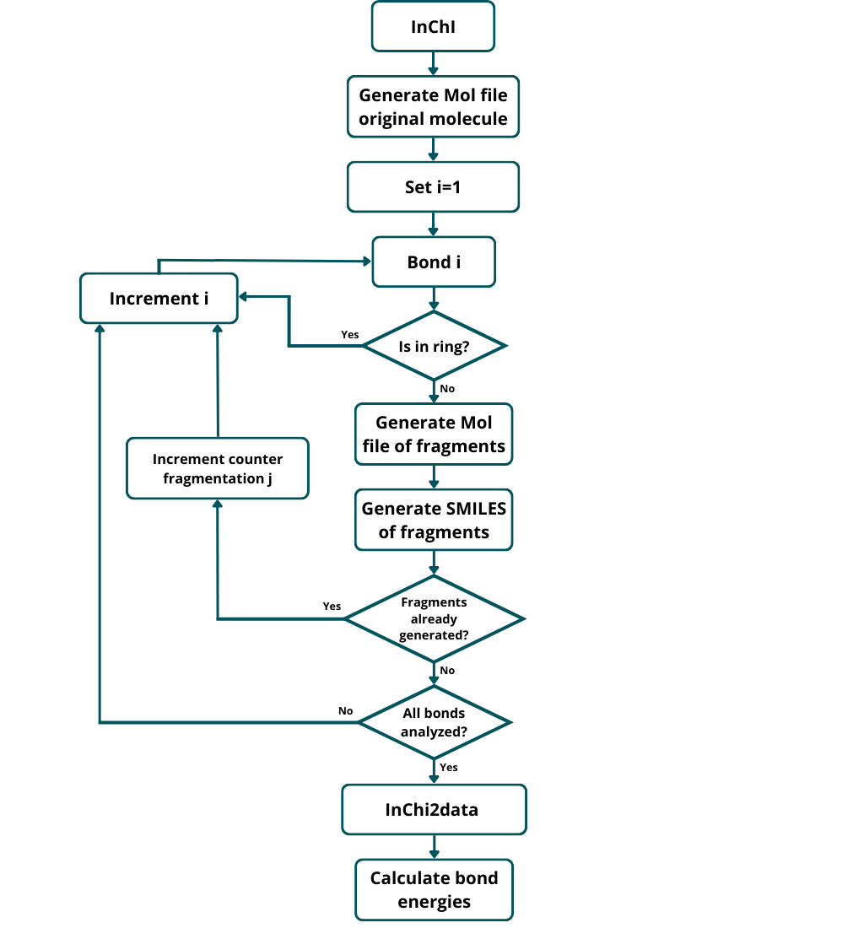
FragsGen flowchart: automatic fragments generation

Slide 30
FragsGen flowchart: automatic fragments generation
Generation of the Cartesian coordinates of every fragment

Slide 31
FragsGen flowchart: automatic fragments generation
Conversion to Z-matrix and simulation in EStokTP

Slide 32
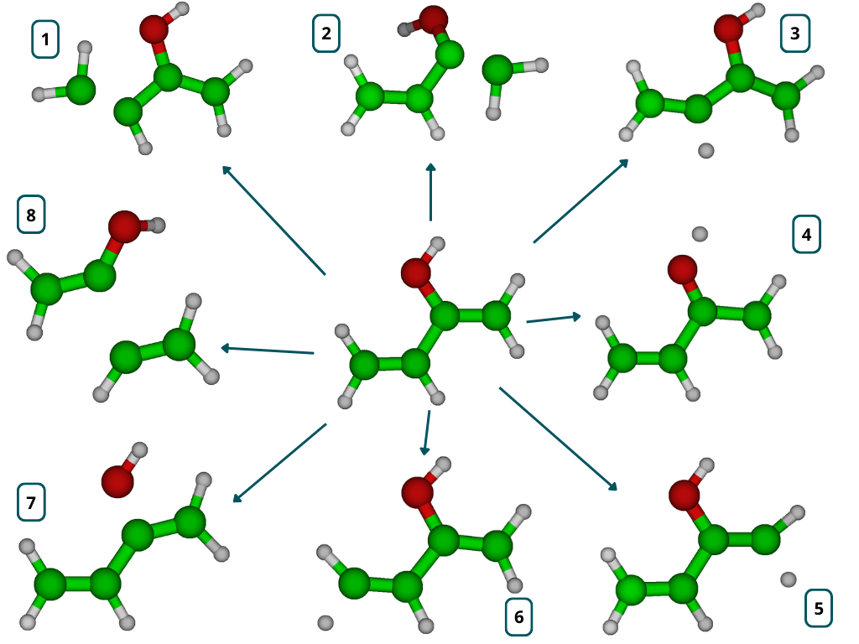
FragsGen results: 1,3-butadiene-2-ol
N | FragsGen[kcal mol⁻¹] | Literature [kcal mol⁻¹]
1 | 144.77 | 174.1^{[4]}
2 | 154.91 | 174.1^{[4]}
3 | 109.86 | 110.7^{[4]}
4 | 85.40 | 84.50^{[5]}
5 | 113.94 | 110.7^{[4]}
6 | 111.32 | 110.7^{[4]}
7 | 107.84 | 90.1^{[4]}
8 | 113.98 | 111.5^{[6]}
[4]: Blanksby S.J et al., Accounts of Chem Research, 36 (4), 255-263
[5]: So S. et al., ACS Earth and Space Chem, 2 (8), 753-763
[6]: Hadad C. M. et al., J. Org. Chem., 63, 8668-8681

Slide 33
Conclusions
Two challenging tasks in the automation of predictive chemical kinetics are the accurate estimation of thermochemical paramaters and the automatic exploration of PES
EStokTP is a powerful software born and continously updated with this final purpose.
In the present work three codes, working in synergy with EStokTP, were developed:
InChI2data
Automatic generation of EStokTP input files, starting from InChIs identifiers
CHEMTP
Estimation of thermochemical parameters based on partition functions + atomization schemes
FragsGen
Automatic generation of fragmentation products and estimation of bond energies

Slide 34
Thanks for the kind attention!
Any questions?

