Slide 1
The Battle of Neighborhoods
Data Science Capstone Project Coursera

Slide 2
Content
1. Introduction
2. Big Picture of the problem
3. Getting Data
4. Exploring the Data
5. Data Preparation
6. Models Building
7. Result
8. Conclusion

Slide 3
Introduction
The goal of this project is to compare the neighborhoods of cities of Toronto and New York and determine how similar or dissimilar they are.
Let's imagine a scenario where a bank in New York wants to relocate in Toronto, in which neighborhood can we advice them to move on. How can we use data science to recommend them the right place to relocate?
My model will be generalized for any other venues in New York that wants to relocate in any other neighborhood In Toronto. Based on the current location of any venue in New York, the model will assign similar venue in Toronto and vice versa.
For this project, I will frame the problem as an offline unsupervised leaning since we I will not use labeled online data.
I will use K-mean algorithm to cluster the neighborhood based on similar venues.
According to my expertise having visited both cities, Fox Hills in New York is most likely to Parkwoods in Toronto. Let’s see if our model will confirm this assumption.

Slide 4
Getting Data
New York data are available for free of use at location: https://geo.nyu.edu/catalog/nyu_2451_3457
Toronto Data extracted using wed scrapping with BeautifulSoup4 package. Source of data https://en.wikipedia.org/wiki/List_of_postal_codes_of_Canada:_M
Foursquare API used to explore the neighborhoods
Geocoder package used to get geographical coordinates of each postal code

Slide 5
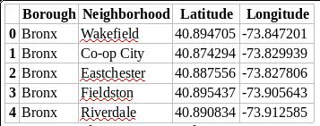
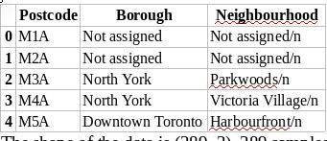
Exploring data
New York Data
After downloading the data in a Pandas Data frame, here is the first five rows of New York data.
The shape of data set is the follow: (306, 4). 306 samples and 4 features: Borough, Neighborhood, Latitude, Longitude.
Toronto Data
Here is the first five rows of Toronto data frame after web scrapping.
The shape of the data is (289, 3). 289 samples and 3 features
The features Postcode, Borough, Neighbourhood are all from Text Type.

Slide 6
Data preparation
Ignoring cells with a borough that is Not assigned to delete missing values
Combining into one row the neighborhoods existing in one postal code order in to eliminate duplicate neighborhoods
Add latitude and the longitude coordinates of each neighborhood. We saw in previous section that those feature was missing for Toronto dataset
Feature selection: here I choose only the necessary columns. Post code from New York dataset
Concatenated dataset of Toronto and New York in one single dataset

Slide 7
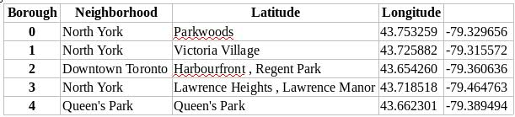
Data Preparation cont...
The final dataset after preparation consist of 4 features and 409 rows

Slide 8
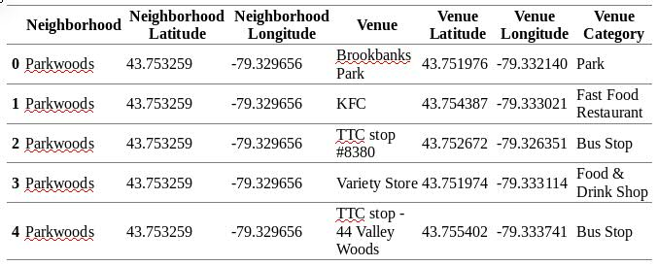
Exploring data with Foursquare API
Foursquare API used to explore neighborhoods
Top 10 venues for each neighborhood in a radius of 500 meters
There are 456 unique categories from all the returned venues
The case of “Parkwoods”

Slide 9
Model Buiding
K-Mean cluster algorithm
K = 5, clustering our dataset in five clusters
Using Sckit Learn package for model buiding
Python code:
# import k-means from clustering stage
from sklearn.cluster import Kmeans
# set number of clusters
kclusters = 5
toronto_grouped_clustering = toronto_grouped.drop('Neighborhood', 1)
# run k-means clustering
kmeans = KMeans(n_clusters=kclusters, random_state=0).fit(toronto_grouped_clustering)
# check cluster labels generated for each row in the dataframe
kmeans.labels_[0:10]

Slide 10
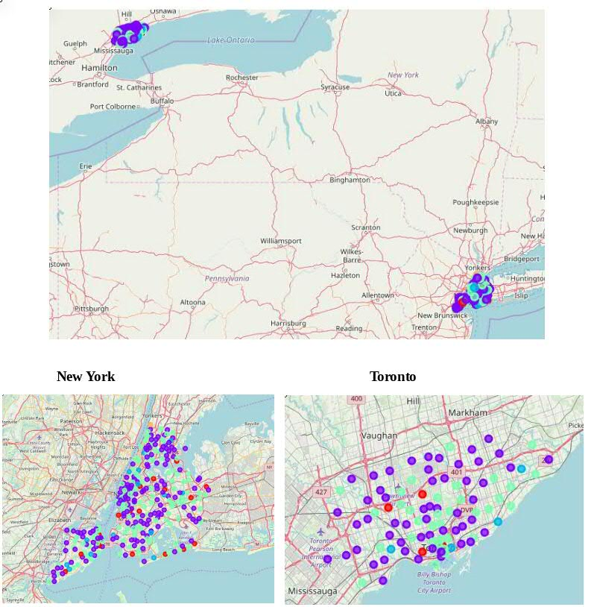
Result
Visualizing our cluster using Folium package

Slide 11
Result cont...
Cluster 1 in red consist on 22 Neighborhood.
Cluster 2 in purple color consist of 205 Neighborhoods is the most common venues in both New York and Toronto
Cluster 3 in blue consist on 18 neighborhoods in both Toronto and New York
Cluster 4 in green color consist of 157 neighborhood in both Toronto and New York.
Cluster 5 consist of only one neighborhood “North Riverdale” located in Toronto

Slide 12
Conclusion
Cities of Toronto and New York are very similar in terms of neighborhoods. Both cities are financial capitals of their respective countries.
A bank from New York can easily move to Toronto in the Neighborhood which is in the same cluster. In the same way venue in Toronto can easily move to similar neighborhood in New York.
We can also confirm our initial assumption. “Fox Hills” in New York and “Parkwoods” in Toronto appears in the same cluster.

Slide 13
Thank You

