Slide 1

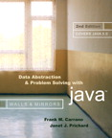
Chapter 5
Linked Lists

Slide 2

Preliminaries
Options for implementing an ADT
  Array
    Has a fixed size
    Data must be shifted during insertions and deletions
  Linked list
    Is able to grow in size as needed
    Does not require the shifting of items during insertions and deletions

Slide 3
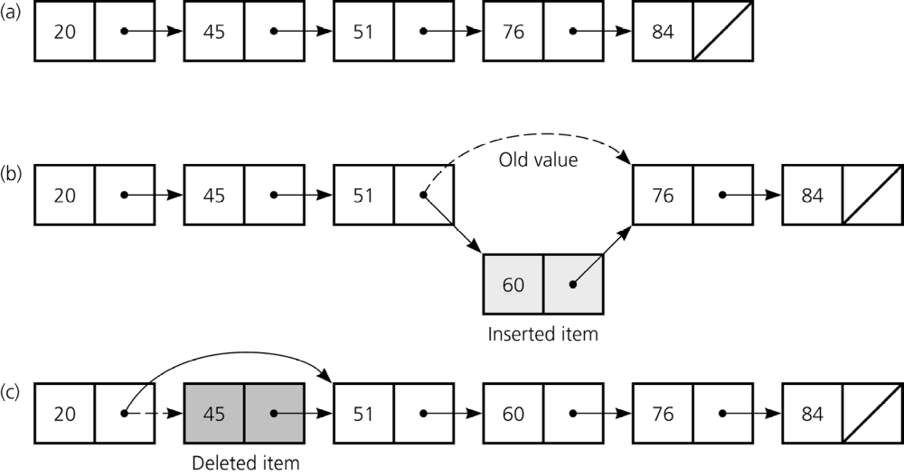
Preliminaries
Figure 5-1
a) A linked list of integers; b) insertion; c) deletion

Slide 4
Object References
A reference variable
  Contains the location of an object
  Example
    Integer intRef;
    intRef = new Integer(5);
  As a data field of a class
    Has the default value null
  A local reference variable to a method
    Does not have a default value

Slide 5
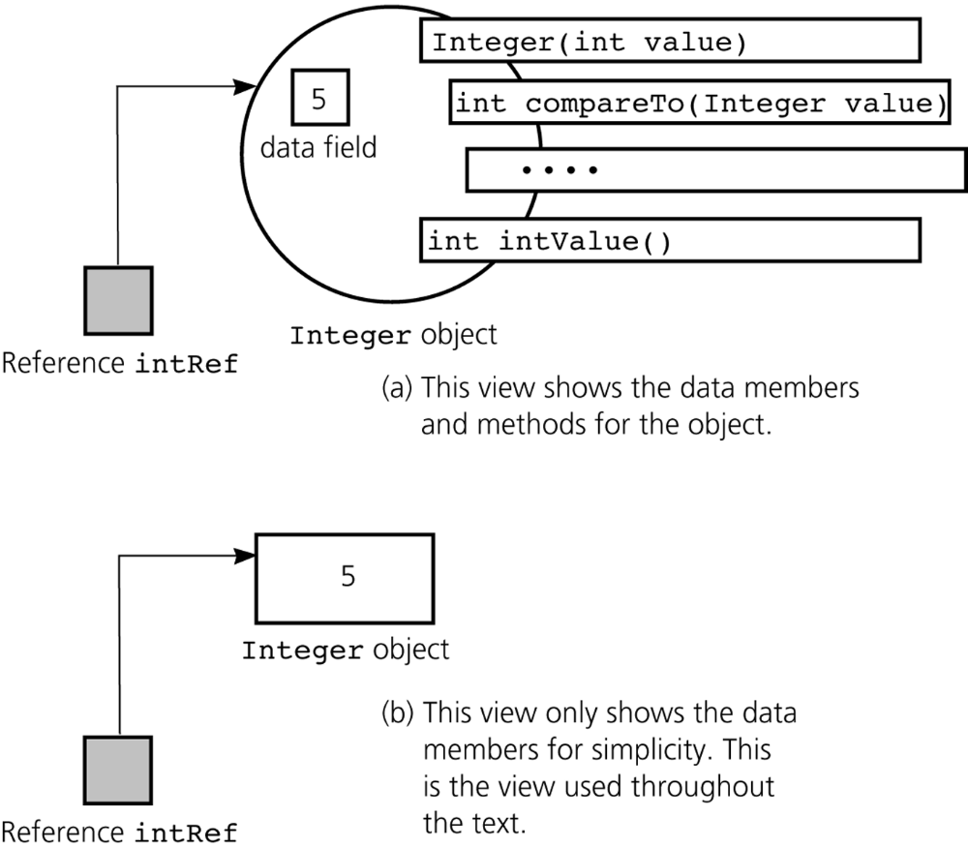
Object References
Figure 5-2
A reference to an Integer object

Slide 6
Object References
When one reference variable is assigned to another reference variable, both references then refer to the same object
  Integer p, q;
  p = new Integer(6);
  q = p;
A reference variable that no longer references any object is marked for garbage collection

Slide 7
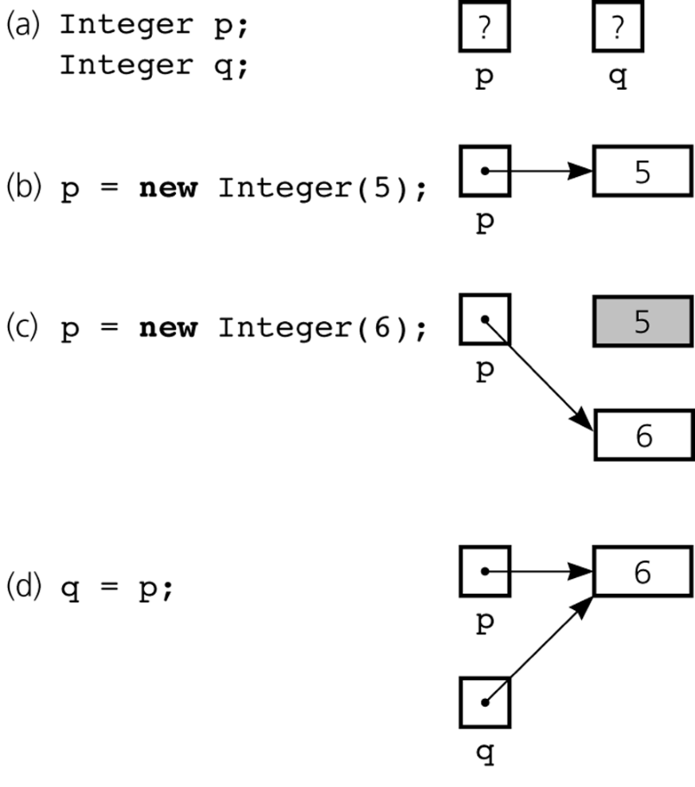
Object References
Figure 5-3a-d
a) Declaring reference variables; b) allocating an object; c) allocating another object, with the dereferenced object marked for garbage collection

Slide 8
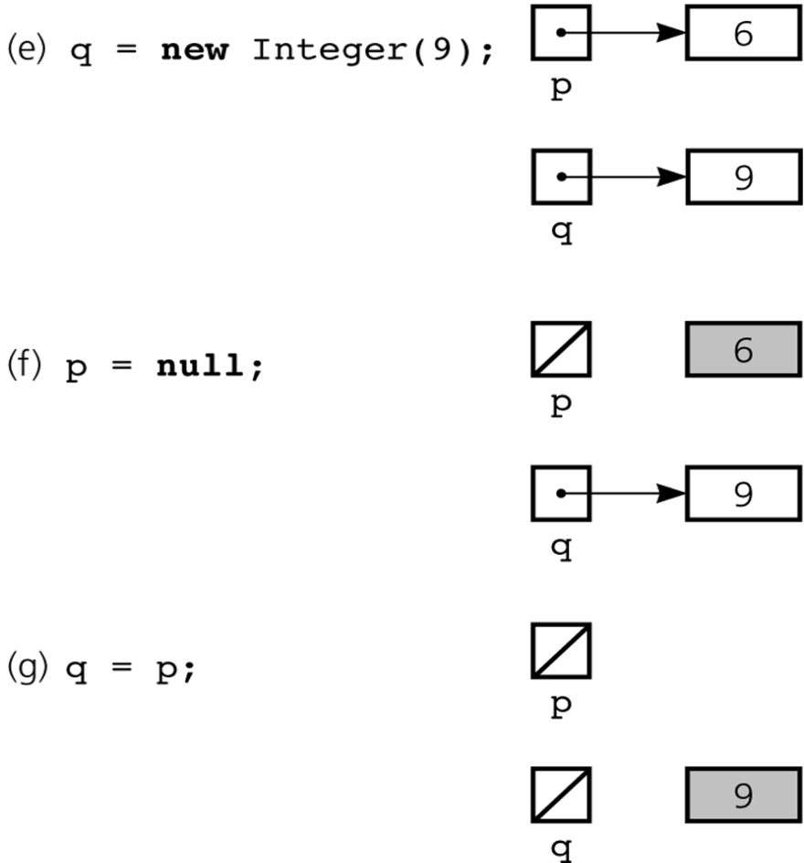
Object References
Figure 5-3e-g
e) allocating an object; f) assigning null to a reference variable; g) assigning a reference with a null value

Slide 9
Object References
An array of objects
  Is actually an array of references to the objects
  Example
    Integer[] scores = new Integer[30];
  Instantiating Integer objects for each array reference
    scores[0] = new Integer(7);
    scores[1] = new Integer(9); // and so on …

Slide 10
Object References
Equality operators (== and !=)
  Compare the values of the reference variables, not the objects that they reference
equals method
  Compares objects field by field
When an object is passed to a method as an argument, the reference to the object is copied to the method’s formal parameter
Reference-based ADT implementations and data structures use Java references

Slide 11
Resizable Arrays
The number of references in a Java array is of fixed size
Resizable array
  An array that grows and shrinks as the program executes
  An illusion that is created by using an allocate and copy strategy with fixed-size arrays
java.util.Vector class
  Uses a similar technique to implement a growable array of objects

Slide 12
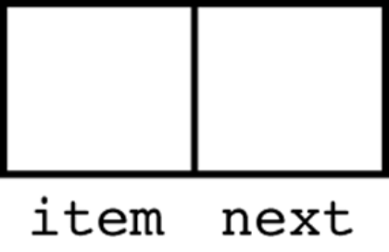
Reference-Based Linked Lists
Linked list
  Contains nodes that are linked to one another
  A node
    Contains both data and a “link” to the next item
    Can be implemented as an object
    public class Node {
    private Object item;
    private Node next;
    // constructors, accessors,
    // and mutators …
    } // end class Node
Figure 5-5
A node

Slide 13
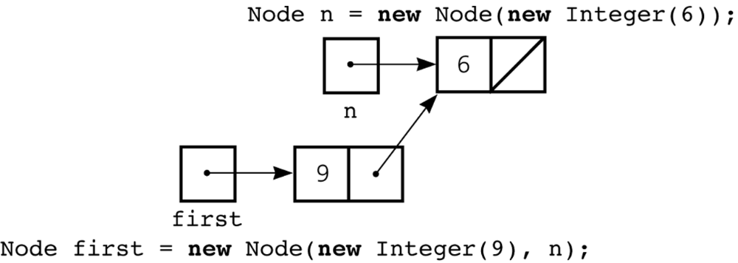
Reference-Based Linked Lists
Using the Node class
  Node n = new Node (new Integer(6));
  Node first = new Node (new Integer(9), n);
Figure 5-7
Using the Node constructor to initialize a data field and a link value

Slide 14
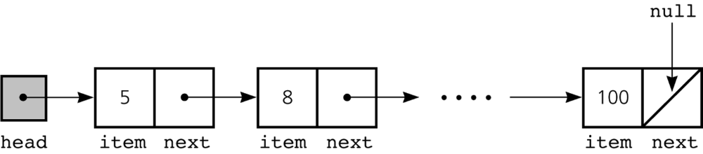
Reference-Based Linked Lists
Data field next in the last node is set to null
head reference variable
  References the list’s first node
  Always exists even when the list is empty
Figure 5-8
A head reference to a linked list

Slide 15
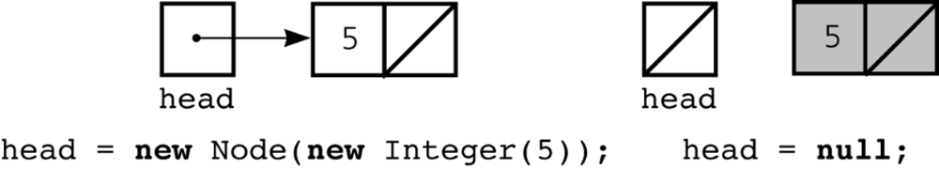
Reference-Based Linked Lists
head reference variable can be assigned null without first using new
  Following sequence results in a lost node
    head = new Node(); // Don’t really need to use new here
    head = null; // since we lose the new Node object here
Figure 5-9
A lost node

Slide 16
Programming with Linked Lists:
Displaying the Contents of a Linked List
curr reference variable
  References the current node
  Initially references the first node
To display the data portion of the current node
  System.out.println(curr.getItem());
To advance the current position to the next node
  curr = curr.getNext();

Slide 17
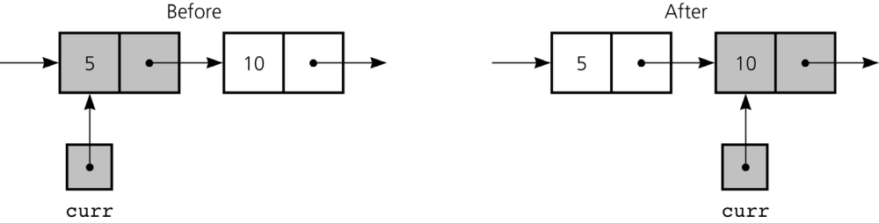
Displaying the Contents of a Linked List
Figure 5-10
The effect of the assignment curr = curr.getNext( )

Slide 18
Displaying the Contents of a Linked List
To display all the data items in a linked list
  for (Node curr = head; curr != null; curr = curr.getNext()) {
  System.out.println(curr.getItem());
  } // end for

Slide 19
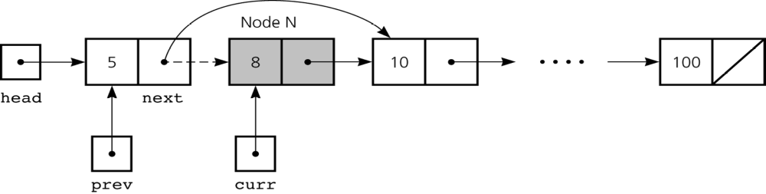
Deleting a Specified Node from a Linked List
To delete node N which curr references
  Set next in the node that precedes N to reference the node that follows N
  prev.setNext(curr.getNext());
Figure 5-11
Deleting a node from a linked list

Slide 20
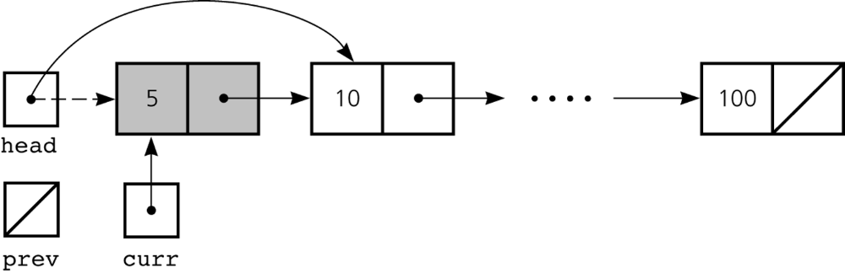
Deleting a Specified Node from a Linked List
Deleting the first node is a special case
  head = head.getNext();
Figure 5-12
Deleting the first node

Slide 21
Deleting a Specified Node from a Linked List
To return a node that is no longer needed to the system
  curr.setNext(null);
  curr = null;
Three steps to delete a node from a linked list
  Locate the node that you want to delete
  Disconnect this node from the linked list by changing references
  Return the node to the system

Slide 22
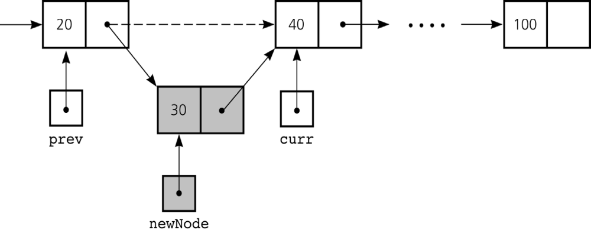
Inserting a Node into a Specified Position of a Linked List
To create a node for the new item
  newNode = new Node(item);
To insert a node between two nodes
  newNode.setNext(curr);
  prev.setNext(newNode);
Figure 5-13
Inserting a new node into a linked list

Slide 23
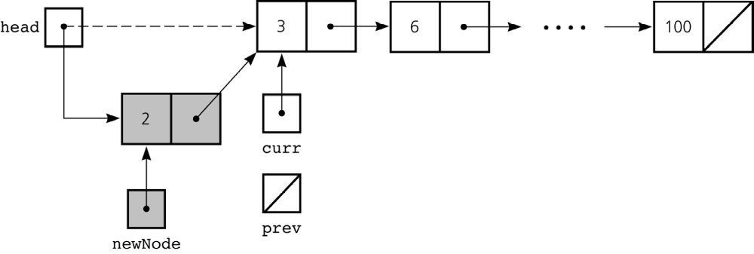
Inserting a Node into a Specified Position of a Linked List
To insert a node at the beginning of a linked list
  newNode.setNext(head);
  head = newNode;
Figure 5-14
Inserting at the beginning of a linked list

Slide 24
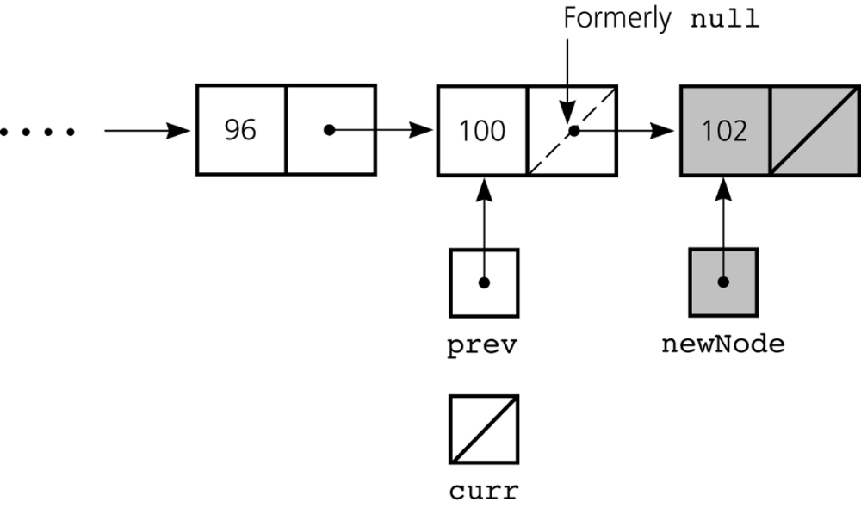
Inserting a Node into a Specified Position of a Linked List
Inserting at the end of a linked list is not a special case if curr is null
  newNode.setNext(curr);
  prev.setNext(newNode);
Figure 5-15
Inserting at the end of a linked list

Slide 25
Inserting a Node into a Specified Position of a Linked List
Three steps to insert a new node into a linked list
  Determine the point of insertion
  Create a new node and store the new data in it
  Connect the new node to the linked list by changing references

Slide 26
Determining curr and prev
Determining the point of insertion or deletion for a sorted linked list of objects
  for ( prev = null, curr = head;
  (curr != null) &&
  (newValue.compareTo(curr.getItem()) > 0);
  prev = curr, curr = curr.getNext() ) {
  } // end for

Slide 27
Please open file carrano_ppt05_B.ppt
to continue viewing chapter 5.

