Slide 1
Teaching STAMP: High Level Communication Design Concerns for a Domestic Robot
Michael J. Findler, PhD Ritesh Kumar Chalawadi Software Engineering Software Engineering findler@uhcl.edu 1 (281) 515-0007

Slide 2
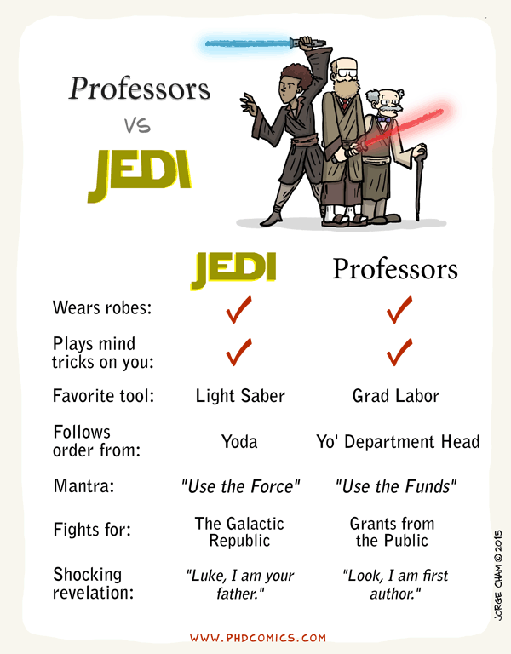
Introduction
Motivation
First Attempt
Second/Third Attempt
Current Attempt
Next Attempt

Slide 3
Motivation
Motivation
First Attempt
Second/Third Attempt
Current Attempt
Next Attempt
Recently started teaching at the University of Houston Clear Lake
Johnson Space Center (“Houston, we have a problem”)
Experience
Industrial engineering
Safety officer in the United States Air Force
The SWEN student population
overwhelmingly foreign students (95%)
little or no experience in system engineering
As mentioned frequently, HAZOPS, FTA and FMEA do not work with Software
Notes:
Software Safety was on the books.
Had not been taught in 5 years.

Slide 4
First Attempt
Motivation
First Attempt
Second/Third Attempt
Current Attempt
Next Attempt
Teach standard safety techniques
Hazardous Operations (HAZOPS)
Failure Mode, Effects and Criticality Analysis (FMECA)
Fault Tree Analysis (FTA)
This was a horrible failure
Learned about STAMP
Borrowed heavily from Leveson
Students lack technical terminology, so they use generics – no domain considerations

Slide 5
First Attempt Topics
Motivation
First Attempt
Second/Third Attempt
Current Attempt
Next Attempt
Project intensive
Intro
SW vs HW
CAST
FTA
STPA
HAZOP
Design for Safety
FMEA
Intro
SW vs HW
CAST
FTA
STPA
HAZOP
FMEA
Design for Safety
1 1 4 1
4 2 1 1
Notes:
Numbers are approximate weights
Also add a week for description of available accidents

Slide 6
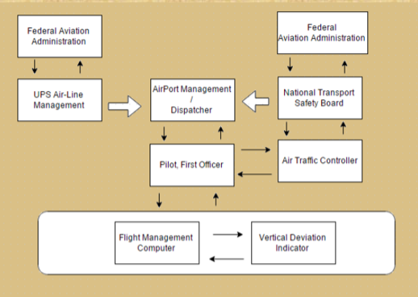
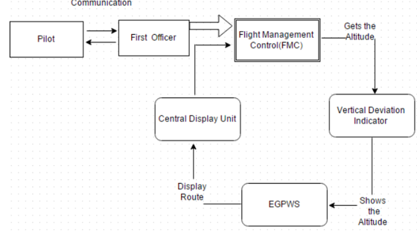
CAST/STPA Control Structure
Motivation
First Attempt
Second/Third Attempt
Current Attempt
Next Attempt
CAST STPA
Notes:
Generic
No real understanding of control Structure
Top score

Slide 7
Second Attempt
Motivation
First Attempt
Second/Third Attempt
Current Attempt
Next Attempt
I kept the project
Dumped the Traditional methods
Hardware techniques to software systems WAS WRONG
Extended CAST analysis to 4 weeks
Extended STPA to 4 weeks
PROBLEM: REQ / ACK generic control structures
PROBLEM: Minimum effort exerted for STPA tables and charts
Students afraid of using wrong terminology – play it safe!

Slide 8
Second/Third Attempt Topics
Project intensive
Motivation
First Attempt
Second/Third Attempt
Current Attempt
Next Attempt
Intro
SW vs HW
CAST
STPA
Design for Safety
Intro
SW vs HW
STPA
FMEA
Design for Safety
1 4
4 2
Notes:
Numbers are approximate weights
Also add a week for description of available accidents

Slide 9
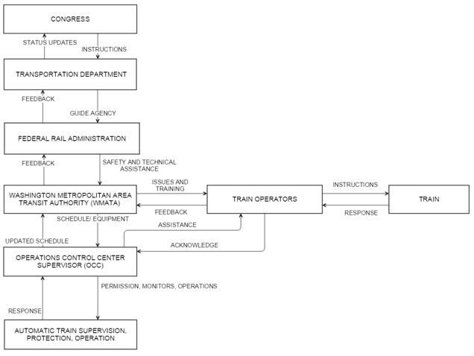
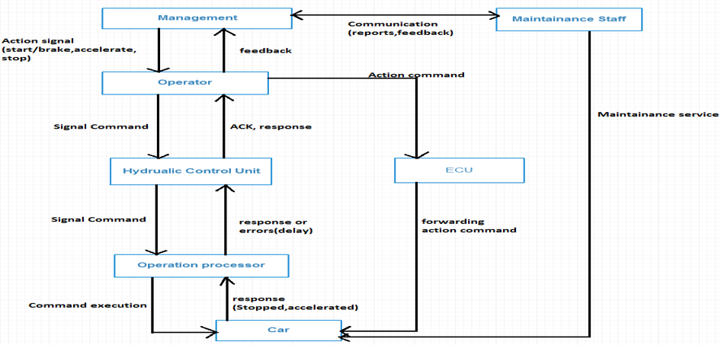
CAST/STPA Control Structure
Motivation
First Attempt
Second/Third Attempt
Current Attempt
Next Attempt
CAST STPA
Notes:
Generic
No real understanding of control Structure
Top score

Slide 10
Current Attempt
Motivation
First Attempt
Second/Third Attempt
Current Attempt
Next Attempt
More Like a STAMP Workshop
More of a hybrid class
As opposed to traditional versus “flipped”
Reading done before class
Homework done in class
Using Active Critical Thinking (ACT) techniques
What is done in class must be replicated outside of class and turned in the next week
Each student responsible for
Weekly quiz/thought paper
Three CAST homeworks
Three STPA homeworks
Each Group responsible for
Newspaper article
CAST
CAST presentation
STPA
Design for Safety Presentation

Slide 11
YAY for XSTAMPP
Motivation
First Attempt
Second/Third Attempt
Current Attempt
Next Attempt
eXtensible STAMP Platform (XSTAMPP) v. 2.0 showed up
We used for STPA portion of homework
Did FANTASTIC!
Less Generic control structures
PROBLEM: Students grump about the amount of work
Student came back to campus and said they had to use the methodology in an internship. The bosses were impressed!

Slide 12
Second Attempt Topics
Motivation
First Attempt
Second/Third Attempt
Current Attempt
Next Attempt
Intro
SW vs HW
CAST
STPA
Design for Safety
Newspaper
Intro
SW vs HW
STPA
FMEA
Design for Safety
Newspaper
1 2
4 2 4
Project intensive
Notes:
Numbers are approximate weights
Also add a week for description of available accidents

Slide 13
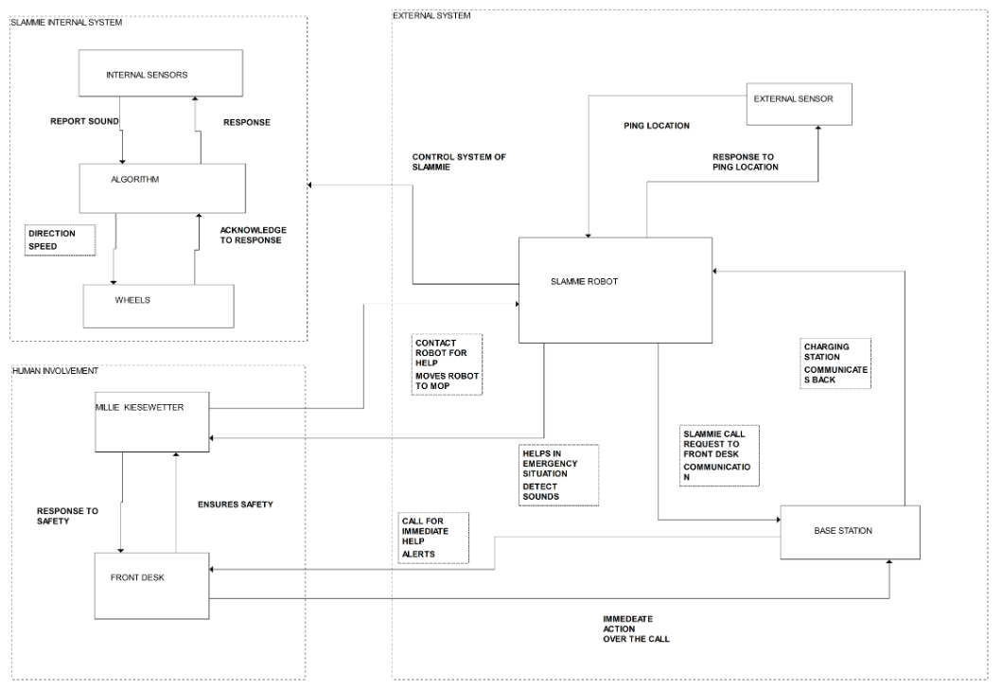
CAST Control Structure
Motivation
First Attempt
Second/Third Attempt
Current Attempt
Next Attempt

Slide 14
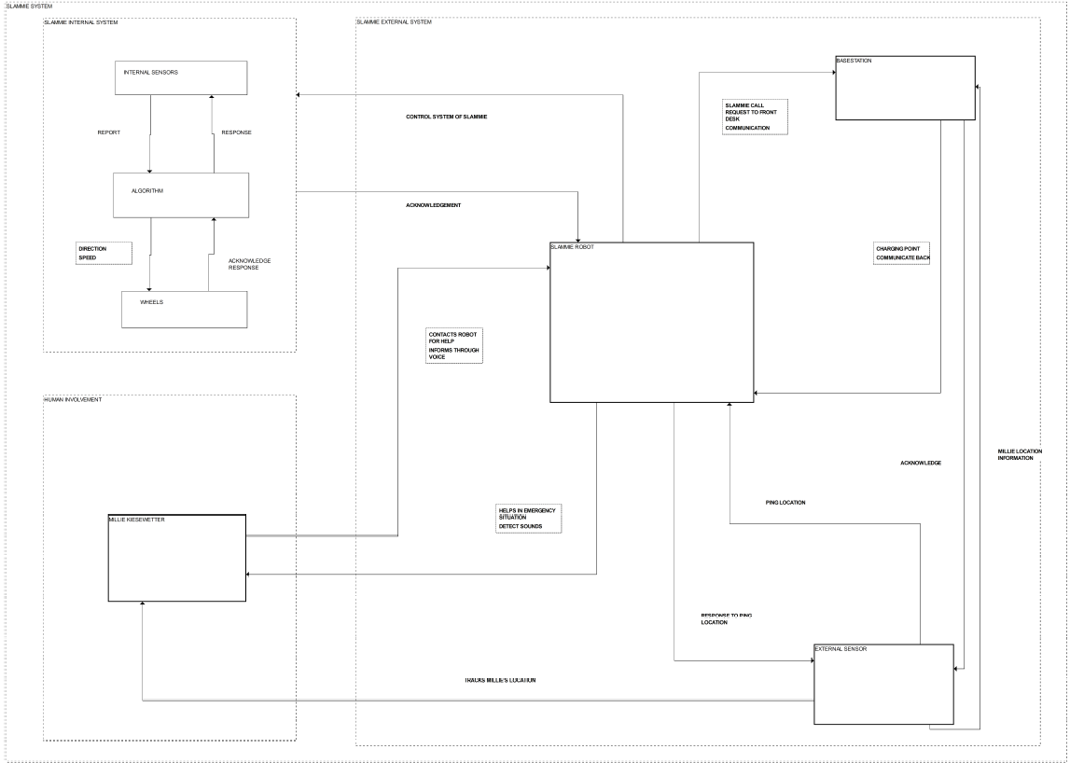
STPA Control Structure
Motivation
First Attempt
Second/Third Attempt
Current Attempt
Next Attempt

Slide 15
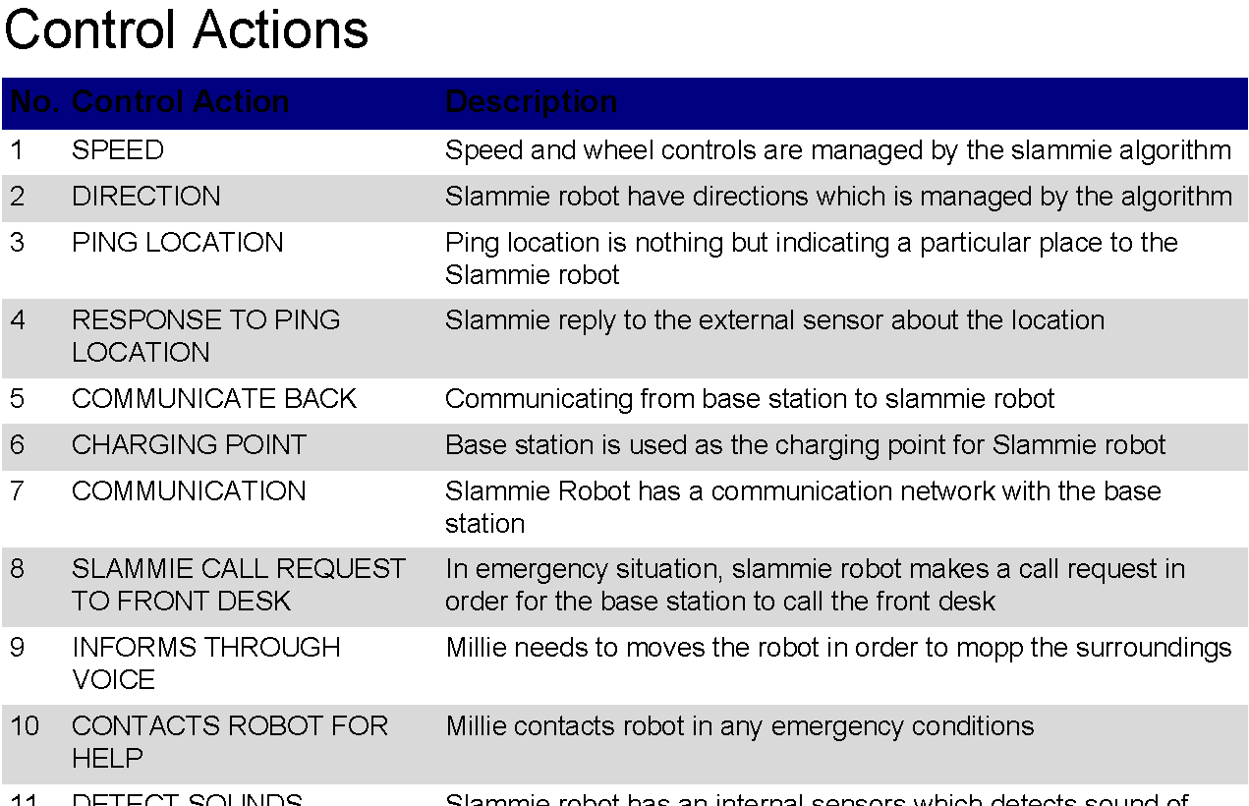
Motivation
First Attempt
Second/Third Attempt
Current Attempt
Next Attempt

Slide 16
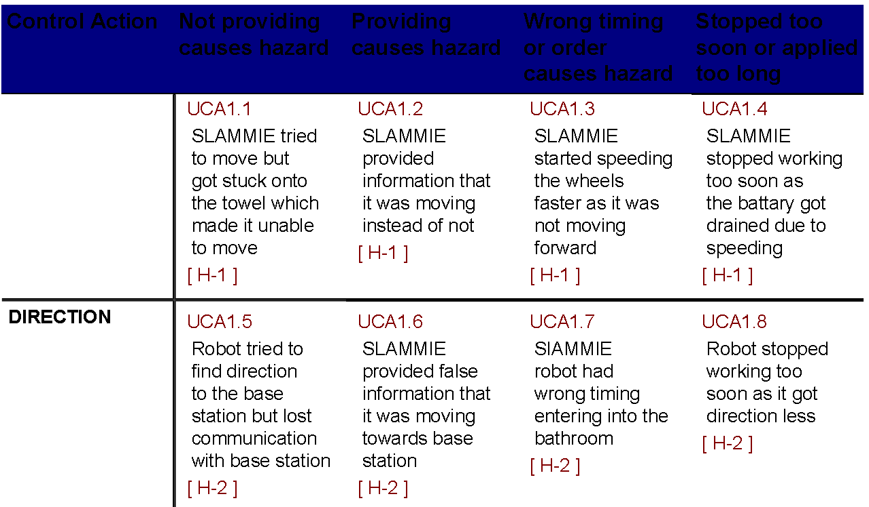
Motivation
First Attempt
Second/Third Attempt
Current Attempt
Next Attempt

Slide 17
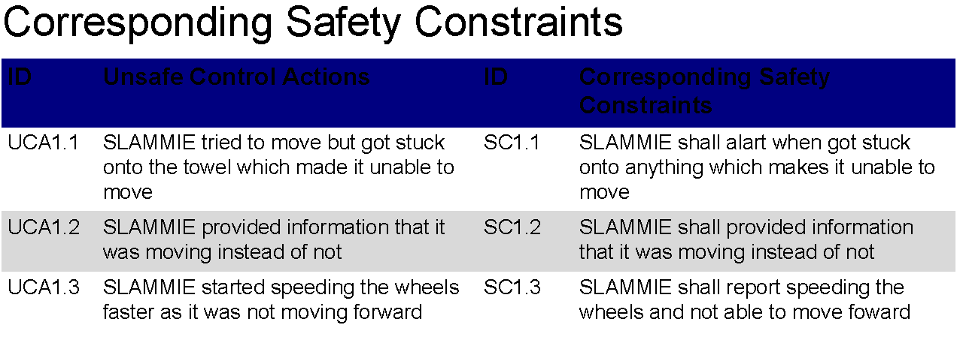
Motivation
First Attempt
Second/Third Attempt
Current Attempt
Next Attempt

Slide 18
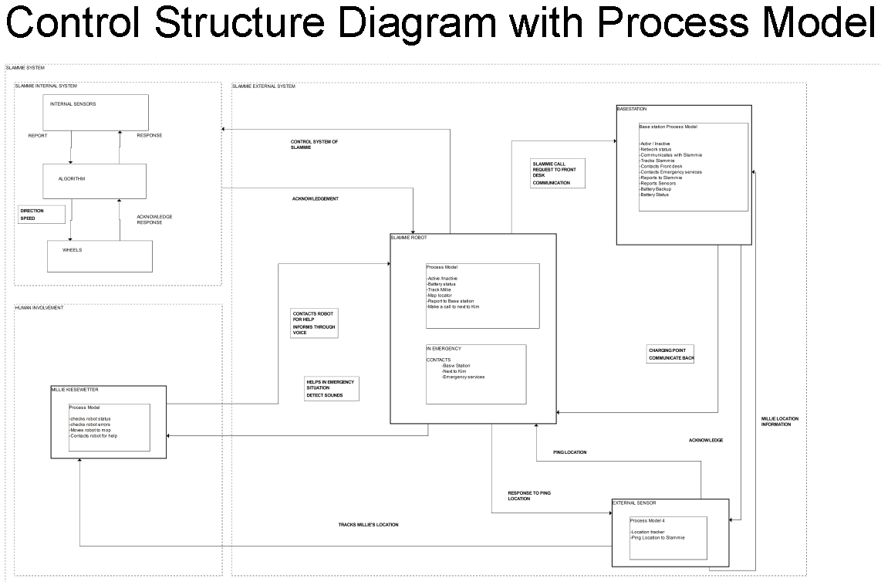
Motivation
First Attempt
Second/Third Attempt
Current Attempt
Next Attempt

Slide 19
Next Attempt
Motivation
First Attempt
Second/Third Attempt
Current Attempt
Next Attempt
Incorporate XSTAMPP into CAST
Encourage students to become their own “experts”
Tell the story, the technical words can come later
Continue Active Critical Thinking

Slide 20
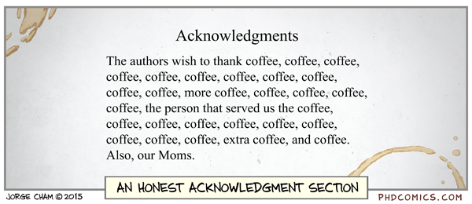
Honestly, I would like to thank Ritesh Kumar Chalawadi

Slide 21
Links
Skydrive folder with files mentioned in presentation
https://1drv.ms/f/s!Ao_Q8jQ3JqgCgdorvnj2uf6wckBWBA
XSTAMPP directory
https://sourceforge.net/projects/stampp/

