Slide 1
Advanced Git
Maya Anderson
06/12/2017

Slide 2
Table of contents
Git and its Benefits
Git Internals
Sample Workflow
Git Best Practices
GitHub Workflow - Fork and Pull Request
Git Commands

Slide 3

What is Git?
Distributed SCM
Free
Open-source
By Linus Torvalds for Linux kernel development – 2005
Every working directory - full-fledged local repository:
complete history
full version tracking
Every commit is a snapshot of the whole repository
Notes:
One of the nicest features of any Distributed SCM, Git included, is that it's distributed. This means that instead of doing a "checkout" of the current tip of the source code, you do a "clone" of the entire repository.
Multiple Backups -This means that even if you're using a centralized workflow, every user essentially has a full backup of the main server. Each of these copies could be pushed up to replace the main server in the event of a crash or corruption. In effect, there is no single point of failure with Git unless there is only a single copy of the repository.
Any Workflow
Because of Git's distributed nature and superb branching system, an almost endless number of workflows can be implemented with relative ease.
git - the stupid content tracker
When asked why [Linus Torvalds] called the new software, "git," British slang meaning "a rotten person," he said. "I'm an egotistical bastard, so I name all my projects after myself. First Linux, now git."

Slide 4

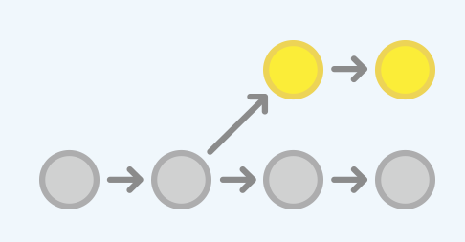

Git Benefits
Fast
Better history, less fear
Flexibility in where you work
Compact and user-friendly command-line
Flexible and powerful – rewrite local history
Cheap and easy local Branches
Git is the de facto standard of OSS (GitHub)
Social coding = social network + coding
Corporate GitHub - https://github.ibm.com/
Notes:
“Social coding" - software development by a distributed, virtual community.
Small and Fast
* Nearly all operations are performed locally, giving it a huge speed advantage on centralized systems that constantly have to communicate with a server somewhere.
* Git was built to work on the Linux kernel, meaning that it had to effectively handle large repositories from day one. Git is written in C, reducing the overhead of runtimes associated with higher-level languages. Speed and performance has been a primary design goal of the Git from the start.
* Clearly, in many of the common version control operations, Git is one or two orders of magnitude faster than SVN, even under ideal conditions for SVN.
* One place where Git is slower is in the initial clone operation. Here, Git is downloading the entire history rather than only the latest version. As seen in the above charts, it's not considerably slower for an operation that is only performed once.
* The size of the data on the client side is very similar even though Git also has every version of every file for the entire history of the project. This illustrates how efficient it is at compressing and storing data on the client side.

Slide 5
Git Internals

Slide 6
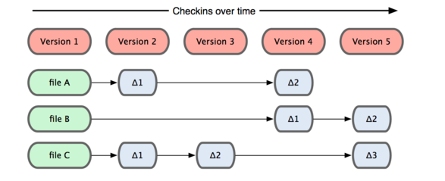
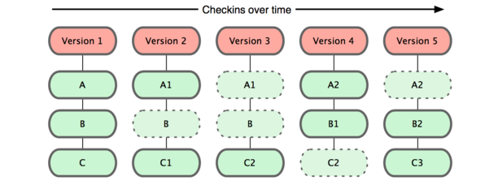
Git Overview Different from other SCMs
Subversion, CVS, Perforce, Mercurial and the like all use Delta Storage systems - they store the differences between one commit and the next.
Git stores a snapshot of what all the files in your project look like in this tree structure each time you commit.
Git is distributed and decentralized - every developer checking out code from a central repository will have their own cloned repository installed on their machine.

Slide 7
Git Object Model
Content-addressable filesystem
A simple key-value data store
A DAG of objects of different types
Objects stored compressed
Objects stored identified by an SHA-1 hash
Notes:
At the core of Git is a simple key-value data store. You can insert any kind of content into it, and it will give you back a key that you can use to retrieve the content again at any time.
In simplified form, git object storage is "just" a DAG of objects, with a handful of different types of objects. They are all stored compressed and identified by an SHA-1 hash (that, incidentally, isn't the SHA-1 of the contents of the file they represent, but of their representation in git).

Slide 8
Git Object Model The SHA
All the history of a project is stored in files referenced by a 40-digit "object name“, e.g. 16b36c697eb2d24302f89aa22d9170dfe609855b (can often be referred to by first 6 digits, e.g. 16b36c)
The name is calculated by taking the SHA1 hash of the contents of the object.
Compare objects just by comparing names.
Same content => same name, even in different branches
Detect errors by checking that the object's name is still the SHA1 hash of its contents.

Slide 9
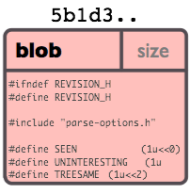
Git Object Model Blob Object
A blob generally stores the contents of a file
A chunk of binary data
If two files have the same contents, they will share the same blob object
Renaming a file does not change the object that file is associated with
Compressed with zlib
Notes:
It doesn't refer to anything else or have attributes of any kind, not even a file name.
zlib is designed to be a free, general-purpose, legally unencumbered -- that is, not covered by any patents -- lossless data-compression library for use on virtually any computer hardware and operating system. The zlib data format is itself portable across platforms. Unlike the LZW compression method used in Unix compress(1) and in the GIF image format, the compression method currently used in zlib essentially never expands the data. (LZW can double or triple the file size in extreme cases.) zlib's memory footprint is also independent of the input data and can be reduced, if necessary, at some cost in compression. A more precise, technical discussion of both points is available on another page.
zlib was written by Jean-loup Gailly (compression) and Mark Adler (decompression). Jean-loup is also the primary author/maintainer of gzip(1), the author of the comp.compression FAQ list and the former maintainer of Info-ZIP's Zip; Mark is also the author of gzip's and UnZip's main decompression routines and was the original author of Zip. Not surprisingly, the compression algorithm used in zlib is essentially the same as that in gzip and Zip, namely, the `deflate' method that originated in PKWARE's PKZIP 2.x.

Slide 10
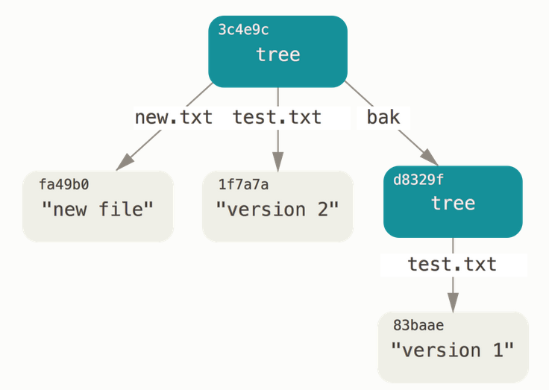
Git Object Model Tree Object
A tree is a simple object that has a bunch of pointers to blobs and other trees - it generally represents the contents of a directory or subdirectory.
Since trees and blobs are named by the SHA1 hash of their contents, two trees have the same SHA1 name iff their contents (recursively) are identical.
This allows git to quickly determine the differences between two related tree objects, since it can ignore any entries with identical object names.
3c4e9c…
tree |  | size
tree | d8329f | bak
blob | fa49b0 | new.txt
blob | 1f7a7a | test.txt

Slide 11
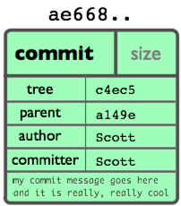

Git Object Model Commit Object
A commit is defined by
a tree: SHA1 name of a tree object – “snapshot”
parent(s): The SHA1 name of some number of commits which represent the immediately previous step(s) in the history of the project.
an author: The name of the person responsible for this change + date.
a committer: who actually created the commit (not necessarily the author) + date
a comment describing this commit.
a149e
ae668
Notes:
The "commit" object links a physical state of a tree with a description of how we got there and why.
Note that a commit does not itself contain any information about what actually changed; all changes are calculated by comparing the contents of the tree referred to by this commit with the trees associated with its parents. In particular, git does not attempt to record file renames explicitly, though it can identify cases where the existence of the same file data at changing paths suggests a rename. (See, for example, the -M option to git diff).
A commit is usually created by git commit, which creates a commit whose parent is normally the current HEAD, and whose tree is taken from the content currently stored in the index.

Slide 12
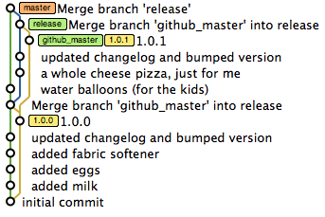
Git Object Model Tag
Tag object contains a tagger, a date, a message and a pointer.
Points to a commit rather than a tree. It’s like a branch reference, but it never moves!
Mark release points (v1.0, and so on)
A tag can be created without a tag object – lightweight tag vs. annotated tag
Notes:
List available tags
$ git tag
$ git tag -l "v1.8.5*“
Create tags:
$ git tag -a v1.4 -m "my version 1.4“ # Annotated tag
$ git tag v1.4-lw # Lightweight tag
$ git tag -a v1.2 9fceb02 # Tag a commit
Push tags - $ git push origin --tags
Create a branch that matches the tag commit:
$ git checkout -b version2 v2.0.0
Of course if you do this and do a commit, your version2 branch will be slightly different than your v2.0.0 tag since it will move forward with your new changes, so do be careful!
http://blog.scottlowe.org/2015/01/27/using-fork-branch-git-workflow/

Slide 13
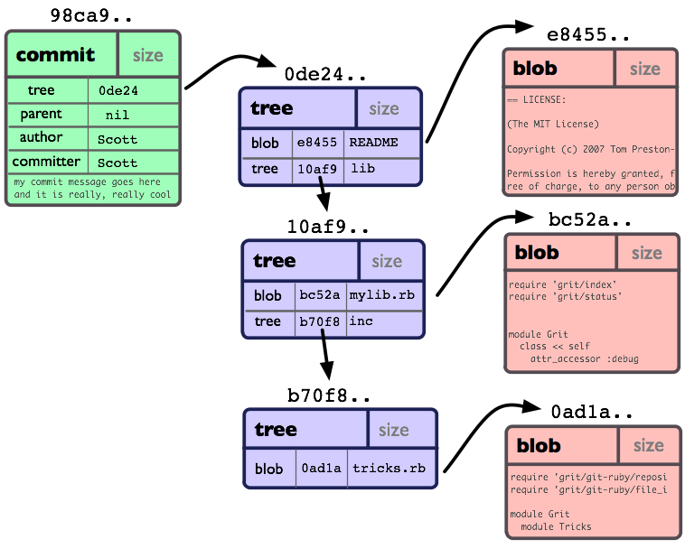
Git Object Model The Objects
Every object consists of three things - a type, a size and content
Object types:
"blob" is used to store file data - it is generally a file.
"tree" is basically like a directory - it references other trees and/or blobs (i.e. files and sub-directories)
"commit" points to a single tree at a certain point in time. It contains a timestamp, author of the changes, a pointer to the previous commit(s), etc.
"tag" is a way to mark a specific commit as special in some way (e.g. specific releases).
|-- README
|-- lib
|-- inc
|-- tricks.rb
|-- mylib.rb

Slide 14
The Git Directory
|-- HEAD # pointer to your current branch
|-- config # your configuration preferences
|-- hooks/ # pre/post action hooks
|-- index # index file (staging area)
|-- logs/ # a history of where your branches have been
|-- objects/ # your objects (commits, trees, blobs, tags)
|-- refs/ # pointers to your branches
Notes:
cat .git/HEAD
find .git/refs (tree .git/refs)
find .git/objects -type f
git cat-file -p 003411441ed23a3e7a6c03fe9ffd90f00cbe88bb
git cat-file -t b95d69

Slide 15
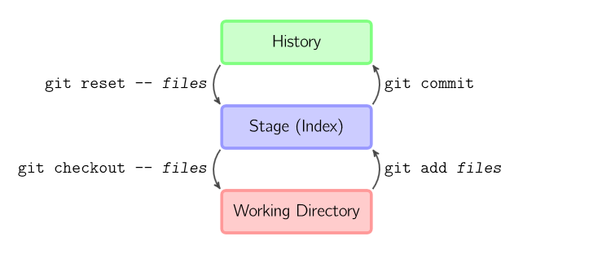
The Working Directory
The current checkout of the files you are working on.
The working directory is simply a temporary checkout place where you can modify the files until your next commit.
Notes:
git add files copies files (at their current state) to the stage.
git checkout -- files copies files from the stage to the working directory. Use this to throw away local changes.

Slide 16
The Git Index
The Git index - a staging area between your working directory and your repository
Use the index to build up a set of changes that you want to commit together.
When you create a commit, what is committed is what is currently in the index, not what is in your working directory.
git status command - see which files are staged (currently in your index), which are modified but not yet staged, and which are completely untracked.
Notes:
If you blow the index away entirely, you generally haven't lost any information as long as you have the name of the tree that it described.
The index is a binary file (generally kept in .git/index) containing a sorted list of path names, each with permissions and the SHA1 of a blob object; git ls-files can show you the contents of the index:
$ git ls-files --stage
The index is one of the most important data structures in git. It represents a virtual working tree state by recording list of paths and their object names and serves as a staging area to write out the next tree object to be committed. The state is "virtual" in the sense that it does not necessarily have to, and often does not, match the files in the working tree.
https://stackoverflow.com/questions/4084921/what-does-the-git-index-contain-exactly
git commit saves a snapshot of the stage as a commit.
git reset -- files unstages files; that is, it copies files from the latest commit to the stage. Use this command to "undo" a git add files. You can also git reset to unstage everything.

Slide 17
Basic Usage
git diff --cached
git diff
Notes:
git add files copies files (at their current state) to the stage.
git commit saves a snapshot of the stage as a commit.
git reset -- files unstages files; that is, it copies files from the latest commit to the stage. Use this command to "undo" a git add files. You can also git reset to unstage everything.
git checkout -- files copies files from the stage to the working directory. Use this to throw away local changes.
History (HEAD) - last commit snapshot, next parent
The Index - proposed next commit snapshot
The Working Directory - sandbox

Slide 18
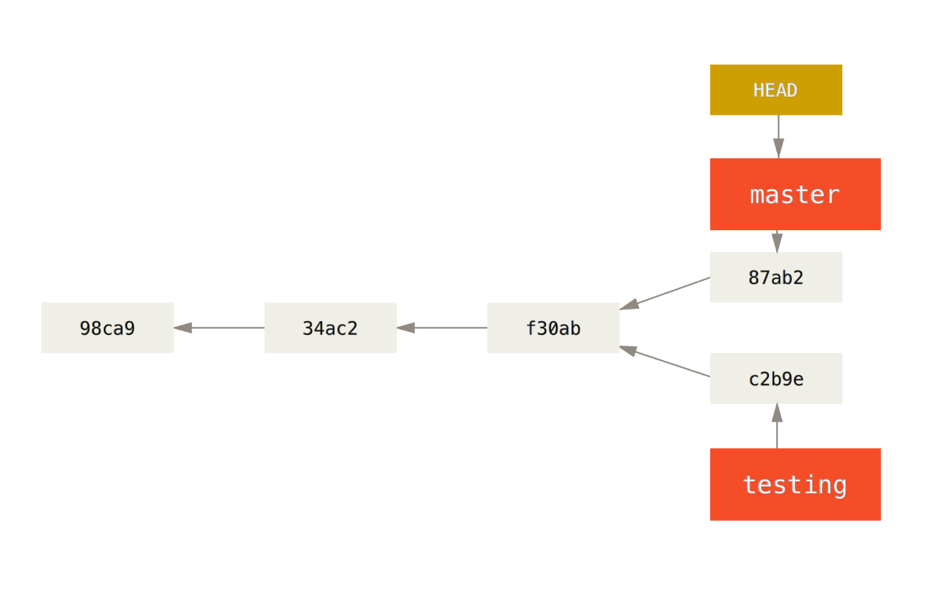
Branches
Branches in Git are incredibly lightweight - references to a specific commit.
Branch early, and branch often
Because there is no storage / memory overhead with making many branches, it's easier to logically divide up your work than have big beefy branches
Remote-tracking branches:
git checkout --track origin/serverfix
Notes:
Git allows and encourages you to have multiple local branches that can be entirely independent of each other. The creation, merging, and deletion of those lines of development takes seconds.
Frictionless Context Switching. Create a branch to try out an idea, commit a few times, switch back to where you branched from, apply a patch, switch back to where you are experimenting, and merge it in.
Role-Based Codelines. Have a branch that always contains only what goes to production, another that you merge work into for testing, and several smaller ones for day to day work.
Feature Based Workflow. Create new branches for each new feature you're working on so you can seamlessly switch back and forth between them, then delete each branch when that feature gets merged into your main line.
Disposable Experimentation. Create a branch to experiment in, realize it's not going to work, and just delete it - abandoning the work—with nobody else ever seeing it (even if you've pushed other branches in the meantime).

Slide 19
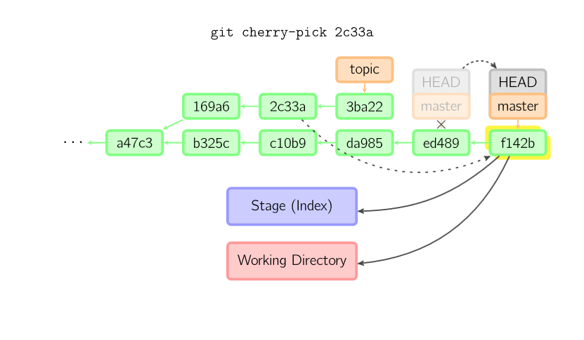
Cherry Pick
Notes:
The cherry-pick command "copies" a commit, creating a new commit on the current branch with the same message and patch as another commit.

Slide 20
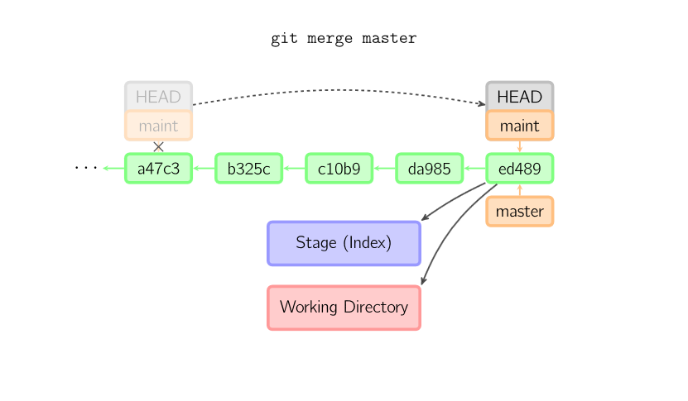
Merge
Notes:
A merge creates a new commit that incorporates changes from other commits.
Before merging, the stage must match the current commit.
The trivial case is if the other commit is an ancestor of the current commit, in which case nothing is done.
The next most simple is if the current commit is an ancestor of the other commit. This results in a fast-forward merge. The reference is simply moved, and then the new commit is checked out.

Slide 21
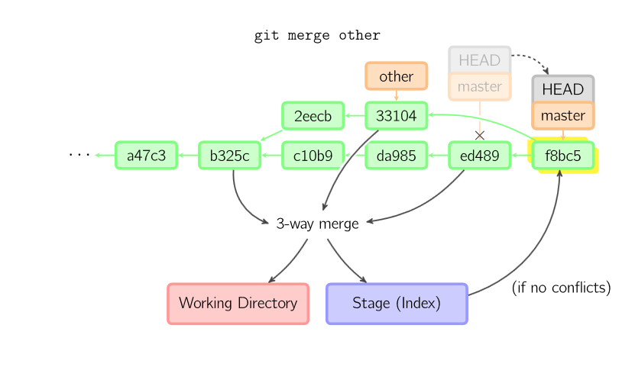
3-Way Merge
Notes:
Otherwise, a "real" merge must occur. You can choose other strategies, but the default is to perform a "recursive" merge, which basically takes the current commit (ed489 below), the other commit (33104), and their common ancestor (b325c), and performs a three-way merge. The result is saved to the working directory and the stage, and then a commit occurs, with an extra parent (33104) for the new commit
--squash – merge all commits into one

Slide 22
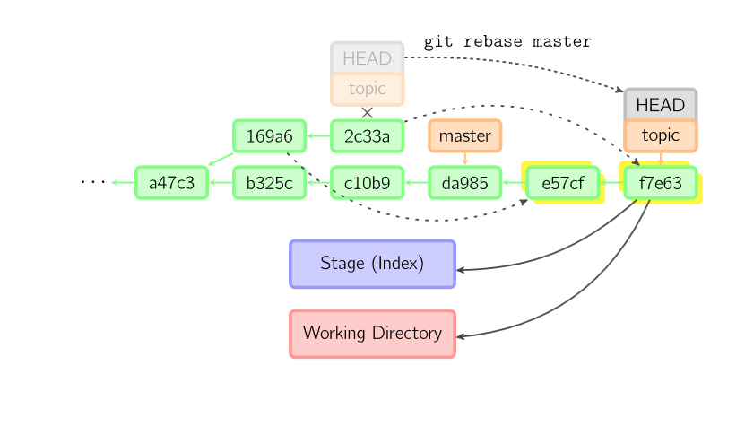
Rebase
Notes:
A rebase is an alternative to a merge for combining multiple branches. Whereas a merge creates a single commit with two parents, leaving a non-linear history, a rebase replays the commits from the current branch onto another, leaving a linear history. In essence, this is an automated way of performing several cherry-picks in a row.

Slide 23


IDE
Just import the project into the IDE once
Same workspace used across branch changes!

Slide 24

Git Best Practices – Do’s
Do read about git
Do commit early and often
Do choose a workflow
Do use branches
Do make useful commit messages
Do keep up to date
Do use useful tools
Do keep everything under source control – code, application configuration files, infrastructure configuration files, docker files, …

Slide 25
Git Best Practices – Dont’s
Don't panic
Don't rewrite public history
Don't change where a tag points
Don't commit large binary files (when possible)
Don't create very large repositories (when possible. Submodules can be of help)
Don't use reset (--hard || -merge) without committing/stashing
Don't prune the reflog

Slide 26
Sample Workflows

Slide 27

Sample Workflow - Working on Local Repository
On master: git pull --rebase
On master: git checkout –b <new-branch>
Main Loop:
On new-branch: modify files
On new-branch: git add/rm <files>
On new-branch: git commit [–m “my commit message”]
Switching between branches:
git checkout master
git checkout <new-branch>
Notes:
git add -A stages All
git add . stages new and modified, without deleted
git add -u stages modified and deleted, without new

Slide 28
Practice: Introduction
echo "Forgot this file!" > forgot.txt
git status
git add forgot.txt
git log --name-only # notice last commit message and files
git commit --amend -m "Here's a replacement commit message."
git log --name-only # notice last commit message and files
echo "Don't really need this line." > myfile.txt
git add myfile.txt
git status
git reset HEAD myfile.txt # Unstage.
git status
git checkout myfile.txt # Delete change.
git status
git checkout -- . #to discard changes in working directory
Oops! We made a mistake there, by not adding our new changes into the commit. Fortunately for us, git can rewrite history! If we commit those changes with the "--amend" option, we're actually changing the last commit. We can also change its commit message.
What if we accidentally stage something, we can unstage it with git reset. If we have untracked changes to a file that we want to discard, we can reset that file with git checkout. Bear in mind, you will lose those changes forever if you do this!
Note:
git add -A stages All
git add . stages new and modified, without deleted
git add -u stages modified and deleted, without new

Slide 29
Practice: Merge
Change file in master
git checkout –b newBranch
git reset --hard HEAD^
Change same line in the file in newBranch
Commit the change
Change another line in the file
Commit the new change
git merge master
Fix merge errors
Add file to index
git commit
Create and checkout new branch
Remove last commit from the new branch
Commit message auto-generated
Notes:
If you just want to start over, you can also run git reset --hard HEAD, and your repository will be back to the last committed state. Remember that any uncommitted work will be lost, so make sure you don’t want any of your changes.

Slide 30
Practice: Git Aliases
git config --global alias.unstage ‘reset HEAD --’ # remove from index
echo “D” > d.txt; git add .
git status # d.txt staged (added to index)
git unstage d.txt
git status # d.txt untracked
git checkout -- d.txt # discard changes
git config --global alias.lg ‘log --oneline --decorate --graph --all’
git config --global alias.changed ‘show --pretty="format:" --name-only’

Slide 31
Practice: Tags
List available tags
$ git tag
$ git tag -l "v1.8.5*“
Create tags:
$ git tag -a v1.4 -m "my version 1.4“ # Annotated tag
$ git tag v1.4-lw # Lightweight tag
$ git tag -a v1.2 9fceb02 # Tag a commit
Push tags - $ git push origin --tags
Create a branch that matches the tag commit:
$ git checkout -b version2 v2.0.0
Of course if you do this and do a commit, your version2 branch will be slightly different than your v2.0.0 tag since it will move forward with your new changes, so do be careful!

Slide 32
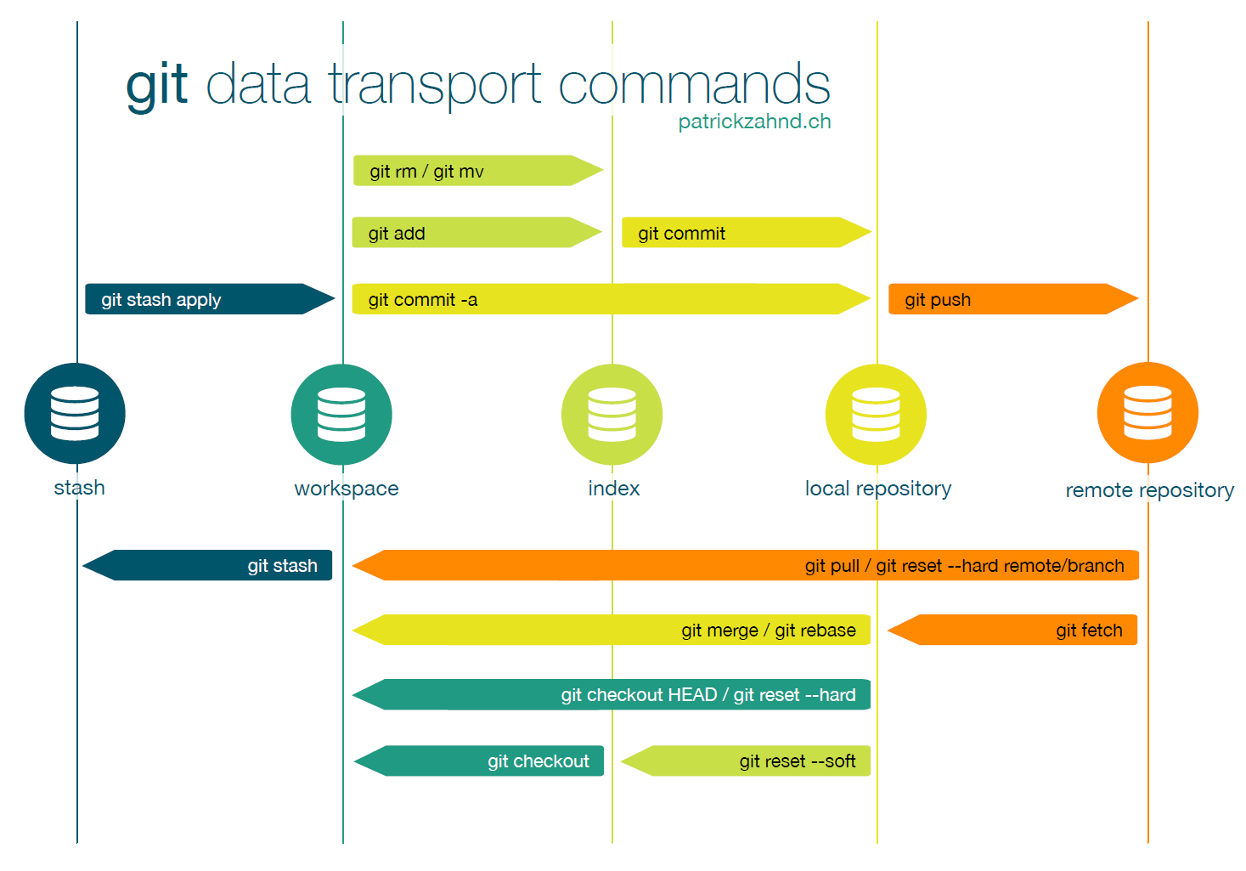
Source: http://www.patrickzahnd.ch/wp-content/uploads/2014/02/git-transport-v1.pdf

Slide 33
Sample Workflow – Pushing to Remote Repo
On master: git pull --rebase
On new-branch: git rebase master
On master: git merge <new-branch>
On master: git push origin master

Slide 34

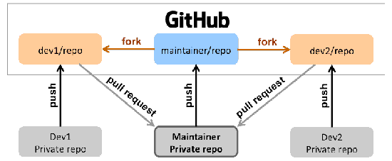
Fork & Pull Request GitHub Workflow
Fork a GitHub repository.
Clone the forked repository to your local system.
Add a Git remote for the original repository (upstream).
Create a feature branch in which to place your changes.
Make your changes to the new branch.
Commit the changes to the branch.
Push the branch to GitHub.
Open a pull request from the new branch to the original repo.
Clean up after your pull request is merged.
Upstream
repository
Notes:
http://blog.scottlowe.org/2015/01/27/using-fork-branch-git-workflow/
Create a topic branch from master.
Make some commits to improve the project.
Push this branch to your GitHub project.
Open a Pull Request on GitHub.
Discuss, and optionally continue committing.
The project owner merges or closes the Pull Request.

Slide 35
Common GitHub Problems
Failed authentication – SSH Keys
Unauthorized GitHub server
Permissions
Remote vs Upstream

Slide 36
GitHub: Generating SSH keys
Follow steps on : https://help.github.com/articles/generating-ssh-keys/
Summary (windows):
Generate a new SSH key:
ssh-keygen -t rsa -b 4096 -C `email address`
Add your key to the ssh-agent
eval `ssh-agent -s`
ssh-add ~/.ssh/id_rsa
Add your SSH key to your account
Copy to clipboard: clip < ~/.ssh/id_rsa.pub
Paste to github
Test the connection
ssh -T git@github.com

Slide 37
Practice: GitHub Fork & Pull-Request Exercise
Fork the GitHub repository: https://github.ibm.com/MAYAA/advanced-git
Clone the forked repository to your local system:
git clone git@github.ibm.com:<username>/advanced-git.git
Add a Git remote for the original repository (upstream): git remote add upstream git@github.ibm.com:MAYAA/advanced-git.git
Create a feature branch in which to place your changes: git checkout –b <your_branch>
Make your changes to the new branch – create a new file with your name.
Commit the changes to the branch.
Push the branch to GitHub: git push origin <your_branch>
Open a pull request from the new branch to the original repo.
Clean up after your pull request is merged:
git branch –D <your_branch>
git push origin --delete <your_branch>

Slide 38
Git Commands

Slide 39
Basic Configuration
Git bash completion and prompt:
$ wget https://raw.githubusercontent.com/git/git/master/contrib/completion/git-completion.bash
$ wget https://raw.githubusercontent.com/git/git/master/contrib/completion/git-prompt.sh
$ . ~/git-completion.bash
$ . ~/git-prompt.sh
$ export GIT_PS1_SHOWDIRTYSTATE=1
$ export PS1='\w$(__git_ps1 " (%s)")\$ ‘
OR
$ export PS1='[\u@\h \W$(__git_ps1 " (%s)")]\$ '
Configure a common .gitignore file
$ touch ~/.gitignore
$ git config --global core.excludesfile ~/.gitignore
Configure a common .gitattributes file
$ echo "*.java diff=java" > ~/.gitattributes
$ git config --global core.attributesfile "~/.gitattributes”
Notes:
Change the editor of Git’s messages:
git config --global core.editor vim

Slide 40
Git Tools Configuration
Set the diff and merge tools to meld or any other diff editor of your choice.
$ git config --global diff.tool meld
$ git config --global merge.tool meld
$ git config --global difftool.prompt false
$ git config --global mergetool.prompt false
Notes:
Tell git diff to use mnemonic prefixes (index, work tree, commit, object) instead of the standard a and b notation:
git config --global diff.mnemonicprefix true
Enable the recording of resolved conflicts, so that identical hunks can be resolved automatically later on.
git config --global rerere.enabled true
You may also want to investigate the rerere.autoupdate setting.

Slide 41
Git Attributes
Path-specific settings - Git applies those settings only for a subdirectory or subset of files
.gitattributes file in one of your directories (normally the root of your project)
or in the .git/info/attributes file if you don’t want the attributes file committed with your project.
Example usage:
specify separate merge strategies for individual files or directories
tell Git how to diff non-text files
$ echo "*.java diff=java" > ~/.gitattributes
$ git config --global core.attributesfile "~/.gitattributes“
Notes:
https://git-scm.com/book/en/v2/Customizing-Git-Git-Attributes

Slide 42
.gitignore
Configure a common .gitignore file
$ touch ~/.gitignore
$ git config --global core.excludesfile ~/.gitignore
*.class
!/vmlinux*
A leading "**" followed by a slash means match in all directories
A trailing "/**" matches everything inside
A slash followed by two consecutive asterisks then a slash matches zero or more directories
https://github.com/github/gitignore - A collection of useful .gitignore templates
Notes:
- For example, "**/foo" matches file or directory "foo" anywhere, the same as pattern "foo“
- For example, "abc/**" matches all files inside directory "abc", relative to the location of the .gitignore file, with infinite depth.
- "a/**/b" matches "a/b", "a/x/b", "a/x/y/b"

Slide 43
Useful Commands
Rewriting last commit:
git add forgotten_file
git commit --amend
Visual tools
gitk
git mergetool
git difftool
Stashing changes
git stash list/save/pop/apply
Notes:
Use git stash when you want to record the current state of the working directory and the index, but want to go back to a clean working directory. The command saves your local modifications away and reverts the working directory to match the HEAD commit.

Slide 44
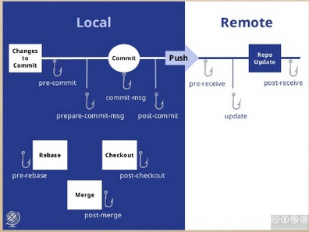
Client-Side Hooks
pre-commit – e.g. make sure tests run
prepare-commit-msg – template commit message
commit-msg - check that your commit message conforms to a pattern
pre-rebase – e.g. disallow rebasing any commits that have already been pushed
Notes:
Fire off custom scripts when certain important actions occur.
https://git-scm.com/book/en/v2/Customizing-Git-Git-Hooks
Note
It’s important to note that client-side hooks are not copied when you clone a repository. If your intent with these scripts is to enforce a policy, you’ll probably want to do that on the server side; see the example in An Example Git-Enforced Policy.

Slide 45
Server-Side Hooks
update – check commit message matches a template
post-receive - update other services or notify users: email a list, message on slack, notify a continuous integration server, update a ticket-tracking system
Notes:
https://git-scm.com/book/gr/v2/Customizing-Git-An-Example-Git-Enforced-Policy#_an_example_git_enforced_policy
chmod u+x .git/hooks/update
https://longair.net/blog/2011/04/09/missing-git-hooks-documentation/
http://githooks.com/

Slide 46
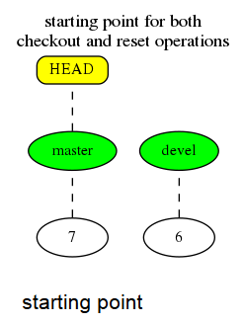
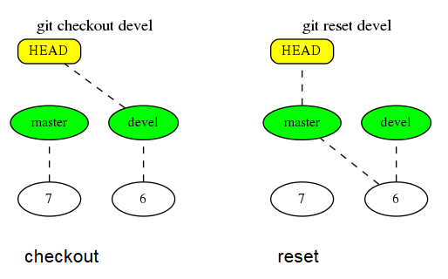
Undo
Undo a commit:
$ git reset --soft HEAD^
Totally Undo multiple commits:
$ git reset --hard HEAD~5
Commit a revert commit:
$ git revert 3720b35
Git rewrite history
git rebase –i HEAD~3
Notes:
On the commit-level, resetting is a way to move the tip of a branch to a different commit. This can be used to remove commits from the current branch.
git reset --mixed HEAD has the affect of unstaging all changes, but leaves them in the working directory. On the other hand, if you want to completely throw away all your uncommitted changes, you would use git reset --hard HEAD.

Slide 47
Reset
On the commit-level, resetting is a way to move the tip of a branch to a different commit, e.g. to remove commits from the current branch.
git reset --mixed HEAD has the affect of unstaging all changes, but leaves them in the working directory.
git reset --hard HEAD completely throws away all your uncommitted changes
The reset command overwrites the three trees in a specific order, stopping when you tell it to.
Move whatever branch HEAD points to (stop if --soft)
THEN, make the Index look like that (stop here unless --hard)
THEN, make the Working Directory look like that
Notes:
https://git-scm.com/blog/2011/07/11/reset.html

Slide 48
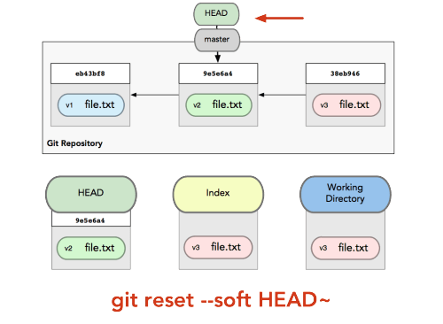
Soft Reset - Moving HEAD
https://git-scm.com/blog/2011/07/11/reset.html
Notes:
When you reset back to HEAD~ (the parent of HEAD), you are moving the branch back to where it was without changing the Index (staging area) or Working Directory. You could now do a bit more work and commit again to accomplish basically what git commit --amend would have done.

Slide 49
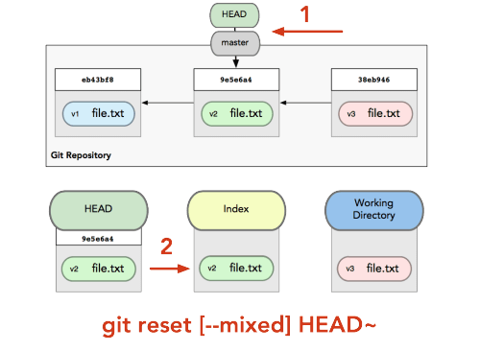
Mixed Reset - Moving HEAD, Updating the Index
https://git-scm.com/blog/2011/07/11/reset.html
Notes:
It undid your last commit, but also unstaged everything.
You rolled back to before you ran all your git adds AND git commit.

Slide 50
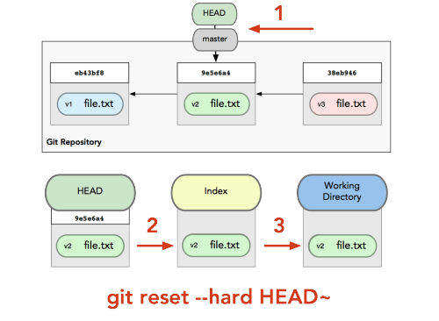
Hard Reset - Moving HEAD, Updating the Index, Updating the Working Directory
https://git-scm.com/blog/2011/07/11/reset.html
Notes:
You undid your last commit, all the git adds, and all the work you did in your working directory.
Any other invocation of reset can be pretty easily undone, the --hard option cannot, since it overwrites (without checking) any files in the Working Directory.
In this particular case, we still have v3 version of our file in a commit in our Git DB that we could get back by looking at our reflog, but if we had not committed it, Git still would have overwritten the file.

Slide 51
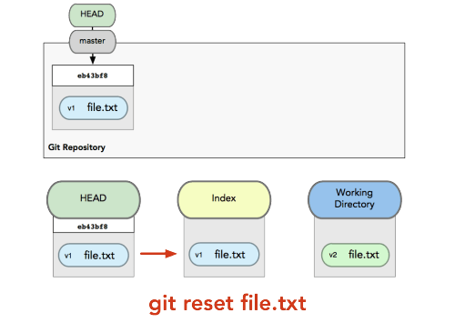
Mixed Reset on file - Updating the Index
https://git-scm.com/blog/2011/07/11/reset.html
Notes:
it unstages the file

Slide 52
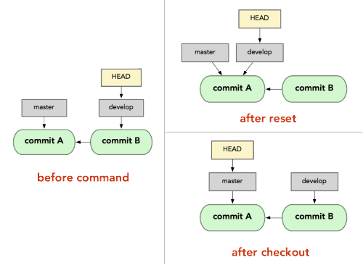
Checkout
Checkout [branch]
Where reset will move the branch that HEAD points to, checkout will move HEAD itself to point to another branch.
https://git-scm.com/blog/2011/07/11/reset.html

Slide 53
Checkout
Checkout [branch] file
Updates the index with that file at that commit, but it also overwrites the file in the working directory
Checkout commit
Update all files in the working directory to match the specified commit
Use either a commit hash or a tag as the <commit> argument
Causes detached HEAD state

Slide 54
Git Diff
To see the difference between working dir and the staging area (index)
git diff
To see the difference between staging area (index) and repository
git diff --cached
To see the difference from one commit compared to its parent, use git show <commit>:
$ git show 3720b35
To compare two specific commits, use git diff <commit_from>..<commit_to>:
$ git diff a2a1eb3..068b9b9
Compare files in two branches:
$ git difftool branch1:config/environment.rb branch2:config/environment.rb
Compare my local repository to a remote one:
git diff origin/master master
OR
git diff origin/master -- <the_file>

Slide 55
Git Log
Show the difference introduced in each commit (-p), limiting the output to only the last two entries (-2)
$ git log -p -2
Specify your own log output format
$ git log --pretty=format:"%h - %an, %ar : %s"
Draws an ASCII graph representing the branch structure of the commit history
$ git log --graph --oneline --decorate
Filter commits by their commit message
$ git log --grep="JRA-224:"
Show the commits that introduced a change to the code that added or removed the specified string
$ git log -Sfunction_name

Slide 56
Working with commits
Cherry-pick:
git cherry-pick [--no-commit] 5d3e1b6
Git revert
git revert 5d3e1b6
Interactive add
git add –i
Squashing commits:
git reset --soft HEAD~2 OR git rebase -i HEAD~2
git commit

Slide 57
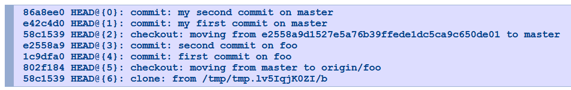
When all else fails
git reflog - shows all the values that HEAD has taken in the past
Switch to the lost HEAD:
git branch newbranch HEAD@{3} OR
git branch newbranch e2558a9
How to reset my local repository to be just like the remote repository
git fetch origin
git reset --hard origin/<your branch>

Slide 58
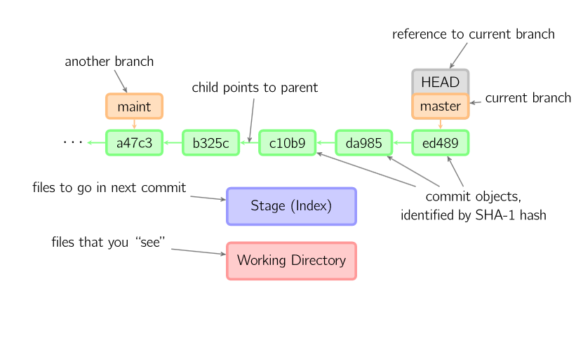
Think graphs!!!!
Notes:
Commits are shown in green as 5-character IDs, and they point to their parents.
Branches are shown in orange, and they point to particular commits.
The current branch is identified by the special reference HEAD, which is "attached" to that branch.
In this image, the five latest commits are shown, with ed489 being the most recent.
master (the current branch) points to this commit, while maint (another branch) points to an ancestor of master's commit.

Slide 59
References
A Visual Git Reference
The Git Community Book
Understanding Git Conceptually
Git Explained: For Beginners
Online application designed to help beginners grasp the powerful concepts behind branching
Google

Slide 60

Git Rules!!!

