Slide 1
Backend Quick Look
Matt Fisher

Slide 2
Backend Overview
Built with python36
Currently aggregates 141 data sources into the ~13 data layers shown in the front end
Some sources are easier than others!
Example: easy source
Example: difficult source

Slide 3
Folder Layout
cre_rest prop_report
General_Tools
US NC
NC_Apex
NC_Carrboro
NC_Cary
NC_ChapelHill
NC_County_Orange
NC_County_Wake
NC_Durham
NC_FuquayVarina
NC_Garner
NC_HollySprings
NC_Morrisville
NC_Raleigh
NC_Triangle
NC_WakeForest GA_County_Fulton GA_Atlanta LICENSE.txt
readme.txt
National
Statewide
Legend
-- Frontend / REST Support
-- Functions and Modules For Data Collection -- Main Data Collection Folders -- Future Data Folder
Countywide
Citywide
Market

Slide 4
Example Contents: City
~/cre/NC_Raleigh$ ls
run.py
urls.py
{ "permits.csv" : {
"url" : https://opendata.arcgis.com/datasets/bdfad82b15344d37beb28d7f90b6c4be_0.csv,
"norm_fields" : {
"est_sqft" : "totalsqft",
”upin" : "pin",
"units" : "housingunitstotal",
"permit_num": "permitnum",
"est_cost":"estprojectcost",
"status" : "statuscurrent",
"use" : "censuslanduse",
"issue_date" : "issueddate",
"issue_mo" : "issueddate_mth",
"issue_yr" : "issueddate_yr",
"wk_class" : "workclass",
"perm_class" : "permitclass",
"occup" : "occupancyclass",
"descr" : "description”
},
}, }
params = get_params(['crime’,'permits','zoning','sewer']) if params['permits']:
get_data.get(urls,"permits.csv")
All norm_field names will be provided!
This is an example of an easy dataset!
Finding errors, missing values, etc is a large theme of this project!

Slide 5
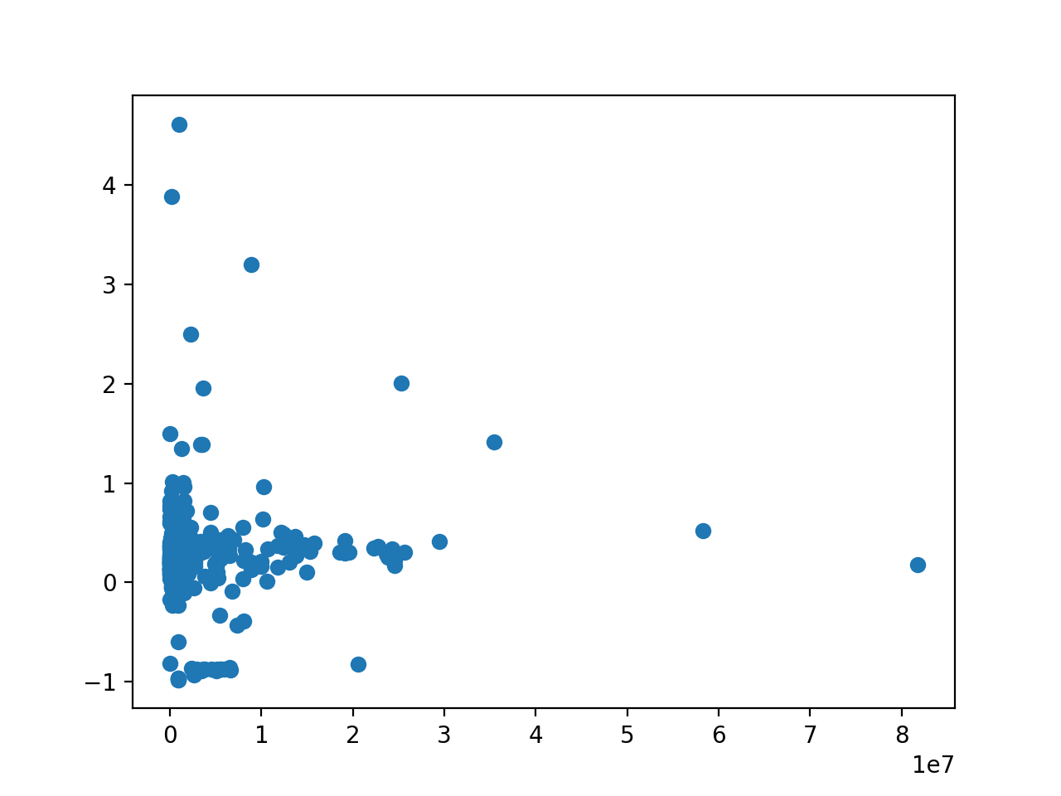
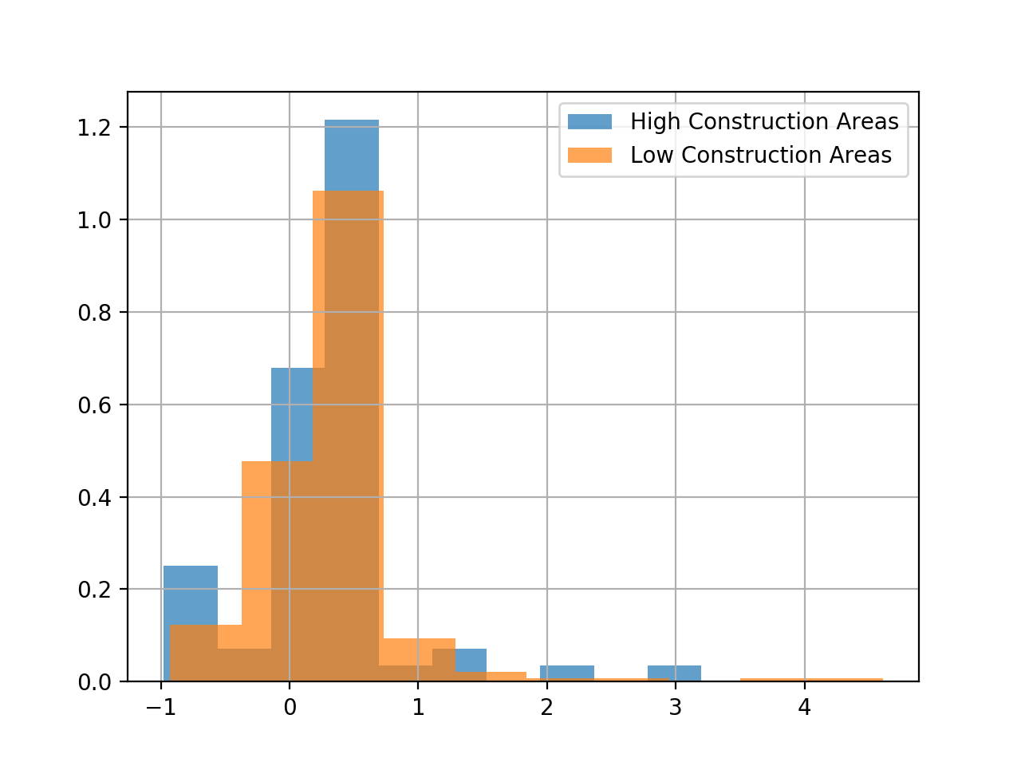
Data Complete: Hypothesis Testing
Effect of Construction
3 Year Sales Price Increase (%)
Probability Density
$ Cost of Construction within 0.5 radius
3 Year Sales Price Increase (%)

Slide 6

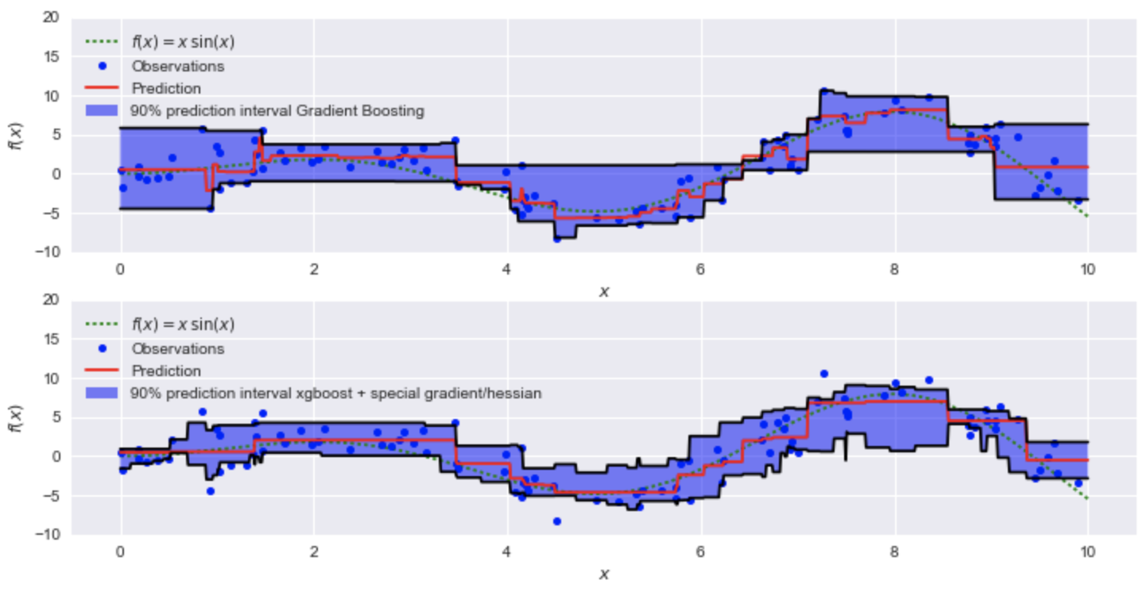
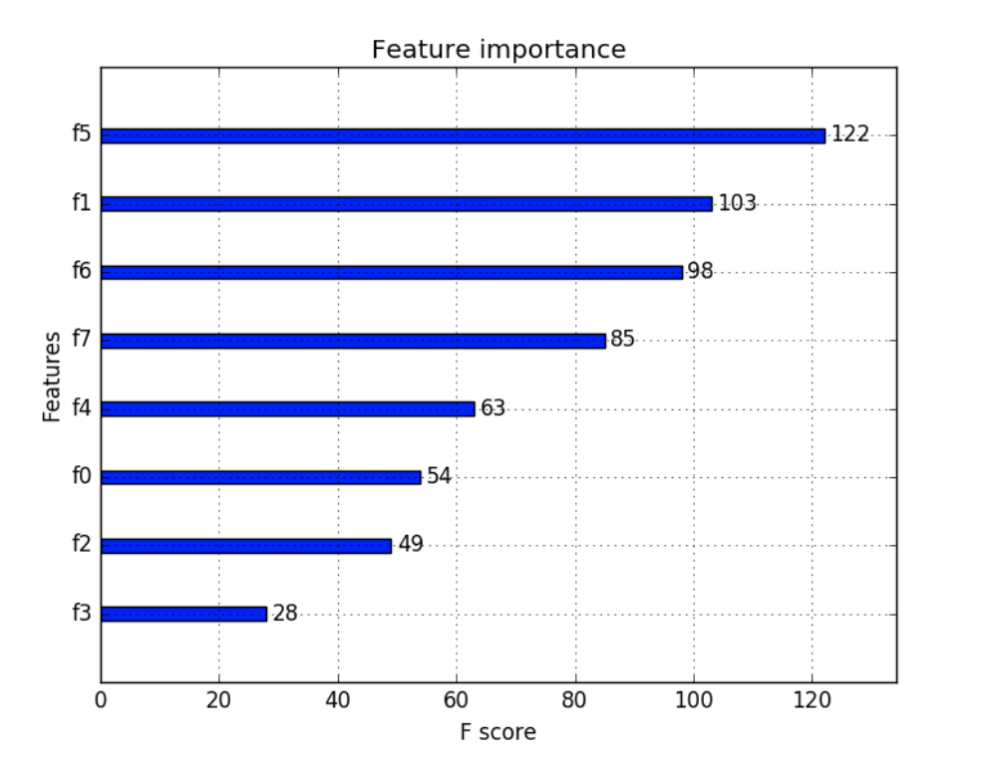
Regression Analysis

Slide 7
Projects Review
Check Out Sales Data
- Verify Sales Prices
- Multiple Sales / Grouping
Data Scraping: Atlanta
Regression Analysis

