Slide 1

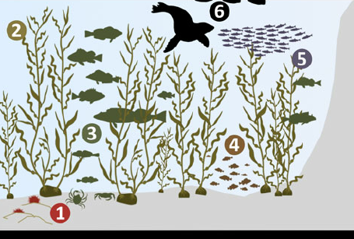
What drives biodiversity and kelp abundance in southern California kelp forests?
Mary C Fisher¹, Yichao Wang², Tim Xi³
1. School of Environmental and Forestry Sciences, University of Washington, Seattle WA
Background
Results
Kelp forests are highly diverse, productive ecosystems (1)
Provide habitat to marine mammals, birds, fish and invertebrates
Support primary and secondary production
Sequester carbon, slowing climate change
Kelp forest ecosystems are in decline around the world due to a combination of climate change, water pollution, and other anthropogenic stressors (1,2). To understand what environmental conditions contribute to healthy kelp forests, we turn to the Santa Barbara Coastal Long-term Ecological Monitoring Network (3). Long-term monitoring data are critical for understanding complex ecological processes and long-term change (4).
Research Questions
What is the relationship between giant kelp (Macrocystis pyrifera) abundance / size and oceanographic and herbivory conditions?
What is the relationship between biodiversity and oceanographic and habitat conditions?
Long-term Ecological Monitoring Data
What is the relationship between giant kelp (Macrocystis pyrifera) abundance / size and oceanographic and herbivory conditions?
We did not detect a strong correlation between mean giant kelp size / density and herbivory, or mean giant kelp size / density and water temperature and chemistry
1
3
4
2
Methods
Adapted from Figure 2, Szpak et al. (2013)
1
Water Temperature & Chemistry^{1,2}
Winter Temperature Mean and Variance (F)
Summer Temperature Mean and Variance (F)
Mean particulate organic carbon and particulate organic nitrogen (μmol/L)
Mean nitrogen, ammonia, phosphorus (μmol/L)
Total chlorophyll (μmol/L)
3
Kelp Abundance & Size^{3,4}
Mean giant kelp density (individuals / m²)
Mean giant kelp size (number of fronds, holdfast diameter)
Total giant kelp biomass (g / m²)
2
Herbivory³
Total urchin abundance (S. purpuratus and S. franciscanus)
4
Fish, Invertebrate, Algae Biodiversity⁴
Total biomass (g / m²)
Taxon diversity (Simpson’s Diversity Index)
SBC LTER Data Sets: 1. Ocean: Ocean Currents and Biogeochemistry. 2. Reef: Bottom Temperature. 3. Reef: Kelp Forest Community Dynamics. 4. Reef: Annual Time Series of Biomass for Kelp Forest Species
Conclusions
To deal with variation and noise, long-term ecological monitoring data sets need high spatial and temporal coverage: this data set could start with finer temporal coverage for biological data (spring / fall surveys), and greater spatial coverage for water chemistry data (all sites with biological data).
Sources
1. Krumhansl et al. (2016) Proceedings of the National Academy of Sciences. 2. Reed et al. (2014) Marine & Freshwater Research. 3. Santa Barbara Coastal LTER & D Reed (2020) Environmental Data Initiative. https://sbclter.msi.ucsb.edu/data/catalog. 4. JE Hobbie (2003) BioScience. 5. Szpak et al. (2013) Archaeol Anthropol Sci.

