Slide 1

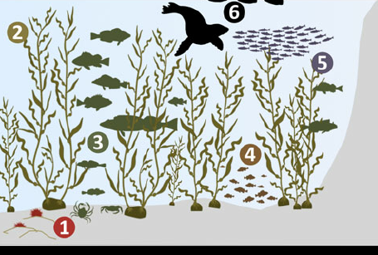
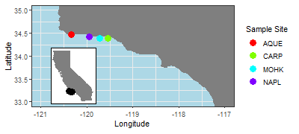
What drives biodiversity and kelp abundance in southern California kelp forests?
Mary C Fisher¹, Yichao Wang², Tim Xi³
1. School of Environmental and Forestry Sciences, University of Washington, Seattle WA
Background
Research Questions
Results & Conclusions
Kelp forests are highly diverse, productive ecosystems (1)
Provide habitat to marine mammals, birds, fish and invertebrates
Support primary and secondary production
Kelp forest ecosystems are in decline due to climate change, water pollution, and other anthropogenic stressors (1,2). To understand what conditions support healthy kelp forests, we turn to the Santa Barbara Coastal Long-term Ecological Monitoring Network (3). Long-term monitoring data are critical for understanding complex ecological processes and long-term change (4).
What is the relationship between giant kelp (Macrocystis pyrifera) abundance / size and oceanographic and herbivory conditions?
What is the relationship between biodiversity and oceanographic and habitat conditions?
What is the relationship between giant kelp (Macrocystis pyrifera) abundance / size and oceanographic and herbivory conditions?
We did not detect a strong correlation between mean giant kelp size / density and herbivory, or mean giant kelp size / density and water temperature and chemistry
Long-term Ecological Monitoring Data
1
Methods
3
4
2
Adapted from Figure 2, Szpak et al. (2013)
1
Water Temperature & Chemistry^{1,2}
Winter Temperature Mean and Variance (F)
Summer Temperature Mean and Variance (F)
Mean particulate organic carbon and particulate organic nitrogen (μmol/L)
Mean nitrogen, ammonia, phosphorus (μmol/L)
Total chlorophyll (μmol/L)
3
Kelp Abundance & Size^{3,4}
Mean giant kelp density (individuals / m²)
Mean giant kelp size (number of fronds, holdfast diameter)
Total giant kelp biomass (g / m²)
2
Herbivory³
Total urchin abundance (S. purpuratus and S. franciscanus)
4
Fish, Invertebrate, Algae Biodiversity⁴
Total biomass (g / m²)
Taxon diversity (Simpson’s Diversity Index)
SBC LTER Data Sets: 1. Ocean: Ocean Currents and Biogeochemistry. 2. Reef: Bottom Temperature. 3. Reef: Kelp Forest Community Dynamics. 4. Reef: Annual Time Series of Biomass for Kelp Forest Species
Sources
1. Krumhansl et al. (2016) Proceedings of the National Academy of Sciences. 2. Reed et al. (2014) Marine & Freshwater Research. 3. Santa Barbara Coastal LTER & D Reed (2020) Environmental Data Initiative. https://sbclter.msi.ucsb.edu/data/catalog. 4. JE Hobbie (2003) BioScience. 5. Szpak et al. (2013) Archaeol Anthropol Sci.

