Slide 1
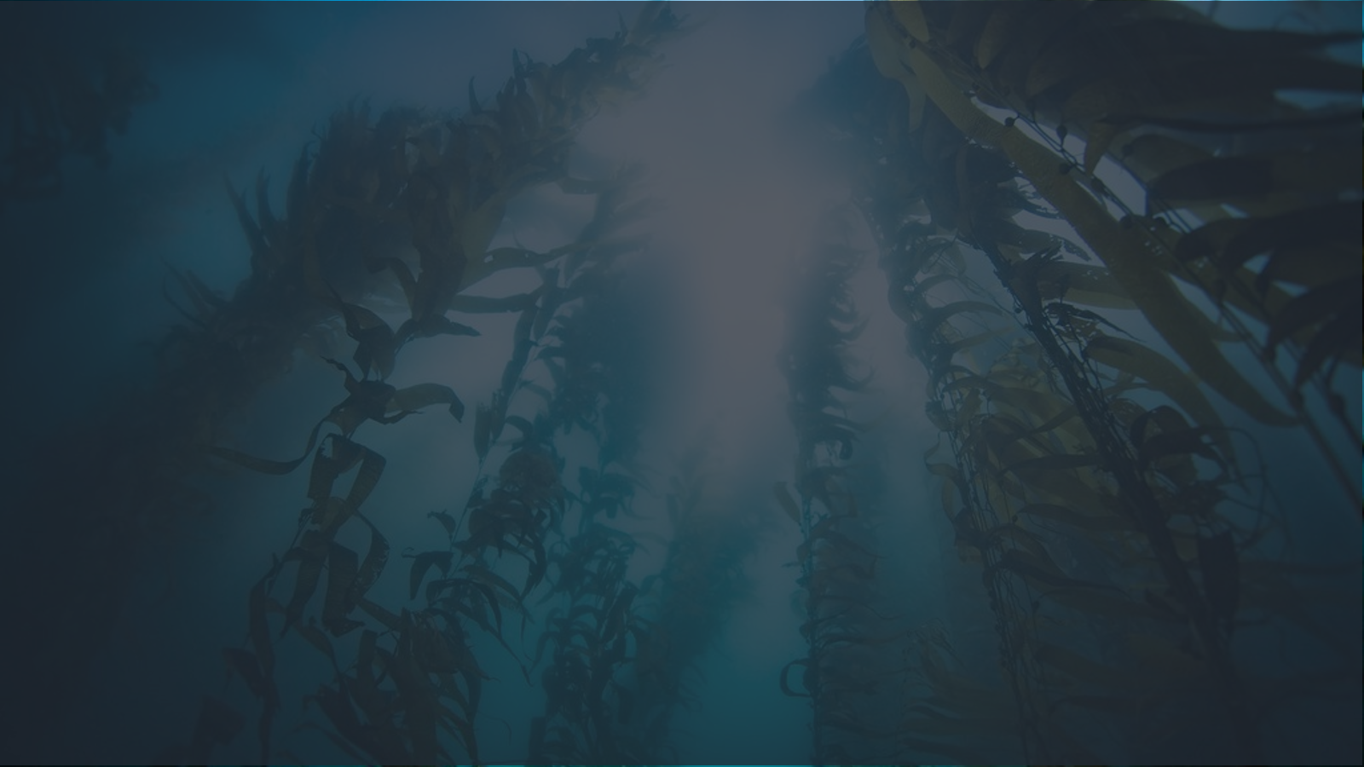
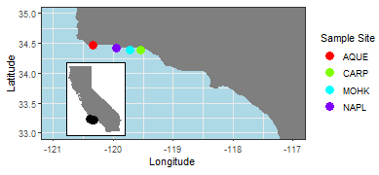
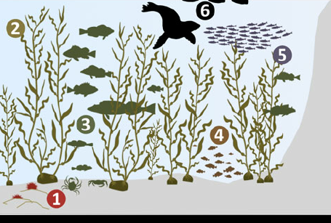
What drives biodiversity and kelp abundance in southern California kelp forests?
Mary C Fisher, Yichao Wang, Tim Xi
CSS&S / STAT 504 Group 5
Background
Research Questions
Results & Conclusions
Kelp forests are highly diverse, productive ecosystems which are in decline due to climate change, water pollution, and other anthropogenic stressors (1). To understand what conditions support healthy kelp forests, we turn to the Santa Barbara Coastal Long-term Ecological Monitoring Network (2). Long-term monitoring data are critical for understanding complex ecological processes and long-term ecological change (3).
Question 1
Significant effects of urchin abundance (negative effect) and summer temperature (positive effect) on kelp biomass aligns with results from previous studies (4)
Predictor variables did not explain variation in mean giant kelp size and density.
Question 2
Random forests stressed importance of kelp biomass in supporting biodiversity, whereas regression primarily detected correlations with water chemistry and temperature
Predictor variables did not explain variation in fish and algae biodiversity, or algae biomass
What is the relationship between giant kelp (Macrocystis pyrifera) abundance / size and oceanographic and herbivory conditions?
What is the relationship between kelp forest ecosystem biodiversity and oceanographic and habitat conditions?
Methods
Long-term Ecological Monitoring Data
Data
Four Santa Barbara Coastal Long-Term Ecological Research data sets (center panel; 3), collected from four kelp forest sites from 2002-2018 (Fig. 1)
Table 2. Best fit multiple linear regression models for final response variables. (*) indicates the predictor variable was significant at α = 0.05.
Figure 1. Sampling sites for this study. Sites represent different oceanographic regimes and levels terrestrial runoff. Inset: Site location on California coastline
1
Multiple Linear Regression Model | BIC | Adj. R² | MSE
(Kelp Biomass)^{1/3} ~ Site* - (Urchin Abundance)^{1/2}* + Ammonia* + log(Summer Temperature Variance)* | 152.04 | 0.66 | 2.58
(Fish Biomass)^{0.06} ~ Particulate Organic Carbon + log(Particulate Organic Nitrogen) + log(Total Chlorophyll) + Site |  | 0.67 | 0.003
(Invertebrate Biomass)^{0.125} ~ log(Total Chlorophyll) + Site | -32.73 | 0.96 | 0.022
(Invertebrate Diversity)⁻² ~ Ammonia + log(Summer Temperature Mean) + (Kelp Biomass)^{1/3} +Site |  | 0.91 | 0.003
3
Calculated inverse Simpson’s Diversity Index for fish, invertebrate, and algae taxon diversity
Multiple Linear Regression
Conducted for every available response variable, with final analysis focused on variables for which we obtained good model fit (Table 1)
Forward and backward stepwise model selection, using Bayesian Information Criterion
Since this is a time series data set, predictor y_{i,t-1} was added when all available predictors were poorly correlated with the response variable (y_{i,t-1} = response value at site i from the previous year t-1)
Random Forests
Constructed to identify important predictor variables for response variables retained in final multiple linear regression
4
2
Table 3. Most important predictor variables ranked by random forest analysis, and the root mean squared error of the optimal model.
Adapted from Figure 2, Szpak et al. (2013)
Response | Important Predictors | RMSE
log(Kelp Biomass) | log(Kelp Biomass_{i,t-1}), (Urchin Abundance)^{1/2}, Site, log(Particulate Organic Nitrogen) | 2.89
(Fish Biomass)^{0.06} | Site, log(Kelp Biomass) | 0.073
(Invertebrate Biomass)^{0.125} | Site, log(Kelp Biomass), log(Particulate Organic Nitrogen) | 0.198
(Invertebrate Diversity)⁻² | log(Particulate Organic Nitrogen), Site, log(Kelp Biomass), log(Total Chlorophyll) | 0.153
1
Water Temperature & Chemistry^{1,2}
Winter Temperature Mean and Variance (F)
Summer Temperature Mean and Variance (F)
Mean particulate organic carbon and particulate organic nitrogen (μmol/L)
Mean nitrogen, ammonia, phosphorus (μmol/L)
Total chlorophyll (μmol/L)
3
Kelp Abundance & Size^{3,4}
Mean giant kelp density (individuals / m²)
Mean giant kelp size (number of fronds, holdfast diameter)
Giant kelp total biomass (g / m²)
2
Herbivory³
Total urchin abundance (S. purpuratus and S. franciscanus)
Fish, Invertebrate, Algae Biodiversity⁴
Total biomass (g / m²)
Taxon diversity (Simpson’s Diversity Index)
Overall Conclusion
Ecological data is noisy! Long-term ecological data sets need high spatial and temporal coverage; our analysis would have benefitted from finer temporal coverage for biological data, and greater spatial coverage for water chemistry data.
4
Table 1. Variables used in initial and final regressions for each research question.
 | Initial Response Variables | Final Response Variables | Predictor Categories
1 | Log(Mean Kelp Density) Log(Mean Kelp Size) (Kelp Biomass)^{1/3} | (Kelp Biomass)^{1/3} | Water Temperature and Chemistry Herbivory
2 | (Fish Biomass)^{0.06}, (Invertebrate Biomass)^{0.125}, (Invertebrate Biomass)^{0.45} Fish Diversity, (Invertebrate Diversity)⁻², (Algae Diversity)^{0.5} | (Fish Biomass)^{0.06} (Invertebrate Biomass)^{0.125} (Invertebrate Diversity)⁻² | Kelp Biomass Water Temperature and Chemistry
SBC LTER Data Sets: 1. Ocean: Ocean Currents and Biogeochemistry. 2. Reef: Bottom Temperature. 3. Reef: Kelp Forest Community Dynamics. 4. Reef: Annual Time Series of Biomass for Kelp Forest Species
Detailed results and R code available at: github.com/mfisher5/504_BiodivSB
Sources
1. Krumhansl et al. (2016) Proc. Nat. Acad. Sci. 113(48) 2. Santa Barbara Coastal LTER & D Reed (2020) Environmental Data Initiative. 3. JE Hobbie (2003) BioScience. 4. Halpern et al. (2006) Science, 312(5777) 5. Szpak et al. (2013) Archaeol Anthropol Sci.

