Slide 1

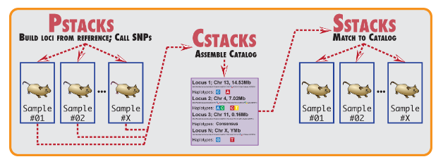
RAW DATA
Raw data from Illumina HiSeq 4000 is downloaded from Oregon’s online interface. Raw data format: gzipped FastQ files, phred 33 quality scoring
DEMULTIPLEX & FILTER
Raw sequencing data is trimmed to remove the barcode and the last 2 bases of the read. Reads are also quality filtered.
US SAMPLES
RAW DATA
Raw data from Illumina HiSeq 4000 is downloaded from Oregon’s online interface. Raw data format: gzipped FastQ files, phred 33 quality scoring
DEMULTIPLEX & FILTER
Raw sequencing data is trimmed to remove the barcode and the last 2 bases of the read. Reads are also quality filtered.
BUILD A REFERENCE
10 samples from each sampling location are combined into a single subset and used to build a reference database of loci de novo. Subset chosen based on # stacks and # raw reads.
ALIGN TO REFERENCE
IDENTIFY SNPS & CALL GENOTYPES
Align the demultiplexed and filtered FastQ files from process_radtags to the new reference database of loci.
Use the alignment files to develop a final set of loci, and then identify SNPs at each locus. Randomly select one SNP per locus to genotype in all individuals.
--------COMBINED--------
KOREAN SAMPLES
BOWTIE
Align FastQ files against reference database (outputs individual `.sam` files)
POPULATIONS

Slide 2
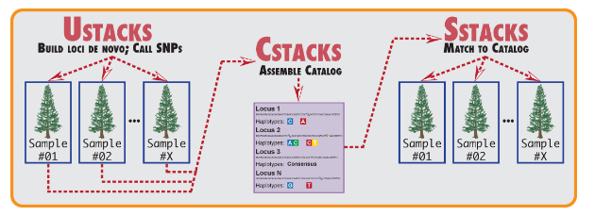
POPULATIONS
BOWTIE filtering
Create a database using the populations output
Align loci against themselves
Discard loci that align best to non-self sequences
BLAST filtering
Create database using the filtered BOWTIE output
Align loci against themselves
Discard loci that align best to non-self sequences, or do not return a match
BOWTIE
Create a final reference database using the double-filtered BLAST output

Slide 3
RAW DATA
Raw data from Illumina HiSeq 4000 is downloaded from Oregon’s online interface. Raw data format: gzipped FastQ files, phred 33 quality scoring
DEMULTIPLEX & FILTER
Raw sequencing data is trimmed to remove the barcode and the last 2 bases of the read. Reads are also quality filtered.
BUILD A REFERENCE
*skip*
ALIGN TO REFERENCE
IDENTIFY SNPS & CALL GENOTYPES
Align the demultiplexed and filtered FastQ files from process_radtags to the Korean reference database of loci.
Use the alignment files to develop a final set of loci, and then identify SNPs at each locus. Randomly select one SNP per locus to genotype in all individuals.
BOWTIE
Align FastQ files against reference database (outputs individual `.sam` files)
POPULATIONS

Slide 4
RAW DATA
Demultiplex and filter
Build a de novo reference “genome”
Align individuals to reference
Identify SNPs and call genotypes
Align final set of loci to the Atlantic cod genome
Demultiplex and filter
RAW DATA

