Slide 1
KOR v. AK Samples: Number of Loci
Histogram series through the stacks pipeline

Slide 2
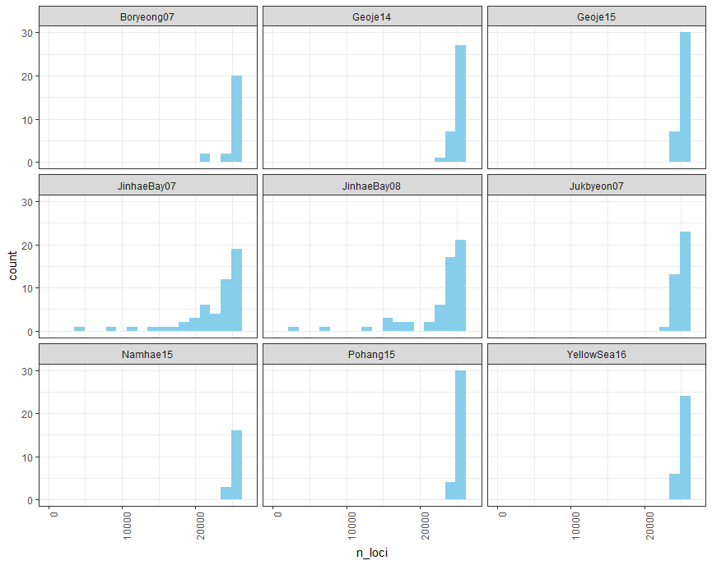
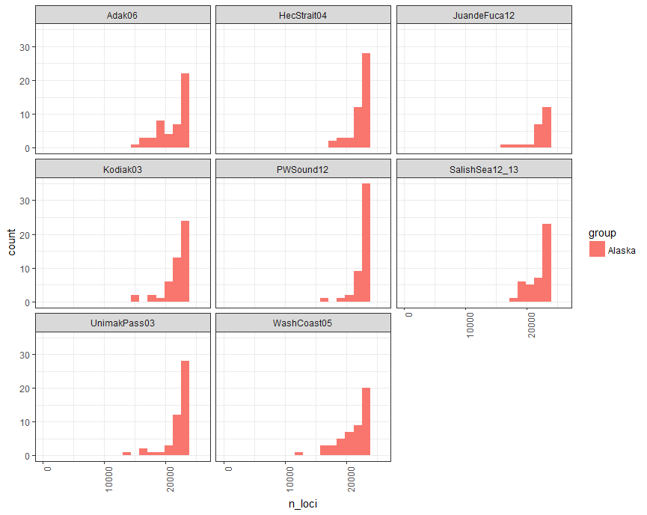
Pstacks (Alignment to reference genome)

Slide 3
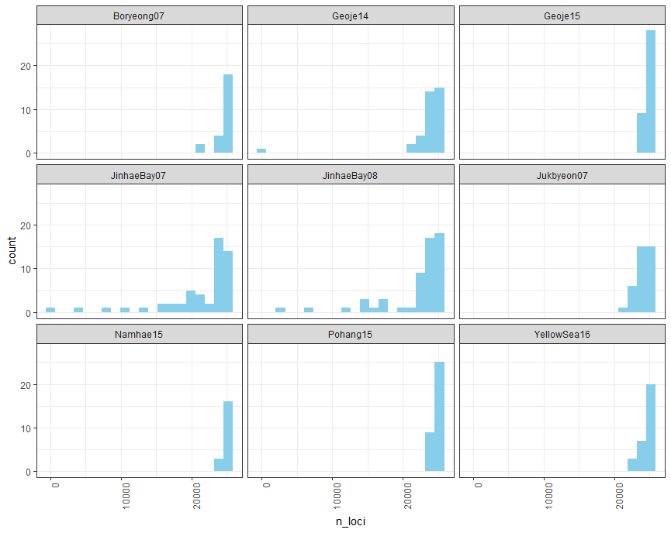
Sstacks (Alignment to catalog)

Slide 4
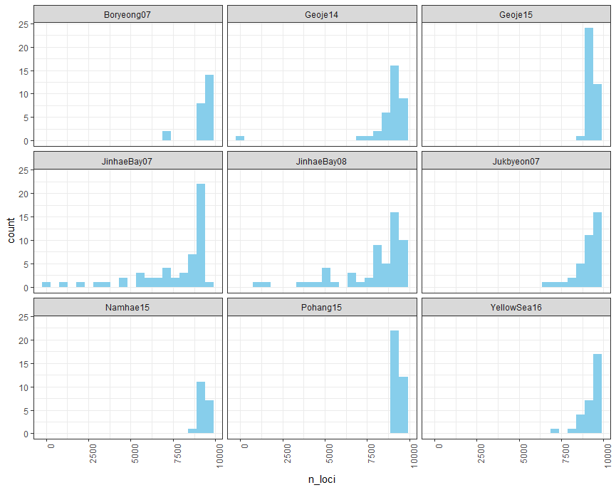
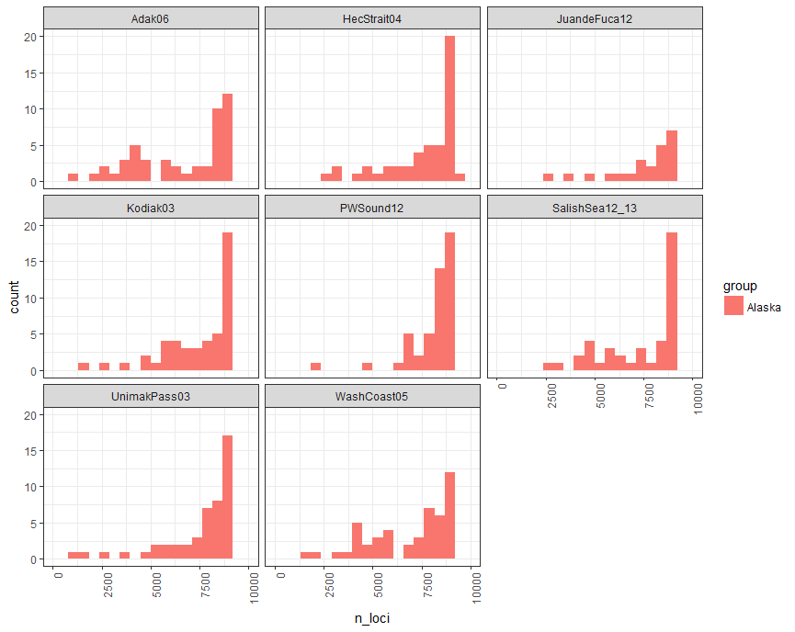
Genepop, Corrected Genotypes

Slide 5
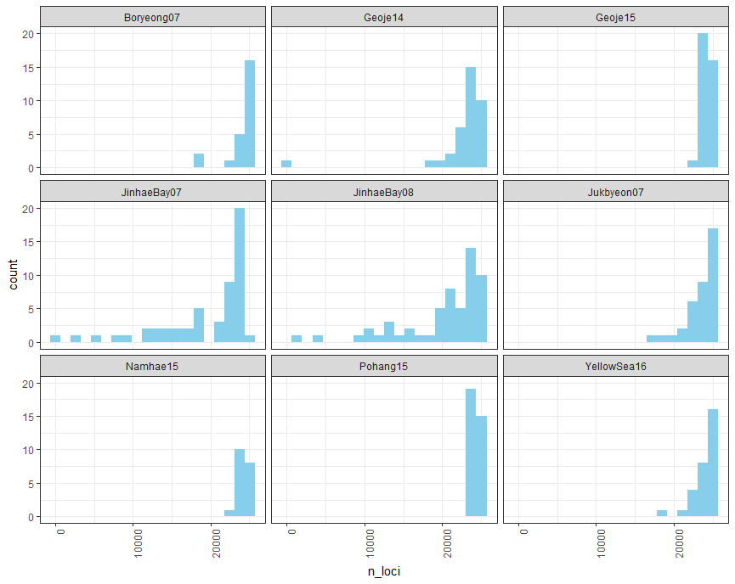
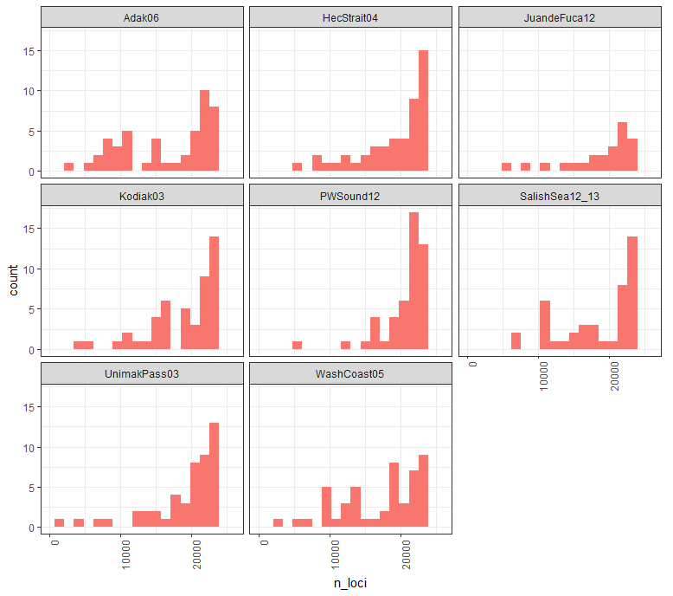
Sstacks, where depth > 10 (alignment to catalog)

Slide 6
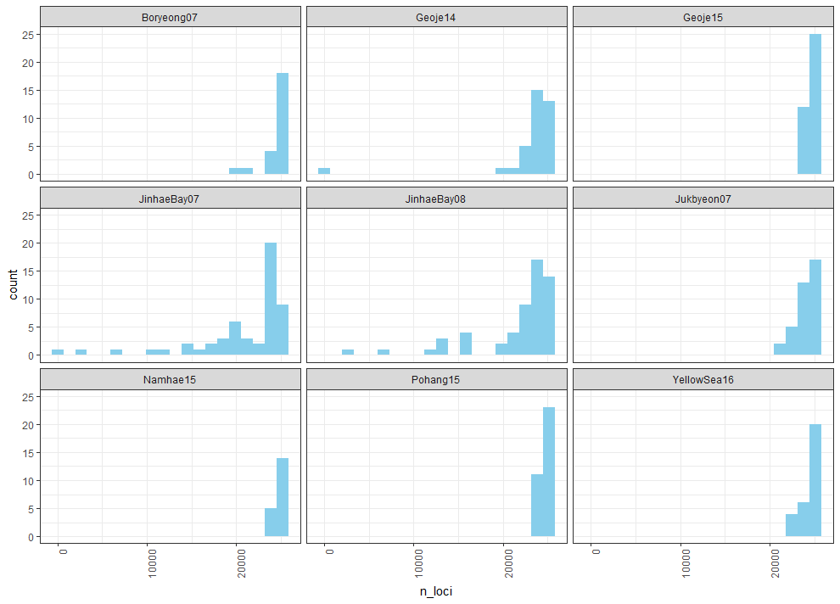
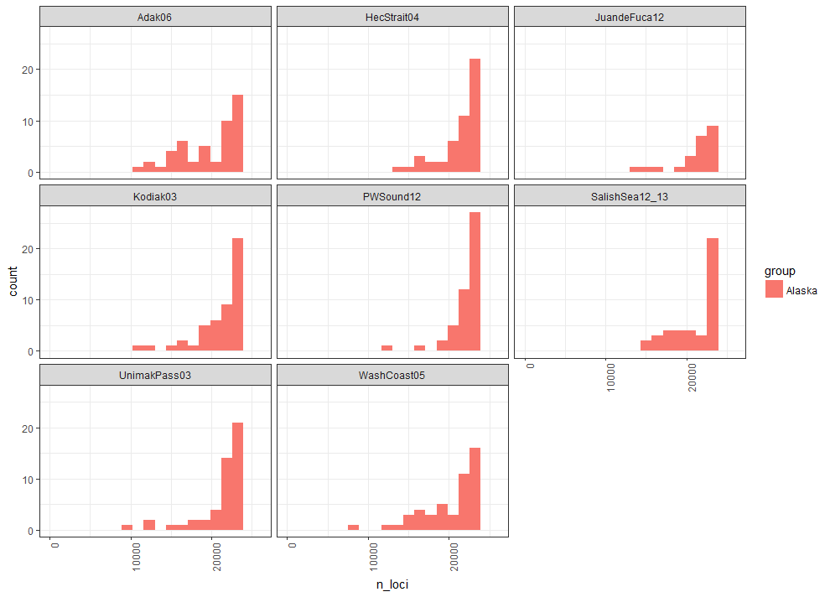
Sstacks, where depth > 5 (alignment to catalog)

