Slide 1
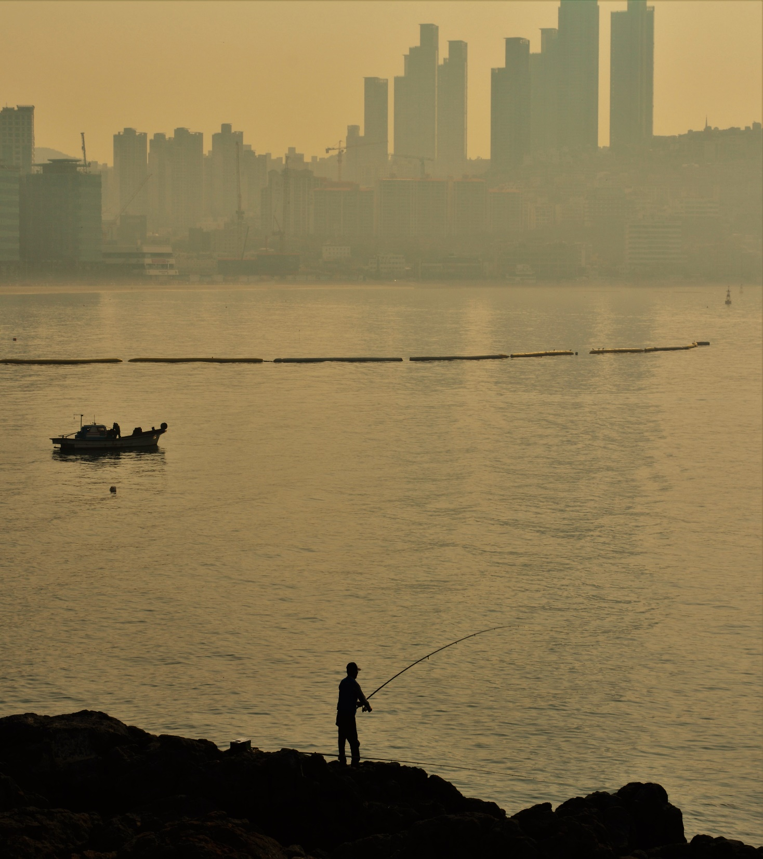
Population structure of Pacific cod around the Korean peninsula
Mary Fisher¹
Thomas Helser²
Sukyung Kang³
Wooseok Gwak⁴
Mike Canino²
Lorenz Hauser¹
¹ School of Aquatic and Fisheries Sciences, University of Washington
² Alaska Fisheries Science Center, NOAA
³ National Institute of Fisheries Science
⁴College of Marine Sciences, Gyeongsang National University

Slide 2
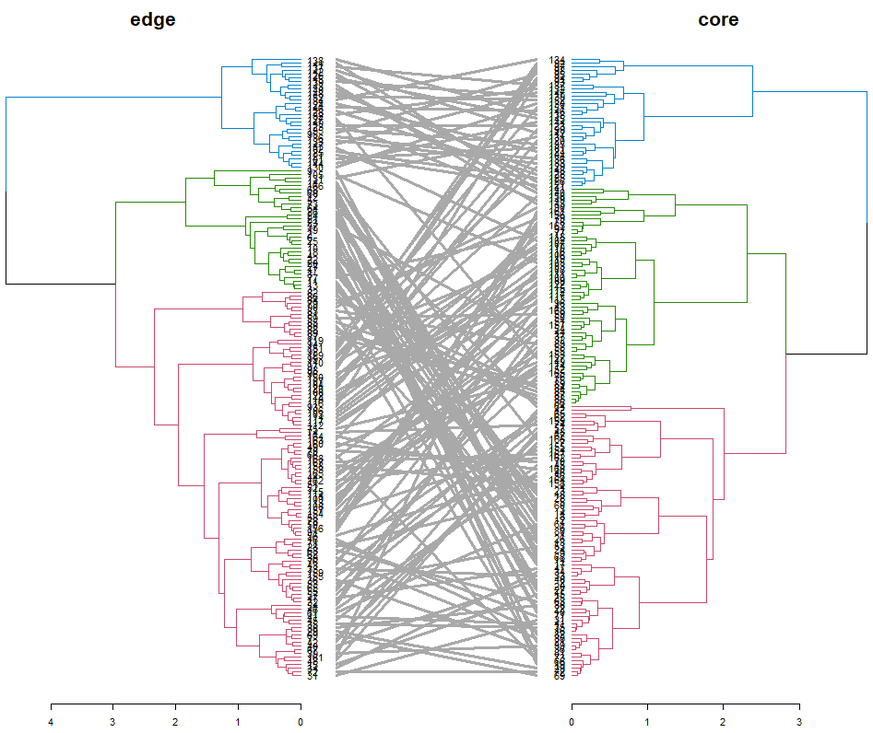
site fidelity
Where/when fish was caught
Where/when fish was born
Hierarchical Agglomerative Cluster Analysis
Ward method
Tanglegrams by sampling site

Slide 3
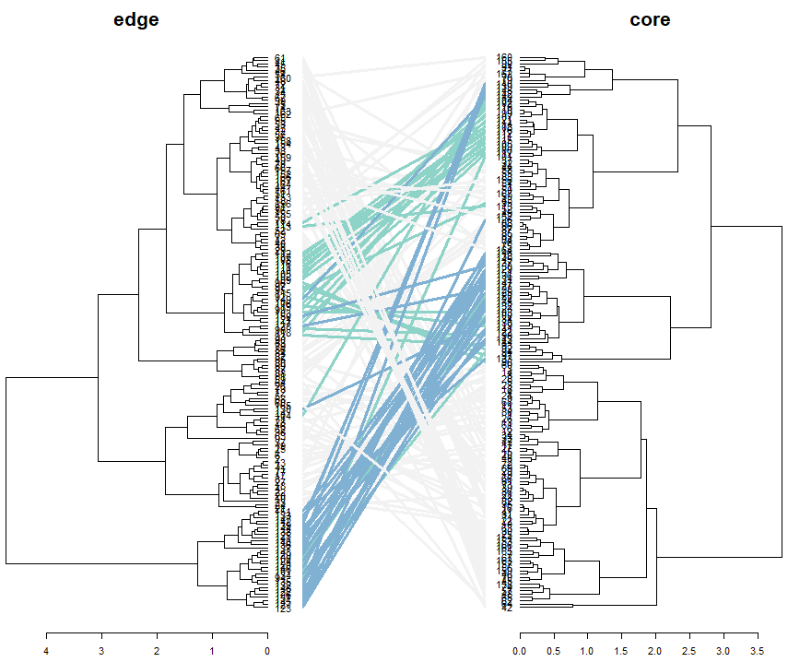
site fidelity
Where/when fish was caught
Where/when fish was born
Hierarchical Agglomerative Cluster Analysis
Jinhae Bay – early / late spawning groups consistent over time

