Slide 1

Population structure of Pacific cod around the Korean peninsula
Mary Fisher¹
Thomas Helser²
Sukyung Kang³
Wooseok Gwak⁴
Mike Canino²
Lorenz Hauser¹
¹ School of Aquatic and Fisheries Sciences, University of Washington
² Alaska Fisheries Science Center, NOAA
³ National Institute of Fisheries Science
⁴College of Marine Sciences, Gyeongsang National University

Slide 2
population structure & marine species
Movement and migration behavior
Ecological
Interbreeding among populations of a single species
Evolutionary
Notes:
Structure in marine populations can be characterized on two timescales: ecological and evolutionary

Slide 3
population structure & pacific cod
Movement and migration behavior
Annual migration to spawning aggregations
(site fidelity)
Ecological
Interbreeding among populations of a single species
Evolutionary
Amount of straying between spawning aggregations
Notes:
Structure in marine populations can be characterized on two timescales: ecological and evolutionary

Slide 4
population structure & marine research
Movement and migration behavior
Mark-Recapture
Ecological
Interbreeding among populations of a single species
Evolutionary
Genetic markers
Notes:
Structure in marine populations can be characterized on two timescales: ecological and evolutionary

Slide 5
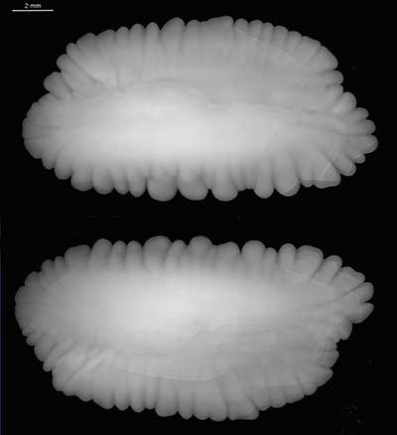
population structure & marine species
Movement and migration behavior
Otolith Micro-chemistry
Ecological
Interbreeding among populations of a single species
Evolutionary
Genetic markers
Notes:
Structure in marine populations can be characterized on two timescales: ecological and evolutionary

Slide 6
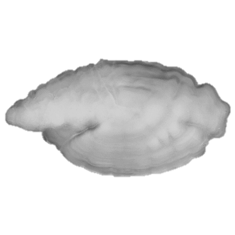
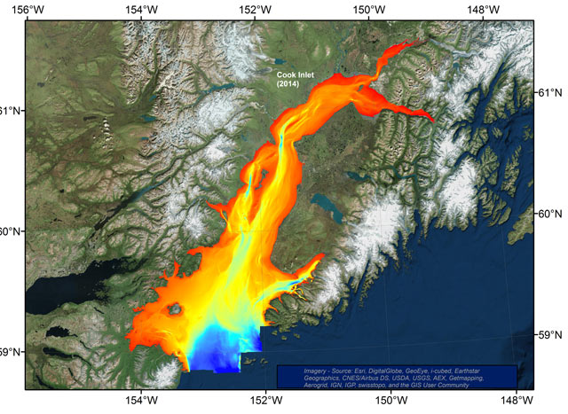
Notes:
Otolith microchemistry: salmon example

Slide 7
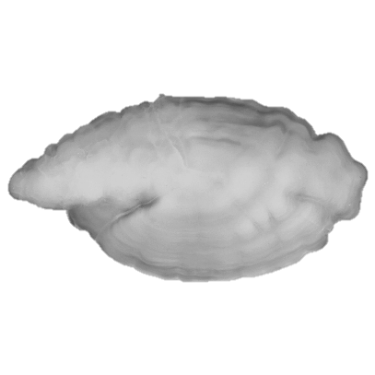

Slide 8
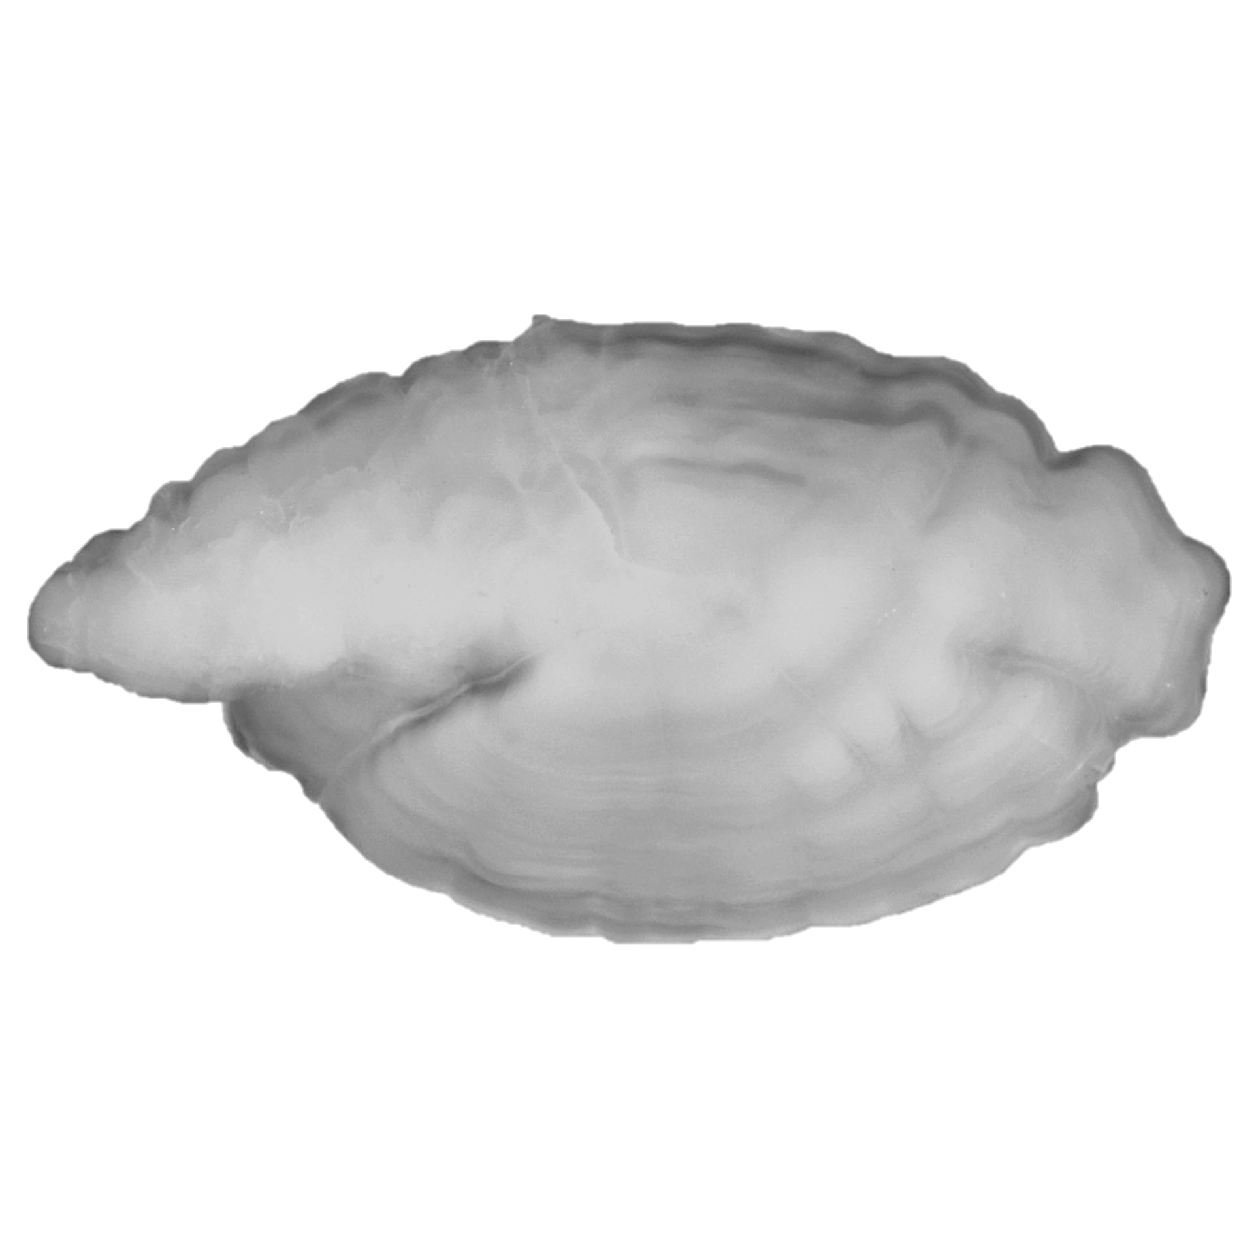

Slide 9
(Natal site)
(Sampling site)

Slide 10
data
Response variables:
8 elements, expressed as concentration ratios
5,405 genetic markers, single nucleotide polymorphisms
Explanatory variables
Sampling site (spawning aggregate)
Sampling year (spawning season)
Sampling month (early v. late spawners)

Slide 11
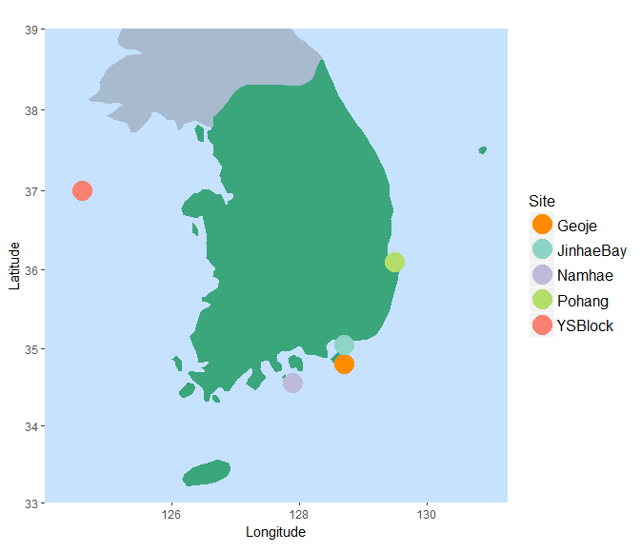
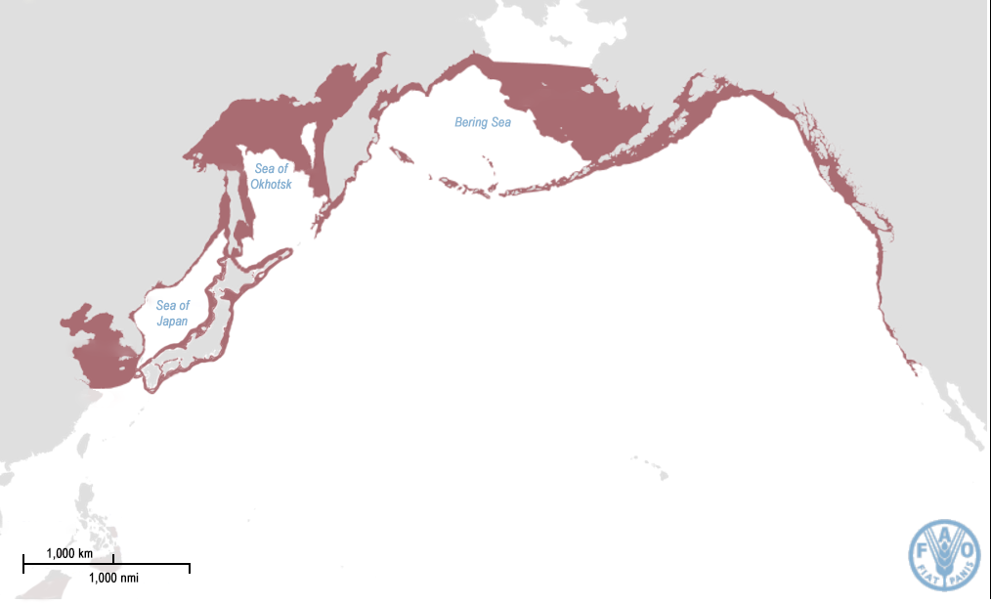
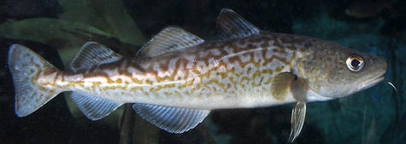
data
5 sites
2 temporal samples
Between years (2014 v. 2015) at Geoje
Within year (early v. late) at J. Bay

Slide 12
questions
How different are otolith microchemistry concentrations across Pacific cod spawning grounds around the Korean peninsula?
Do Pacific cod display site fidelity to natal spawning aggregates?
What additional insights and management tools can be gained by comparing and/or integrating next-generation genetic data with otolith microchemistry data?

Slide 13
methods
How different are otolith microchemistry concentrations across Pacific cod spawning grounds around the Korean peninsula?
PERMANOVAs on otolith edge
NMDS of otolith edge
Notes:
Note that microchemistry data was not multivariate normal, so stuck with tests that did not have distributional assumptions.
Also relativized the microchemistry data by maximum to work with a Euclidean matrix

Slide 14
0tolith microchemistry variation
PERMANOVAs showed significant spatial and temporal variation
Sampling site: p = 1 x 10⁻⁵
Spawning Year: p = 2 x 10⁻⁵
Spawning Month: p = 2 x 10⁻⁵

Slide 15
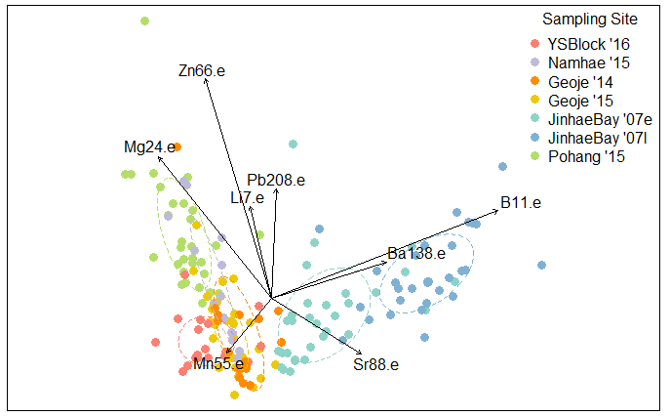
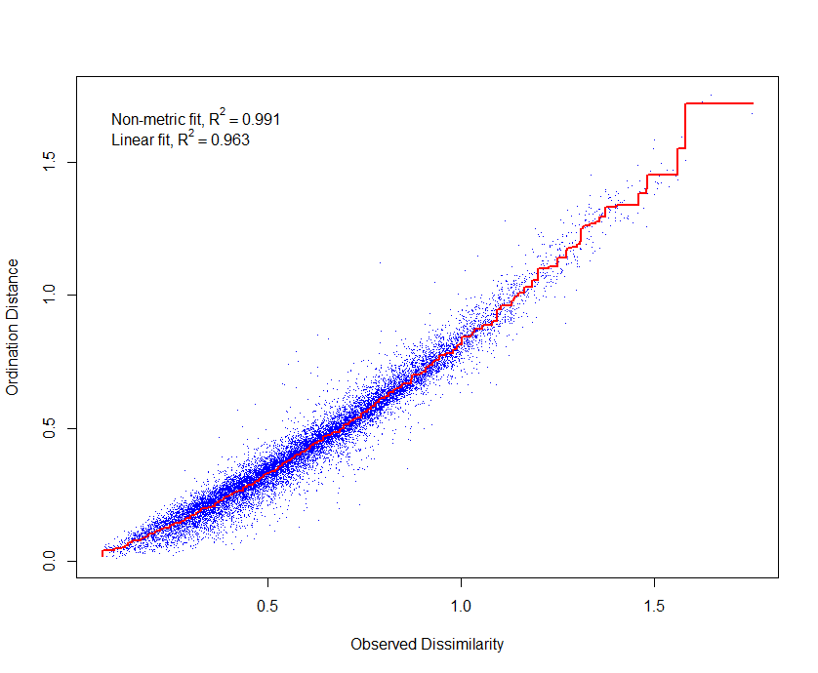
0tolith microchemistry variation
K = 3
Stress = 0.0934
Linear R² = 0.96
Notes:
Continuous variables overlaid as vectors

Slide 16
0tolith microchemistry variation
K = 3
Stress = 0.0934
Linear R² = 0.96
Notes:
Jinhae Bay – inshore fjord spawning aggregate. Boron, barium, strontium = salinity profile *temporal variation evident*
Pohang – industrial port

Slide 17
methods
How different are otolith microchemistry concentrations across Pacific cod spawning grounds around the Korean peninsula?
Do Pacific cod display site fidelity to natal spawning aggregates?
Mantel Test
Hierarchical Cluster Analysis

Slide 18
site fidelity
Mantel test showed moderate positive correlation between elemental fingerprint at otolith core and edge for each individual
R = 0.3441
p = 1 x 10⁻⁵

Slide 19
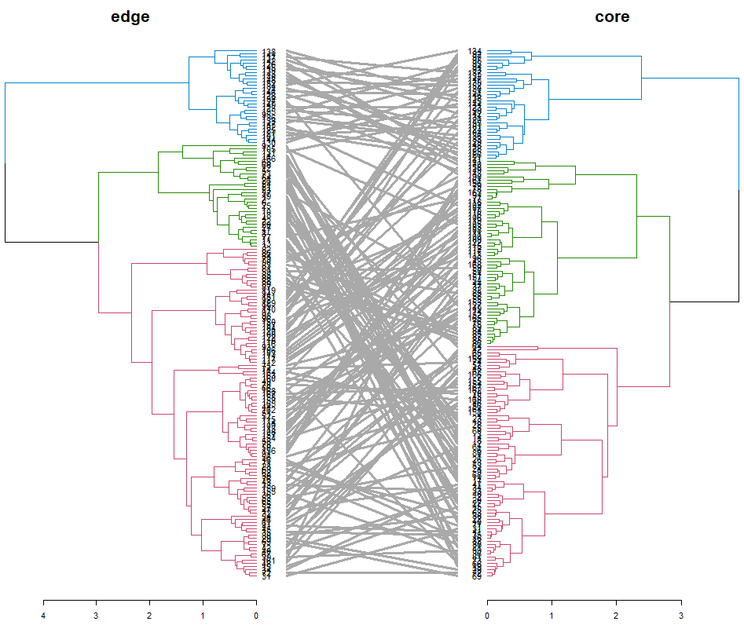
site fidelity
Where/when fish was caught
Where/when fish was born
Hierarchical Agglomerative Cluster Analysis
Ward method
Tanglegrams by sampling site

Slide 20
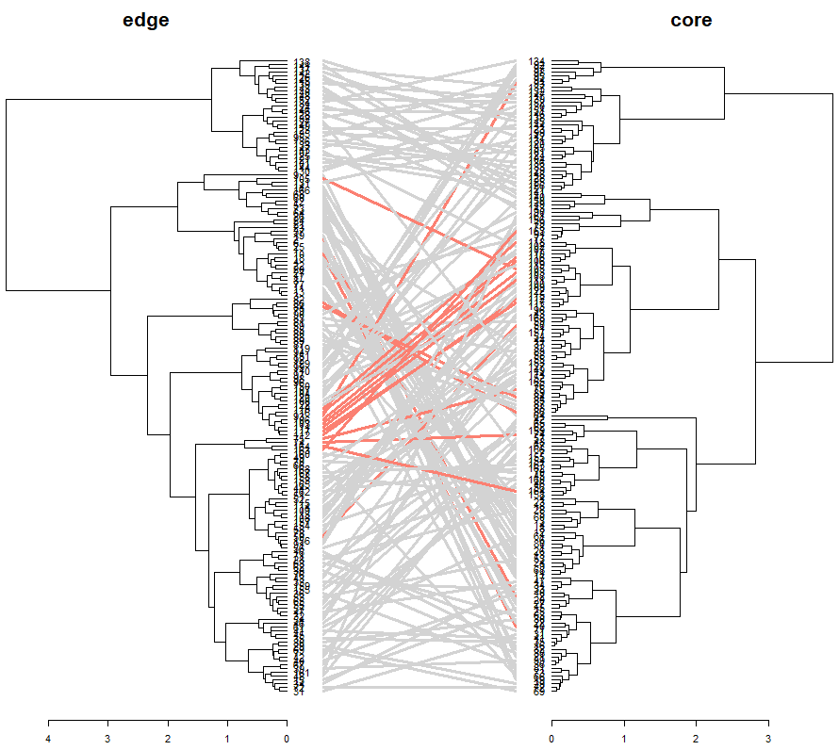
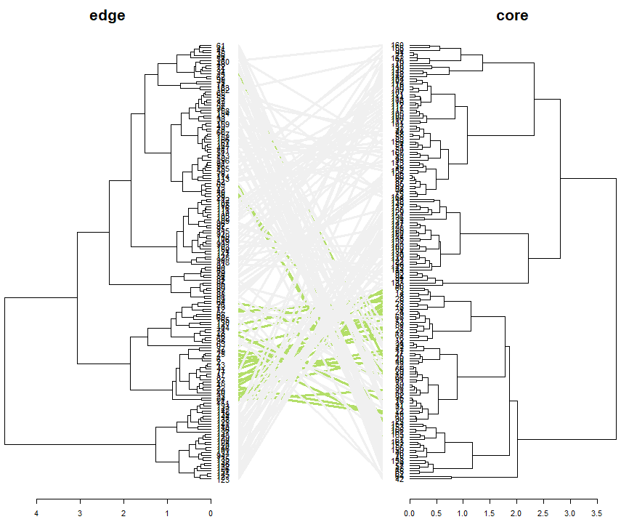
site fidelity
Hierarchical Agglomerative Cluster Analysis
Yellow Sea – more temporal variation
Pohang – less
temporal variation
Where/when fish was caught
Where/when fish was born
Where/when fish was caught
Where/when fish was born

Slide 21
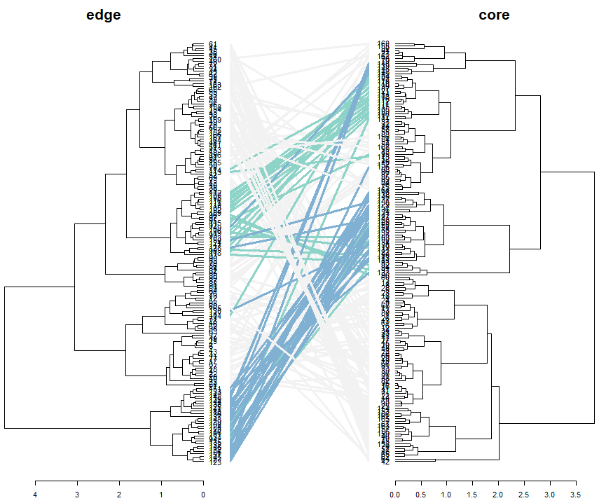
site fidelity
Hierarchical Agglomerative Cluster Analysis
Jinhae Bay – early / late spawning groups consistent over time
Where/when fish was caught
Where/when fish was born

Slide 22
methods
How different are otolith microchemistry concentrations across Pacific cod spawning grounds around the Korean peninsula?
Do Pacific cod display site fidelity to natal spawning aggregates?
What additional insights and management tools can be gained by comparing and/or integrating next-generation genetic data with otolith microchemistry data?
NMDS

Slide 23
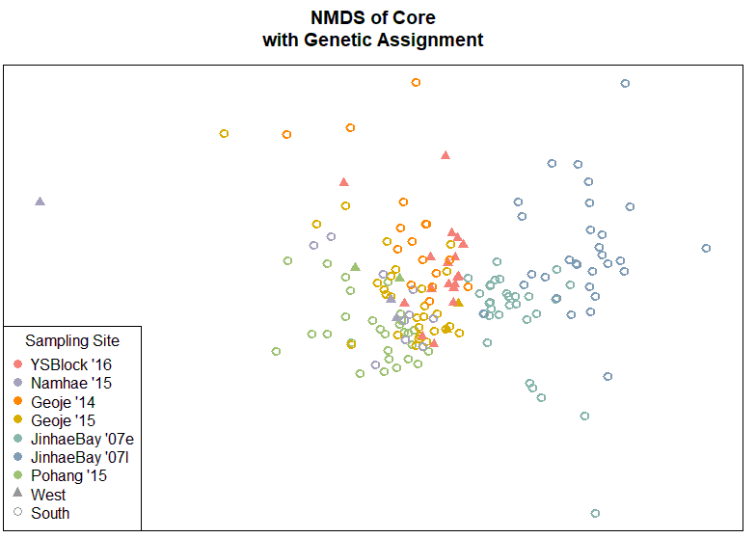
genetics v. otolith microchemistry
K = 3
Stress = 0.0933
Linear R² = 0.97
Conclusions:
2 genetically distinct groups: west and south
Otolith microchemistry shows structure on finer scales
Potential for verifying source of genetic migrants
Notes:
Categorical variable overlaid with point size

Slide 24




acknowledgements
Age & Growth Lab, Alaska Fisheries Science Center
MERlab, University of Washington
Dr. Wooseok Gwak , GNU & Dr. Sukyung Kang, NIFS
NOAA and NIFS: US-Korea Joint Panel on Fisheries Research
sources
Gwak, W. S. & Nakayama, K. Genetic variation and population structure of the Pacific cod Gadus macrocephalus in Korean waters revealed by mtDNA and msDNA markers. Fish. Sci. 77, 945–952 (2011).
Matta, M. E., Short, J., Helser, T., Ormseth, O. & Miller, J. Spatial and temporal variation in otolith elemental chemistry of young-of-year Pacific cod in the Gulf of Alaska.
Rand, K. M., Munro, P., Neidetcher, S. K. & Nichol, D. G. Observations of Seasonal Movement from a Single Tag Release Group of Pacific Cod in the Eastern Bering Sea. Mar. Coast. Fish. 6, 287–296 (2014).
McCune, B. & Grace, J. B. Chapter 9: Data Transformations. in Analysis of Ecological Communities 67–79 (MjM Software, 2002).
Oksanen, J. et al. vegan: Community Ecology Packages. (2018).
R Core Team. R: A language and environment for statistical computing. R Found. Stat. Comput. (2013)
Galili, T. dendextend: an R package for visualizing, adjusting, and comparing trees of hierarchical clustering. Bioinformatics (2015). doi:10.1093/bioinformatics/btv428

Slide 25
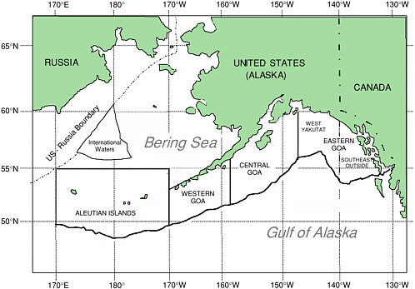
population structure & fisheries management

