Slide 1
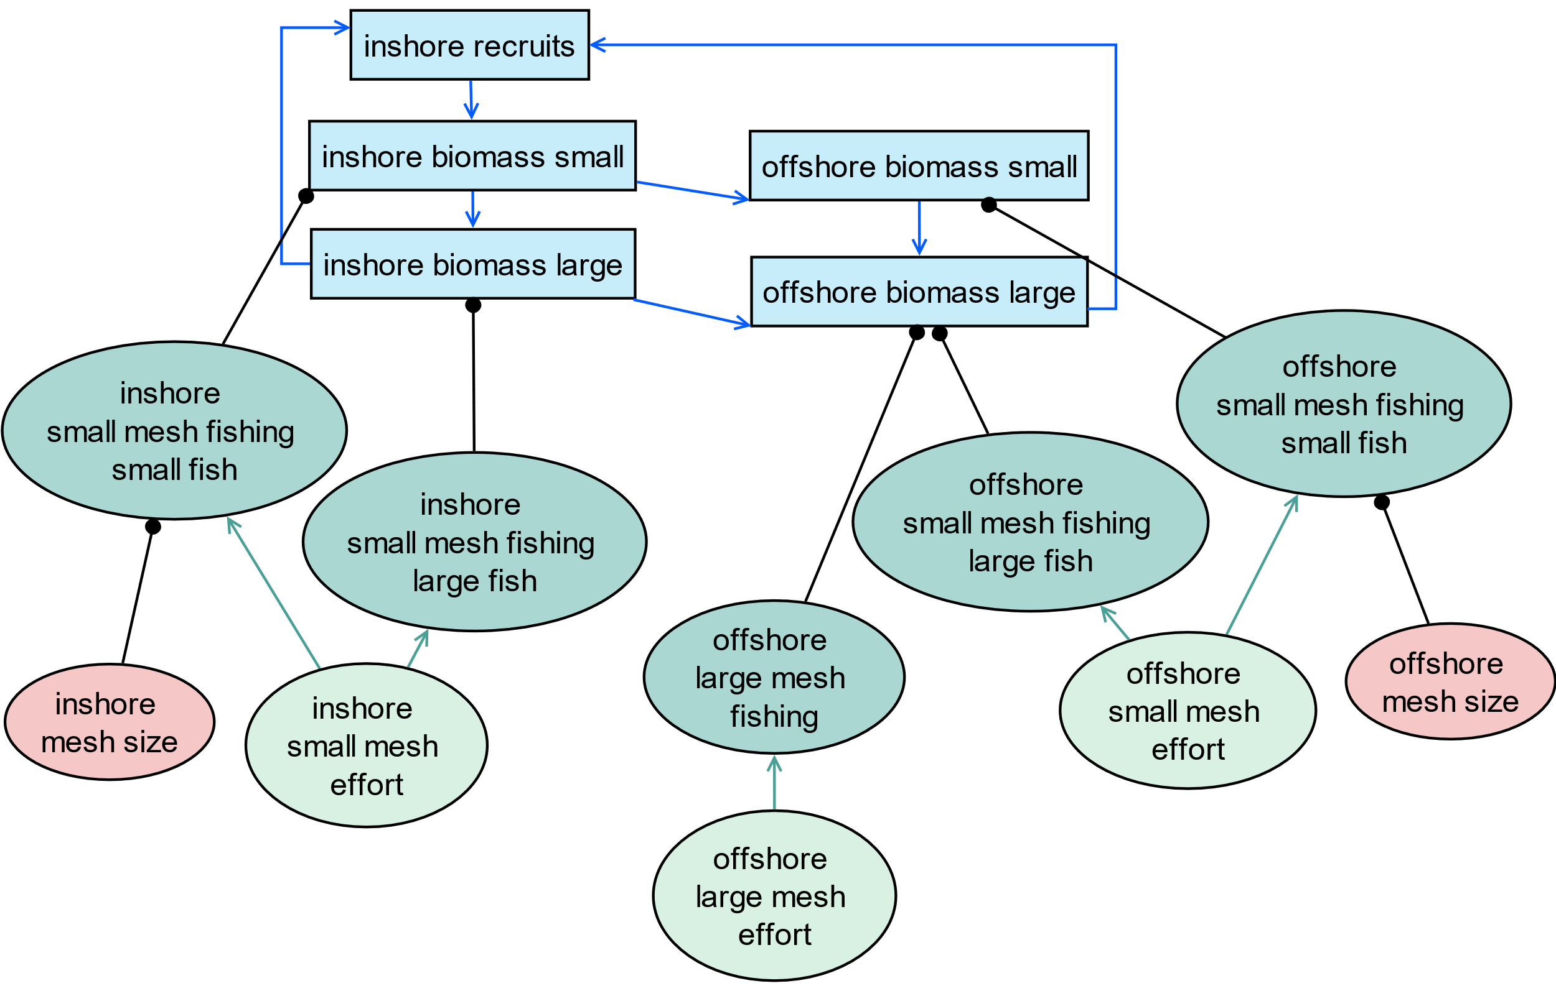
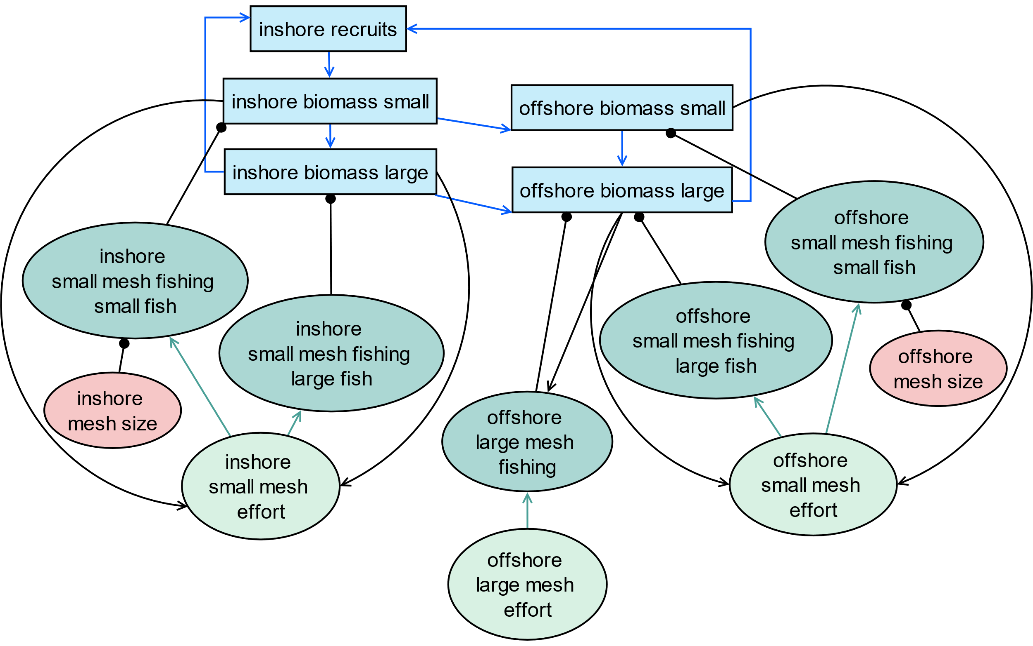
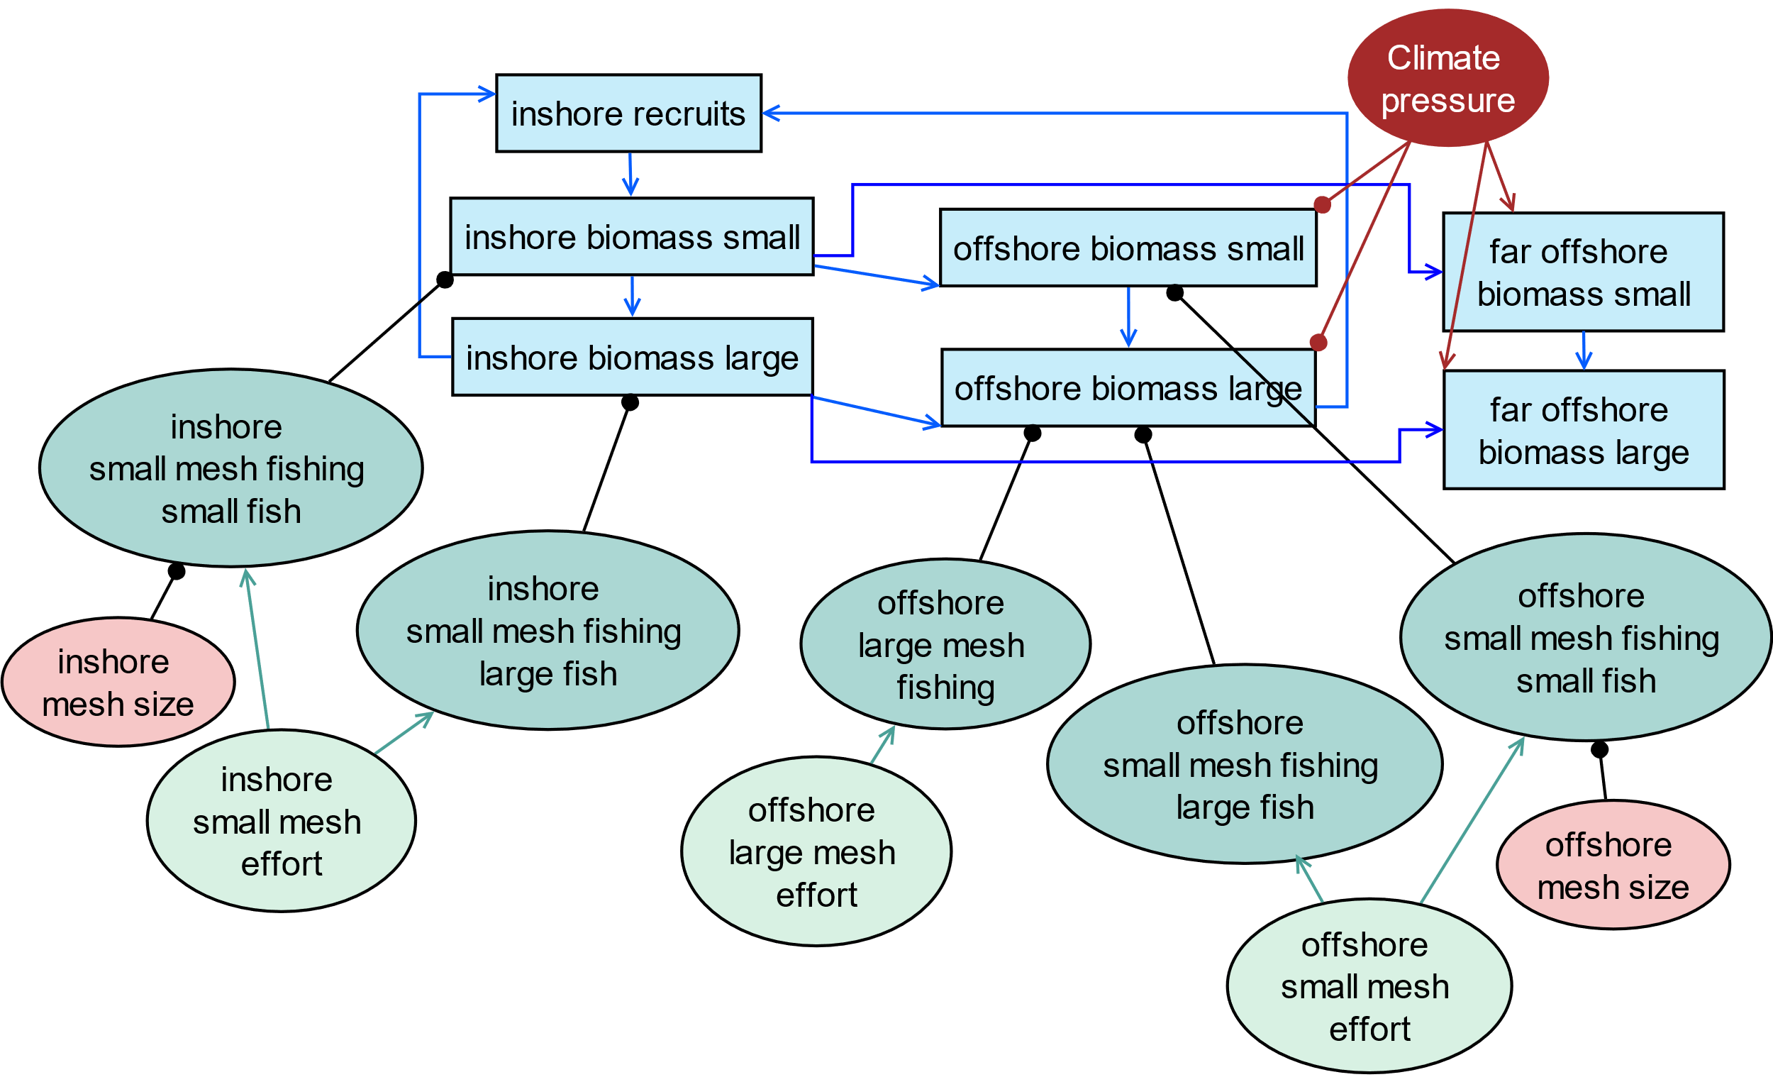
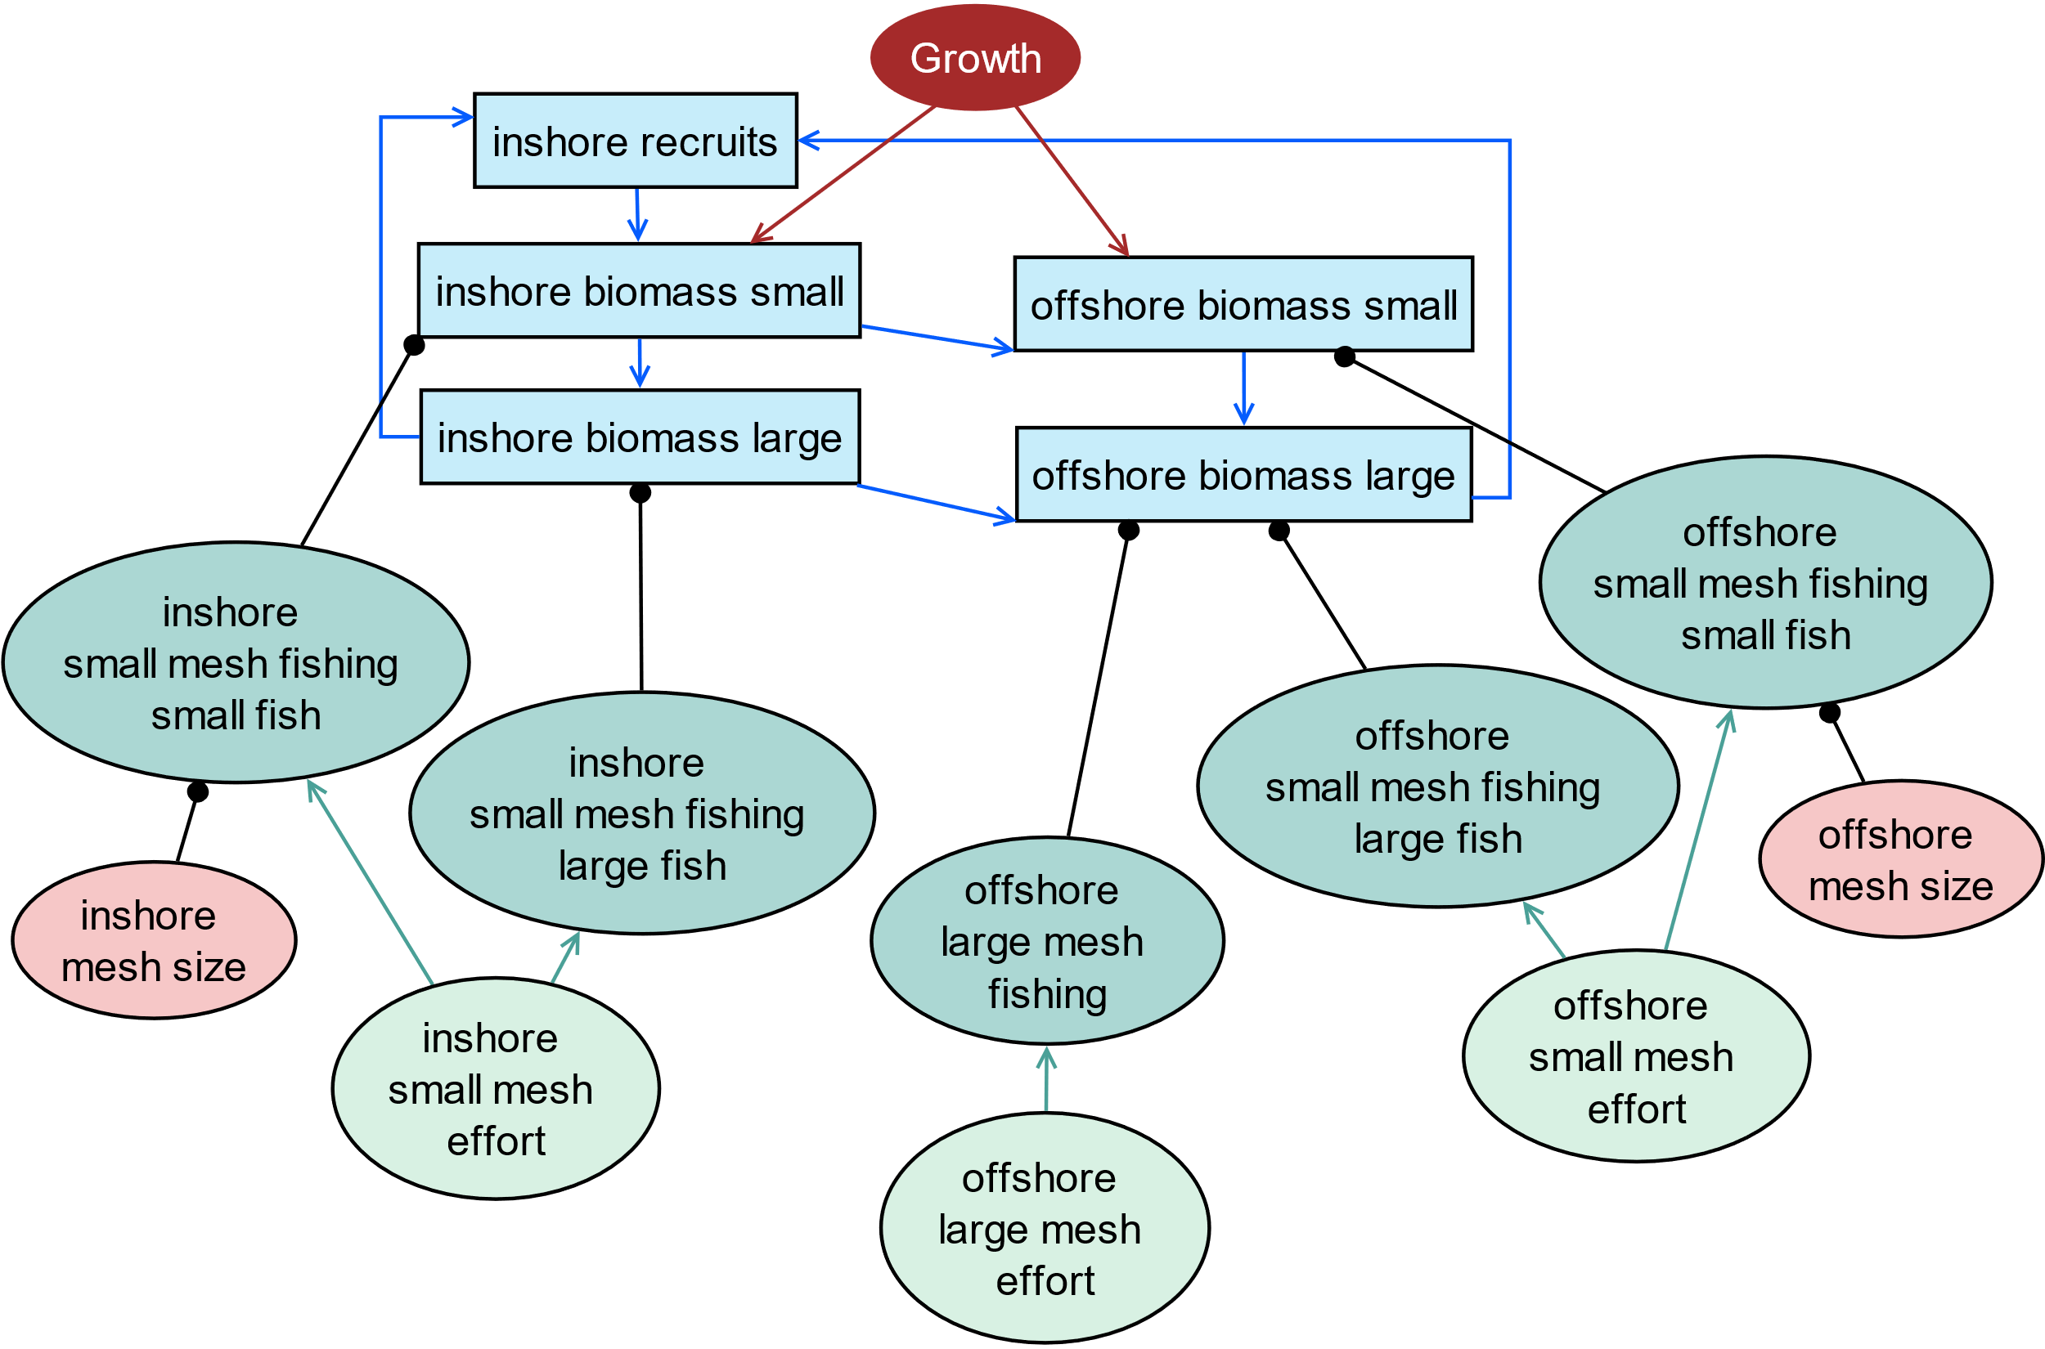
(a) | (b)
(c) | (d)
 | inshore biomass |  | offshore biomass |  | inshore small mesh fishing |  | offshore small mesh fishing |  | offshore large mesh fishing
 | small fish | large fish | small fish | large fish | small fish | large fish | small fish | large fish
Spawning biomass
Fishery 1 catch | (-b) | (-b) | (-b) | (-b)
Fishery 2 catch |  |  |  | (-b)
Total catch | (-b) | (-b) | (-b) | (-b)

