Slide 1
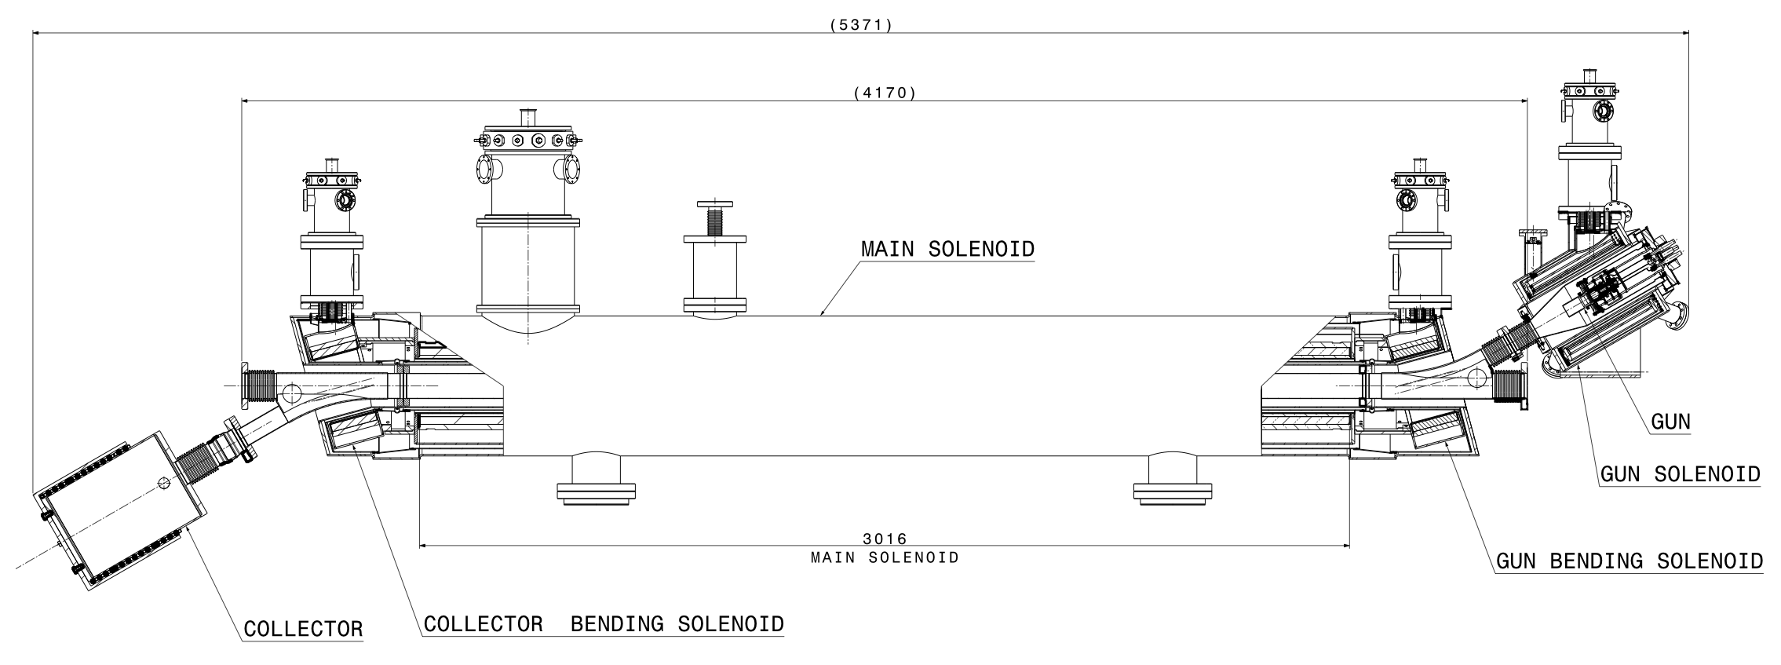
What is an electron lenses?
DC or pulsed low-energy e-beam
circulating beam affected by electromagnetic field of e-beam
e-beam confined and guided by strong solenoids
HL-LHC e-lens
D. Perini, A. Kolehmainen
e-beam
p-beam
Courtesy of CERN EN-MME group
C. Zanoni, WEPVA117
Notes:
solenoid field has to be > 0.2 T in order to confine beam against space charge forces

Slide 2
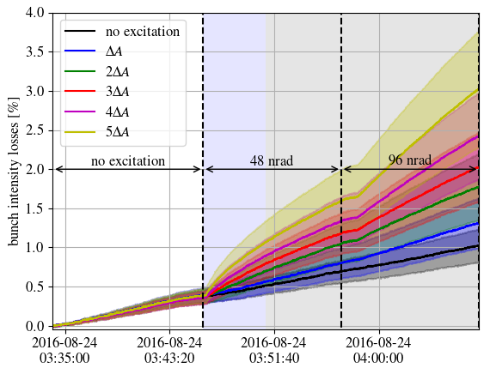
fast adjustment
equilibrium state
Notes:
solenoid field has to be > 0.2 T in order to confine beam against space charge forces

Slide 3
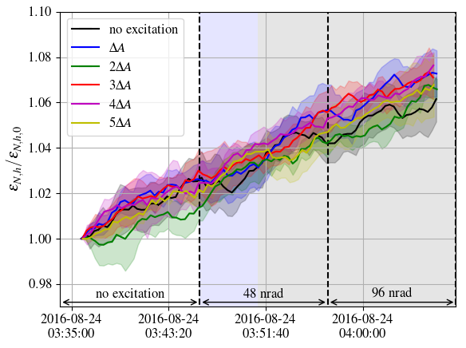
fast adjustment
equilibrium state
Notes:
solenoid field has to be > 0.2 T in order to confine beam against space charge forces

Slide 4
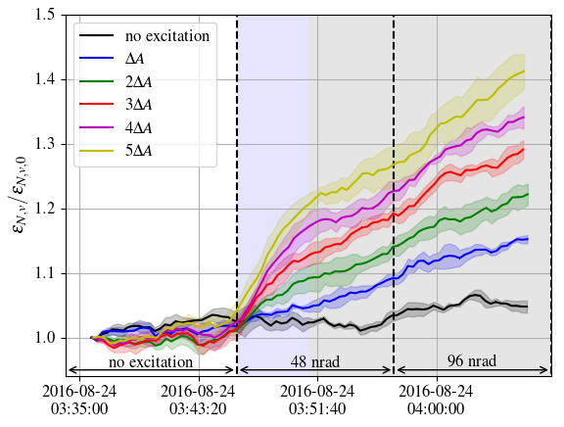
fast adjustment
equilibrium state
Notes:
solenoid field has to be > 0.2 T in order to confine beam against space charge forces

