Slide 1
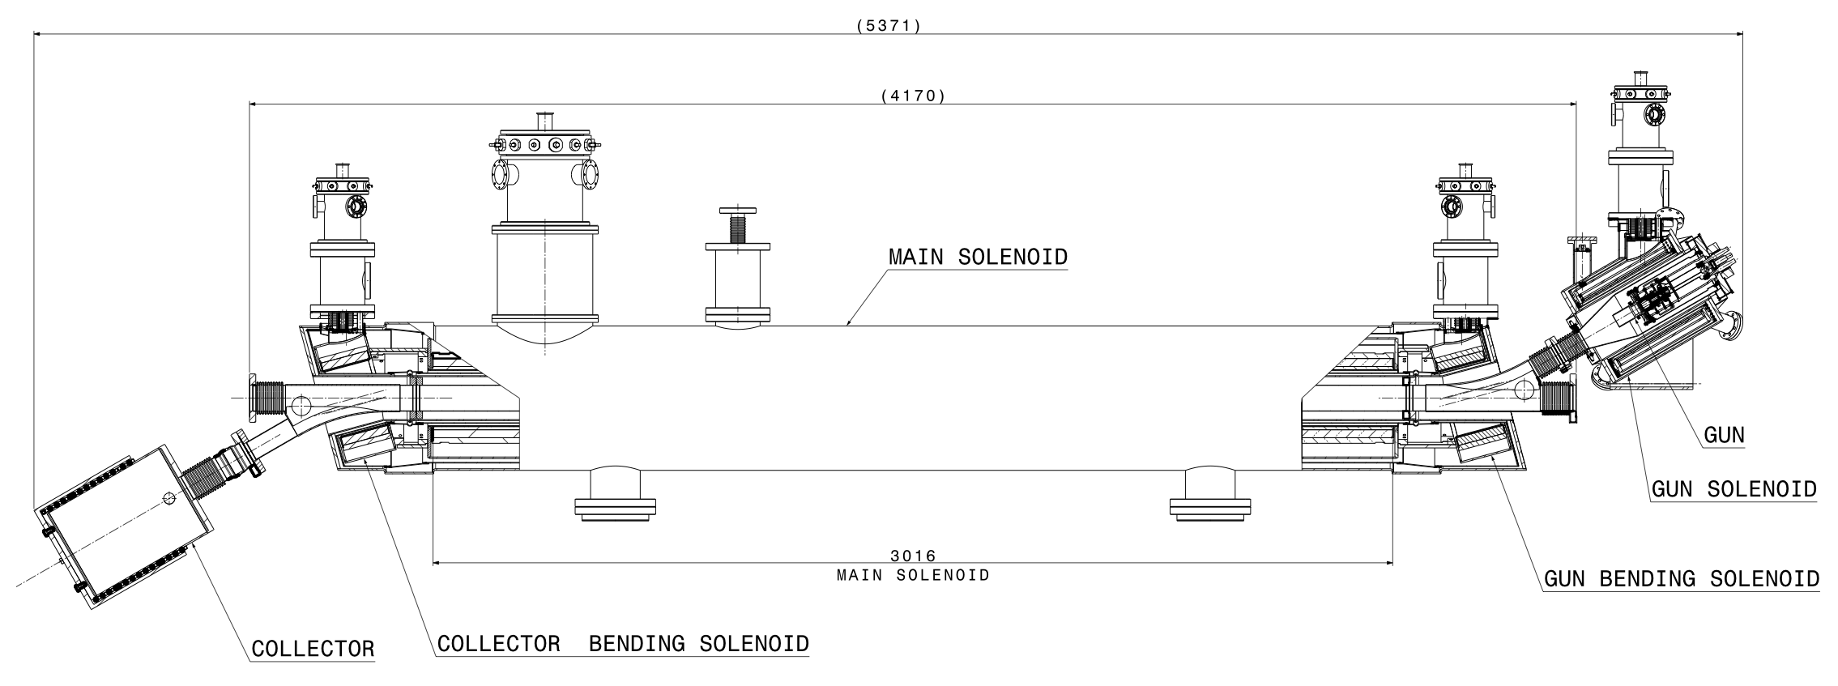
What is an electron lenses?
DC or pulsed low-energy e-beam
circulating beam affected by electromagnetic field of e-beam
e-beam confined and guided by strong solenoids
HL-LHC e-lens
D. Perini, A. Kolehmainen
e-beam
p-beam
Courtesy of CERN EN-MME group
C. Zanoni, WEPVA117
Notes:
solenoid field has to be > 0.2 T in order to confine beam against space charge forces

Slide 2
What is active halo control?
primary
collimator
secondary
collimator
shower
absorbers
circulating beam

Slide 3
What is active halo control?
primary
collimator
secondary
collimator
shower
absorbers
Hollow
e-lens
circulating beam
Notes:
- actively control diffusion speed of the halo particles

