Slide 1
Equations to recover corrected sample scattering cross-sections

Slide 2
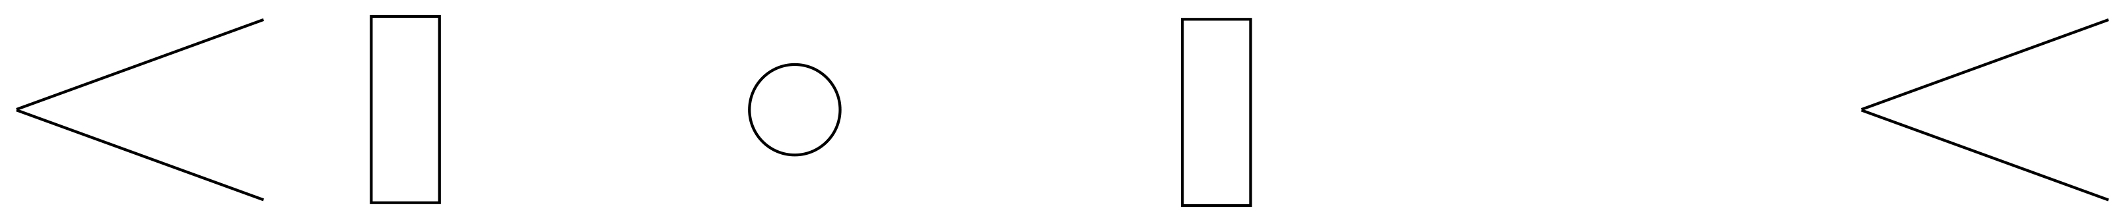
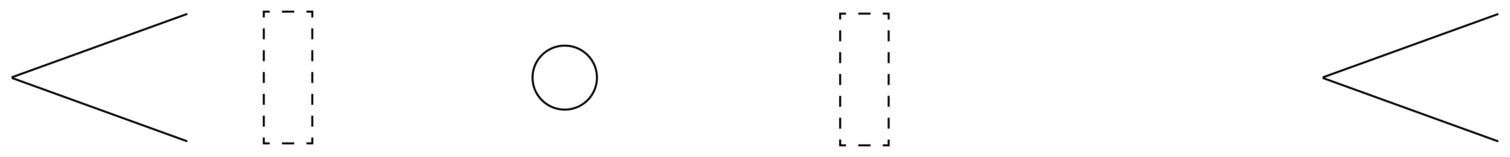

















$$\left\{\begin{aligned}\begin{aligned}[{{eF}_{1}+(1−e)]S}^{↑↑}f \\ {\left[e+\left(1−e\right)F_{1}\right]S}^{↓↓}(1−f) \\ [{{eF}_{1}+(1−e)]S}^{↑↓}(1−f)\end{aligned} \\ [{e+\left(1−e\right)F_{1}]S}^{↓↑}f\end{aligned}\right\}Σ=A↓$$
$$\left\{\begin{aligned}\begin{aligned}[{{eF}_{1}+(1−e)]S}^{↑↑}(1−f) \\ {\left[e+\left(1−e\right)F_{1}\right]S}^{↓↓}f \\ [{{eF}_{1}+(1−e)]S}^{↑↓}f\end{aligned} \\ [{e+\left(1−e\right)F_{1}]S}^{↓↑}(1−f)\end{aligned}\right\}Σ=B↑$$
$$\begin{aligned}\begin{aligned}[{{eF}_{1}+(1−e)]S}^{↑↑} \\ {[e+\left(1−e\right)F_{1}]S}^{↓↓} \\ [{{eF}_{1}+(1−e)]S}^{↑↓}\end{aligned} \\ [{e+\left(1−e\right)F_{1}]S}^{↓↑}\end{aligned}$$
$$F_{1}↓$$
$$e+(1−e)F_{1}↓$$
$$\frac{F_{2}A+B}{\left(F_{2}+1\right)\left(F_{1}+1\right)}$$
$$\vec{S}$$
$$M_{on,on}$$
$$1↑$$
$${eF}_{1}+(1−e)↑$$
$$\begin{aligned}\begin{aligned}{1S}^{↑↑} \\ {F_{1}S}^{↓↓} \\ 1 S^{↑↓}\end{aligned} \\ F_{1}S^{↓↑}\end{aligned}$$
$$\begin{matrix}\left\{\begin{matrix}{F_{1}S}^{↓↓} \\ 1 S^{↑↓}\end{matrix}\right\}Σ=C↓ \\ \left\{\begin{matrix}{1S}^{↑↑} \\ F_{1}S^{↓↑}\end{matrix}\right\}Σ=D↑\end{matrix}$$
$$F_{1}↓$$
$$F_{1}↓$$
$$\frac{F_{2}C+D}{\left(F_{2}+1\right)\left(F_{1}+1\right)}$$
$$\vec{S}$$
$$M_{off,off}$$
$$1↑$$
$$1↑$$

Slide 3
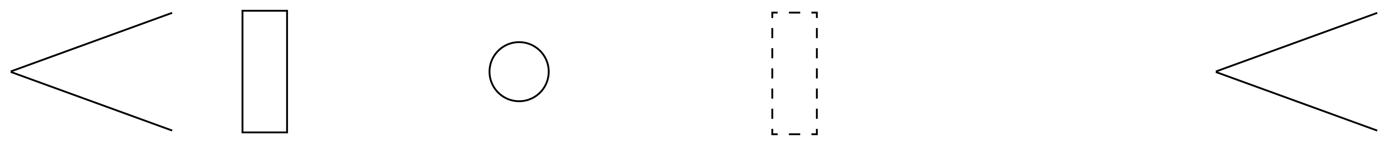
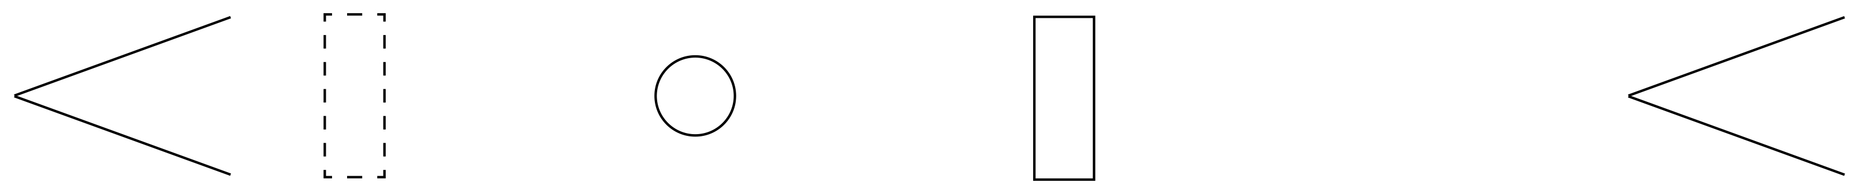

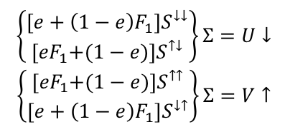





$$\begin{aligned}\begin{aligned}[{{eF}_{1}+(1−e)]S}^{↑↑} \\ {[e+\left(1−e\right)F_{1}]S}^{↓↓} \\ [{{eF}_{1}+(1−e)]S}^{↑↓}\end{aligned} \\ [{e+\left(1−e\right)F_{1}]S}^{↓↑}\end{aligned}$$
$$\begin{matrix}\left\{\begin{matrix}{[e+\left(1−e\right)F_{1}]S}^{↓↓} \\ {[eF}_{1}+(1−e)]S^{↑↓}\end{matrix}\right\}Σ=U↓ \\ \left\{\begin{matrix}{{[eF}_{1}+(1−e)]S}^{↑↑} \\ [{e+\left(1−e\right)F_{1}]S}^{↓↑}\end{matrix}\right\}Σ=V↑\end{matrix}$$
$$F_{1}↓$$
$$e+(1−e)F_{1}↓$$
$$\frac{F_{2}U+V}{\left(F_{2}+1\right)\left(F_{1}+1\right)}$$
$$\vec{S}$$
$$M_{on,off}$$
$$1↑$$
$${eF}_{1}+(1−e)↑$$
$$\left\{\begin{aligned}\begin{aligned}fS^{↑↑} \\ (1−f{{)F}_{1}S}^{↓↓} \\ {(1−f)S}^{↑↓}\end{aligned} \\ {fF_{1}S}^{↓↑}\end{aligned}\right\}Σ=W↓$$
$$\left\{\begin{aligned}\begin{aligned}(1−f)S^{↑↑} \\ {fF_{1}S}^{↓↓} \\ {fS}^{↑↓}\end{aligned} \\ {\left(1−f\right)F_{1}S}^{↓↑}\end{aligned}\right\}Σ=X↑$$
$$F_{1}↓$$
$$F_{1}↓$$
$$\begin{aligned}\begin{aligned}{1S}^{↑↑} \\ {F_{1}S}^{↓↓} \\ 1 S^{↑↓}\end{aligned} \\ F_{1}S^{↓↑}\end{aligned}$$
$$\vec{S}$$
$$\frac{F_{2}W+X}{\left(F_{2}+1\right)\left(F_{1}+1\right)}$$
$$M_{off,on}$$
$$1↑$$
$$1↑$$

Slide 4
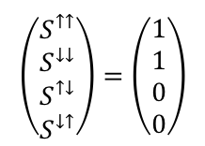
Equations to calculate polarization and flipping efficiencies
$$\left(\begin{matrix}S^{↑↑} \\ S^{↓↓} \\ S^{↑↓} \\ S^{↓↑}\end{matrix}\right)=\left(\begin{matrix}1 \\ 1 \\ 0 \\ 0\end{matrix}\right)$$

Slide 5









There is a factor of $\frac{1}{\left(F_{1}+1\right)}$implied.
$$\left\{\begin{aligned}\begin{aligned}\left[{eF}_{1}+(1−e)\right]f \\ \left[e+\left(1−e\right)F_{1}\right](1−f) \\ 0\end{aligned} \\ 0\end{aligned}\right\}Σ=A↓$$
$$\left\{\begin{aligned}\begin{aligned}[{eF}_{1}+(1−e)](1−f) \\ [e+\left(1−e\right)F_{1}]f \\ 0\end{aligned} \\ 0\end{aligned}\right\}Σ=B↑$$
$$\begin{aligned}\begin{aligned}{eF}_{1}+(1−e)↑ \\ e+\left(1−e\right)F_{1}↓ \\ 0\end{aligned} \\ 0\end{aligned}$$
$$F_{1}↓$$
$$e+(1−e)F_{1}↓$$
$$\frac{F_{2}A+B}{\left(F_{2}+1\right)\left(F_{1}+1\right)}$$
$$\vec{S}$$
$$M_{on,on}$$
$$1↑$$
$${eF}_{1}+(1−e)↑$$
$$\begin{aligned}\begin{aligned}1↑ \\ F_{1}↓ \\ 0\end{aligned} \\ 0\end{aligned}$$
$$\begin{matrix}\left\{\begin{matrix}F_{1} \\ 0\end{matrix}\right\}Σ=C↓ \\ \left\{\begin{matrix}1 \\ 0\end{matrix}\right\}Σ=D↑\end{matrix}$$
$$F_{1}↓$$
$$F_{1}↓$$
$$\frac{F_{2}C+D}{\left(F_{2}+1\right)\left(F_{1}+1\right)}$$
$$\vec{S}$$
$$M_{off,off}$$
$$1↑$$
$$1↑$$

Slide 6





There is a factor of $\frac{1}{\left(F_{1}+1\right)}$implied.
$$\begin{aligned}\begin{aligned}{eF}_{1}+(1−e)↑ \\ e+\left(1−e\right)F_{1}↓ \\ 0\end{aligned} \\ 0\end{aligned}$$
$$\begin{matrix}\left\{\begin{matrix}e+\left(1−e\right)F_{1} \\ 0\end{matrix}\right\}Σ=U↓ \\ \left\{\begin{matrix}{[eF}_{1}+(1−e)] \\ 0\end{matrix}\right\}Σ=V↑\end{matrix}$$
$$F_{1}↓$$
$$e+(1−e)F_{1}↓$$
$$\frac{F_{2}U+V}{\left(F_{2}+1\right)\left(F_{1}+1\right)}$$
$$\vec{S}$$
$$M_{on,off}$$
$$1↑$$
$${eF}_{1}+(1−e)↑$$
$$\left\{\begin{aligned}\begin{aligned}f \\ (1−f{)F}_{1} \\ 0\end{aligned} \\ 0\end{aligned}\right\}Σ=W↓$$
$$\left\{\begin{aligned}\begin{aligned}(1−f) \\ fF_{1} \\ 0\end{aligned} \\ 0\end{aligned}\right\}Σ=X↑$$
$$F_{1}↓$$
$$F_{1}↓$$
$$\begin{aligned}\begin{aligned}1↑ \\ F_{1}↓ \\ 0\end{aligned} \\ 0\end{aligned}$$
$$\vec{S}$$
$$\frac{F_{2}W+X}{\left(F_{2}+1\right)\left(F_{1}+1\right)}$$
$$M_{off,on}$$
$$1↑$$
$$1↑$$

Slide 7
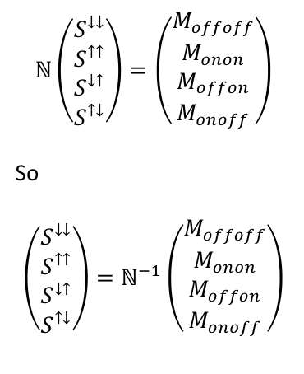
Equations to recover S from M. Note rearrangement of terms.
$$ℕ\left(\begin{matrix}S^{↓↓} \\ S^{↑↑} \\ S^{↓↑} \\ S^{↑↓}\end{matrix}\right)=\left(\begin{matrix}M_{offoff} \\ M_{onon} \\ M_{offon} \\ M_{onoff}\end{matrix}\right)$$
So
$$\left(\begin{matrix}S^{↓↓} \\ S^{↑↑} \\ S^{↓↑} \\ S^{↑↓}\end{matrix}\right)=ℕ^{−1}\left(\begin{matrix}M_{offoff} \\ M_{onon} \\ M_{offon} \\ M_{onoff}\end{matrix}\right)$$

